Slide 1
Object Oriented Programming
Notes:
based on the concept of "objects", which may contain data, in the form of fields, often known as attributes; and code, in the form of procedures, often known as methods. A feature of objects is that an object's procedures can access and often modify the data fields of the object with which they are associated.

Slide 2
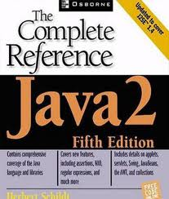
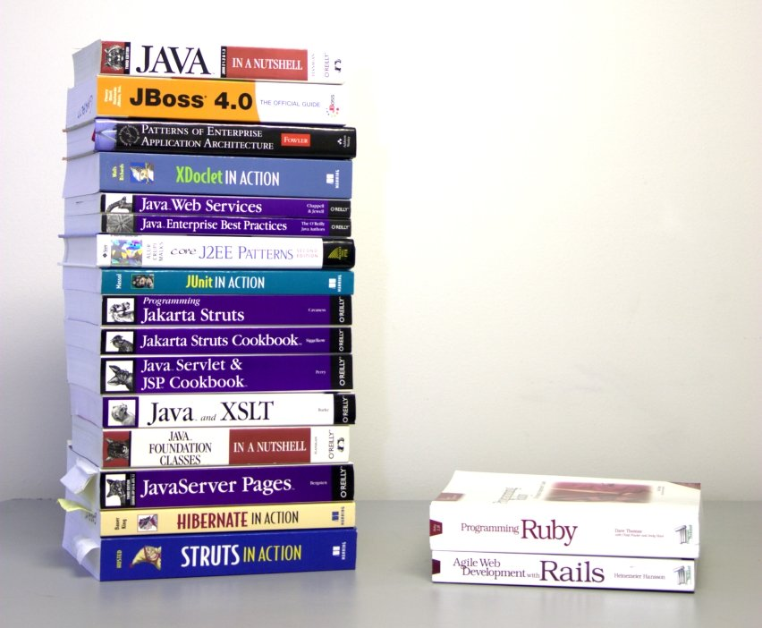
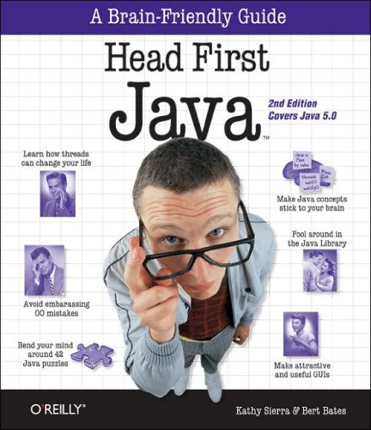
Text Books
The Complete Reference Java 2 by Herbert
Schildt

Slide 3
Grading Criteria
Quiz 10%
Assignment 10%
Mid Exam 30%
Final Exam 50%

Slide 4

CLASSROOM ETIQUETTE:
Arrive at class on time
Do be prepared for class
Most classes will begin on time and end on time. If you need to know about schedule or assignment changes, kindly ask about them from the class representative. If you have a real need to leave the class early, just leave quietly.
Do put cell phones away and on vibrate…Texting should not be going on in class
Do stay AWAKE and be attentive

Slide 5
Topics To be Covered Today
What is a Program?
Evolution of Programming Languages
Why Java
Java History
Versions of Java
Features of Java
Java Procedure

Slide 6
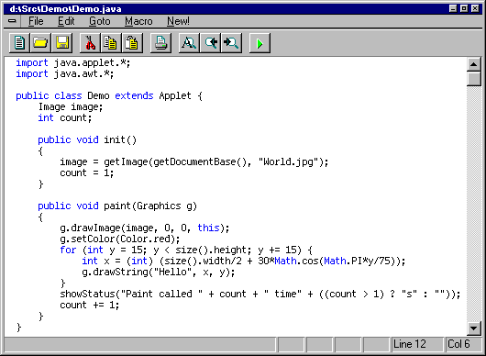
What is a Program?
A computer program (also a software program, or just a program) is a sequence of instructions written to perform a specified task for a computer.
Notes:
Historically, a program has been viewed as a logical procedure that takes input data, processes it, and produces output data.

Slide 7
The Evolution of Programming Languages
Machine language: 1940’s
Assembly language: early 1950’s
Higher-level languages: late 1950’s
Fortran: scientific computation
Cobol: business data processing
Lisp: symbolic computation
Today: thousands of programming languages
https://statisticstimes.com/tech/top-computer-languages.php

Slide 8
Machine Languages
Comprised of 1s and 0s
The “native” language of a computer
Difficult to program – one misplaced 1 or 0 will cause the program to fail.
Example of code: 1110100010101 111010101110 10111010110100 10100011110111

Slide 9
Assembly Languages
Assembly languages are a step towards easier programming.
Assembly languages are comprised of a set of elemental commands which are tied to a specific processor.
Assembly language code needs to be translated to machine language before the computer processes it.
Example: ADD 1001010, 1011010
Notes:
Uses assembler,
An assembly language contains the same instructions as a machine language, but the instructions and variables have names instead of being just numbers.,
Each type of CPU has its own machine language and assembly language, so an assembly language program written for one type of CPU won't run on another.

Slide 10
High-Level Languages
High-level languages represent a giant leap towards easier programming.
The syntax of HL languages is similar to English.
Example:
Student_name = first_name + last_name
Interpreter – Executes high level language programs without compilation.
Historically, we divide HL languages into two groups:
Procedural languages
Object-Oriented languages (OOP)

Slide 11
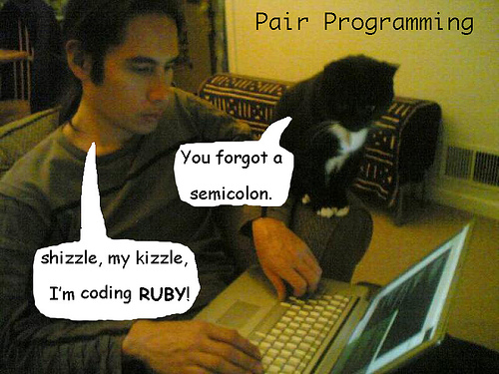
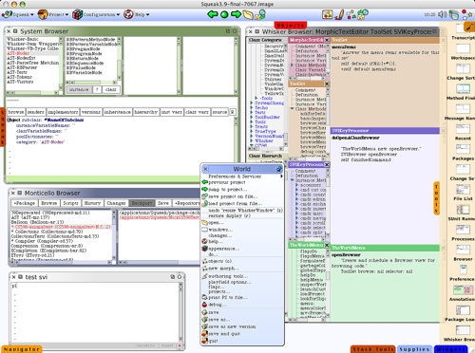

What is Programming?
When we say “programming” we are actually referring to the science of transforming our intentions in a high-level programming language.

Slide 12
What are we doing in this course?
Learn programming in a high-level programming language.
We will study Object-Oriented Programming using ‘Java’, a popular high-level object-oriented programming language.

Slide 13
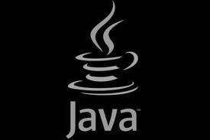

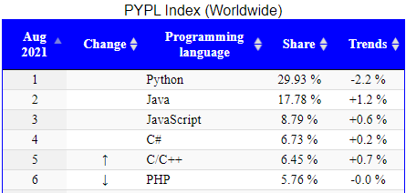
Why Java?
It’s the current “hot” language
Java mean Cup of coffee
It’s almost entirely object-oriented
It has a vast library of predefined objects and operations
It’s more platform independent
this makes it great for Web programming
It’s more secure
It isn’t C++
Notes:
PopularitY of Programming Language Index

Slide 14


Java History
Java
was created in 1991
by James Gosling et al. of Sun Microsystems.
Initially called Oak, in honor of the tree outside Gosling's window, its name was changed to Java because there was already a language called Oak.

Slide 15
Java History contd. . . . .
The term Java actual refers to more than just a particular language like C or Pascal. Java encompasses several parts, including :
A high level language � the Java language is a high level one that at a glance looks very similar to C and C++ but offers many unique features of its own.
Java bytecode - a compiler, such as Sun's javac, transforms the Java language source code to bytecode that runs in the JVM.
Java Virtual Machine (JVM) a program, such as Sun's java, that runs on a given platform and takes the bytecode programs as input and interprets them just as if it were a physical processor executing machine code.

Slide 16
Java History contd. . . . .
Sun provides a set of programming tools such as javac, java and others in a bundle that it calls a Java Software Development Kit for each version of the language and for different platforms such as Windows, Linux, etc..
Sun also provides a runtime bundle with just the JVM when the programming tools are not needed.

Slide 17
Versions of Java
Since its introduction, Sun has released a new version of the Java language every two years or so.
These new versions brought enhancements, new capabilities and fixes to bugs.
Until recently, the versions were numbered 1.x, where x reached up till 4. (Intermediate revisions were labeled with a third number - 1.x.y - as in 1.4.2.)
The next version, however, is called Java 5.0 rather than Java 1.5.

Slide 18
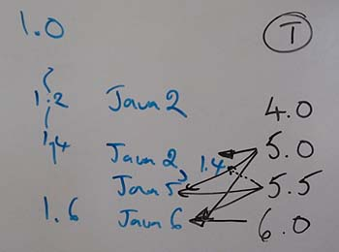
Versions of Java
JDK 1.0 (January 23, 1996)
JDK 1.1 (February 19, 1997)
J2SE 1.2 (December 8, 1998)
J2SE 1.3 (May 8, 2000)
J2SE 1.4 (February 6, 2002)
J2SE 5.0 (September 30, 2004)

Slide 19
Versions of Java
Java SE 6 (December 11, 2006)
Java SE 6 Update 10(Released October 15, 2008 )
Java SE 6 Update 11(Released December 3, 2008)
Java SE 6 Update 12
Java SE 6 Update 14(Released May 28, 2009)
Java SE 6 Update 16(Released August 11, 2009)
Java SE 6 Update 17(Released November 4, 2009)
Java SE 6 Update 18(Released January 13, 2010)
Java SE 6 Update 19(Released March 30, 2010)
Java SE 6 Update 20(Released April 15, 2010)
Java SE 6 Update 21(Released July 7, 2010)

Slide 20
Versions of Java
Java SE 7.0
Java 7 is a major update to Java (July 2011)
Java SE 8.0
Java 8 is a major update to Java 7 (March 2014)
Java SE 9.0
Java 9 is a major update to Java 8 (September 2017)
…….
……..
https://en.wikipedia.org/wiki/Java_version_history

Slide 21
Features of Java
Simple
syntax is based on C++
removed many confusing and/or rarely-used features e.g., explicit pointers, operator overloading etc.
No need to remove unreferenced objects because there is Automatic Garbage Collection in java
object-oriented
Code of the java Language is Written into the classes and Objects So this feature of java is most Popular because it also Supports Code Reusability, Maintainability etc.
Notes:
Java language is simple because:
syntax is based on C++ (so easier for programmers to learn it after C++).

Slide 22
Features of Java
Java is platform Independent
With Java, you can compile source code on Windows and the compiled code (bytecode to be precise) can be executed (interpreted) on any platform running a JVM. So yes you need a JVM but the JVM can run any compiled code, the compiled code is platform independent

Slide 23
Java vs C++
C/C++ is not platform independent, because when we compile C/C++ source code, it will generate binary code which can be understood by current OS only. When we move this source code to other platform and then compile C/C++ binary code, the binary code generated cannot be understood by this new platform

Slide 24
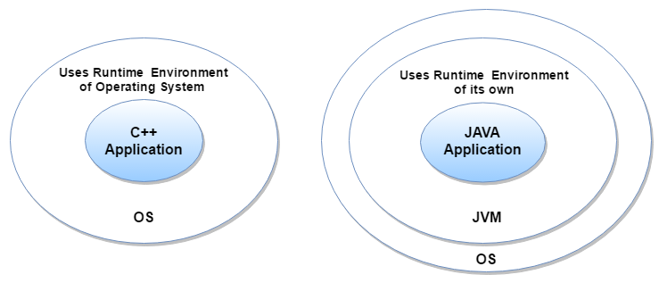
Features of Java
Portable
We may carry the java bytecode to any platform
Secure
Java Programs run inside virtual machine sandbox

Slide 25
Features of Java
Java is Multi-Threaded. ... A single Java program can have many different threads executing independently and continuously. Three Java applets on the same page can run together with each getting equal time from the CPU

Slide 26
Features of Java
interpreted and high-performance – Java programs are compiled into an intermediate representation – bytecode:
can be later interpreted by any JVM
can be also translated into the native machine code for
efficiency.

Slide 27
Features of Java
dynamic – The linking of data and methods to where they are located, is done at run-time.
New classes can be loaded while a program is running. Linking is done on the fly.
Even if libraries are recompiled, there is no need to recompile code that uses classes in those libraries. This differs from C++, which uses static binding.

Slide 28

Java Procedure
The essential steps to create and run Java programs go as follows:
Create a Java source code file
Compile the source code
Run the compiled code in a Java Virtual Machine.

Slide 29
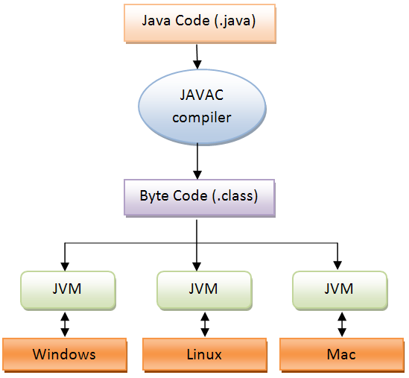
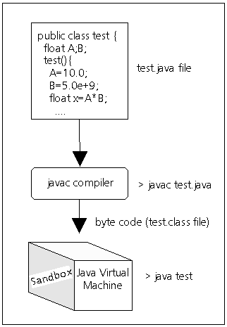
Steps for creating and running a Java program

Slide 30
Java Procedure Detail
You create the code with a text editor (for example notepad) and save it to a file with the ".java" suffix.
All Java source code files must end with this type name.
The first part of the name must match the class name in the source code.
In the figure the class name is Test so you must therefore save it to the file name Test.java.

Slide 31

Java Procedure Detail
With the javac program, you compile this file as follows:
C:> javac Test.java
This creates a bytecode file (or files if the code file included more than one class) that ends with the ".class" type appended.
Here the output is Test.class.
The bytecode consists of the instructions for the Java Virtual Machine (JVM or just VM).

Slide 32
Java Procedure Detail
The JVM is an interpreter program that emulates a processor that executes the bytecode instructions just as if it were a hardware processor executing native machine code instructions.
The Java bytecode can then run on any platform in which the JVM is available and the program should perform the same.
This Write Once, Run Anywhere (WORA) approach is a key goal of the Java language.

Slide 33
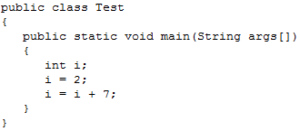
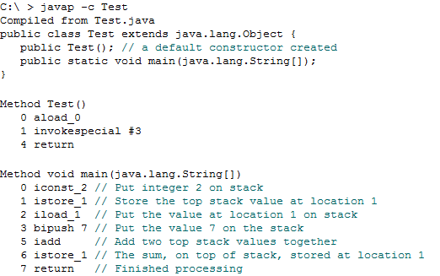
Another Example with Bytecode Representation
Test.java
Compile it with
> javac Test.java
Command used for
reading bytecode file
Bytecode Representation

Slide 34
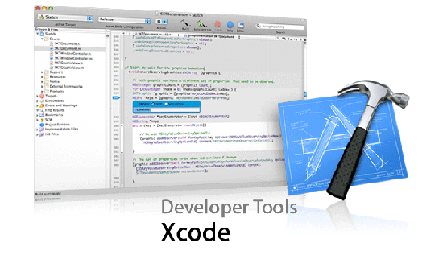
Programming Tools
Integrated Development Environment (IDE) - graphical user interface programming environments (often called GUI Builders) are elaborate, programs that allow you to interactively build graphical interfaces, edit the code, execute and run the applets and applications all within the IDE system. Example Java IDEs include:
NetBeans
Borland JBuilder
Eclipse
Dr Java

Slide 35

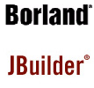
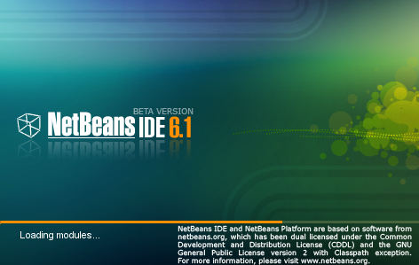

Programming Tools

Slide 36
Questions?

