Slide 1
Object Oriented Programming

Slide 2
Previous Lecture
What is a Program?
Evolution of Programming Languages
Why Java
Java History
Versions of Java
Features of Java
Java Procedure

Slide 3
Topics To Be Covered Today
Creating Simple Java Application
Lexical Issues
Java Class Library
Notes:
Lexical; of or relating to dictionaries (words)

Slide 4
Getting Started
To begin developing Java programs, follow
these steps:
Step 1: Obtain the Software Development Kit (SDK) for J2SE (Java 2 Platform, Standard Edition)
Step 2: Install the SDK

Slide 5
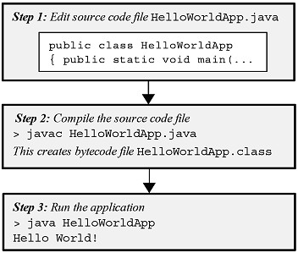
Simple Java Application

Slide 6
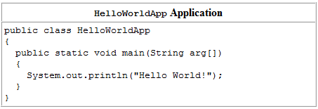
Simple Application
Step 1: Use an editor to enter the following code for the HelloWoldApp program:
Save this code in a file called HelloWorldApp.java

Slide 7
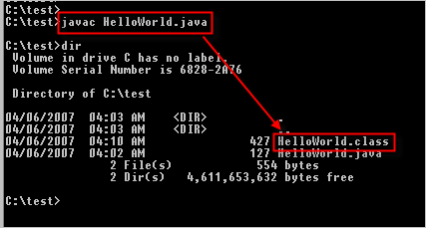
Simple Application
Step 2: Compile the application with the command line:
> javac HelloWorldApp.java
This creates the class file (with the bytecode output):
HelloWorldApp.class

Slide 8
Simple Application
Step 3: Use the java command to run the program:
> java HelloWorldApp
Hello World!
The output is printed after the command line.
Output

Slide 9
Description
The keyword class is used to declare that a new class is being defined.
HelloWorldApp is an identifier that is the name of the class.
The entire class definition, including all of its members, will be between the opening curly brace ({) and the closing curly brace (}).
The use of the curly braces in Java is identical to the way they are used in C, C++.
In Java, all program activity occurs within class. This is one reason why all Java programs are object-
oriented.

Slide 10
Description
The next line of code is
All Java applications begin execution by calling main( ).
The public keyword is an access specifier, which allows the programmer to control the visibility of class members. When a class member is preceded by public, then that member may be accessed by code outside the class in which it is declared.
main( ) must be declared as public, since it must be called by code outside of its class when the program is started.

Slide 11
Description
The keyword static allows main( ) to be called without having to instantiate a particular instance of the class. This is necessary since main( ) is called by the Java interpreter before any objects are made.
The keyword void simply tells the compiler that main( ) does not return a value.

Slide 12
Description
main( ) is the method called when a Java application begins. Java is case-sensitive. Thus, Main is different from main.
It is important to understand that the Java compiler will compile classes that do not contain a main( ) method. But the Java interpreter has no way to run these classes. So, if you had typed Main instead of main, the compiler would still compile your program. However, the Java interpreter would report an error because it would be unable to find the main( ) method.
Notes:
Try to execute the code with Main instead of main.

Slide 13
Description
main( ) is simply a starting place for your program.
A complex program will have dozens of classes, only one of which will need to have a main( ) method to get things started.
String arg[ ] declares a parameter named arg, which is an array of instances of the class String.
arg receives any command-line arguments present when the program is executed.
This program does not make use of String arg[ ].

Slide 14
Description
The next line of code is shown here
This line outputs string Hello World!
System is a predefined class that provides access to the system, and out is the output stream that is connected to the console.
Output is actually accomplished by the built-in println( ) method. println( ) displays the string which is passed to it.
Notes:
Difference between println() and print() ?

Slide 15
Comparison
Valid java main method signature
public static void main(String[] args)
public static void main(String []args)
public static void main(String args[])
public static void main(String... args)
static public void main(String[] args)
public static final void main(String[] args)
final public static void main(String[] args)
Invalid java main method signature
public void main(String[] args)
static void main(String[] args)
public void static main(String[] args)
public static void main()

Slide 16
Lexical Issues
Whitespace
Java is a free-form language.
For example, the program could have been written all on one line or in any other strange way you felt like typing it.
In Java, whitespace is a space, tab, or newline.

Slide 17
Lexical Issues
Identifiers
Identifiers are used for class names, method names, and variable names.
An identifier may be any descriptive sequence of uppercase and lowercase letters, numbers, or the underscore and dollar-sign characters.
They must not begin with a number.
Java is case-sensitive, so VALUE is a different identifier than Value.
Some examples of valid identifiers are:
AvgTemp count a4 $test this_is_ok _a
Invalid variable names include:
2count high-temp Not/ok

Slide 18
Lexical Issues
Literals
A constant value in Java is created by using a literal representation of it.
For example, here are some literals:
100 98.6 ‘X’ “This is a test”
Left to right, the first literal specifies an integer, the next is a floating-point value, the third is a character constant, and the last is a string.
A literal can be used anywhere, a value of its type is allowed.

Slide 19
Lexical Issues
Comments
The statements in a program that are not executed by the compiler and interpreter.
There are three types of comments defined by Java. You already know two: single-line and multiline. The third type is called a documentation comment.
This type of comment is used to produce an HTML file that documents your program.
The documentation comment begins with a /** and ends with a */.

Slide 20
Lexical Issues
Separators
In Java, there are a few characters that are used as separators.
The most commonly used separator in Java is the semicolon.

Slide 21
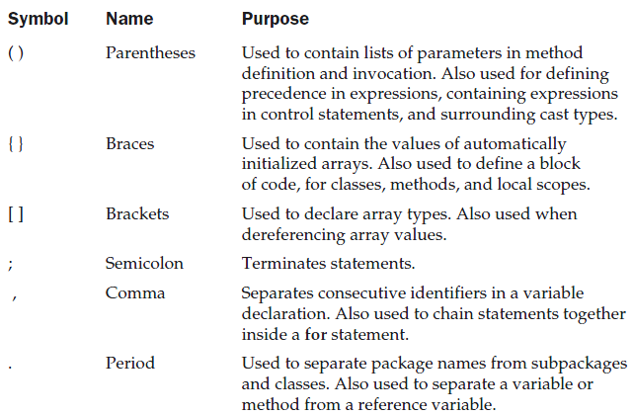

Slide 22
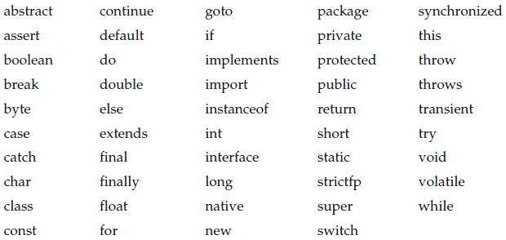
Lexical Issues
The Java Keywords
There are 49 reserved keywords currently defined in the Java language
The keywords const and goto are reserved but not used.

Slide 23
Java Class Libraries
the Java environment relies on several built-in class libraries that contain many built-in methods that provide support for such things as I/O, string handling, networking, and graphics.
The standard classes also provide support for windowed output.
Thus, Java as a totality is a combination of the Java language itself, plus its standard classes.

Slide 24
Question
Can you save a java source file by other name than the class name?

Slide 25
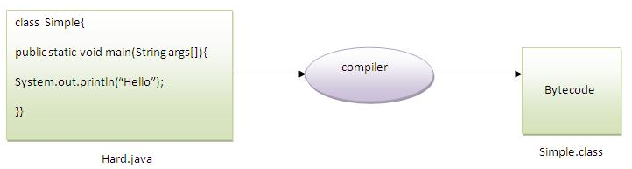
Answer
Yes, if the class is not public. It is explained in the figure given below:
To Compile: javac Hard.java
To Run: java Simple

Slide 26
Questions?

