Slide 1
Object Oriented Programming

Slide 2
Topics To Be Covered Today
Value, Variable and Data Type
Type Conversion
Arithmetic Expression Evaluation
Scope of variable

Slide 3
Simplistic View of a Computer
Each location is
1 byte of memory
1 byte = 8 bits
Each bit is carrying 1 or 0.

Slide 4
Variable
To store a value inside a computer a ‘variable’ is used.
A variable is a space in the memory to store a value.
This space is reserved until the variable is required.
A combination of "vary + able" which means its value can be changed.

Slide 5
What Makes a Variable
Variable has three important characteristics:
Type
How much memory do a variable need.
This information is determined by a type.
Name
How to differentiate a variable with another variable of the same type.
Name refers to the memory location assigned to this variable.
Value
What is the value?
The actual value contained by a variable.

Slide 6
An Example of a Variable
Type of the variable is integer (written as “int” in Java)
int
temperature
35
=
A name of the variable
An initial value of the variable

Slide 7
Example of a Variable (Memory View)
int temperature =35
00000000
Location 0
Locations 0 – 3 are collectively
called as ‘temperature’
00000000
Location 1
00000000
Location 2
00100011
Location 3
Location 4
100011 is the binary equivalent of 35
Location 5

Slide 8
Changing the Value of Variable
Lets change the value of ‘temperature’.
temperature = 45902
00000000
Location 0
Locations 0 – 3 are collectively
called as ‘temperature’
00000000
Location 1
Location 2
10110011
Location 2
01001110
Location 3
Location 4
1011001101001110 is the binary equivalent of 45902
Location 5

Slide 9
Types of Variables
There are three types of variables:
local variable
A variable which is declared inside the method is called local variable.
instance variable
A variable which is declared inside the class but outside the method, is called instance variable . It is not declared as static.
static variable
A variable that is declared as static is called static variable. It cannot be local.

Slide 10
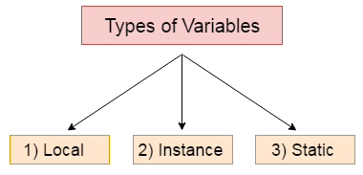
Types of Variables (Example)
class A{
int data=50;//instance variable
static int m=100;//static variable
void method(){
int n=90;//local variable
}
}//end of class

Slide 11
Data Types in Java
Data types represent the different values to be stored in the variable.
In java, there are two types of data types:
Primitive data types
Non-primitive data types
Notes:
Primitive: Original; primary; radical; not derived from another

Slide 12
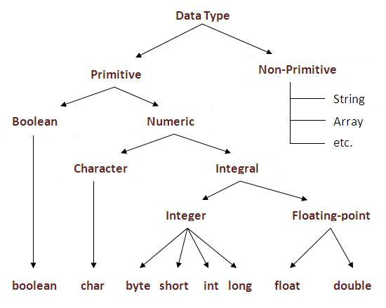
Data Types in Java

Slide 13
Primitive data types: The predefined data types provided by Java language are known as primitive data types. Primitive data types are also known as in-built data types.
Non-primitive data types: The data types that are derived from primitive data types of the Java language are known as non-primitive data types. It is also known as derived data types or reference data types.

Slide 14
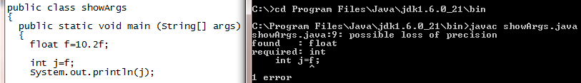
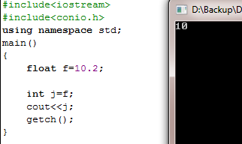
Type of a Variable
Among other advantages a ‘type’ binds the memory to a variable name.
Java is more strictly typed than either language.
For example, in C/C++ you can assign a floating-point value to an integer. In Java, you cannot.
Also, in C there is not necessarily strong type-checking between a parameter and an argument. In Java, there is.
Java
C++

Slide 15
Int Data type
By default, The type int is of 4 bytes (32 bits)
Therefore, it can hold maximum of 2,147,483,647 value (2³¹-1).
It can also hold values in negative down to
-2,147,483,648 (-2³¹).
In Java SE 8 and later, you can use the int data type to represent an unsigned 32-bit integer
(‘0’ – ‘2³¹-1’)
Static methods like compareUnsigned, divideUnsigned etc have been added to the Integer class to support the arithmetic operations for unsigned integers

Slide 16
Double
int cannot hold a real value.
Therefore, a type “double” is used to hold real values.
Double takes 8 bytes of memory instead of 4 bytes of a double.
Out of the 8 bytes in a double 4 bytes are used to hold the value before the decimal point and 4 bytes for the value after the decimal point.

Slide 17
Relative Comparison of int and double
int numPeople = 2;
Reserves 32 bits (4 bytes)
and sets the value stored
in that space to 2. The name
‘numPeople’ is associated with
this space.
double bill = 32.45;
Reserves 64 bits (8 bytes)
and sets the value stored
in that space to 32.45. The name
‘bill’ is associated with
this space.

Slide 18
Char Data Type
In Java, the data type used to store characters is char.
However char in Java is not the same as char in C or C++.
In C/C++, char is an integer type that is 8 bits wide.
This is not the case in Java. Instead, Java uses Unicode to represent characters.
Unicode defines a fully international character set that can represent all of the characters found in all human languages.
It is a unification of dozens of character sets, such as Latin, Greek, Arabic, Cyrillic, Hebrew, Katakana, Hangul, and many more.
For this purpose, it requires 16 bits. Thus, in Java char is a 16-bit type.
https://www.compart.com/en/unicode/category/So

Slide 19
Boolean Data Type
Java has a simple type, called boolean, for logical values.
It can have only one of two possible values, true or false.
This is the type returned by all relational operators, suchas a < b.
boolean is also the type required by the conditional expressions that govern the control statements such as if and for.
How much memory will be required to store a Boolean variable??

Slide 20
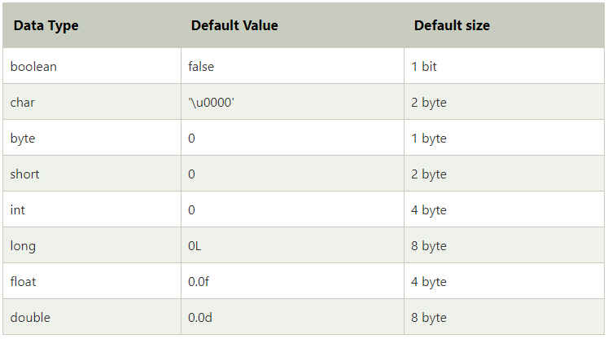
Simple Types in Java

Slide 21
Type Conversion
Java can perform conversion automatically
Depends upon type compatibility
int value can be assigned to long.
Not all type conversions implicitly allowed.
Cant assign a long value to int.
Solution
Casting

Slide 22
Type Conversion (cont.)
Widening conversion
Narrow data types are converted into broad data type with out loss of information
Both types are compatible.
Numeric types are not compatible with Boolean and char
Destination type is larger than source type.
Example
byte → int
int → long

Slide 23
Widening Conversion (Example)
class Simple{
public static void main(String[] args){
int a=10;
float f=a;
System.out.println(a);
System.out.println(f);
}}

Slide 24
Type Conversion (cont.)
Narrowing conversion
Broader data type is converted into narrower data type with loss of information
Process is called casting (explicit type conversion)
Target variable = (Target-type) Source variable
byte b;
int a=50;
b=(byte)a;
Truncation??????

Slide 25
Narrowing conversion (Exp)
class Simple{
public static void main(String[] args){
float f=10.5f;
//int a=f;//Compile time error
int a=(int)f;
System.out.println(f);
System.out.println(a);
}}

Slide 26
Type Conversion in Expressions
Type conversion in expressions
(f*b) + (i/c) –(d*s) ?????????

Slide 27
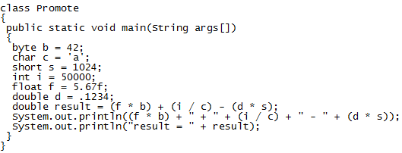

Type Conversion in Expressions

Slide 28
Description
In the first subexpression, f * b, b is promoted to a float and the result of the subexpression is float.
Next, in the subexpression i / c, c is promoted to int, and the result is of type int. Then, in d * s, the value of s is promoted to double, and the type of the subexpression
is double.
Finally, these three intermediate values, float, int, and double, are considered.
The outcome of float plus an int is a float. Then the resultant float minus the last double is promoted to double, which is the type for the final result of the expression.

Slide 29

Manipulating Variables
Assignment Statement
In Mathematics the value x = x + 1 is not possible why?
In Java x = x +1 is possible because “=” is an assignment operator and not an equality operator.
Assignment operator means that the contents of the right hand side is transferred to the memory location of the left hand side.

Slide 30
Assignment Statement
x
=
5671
5671 is written at the memory location reserved for x

Slide 31
Constants
Constants are values which cannot be modified e.g. the value of Pi
To declare a constant in Java, we write a keyword “final” before the variable type.
final double pi = 3.14;

Slide 32
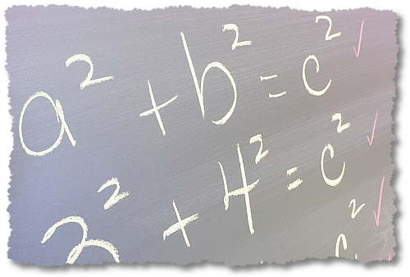
What is the Result of this Expression?
What is the result of this arithmetic expression
6 + 2 * 3 / 6
7
0.5
13.0
4

Slide 33
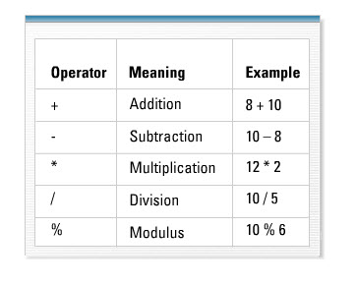
Manipulating Values
Mathematical Operators
Common mathematical operators are available in Java for manipulating values e.g. addition(+), subtraction(-), multiplication(*), division(/), and modulus (%).
Java has many other operators also which we will study in due course.

Slide 34
Arithmetic Expression Evaluation
To evaluate an arithmetic expression two concepts needs to be understood
Operator Precedence
Operator precedence controls the order in which operations are performed
Operator Associativity
The associativity of an operator specifies the order in which operations of the same precedence are performed

Slide 35
Operator Precedence and Associativity
Operators Precedence and Associativity for Java is following
*, /, % → Do all multiplications, divisions and remainders from left to right.
+, - → Do additions and subtractions from left to right.

Slide 36
Evaluating an Expression
6 + 2 * 3 / 6
Three operators are in this expression.
However, * and / both have the same precedence and + has lower precedence then these two.
* and / will be evaluated first but both have the same precedence level.
Therefore, operator associativity will be used here to determine the first to get evaluated i.e. left to right.

Slide 37
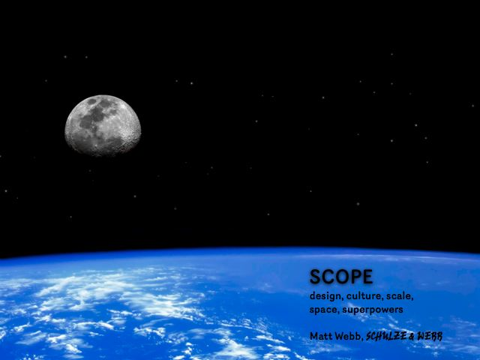
Scope of variable

Slide 38
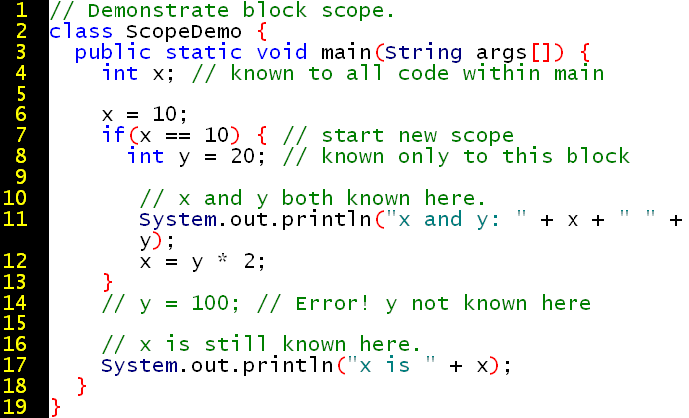
Scope of variable
Most other computer languages define two general categories of scopes: global and local.
In Java, the two major scopes are those defined by a class and those defined by a method.
The scope defined by a method begins with its opening curly brace.

Slide 39
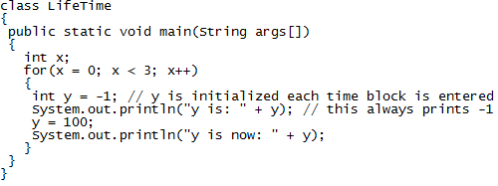
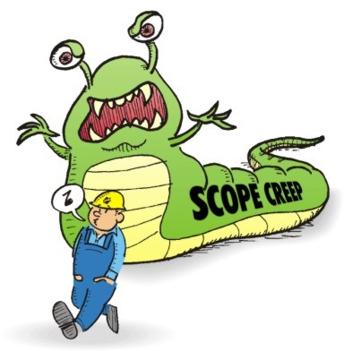
Output???

Slide 40

Output

Slide 41
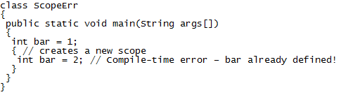

Another Example
Blocks can be nested, In Java you cannot declare a
variable to have the same name as one in an outer scope.
In this regard, Java differs from C and C++.

Slide 42
Primitive Data Types
So far the variable types that we have studied are primitive data types.
Primitive data types only have a memory space for storing values.
However, Object-Oriented Programming is special because OOP has more variables than just primitive data types.

Slide 43
Objects
Objects are one step ahead of primitive data types.
They contain values and operations both.
e.g. A String object has a value as well as operations that could be performed on that value e.g. operations to find its size, operation to compare its size with another String etc.

Slide 44
Class Participation
What will be output:
25-((5*4)/2)-10+4

Slide 45
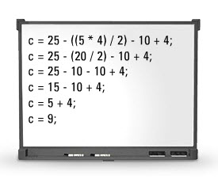

Class Participation

Slide 46
Class Participation
1 : What will be output?
float f=65/10+38/10;
System.out.println(f);
float f=65.0/10+38.0/10;
System.out.println(f);
float f=65.0f/10+38.0f/10;
System.out.println(f);

Slide 47
Class Participation
2: What will be the output?
int i=638;
byte b=(byte)i;
System.out.println(b);

Slide 48
Questions?

