Slide 1
Object Oriented Programming

Slide 2
Topics To Be Covered Today
Control Flow statements
Selection statements
Iteration statements
Jump statements

Slide 3
Control Flow
Writing a program means typing statements into a file.
Without control flow, the interpreter would execute these statements in the order they appear in the file, left-to-right, top-down.
Control flow statements, when inserted into the text of the program, determine in which order the program should be executed.

Slide 4
Control Flow statements
Control statements are divided into three groups:
selection statements allow the program to choose different parts of the execution based on the outcome of an expression
iteration statements enable program execution to repeat one or more statements
jump statements enable your program to execute in a non-linear fashion

Slide 5
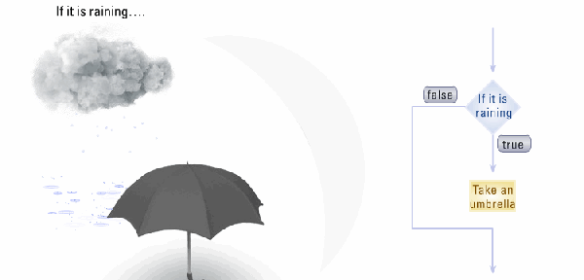
Selection statements
Java selection statements allow to control the flow of program’s execution based upon conditions known only during run-time.
Java provides four selection statements:
if
if-else
if-else-if
switch

Slide 6
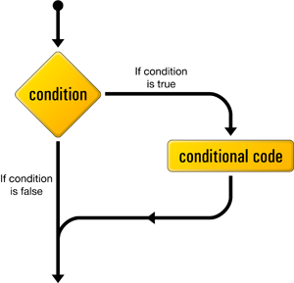
If statement
General form:
if (expression) statement
If expression evaluates to true, execute statement, otherwise do nothing.
The expression must be of type boolean.

Slide 7
Simple/Compound statements
The component statement may be:
simple
if (expression) statement;
compound
if (expression) {
statement;
}

Slide 8
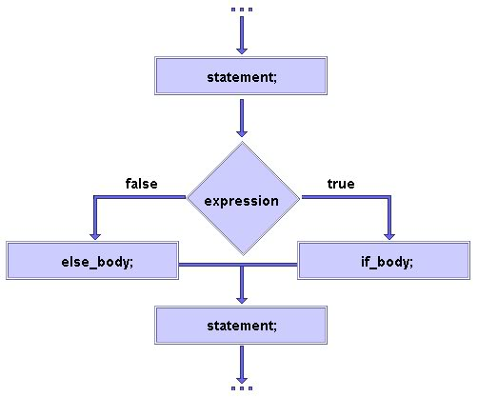
If-else statement
Suppose you want to perform two different statements depending on the outcome of a boolean expression. if-else statement can be used.
General form:
if (expression) statement1
else statement2
Again, statement1 and
statement2 may be simple
or compound.

Slide 9
If-else-if statement
General form:
if (expression1) statement1
else if (expression2) statement2
else if (expression3) statement3
…
else statement
Semantics:
statements are executed top-down
as soon as one expressions is true, its statement is executed
if none of the expressions is true, the last statement is executed

Slide 10
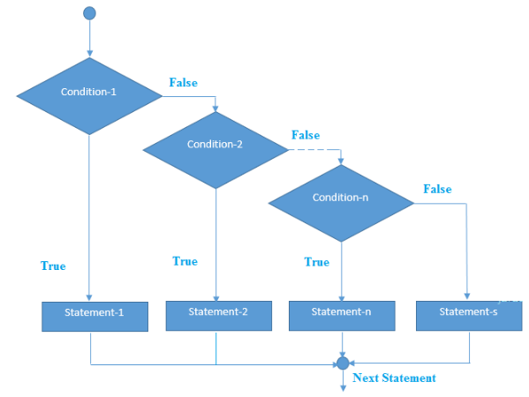
if-else-if ladder

Slide 11
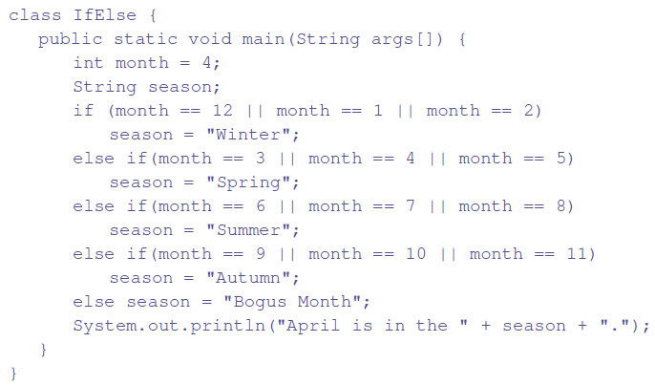
Example: if-else-if

Slide 12
Switch statement
switch provides a better alternative than if-else-if when the execution follows several branches depending on the value of an expression.
General form:
switch (expression) {
case value1: statement1; break;
case value2: statement2; break;
case value3: statement3; break;
…
default: statement(code to be executed if all cases are not matched);
}

Slide 13
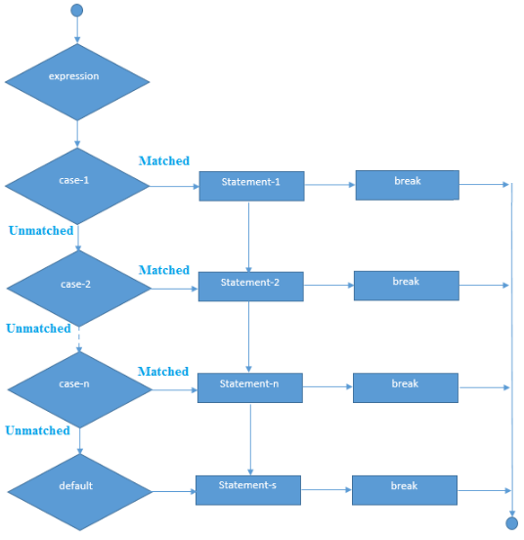
Switch statement

Slide 14
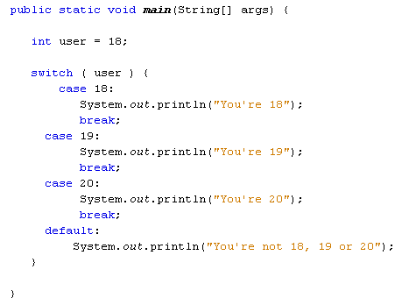
Switch statement

Slide 15
Switch Assumptions/Semantics
Assumptions:
expression must be of type byte, short, int or char
each of the case values must be a literal of the compatible type
case values must be unique
Semantics:
expression is evaluated
its value is compared with each of the case values
if a match is found, the statement following the case is executed
if no match is found, the statement following default is executed
break makes sure that only the matching statement is executed.
Both default and break are optional.
Java Switch Statement is fall-through
Notes:
It means it executes all statement after first match if break statement is not used with switch cases

Slide 16
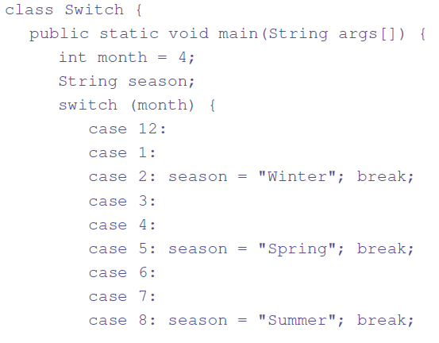
Example: Switch (practice)

Slide 17
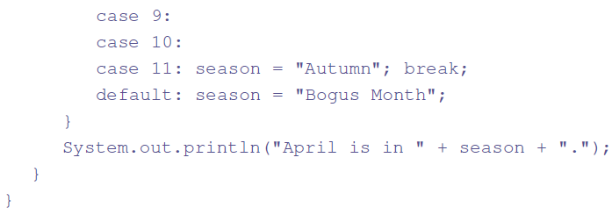
Example: Switch

Slide 18
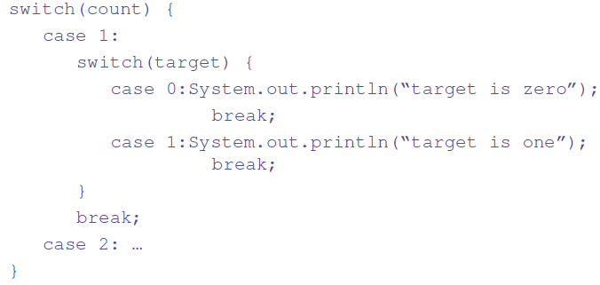
Nested switch statement
A switch statement can be nested within another switch statement:
Since, every switch statement defines its own block, no conflict arises between the case constants in the inner and outer switch statements.

Slide 19
Comparing switch and if
Main differences:
switch test only for equality, while if-else statement test for equality as well as for logical expression.
switch statement evaluates only character or integer value while if statement evaluates integer, character, floating-point type or boolean type.
Java creates a “jump table” for switch expressions, so a switch statement is usually more efficient than a set of nested if statements

Slide 20
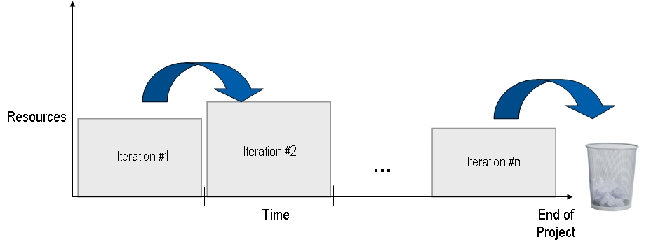
Iteration statements
Java iteration statements enable repeated execution of part of a program until a certain termination condition becomes true.
Java provides three iteration statements:
While
do-while
for

Slide 21
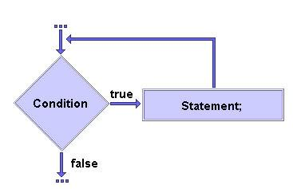
While statement
General form:
while (expression) statement
where expression must be of type boolean.
Semantics:
repeat execution of statement until expression becomes false
expression is always evaluated before statement
if expression is false initially, statement will never get executed
Notes:
If the number of iteration is not fixed, it is recommended to use while loop.

Slide 22
Simple/compound statement
The component statement may be:
simple
while (expression) statement;
compound
while (expression) {
statement;
}

Slide 23
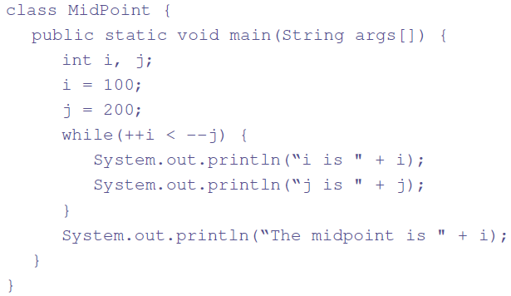
Example: while

Slide 24
Java Infinitive While Loop
If you pass true in the while loop, it will be infinitive while loop
while(true)
System.out.println("infinitive while loop");
Now, you need to press ctrl+c to exit from the program.

Slide 25
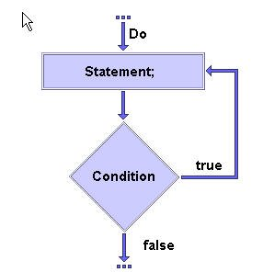
Do-while statement
If a component statement has to be executed at least once, the do-while statement is more appropriate than the while statement.
General form:
do statement
while (expression);
where expression must be of type boolean.
Semantics:
repeat execution of statement until expression becomes false
expression is always evaluated after statement
even if expression is false initially, statement will be executed
Notes:
If the number of iteration is not fixed and you must have to execute the loop at least once, it is recommended to use do-while loop.

Slide 26
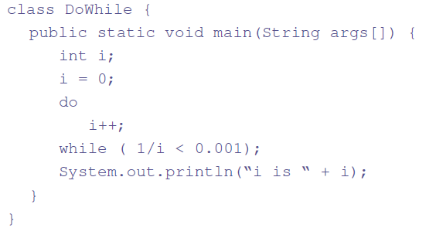
Example: Do-While

Slide 27
For statement
When iterating over a range of values, for statement is more suitable to use then while or do-while.
General form:
for (initialization; termination; increment)
statement
where:
initialization statement is executed once before the first iteration
termination expression is evaluated before each iteration to determine when the loop should terminate
increment statement is executed after each iteration
Notes:
If the number of iteration is fixed, it is recommended to use for loop.

Slide 28
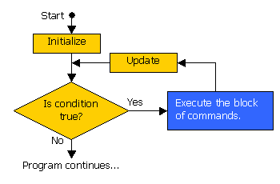
For statement Semantics
This is how the for statement is executed:
initialization is executed once
termination expression is evaluated:
if false, the statement terminates
otherwise, continue to (3)
component statement is executed
increment statement is executed
control flow continues from (2)

Slide 29

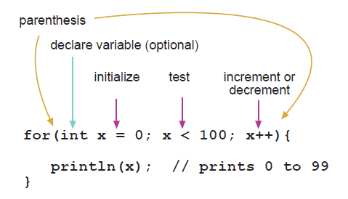
Loop Control Variable
The for statement may include declaration of a loop control variable:
The variable does not exist outside the for statement.

Slide 30
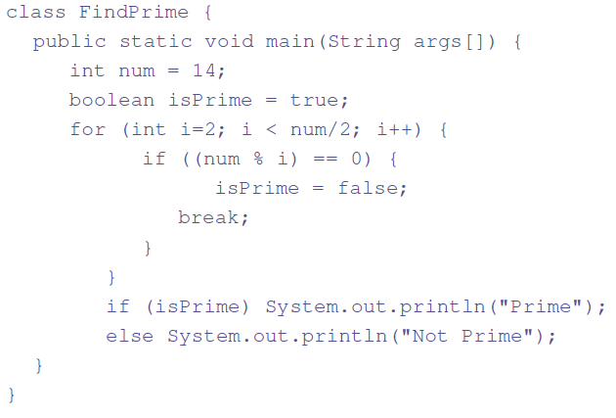
Example: for

Slide 31
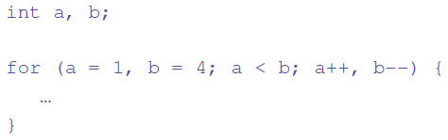
Many Initialization/Iteration Parts
The for statement may include several initialization and iteration parts.
Parts are separated by a comma:

Slide 32
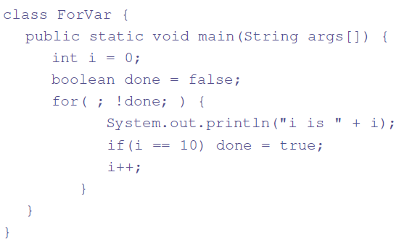
for statement Variations
The for statement need not have all components:

Slide 33
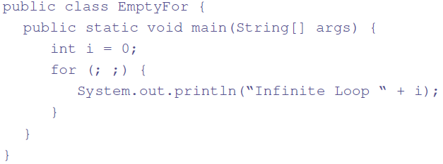
Empty for (practice)
In fact, all three components may be omitted:

Slide 34
Java for-each Loop
The for-each loop is used to traverse array or collection in java
Easier to use than simple for loop because we don't need to increment value and use subscript notation.
works on elements basis not index and returns element one by one in the defined variable.

Slide 35
Example
public class ForEachExample {
public static void main(String[] args) {
int arr[]={12,23,44,56,78};
for(int i:arr){
System.out.println(i);
}
}
}

Slide 36
Java Labeled For Loop
We can have name of each for loop. i.e. we can use label before the for loop
It is useful if we have nested for loop so that we can break/continue specific for loop.
Normally, break and continue keywords breaks/continues the inner most for loop only.

Slide 37
Example
public class LabeledForExample {
public static void main(String[] args) {
aa:
for(int i=1;i<=3;i++){
bb:
for(int j=1;j<=3;j++){
if(i==2&&j==2){
break aa;
}
System.out.println(i+" "+j);
}
}
}
}

Slide 38
Example 2
public class LabeledForExample2 {
public static void main(String[] args) {
aa:
for(int i=1;i<=3;i++){
bb:
for(int j=1;j<=3;j++){
if(i==2&&j==2){
break bb;
}
System.out.println(i+" "+j);
}
}
}
}
Output ????

Slide 39
Jump Statements
Java jump statements enable transfer of control to other parts of program.
Java provides three jump statements:
break
continue
return
In addition, Java supports exception handling that can also alter the control flow of a program. Exception handling will be explained in its own section.

Slide 40
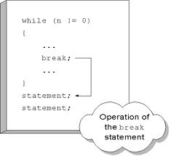
Break Statement
The break statement has three uses:
to terminate a case inside the switch statement
to exit an iterative statement
to transfer control to another statement
(1) has been described earlier.
We continue with (2) and (3).

Slide 41
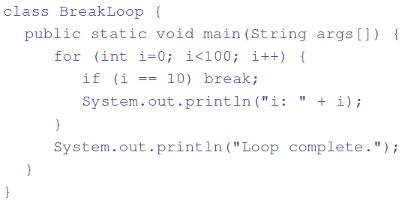
Loop Exit with Break
When break is used inside a loop, the loop terminates and control is transferred to the following instruction.

Slide 42
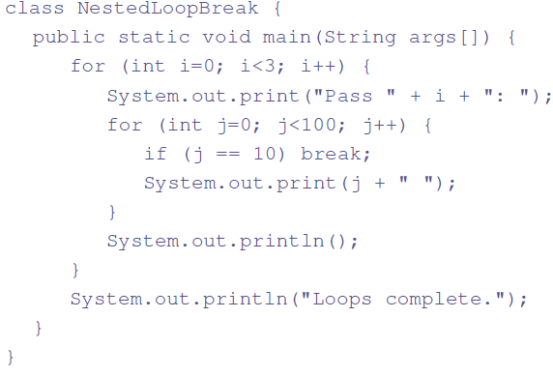
Break with Nested Loops
Used inside nested loops, break will only terminate the innermost loop:

Slide 43
Control Transfer with Break
break occurs in two versions:
Unlabelled
Labeled
The labeled break statement is a “civilized” replacement for goto.

Slide 44
Labeled Break
General form:
break label;
where label is the name of a label that identifies a block of code:
label: { … }
The effect of executing break label; is to transfer control immediately after the block of code identified by label.

Slide 45
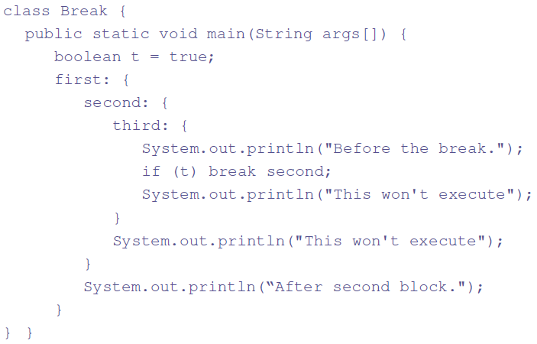
Example: Labeled Break

Slide 46
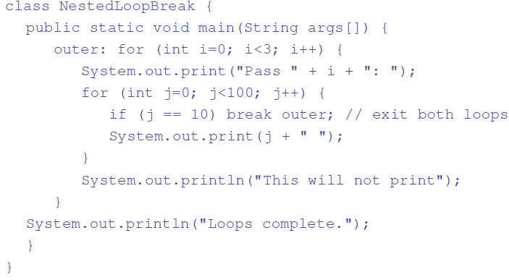
Example: Nested Loop Break
Notes:
J is 0>9 printed just for pass0.

Slide 47
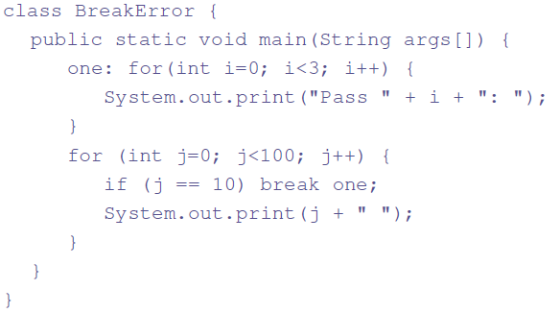
Break without proper Label
It is not possible to break to any label which is not defined for an enclosing block. Trying to do so will result in a compiler error.

Slide 48
Continue Statement
The break statement terminates the block of code, in particular it terminates the execution of an iterative statement.
The continue statement forces the early termination of the current iteration to begin immediately the next iteration.
Like break, continue has two versions:
unlabelled – continue with the next iteration of the current loop
labeled – specifies which enclosing loop to continue

Slide 49
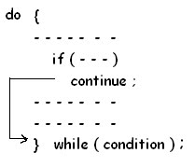
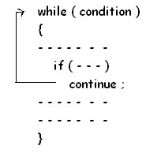
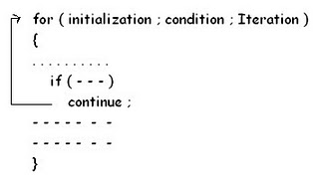
Continue Statement
Do while
While
for

Slide 50
Example: Unlabeled Continue
public class ContinueExample {
public static void main(String[] args) {
for(int i=1;i<=10;i++){
if(i==5){
continue;
}
System.out.println(i);
}
}
} Output???

Slide 51
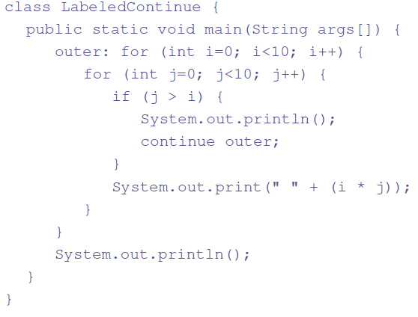
Example: Labeled Continue

Slide 52

Return statement
The return statement is used to return from the current method: it causes program control to transfer back to the caller of the method.
Two forms:
return without value
return;
return with value
return expression;

Slide 53
Questions?

