Slide 1
Object Oriented Programming

Slide 2
Topics To Be Covered Today
Java Naming Conventions
Objects versus Class
Three main concepts of OOP
Encapsulation
Inheritance
Polymorphism
Method
Parameterized
Value-Returning

Slide 3
Java Naming conventions
A rule to follow as you decide what to name your identifiers
not forced to follow. So, it is known as convention not rule.
Advantage of naming conventions in java
Code becomes easy to read for yourself and for other programmers as readability of Java program is very important
less time is spent to figure out what the code does.
CamelCase in java naming conventions
e.g. actionPerformed(), firstName
Notes:
All the classes, interfaces, packages, methods and fields of java programming language are given according to java naming convention.

Slide 4
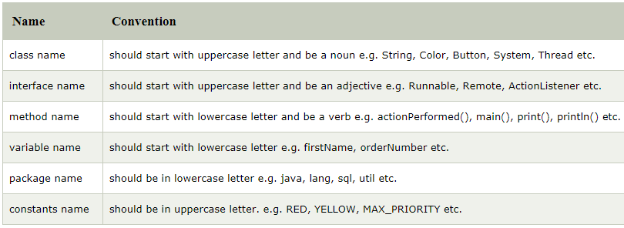
Java Naming conventions

Slide 5
What is an Object?
Real world objects are things that have:
State
represents data (value) of an object
Behavior
represents the behavior (functionality) of an object
Identity
Object identity is typically implemented via a unique ID. The value of the ID is not visible to the external user. But, it is used internally by the JVM to identify each object uniquely
Example: your pen:
state – name is Reynolds, color is white
behavior – writing

Slide 6

Object Definitions:
Object is:
a real world entity.
an entity which has state and behavior.
an instance of a class
Notes:
Class is a template or blueprint from which objects are created. So object is the instance(result) of a class.

Slide 7
What is a Class
A class is a blueprint that defines the variables and methods common to all objects of a certain kind.
Objects are created from class. So, object holds values for the variables defined in the class.
Example: ‘your dog’ is a object of the class Dog.

Slide 8
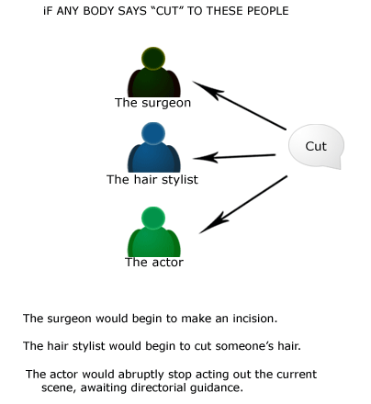


Three main concepts
Polymorphism
Encapsulation
Inheritance

Slide 9
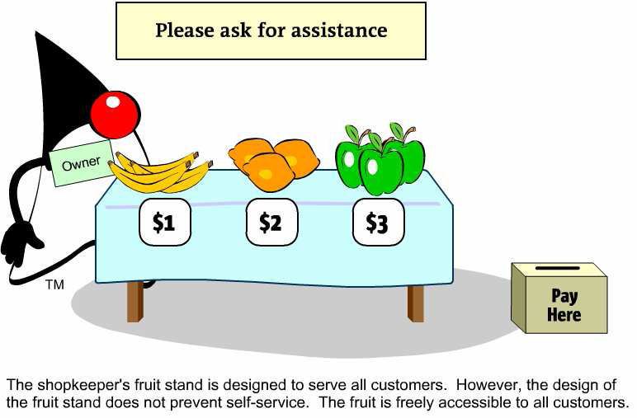
Encapsulation

Slide 10
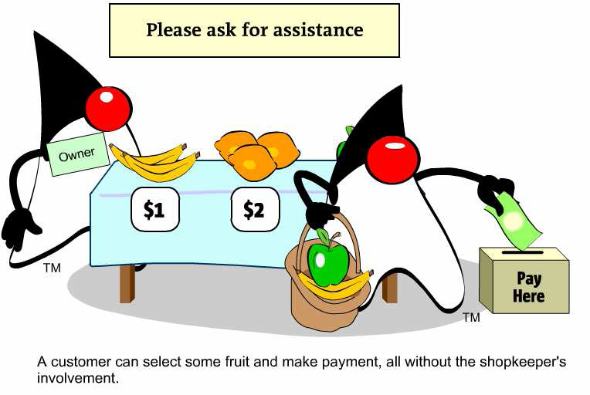
Encapsulation

Slide 11
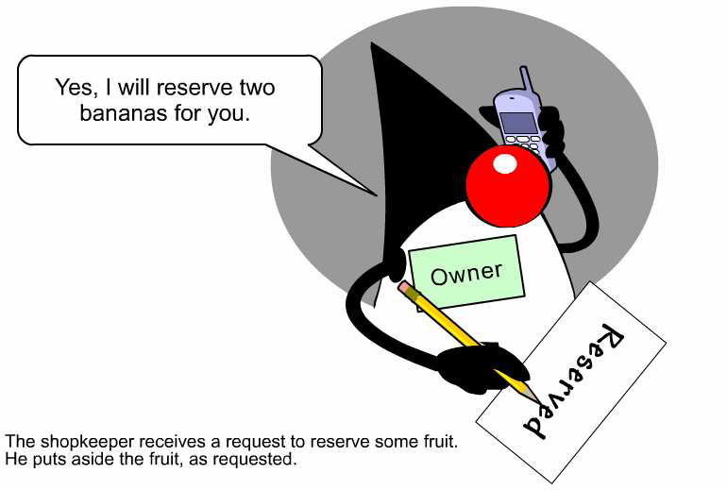
Encapsulation

Slide 12
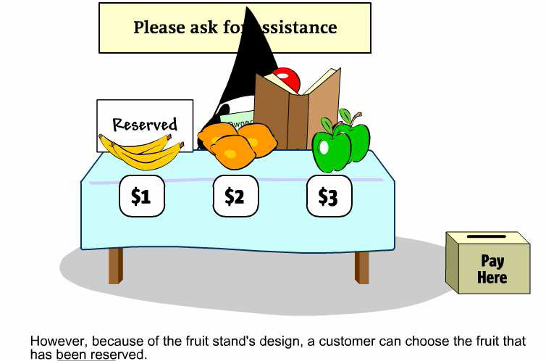
Encapsulation

Slide 13
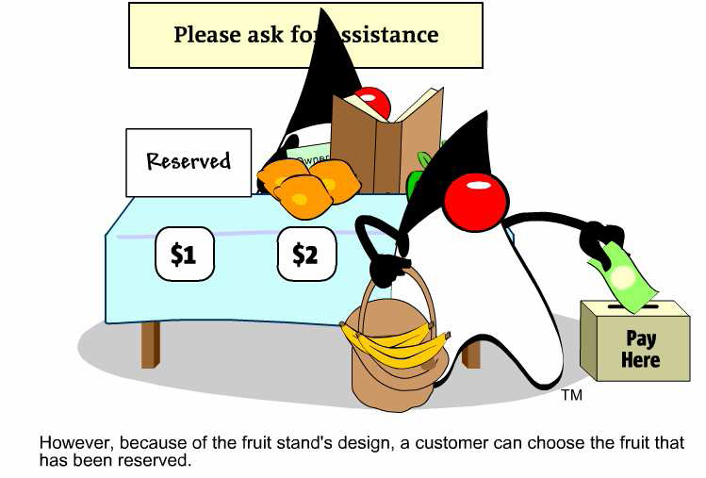
Encapsulation

Slide 14
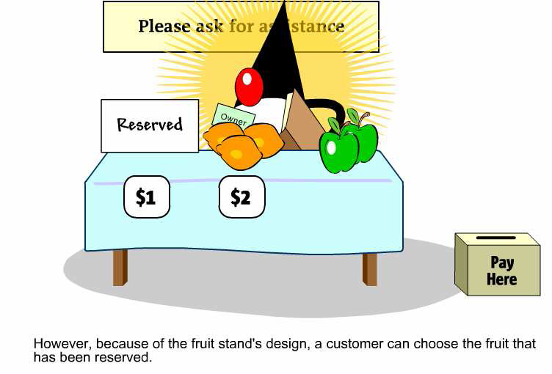
Encapsulation

Slide 15
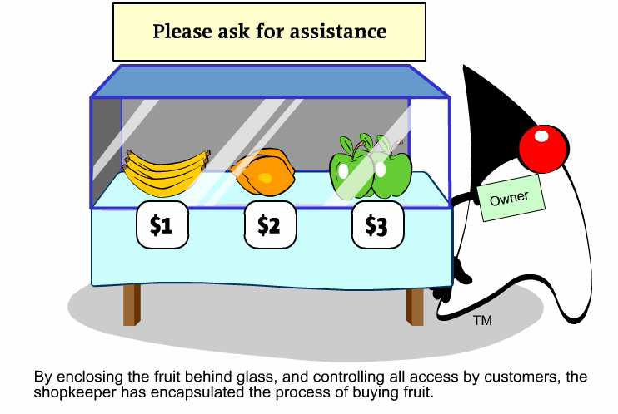
Encapsulation

Slide 16
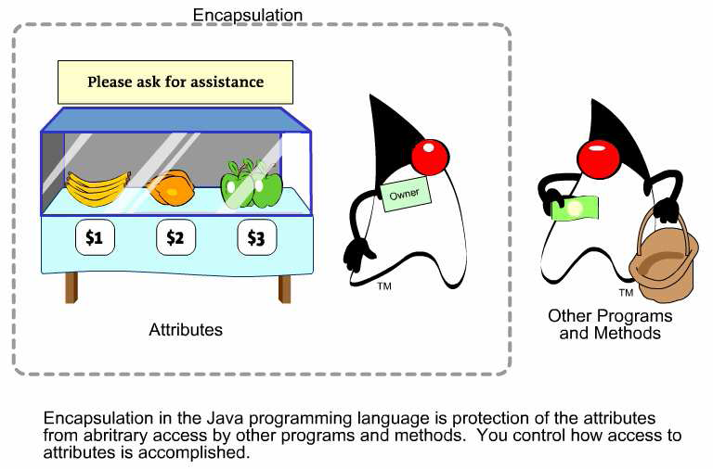
Encapsulation

Slide 17
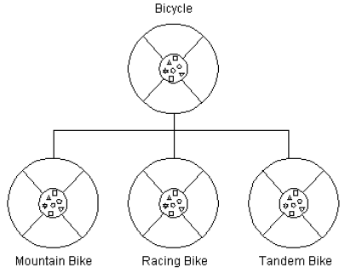
Inheritance
Features:
a class obtains variables and methods from another class
the former is called subclass, the latter super-class
a sub-class provides a specialized behavior with respect to its super-class
inheritance faciliates code reuse and avoids duplication of data
Super-class
Subclass

Slide 18
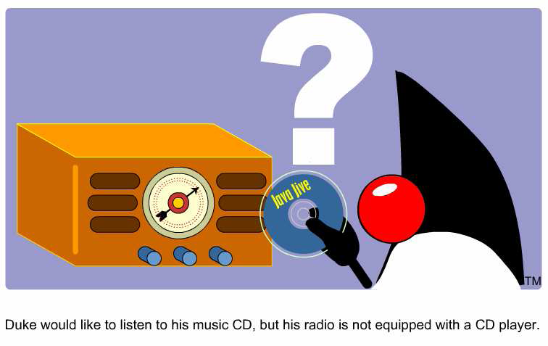
Inheritance

Slide 19
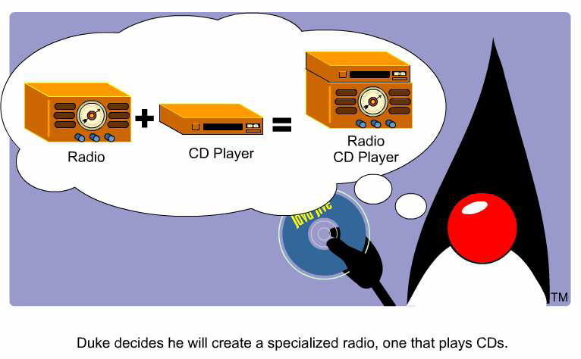
Inheritance

Slide 20
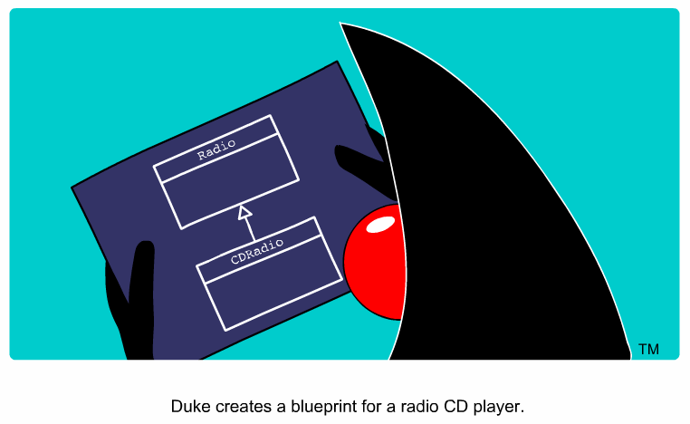
Inheritance

Slide 21
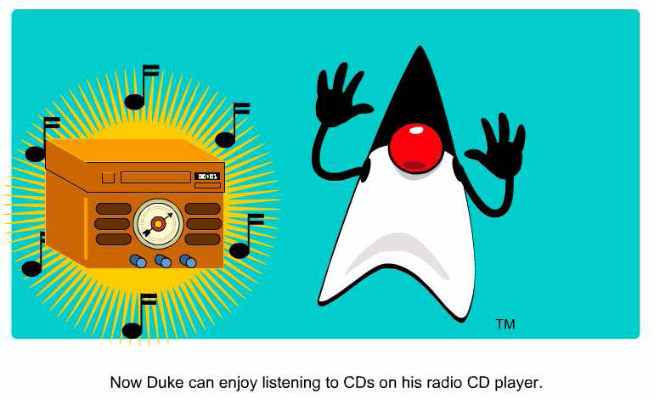
Inheritance

Slide 22
Polymorphism
Polymorphism = many different (poly) forms of objects that share a common interface respond differently when a method of that interface is invoked.
Polymorphism is enabled by inheritance:
a super-class defines an interface that all sub-classes must follow
it is up to the sub-classes how this interface is implemented; a subclass may override methods of its super-class
Therefore, objects from the classes related by inheritance may receive the same requests but respond to such requests in their own ways.

Slide 23
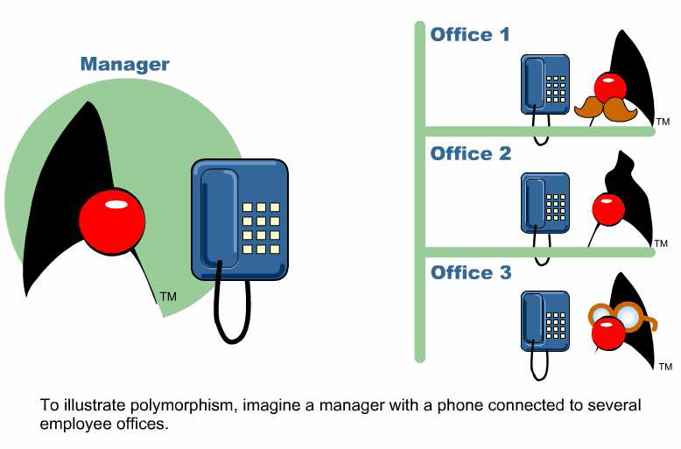
Polymorphism

Slide 24
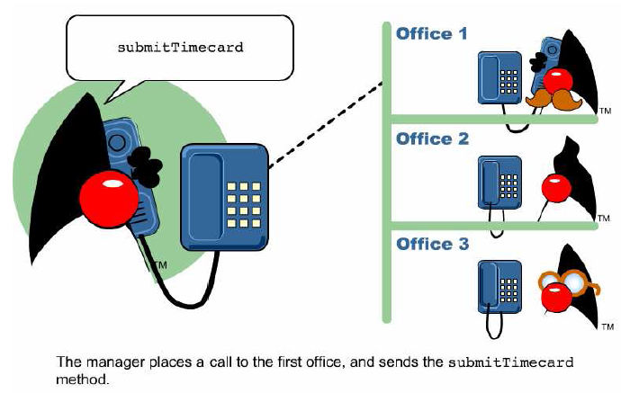
Polymorphism

Slide 25
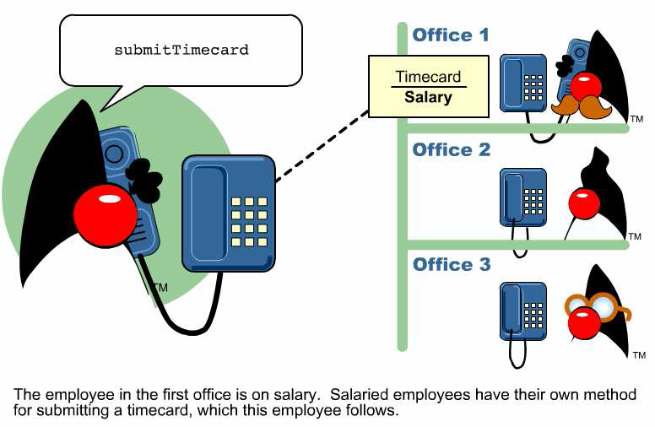
Polymorphism

Slide 26
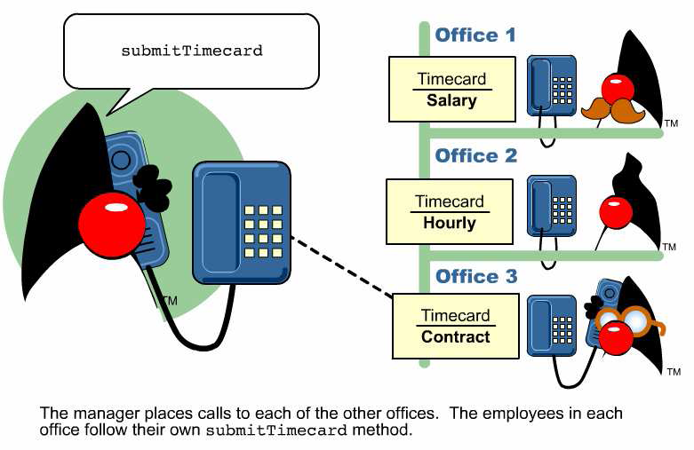
Polymorphism

Slide 27

Polymorphism

Slide 28
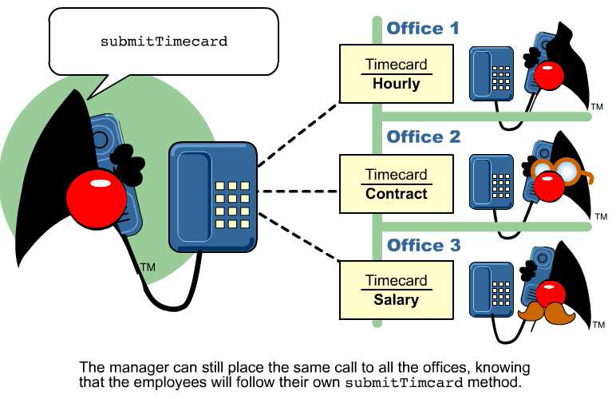
Polymorphism

Slide 29

Polymorphism

Slide 30
Object
Everything in Java is an object.
Well ... almost.
Object lifecycle:
Creation
Usage
Destruction

Slide 31
Object Creation
A variable s is declared to refer to the objects of type/class String:
String s;
The value of s is null; it does not yet refer to any object.
A new String object is created in memory with initial “abc” value:
String s = new String(“abc”);
Now s contains the address of this new object.
Notes:
The new keyword is used to allocate memory at run time. All objects get memory in Heap memory area.

Slide 32
Object Usage
Objects are used mostly through variables.
Four usage scenarios:
one variable, one object
two variables, one object
two variables, two objects
one variable, two objects

Slide 33
One Variable, One Object
One variable, one object:
String s = new String(“abc”);
What can you do with the object addressed by s?
Check the length: s.length() == 3
Return the substring: s.substring(2)
Depending what is allowed by the definition of String.

Slide 34
Two Variables, One Object
Two variables, one object:
String s1 = new String(“abc”);
String s2;
Assignment copies the address, not value:
s2 = s1;
Now s1 and s2 both refer to one object. After
s1 = null;
s2 still points to this object.
What if s1=s2?

Slide 35
Two Variables, Two Objects
Two variables, two objects:
String s1 = new String(“abc”);
String s2 = new String(“abc”);
s1 and s2 objects have initially the same values:
s1.equals(s2) == true
But they are not the same objects:
(s1 == s2) == false
They can be changed independently of each other.

Slide 36
One Variable, Two Objects
One variable, two objects:
String s = new String(“abc”);
s = new String(“cba”);
The “abc” object is no longer accessible through any variable.

Slide 37

Object Destruction
A program accumulates memory through its execution.
Two mechanism to free memory that is no longer needed by the program:
manual – done in C/C++
automatic – done in Java
In Java, when an object is no longer accessible through any variable, it is eventually removed from the memory by the garbage collector.
Garbage collector is parts
of the Java Run-Time Environment.

Slide 38
Class
A basis for the Java language.
A template or blueprint from which objects are created
Each concept we wish to describe in Java must be included inside a class.
A class in Java can contain:
fields
methods
constructors
blocks
nested class and interface

Slide 39
Class Defination
A class contains a name, several variable declarations (instance variables) and several method declarations. All are called members of the class.
General form of a class:
class <class_name>{
field; //instance variable
method;
}

Slide 40
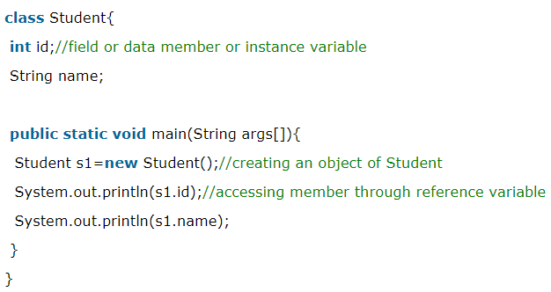
Object and Class Example: main within class

Slide 41
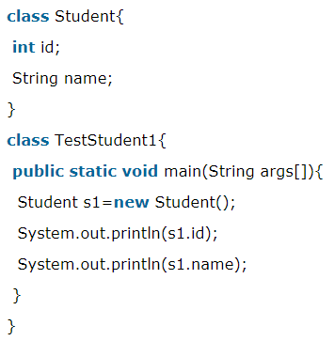
Object and Class Example: main outside class (better approach)

Slide 42
Ways to initialize object
There are 3 ways to initialize object in java.
By reference variable
By method
By constructor
Will be discussed later in Constructor topic

Slide 43
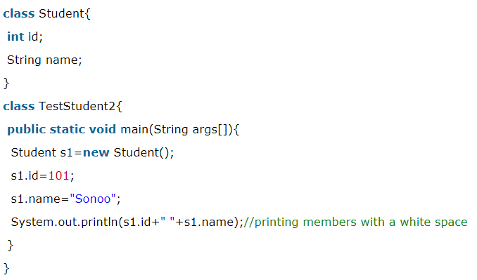
1.Initialization through reference
Initializing object simply means storing data into object

Slide 44
Variable Independence
We can also create multiple objects and store information in it through reference variable
Each object has its own copy of the instance variables:
changing the variables of one object has no effect on the variables of another object.

Slide 45
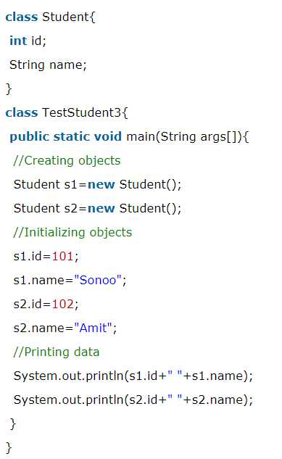
Variable Independence

Slide 46
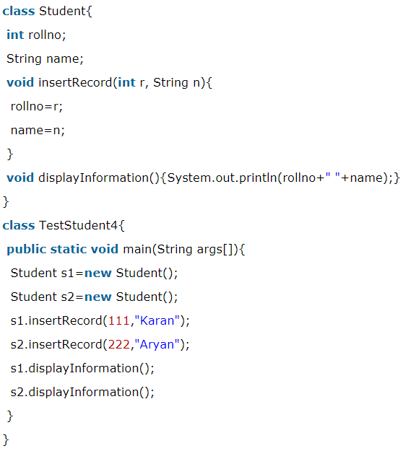
2. Initialization through method

Slide 47
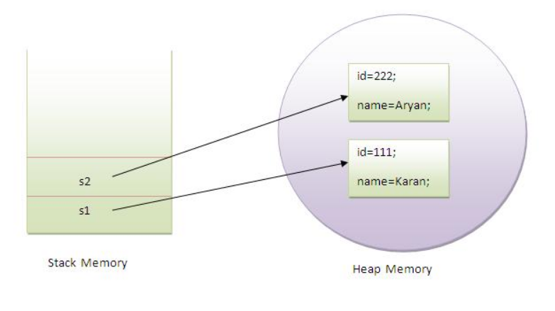
Memory Point of view
Object gets the memory in heap memory area
s1 and s2 both are reference variables that refer to the objects allocated in memory.
Notes:
object gets the memory in heap memory area. The reference variable refers to the object allocated in the heap memory area. Here, s1 and s2 both are reference variables that refer to the objects allocated in memory.

Slide 48
Declaring Objects
Obtaining objects of a class is a two-stage process:
Declare a variable of the class type:
Student s1;
The value of s1 is a reference to an object, if one exists, or null.
At this moment, the value of s1 is null.
Acquire an actual, physical copy of an object and assign its address to the variable. How to do this?

Slide 49
Operator new
Allocates memory for a Student object and returns its address:
Student s1= new Student();
The address is then stored in the s1 reference variable.

Slide 50
Declaring VS Operator new
Statement Effect
Student s1;
s1
s1= new Student();
s1
Student object
null
rollno
name

Slide 51
Memory Allocation
Memory is allocated for objects dynamically.
This has both advantages and disadvantages:
as many objects are created as needed
allocation is uncertain – memory may be insufficient
Variables of simple types do not require new:
int n = 1;
In the interest of efficiency, Java does not implement simple types as objects. Variables of simple types hold values, not references.

Slide 52
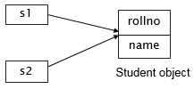
Assigning Reference Variable
Assignment copies address, not the actual value:
Student s1 = new Student();
Student s2 = s1;
Both variables point to the same object.
Variables are not in any way connected. After
s1 = null;
s2 still refers to the original object.

Slide 53
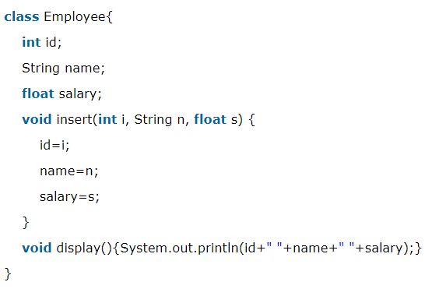
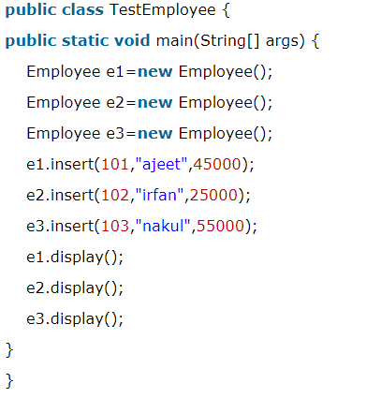
Object and Class Example: Employee

Slide 54
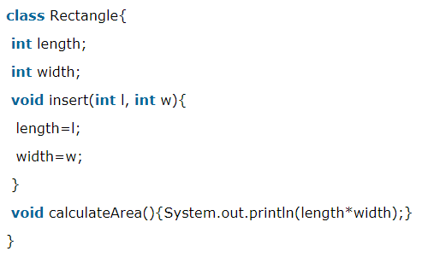
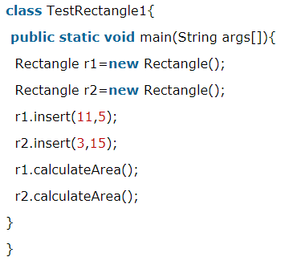
Object and Class Example: Rectangle

Slide 55
Anonymous object
Anonymous simply means nameless
An object which has no reference is known as anonymous object
can be used at the time of object creation only.
If you have to use an object only once, anonymous object is a good approach
new Calculation();//anonymous object

Slide 56
Comparison
Calling method through reference:
Calculation c=new Calculation();
c.fact(5);
Calling method through anonymous object:
new Calculation().fact(5);

Slide 57
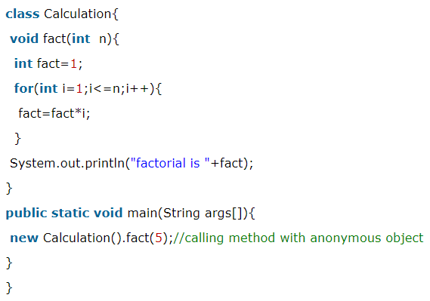
Example
fact = 1
i=1
fact=1*1=1
i=2
fact=1*2=2
i=3
fact=2*3=6
i=4
fact=6*4=24
i=5
fact=24*5=120

Slide 58
Creating multiple objects by one type only
We can create multiple objects by one type only as we do in case of primitives.
Initialization of primitive variables:
int a=10, b=20;
Initialization of reference variables:
Rectangle r1=new Rectangle(), r2=new Rectangle();//creating two objects

Slide 59
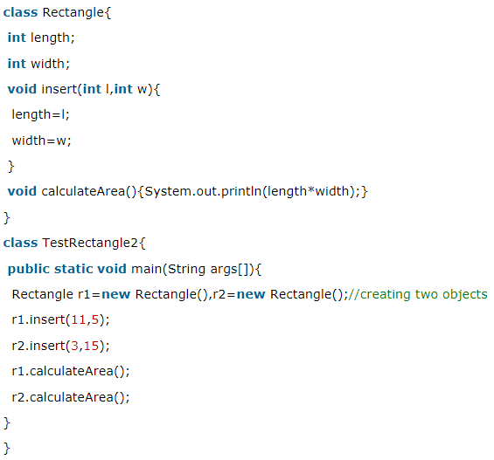
Example

Slide 60

Methods
General form of a method definition:
Components:
type - type of values returned by the method. If a method does not return any value, its return type must be void.
name is the name of the method
parameter-list is a sequence of type-identifier lists separated by commas
return value indicates what value is returned by the method.

Slide 61
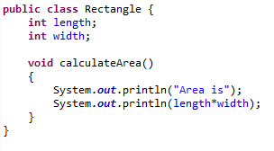
Example: Method
Classes declare methods to hide their internal data structures, as well as for their own internal use:
Within a class, we can refer directly to its member variables:

Slide 62
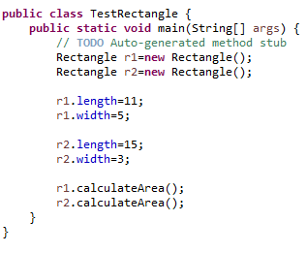
Example: Method

Slide 63
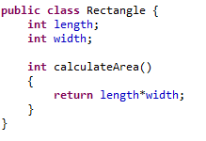
Value-Returning Method
The type of an expression returning value from a method must agree with the return type of this method:

Slide 64
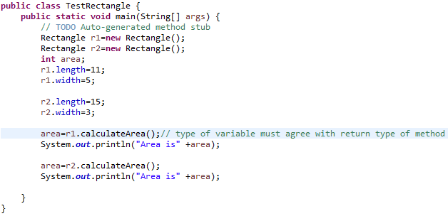
Value-Returning Method

Slide 65
Parameterized Method
Parameters increase generality and applicability of a method:
method without parameters
int square() { return 10*10; }
method with parameters
int square(int i) { return i*i; }
Parameter: a variable receiving value at the time the method is invoked.
Argument: a value passed to the method when it is invoked.

Slide 66
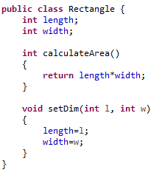
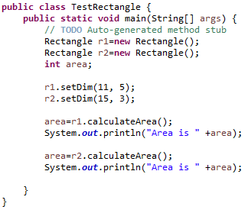
Example: Parameterized Method

Slide 67
Questions?

