Slide 1
Object Oriented Programming

Slide 2
Topics to be covered today
Constructor
Default Constructor
Parameterized Constructor
Constructor Overloading
Java Copy Constructor
Static Keyword
this keyword
Object As an Argument
Argument Passing
Returning Objects

Slide 3
Constructor
Special type of method which is used to initialize the object
It is called when an instance of object is created and memory is allocated for the object.
If no constructor defined for a class, java compiler creates a default constructor
Why named constructer??
Because it constructs the values at the time of object creation

Slide 4
Rules for creating java constructor
There are basically two rules defined for the constructor.
Constructor name must be same as its class name
Constructor must have no explicit return type

Slide 5
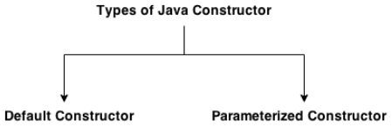
Types of java constructors
There are two types of constructors in java:
Default constructor (no-arg constructor)
Parameterized constructor

Slide 6
1. Java Default Constructor
A constructor is called "Default Constructor" when it doesn't have any parameter.
Syntax
<class_name>(){}
Called:
Every time an object is created using new() keyword, at least one constructor is called(default constructor.)
If no constructor defined for a class, java compiler creates a default constructor which automatically initializes all its instance variables with zero

Slide 7
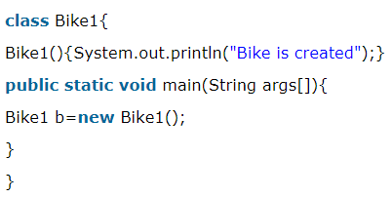
Example
“no-arg constructor” named “Bike1” is created in the Bike1 class. It will be invoked at the time of object creation.

Slide 8
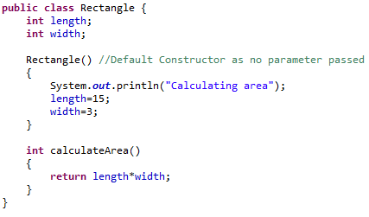
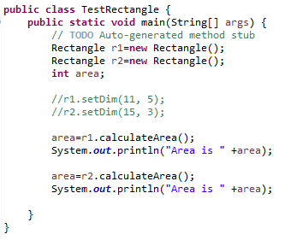
Rectangle Example with constructor

Slide 9
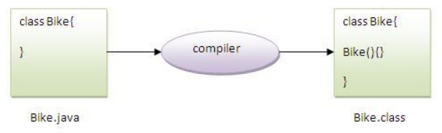
Rule
If there is no constructor in a class, compiler automatically creates a default constructor.

Slide 10
Class Participation
Q) What is the purpose of default constructor?

Slide 11
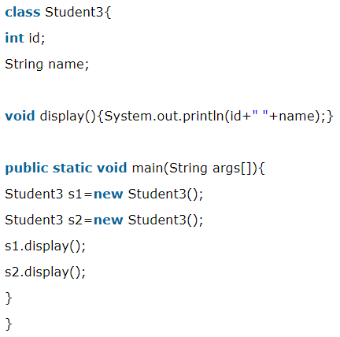
Answer
Default constructor is used to provide the default values to the object like 0, null etc. depending on the type.

Slide 12
2. Java parameterized constructor
A constructor which has a specific number of parameters.
Why parameterized constructor is used?
Parameterized constructor is used to provide different values to the distinct objects.

Slide 13
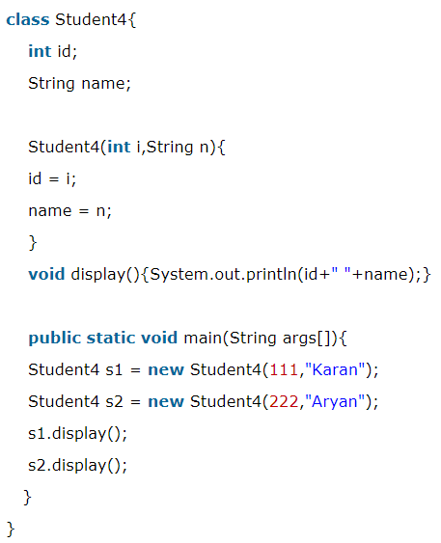
Example

Slide 14
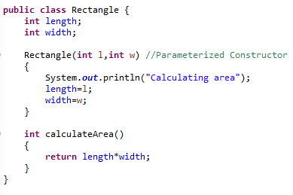
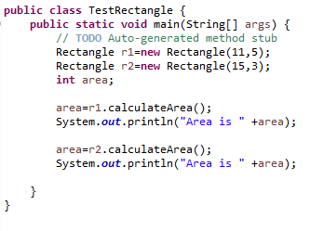
Rectangle Example with Parameterized constructor
So far, all rectangles have the same dimensions.
We need a constructor able to create rectangles with different dimensions

Slide 15
Constructor Overloading in Java
Constructor overloading in Java is a technique of having more than one constructor with different parameter lists.
They are:
arranged in a way that each constructor performs a different task.
differentiated by the compiler by the number of parameters in the list and their types.

Slide 16
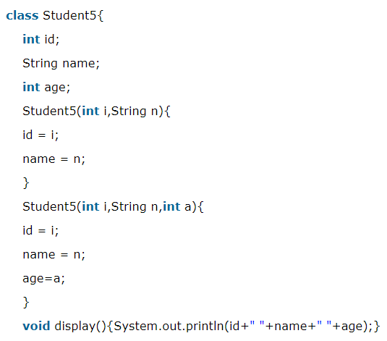
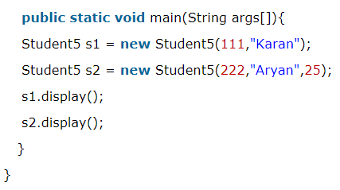
Example

Slide 17
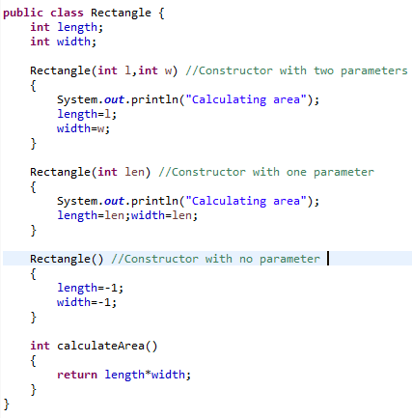
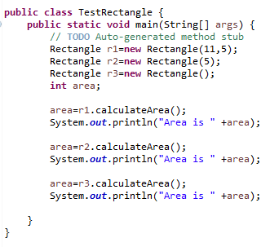
Constructor Overloading(Rectangle)

Slide 18
Java Copy Constructor
There is no copy constructor in java.
But, we can copy the values of one object to another like copy constructor in C++.
Ways to copy the values of one object into another in java, are:
By constructor
By assigning the values of one object into another
By clone() method of Object class
Will be discussed after Exception Handling and interface section

Slide 19
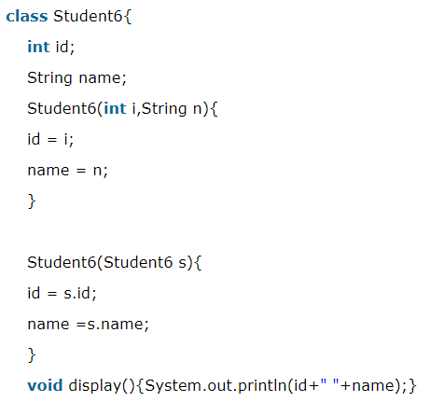
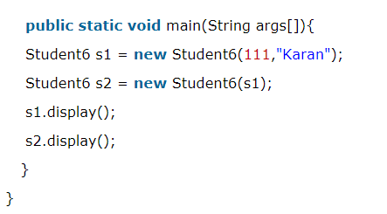
1. Copying using java constructor
Passing Object to constructor

Slide 20
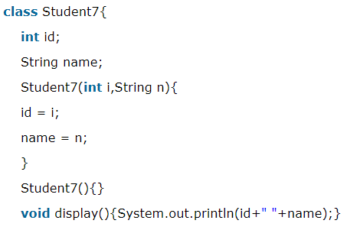
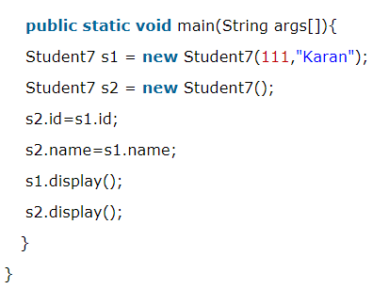
2. Copying values w/o constructor
We can also copy the values of one object into another by assigning the objects values to another object

Slide 21
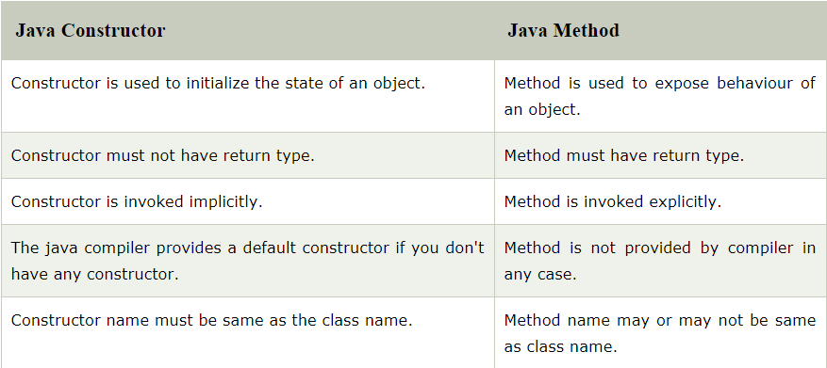
Constructor VS Method

Slide 22
Question
Q) Can constructor perform other tasks instead of initialization?
Ans: Yes, like object creation, starting a thread, calling method etc. You can perform any operation in the constructor as you perform in the method.

Slide 23
Java static keyword
static keyword in java is used for memory management mainly
The static can be:
variable (also known as class variable)
method (also known as class method)
block
nested class
Will be discussed in next lecture in “Inner Classes”

Slide 24
1. static variable
If you declare any variable as static, it is known static variable.
Use:
Can be used to refer the common property of all objects (that is not unique for each object) e.g. company name of employees, college name of students etc.
Advantage:
Gets memory only once in class area at the time of class loading
Makes a program memory efficient (i.e. saves memory).

Slide 25
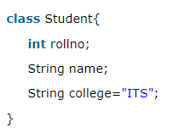
problem without static variable
Suppose there are 500 students, then what ??
Solution ??

Slide 26
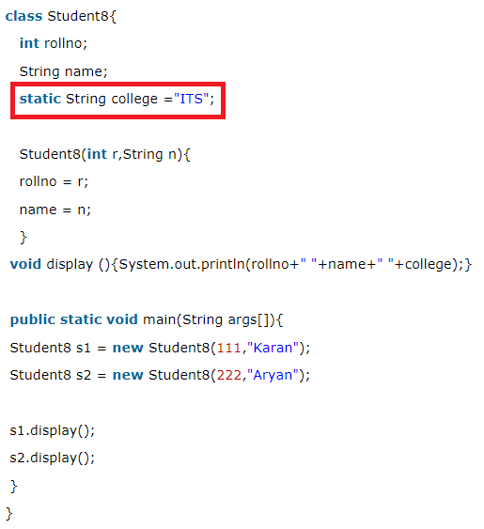
Example (Solution)

Slide 27
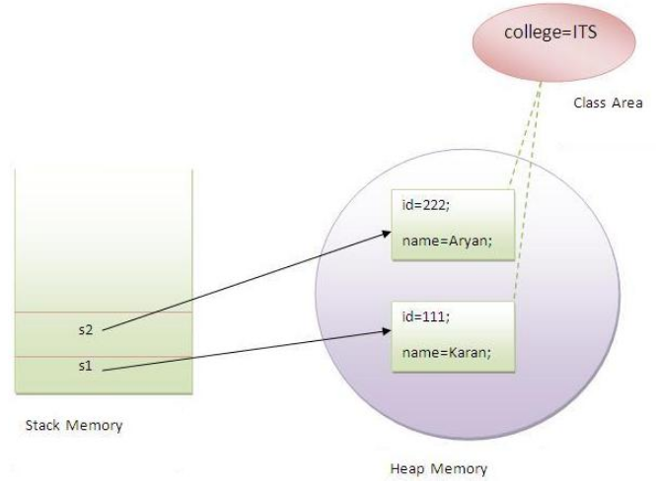
Memory point of View

Slide 28
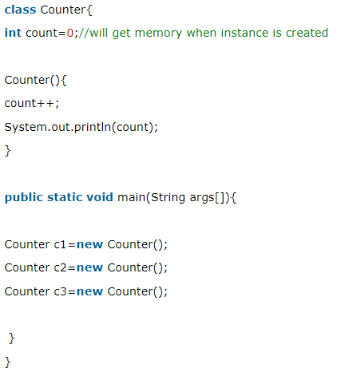
Another Example
Program of counter without static variable

Slide 29
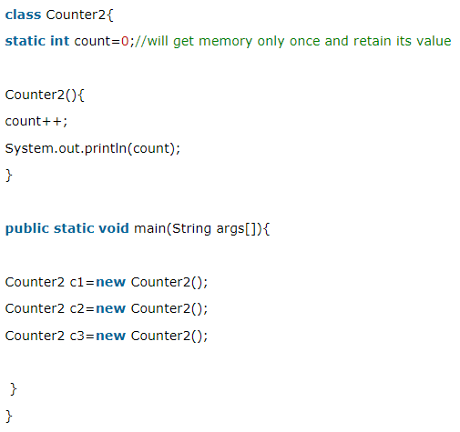
Program of counter by static variable

Slide 30
2. Java static method
If you apply static keyword with any method, it is known as static method.
A static method;
belongs to the class rather than object of a class.
can be invoked without the need for creating an instance of a class.
can access static data member and can change it’s value

Slide 31
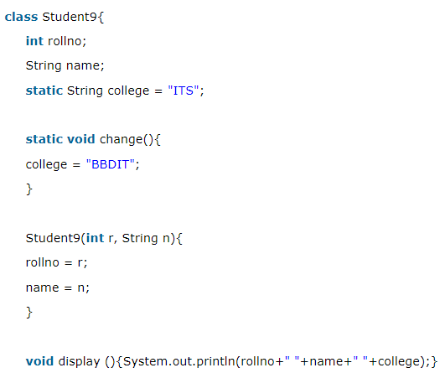
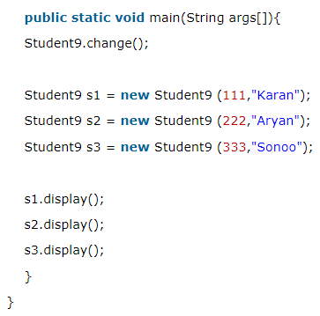
Example
Program of changing the common property of all objects (static field).

Slide 32
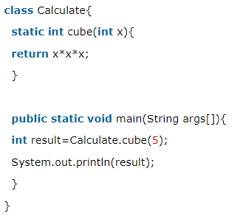
Another Example
Program to get cube of a given number by static method

Slide 33
Restrictions for static method
The static method can not use non static data member or call non-static method directly.
this and super cannot be used in static context.

Slide 34
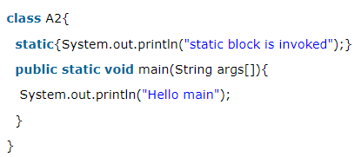
3. Java static block
Is used to initialize the static data member.
It is executed before main method at the time of classloading.

Slide 35
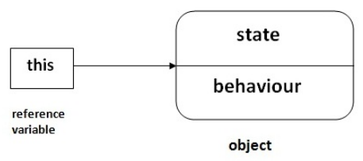
this keyword in java
this is a reference variable that refers to the current object.

Slide 36
Usage of java this keyword
this can be:
used to refer current class instance variable.
used to invoke current class method (implicitly)
used to invoke current class constructor.
passed as an argument in the method call.
passed as argument in the constructor call.
used to return the current class instance from the method

Slide 37
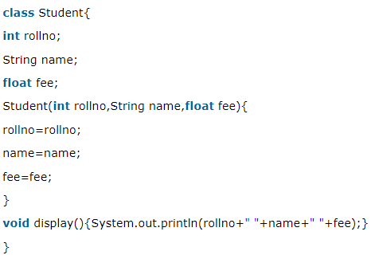
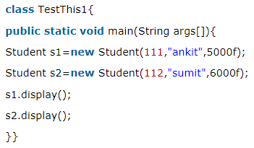
1. this: to refer current class instance variable
If there is ambiguity between the instance variables and parameters, this keyword resolves the problem of ambiguity
Output:
0 null 0.0
0 null 0.0
Problem???

Slide 38
Instance Variables Hiding
Variables with the same names:
it is illegal to declare two local variables with the same name inside the same or enclosing scopes
parameters and instance variables are same. So, this keyword is used to distinguish local variable and instance variable
Also that same-named local variables/parameters will hide the instance variables, using this is necessary to regain access to them.

Slide 39
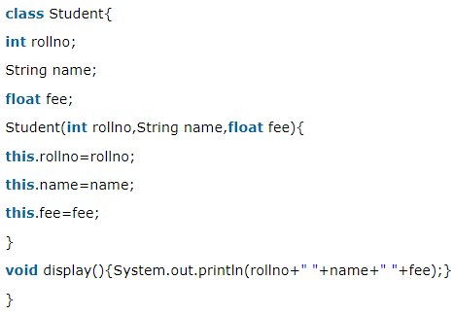
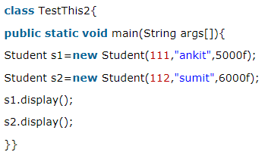
Solution
It is better approach to use meaningful names for variables. So, same names are used for instance variables and parameters in real time, and always used this keyword.

Slide 40
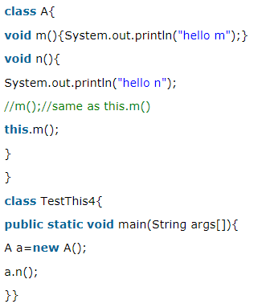
2. this: to invoke current class method
method of the current class can be invoked using this keyword

Slide 41
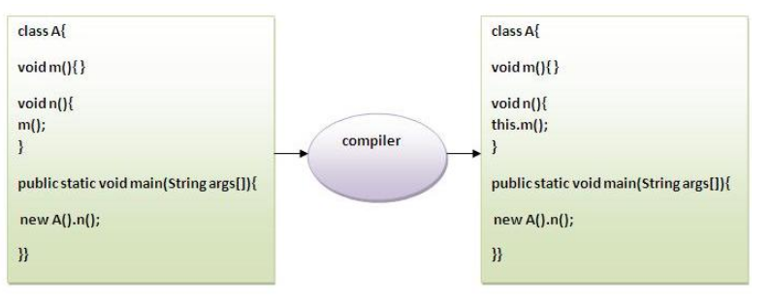
If this not used ??
If not used, the compiler automatically adds this keyword while invoking the method.

Slide 42
3. this() : to invoke current class constructor
The this() constructor call can be used to invoke the current class constructor i.e. to reuse the constructor
It maintains the chain between the constructors i.e. it is used for constructor chaining.

Slide 43
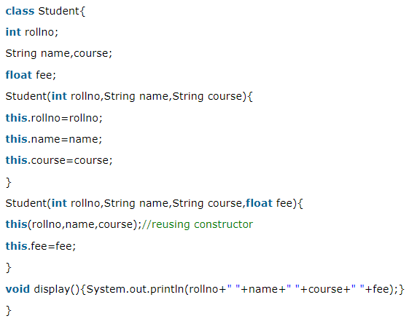
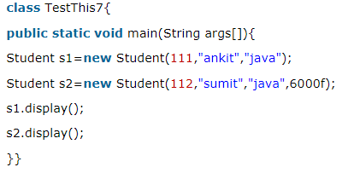
Example
Rule: Call to this() must be the first statement in constructor. Otherwise C.T Error

Slide 44
Object Argument
Object can be passed as an argument in both:
Method
Constructor (already discussed in copy constructors)

Slide 45
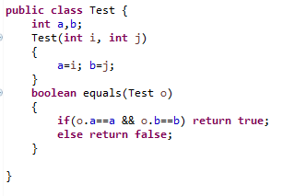
Object Argument in method
So far, all methods received arguments of simple types.
They may also receive an object as an argument. Here is a method to check if a parameter object is equal to the invoking object:

Slide 46
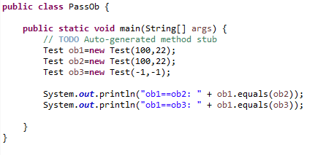
Object Argument

Slide 47
Argument Passing
Two types of variables:
simple types
class types
Two corresponding ways of how the arguments are passed to methods:
by value: a method receives a copy of the original value; parameters of simple types
by reference: a method receives the memory address of the original value, not the value itself; parameters of class types

Slide 48
Call by Value and Call by Reference in Java
There is only call by value in java, not call by reference
If we call a method passing a value, it is known as call by value
The changes being done in the called method, is not affected in the calling method
Notes:
Why There is only call by value in java, not call by reference?

Slide 49
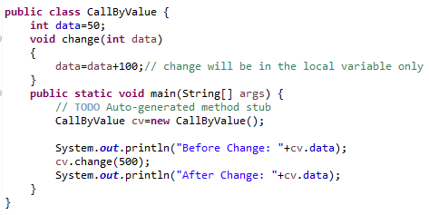
Call by Value/Simple Type Argument Passing
In case of call by value original value is not changed
the parameter that receives the argument has no effect outside the method

Slide 50
Class Type Argument Passing (pass Object as reference)
In case of call by reference original value is changed if we made changes in the called method
Objects are passed to the methods by reference
a parameter obtains the same address as the corresponding argument
As the parameter hold the same address as the argument, changes to the object inside the method do affect the object used by the argument

Slide 51
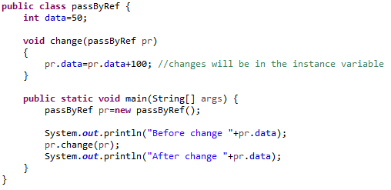
Example

Slide 52
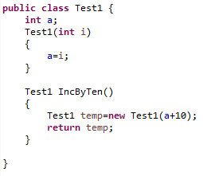
Returning Objects
So far, all methods returned no values or values of simple types.
Methods may also return objects:

Slide 53
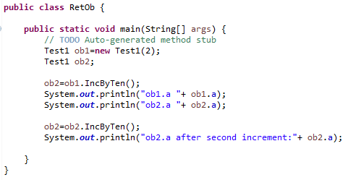
Returning Objects
Each time a method incrByTen is invoked a new object is created and a reference to it is returned:

Slide 54
Questions

