Slide 1
Object Oriented Programming

Slide 2
Topic to be covered today
Abstract Window Toolkit (AWT)
Event Handling
Adapter Classes

Slide 3
Java Abstract Window Toolkit (AWT)
an API to develop GUI or window-based applications in java
AWT components are platform-dependent
components are displayed according to the view of operating system.
AWT is heavyweight
its components are using the resources of OS.

Slide 4
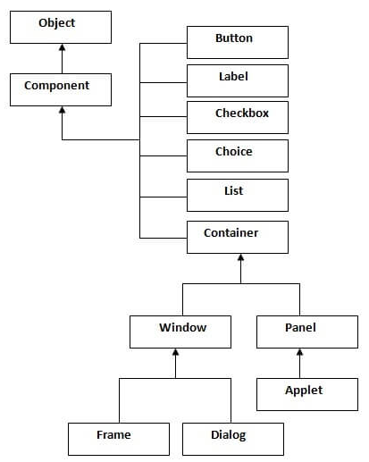
AWT Hierarchy

Slide 5
Contd..
Component
an abstract super class for GUI controls and it represents an object with graphical representation.
Container
The Container is a component in AWT that can contain another components like buttons, textfields, labels etc.
The classes that extends Container class are known as container such as Frame, Dialog and Panel.
Window
The window is the container that have no borders and menu bars.

Slide 6
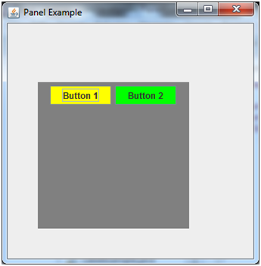
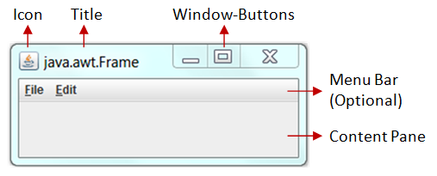
Contd..
Panel
The Panel is the container that doesn't contain menu bars.
It can have other components like button, textfield etc.
Frame
The Frame is the container that contain title bar and can have menu bars.
It can have other components like button, textfield etc.

Slide 7
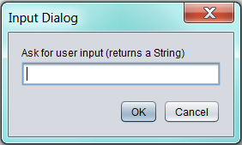
Contd..
Dialog
represents a top level window with a border and a title used to take some form of input from the user
Unlike Frame, it doesn't have maximize and minimize buttons.

Slide 8
Ways to create a frame
There are two ways to create a frame in AWT.
By extending Frame class (inheritance)
By creating the object of Frame class (association)

Slide 9
Useful Methods of Component class
public void add(Component c)
inserts a component on this component.
public void setSize(int width,int height)
sets the size (width and height) of the component.
public void setLayout(LayoutManager m)
defines the layout manager for the component.
public void setVisible(boolean status)
changes the visibility of the component, by default false.

Slide 10
Common AWT UI Elements
Label
Button
TextField
TextArea
Checkbox
CheckboxGroup
Choice
List
Canvas
Scrollbar
MenuItem & menu
Dialog
File Dialog
And so on….

Slide 11
Events
An event is an action initiated by the user interacting with the program.
Changing the state of an object is known as an event
Examples
Keyboard events - pressing a key, holding a key, releasing a key
Mouse events - moving the mouse, clicking the mouse
GUI events - clicking on a button, resizing a window, closing a window, opening a window
An event in Java is an object of a particular event class, that represents some user actions to which the GUI might respond

Slide 12
Low Level Events
Low level events represent direct communication from the user
key press or a key release, a mouse click, drag, move, or release, and so on
java.awt.event.ComponentEvent
component resized, moved, hidden etc
java.awt.event.FocusEvent
component got focus, lost focus
java.awt.event.KeyEvent
key press, key release, etc
java.awt.event.MouseEvent
mouse down, mouse move, mouse drag, mouse up, mouse cursor enters or exits a component
java.awt.event.ContainerEvent
a component added to or removed from the container
java.awt.event.WindowEvent
the window activated, deactivated, opened, closed, iconified, or deiconified

Slide 13
High Level Events
High level events usually involve one or more low level events
java.awt.event.ActionEvent
do a command
java.awt.event.AdjustmentEvent
a value was adjusted
Such as scrollbar motions
java.awt.event.ItemEvent
item state has changed
occurs when the user selects a checkbox, choice, or list item
java.awt.event.TextEvent
the value of the text object changed

Slide 14
How Do the Low and High Level Events Work in Java?
When the user clicks the mouse on a button, then releases it, the button gets two or three separate, low level mouse events
one for mouse down
one for mouse up
possibly one for mouse drag (if the user moves the mouse while the button is pressed)
However, the button then fires one high level event only - ActionEvent

Slide 15
Event Hierarchy
Events are organized into hierarchy of event classes
Event classes contain data relevant to a particular event type
An event is an object of one of the event classes

Slide 16
Event Hierarchy in Java
java.lang.Object
java.util.EventObject
java.awt.AWTEvent
ActionEvent
AdjustmentEvent
ComponentEvent
ItemEvent
TextEvent
ContainerEvent
FocusEvent
InputEvent
WindowEvent
KeyEvent
MouseEvent

Slide 17
Event Handling
The mechanism that controls the event and decides what should happen if an event occurs
The mechanism executes the code, known as event handler, when an event occurs
Java Uses the Delegation Event Model to handle the events.
This model defines the standard mechanism to generate and handle the events

Slide 18
Delegation Event Model
The Delegation Event Model has the following key participants:
Events Source
an object that generates an event
responsible for providing information of the occurred event to it's handler.
Listener
an object that listens to the event
A listener gets notified when an event occurs. Once the event is received by listener, it process the event an then returns.
also known as event handler

Slide 19
Contd..
In this model, Listener needs to be registered with the source object so that the listener can receive the event notification.
This is an efficient way of handling the event because the event notifications are sent only to those listener that want to receive them.

Slide 20
Steps involved in event handling
The User clicks the button and the event is generated.
Now the object of concerned event class is created automatically and information about the source and the event get populated with in same object.
Event object is forwarded to the method of registered listener class.
The method is now get executed and returns.

Slide 21
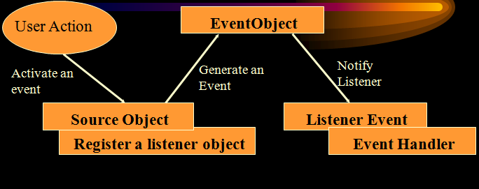
Event Handling Components

Slide 22
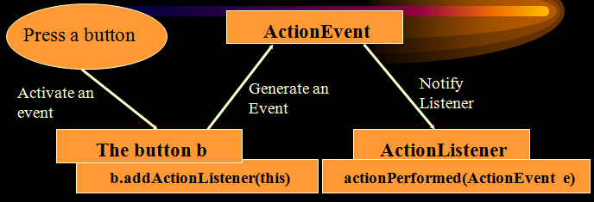
Example

Slide 23
Events and Listeners
Each event is represented by an object that gives information about the event and identifies the event source.
Each event source can have multiple listeners registered on it. A single listener can register with multiple event sources.
event listener 1
event listener 2
event source
event listener 3

Slide 24
Event Classes and Event Listeners
Event Classes
represent the events
all event state objects are derived from “EventObject” class (root class for events)
Event Listeners
represent the interfaces responsible to handle events
Every method of an event listener interface has a single argument as an object which is subclass of EventObject class
For example:
MouseEvent listener’s methods will accept instance of MouseEvent, where MouseEvent derives from EventObject.

Slide 25
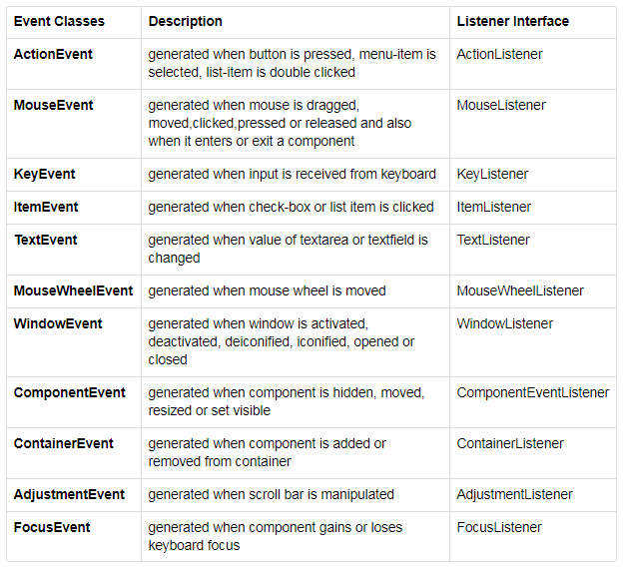
Important Event Classes and Interface
MouseMotionListener

Slide 26
Steps to handle events
Implement appropriate interface in the class.
Register the component with the listener.

Slide 27
Java Event Handling Code
We can put the event handling code into one of the following places:
Within class
Other class
Anonymous class

Slide 28
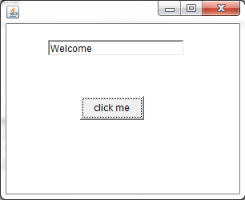
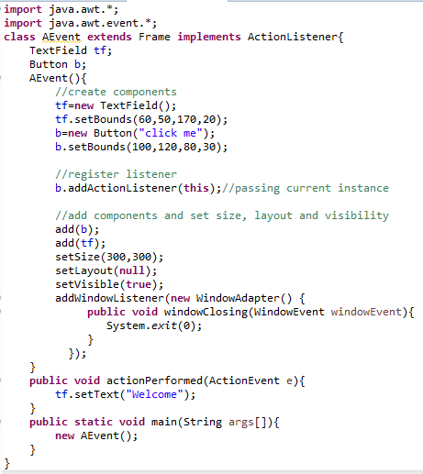
1. Within class
Notes:
public void setBounds(int x, int y, int width, int height)

Slide 29
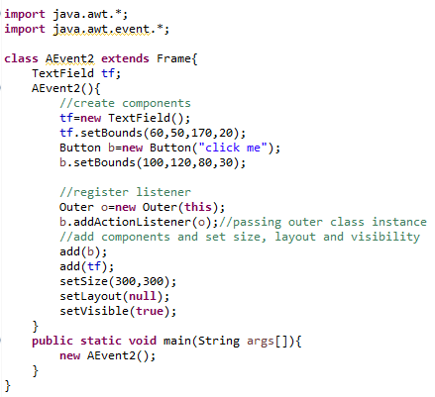
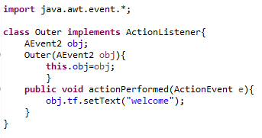
2.Outer class

Slide 30
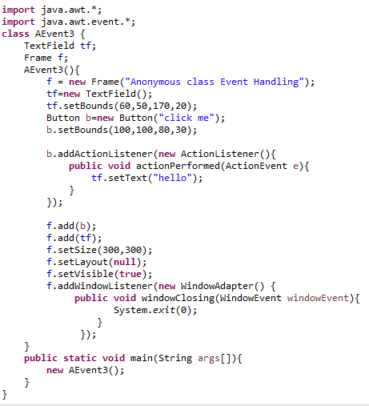
3.Anonymous class

Slide 31
Question
How many components event handling has?
Event handling has three main components,
Events : An event is a change in state of an object.
Events Source : Event source is an object that generates an event.
Listeners : A listener is an object that listens to the event. A listener gets notified when an event occurs.

Slide 32
Question
How Events are handled ?
A source generates an Event and send it to one or more listeners registered with the source. Once event is received by the listener, they process the event and then return

Slide 33
Java MouseListener Interface
The Java MouseListener is notified whenever you change the state of mouse.
It is notified against MouseEvent.
The MouseListener interface is found in java.awt.event package.
It has five methods.
public abstract void mouseClicked(MouseEvent e);
public abstract void mouseEntered(MouseEvent e);
public abstract void mouseExited(MouseEvent e);
public abstract void mousePressed(MouseEvent e);
public abstract void mouseReleased(MouseEvent e);

Slide 34
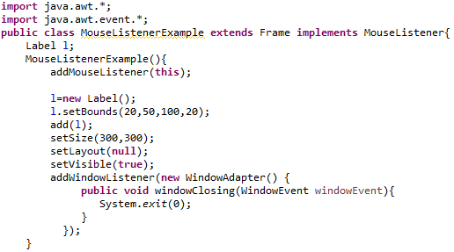
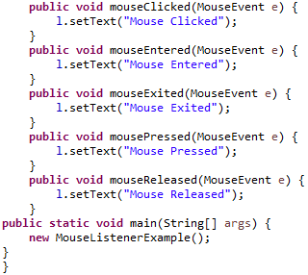
Example

Slide 35
Java KeyListener Interface
The Java KeyListener is notified whenever you change the state of key.
It is notified against KeyEvent.
The KeyListener interface is found in java.awt.event package.
It has three methods.
public abstract void keyPressed(KeyEvent e);
public abstract void keyReleased(KeyEvent e);
public abstract void keyTyped(KeyEvent e);

Slide 36
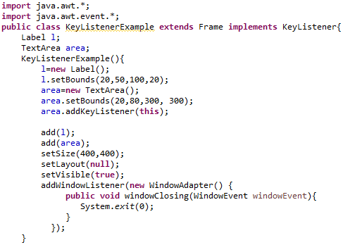
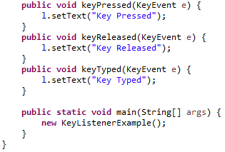
Example

Slide 37
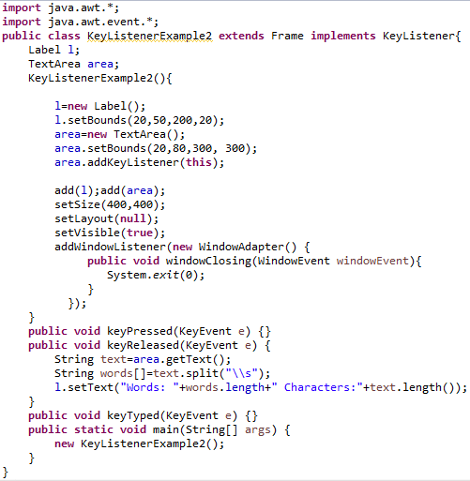
Example2: Count Words & Characters

Slide 38
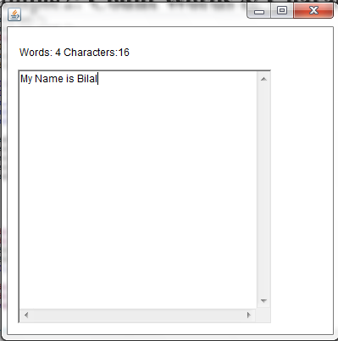
Output

Slide 39
Adapter Classes
Java adapter classes provide the default implementation of listener interfaces.
If you inherit the adapter class, you will not be forced to provide the implementation of all the methods of listener interfaces. So it saves code.
The adapter classes are found in following packages:
java.awt.event
java.awt.dnd
javax.swing.event

Slide 40
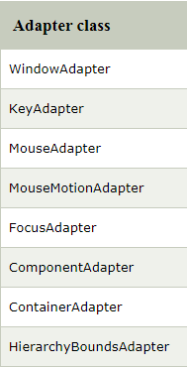
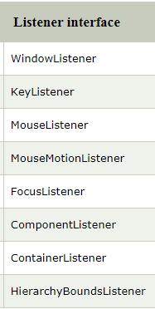
The Adapter classes with their corresponding listener
java.awt.event Adapter classes

Slide 41
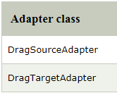
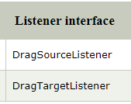
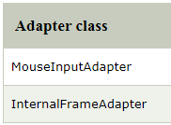
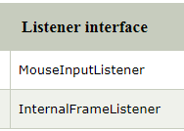
Contd..
java.awt.dnd Adapter classes
javax.swing.event Adapter classes

Slide 42
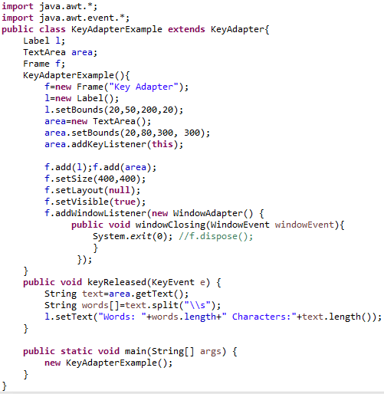
Example (Count Words & Characters)

Slide 43
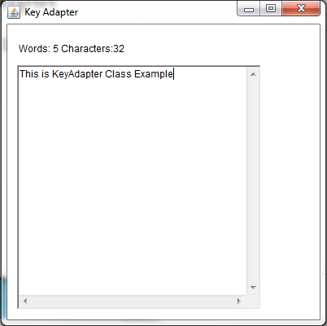
Output

