Slide 1

Software Project Management
INTRODUCTION
Dr. Sumaira nazir
ASSISTANT PROFESSOR
Department of software engineering , FEc
National University Of Modern Languages H-9 Islamabad

Slide 2
Recommended Textbooks/Reference Books
Credit Hours | 3 (3+0)
Pre-requisites | Software Engineering
Recommended Textbook(s) | Information technology project management, Kathy Schwalbe 9th Edition, Cengage, 2019
Recommended Reference (Books/Websites/Articles) | Mastering software project management: Best practices, tools and techniques Chemuturi, M. & Cagley, T. M. (2010)

Slide 3
Course Learning Outcomes
CLOs | Description | Domain | Taxonomy Level | PLOs | Assessment Artifact
CLO-1 | Explain fundamental concepts of project management, knowledge areas and process groups to state their main idea. | Cognitive | 2 | 2 | A1, Q1, Midterm
CLO-2 | Demonstrate the ability to compare software project management process areas and knowledge areas | Cognitive | 2 | 3 | A2, Q2 Midterm, Final Term
CLO-3 | Apply acquired knowledge of software project management knowledge areas and process groups to develop various software project management plans on small scale project. | Cognitive | 3 | 3 | A3, Q3, Presentation /Project, Final Term
National University Of Modern Languages H-9 Islamabad

Slide 4
Course Outline
Introduction to Project Management.
The Project Management Process Groups.
Project Integration Management.
Project Scope Management.
Project Time Management.
Project Cost Management

Slide 5
Course Outline
Project Quality Management.
Project Human Resource Management.
Project Communications Management.
Project Risk Management.
Project Procurement Management.
Project Controlling and tracking

Slide 6
Why Software Project Fails?

Slide 7
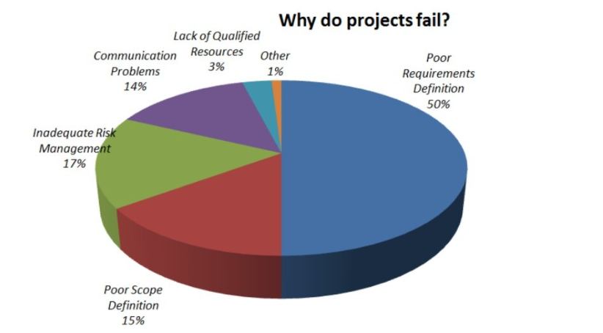
Why Project Fails?

Slide 8
Why Project Fail?
Poorly defined project scope
Poor Product Requirements
Insufficient stakeholders’ management
Inefficient Communication
No Sufficient Project and Planning Phases
Project constraints are not identified

Slide 9
Why Project Fail?
Inaccurate estimates
Poor Risk Management
Insufficient Quality Assurance
Poor Resource Management
Poor Project Monitoring and Controlling
Poor Procurement Management

Slide 10
Poorly defined project scope

Slide 11
Poorly defined project scope
The project scope outlines everything you’re going to do (and not going to do).
Scope creep in project management refers to uncontrolled, continuous changes in a project’s scope.
Generally, a poorly defined project scope results in
scope creep

Slide 12
Poorly defined project scope
Scope creep is seen as a negative occurrence, which should be avoided.
A project with a poorly defined project scope has more chances of failing and experiencing a range of problems.

Slide 13
Poorly defined project scope
Poorly defined project scope can leads to
Failing to meet client expectations
Continuous changes being requested throughout the project course
Major changes are required during the project life cycle
The budget goes beyond the allocated budget
Failing to adhere to deadlines
Poorly defined project scope invariably results in poor employee performance, longer timelines, and higher project costs.

Slide 14
Poor Product Requirements

Slide 15
Poor product requirements
Product development starts without requirements.
Requirements are not
single/atomic, Complete, Consistent, Verifiable, Traceable, Prioritized (Quality Indicators for requirements)
Requirements are not tested.
Lack of formality in the scope definition results in
different people having different understanding of what is in and what is out of scope

Slide 16
Poor product requirements
Open ended requirements (such that end with 'etc.")
No or lack of involvement of those who will eventually use the product during the requirements development

Slide 17
Poor product requirements
Individual requirements are never checked against the project's overall objectives to ensure each requirement supports the project's objective
The project requirements are written based on the assumptions

Slide 18
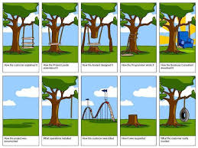

Slide 19
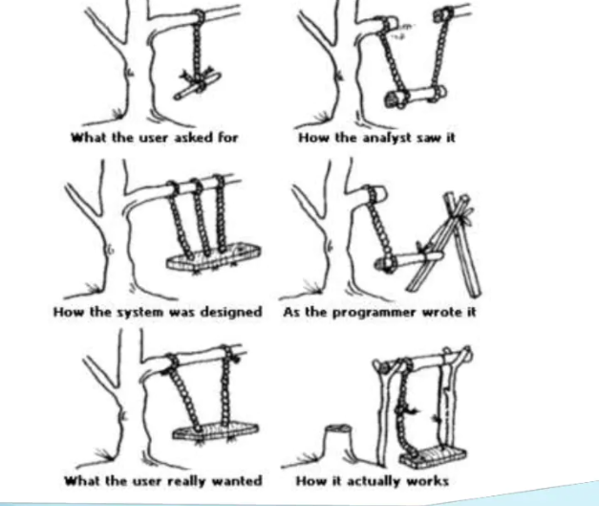

Slide 20
Insufficient stakeholders’ management

Slide 21
Insufficient stakeholders’ management
Not all project stakeholders are identified.
For Example
NUML LMS Stakeholders?
Stakeholder are not analyzed from the perspective of their interest in the project.

Slide 22
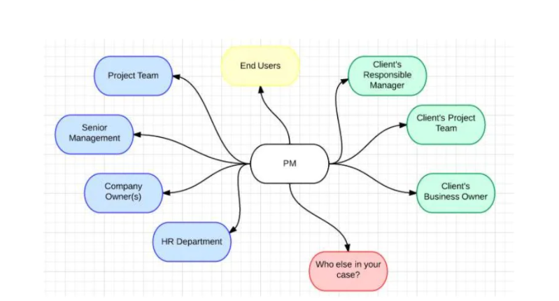
Who are the stakeholders?

Slide 23
Stakeholders Management Steps
Stakeholders’ management will be discussed in detail. Following are the basic steps for stakeholders’ management.
Identity Stakeholders
identifying everyone affected by the work or its outcomes
Plan Stakeholder Management
deciding how you will engage with the stakeholders

Slide 24
Stakeholders Management
Manage Stakeholder Engagement –
communicating with stakeholders and ensuring appropriate stakeholder engagement
Control Stakeholder Engagement - monitoring the overall relationships and adjusting your strategies and plans as needed

Slide 25
Inefficient Communication

Slide 26
Inefficient Communication
PMI (Project Management Institute) says that poor communication leads to project failures one-third of the time.
No time spent on the development of Communication Plan

Slide 27
Inefficient Communication
Roles and responsibilities are not identified or properly communicated
Priorities of different communication channels are not identified (When to email, to call, to use skype)
No records of oral communication (No minutes of meeting)

Slide 28
Inefficient Communication
Too much meetings, unnecessary people are invited in meeting
Meeting are not effective (no goal, no agenda)

Slide 29
No Sufficient Project and Planning Phases

Slide 30
No Sufficient Project and Planning Phases
No project initiation/ planning phase at al.
Planning is considered as project Manager responsibility rather than team activity
Failure to break large master plan

Slide 31
No Sufficient Project and Planning Phases
No milestone or deadline are set
Unclear roles and responsibilities
Unprioritized requirements
Change request handled informally.
Change request Process by change control board

Slide 32
Project constraints are not identified

Slide 33
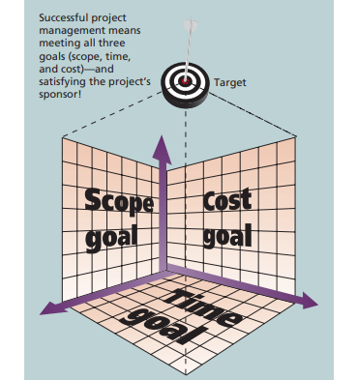
Triple Constraints

Slide 34
Project constraints are not identified
1-Project constraints are not identified and discussed with clients
2-Project constraints are not considered during project initiation/ planning

Slide 35
Inaccurate estimates

Slide 36
Inaccurate estimates
Forcing team to provide estimate without defining the scope
Forcing team to cut estimates to secure contacts
Assumption used for estimation is poorly documented
Estimation is done without the analysis of the historical data collected from previous similar projects

Slide 37
Poor Risk Management

Slide 38
Poor Risk Management
No risk management process
Risk identification and mitigation
Poor risk management can result in
delay in the project schedule, late-running projects, overspent budgets, and project failure.
Projects have a certain degree of uncertainty about them, and having a risk management plan can lower the uncertainty besides increasing the likelihood of completing your project on time.

Slide 39
Insufficient Quality Assurance

Slide 40
Insufficient Quality Assurance
No Quality Assurance plan/ processes
Leads to
defects, errors, bugs, and failures that can compromise the functionality, performance, security, and usability of project

Slide 41
Poor Resource Management

Slide 42
Poor Resource Management
What human resources are required? Which people and for how long? Are any of them currently working on another project or could they be called away before my project is completed?
What facilities are required? Do we have the office space, desks, computers, meeting spaces, and production areas necessary to make this project a success?

Slide 43
Poor Project Monitoring and controlling

Slide 44
Poor Project Monitoring and controlling
Monitoring and controlling the project is perhaps one of the less understood facts that project managers and their teams are not paid adequate attention to.
You don’t need to be a rocket scientist to figure out that you should “track, review, and regulate the progress of the project; identify areas that call for changes in the planning, and initiate the corresponding changes.”

Slide 45
Poor Project Monitoring and controlling
Ensure that the project stays on track, and when it falls behind on budget or schedule then the plan should be changed to get the project back on track.

Slide 46
Poor Project procurement management

Slide 47
Poor Project procurement management
Project procurement management involves acquiring or procuring goods and services for a project from outside the performing organization

Slide 48
Poor Project procurement management
When procurement is not managed efficiently, it can lead to delays, cost overruns, and poor-quality workmanship.
This, in turn, can cause project failure and damage reputations.
One of the main impacts of ineffective procurement is delayed timelines.

