Slide 1
WATT-WATCH
⚡
Smart electricity bill warning and saving assistant for households
Presented by: [Your name] · [College / Department]
Notes:
Introduce yourself and the project. WATT-WATCH helps families see their electricity bill coming before it arrives. Replace [Your name] and [College / Department] before presenting.

Slide 2
The problem: bills jump between slabs
Tamil Nadu bills households every 2 months on a slab system
The price of each extra unit rises as usage crosses each slab
Families only see their usage when the bill arrives, too late to change it
Rates used in the app, based on TNERC Tariff Order No. 6 of 2025 (domestic LT IA). First 100 units free under the Government subsidy.
Notes:
Explain slab billing: units are charged in steps, and each step costs more. Because bills come every two months, families can't react in time.

Slide 3
Our solution: see the bill coming
1
→
2
→
3
→
4
→
5
→
6
Scan
Track
Predict
Warn
Reduce
Save
Photo of the meter or type the reading
Units used since the last bill
Expected units and bill for the cycle
Early alert before a costlier slab
Plan: which appliances to cut
Units, money and CO2 saved
No extra hardware: a web app that works in any browser, on a phone or a computer.
Notes:
Walk through the six steps. Step 4, the early warning, is the key idea: the user is told before the bill jumps.

Slide 4
Technology
Python
Streamlit
All calculations: bill, prediction, warning, saving plan
The web interface: welcome pop-up, sidebar and 4 tabs
SQLite
Tesseract OCR
Database of households, meter readings and bills
Reads the number from a meter photo
Notes:
Python does the logic, Streamlit turns it into a web page, SQLite stores the data in one file, and Tesseract reads meter photos.

Slide 5
Database: three linked tables
Household
→
EB_Meter
→
Electricity_Bill
House_ID (PK)
Consumer_Number
Household_Name
Address
Connection_Type
Meter_ID (PK)
House_ID (FK)
Meter_Number
Previous_Reading
Current_Reading
Units_Consumed
Reading_Date
Previous_Reading_Date *
Bill_ID (FK) *
Bill_ID (PK)
House_ID (FK)
Billing_Period
Units_Consumed
Bill_Amount
Payment_Status
One household has many readings and many bills. Units_Consumed = Current_Reading − Previous_Reading (calculated, never typed). * Added: Previous_Reading_Date (to get units per day) and Bill_ID (empty = current, unbilled cycle).
Notes:
PK is a primary key (unique ID). FK is a foreign key linking to another table. Starts with 10 sample households from our database document.

Slide 6
Bill calculation: slab by slab
Slab (units) | Units | Rate (Rs) | Amount (Rs)
0 - 100 | 100 | 0.00 | 0.00
101 - 400 | 300 | 4.80 | 1,440.00
401 - 450 | 50 | 6.45 | 322.50
Total | 450 |  | 1,762.50
Rs 1,762.50
Bill for 450 units in 2 months
Rs 240
Sample: Arun, 150 units
Each unit is charged at the rate of the slab it falls in. Rates can be edited in the app's sidebar when the tariff changes.
Rs 960
Sample: Lakshmi, 300 units
Notes:
Walk through the 450-unit example. The first 100 units are free, units 101-400 cost Rs 4.80, and units above 400 cost Rs 6.45.

Slide 7
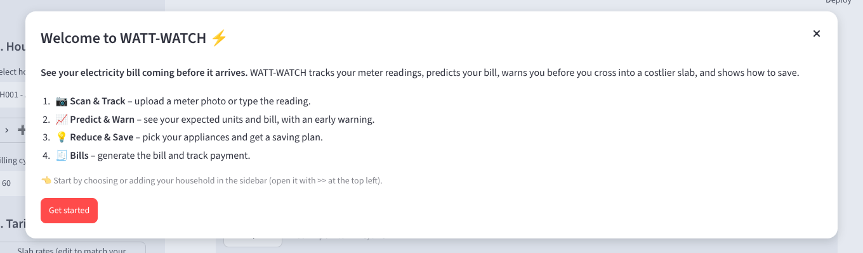
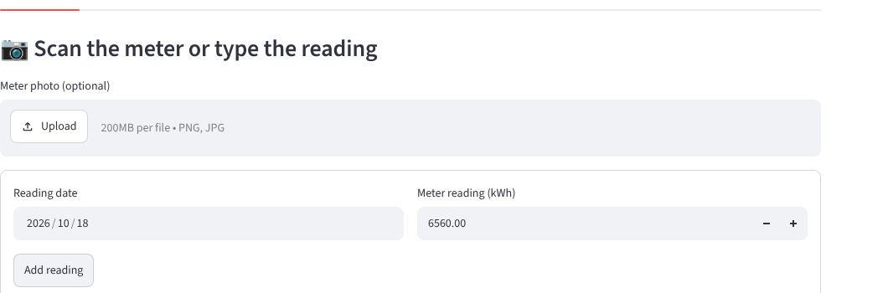
Welcome pop-up and meter tracking
A welcome pop-up explains the 4 steps when the site opens.
Type the reading or upload a meter photo. Readings that go down are rejected, because a meter only counts up.
6400 → 6560
160 units
8.9 / day
Lakshmi's meter readings
used in 18 days
average usage
Notes:
Show the welcome pop-up, then how a reading is added for the sample household Lakshmi (H007).

Slide 8
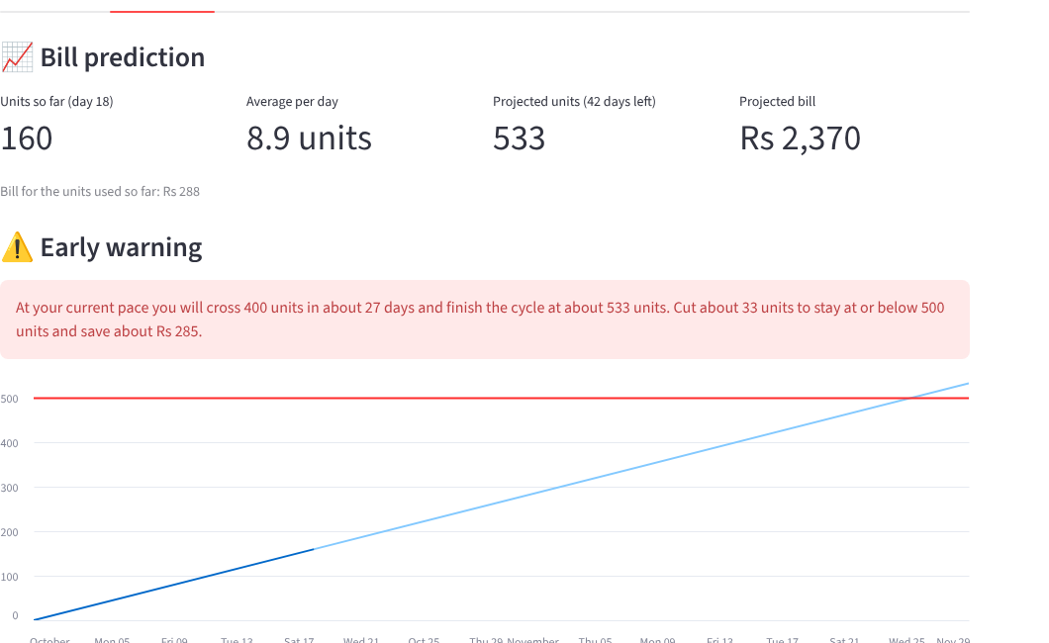
Prediction and early warning
533 units
predicted for the 60-day cycle
Rs 2,370
predicted bill
~27 days
until crossing 400 units
Predicted units = units so far + units per day × days left
Notes:
Units per day is the slope of a straight line through recent readings. The warning says Lakshmi should cut about 33 units to stay at or below 500.

Slide 9
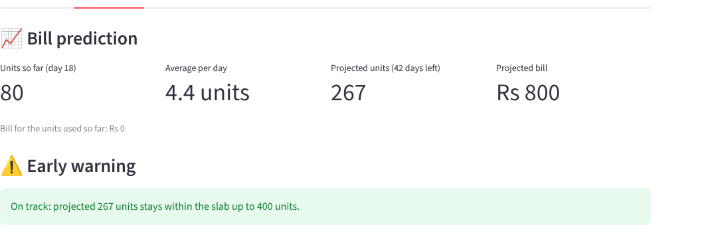
Improvement: a realistic warning
Before
Every home crosses the free 100-unit limit, so the app told almost everyone to cut back to 100 units.
After
The warning ignores the free-units limit and only checks slabs that cost money (rate > 0).
Sample household Arun (80 units in 18 days) is now correctly shown as on track.
paid_limits = [s.upto for s in tariff.slabs if s.rate > 0 ...]
Notes:
This is the code change made in alerts.py. Tests still pass (33 tests).

Slide 10
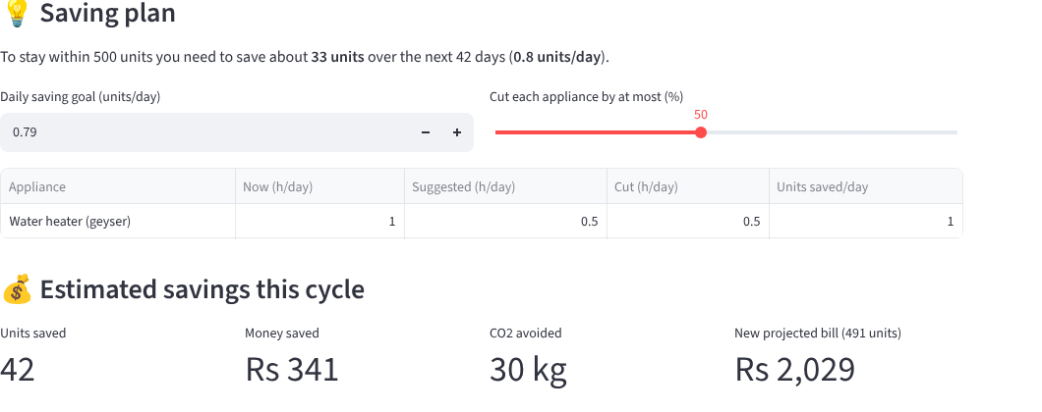
Saving plan: cut the right appliance
42 units
saved this cycle
Rs 341
money saved
Units per day = watts × quantity × hours ÷ 1000
Cut the most powerful appliances first
At most 50% of an appliance's hours; never the fridge
30 kg
CO2 avoided
Water heater 1 h → 0.5 h a day keeps Lakshmi below 500 units.
Notes:
One hour of a 2000 W geyser saves as much as 20 hours of a 100 W TV, so powerful appliances are cut first.

Slide 11
Results, limitations and future work
Results
Limitations
Future work
Working web app with database
Bill matches the slab tariff
Early warning before costlier slabs
Saving plan with units, money and CO2
33 automated tests pass
Tested with sample household data
OCR needs clear meter photos
Prediction assumes steady daily use
Tariff must be updated when revised
Installable mobile app
User logins per household
SMS / WhatsApp reminders
Testing with real homes over a full cycle
Notes:
Be honest: testing was done with the sample households from our database document; testing with real homes is future work.

Slide 12
Thank you
Questions?
Code: github.com/ZumairaSultana/WATTWATCH
Notes:
Invite questions. Keep the live app or the demo video ready.

