Slide 1
SenseAd
Group 5: Bakir Hajdarevic, Daniel Machlab, Ryan Wedoff, and Luka Zdilar

Slide 2
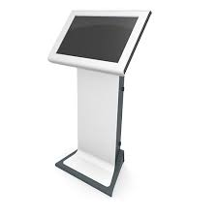

Weather
Customer Traffic
Kiosk
Other
Hello, John Doe.
Wanna burn fat?
Try our new…
R-PI3
Environmental Monitoring
Servers
Database
Mobile App
Welcome, John Doe.
IOTA: The Tangle
Ad Storage
Facial ID
User Preference
Opt in?
The Tangle

Slide 3
Mobile App

Slide 4
Kiosk

Slide 5
IOTA: The Tangle

Slide 6

Environmental Monitoring
Customer Traffic
Weather
IR
.
%
R-Pi-3
IOTA: The Tangle
Other

Slide 7
Timetable for Completion

