Slide 1



Interactive Solar System
TESP 2018 – Hands-On Project

Slide 2
Tohoku University Sendai, Japan
Motivation
h
projector
communication

Slide 3
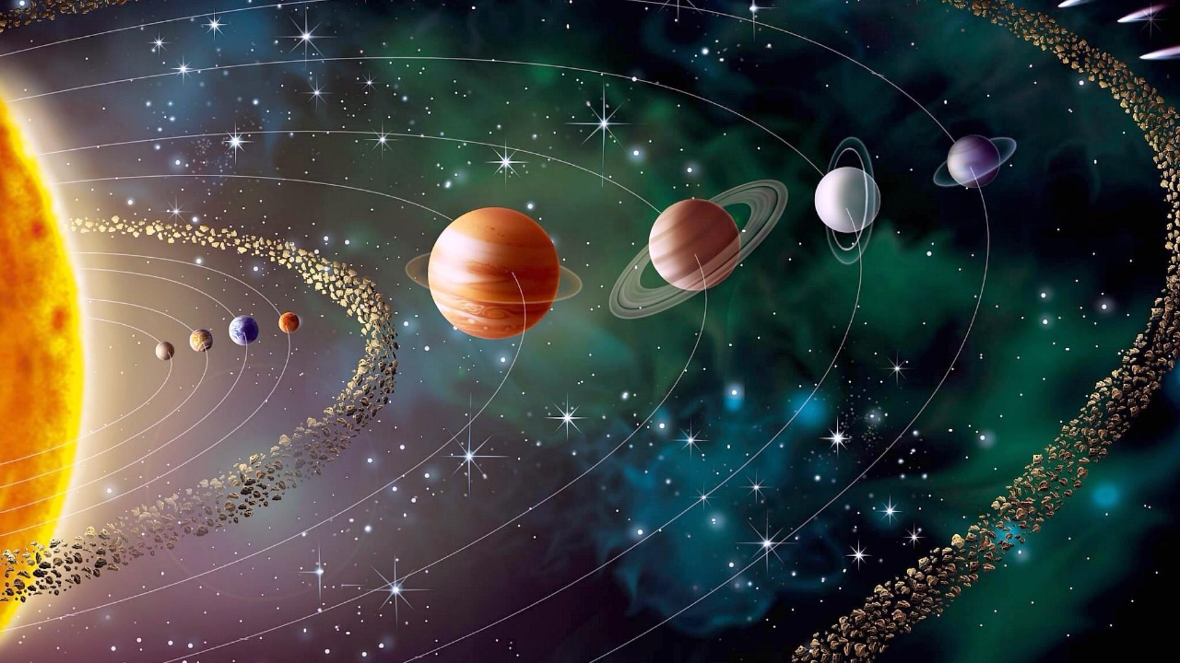
Tohoku University Sendai, Japan
Goal

Slide 4
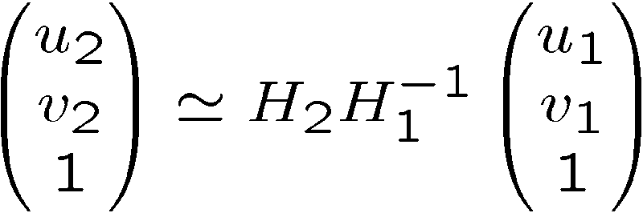
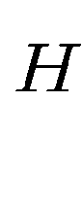
Tohoku University Sendai, Japan
Theory
Camera plane
Projector plane
v2
H
v1
u2
u1

Slide 5
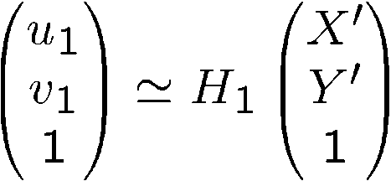
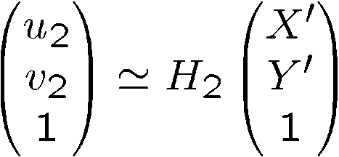
Tohoku University Sendai, Japan
Theory
f
Projector
(u1, v1)
Camera
(u2, v2)

Slide 6
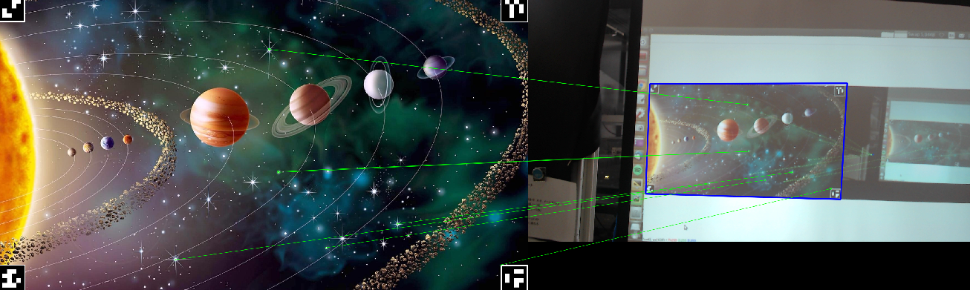
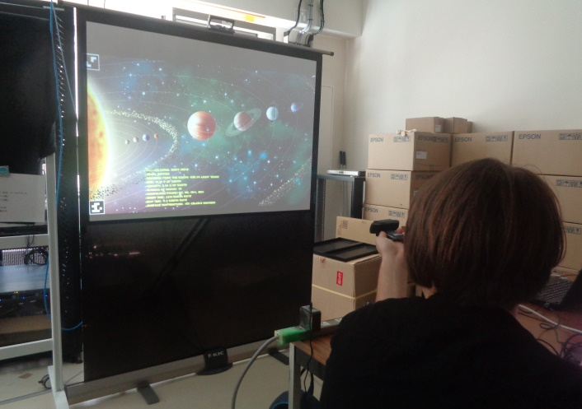
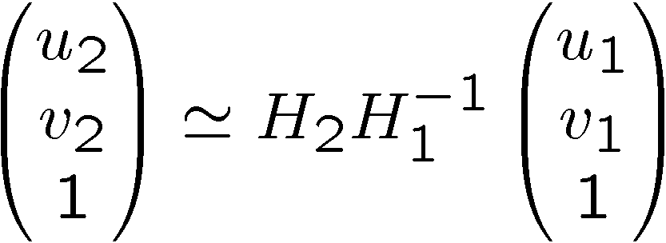
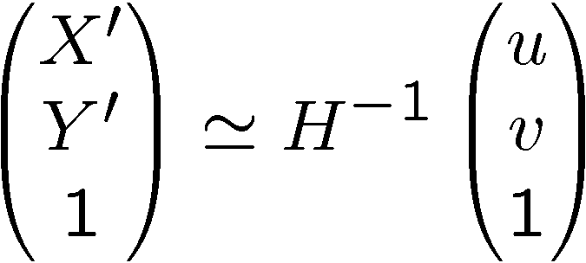
Tohoku University Sendai, Japan
Realisation
Photo homography lines project

Slide 7
Tohoku University Sendai, Japan
Issues Encountered
Blender animation integration issues
Low frame rate of camera

Slide 8
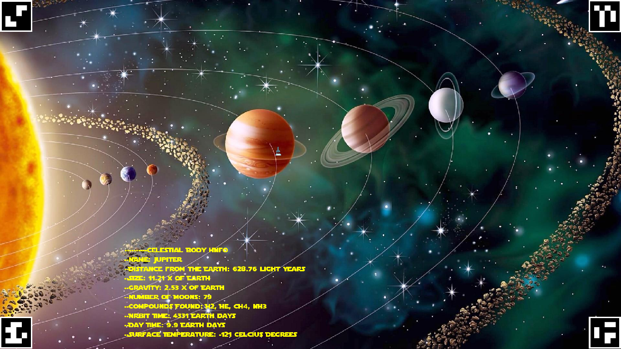
Tohoku University Sendai, Japan
Application
Photo project with/without text

Slide 9
Tohoku University Sendai, Japan
Application
Demonstration on screen

Slide 10


Slide 11
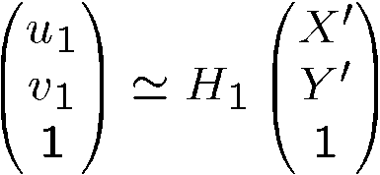
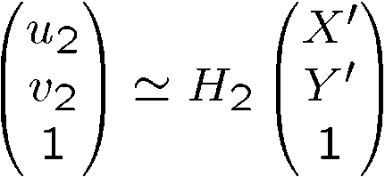
Tohoku University Sendai, Japan
Theory
Projector
(u1, v1)
Camera
(u2, v2)

