Slide 1
TESP2018 Hands-On Activity Development of a Virtual Handheld Projector
Hashimoto Laboratory
Tohoku University

Slide 2
Background
handheld
projector
laser pointer
projector
projector
Laser pointer is a tool widely used in presentation scenes
But only 2D position can be presented
A handheld projector can be used instead of a laser pointer to present richer information
But still bulky and costly

Slide 3
Goal
small camera as a virtual handheld projector
projector
communication
Let’s replace the handheld projector with a small camera
By analyzing the image taken by the camera, the projected image is controlled

Slide 4
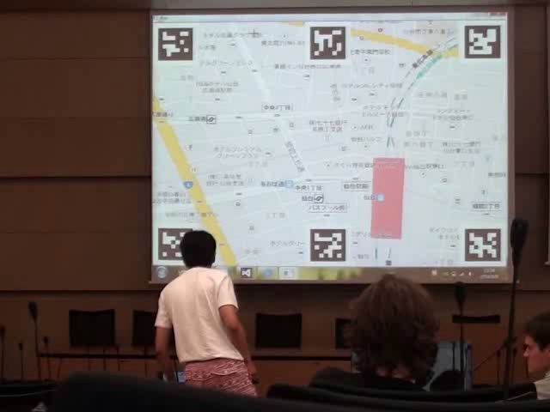
TESP2014

Slide 5
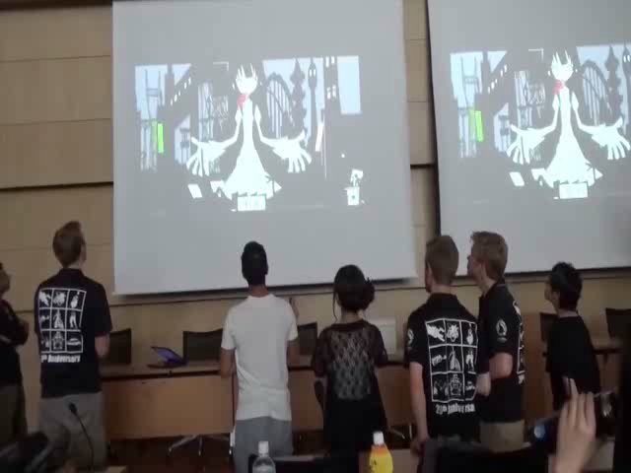
TESP2015

Slide 6
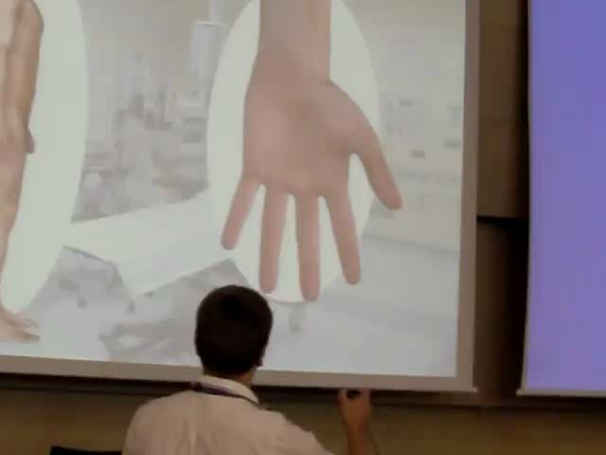
TESP2016

Slide 7
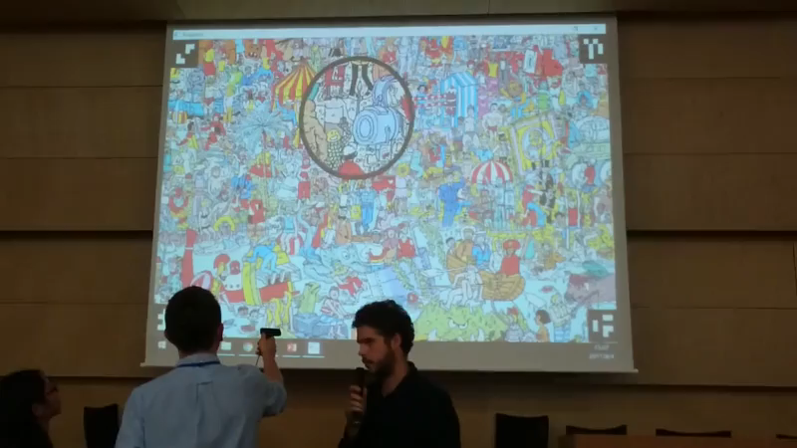
TESP2017

Slide 8
What to Do
To develop software to control the projected image as if the handheld camera was a handheld projector
image processing, geometrical analysis, graphics rendering
and (hopefully) to develop applications utilizing the virtual projector metaphor
e.g. novel interaction techniques with projected materials
The participants are expected to install a famous computer vision library OpenCV and related software in their PC so that they can bring the environment back home
Programming with OpenCV can be done with C/C++ or Python, so the participants are expected to have basic knowledge and programming experience in (either of) these languages

