Slide 1



Interactive Solar System
TESP 2018 – Hands-On Project

Slide 2
Tohoku University Sendai, Japan
Team
(photo team)

Slide 3
Tohoku University Sendai, Japan
Goal
Photo solar system

Slide 4
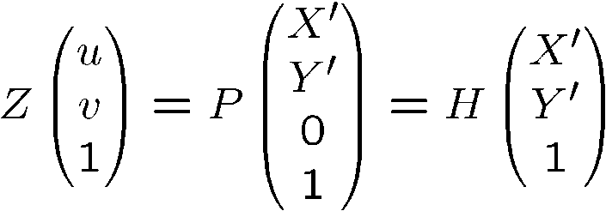
Tohoku University Sendai, Japan
Theory
Projection screen
Sensor
v
H
Y`
u
X`

Slide 5
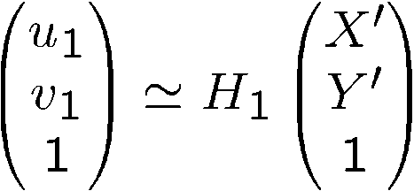
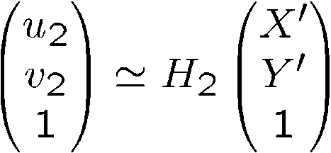
Tohoku University Sendai, Japan
Theory
f
Projector
(u1, v1)
Camera
(u2, v2)

Slide 6
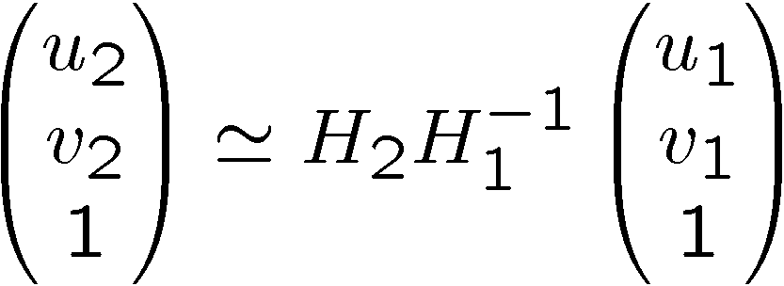
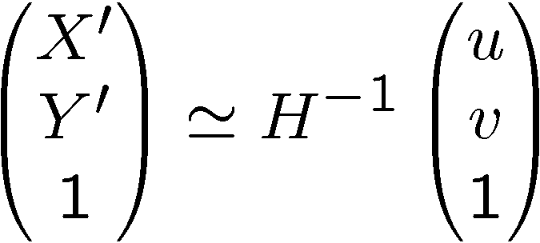
Tohoku University Sendai, Japan
Realisation
Photo homography lines project

Slide 7
Tohoku University Sendai, Japan
Realisation
Outlier Removal

Slide 8
Tohoku University Sendai, Japan
Application
Photo project with/without text

Slide 9
Tohoku University Sendai, Japan
Application
Demonstration on screen

Slide 10


Slide 11
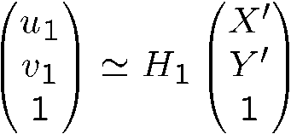
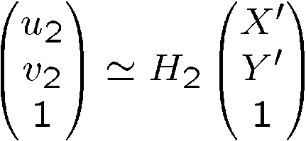
Tohoku University Sendai, Japan
Theory
Projector
(u1, v1)
Camera
(u2, v2)

