Slide 1
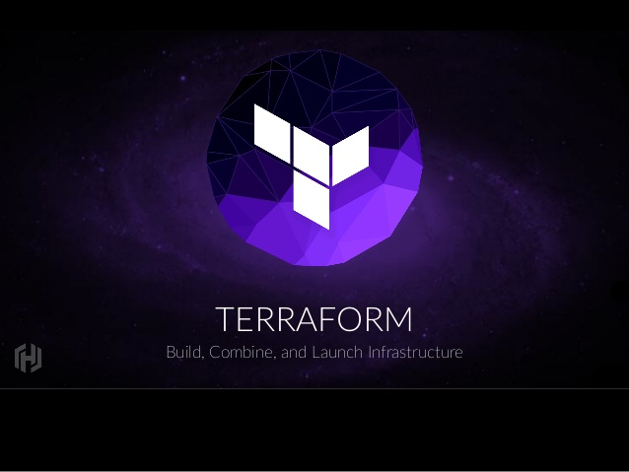

Slide 2
Contents
Difference between CFT and Terraform
Introduction to Terraform
Advantages of Terraform
Use Cases of Terraform
Example Configuration

Slide 3
Difference between CFT and Terraform
AWS Uses CloudFormation Template -JSON
Azure uses Azure Resource Manager(ARM) Templates –JSON
Terraform uses They developed Their own language is called as - HCL

Slide 4
Challenges
We cannot exchange AWS CFT with Azure ARM and vice versa
JSON is complex and steep learning curve
ARM and CFT Deployment is slow
Using Loops for multiple resources are not easy
Importing of existing resources(VM, NW, Subnet) is not that easy or not possible
We cannot divide the code in to multiple files in a single deployment.

Slide 5
Introduction To Terraform
What is Terraform ?
Infrastructure as a code
Execution plans
Resource graph
Change Automation

Slide 6
What is Terraform
Terraform is a tool for building, changing, and versioning infrastructure safely and efficiently. Terraform can manage existing and popular service providers as well as custom in-house solutions.
Configuration files describe to Terraform the components needed to run a single application or your entire datacenter.
Terraform generates an execution plan describing what it will do to reach the desired state, and then executes it to build the described infrastructure.
As the configuration changes, Terraform is able to determine what changed and create incremental execution plans which can be applied.

Slide 7
Infrastructure as a code
Infrastructure is described using a high-level configuration syntax.
This allows a blueprint of your datacenter to be versioned and treated as you would any other code.
Additionally, infrastructure can be shared and re-used.

Slide 8
Execution Plans
Terraform has a "planning" step where it generates an execution plan.
The execution plan shows what Terraform will do when you call apply.
This lets you avoid any surprises when Terraform manipulates infrastructure.

Slide 9
Resource Graph
Terraform builds a graph of all your resources, and parallelizes the creation and modification of any non-dependent resources.
Because of this, Terraform builds infrastructure as efficiently as possible, and operators get insight into dependencies in their infrastructure.

Slide 10
Change Automation
Complex change sets can be applied to your infrastructure with minimal human interaction.
With the previously mentioned execution plan and resource graph, you know exactly what Terraform will change and in what order, avoiding many possible human errors.

Slide 11
Advantages of Terraform
Its an vendor independent application or tool.
Code is easy to understand and study.
Terraform fast when compared to AWS and Azure
Deploying multiple resources is very easy
We can import existing resources in to AWS/Azure with terraform
We can divide the code in to multiple files and execute.

Slide 12
Use Cases of Terraform
Multi Tier Applications
Self service clusters
Disposable Environment
Resource Schedulers
Multi cloud Deployment

Slide 13
Multi-Tier Application
Terraform is an ideal tool for building and managing these infrastructures.
Each tier can be described as a collection of resources, and the dependencies between each tier are handled automatically;
Terraform will ensure the database tier is available before the web servers are started and that the load balancers are aware of the web nodes.

Slide 14
Self-Service Cluster
Using Terraform, the knowledge of how to build and scale a service can be codified in a configuration.
Terraform configurations can be shared within an organization enabling customer teams to use the configuration as a black box and use Terraform as a tool to manage their services.

Slide 15
Disposable Environment
Using Terraform, the production environment can be codified and then shared with staging, QA or dev.
These configurations can be used to rapidly spin up new environments to test in, and then be easily disposed of.
Terraform can help tame the difficulty of maintaining parallel environments, and makes it practical to elastically create and destroy them.

Slide 16
Resource Scheduler
Terraform is not limited to physical providers like AWS. Resource schedulers can be treated as a provider, enabling Terraform to request resources from them.
This allows Terraform to be used in layers: to setup the physical infrastructure running the schedulers as well as provisioning onto the scheduled grid.

Slide 17
Multi Cloud Deployment
Realizing multi-cloud deployments can be very challenging as many existing tools for infrastructure management are cloud-specific.
Terraform is cloud-agnostic and allows a single configuration to be used to manage multiple providers, and to even handle cross-cloud dependencies.
This simplifies management and orchestration, helping operators build large-scale multi-cloud infrastructures.

Slide 18
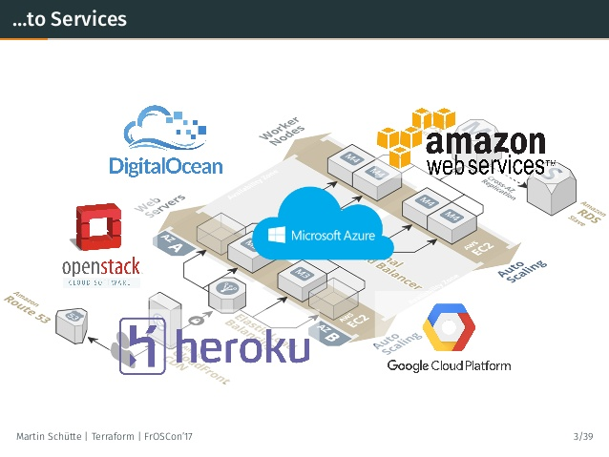
Multi-Cloud

Slide 19
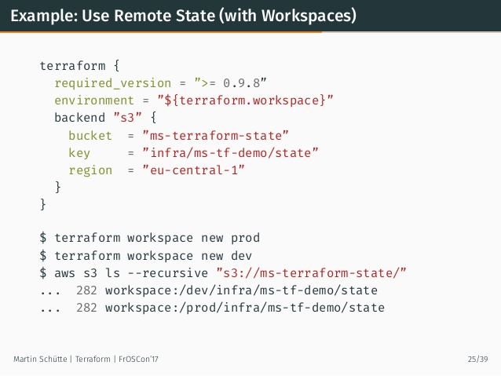
Example Configuration

Slide 20
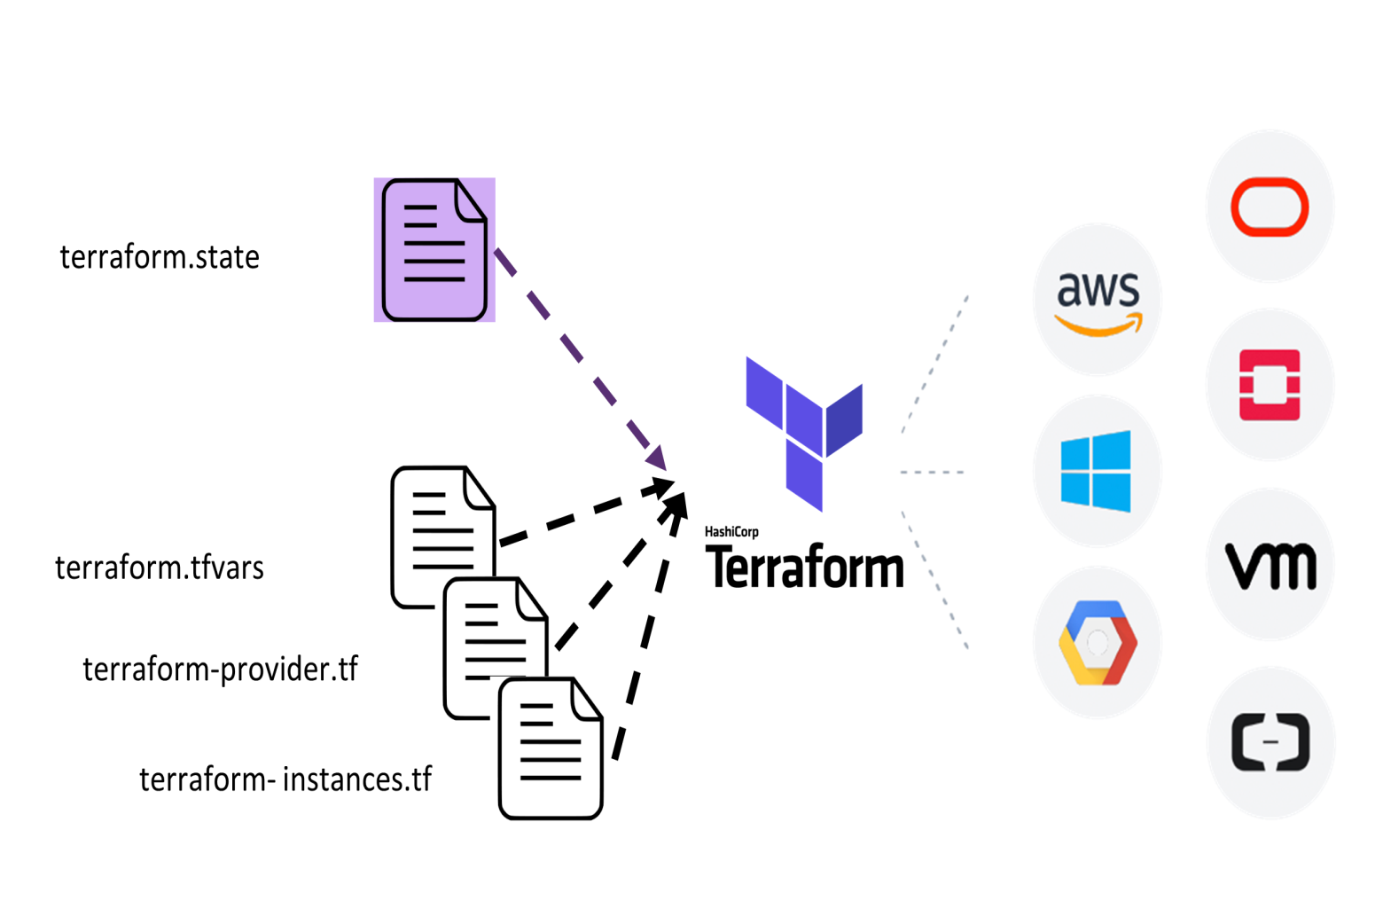
Example

Slide 21
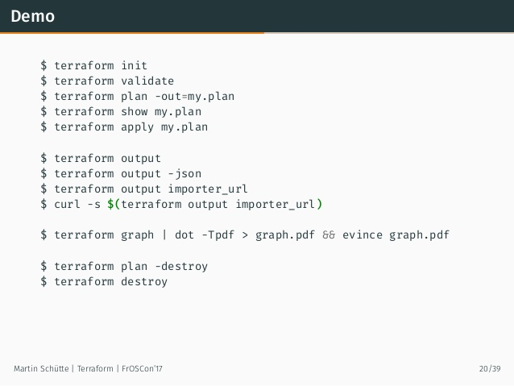
Demo of Terraform

Slide 22
THANK YOU

