Slide 1
Python-06

Slide 2
Useful functions:
#Here is a operator in python which is used to automatically enter the numbers in to a list.
#The operator we use is 'range' operator.
for num in range(0,11,2):
print(num)
#if want to place it in the list.
a=list(range(2,11,2))
print(a)

Slide 3
#There are some operator which is used to print a letter in a string and index of the string
index=0
word='shiva’
for letter in word:
print((index,letter))
index=index+1
#For the above program we are gonna get a tuple as a output,with the letter and its corresponding index.
#We can also auto generate these by using the 'enumerate' keyword.

Slide 4
for item in enumerate(word):
print(item)
#We can also combine two lists by using 'zip' function
l1=[1,2,3]
l2=['a','b','c’]
for items in zip(l1,l2):
print(items)

Slide 5
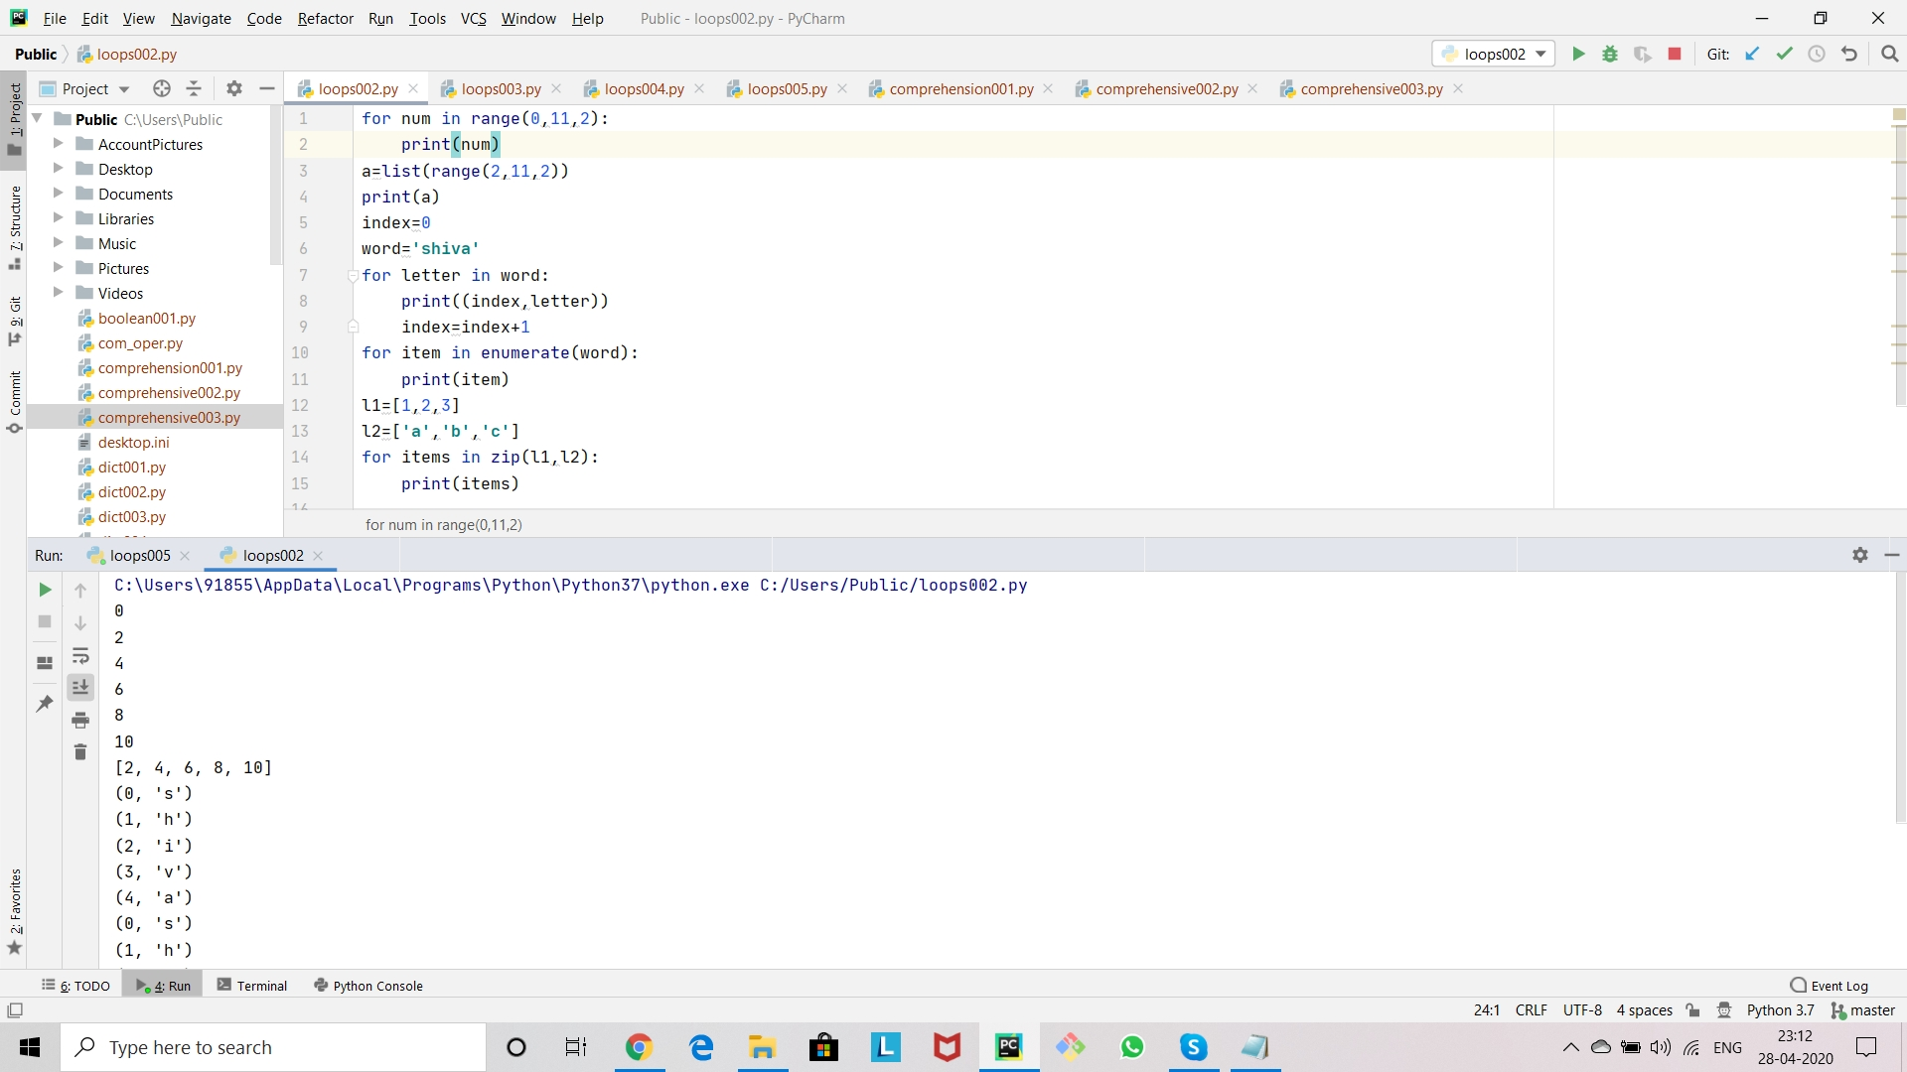

Slide 6
#what if we try to combine lists of uneven size.
l1=[1,2,3,4,5]
l2=['a','b','c’]
for items in zip(l1,l2):
print(items)
#The output is going to be tuples they are (1,'a'),(2,'b'),(3,'c’).

Slide 7
#Here we can see we only get three tuples as we have 5 items in the first list.
#From these we can learn that zip funtion is going to consider the shortest list.
#We can also check is some item in a list or not
l3=[1,2,3]
a='x' in l3
print(a)
#In the output we are going to get false which means the item 'x' is not in the list.

Slide 8
#lets try to check strings.
b='a' in 'shiva’
print(b)
#For integers in a list to find the maximum or minimum numbers in it we can use 'max' and 'min' function.
l4=[100,250,870,963]
x=min(l4)
print(x)
y=max(l4)
print(y)

Slide 9
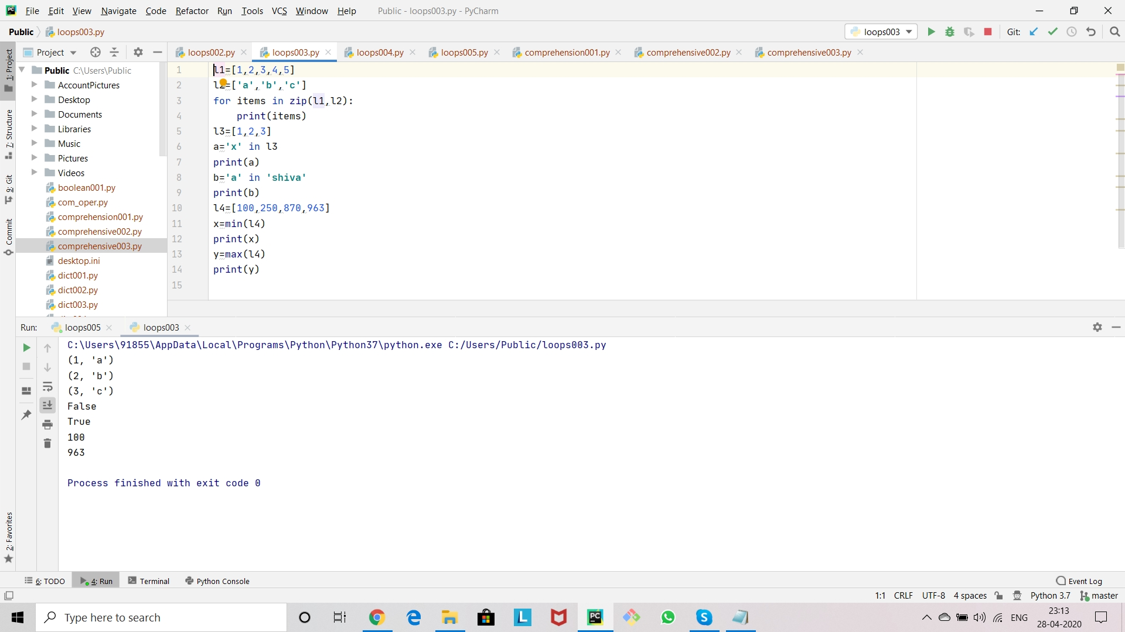

Slide 10
#We can also shuffle items in a list,by using shuffle function.
#We need to import shuffle function from the library.
#To import that we need to use the following line of code.
from random import shuffle
l1=[1,2,3,4,5,6]
shuffle(l1)
print(l1)

Slide 11
#We can also grab a random integer from a number range by using 'randint’.
#For that we need to import 'randint' function from the library.
from random import randint
l2=randint(0,100)
print(l2)

Slide 12
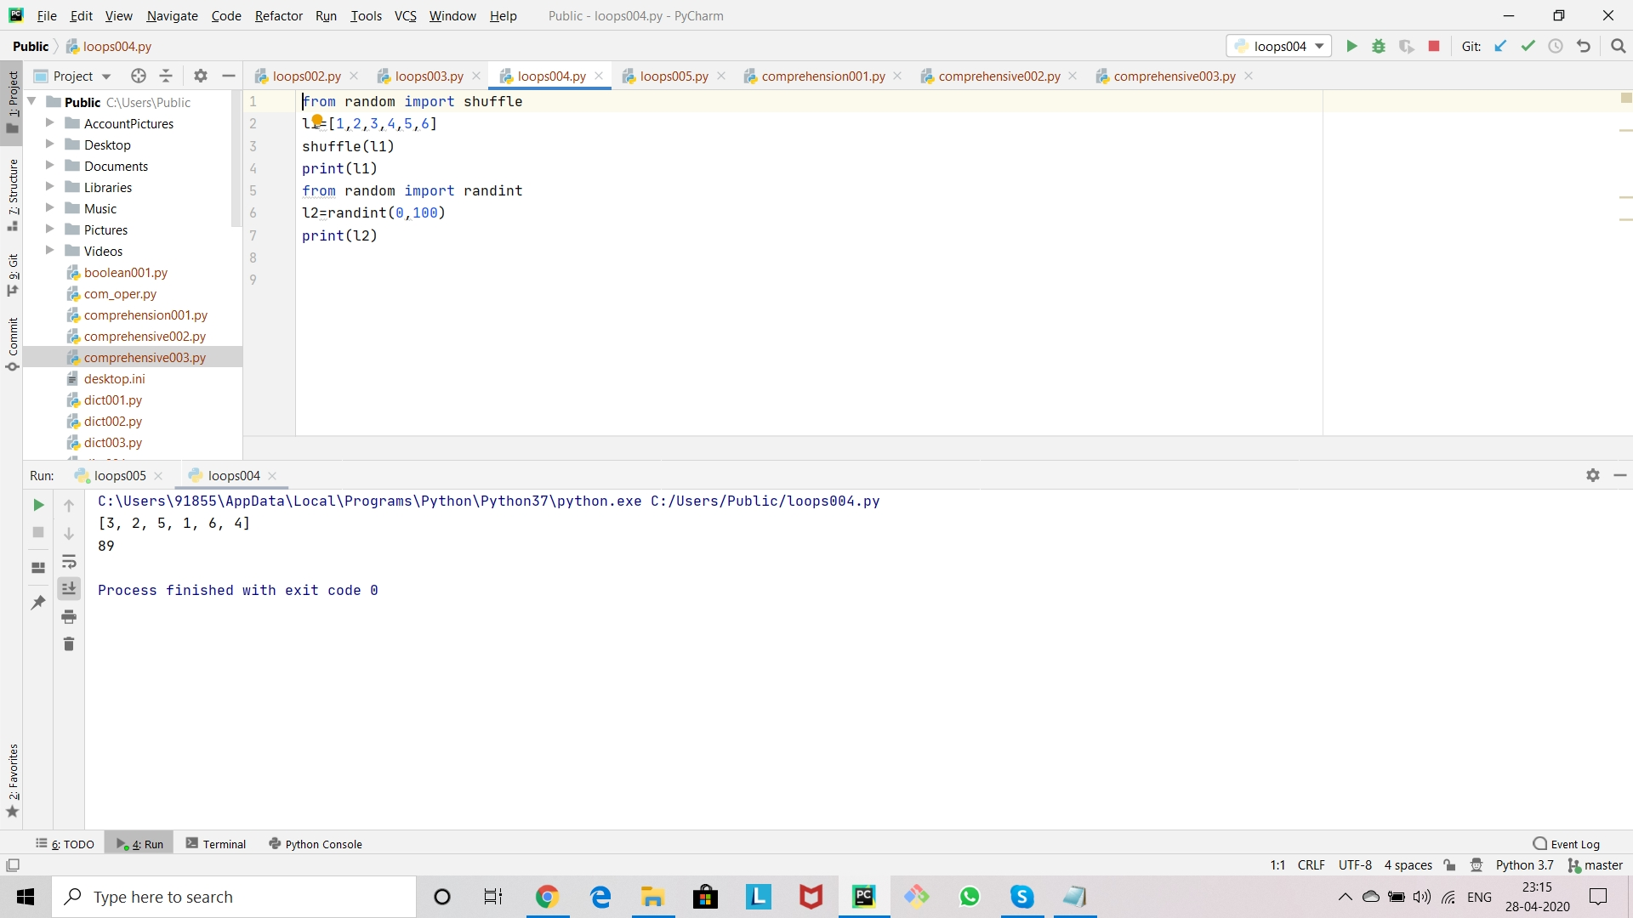

Slide 13
#We can also give input to a program by using 'input'keyword.
name=input('enter ur name:’)
print(name)
#But the problem with input is that it considers its input as string.
#lets see a example for it
birthyear=input('enter ur birthyear:’)
print(birthyear)
type_of_input=type(birthyear)
print(type_of_input)

Slide 14
#When we look about the type of input it shows it as a 'string’.
#By which we can understands that 'input' function considers the input given to it as a'string' by default.
#As we entered a number as an input.
#So we can change its datatype in the output itself.
x=int(birthyear)
print(x)
y=type(x)
print(y)
#Here we can see that the datatype got changed,as the output is int.

Slide 15
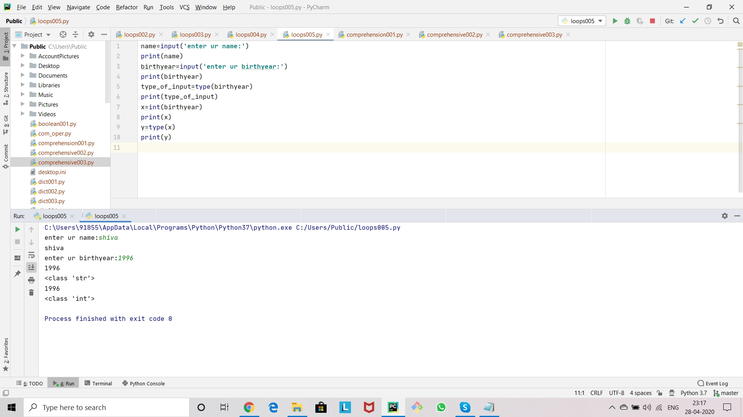

Slide 16
Comprehensive functions
#We can create a list automatically by using for-loop
#But it work for integers.Consider that if we want the items in a string to be placed in a list.
#So for that we can use some techniques and functions called list comprehensions.
s1='shiva’
l1=[]
for letter in s1:
l1.append(letter)
print(l1)

Slide 17
#We can also break the obove statement into more simplest form.
s2='hello’
l2=[le1 for le1 in s2]
print(l2)
#We can also try some other thing to make it simple.
l3=[le2 for le2 in 'world’]
print(l3)
#These are the simplest ways to put items in a string into a list.
#We can use range function to put the numbers into a list.
l4=[num for num in range(1,11)]
print(l4)

Slide 18
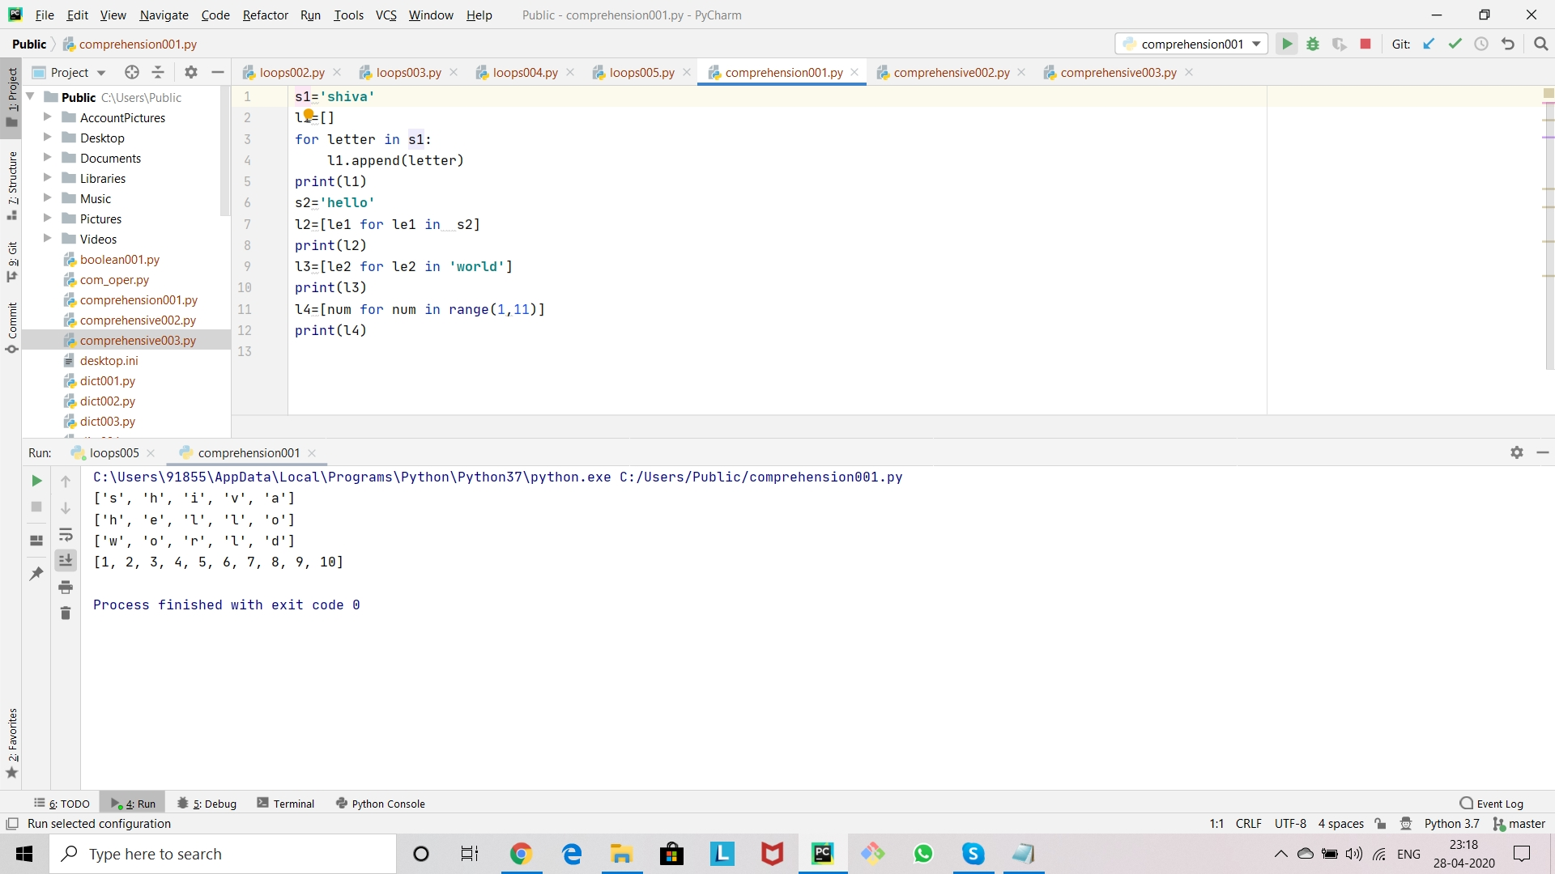

Slide 19
#There are certain other operations we can do using these comprehensive types they are
#If we want to find the square of numbers of certain range and place them in a list.
l1=[num**2 for num in range(1,5)]
print(l1)
#We can also find cube roots of the number of certain range and put them in a list.
l2=[num**3 for num in range(1,10)]
print(l2)

Slide 20
#With in the list we can perform some other operations also,like putting all the even numbers together,numbers which are divisable by '3' in between 1-100,etc.
l3=[num for num in range(1,100) if num%3==0]
print(l3)
#Here is a program in which an profit amount of 25,000 rupees divided to a grow of people based on the investment percent they put in the business.
total_profit=25000
percentage_of_investment=[40,20,22,18]
amount_tobe_shared=[(total_profit*share)/100 for share in percentage_of_investment]
print(amount_tobe_shared)

Slide 21
#Lets consider if we want to print only the persons profit whose share is less than 40%.
share_less_than_40_percent=[(total_profit*share)/100
for share in percentage_of_investment if share<40]
print(share_less_than_40_percent)

Slide 22
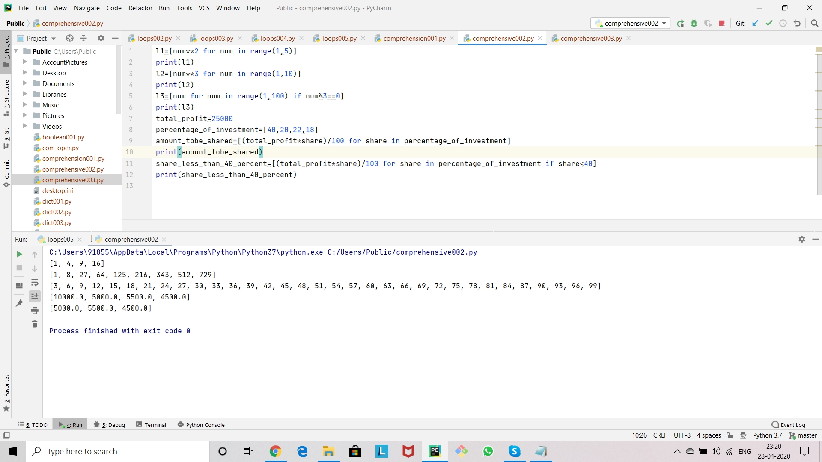

Slide 23
#Here are some programs to show how list comprehension works.
#Consider a program to print on the words which starts with letter 'w’.
s1='print the words which starts with s in this sentence’
for word in s1.split():
if word[0] =='w’:
l=[word]
print(l)

Slide 24
#By using the above lines of code we can print the words which start with 'w’.
#We can also put those words in a list.
l1=[word for word in s1.split() if word[0]=='w’]
print(l1)

Slide 25
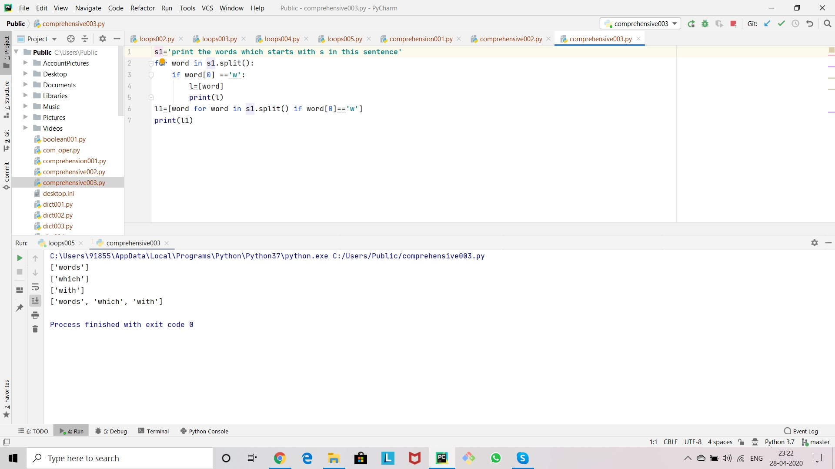

Slide 26
Thank you

