Slide 1
Python-04

Slide 2
Comparison-operators
#Comparision operators are operators used to compare two elements
#The elements can be of same or different data-types
#The operators are given below.
#'==','!=','>','<','>=','<=".

Slide 3
a=3
b=4
c=a==b
print(c)
c=a!=b
print(c)
c=a>b
print(c)
c=a<b
print(c)
c=a>=b
print(c)
c=a<=b
print(c)

Slide 4
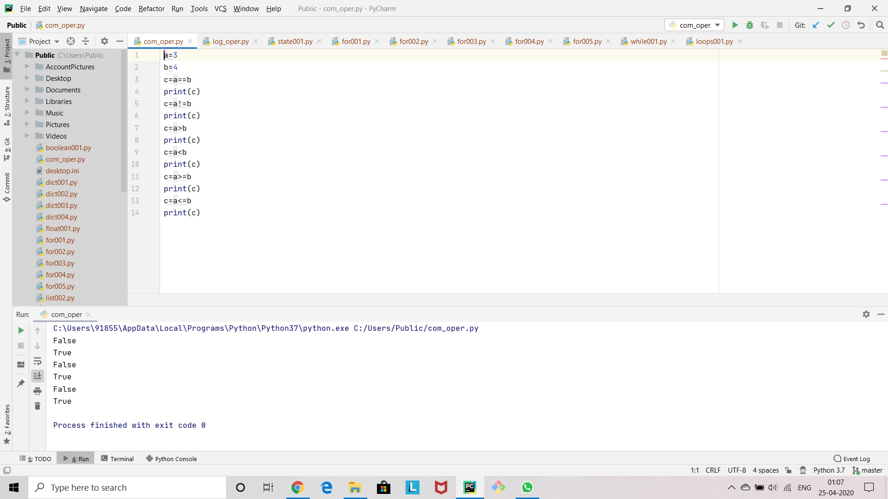

Slide 5
Logical-operators
#Logical operators are use to chain different comparision operators.
#These logical operators are 'and','or','not’.
#lets consider four elements a,b,c,d.
a=1
b=2
c=3
d=4
l1 = a < b and c > d
print(l1)

Slide 6
l2 = a < b or c > d
print(l2)
l3 = not 1==1
print(l3)

Slide 7
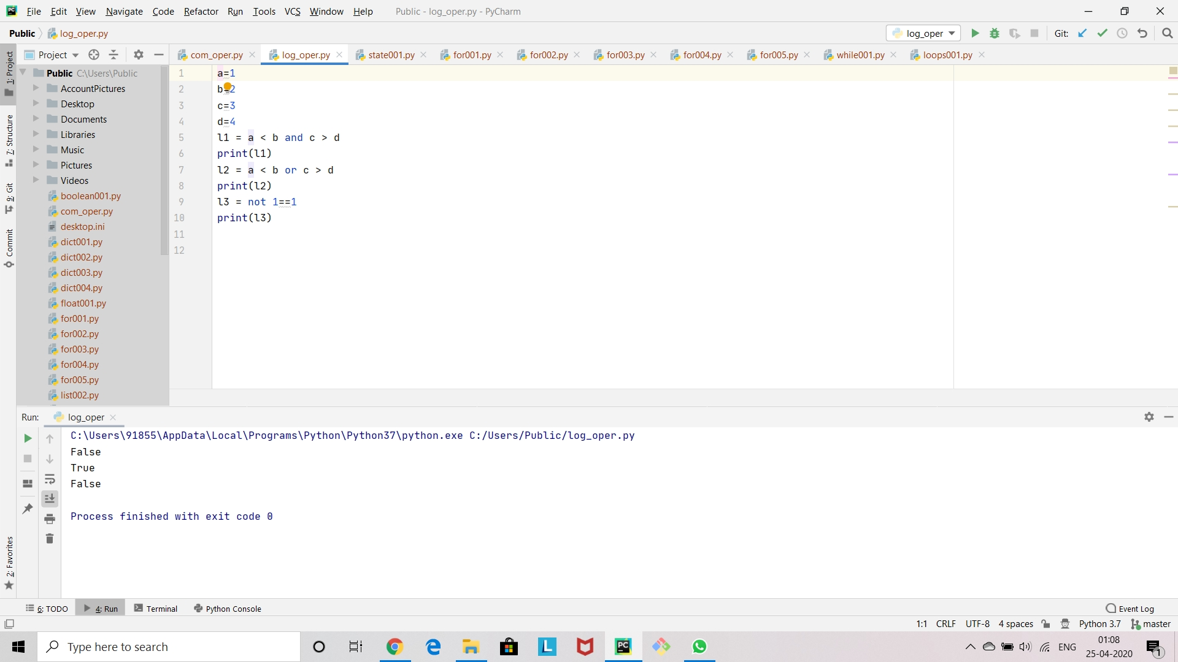

Slide 8
For-loop:01
#Many objects in python are 'iterable' meaning we can iterate over every element in the object.
#such as every element in a list or every character in a string.
#we can use for loops to execute a block of code for iteration.
#The term iterable means you can "iterate" over the object.
#For example you can iterate over every character in string.
#Iterate over every item in a list,iterate over every key in a dictionary.

Slide 9
#Syntax of a for loop
my_iterable=[1,2,3]
for item_name in my_iterable:
print(item_name)

Slide 10
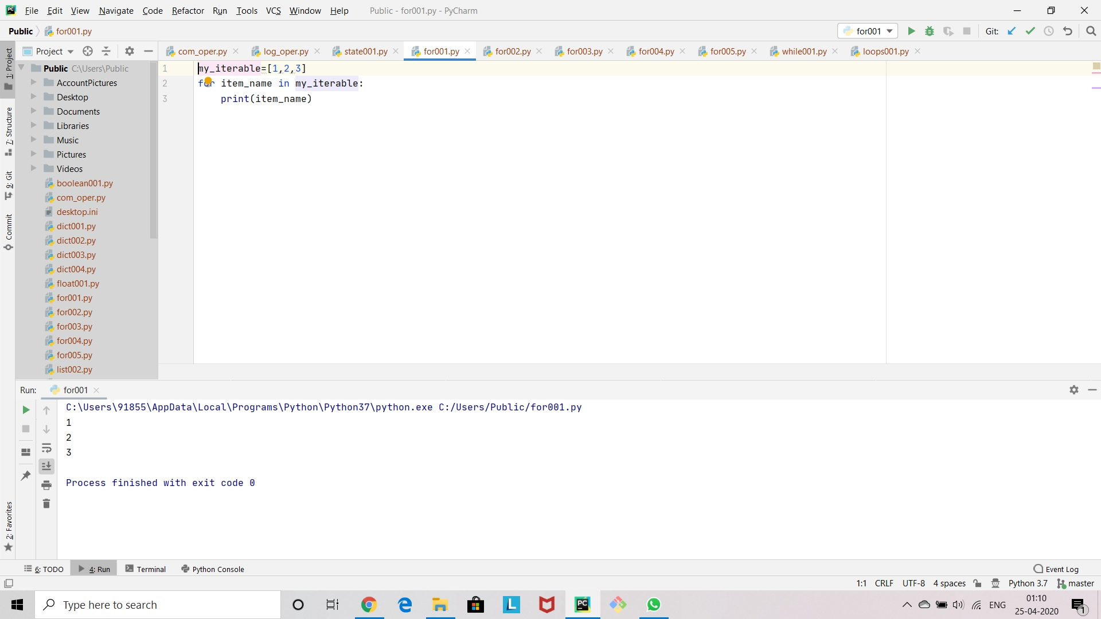

Slide 11
For-loop:02
#Here is a simple example to show how a for-loop works.
my_list=[1,2,3,4,5,6,7,8,9,10]
for num in my_list:
print(num)
#The above statement shows that how for-loop works for a list.
#A program to show how a for-loop works for a tuple.
t1=(1,2,3,4)
for n1 in t1:
print("hello")

Slide 12
#Here is a program to show how tuple unpacking works.
l1=[(1,2),(3,4),(5,6)]
for t in l1:
print(t)
for (a,b) in l1:
print(a)
print(b)

Slide 13
