Slide 1
Python-03

Slide 2
List-03
#program to show how a pop() function works in a list.
#pop() function is used to remove the last item from the list.
l1=[1,2,3,4,5]
print(l1)
l1.pop()
print(l1)
#after using the pop function the last number in the list is removed.
#and here is a program to show which number is removed from the list.
p1=l1.pop()print(p1)

Slide 3
#we can also remove a specific item from the list.
#By specifying its index number in the brackets.
#by default the index number is '-1’.
print(l1)
l1.pop(2)
print(l1)p

Slide 4
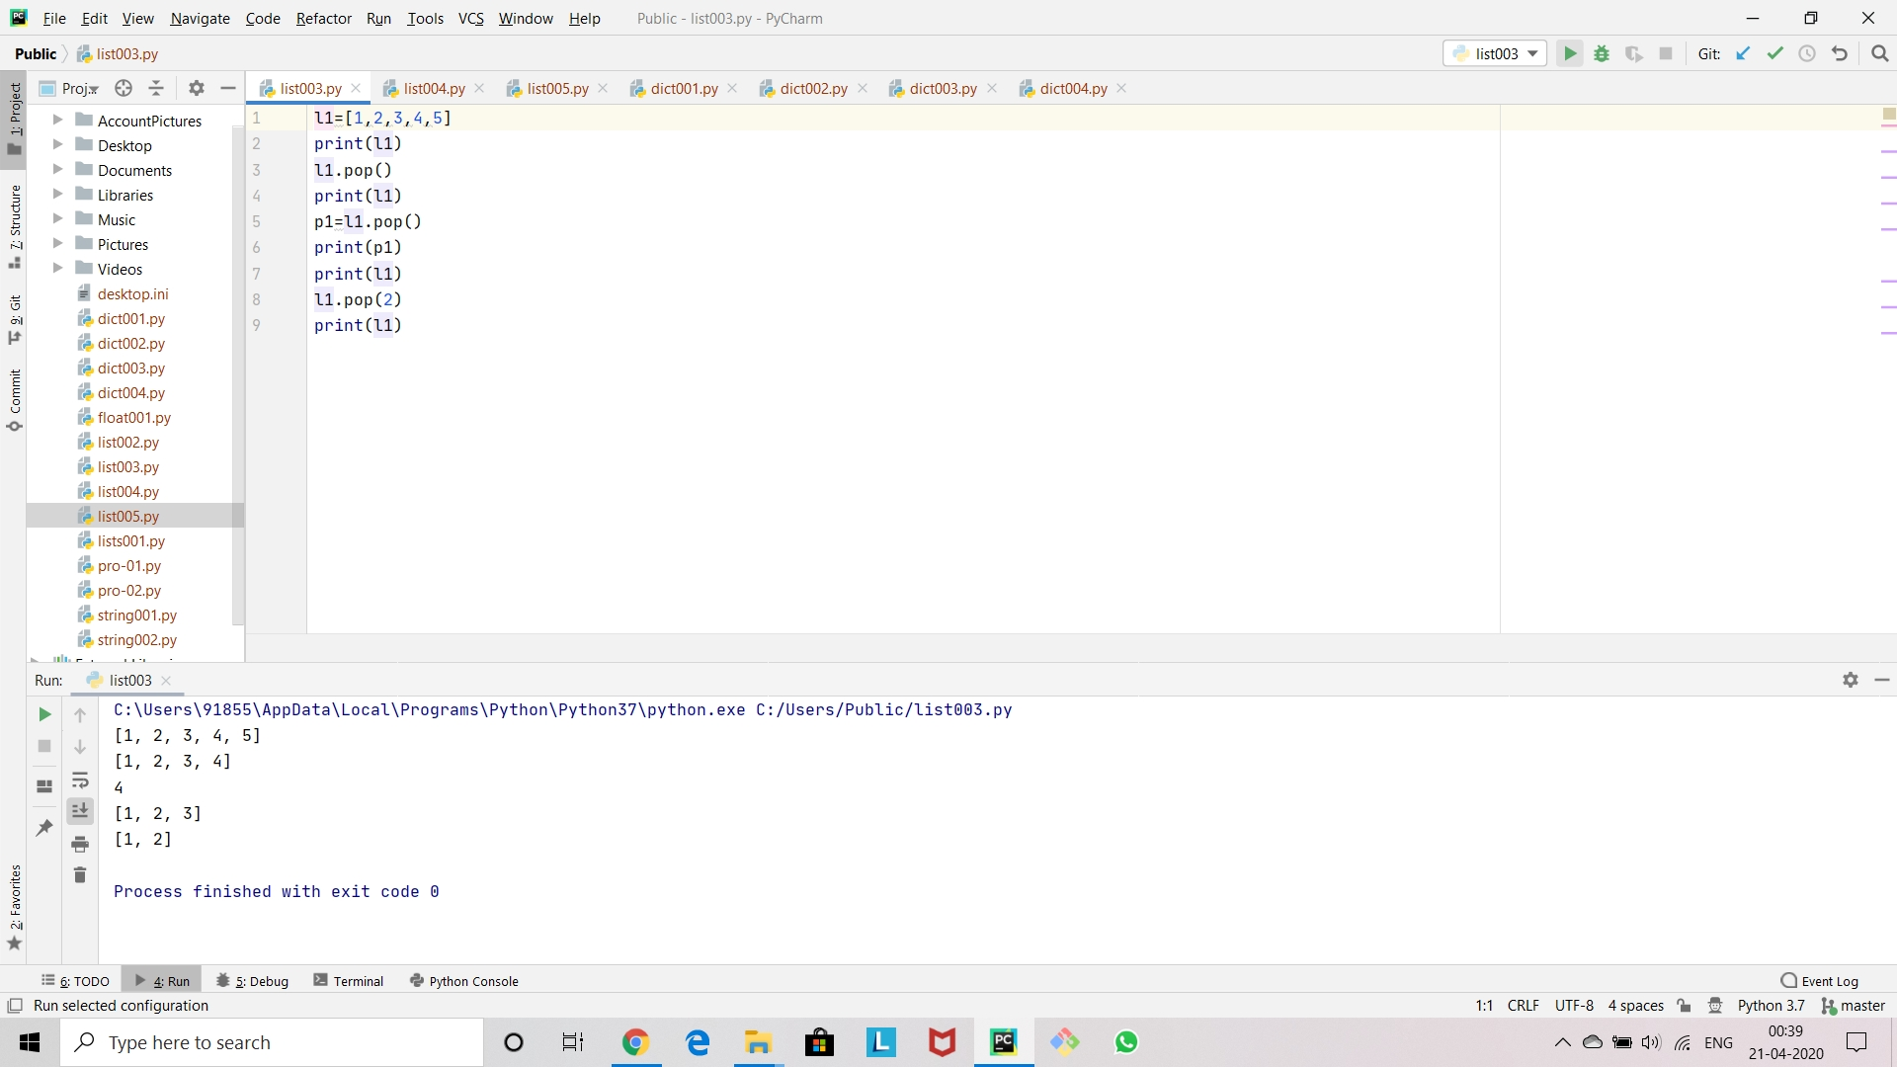

Slide 5
List-04
#program to show how sorting works in lists.#for sorting a list we use sort function.
#By default sort function arranges the items in order.
l1=[4,5,3,6,1,2]
l1.sort
()print(l1)
#The sort function does not give any return value as the append or pop function.
#here is a program to show the above statement.
s1=l1.sort()
print(s1)
#The output for this program is none because it has no return value.
#And in python nonetype means it has no return value.

Slide 6
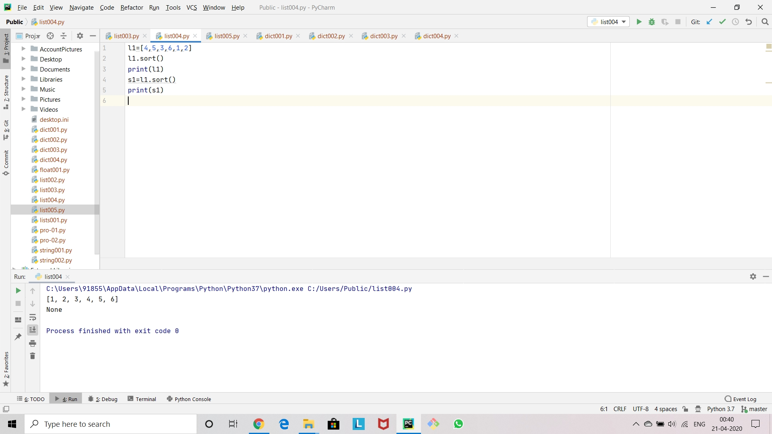

Slide 7
List-05
#Here is a program to reverse the list using reverse function.
l1=[1,2,3,4,5]
print(l1)
l1.reverse()
print(l1)
#The list is printed in reverse order.
#As the sort function the reverse function also does not give any return value
r1=l1.reverse()
print(r1)
#The output for this program is None.
#As we already told that nonetype means it has no return value

Slide 8
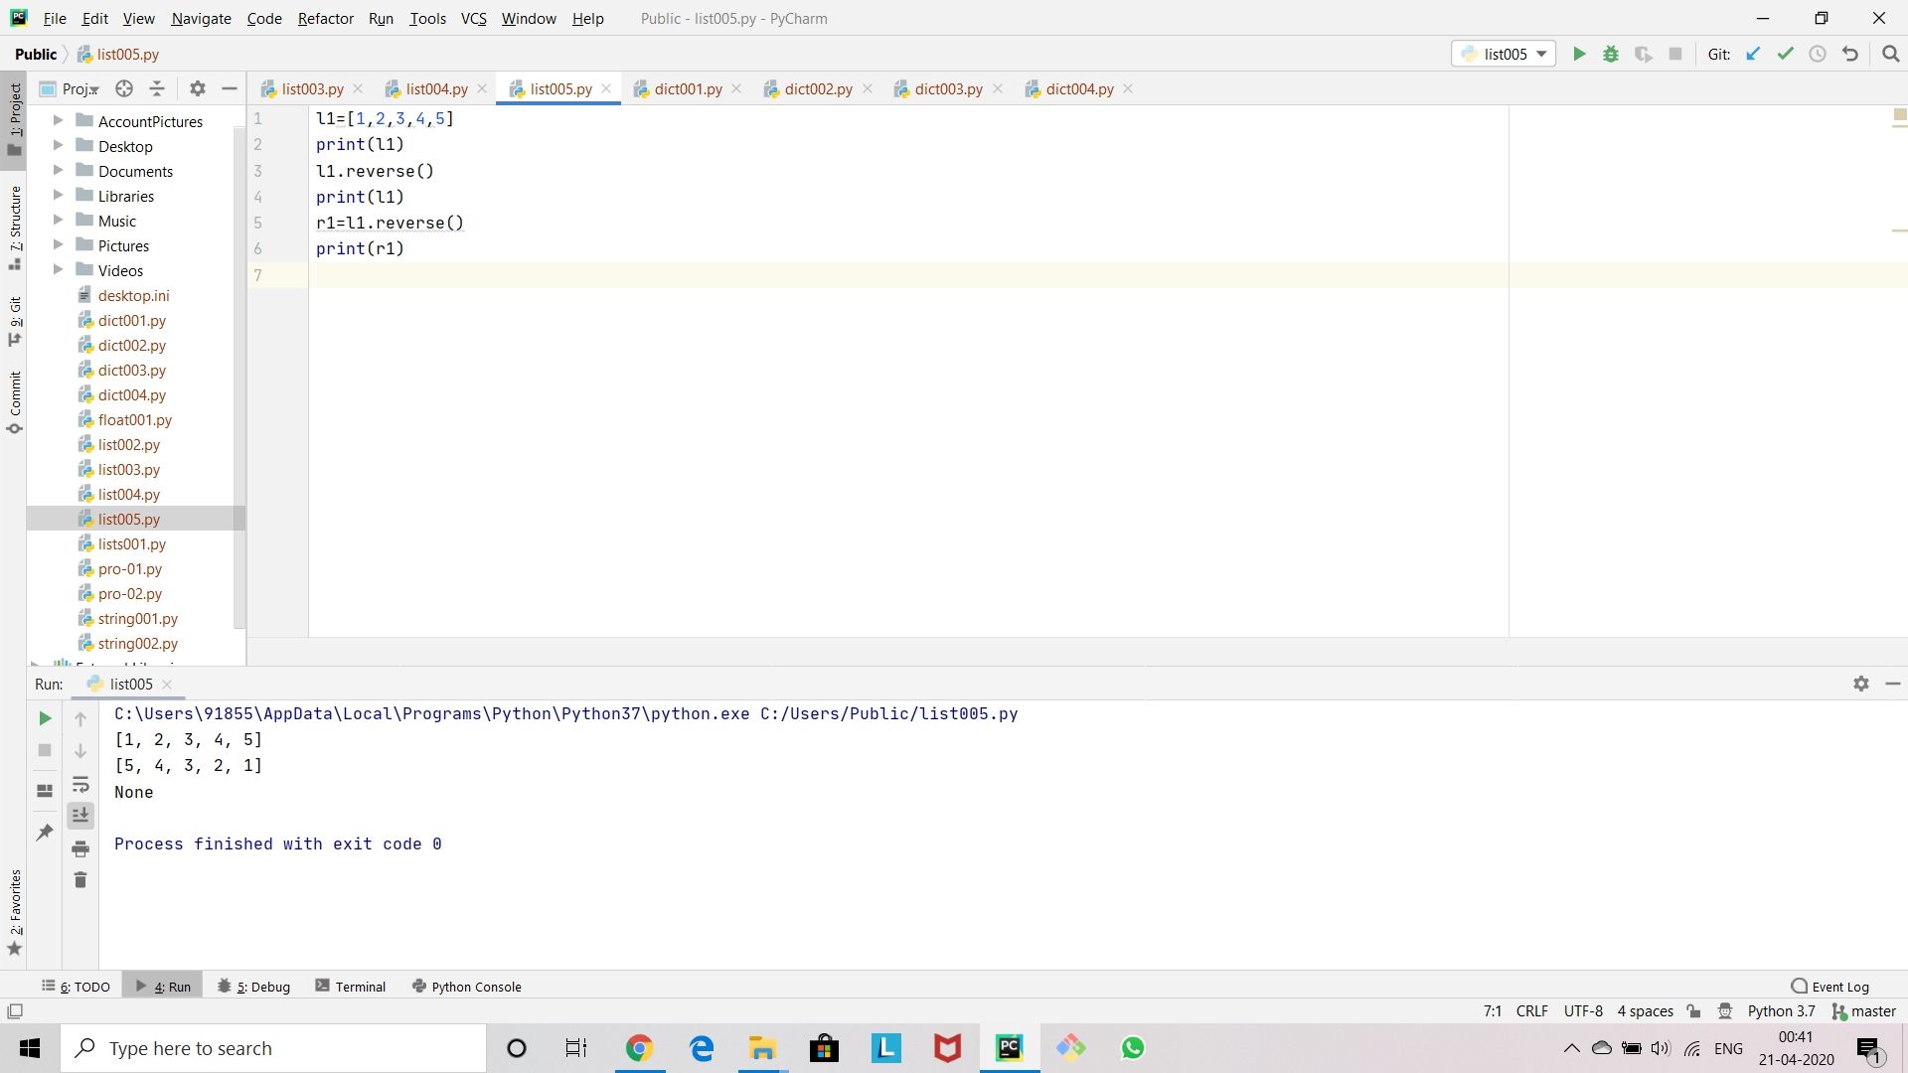

Slide 9
Dictionaries-01
#Dictionaries are unordered mappings for storing objects.
#Dictionaries uses key-value pairs to store objects.
#This key-value pair allows users to grab objects without any need of index location.
#Dictionaries use curly braces and colons to signify the keys and their associated values.
#{'key1':'value1','key2':'value2’}
#In dictionaries objects can be retrieved by using key value names.

Slide 10
#Here is a program to show how dictionaries works
zumeit001={'name':'Shiva','surname':'Bandari','idno':'Z001’}
print(zumeit001)
#For example to retrieve the name of the employee.
print(zumeit001['name'])

Slide 11
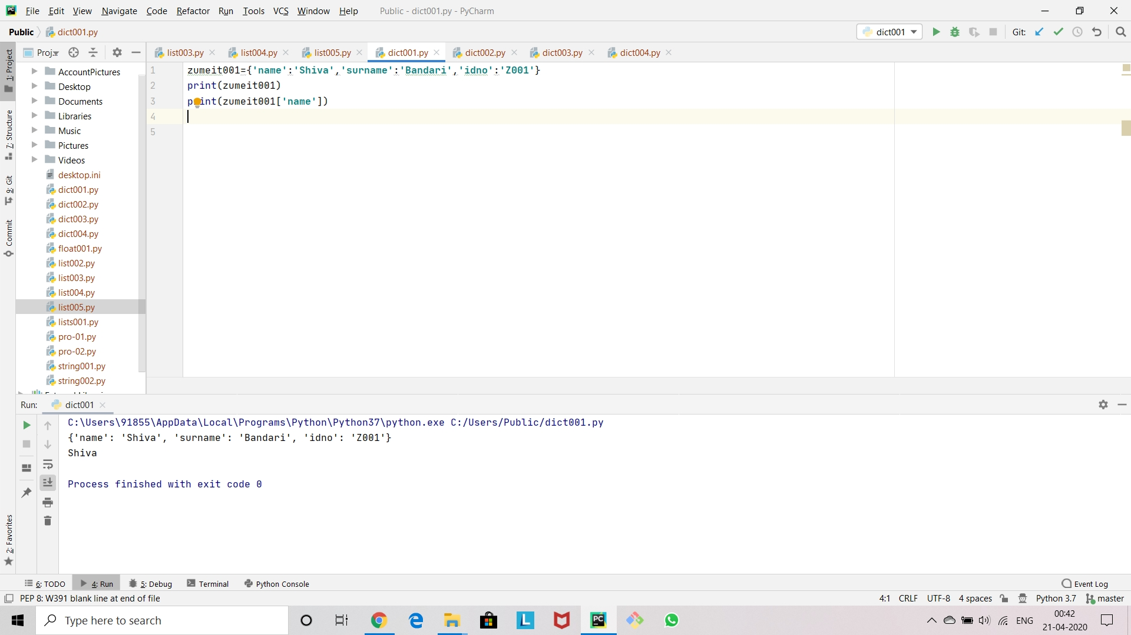

Slide 12
Dictionaries-02
#Dictionaries can be used to hold lists.
#And dictionaries can also be used hold another dictionaries.
#Here is a program to illustrate the above statements.
items={'k1':'keyword','k2':['a','b','c'],'k3':{'ik1':'12','ik2':'23','ik3':'34’}}
print(items['k1’])
print(items['k2’])
print(items['k3'])

Slide 13
#We can also retrieve a value of a key value from the inner dictionaries.
#Here is a program to prove the above statement.
print(items['k3']['ik3’])
#We can also retrive a object from the inner list present in the dictionaries.
print(items['k2'][2])

Slide 14
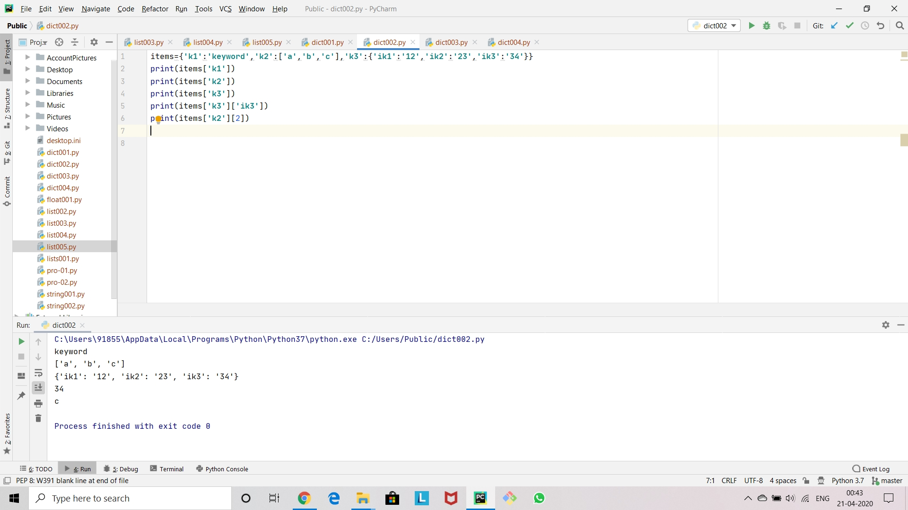

Slide 15
Dictionaries-03
#In dictionaries the values of the values are mutable
#Keys are immutable
d1={'k1':'a','k2':'b','k3':'c’}
print(d1)
print(d1['k1’])
d1['k1']='shiva’
print(d1)

Slide 16
#We can also change the object in a list present in a dictionaries
d2={'l1':['a','b','c’]}
print(d2)
print(d2['l1’])
print(d2['l1'][0])
d2['l1'][0]=d2['l1'][0].upper()
print(d2['l1'][0])print(d2)
#As we already know lists are mutable

Slide 17
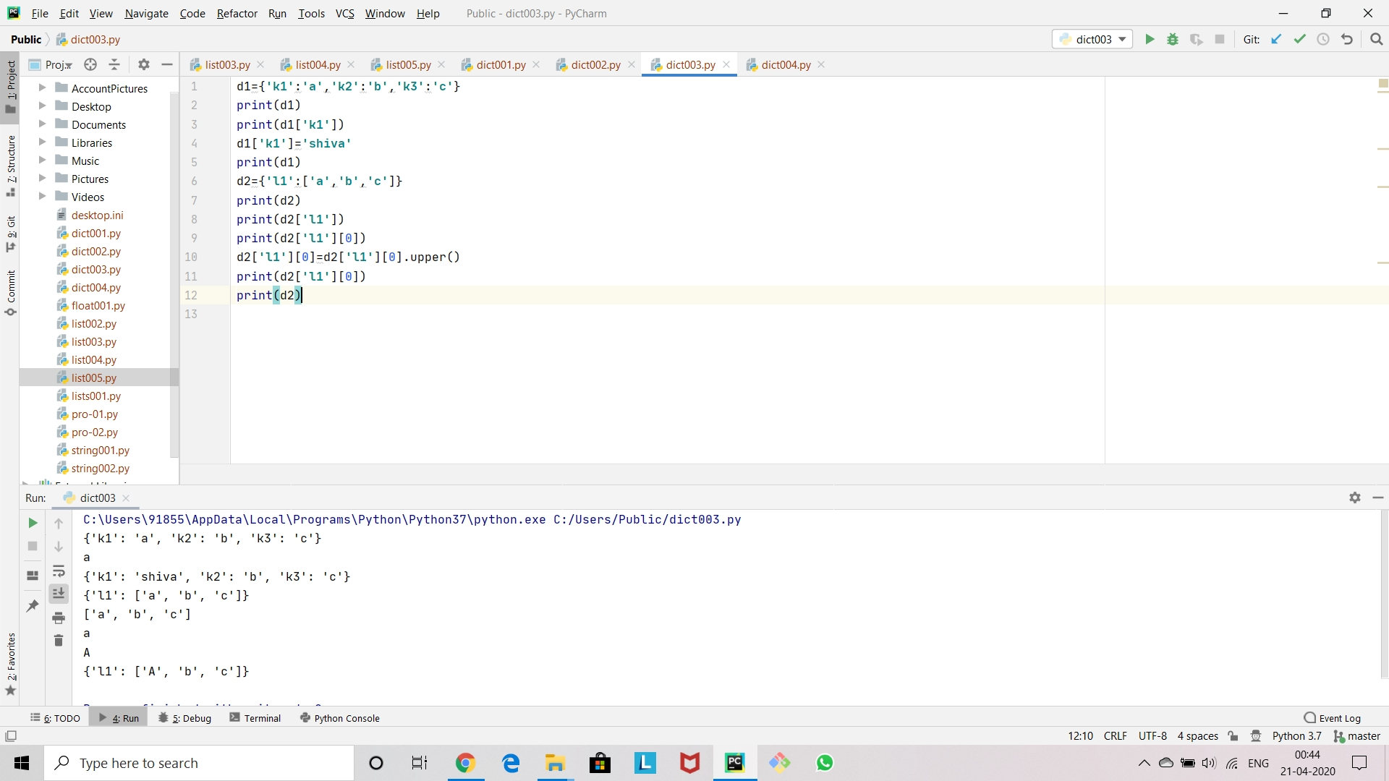

Slide 18
Dictionaries-04
#we can add a keypair and assign a value to the given dictionaries.
d1={'k1':1,'k2’:2}
print(d1)
d1['k3’]=3
print(d1)
#By using the above method we can overwrite a keypair value.
d1['k1']=100
print(d1)

Slide 19
#If you want to get only the keypairs,we can use the below loc.
print(d1.keys())
#Or if you want to get only the values,we can use the below loc
print(d1.values())
#We can also get both keypairs and values in same braces by using the below loc.
print(d1.items())
#The keypair and the value printed in same braces is called a tuple i.e,('k1',100)

Slide 20
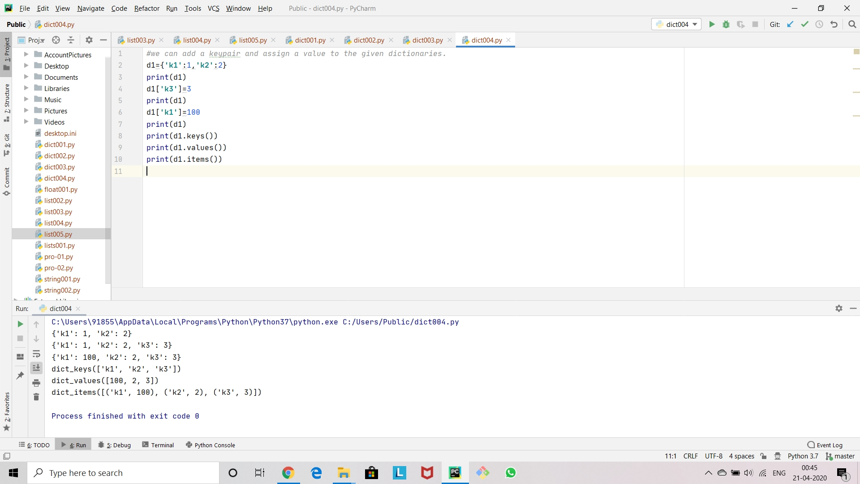

Slide 21
Thank you

