Slide 1
Python-005

Slide 2
For-loop:3
#Here is program to print the even numbers in a list.
l1=[1,2,3,4,5,6,7,8,9,10]
for n in l1:
if n%2==0:
print(n)
#program to print the sum of the numbers in list.
l2=[1,2,3,4,5]
sum=0
for num in l2:
sum=sum+num
print(sum)

Slide 3
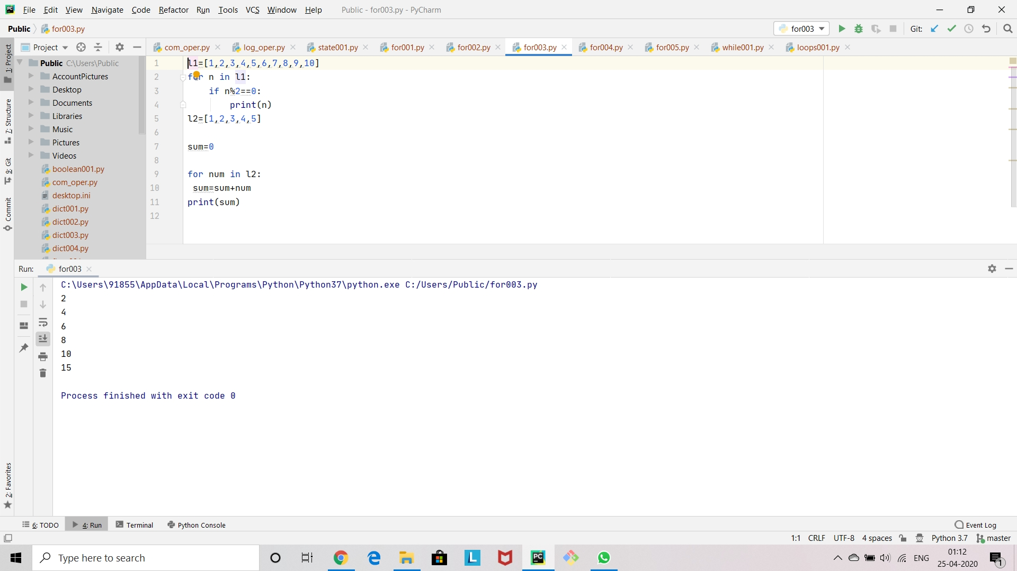

Slide 4
For-loop:4
#Here is a program to show how for-loop works for strings.
1='shiva’
for l in s1:
print(l)
#The letters are printed in a line
#Here is another program to show how tuple unpacking works
t1=[(1,2,3),(4,5,6),(7,8,9)]
for (a,b,c) in t1:
print(b)
#In the above program the middle numbers in the tupples are printed.

Slide 5
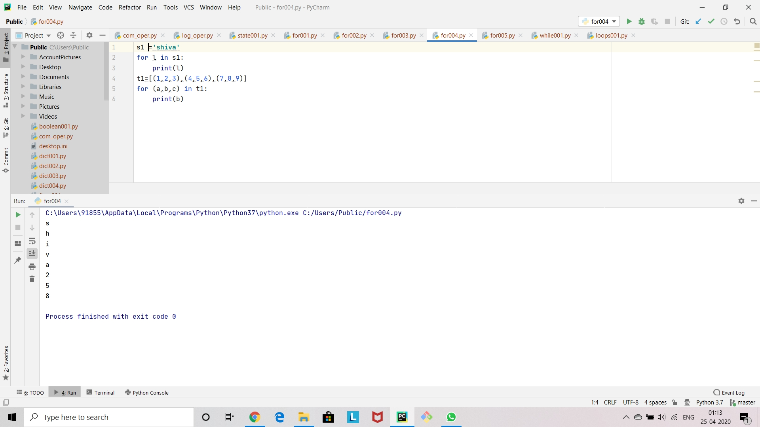

Slide 6
For-loop:5
#Lets look how for-loop works for dictionaries.
d1={'k1':1,'k2':2,'k3’:3}
for i1 in d1:
print(i1)
for i1 in d1.items():
print(i1)
#This gives the output in the form of a tuple.
#so we can use tuple unpacking for this output.
for (a,b) in d1.items():
print(a)
print(b)

Slide 7
#so if we want to print only the values so we can print 'b' in the above program.
#Or if we want to print only the key so we can 'a' in the above program.
#if u want to pick only the values in the for loop so we can use the above program.
for value in d1.values():
print(value)

Slide 8
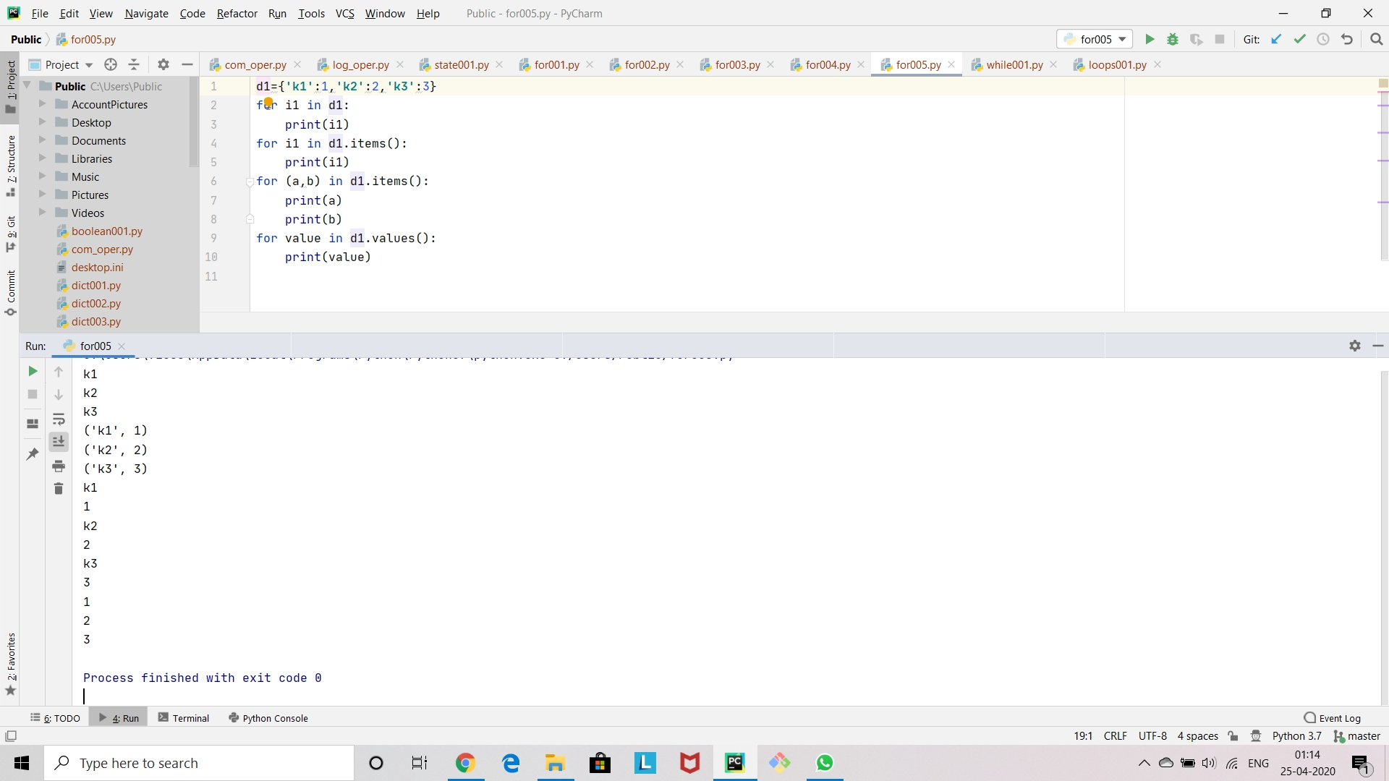

Slide 9
Pass, Break, continue
#There are 3 key words which can be used by loops.
#They are 1.break,2.continue,3.pass.
#break:Breaks out of the current closest enclosing loop.
#continue:Goes to the top of the closest enclosing loop.
#pass:Does nothing at all.
#Lets go from behind and learn about 'pass' keyword.
#Pass keyword is used as a place holder to some code like give below.

Slide 10
x=[1,2,3]
for n1 in x:
#For the above code it is gonna throw a error 'unexpected EOF while parsing’.
#It means that python is gonna expect that it should run some loc after the loops.
Pass
#make sure that the pass must be inside the for loop.
#If we enter 'pass' keyword it neglects its expectation to run a loc.
#Lets go for 'continue' keyword
.s1='swing’
for l1 in s1:

Slide 11
#We that when we try to print 'l1' it is gonna print the letters of the word.
#If we try not to print the letter 's' in the given string.we can use the following loc. if l1=='s’:
continue
print(l1)
#Here it is going to print the word 'wing' by skipping the letter 's’
#And finally we discuss about break
s2='sweet’
for l2 in s2:
if l2=='e’:
break
print(l2)
#during this iteration the a letter 'e' the loop breaks.

Slide 12
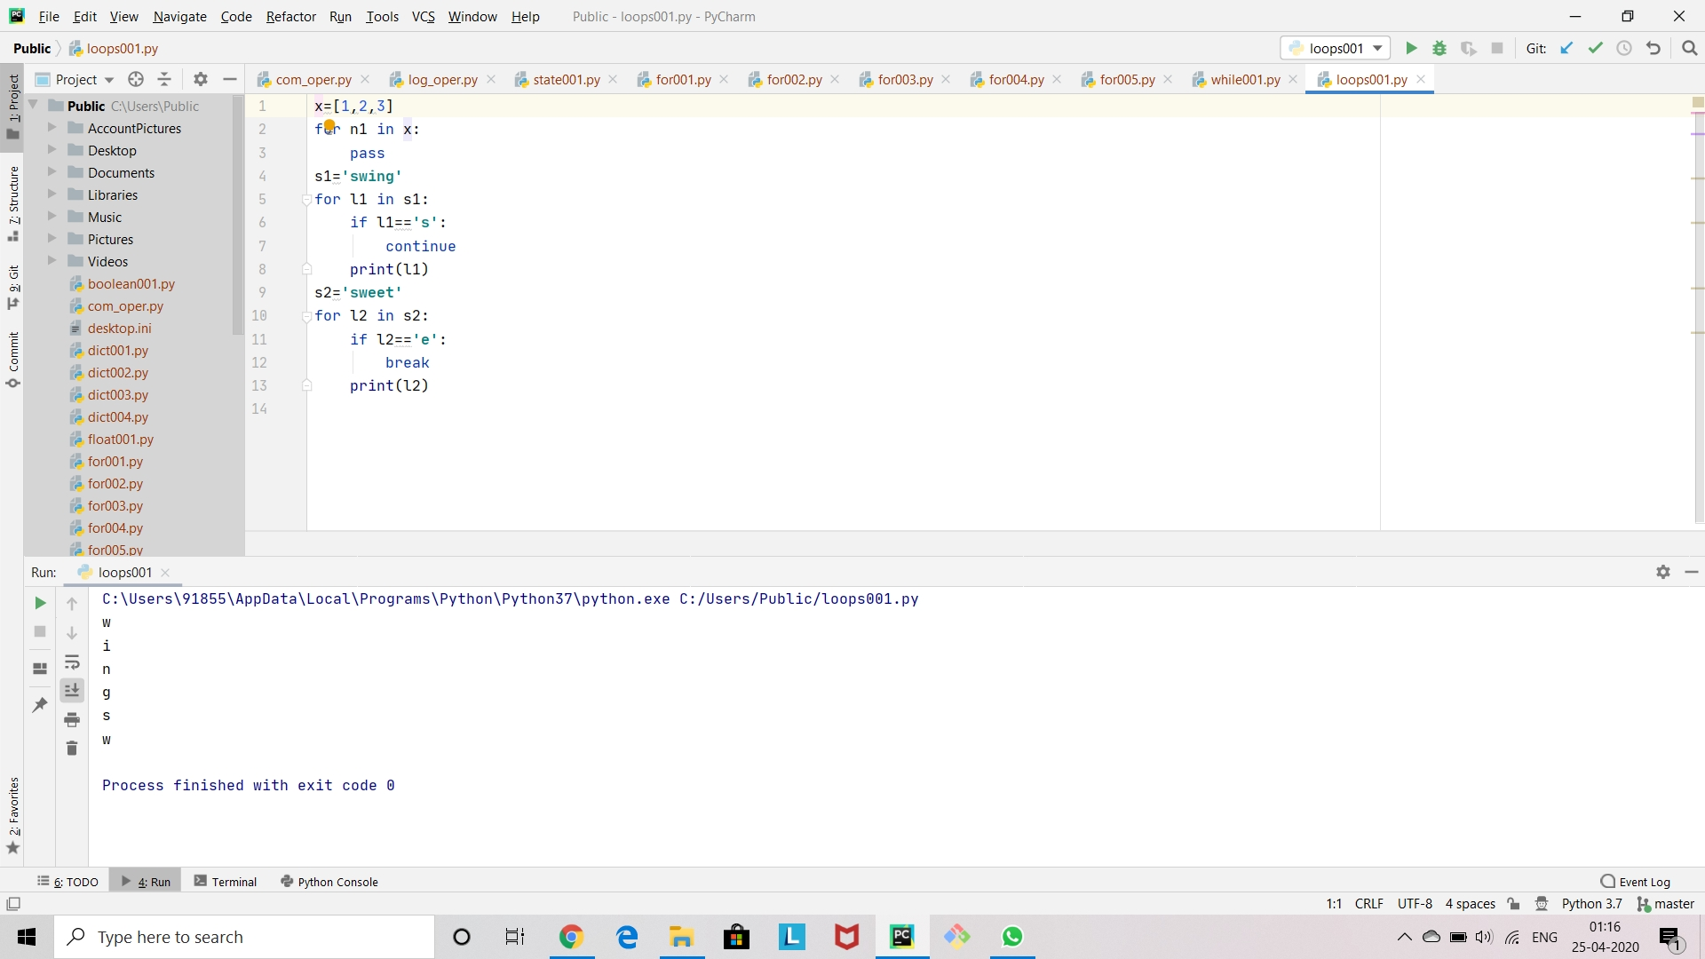

Slide 13
While-loop
#While loops will continue to execute a block of code while some condition remains true.
#For example,while my pool is not full,keep filling water in my pool until water in the pool is full.
#Syntax of a while loop.
#while some_condition:
#do something
#else:
#do something

Slide 14
#You can also combine a while statement with an else statement.
#Here is a program to show how a while statement works.
x=0
while x<5:
print('the current value of x is {}'.format(x))
x=x+1
#x+=1
#we can also include else statement.
else:
print('x is not less than 5')

Slide 15
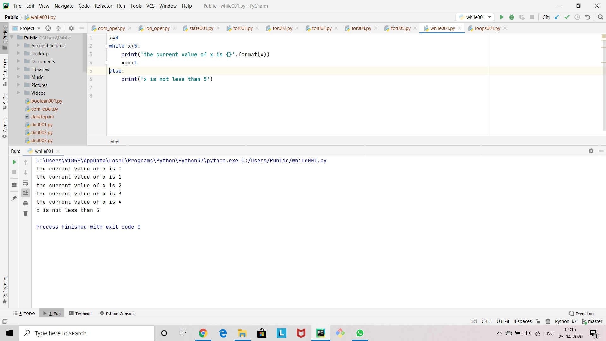

Slide 16
Thank you

