Slide 1
Part – 1 “In times of universal deceit, telling the truth will be a revolutionary act.” George Orwell
Facts, alternative facts, and fact checking in the world of post-truth

Slide 2
Two words caught the imagination of Oxford Dictionary Post-Truth and Alt-Right, so much so that Oxford included it in its dictionary
What is Post Truth?
“Relating to or denoting circumstances in which objective facts are less influential in shaping public opinion than appeals to emotion and personal belief.”
“And to say that we live in a post-truth era doesn't mean that truth doesn't matter anymore, or that no one cares about truth. It means that we live in an era where truth is at risk, where we're in danger of losing sight of what truth means. ….post-truth as the political subordination of reality. ”
World Leaders –Alternative Facts and “Lies”
Trump offered a string of fresh falsehoods: that he had the biggest electoral victory since Reagan (he didn’t); that the crowd at his inauguration was the largest in US history (photographic evidence belies this and Washington, DC, Metro records show subway ridership down that day); that his speech at the CIA resulted in a standing ovation (he never asked the officers to sit). In early February, He claimed that the US murder rate was at a forty-seven-year high (when in fact the Uniform Crime Report showed it to be at a near-historic low).
In one of the rallies ahead of the Gujarat polls, PM Modi insinuated that a conspiracy was afoot by suggesting that former Prime Minister Manmohan Singh, former Vice-President Hamid Ansari and former Army chief General Deepak Kapoor had gathered at the residence of Congress leader Mani Shankar Aiyar at New Delhi on December 6 to meet the Pakistani High Commissioner. PM Modi’s suggestion, implying a link between the meeting and the Gujarat election had kicked up a storm.
PM Modi while addressing a rally in Karnataka in October stated that it was his govt that had launched the Direct Benefit Transfer (DBT) scheme. He added that the Govt had saved up to Rs,57,000 crore by eliminating middlemen and plugging leakages.
Alt Fact -The promise that the weekly cost of EU membership – allegedly, £350m – would be ploughed into the NHS was front and centre in the Vote Leave campaign. But the data was not correct
“To borrow a distinction often made by Trump’s supporters, it was evidently a mistake to take the Leave campaign literally rather than seriously.”

Slide 3
Why are lies and alternative facts successful?
Motivated Reasoning
Individuals engage in motivated reasoning as a way to avoid or lessen cognitive dissonance, the mental discomfort people experience when confronted by contradictory information
Confirmation Bias
Impact how we gather information, but they also influence how we interpret and recall information
Salience
Psychologists view salience detection as a key attentional mechanism enabling humans to focus their limited cognitive re- sources on a relevant subset of the available sensory data - fully all the in- formation available to them, but overemphasize the information their minds focus on
Available Heuristic
the probability of events by availability, i.e., by the ease with which relevant instances come to mind.
Notes:
Motivated Reasoning- especially on matters that directly relate to their comfort, happiness, and mental health. Rather than re-examining a contradiction, it’s much easier to dismiss it.For example for years we have believed that Mughals looted us---so now when we are suddenly presented with the fact that they enriched us with various styles of architecture, calligraohy, music, poetry, music, humor etc so we will find it hard to believe
For example, salience may affect consumer behavior: when consider- ing which of different brands to buy, a consumer might focus on the attributes where the potential brands are most different, neglecting the others \SALIENCE THEORY OF CHOICE UNDER RISK 1281
mental frames, rather than being fixed in the mind of the con- sumer, investor, or voter, are endogenous to the contrasting fea- tures of the alternatives of choice. This notion could perhaps provide a way to study how context shapes preferences in many social domains. – repetition ke level per dekhna hoga

Slide 4
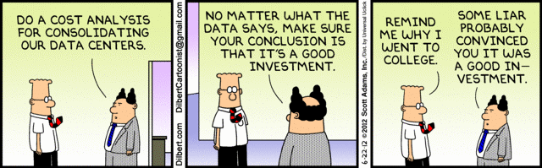
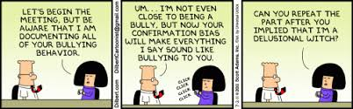
Motivated Reasoning Confirmation Bias

Slide 5
Current Ecosystem to challenge Facts, Alternative Facts and Lies
IFCN- International Fact-Checking Network
Fact Checking Website- Altnews, Boom, Vishvas News
Washington Post Lies Tracker
Research videos and journals
Individuals challenging or demanding accountability

Slide 6
The roadblocks to fact-checking ecosystem
Alternative facts are highly persuasive;
After the Nazis established their rule, radio propaganda incited anti-Semitic acts and denunciations of Jews to authorities by ordinary citizens. The effect of anti-Semitic propaganda varied depending on the listeners’ predispositions toward the message. Nazi radio was most effective in places where anti-Semitism was historically high and had a negative effect in places with historically low anti-Semitism.
Fact checking improves factual knowledge of voters or the audience for that fact
Seasonal influenza is responsible for thousands of deaths and billions of dollars of medical costs per year in the United States, but influenza vaccination coverage remains substantially below public health targets. One possible obstacle to greater immunization rates is the false belief that it is possible to contract the flu from the flu vaccine
Fact checking does not affect policy conclusions or support or decision making for the candidate or piece of information;
The correction also significantly reduced intent to vaccinate among respondents with high levels of concern about vaccine side effects – a response that was not observed among those with low levels of concern
Exposure to facts alone does not decrease support for the candidate, even though voters update their knowledge
The exposure to facts alone may have two effects that go in the opposite directions: on the one hand, facts increase the salience of the immigration issue
Notes:
The participants were randomly allocated to four equally sized groups: (i) control group, (ii) alternative facts group, (iii) fact checking group, and (iv) real facts group. The participants in different groups were asked to read different messages. The control group was presented with no information. Participants in the group “Alt-Facts ”(for alternative facts) were asked to read several statements by Marine Le Pen (MLP) on immigration, each containing factually incorrect or simply misleading information, used as part of a logical argument. Participants in group “Facts” were asked to read a short text containing facts from official sources on the same issues. Participants of the group “Fact-Check” were provided first with the same quotes from MLP and then the same text with facts from official sources. All texts presented to participants had a clear indication of the source.
The results of our experiment confirm that on average the use of alternative facts increases the political support of the politicians irrespective of fact checking, which explains why politicians use alternative facts despite facing the risk of being fact checked. We find that political statements based on alternative facts are highly persuasive and fact checking is ineffective in undoing their effect on voting: being exposed to MLP's rhetoric significantly increases voting intentions in favor of MLP by 5 percentage points, irrespective of whether they are or are not accompanied by fact checking. The effects of all treatments are stronger for those respondents whose prior belief about the unemployment rate among migrants is an overestimation compared to the official statistics. Among those with overestimated priors about unemployment of migrants, Alt-Facts treatment increased MLP voting intentions by 8 percentage points, Fact-check treatment by 7 percentage points, and Facts treatment by 5 percentage points
Let’s assume I want to make immigration a salient issue , I will have to repeatedly reference immigration with alternative facts till a point it just becomes an important issue then whoever talks about the issue becomes an important politician. Even when it will be debunked the issue will still be catapulted to national stage- salience. So when collecting information and archiving be careful the volume of kinds of a narrative, leave room for things that are beyond Hindi belt, Catapulting the group or news to national stage
Doxxing means to search and publish private or identifying information on the individual over the internet, usually with malicious intent. Idea is to embarrass them or draw criticism towards them but it is also often used to ruin someone’s reputation online or cause someone physical harm. This form of ‘revenge’ is far harmful as the gratification is instant but it could have far-reaching consequences.
We show that attention patterns are similar despite the different qualitative nature of the information, meaning that unsubstantiated claims (mainly conspiracy theories) reverberate for as long as other information.

Slide 7
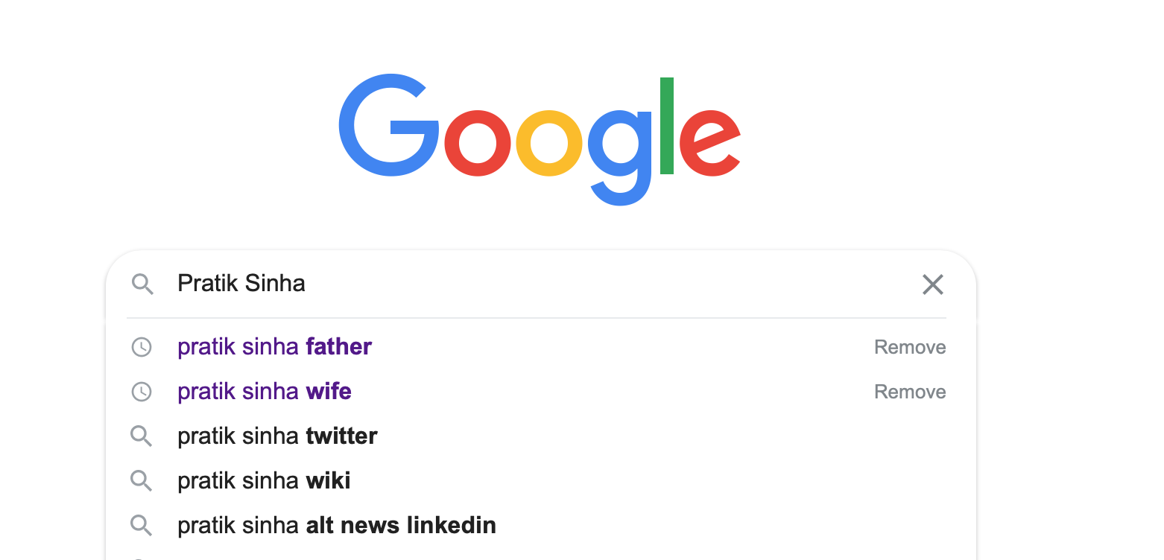
People seldom Agree on Facts but they also seldom agree on the Fact Checkers credibility. That is usually they find confirmation bias and motivated reasoning for Fact checkers individual identity too and thus maligning fact checkers is usually used as a tool by perpetrators of misinformation which is commonly called Doxxing
An example of how Doxxing usually finds foothold

Slide 8
What could we do while debunking?
Avoid Binaries
Not just facts but alternative narratives-Remember to give something else also to think about, for example when people are told that Hindu Muslim fake news, give space to Sufism’s detail
Profile “Trolls” , “Bhakts”. These are Nebulous terms . People with posterior beliefs, are also victims of Fake news.

Slide 9
Signal Boosting or Amplification??
Are we Creating their world view??
(At a Certain Point You Have to Realize That You’re Promoting Them)
Notes:
Didn’t have enough clout to shift the national conversation themselves, and certainly didn’t have enough votes to win an election. These media, instead, depended on the signal- boosting power provided by center-left establishment publications like The New York Times, The Washington Post, and CNN.com to ensure that their messages would spread to a national, or even global, audience.9 That’
Archiving services serve a variety of purposes beyond ad- dressing link rot. Platforms like archive.is are reportedly used to preserve controversial blogs and tweets that the author may later opt to delete [23]. Moreover, they also reduce Web traffic toward “source URLs” when the original content is still ac- cessible, thus depriving them of potential ad revenue streams (users do not visit the original site, but just the archived copy). In fact, anecdotal evidence has emerged that alt-right commu- nities target outlets they disagree with by nudging their users to share archive URLs instead [17], or discrediting them by pointing at earlier versions of articles [27].
The Donald subreddit systematically targets ad revenue of news sources with conflicting ideologies: moderation bots block URLs from those sites and prompt users to post archive URLs instead (e.g., nydailynews.com have 46% of their content censored). According to our conservative estimates, popular news site like the Washington Post lose yearly approx. $70K from their ad revenue because of the use of archiving services on Reddit.

Slide 10
Tackling Amplification on an Online Archive
Date:02-06-2020
Sources:https://858.ma/list/title
https://syrianarchive.org/en
https://yemeniarchive.org/en
https://www.digitaltransgenderarchive.net
https://occupyarchive.org

Slide 11
Archive
Goal
Experience
Collection
-Was there selection in collecting criteria?
-What was the way it was collected?
-What are we archiving?
-What is the method of archiving?
-Why we chose this method
how can we navigate this collection
Additional resources or links
what qualifies as fake news
-Experience with website
-Experience with archive
-Experience with one individual piece
-Are we just facilitating discovery of information within a collection of content sourced from various places?
-Takeaways
- What do we want them to remember
What do we want them to do
What do we want to change

Slide 12
Collection/Archive
Create a user guide of how to navigate the online archive (In that user guide we can mention at least our stand on amplification and how this content should not be used but can be used). This can include how is the archival material organized, what is the meta data, what are the tags, how differently we can view the collection – chronoligically, region wise, tags wise, mention that each content can be listed under various categories because just like real world one content doesn’t concern with just one aspect thus we will use tags rather than broad based categories.
Create a guide which addresses few question
Like are you new to fact checking and fake news?
Do you want to know more about history of fake news, rumour,
do you want to be our ally?
Are you interested in politics of fake news or activism with fake news or impact of fake news?
Are you tired of hearing fake news is only from one side
Live chat bot in case of any Query? Or at least a link with every content to email the organization in case anyone has questions
On the first page itself mentioning the way archive was formed and created
Additional places or websites to go to
Create separate Userflows for people coming to websites- one for researcher, one for ”Ruhi mausi-common social media user” et al
Reference these links
https://www.digitaltransgenderarchive.net/learn/guide?
https://www.digitaltransgenderarchive.net/learn/raceandethnicity

Slide 13
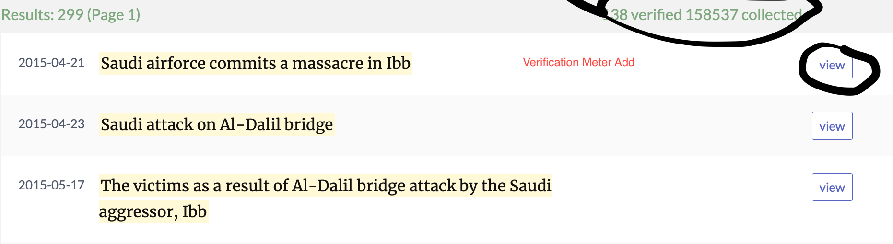
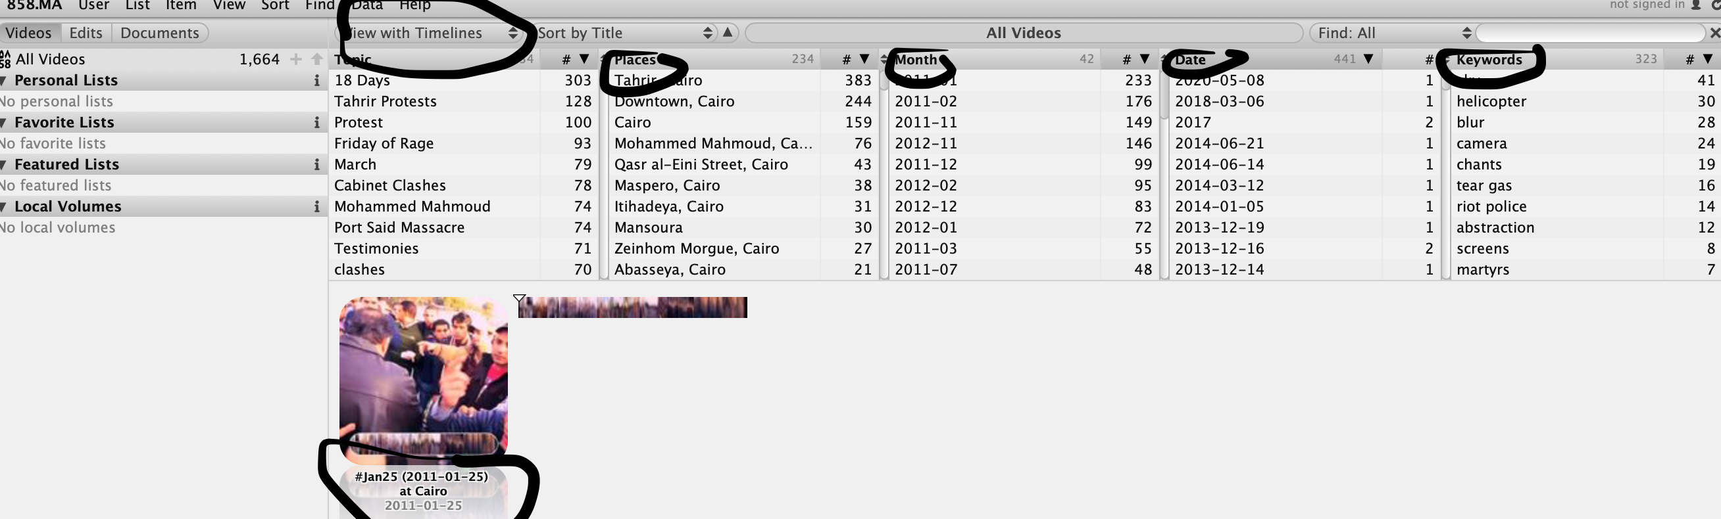
Experience
Shouldn’t overwhelm – basic, simple, intuitive, use headlines like collections, observations, investigation
Reference these links
https://858.ma/timelines/title
-
Add a view button only show text or tags first, this will discourage some people from actually entering things they don’t like, picture are inviting. You can add a verification meter and tags instead of a headline itself
You can choose to display collection
As timelines with just pictures and their date of acquisition
You can also show them as grid where you put tags, data of acquisition and verification meter
You can show them on a map as clusters which be hard but may be you can show as a pictogram where how many from Whatsapp, how many from Sharechat, how many from fact checking websites etc

Slide 14
The categories they have used are places, month, keywords , very generic topic –
for example in case of anti CAA protests or delhi protests- we can use the word demonstration or we can
Also one of the tag could be of article 19 from constitution then only someone who genuinely
knows that and wants to harm will use it

Slide 15
Goal
If our goal is just facilitation of search then we should use timelines, map clusters, tags, pictogram to show just information but our goal is more
Remember that this piece of image was verified, not verified or partially verified – so that with their political biases they incrementally remember
That a lot of information circulated isn’t verified
Which platform its least verified on
We want them to ask questions or seek more
How can we lead to that- add like an email or chat link with the content for them to ask questions to us
Add a link with semi verified and unverified news – which has a blog of how to check sources or ask questions to one who has forwarded
Are we just facilitating discovery of information within a collection of content sourced from various places?
Takeaways
-what do we want them to remember
What do we want them to do
What do we want to change

