Slide 1
Bike Sharing Demand Analysis
What drives demand for shared bikes, and can the next hour be predicted?
17,379 hourly records · Washington D.C. · 2011-01-01 to 2012-12-31 · Descriptive · Visual · Predictive
Notes:
Two years of Capital Bikeshare data from Washington D.C. The project covers all three analysis types: descriptive statistics, data visualization, and a predictive model.

Slide 2
Two years of a city on bikes
Capital Bikeshare, Washington D.C. — hourly rental counts with weather and calendar context
17,379
3,292,679
+64.9%
81.2%
Hourly records
Total rentals
Year-on-year growth
Registered share
99.06% calendar coverage
Across 2011 and 2012
1,243,103 to 2,049,576
Members, not casual riders
What the data holds
Calendar Season, year, month, hour, weekday, holiday and working-day flags
Weather Temperature, feels-like, humidity, wind speed and a 4-level condition code
Target cnt — total bikes rented in that hour, split into casual and registered
Notes:
The weather columns arrive min-max normalised; they are converted back to degrees Celsius, percent and km/h so every chart is readable.

Slide 3
Clean data — with one trap in it
Four checks run before any analysis
0
0
165
100%
Missing values
Duplicate rows
Absent hours
Target consistency
No imputation needed
No de-duplication needed
99.06% coverage — excluded, not zero-filled
cnt = casual + registered, every row
The leakage trap
cnt is exactly casual + registered in all 17,379 rows. Any model handed those two columns reconstructs the target perfectly and reports flawless accuracy while having learned nothing. Both are dropped from the feature set.
This is the most common error made with this dataset — and nothing in the output announces it.
Notes:
Worth dwelling on: a leaked model scores R-squared near 1.0 and is worthless. Everything in the feature set is knowable before the hour starts.

Slide 4
Descriptive and visual analysis
PART ONE
What does demand actually look like?

Slide 5
A typical hour does not exist
Distribution of hourly rental counts
189.5
95.7%
+1.28
72.6x
Mean rentals / hour
Coefficient of variation
Skewness
Peak-to-trough ratio
Median 142
Std. dev. nearly equals the mean
Long right tail of busy hours
17:00 against 04:00
Why the mean misleads here
The mean (189.5) sits a third above the median (142). Most hours are quiet; a small number of commuter peaks carry a disproportionate share of all trips.
Demand ranges from 1 to 977 rentals in an hour — three orders of magnitude.
That variability is structure, not noise. Part Two shows a model can recover most of it.
Notes:
Skewness of +1.28 and a coefficient of variation of 95.7% are the two numbers to quote: hourly demand is highly variable and far from normal.

Slide 6
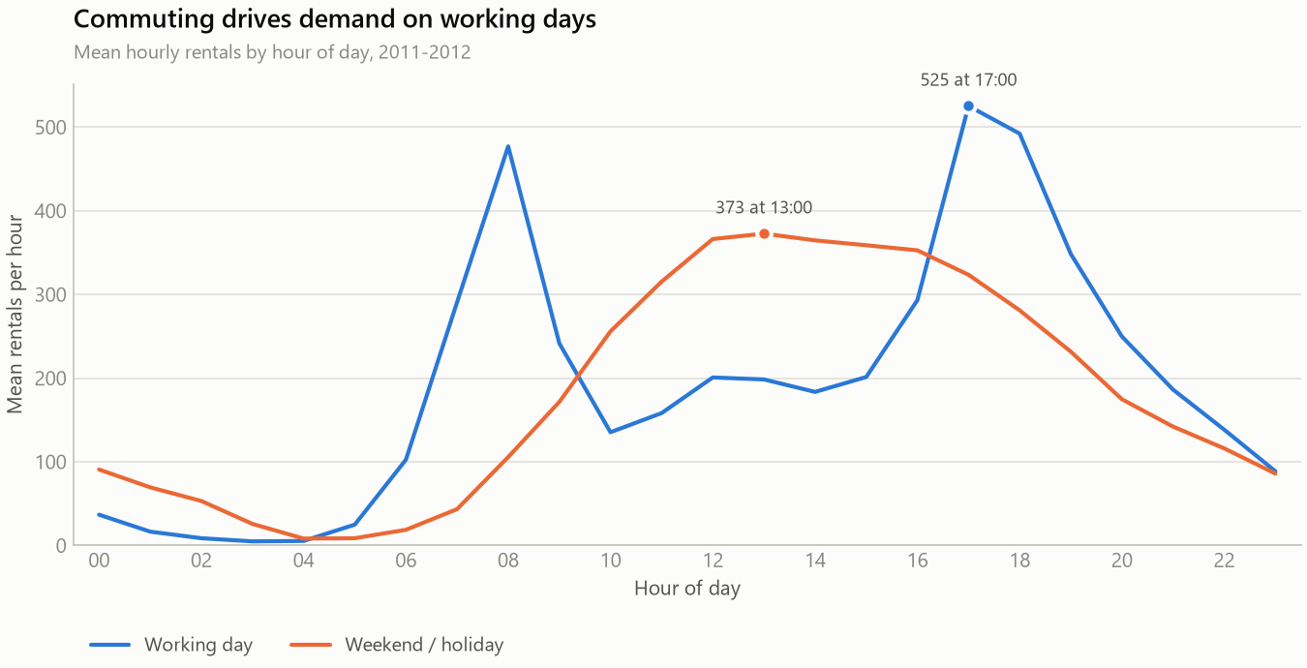
Two different cities share one fleet
Mean rentals by hour of day, split by day type
Takeaway Working days peak at 17:00 with 525 rentals an hour; the weekend curve peaks at 13:00 with 373 and has no commuter spike at all. Averaging the two destroys both patterns.
Notes:
The single most important chart in the deck. Two completely different demand shapes: commuter twin peaks versus a weekend midday hump.

Slide 7
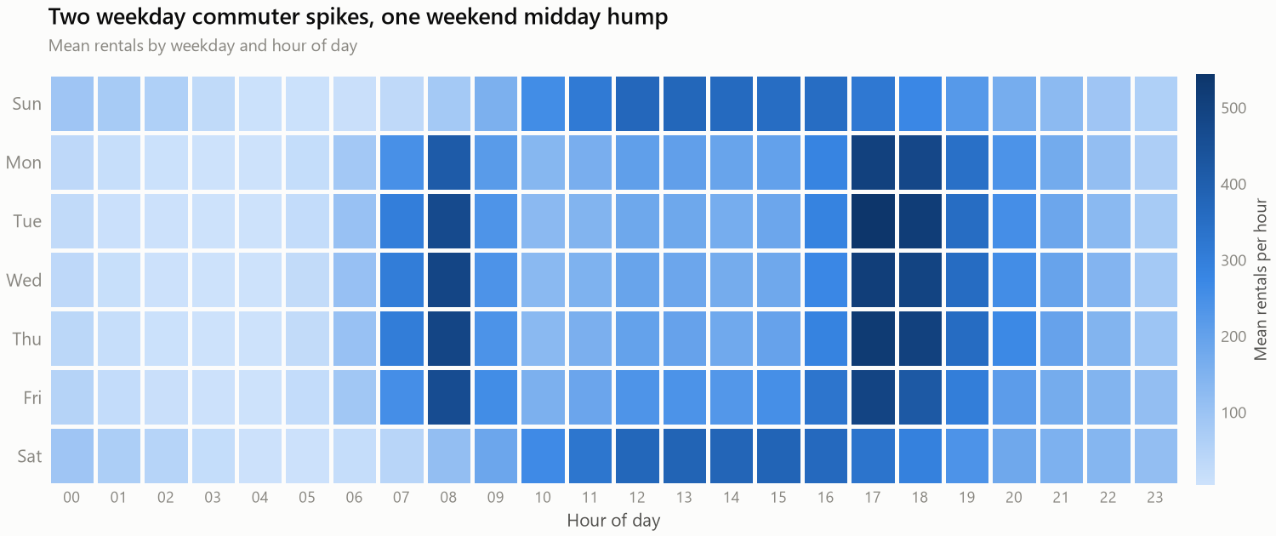
The commuter band is visible by eye
Mean rentals by weekday and hour of day
Takeaway Monday to Friday show two dark vertical bands at the commute; Saturday and Sunday replace them with one broad midday block.
Notes:
A sequential single-hue ramp: darker means busier. No rainbow scales - they invent category boundaries that are not in the data.

Slide 8
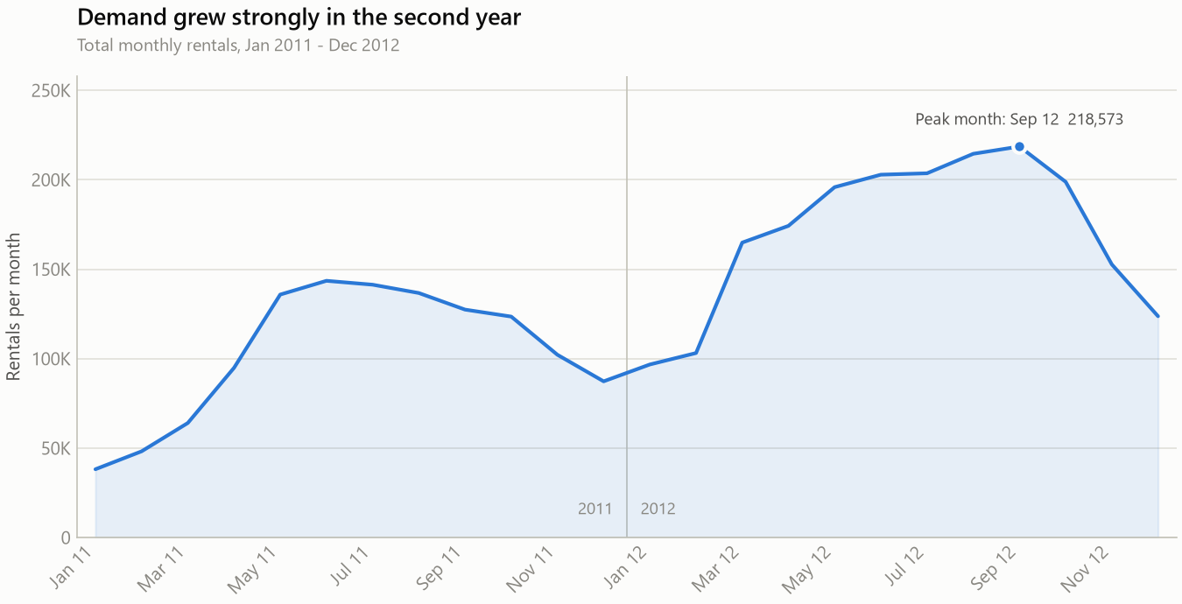
Demand nearly doubled in year two
Total monthly rentals, Jan 2011 to Dec 2012
Takeaway Rentals grew 64.9% year on year while keeping the same seasonal shape — a repeating annual pattern on top of a steady trend, which is what makes the series learnable.
Notes:
The repeating shape matters for modelling: the model can separate the seasonal cycle from the growth trend because it sees the cycle twice.

Slide 9
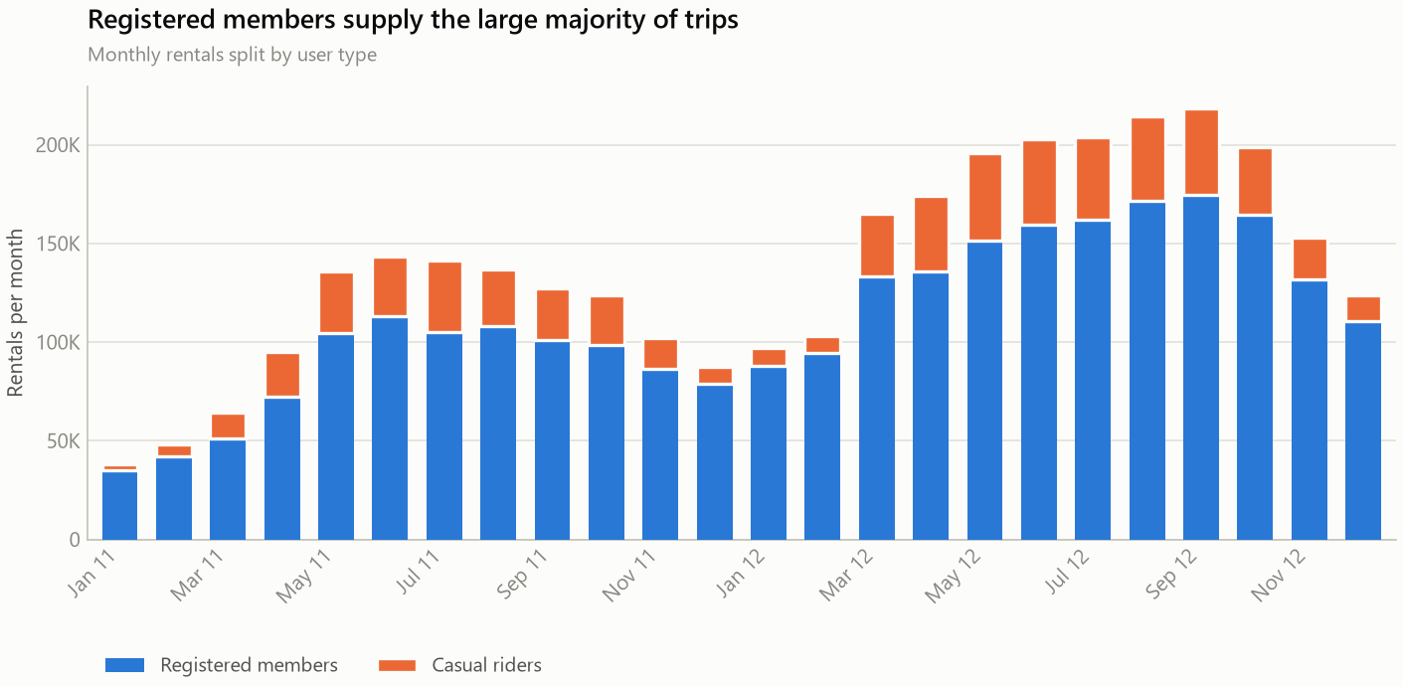
Members carry the service; weekends belong to visitors
Monthly rentals split by user type
Takeaway Registered members are 81.2% of all trips. Casual riders are 31.7% of weekend trips but only 13.2% on working days — commuting and leisure are two products.
Notes:
This is the commercial slide: the conversion opportunity is at weekends.

Slide 10
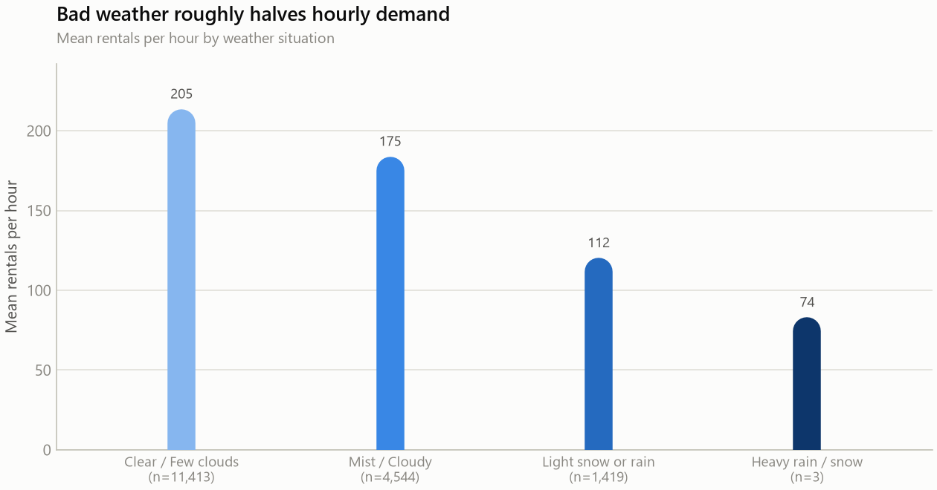
Bad weather halves demand, but not its shape
Mean rentals per hour by weather situation
Takeaway Heavy rain or snow cuts hourly demand 63.7% against clear conditions — but that final bar rests on only 3 hours in two years, so it is a direction, not a dependable effect size.
Notes:
Always show the sample counts when categories are this unbalanced. Three observations cannot support a precise estimate.

Slide 11
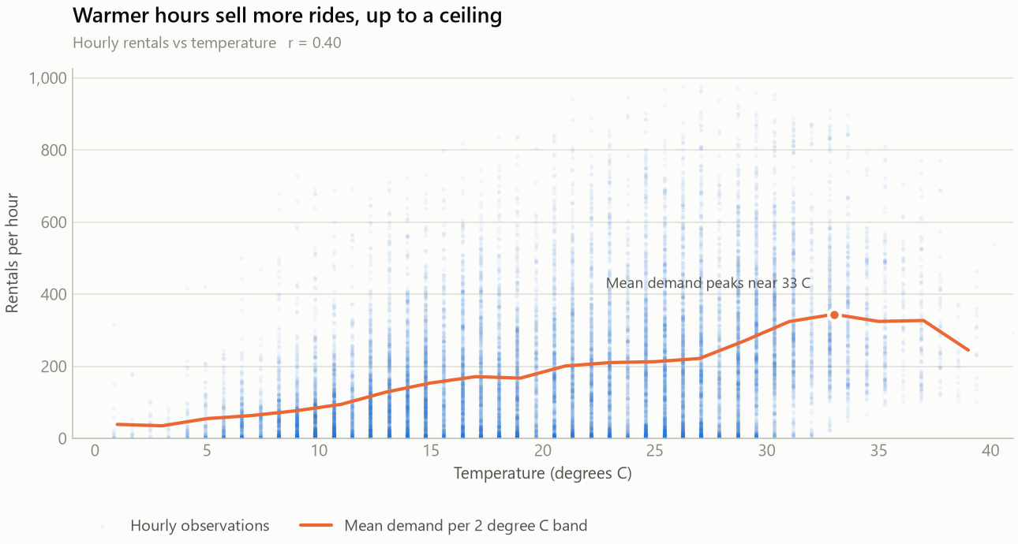
Warmer sells more rides — up to a ceiling
Hourly rentals against temperature · r = 0.405
Takeaway Demand climbs with temperature to roughly 33 °C and then falls away. The relationship is non-linear, which is the first concrete reason to expect tree models to beat linear regression.
Notes:
This slide sets up Part Two: a straight line cannot bend at 33 degrees.

Slide 12
Predictive analysis
PART TWO
Given tomorrow's calendar and forecast, how many bikes will be rented this hour?

Slide 13
How the model was built and tested
Regression on hourly rental counts
1
Features
2
Split
3
Models
18 calendar and weather variables. Hour, month and weekday are also encoded as sine/cosine pairs, so the model treats the clock as the circle it is — hour 23 sits next to hour 00.
Chronological: train on the first 13,903 hours (to 2012-08-07), test on the 3,476 most recent hours it has never seen. A random split is run alongside for contrast.
Linear Regression, Decision Tree, Random Forest and Gradient Boosting, each measured against a naive baseline that always predicts the training mean.
Why the split choice matters
A random split lets a model train on hours that sit between the hours it is tested on — it interpolates inside a series it has already seen instead of forecasting beyond it. For a forecasting question that is the wrong test, and it flatters every model.
Notes:
If asked why not cross-validation: TimeSeriesSplit with 5 expanding folds was also run, mean RMSE 72.6 plus or minus 22.

Slide 14
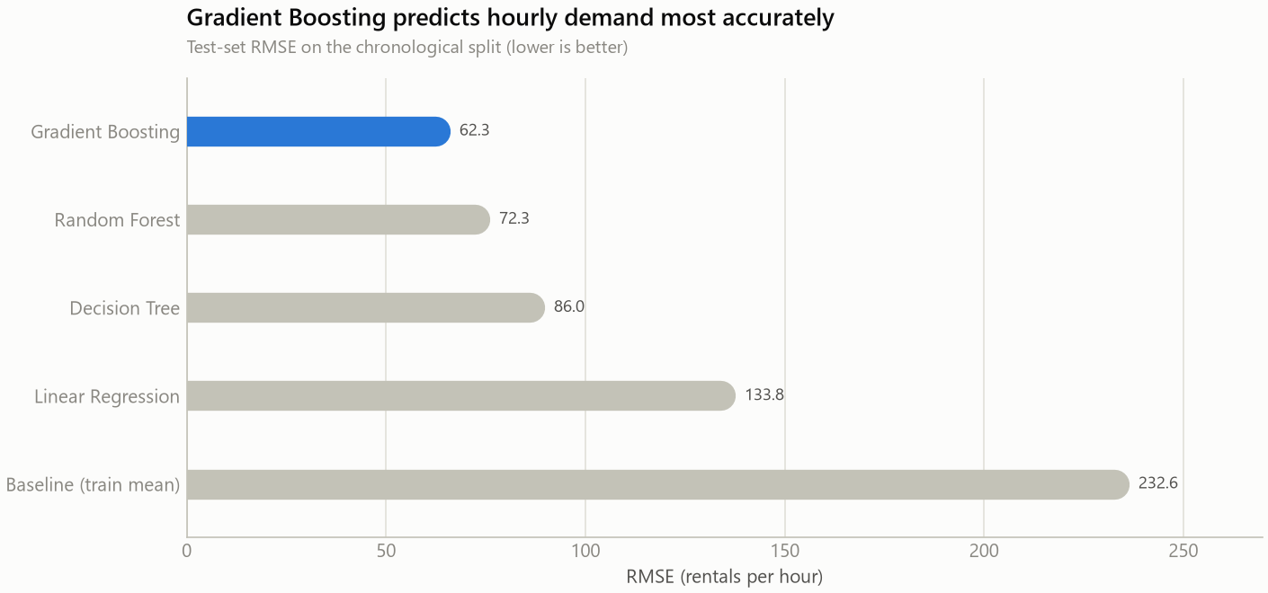
Gradient Boosting forecasts demand best
Test-set RMSE on the chronological split — lower is better
Takeaway Gradient Boosting: RMSE 62.3 rentals an hour, R² 0.92 on unseen future hours — a 73.2% error reduction against the naive baseline.
Notes:
Linear regression trails badly because it cannot bend at 33 degrees and cannot represent the hour-by-day-type interaction.

Slide 15
The same model, two very different scores
Test-set RMSE under each validation scheme
Model | Chronological | Random | Optimism gap
Gradient Boosting | 62.3 | 38.0 | +24.2
Random Forest | 72.3 | 41.3 | +30.9
Decision Tree | 86.0 | 54.4 | +31.6
Linear Regression | 133.8 | 97.8 | +36.1
Every model looks better under a random split. For the winning model the gap is about 24 RMSE: reporting the random-split figure as forecasting accuracy would overstate real performance by roughly a third.
Notes:
This is the methodological point of the whole project: the evaluation design changes the answer more than the model choice does.

Slide 16
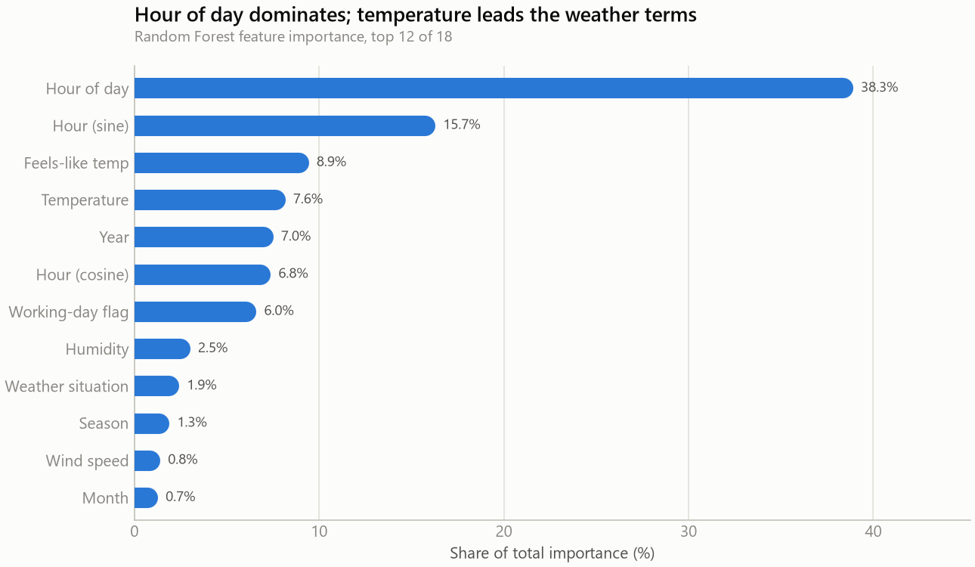
The clock matters more than the weather
Random Forest feature importance, top 12 of 18
Takeaway Hour of day alone carries 38.3% of importance; with its cyclical encodings, time of day accounts for about 61%. Every weather variable together carries roughly 20%.
Notes:
Temperature and feels-like temperature correlate at 0.99, so their importance splits between two near-duplicate columns.

Slide 17
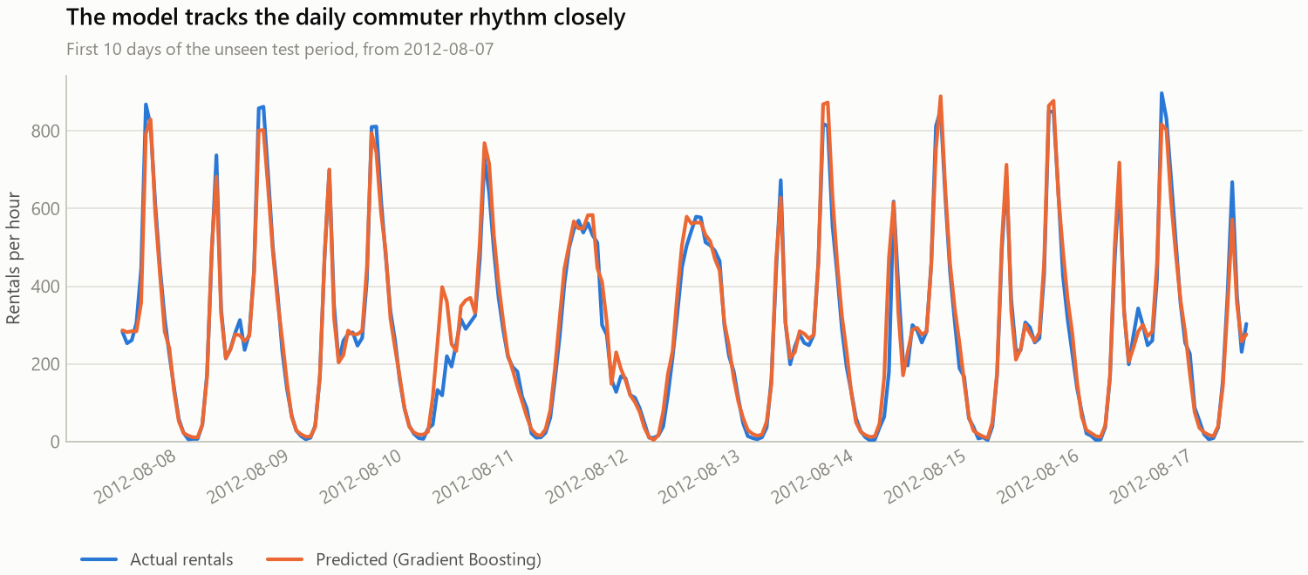
Forecasts track the real commuter rhythm
First 10 days of the unseen test period, from 2012-08-07
Takeaway The model reproduces both commuter peaks and the overnight trough, and follows day-to-day variation rather than repeating an average daily curve. Its weakness is shaving the sharpest peaks.
Notes:
Residuals are heteroscedastic — error grows with demand — so peak hours are where the model is least precise in absolute terms.

Slide 18
Six findings
What two years of rental data say
1
Time beats weather
2
Two businesses, one fleet
Time-of-day features carry about 61% of predictive importance; all weather features together carry roughly 20%.
Working days are commuter-shaped (13.2% casual); weekends are leisure-shaped (31.7% casual).
3
Growth of 64.9% year on year
4
Weather modulates, not determines
Driven almost entirely by registered members rather than casual riders.
Heavy rain or snow cuts demand 63.7%, yet the daily shape survives intact.
5
Demand is predictable
6
Evaluation design changes the answer
Gradient Boosting reaches R² 0.92 on unseen future hours, a 73.2% error reduction over the baseline.
A random split flatters every model by 15 to 30 RMSE and is the wrong test for forecasting.
Notes:
If time is short, findings 1, 2 and 6 are the ones that matter.

Slide 19
What an operator should do with this
Recommendations, and the limits on them
Recommendations
Limitations
Finish fleet rebalancing before 07:00 and 16:00 on working days; treat weather as a secondary adjustment.
Run separate weekday and weekend operating plans — one averaged schedule fits neither.
Target casual-to-member conversion at weekends, where casual riders are 31.7% of trips.
Deploy the model for hour-ahead staffing, with prediction intervals that widen at peaks.
Re-fit each season: the growth term is fitted on two years and cannot be extrapolated.
Two years, one city — the growth term must not be extrapolated past 2012.
Observed weather, not forecast weather: live accuracy would be lower.
Only 3 hours of heavy rain or snow exist in the whole dataset.
Events are unmodelled — Hurricane Sandy produces the largest residual of all.
No spatial dimension, so it cannot drive station-level rebalancing.
Notes:
Lead with the limitations if the audience is technical — they are the first thing a reviewer will ask about.

Slide 20
Demand runs on the clock
17,379 hours of data · 12 figures · 4 models · R² 0.92 on hours the model had never seen
Code, notebook, report and data: see the project repository.
Notes:
Close on the single sentence: demand is governed by the clock, weather only modulates it.

