Slide 1
Utviklerkurs for nybegynnere
Attila Bulenda

Slide 2
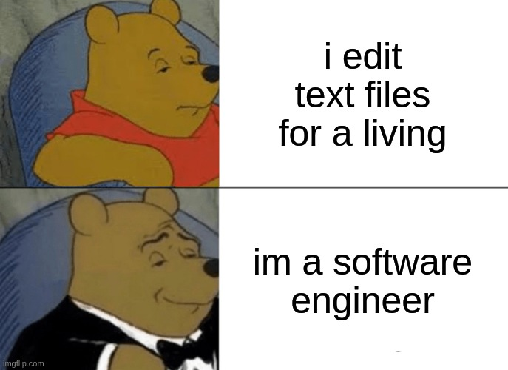
What is programming?
“Computer programming is the process of performing a particular computation (or more generally, accomplishing a specific computing result), usually by designing and building an executable computer program.” – Wikipedia
“In mathematics and computer science, an algorithm is a finite sequence of rigorous instructions, typically used to solve a class of specific problems or to perform a computation.” – Wikipedia
“A programming language is a computer language that is used by programmers (developers) to communicate with computers. It is a set of instructions written in any specific language to perform a specific task.” - https://www.javatpoint.com/programming-language
Different languages are used for different purposes: HTML, CSS, JavaScript, Java, C#, C, Python, SQL, etc.

Slide 3

What is JavaScript?
“It has absolutely nothing to do with Java. It’s like car and carpet.” – Attila
“JavaScript is the Programming Language for the Web. It can update and change both HTML and CSS. It can also calculate, manipulate and validate data.” - https://www.w3schools.com/whatis/whatis_js.asp
We use different JS libraries for different purposes.
Some of the most popular JS libraries for building front-end applications include React, Angular, and Vue.
A popular back-end library for JS applications is NodeJS.
Many more opportunities, e.g.: OpenLayers, Axios, etc.
For testing purposes, we can use Jest, React Testing Library, Cypress, or Playwright.

Slide 4
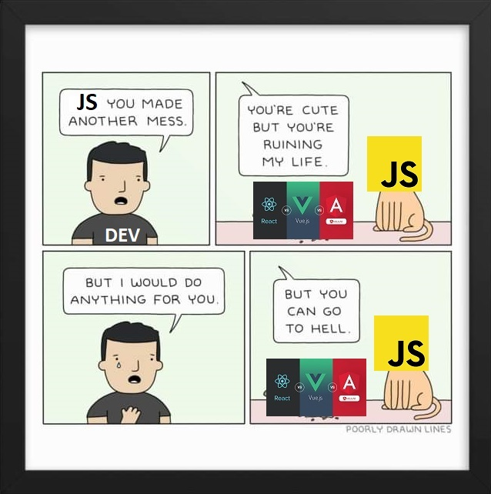
What? Where? When?
https://eloquentjavascript.net/
https://www.w3schools.com/js/default.asp
https://www.freecodecamp.org/learn/javascript-algorithms-and-data-structures/
https://practice.geeksforgeeks.org/explore?page=1&curated[]=8&sortBy=submissions&curated_names[]=Beginner%27s%20DSA%20Sheet
https://www.codecademy.com/learn/introduction-to-javascript
https://www.udemy.com/course/javascript-the-complete-guide-2020-beginner-advanced/
https://www.udemy.com/courses/search/?instructional_level=beginner&lang=en&q=cypress&sort=relevance&src=ukw
https://www.udemy.com/courses/search/?instructional_level=beginner&lang=en&q=playwright&sort=relevance&src=ukw
https://www.udemy.com/course/react-testing-library/
https://www.youtube.com/watch?v=ajiAl5UNzBU&ab_channel=LaithAcademy (Jest)

Slide 5
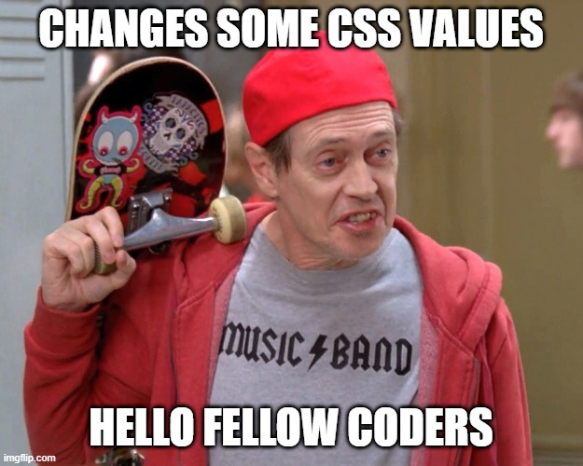
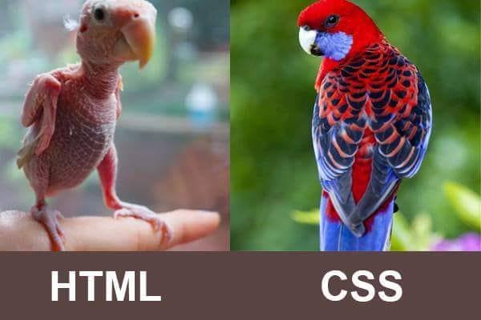
What is HTML and CSS?
HTML:
HTML is the standard markup language for creating Web pages.
HTML stands for Hyper Text Markup Language
HTML is the standard markup language for creating Web pages
HTML describes the structure of a Web page
HTML consists of a series of elements
HTML elements tell the browser how to display the content
HTML elements label pieces of content such as "this is a heading", "this is a paragraph", "this is a link", etc.
https://www.w3schools.com/html/html_intro.asp
CSS:
CSS is the language we use to style a Web page.
CSS stands for Cascading Style Sheets
CSS describes how HTML elements are to be displayed on screen, paper, or in other media
CSS saves a lot of work. It can control the layout of multiple web pages all at once
External stylesheets are stored in CSS files
https://www.w3schools.com/css/css_intro.asp

Slide 6
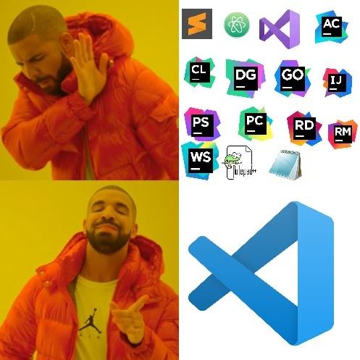
What is a text editor?
“A text editor refers to any form of computer program that enables users to create, change, edit, open and view plain text files. They come already installed on most operating systems, but their dominant application has evolved from notetaking and creating documents to crafting complex code.” - https://online.york.ac.uk/tech-basics-an-introduction-to-text-editors/
Different text editors for different purposes
Some has simpler functionality (Notepad++, Atom), some are more complex (VS Code, IntelliJ)

Slide 7
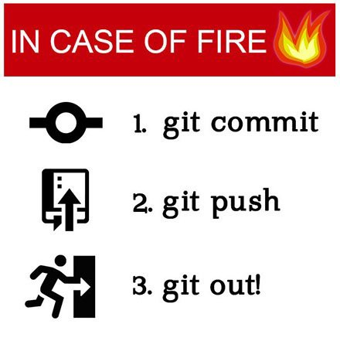
What is version control?
“Version control, also known as source control, is the practice of tracking and managing changes to software code. Version control systems are software tools that help software teams manage changes to source code over time.” - https://www.atlassian.com/git/tutorials/what-is-version-control
Saves time, energy, trouble, conflicts
Connection between your code on your laptop, and the remote repository online: GitHub, Bitbucket, etc.
Different tools to do version control: Git for Windows, GitHub Desktop, VS Code built-in source control

Slide 8
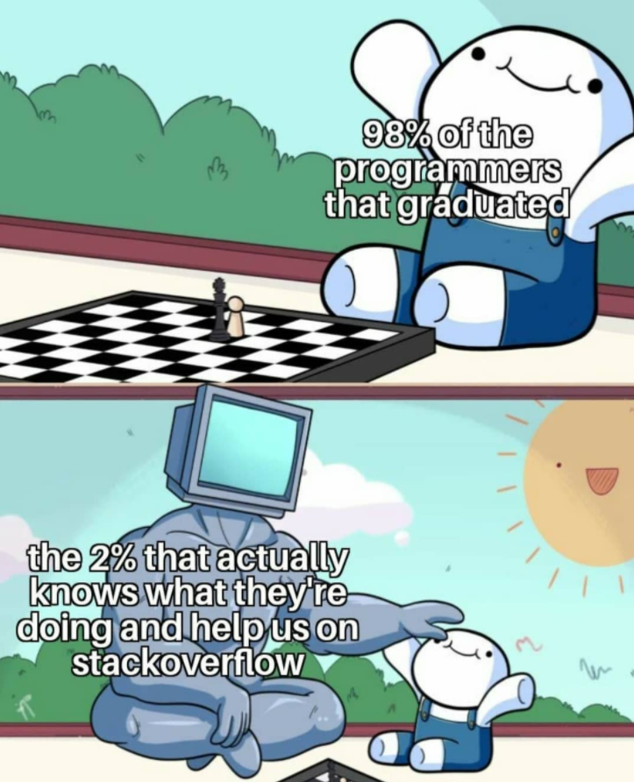
What to do if you are stuck?
In correct order:
Documentation
Google. No, seriously. Learn to use Google.
https://stackoverflow.com/
Ask the other developers

