Slide 1

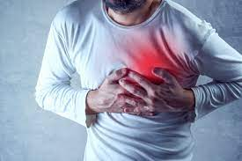
Capstone Project-III
Cardiovascular Risk predication
Team Members
Zunaid
ArunTeja Lonka Upasana Kumari
Sukesh Shetty

Slide 2






Game Plan
Introduction
Exploratory Data Analysis
Feature Processing
ML Model development
Results & Conclusions
Challenges Faced

Slide 3

Introduction
Cardiovascular Heart diseases (CHDs) are the leading cause of death globally.
An estimated 17.9 million people died from CHDs in 2019, representing 32% of all global deaths. Of these deaths, 85% were due to heart attack and stroke.
Most cardiovascular diseases can be prevented by addressing behavioural risk factors such as tobacco use, unhealthy diet and obesity, physical inactivity and harmful use of alcohol.

Slide 4
Problem Statement
The dataset is from an ongoing cardiovascular study on residents of the town of Framingham, Massachusetts. The classification goal is to predict whether the patient has a 10-year risk of future coronary heart disease (CHD). The dataset provides the patients’ information. It includes over 4,000 records and 15 attributes.
Numerical columns: id, age, totChol, sysBP, diaBP, BMI, heartrate, glucose
Categorical columns: education, cigsPerDay, sex, is smoking, BPMed, prevalent Stroke, prevalentHyp, diabetes, TenYearCHD.
Dataset shape: 3390 Rows and,17 Columns/Features

Slide 5
Flow of the Project
Training
Model Development
Load the Data
Data Wrangling
EDA
Feature Engineering
Results
Testing
Model Evaluation

Slide 6
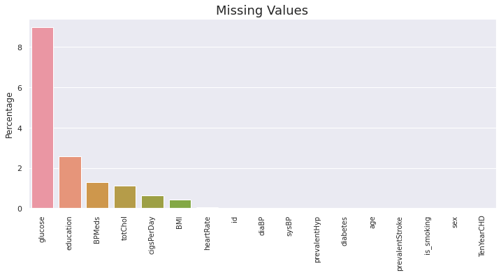
Missing values
Column Total Percentage
glucose 304 8.97
education 87 2.57
BPMeds 44 1.30
totChol 38 1.12
cigsPerDay 22 0.65
BMI 14 0.41
heartrate 1 0.03

Slide 7
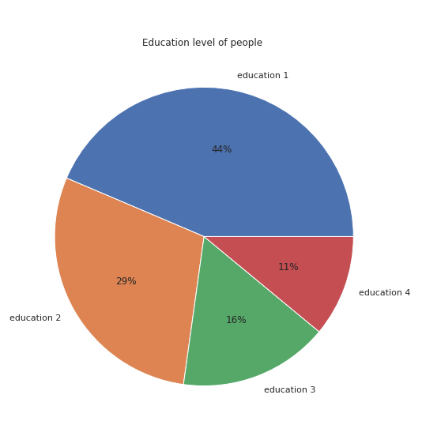
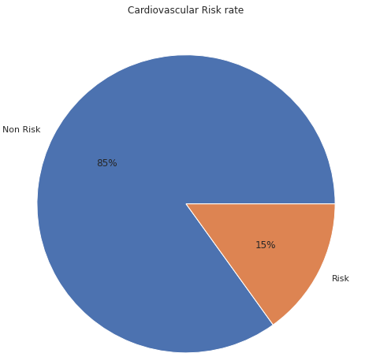
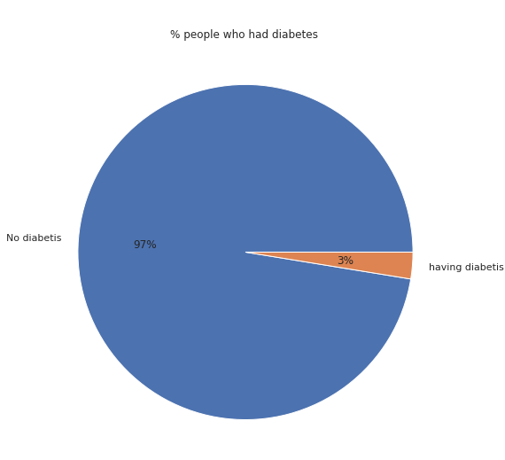
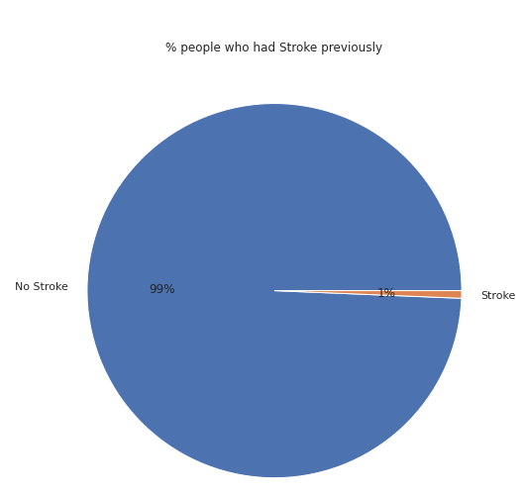
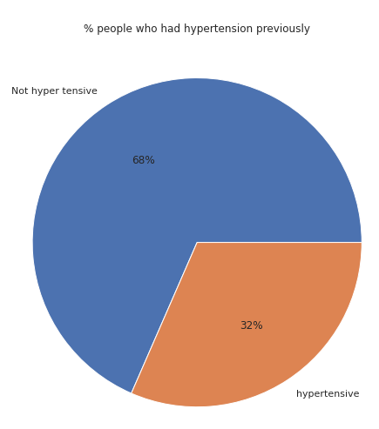
Univariant Analysis

Slide 8
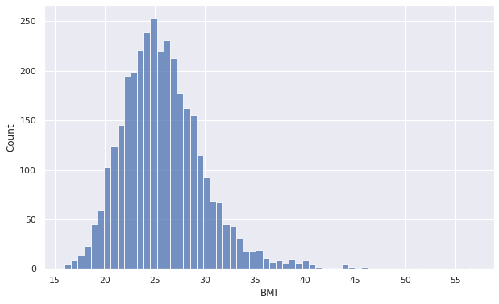
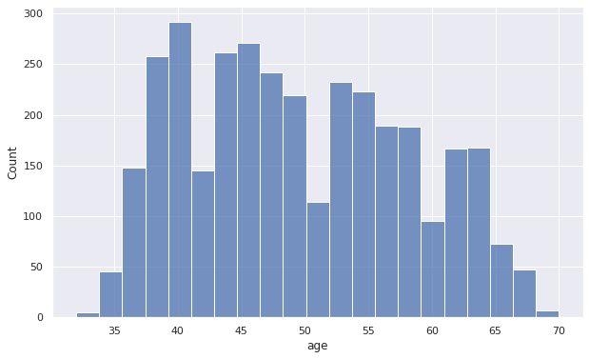
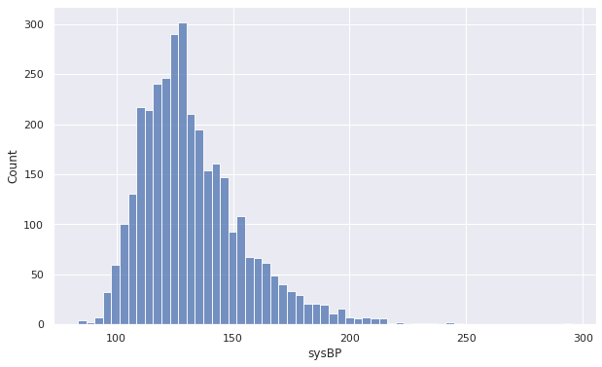
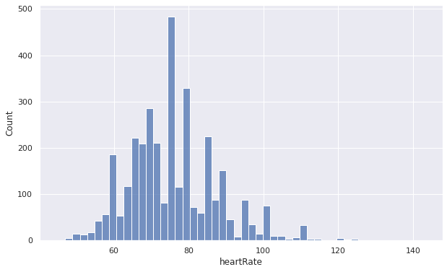
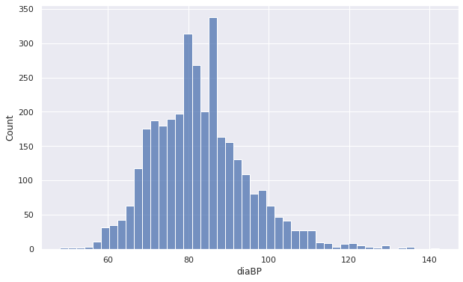
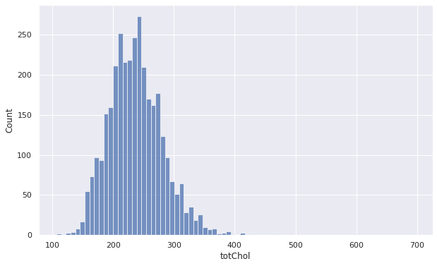
Univariant Analysis

Slide 9
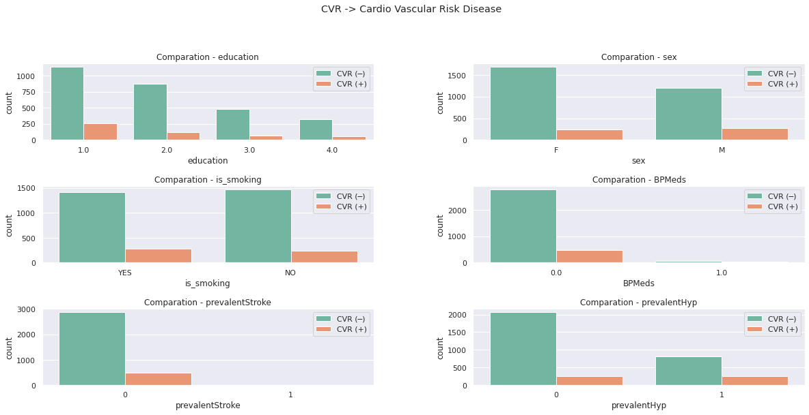
Bi-variant analysis

Slide 10
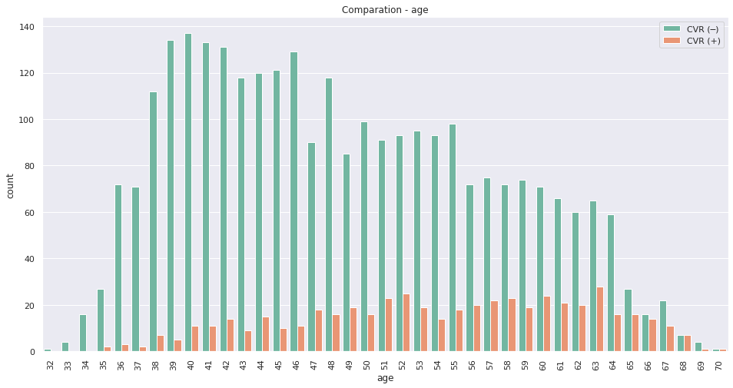
Bi-variant analysis

Slide 11
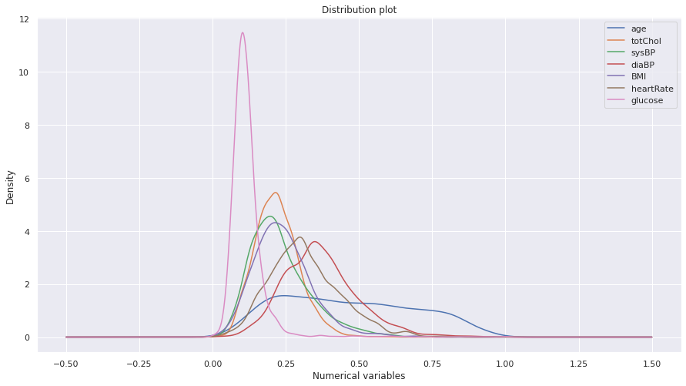
Conclusions of EDA
• Slightly more males are suffering from CHD than females .
• The people who has high BMI are at risk of CHD .
• The people with hypertension are at high risk of CHD
• The percentage of people who have CHD is almost equal between smokers and non-smokers .
• The uneducated people or the people with basic education are at high risk of CHD compared with well educated .

Slide 12
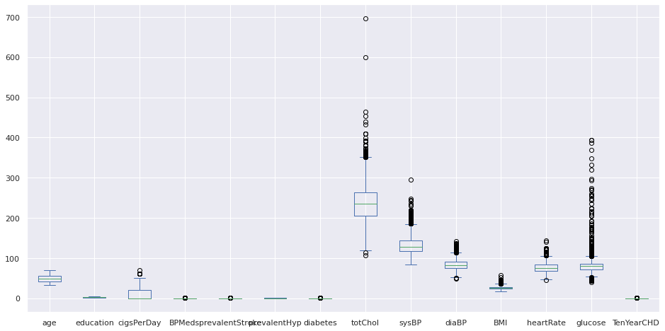
Treatment of Missing Values and Outliers
By the above boxplot we will which features having outliers. cigsPerDay,totChol,sysBP,diaBP,BMI,heartRate,glucose. these features having outliers..

Slide 13
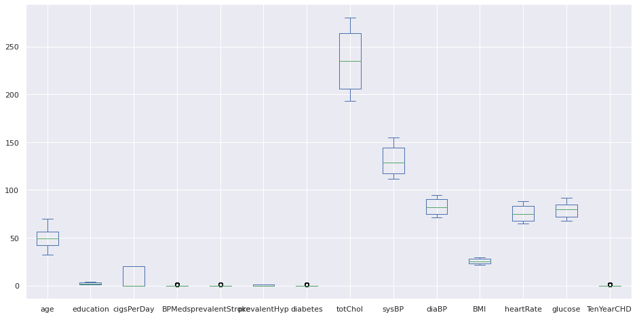
After Outlier Treatment

Slide 14
Feature Engineering
● Feature engineering is the process of selecting, manipulating, and transforming raw data into features that can be used in supervised learning.
● Feature Engineering consists of various process :
1. Feature Creation: Creating features involves creating new variables which will be most helpful for our model.
2. Transformations: Feature transformation is simply a function that transforms features from one representation to another(Normal distribution). We have used Box-cox and log transformation to convert columns to Normal distribution.
3. Feature Selection: Feature extraction is the process of extracting features from a data set to identify useful information. We have used f-regression to do the feature selection

Slide 15
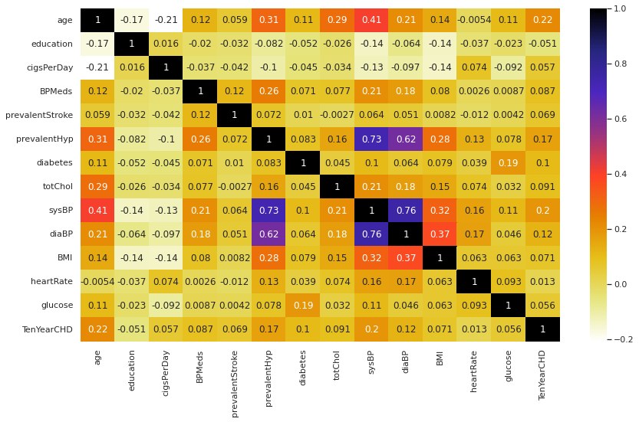
Multicollinearity
.

Slide 16
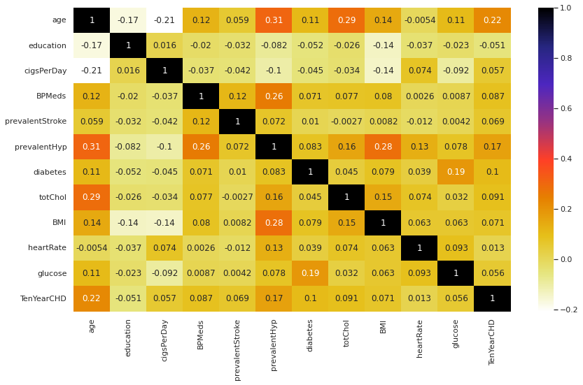
Multicollinearity
As we see in heatmap sysBp and diaBp is highly correlated up to 76 percentage so we have removed that column.

Slide 17
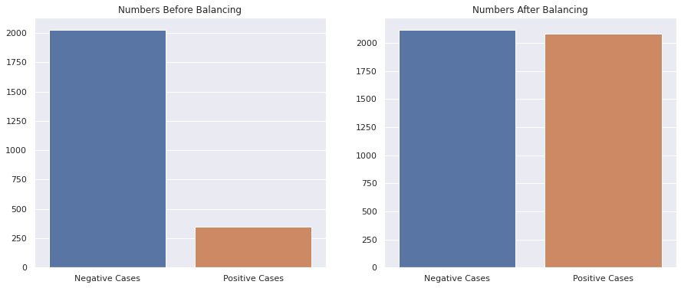
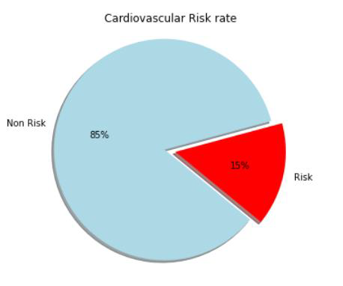
Data Balancing
We using smote technique for over sampling we have train set of size 3960 with 3960 samples of each of the class. Our dataset is now ready for training.

Slide 18

Model development
Now we start building models for our classification problem. We have used following ML Algorithms:
(1)Logistic regression
(2)Support Vector Machine (SVM)
(3)K nearest neighbour (KNN)
(4)Naive Bayes
(5)Decision Tree
(6)Adaboost
(7)Random Forest

Slide 19
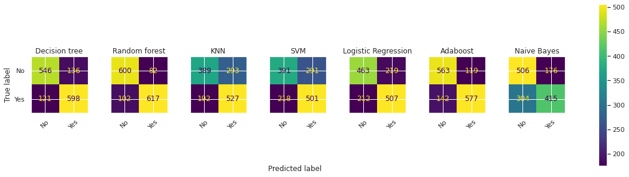
Confusion Matrix

Slide 20

Results & Model Performance

Slide 21
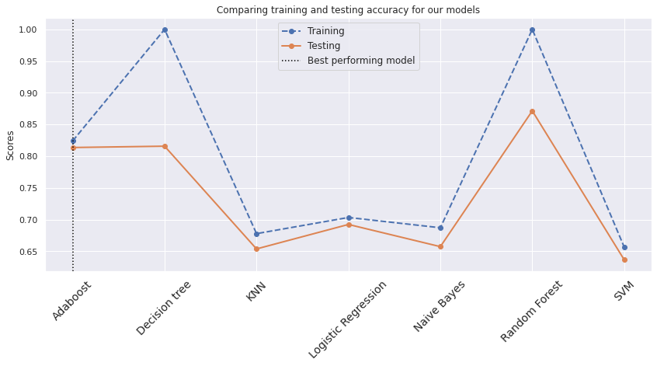
Conclusions:
We already had concluded that ada boost, Logistic Regression are performing well.
Let's just try all other models with hyperparameter tuning and we will try to observe the performance of these models.

Slide 22
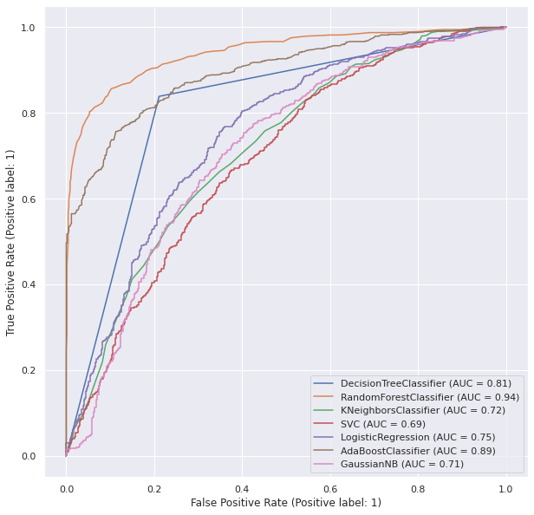
ROC Curves

Slide 23
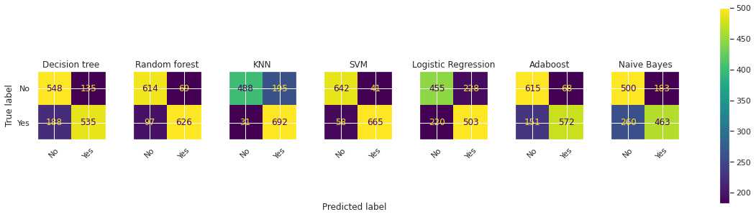
Confusion Metric after Hyperparameter Tuning for all models

Slide 24
Results & Model Performance after Hyperparameter Tuning

Slide 25
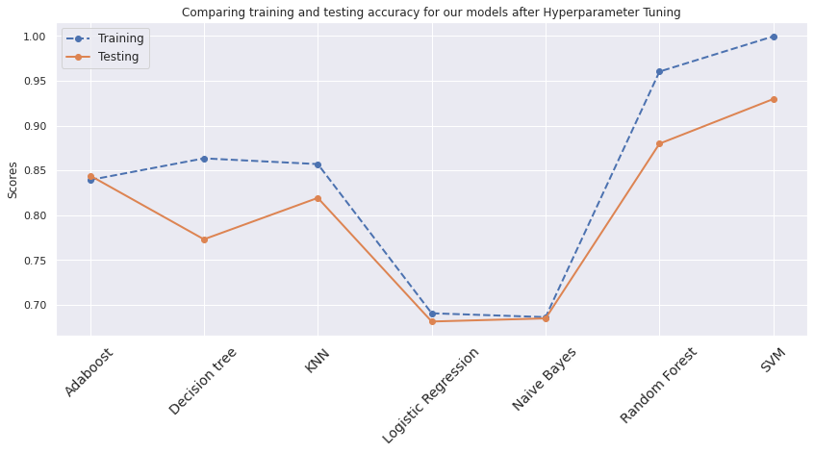
Conclusions:

Slide 26
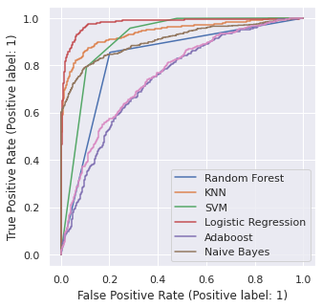
ROC Curves after Hyperparameter Tuning for all models

Slide 27
Results & Conclusions:
Even though the accuracy of some models were increased after hyper parameter tuning, adaboost, svm and Random forest are the best performing models.
Between those if we compare tuned svm,Random forest and Adaboost with the accuracy and recall, tuned SVM, Adaboost are the best performance model for training data as well as test data.
After Hyperparameter tuning also, we saw some models are facing overfitting (i.e., Random Forest and Decision Tree)

Slide 28
Challenges faced
The dependent variable has very few data labelled as ‘1’. So we can observe in all models that precision is more. As the models did not had much of two classes ‘0’ and ‘1’ to learn from the data, the models are failing to predict the data as ‘1’.
Due to this class imbalance, several models are overfitting. Even though we have treated the class imbalance, we could not come over it. We were only able to reduce it
Machine learning models usually required high computation power
We are doing hyper parameter tuning for all models so, it takes lot of time to run the Code.

Slide 29

Refences and links
References:
Alma better
Analytics Vidhya
Kaggle
Quora
Stack over flow

