Slide 1
A CONVERSATION ABOUT THE CHILDREN IN YOUR CLASSROOMS
Every child in your school
can learn to think.
How your teachers, your children and their families can make every hour of learning count.
[SCHOOL NAME] · [DATE]
Notes:
Greet the principal and thank them for their time. Do not mention the product yet. Say: “We would like to talk about the children in your classrooms, and about your teachers — and listen to how you see things.”

Slide 2
YOUR SCHOOL TODAY
Your teachers give everything
inside the classroom.
But learning often stops at the school gate.
Between the last bell and the next morning, what happens to what the children learned today?
Class 3–5 learning · 2
Notes:
Begin by honouring the teachers — they work hard. Then name the problem gently: the classroom does its job, but once children go home the learning rarely continues. Ask: “What do you see happening between the last bell and the next morning?” Then listen.

Slide 3
THE PROBLEM, FROM THREE SIDES
Children, teachers and families all feel it
i.
ii.
iii.
For children
For teachers
At home
Attention drops quickly. Many are afraid of giving the wrong answer, so they stay quiet.
Forty children, one syllabus, limited periods — little time to make every concept feel real.
Evenings fill with screens. Parents want to help, but are unsure how, or short of time.
Class 3–5 learning · 3
Notes:
Walk the three columns. Pause after each and ask: “Does this match your school?” Note their exact words — they become the goals of the pilot.

Slide 4
WE WOULD LIKE TO HEAR FROM YOU
Where do your Class 3–5 children struggle most?
“
Your answers shape everything we propose today.
01 Which subjects or topics do children find hardest?
02 When in a lesson do you see attention drop?
03 Do children use what they learn outside the book?
04 How involved are parents in learning at home?
Class 3–5 learning · 4
Notes:
This is the most important slide: ask, then stay silent and listen. Take notes on maths topics, science topics, attention, confidence, parental involvement. Later in the meeting, refer back to their answers by name.

Slide 5
WHY IT HAPPENS
Four causes teachers tell us about
01
Screens are passive
02
Learning stays in the book
Children watch for hours, but nothing asks them to think.
Concepts rarely meet the child’s own world — money, shops, home.
03
Practice feels like a chore
04
Home is cut off from school
Repetition without a story loses a young child quickly.
Parents are willing, but have no simple way to join in.
Class 3–5 learning · 5
Notes:
Present these as what teachers and parents commonly share — not as statistics. Invite the principal to add their own causes. Do not quote numbers we do not have.

Slide 6
THE QUESTION
How would your school solve this?
01
Less screen time?
Hard to enforce at home.
02
More homework?
More pressure, not more interest.
03
More drills in class?
Periods are already full.
04
Or make screen time make children think?
Turn the screen into a reason to learn.
Class 3–5 learning · 6
Notes:
Ask first: “If you could change one thing, how would you solve it?” Listen. Then go through the usual answers — each has a cost for teachers or families. End on the fourth card: what if the screen itself made children think?

Slide 7
Children don’t lack curiosity.
They lack a reason to lean in.
Give a child a character who needs their help — and the child starts to think.
Notes:
Say this slowly. It is the heart of the meeting. Let it sit for a moment before moving on.

Slide 8
A DIFFERENT KIND OF SCREEN TIME
Watch. Think. Do. Unlock.
01
02
03
04
Watch
Think
Do
Unlock
A short cartoon story where a character faces a real problem.
The story pauses. The child looks, chooses or counts — out loud.
A real-world mission at home: move, help the family, or create.
A grown-up confirms with a PIN, and the next story opens.
The screen becomes the start of learning — not the end of it.
Class 3–5 learning · 8
Notes:
Present the approach before the brand: watch, think, do, unlock. Stress that the child must answer during the pause, and that a parent confirms the real-world activity — so screen time becomes active time and home joins school.

Slide 9
THAT IS WHY WE BUILT
Zungga
Short cartoon stories where the child solves the problem — and then does something real.
LEARN · CREATE · GROW
Notes:
THE REVEAL. Only now say the name: “This is Zungga.” One sentence: short cartoon stories, the child solves the problem, then does something real at home.

Slide 10
WHAT IT MEANS FOR YOUR SCHOOL
Built for your children, your teachers and your families
i.
ii.
iii.
Children
Teachers
Families
Speak up without fear — every answer is welcomed. Learn money, maths and science by solving a story.
A ready 5-minute lesson starter. The whole class answers together. No extra preparation.
One small mission each evening. Parents join learning in minutes, and see the progress.
Zungga · School pilot proposal · 10
Notes:
Make it about them. Children gain confidence; teachers get help, not more work; families get a simple way to take part. Ask: “Which of these matters most for your school?”

Slide 11
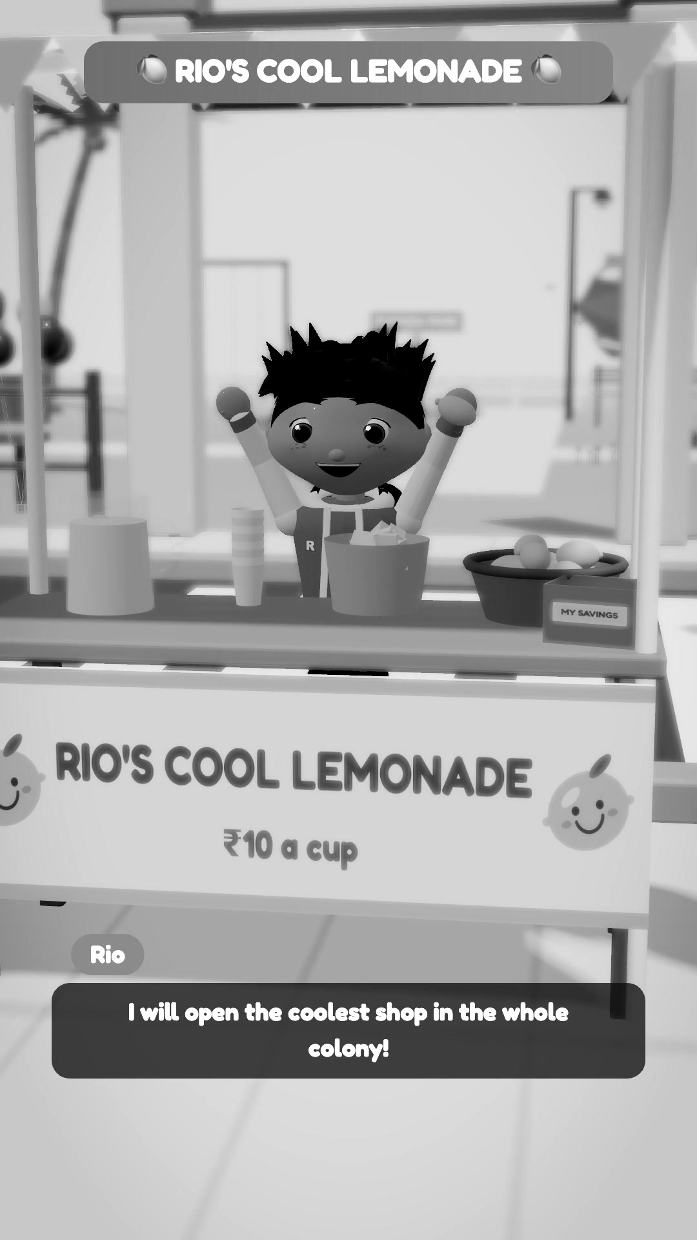
EPISODE 1 · READY TODAY
Rio’s Lemonade Stall
CLASS
3 – 5
SUBJECT
Maths · Money
CONCEPTS
Spent and earned · Profit and loss
LENGTH
3 minutes 18 seconds
BOARDS
Tamil Nadu & Karnataka · English
Zungga · School pilot proposal · 11
Notes:
Introduce the story: on a hot day Rio opens a lemonade stall, spends ₹70 but earns only ₹50 — and turns to the children for help. Characters: Rio, Tara (the careful thinker), Mira (the creative one) and Thatha, the friendly grandfather. Each speaks in their own voice.

Slide 12
Let’s watch
three minutes
Watch for the three pauses
where every child answers.
Notes:
Click the video to play it inside the slide, with sound. Ask the principal to watch for the three pauses. Afterwards: “Would your children answer out loud here?”

Slide 13
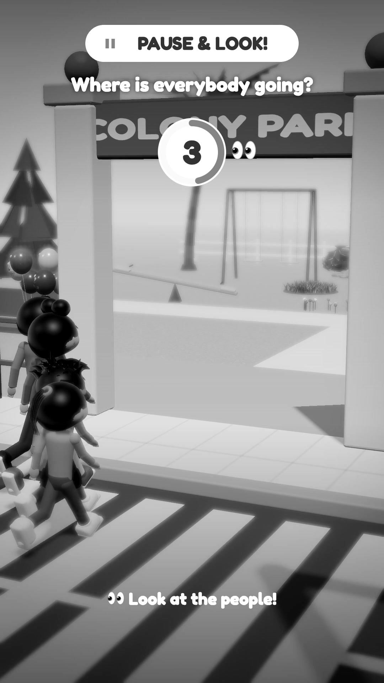
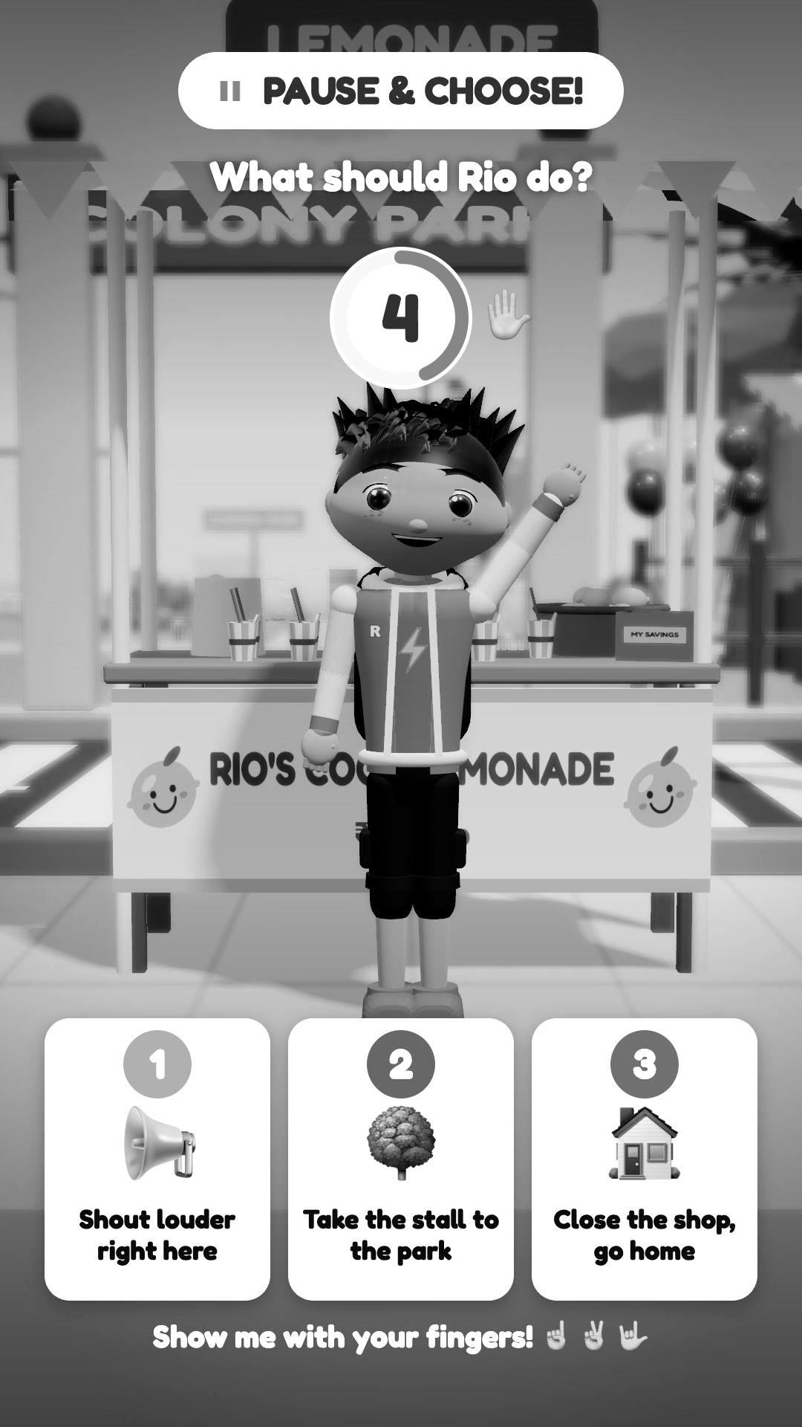
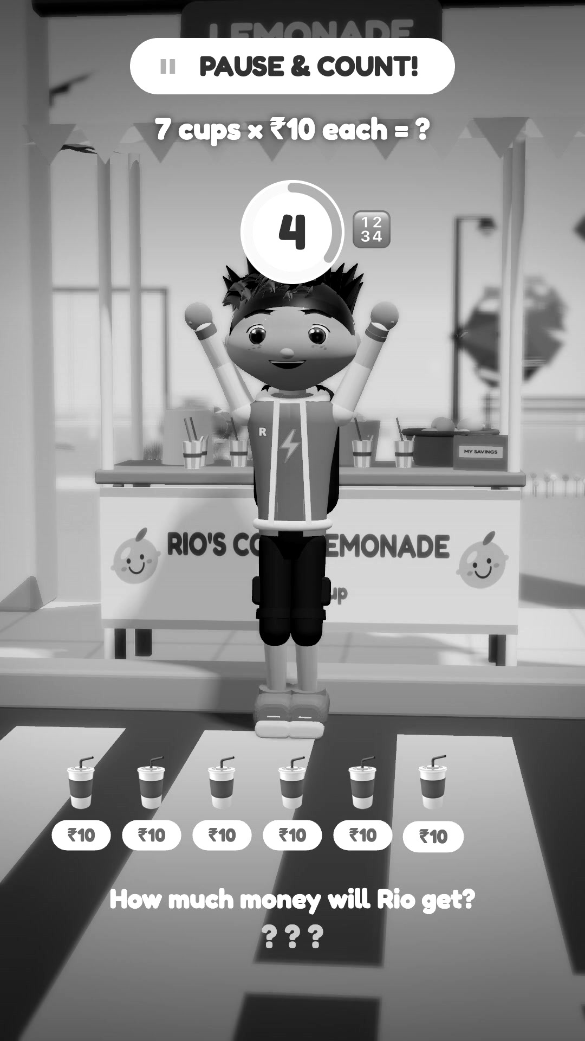
EVERY CHILD CAN ANSWER
Three pauses, three kinds of thinking
01
02
03
Look
Choose
Count
The answer is on screen. Every child gets an easy first success — and confidence.
Three picture cards. Shy children answer with their fingers; the whole class can join.
Syllabus maths, out loud: count in tens, then add.
Zungga · School pilot proposal · 13
Notes:
Why it works for Class 3–5: Look builds confidence, Choose includes shy children and whole classes, Count practises real syllabus maths. After every pause the characters confirm the answer and praise the children.

Slide 14
FOR YOUR TEACHERS
Help for teachers — never extra work
Ready to use
Each episode is a complete 5-minute lesson starter, mapped to a Class 3–5 chapter.
Whole-class mode
The teacher plays it on the classroom screen; the class answers the pauses together.
Fits the syllabus
Tamil Nadu and Karnataka state boards, in English — maths and money first, science next.
Experiential learning
Thinking, problem-solving and doing — as NEP 2020 encourages.
Zungga · School pilot proposal · 14
Notes:
Reassure that Zungga supports teachers and never replaces them. Ask which chapter they would most like to see as an episode — that becomes a pilot episode.

Slide 15
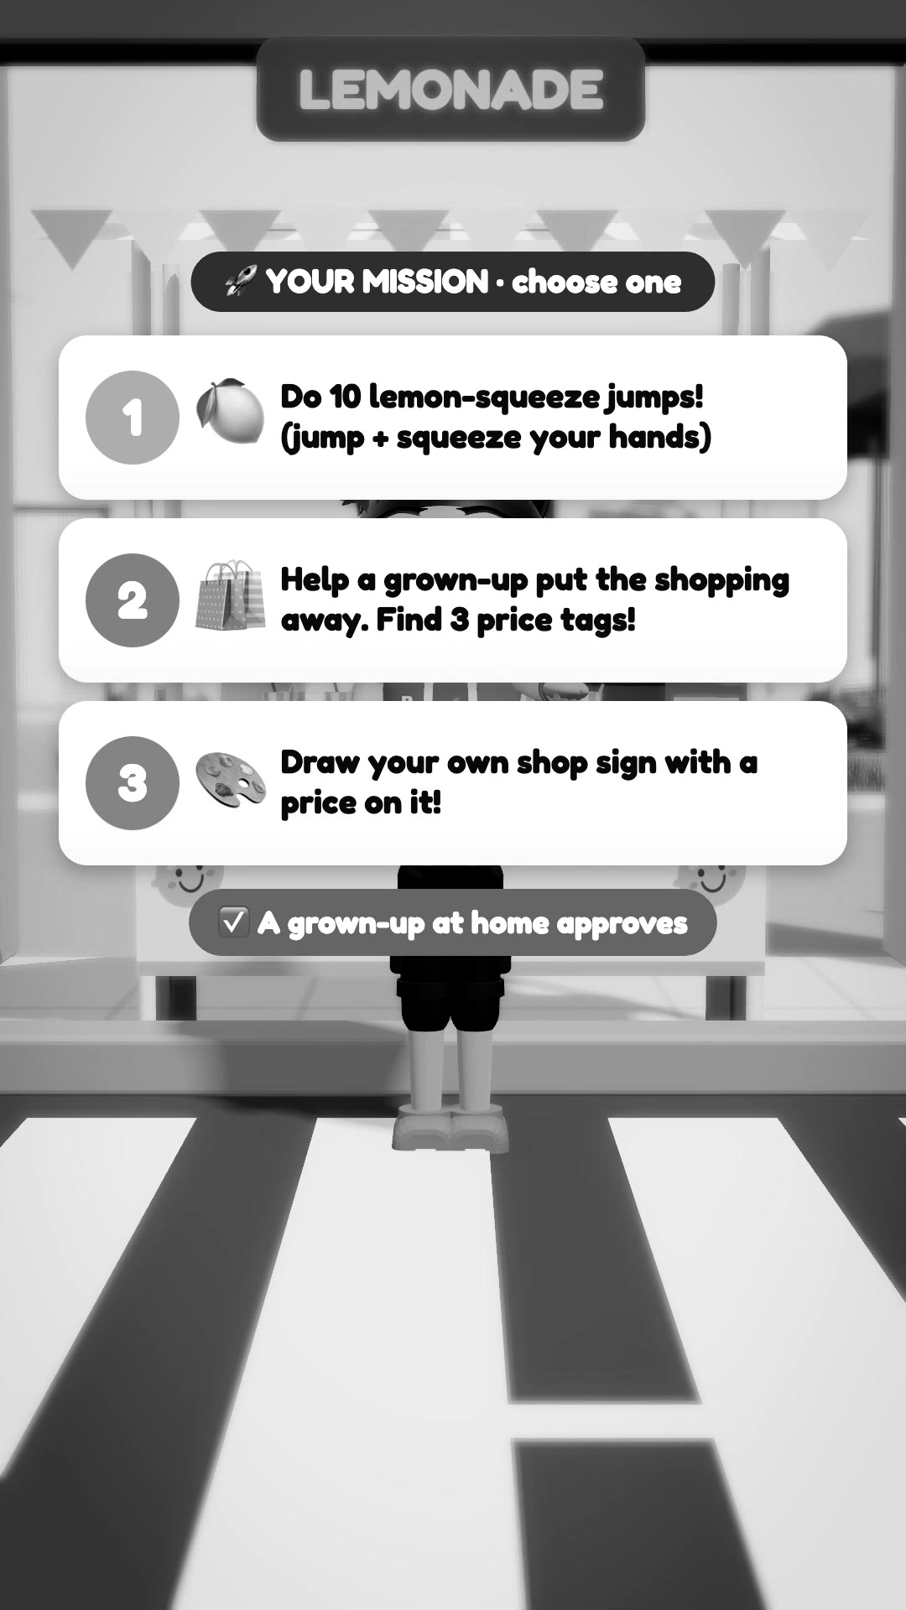
LEARNING THAT REACHES HOME
Every story ends with a mission
01
Move — 10 “lemon-squeeze” jumps
02
Family — Help a grown-up put the shopping away and find three price tags
03
Create — Draw your own shop sign with a price
Always three different choices at the same effort, so no child is left out. A grown-up at home approves with a PIN.
Zungga · School pilot proposal · 15
Notes:
The mission carries school into the home. Three unrelated choices at the same effort — movement, family, creative — so every child, including those who cannot do physical activity, can take part. The parent approves with a PIN and the next story unlocks.

Slide 16
PARENTS STAY IN CONTROL
Safe for children, by design
No tracking
Parent login and PIN
No advertising
No monitoring, location or behaviour profiling of any child.
Every approval needs the parent’s own PIN.
Nothing is ever sold to children.
Minimal data
Kind feedback
Made for India
No child email. Only a name and learning progress.
Every answer is welcomed; praise always comes first.
Designed around India’s child data rules (DPDP Act).
Zungga · School pilot proposal · 16
Notes:
Address screen and data worries directly: the app never tracks children; parents confirm activities themselves with a separate login and PIN; no ads; minimal data with parental consent, following India’s DPDP Act for children.

Slide 17
OUR PROPOSAL
A small, simple four-week pilot
1
4
6–8
[₹__]
CLASS GROUP
WEEKS
STORIES
COST TO SCHOOL
Class 3, 4 or 5 — sections of your choice
Two short sessions a week
Maths and money first, science next
[Free pilot / to be agreed]
Episode 1 is ready today; the remaining stories are in production for the pilot dates.
Zungga · School pilot proposal · 17
Notes:
Keep the ask small and low-risk. Fill in the cost before the meeting. Be honest that Episode 1 is complete and the rest are being produced for the pilot schedule.

Slide 18
MEASURED TOGETHER — WITHOUT TRACKING ANY CHILD
Four weeks, step by step
WEEK 0
WEEKS 1–2
WEEK 3
WEEK 4
Set-up
Stories 1–4
Stories 5–8
Review
Choose sections. Parent consent note. A 20-minute teacher walkthrough.
In class, twice a week. First home missions.
Children lead the answers. More missions.
Teacher feedback, participation, missions approved, children’s own words — shared with you.
Zungga · School pilot proposal · 18
Notes:
Agree a start date. Measurement respects privacy: teacher feedback forms, class participation, a count of approved missions, and children’s own drawings or sentences — reviewed with you in week 4, where we decide the next step together.

Slide 19
TO BEGIN
What we would need from you
01
A class group for the pilot — Class 3, 4 or 5
02
One teacher who will champion it
03
Two 15-minute slots a week
04
Permission to send a parent consent note
Zungga · School pilot proposal · 19
Notes:
Close with a question, not a statement: “Which class would you like to begin with, and could we start on [date]?” Then wait.

Slide 20
Together, let’s help
every child learn to think.
Zungga
Thank you.
[Your name] · [Phone] · [Email]
zungga.com
Notes:
Thank the principal. Offer to send the episode and a one-page pilot summary the same day.

