Slide 1
A CONVERSATION ABOUT CLASS 3–5 LEARNING
More screen time than ever.
Are our children learning more?
[School name] · [Date]
Notes:
Do not introduce the product yet. Open with the problem everyone in the room already feels: children spend more time on screens than ever, yet it rarely turns into learning. Thank the principal for the time, then move straight to the question.

Slide 2
BEFORE WE SHOW ANYTHING
When your Class 3–5 children close the textbook,
what stays with them?
We would love to start by listening — you see these children every day.
Class 3–5 learning · 2
Notes:
Ask this question and then STOP talking. Let the principal answer fully. Write down their exact words — you will use them later in the pilot plan. Follow-up if needed: “Which part of learning do you wish stayed longer — the concept, the interest, or the habit of practice?”

Slide 3
A CONVERSATION
Where do children lose their focus?
🎯
In class
When does attention drop? Which subjects feel hardest?
🏠
At home
What happens after school — practice, or screens?
🌍
In real life
Can they use what they learned outside the book?
🙋
Confidence
Do they speak up, try ideas, and ask questions?
Class 3–5 learning · 3
Notes:
Questions to ask, one card at a time:
• In class: “At what point in a lesson do you see attention drop? Which subjects do children find hardest in Class 3–5?”
• At home: “What do children usually do after school? How much do parents help with practice?”
• Real life: “Can they apply maths or science outside the textbook — for example, with money or measurements?”
• Confidence: “Do children volunteer answers, or wait for the right one?”
Listen more than you speak. Note the subjects and problems they mention.

Slide 4
WHAT TEACHERS AND PARENTS OFTEN TELL US
The gaps usually look like this
📺 Screens are passive
Children watch, but nobody asks them to think.
📚 Learning stays in the book
Concepts rarely meet the child’s real world.
😴 Practice feels like a chore
Repetition without a story loses interest fast.
🤷 Parents want to help
…but are not sure how, or have little time.
Class 3–5 learning · 4
Notes:
Say: “These are things teachers and parents often share with us — does this match what you see here?” Invite them to add or correct. Do not quote numbers we do not have; let the principal’s own experience be the evidence. Connect each point to what they said on the previous slide.

Slide 5
YOUR VIEW
How would you solve this?
⏱️
Less screen time?
Hard to enforce at home
📝
More homework?
More pressure, same interest
🔁
More drills in class?
Class time is already full
💡
Or make screen time make them think?
Turn the screen into a reason to learn
Class 3–5 learning · 5
Notes:
Ask the principal first: “If you could change one thing, how would you solve this?” Listen. Then walk the common answers left to right — each has a cost. Land on the last card: what if the screen itself made children think? That is the bridge to the next slide.

Slide 6
Children don’t lack curiosity.
They lack a reason to lean in.
Give them a character who needs their help — and they think.
Notes:
Pause on this slide. This is the heart of the pitch. Say it slowly. Then: “That is what we built Zungga for.”

Slide 7
A DIFFERENT KIND OF SCREEN TIME
Watch → think → do → unlock
▶️
✋
🏃
✅
Watch
Pause & answer
Real-world mission
Grown-up approves
A short story with a real problem
The child looks, chooses or counts
Choose 1 of 3 activities at home
With a PIN — then the next episode unlocks
Screen time becomes the start of learning — not the end of it.
Class 3–5 learning · 7
Notes:
Walk the loop left to right. Stress two things: (1) the child must THINK during the pause — it is not passive; (2) the episode only unlocks after a real activity at home, approved by a parent. This is how screen time turns into active time.

Slide 8


THAT IS WHY WE BUILT
Learning through cartoon stories where the child solves the problem
📖 Short animated episodes with lovable characters
💡 The story pauses — the child gives the idea
🧪 Science, maths, money, business and life skills
🏃 Every episode ends with a real-world mission
Zungga · School pilot proposal · 8
Notes:
THE REVEAL. Only now say the name: “This is Zungga.” Introduce it in one breath: short cartoon episodes; the story stops and asks the child; then a real-world mission. Mention it covers maths and money today, science next, and life skills.

Slide 9
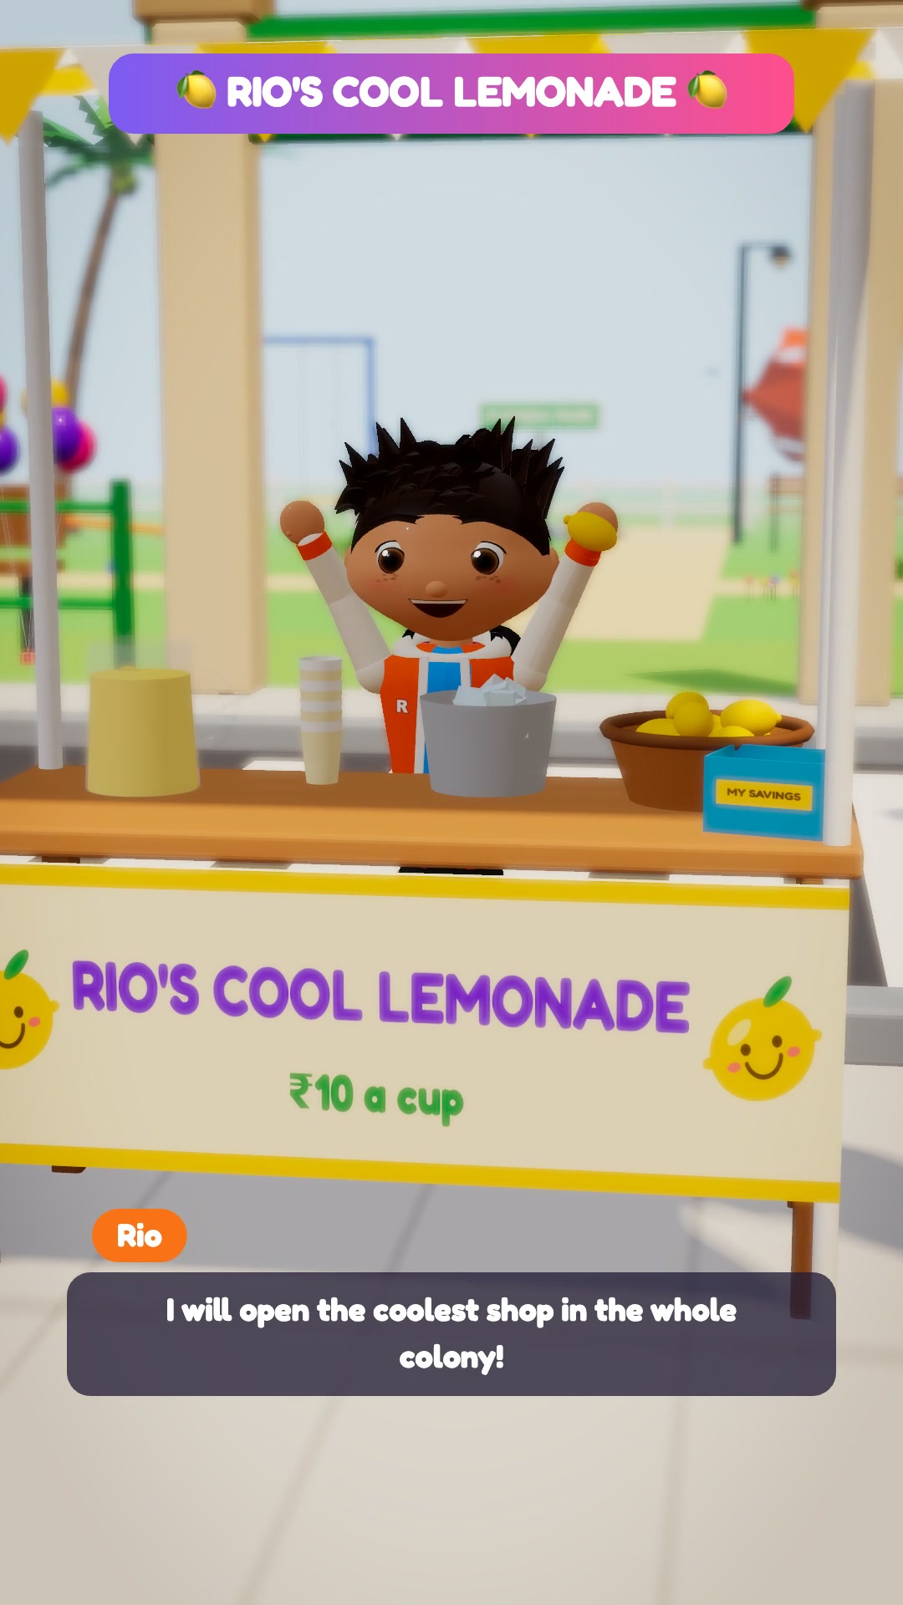
EPISODE 1 · READY TODAY
Rio’s Lemonade Stall
CLASS 3 – 5
SUBJECT Maths · Money
LEARNS Spent vs earned · Profit & loss
LENGTH 3 min 18 s
BOARD Tamil Nadu & Karnataka
Zungga · School pilot proposal · 9
Notes:
Introduce the characters: Rio (energetic), Tara (the careful thinker with her notebook), Mira (creative) and Thatha, the friendly grandfather. Each character has their own voice. The story: Rio opens a lemonade stall on a hot day, spends ₹70, earns only ₹50 — and asks the children for help.

Slide 10
Let’s watch
3 minutes
Watch for the
3 pauses
where the child answers
Notes:
Click the video to play (it plays inside the slide, with sound — check the volume before the meeting). Tell the principal: watch for the three moments where Rio stops and asks the children. Afterwards ask: “Would your children answer out loud here?”

Slide 11
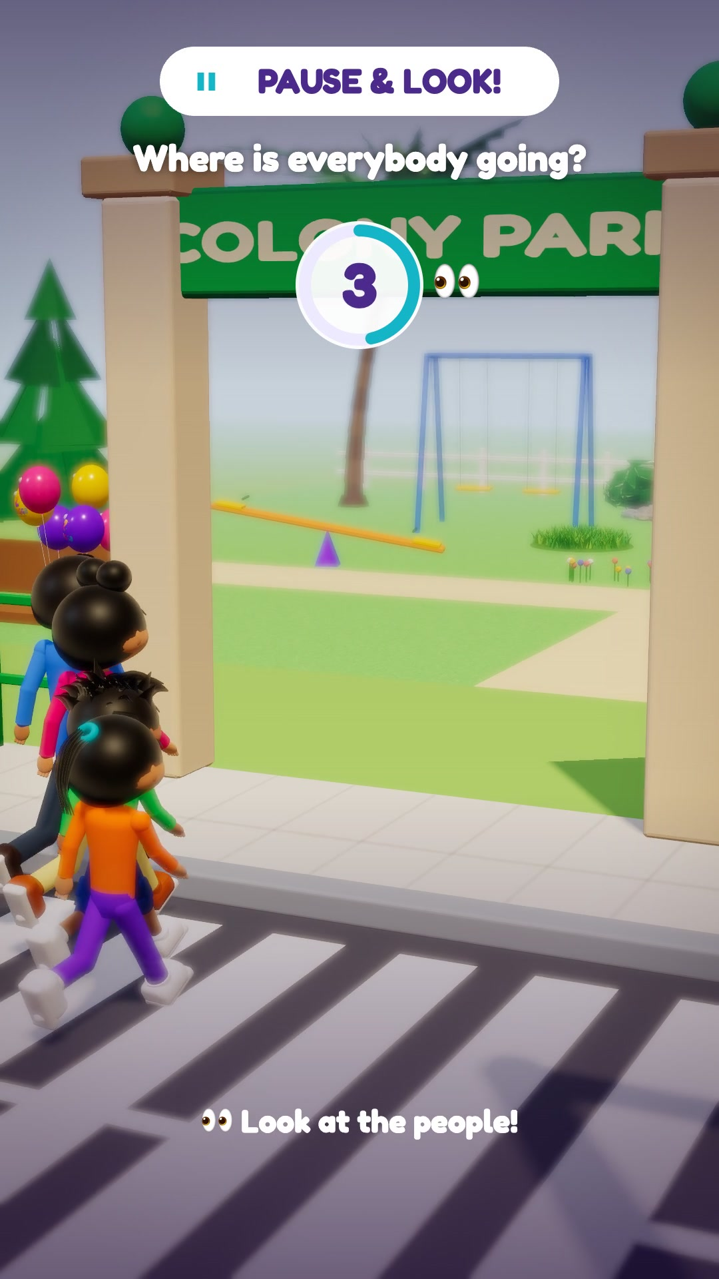
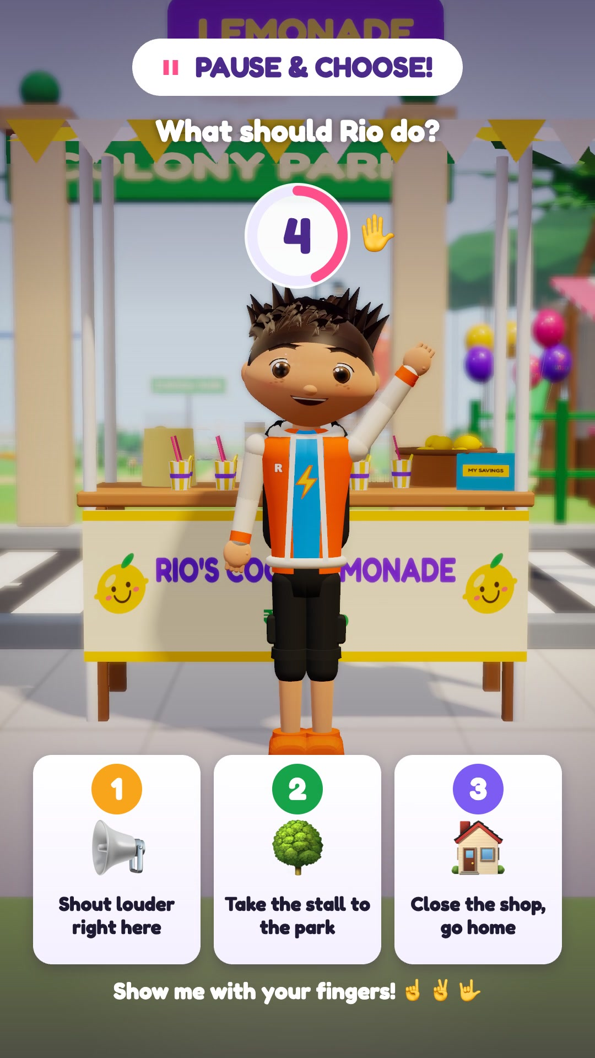
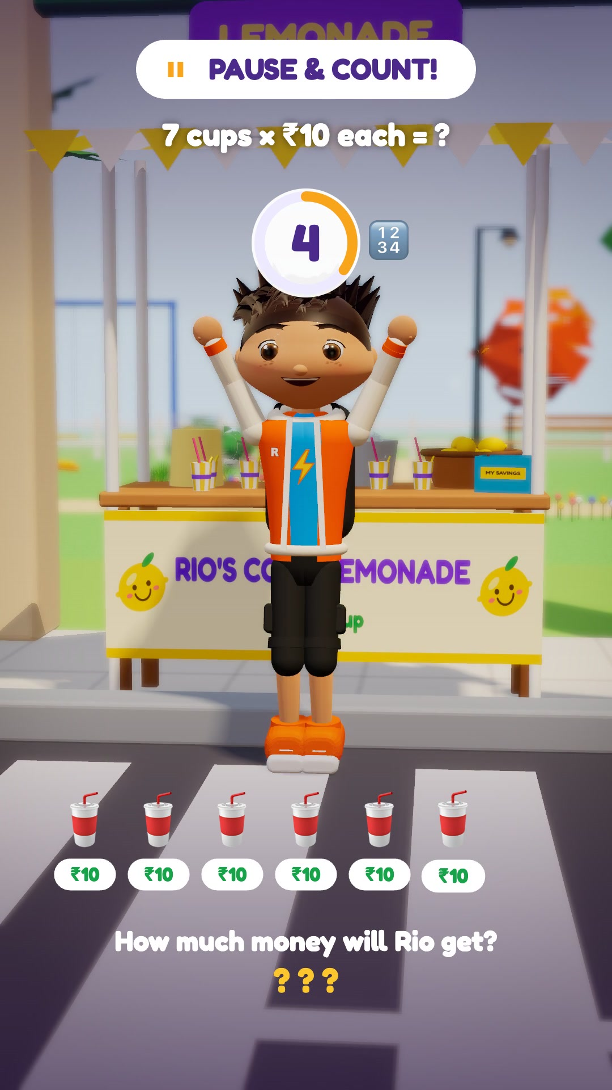
EVERY CHILD CAN ANSWER
Three pauses, three kinds of thinking
👀 Look
✋ Choose
🔢 Count
The answer is on screen — every child gets an easy first win.
Three picture cards; children show 1, 2 or 3 with their fingers.
Syllabus maths: count in tens, then add — out loud, together.
Zungga · School pilot proposal · 11
Notes:
Explain why each pause works for Class 3–5: LOOK builds confidence (the answer is visible), CHOOSE works for shy children and whole classes (fingers), COUNT is real syllabus maths. After each pause the characters confirm the answer and praise: “If you said two, you think like a real business person!”

Slide 12
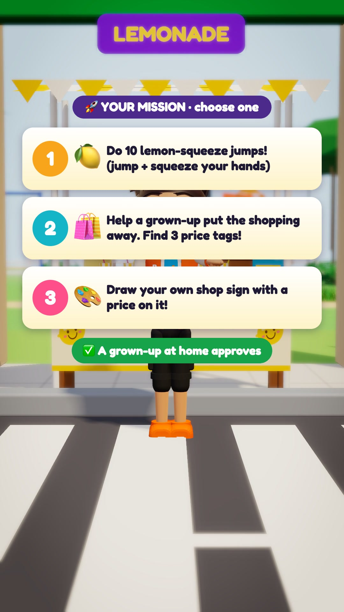
LEARNING THAT LEAVES THE SCREEN
Every episode ends with a real-world mission
🏃 Move: 10 lemon-squeeze jumps
👨‍👩‍👧 Family: Help a grown-up put the shopping away and find 3 price tags
🎨 Create: Draw your own shop sign with a price
Always a choice of three, at the same effort — no child is left out.
Zungga · School pilot proposal · 12
Notes:
The mission links the lesson to home. Always three unrelated choices at the same level of effort — movement, family, creative — so every child (including children who cannot do physical activity) has an option. A grown-up at home confirms it with a PIN, and the next episode unlocks. Long tasks like “help prepare dinner” can be approved later.

Slide 13
PARENTS STAY IN CONTROL
Safe for children, by design
🚫 No tracking
No monitoring, no location, no behaviour profiling.
🔐 Parent login + PIN
Every approval needs the parent’s own PIN.
📵 No ads, ever
Nothing is sold to children inside the app.
🪪 Minimal data
No child email needed; only name and progress.
💬 Kind feedback
Every answer is welcomed; praise comes first.
🇮🇳 Made for India
Designed around India’s child-data rules (DPDP Act).
Zungga · School pilot proposal · 13
Notes:
Principals worry about screens and data — address it directly. The app never tracks children; parents confirm activities themselves with a separate login and PIN. No ads. Minimal data with parental consent. Mention we follow India’s Digital Personal Data Protection Act requirements for children (verifiable parental consent, no tracking or targeted ads).

Slide 14
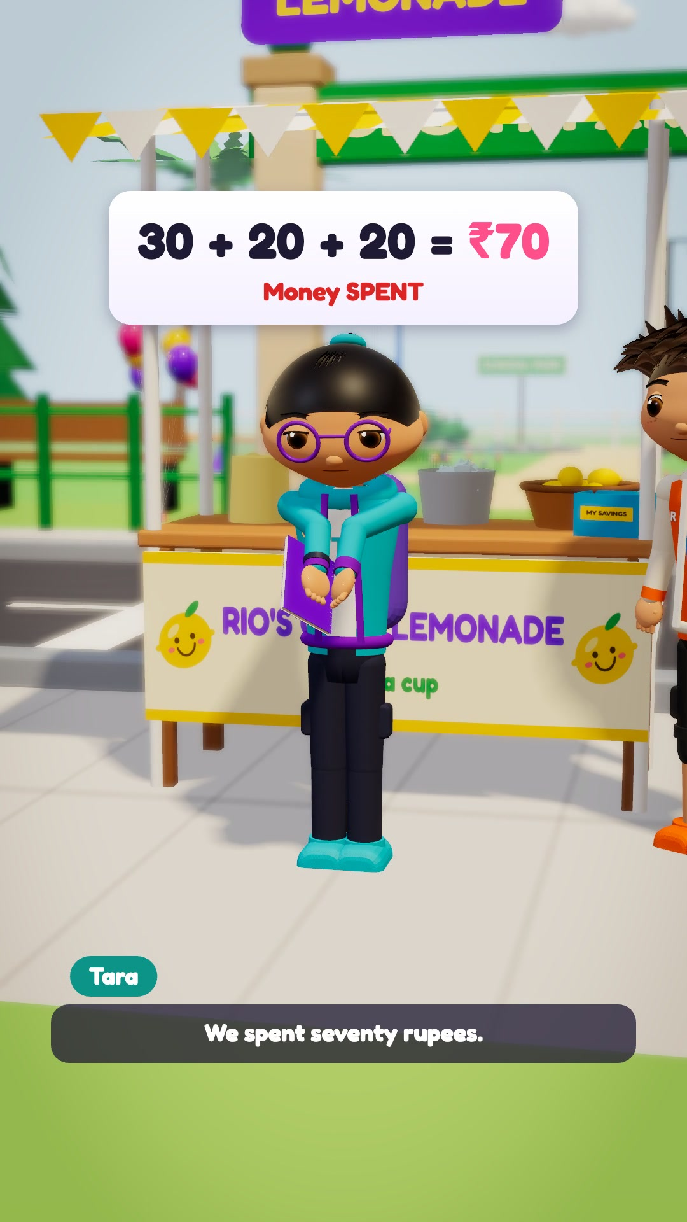
FITS YOUR CLASSROOM
Built around your syllabus and your teachers
📘 Syllabus-linked
Class 3–5, Tamil Nadu & Karnataka state boards, in English
🧑‍🏫 Classroom mode
Teacher plays an episode; the whole class answers the pauses together
🏡 Home connection
Missions bring parents into learning, without extra homework load
🎯 Experiential learning
Thinking, problem-solving and doing — as NEP 2020 encourages
Zungga · School pilot proposal · 14
Notes:
Make it easy for teachers: one episode takes about 5 minutes of class time including the pauses. Content follows the Class 3–5 state-board topics (we map each episode to a chapter). NEP 2020 emphasises experiential learning and critical thinking — this is exactly that. Ask: “Which chapter would you most like to see as an episode?”

Slide 15
OUR PROPOSAL
A small, simple 4-week pilot
1
class group
Class 3, 4 or 5 — your choice of sections
4
weeks
Two short sessions a week
6–8
episodes
Maths & money first, science next
[₹__]
cost to school
[Free pilot / to be agreed]
Episode 1 is ready today; the remaining episodes are in production for the pilot dates.
Zungga · School pilot proposal · 15
Notes:
Keep the ask small and low-risk. Fill in the cost line before the meeting (e.g. free pilot). Be honest: Episode 1 is complete; the rest are being produced with the same studio for the pilot schedule. Ask which class and sections they would like.

Slide 16
WITHOUT TRACKING ANY CHILD
How we will know it worked
🧑‍🏫 Teacher feedback
A 2-minute form after each session
🙌 Class participation
How many hands and answers at each pause
✅ Missions approved
A simple count from parents — nothing more
🖍️ Children’s voice
“What I learned” drawing or sentence at the end
👪 Parent check-in
A short survey in week 4
📋 Week-4 review
We share every finding with you
Zungga · School pilot proposal · 16
Notes:
Measurement respects privacy: teacher forms, classroom observation, counts of approved missions, children's own reflections and a short parent survey. We bring everything to a review meeting in week 4 and decide together whether to continue.

Slide 17
THE PLAN
Four weeks, step by step
WEEK 0
WEEK 1–2
WEEK 3
WEEK 4
Set-up
Episodes 1–4
Episodes 5–8
Review
Choose sections · parent consent note · teacher walkthrough
In class, twice a week · first home missions
Children lead the answers · more missions
Findings meeting with you · decide next steps
Zungga · School pilot proposal · 17
Notes:
Agree on a start date. Week 0 is light: pick the sections, send a consent note to parents (we provide the draft), and a 20-minute teacher walkthrough.

Slide 18
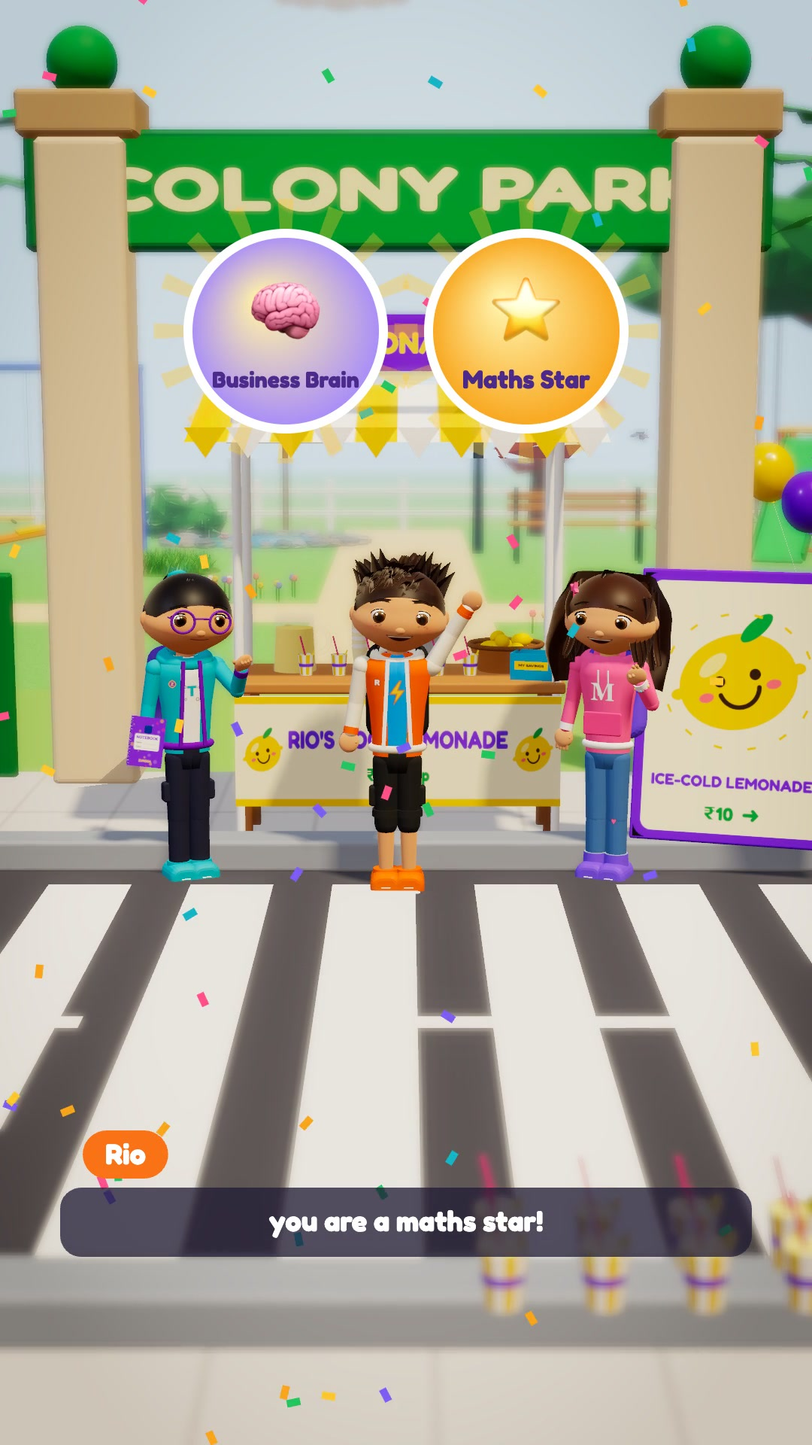
TO BEGIN
What we need from you
1 A class group for the pilot (Class 3, 4 or 5)
2 One teacher champion
3 Two 15-minute slots a week
4 Permission to send a parent consent note
Zungga · School pilot proposal · 18
Notes:
Make the ask concrete and small. Close with a question, not a statement: “Which class would you like to start with, and could we begin on [date]?” Then stop and wait.

Slide 19
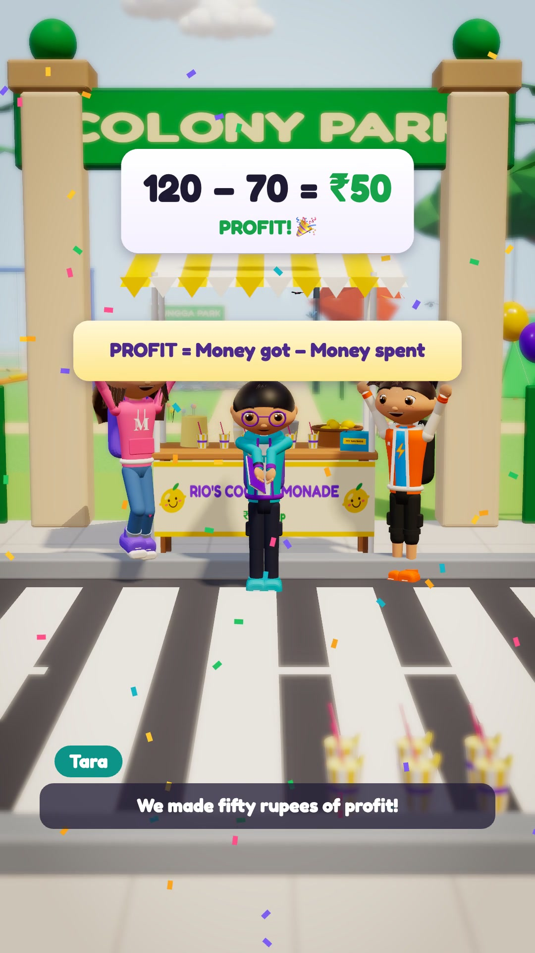
Let’s turn screen time
into skill time — together.
Thank you.
[Your name] · [Phone] · [Email]
zungga.com
Notes:
Thank the principal. Leave contact details. Offer to send the episode video and a one-page pilot summary the same day.

