Slide 1
SANS in McStas

Slide 2
Agenda
A quick discussion of the SANS technique
Sample models for SANS in McStas

Slide 3
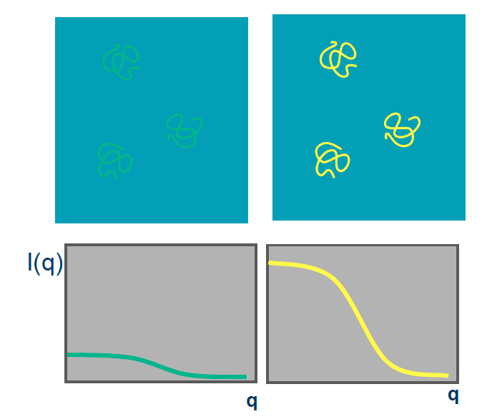
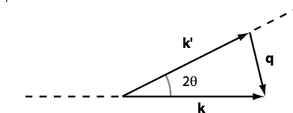
Small angle scattering SANS
SANS method can be used for many types of material
Often: Molecule + Liquid (buffer solution)
Isotropic scattering

Slide 4
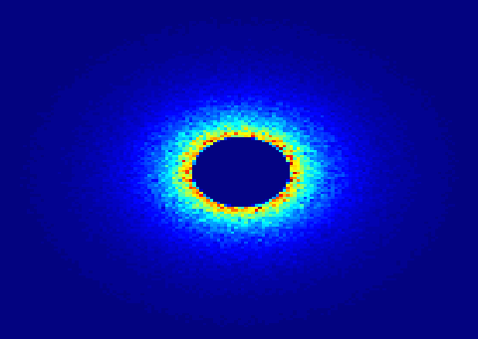

SANS
Small Angle Neutron Scattering
Elastic Scattering
Small angle -> small q -> big r
Gain information on the molecular scale 10-100Å
Low signal to noise
Contrast method
Instrument requirements: good collimation, long flight distance after detector.

Slide 5
McStas has a suite of SANS-models:
Try ellipsoidal and
cylindrical particles
-or-
Elliptic cylinders
Go for Nanodiscs and Liposomes
SANS other samples
SANS_AnySamp.comp
SANS_DebyeS.comp
SANSCylinders.comp
SANSEllipticCylinders.comp
SANSGuinier.comp
SANSLiposomes.comp
SANSNanodiscs.comp
SANSNanodiscsFast.comp
SANSNanodiscsWithTags.
SANSNanodiscsWithTagsFast
SANSPDB.comp
SANSPDBFAST.comp
SANSShells.comp
SANSSpheres.comp
Also – SASmodels from SASview

Slide 6
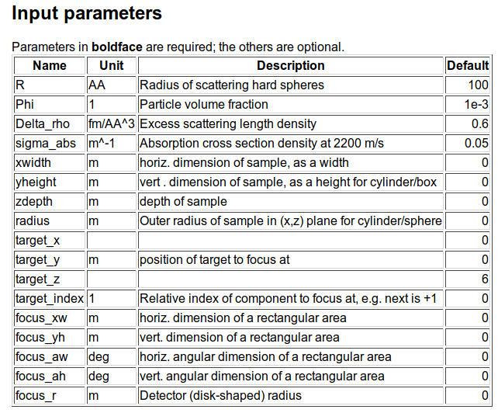
SANS spheres
Dilute, monodisperse, hard spheres in solution, with given contrast and radius

Slide 7
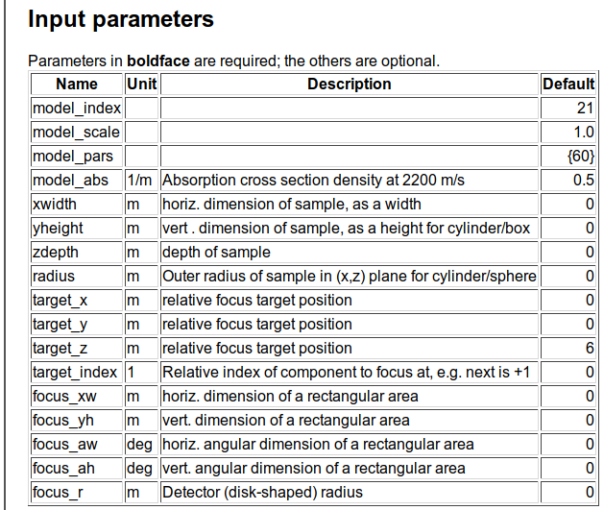
SasView_models

Slide 8
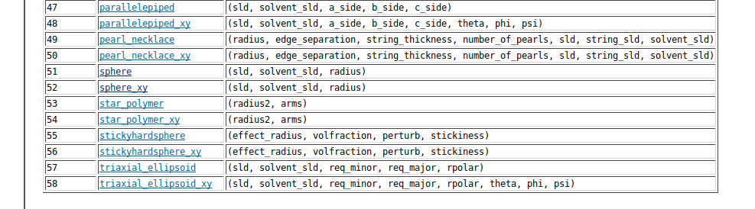
SasView_models

Slide 9
First exercise will take place on the e-neutrons.org infrastructure (using a web-simulator)
Please fill in the form at https://www.e-neutrons.org/?page_id=423
(Once everyone has done this, I will enable the accounts)
You will receive an email with login-credentials
Use these credentials to log in to the simulation quiz at https://www.e-neutrons.org/moodle/mod/quiz/view.php?id=4276
Follow the instructions in the quiz

