Slide 1
TOF spectrometer (direct geometry)

Slide 2
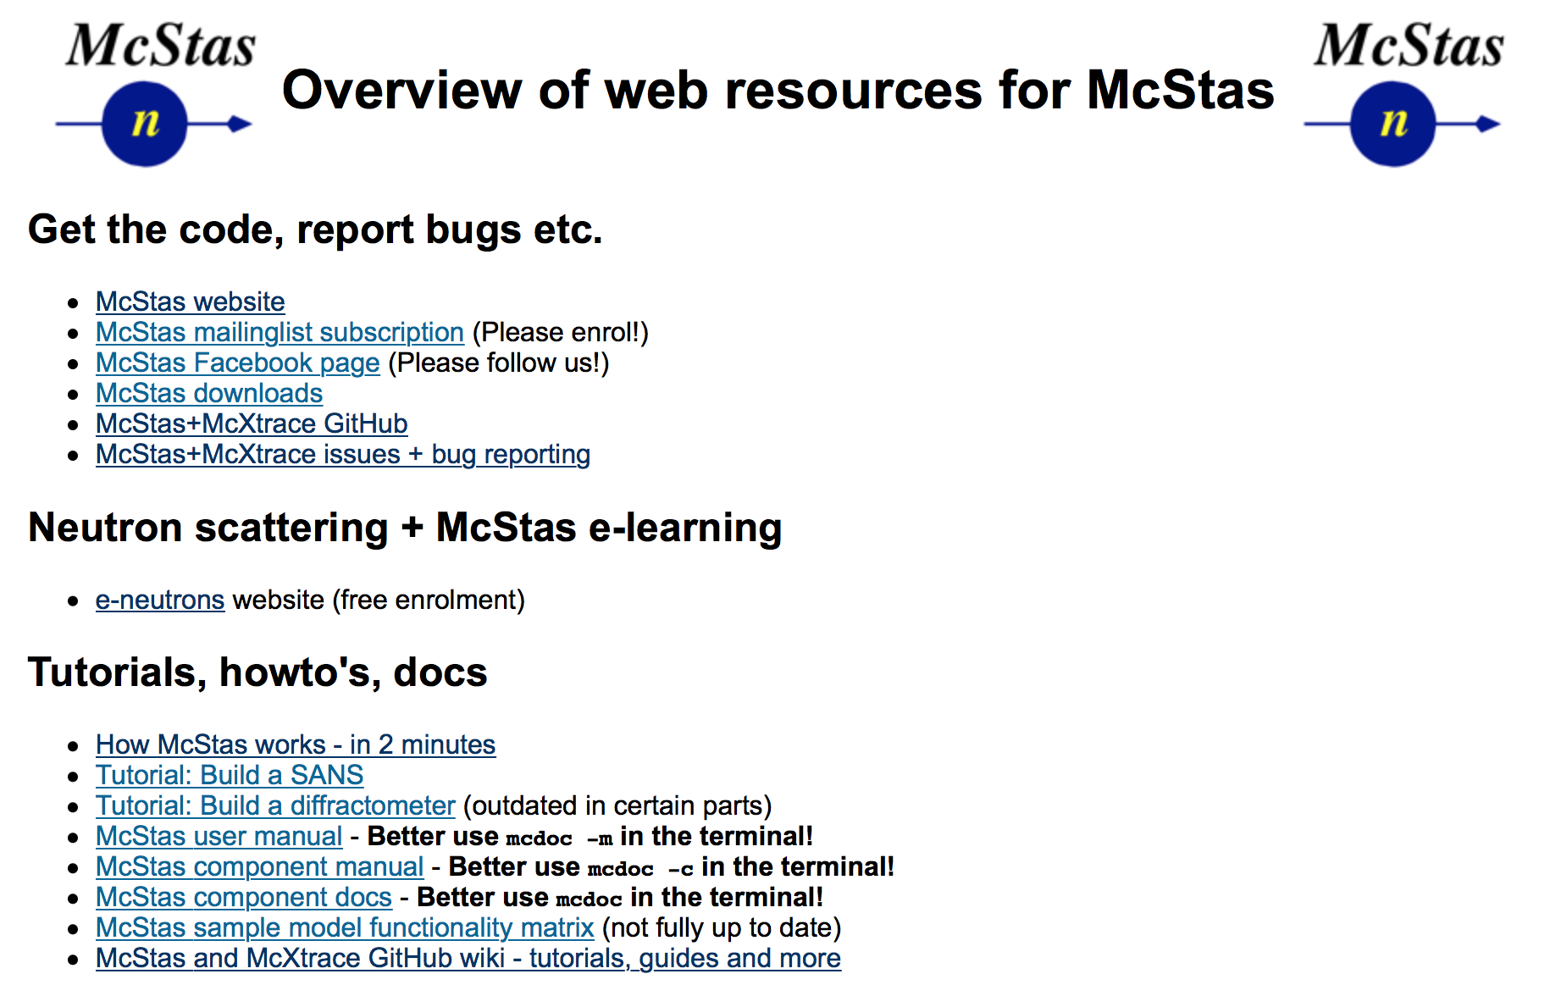
Useful links / docs
http://mcstas.org/links
https://github.com/McStasMcXtrace/McCode/wiki
Documentation on the McCode tools
User documentation for the 2017- Python tool set'
mcrun variants - table overview
mcplot variants - table overview
mcdisplay variants - table overview

Slide 3
Spectroscopy reminder

Slide 4
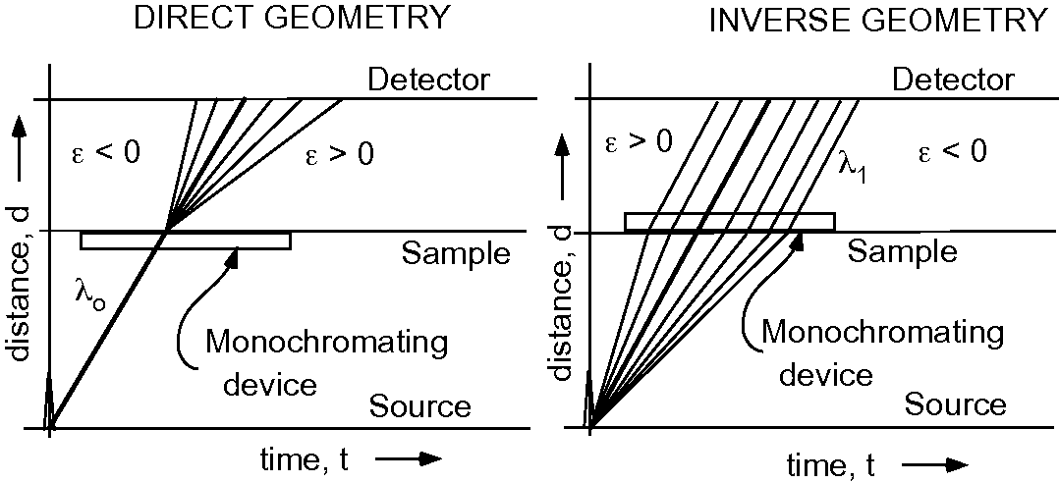
Direct vs. Indirect

Slide 5
Direct vs. Indirect

Slide 6
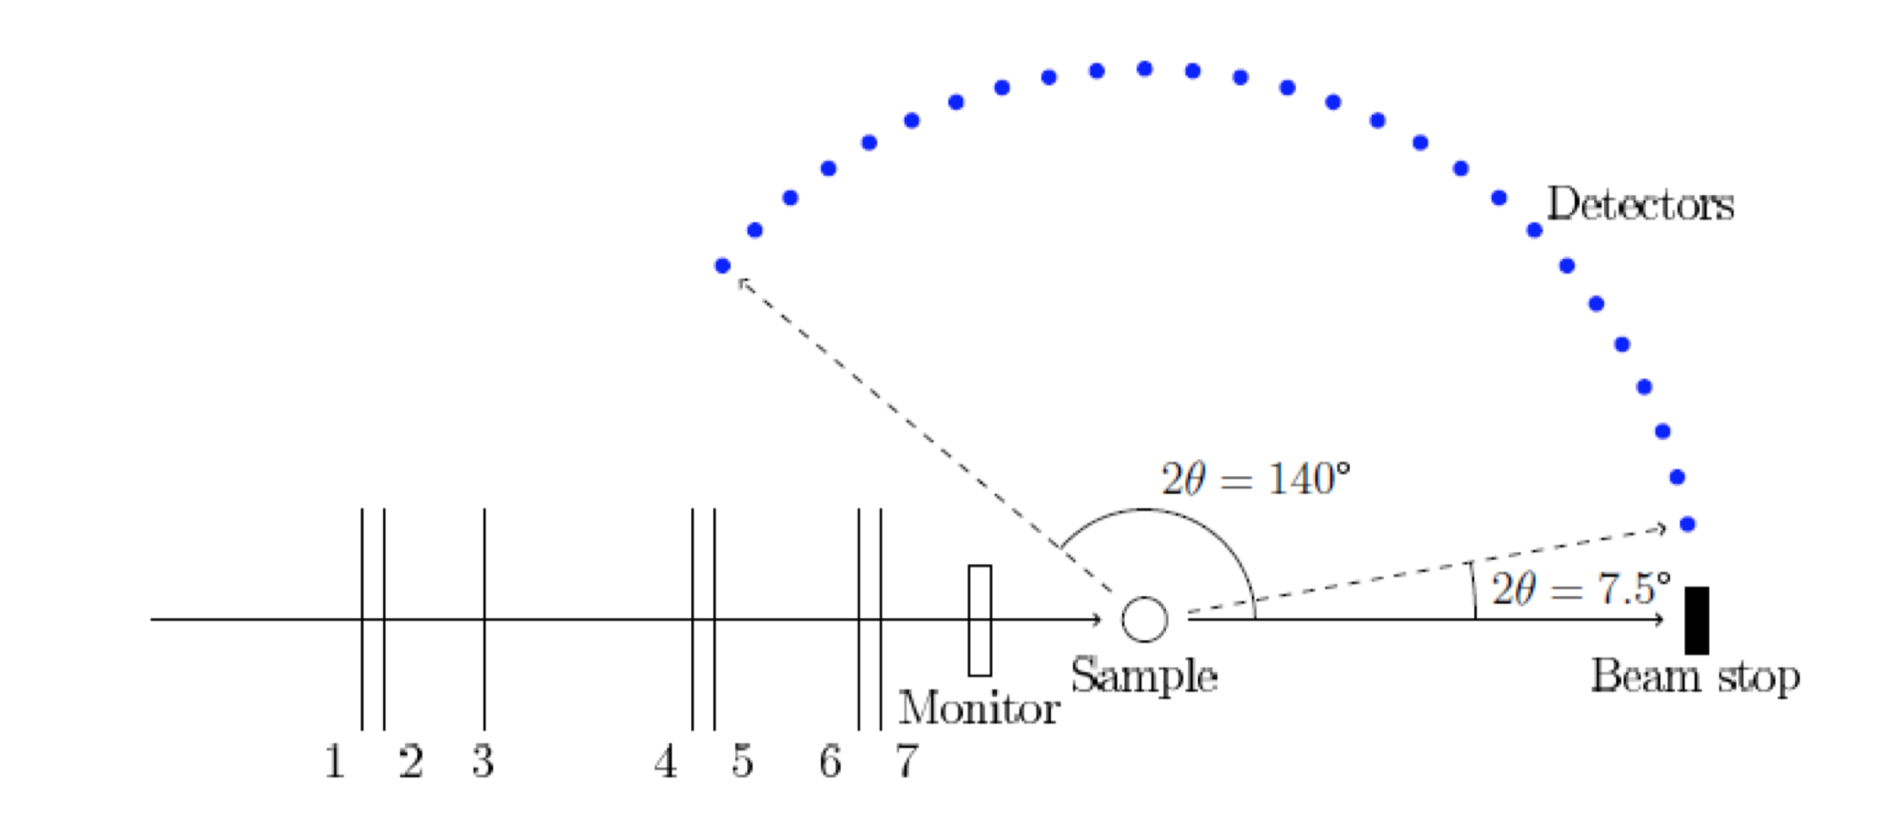
Direct geometry schematic

Slide 7
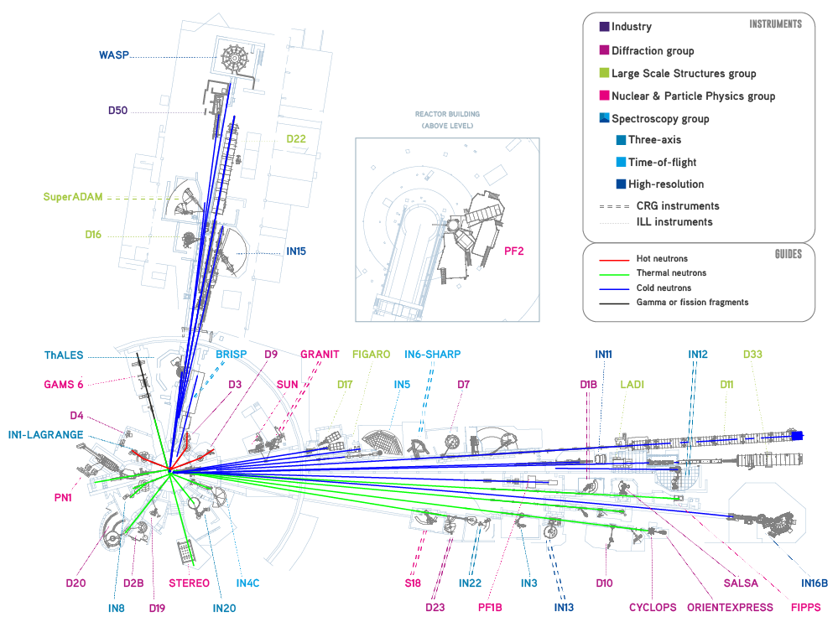

Today’s instruments:
One thermal
One cold

Slide 8
Today’s instruments:
One thermal - IN4
One cold - IN5

Slide 9
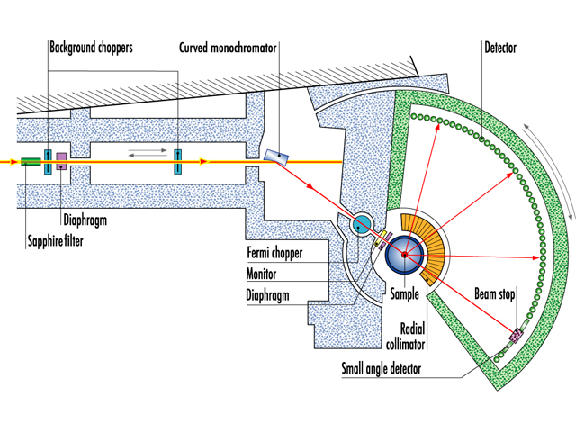
ILL IN4

Slide 10
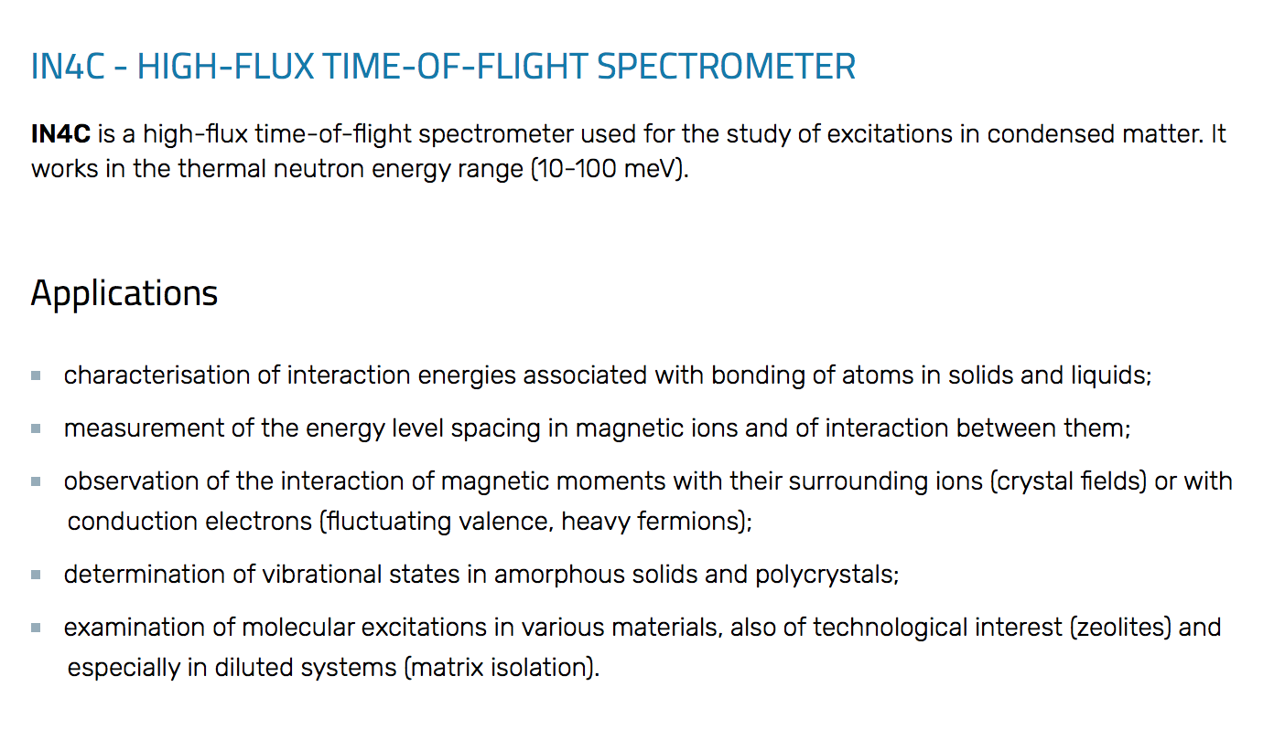
ILL IN4
Thermal, in ILL level C @ reactor face
Use of chopper, focusing monochromator and fermi-chopper

Slide 11
McStas model
Get out ‘Neutron Site -> ILL -> ILL_IN4.instr
Find the documentation for the instrument via Help -> mcdoc Component Reference
Run to compile, and visualise the instrument with mcdisplay-webgl (Use setting in File->Preferences to set mcdisplay tool)
Look at the code in the editor

Slide 12
Special features
In DECLARE/INITIALIZE there is infrastructure to generate an S(q,⍵) with Dirac delta functions which is relevant for the current setting of the instrument
- Accessible by running default parameters, specifically (sample_coh=Dirac2D.sqw. - the default)
Run a simulation with default parameters and 1e7 neutron rays and inspect the output. Locate the detector output that illustrates the instrument resolution

Slide 13
Investigate resolution @ different instrument settings
Run simulations at lambda=1.1, 2.2, 3.3 and 4.4 Å
Hint:
Look at instrument output and documentation, you may have to adjust e.g. monochromator type for non-default wavelength
Comment on the found differences
Optionally play with monochromator mosaicity

Slide 14
ILL IN5

Slide 15
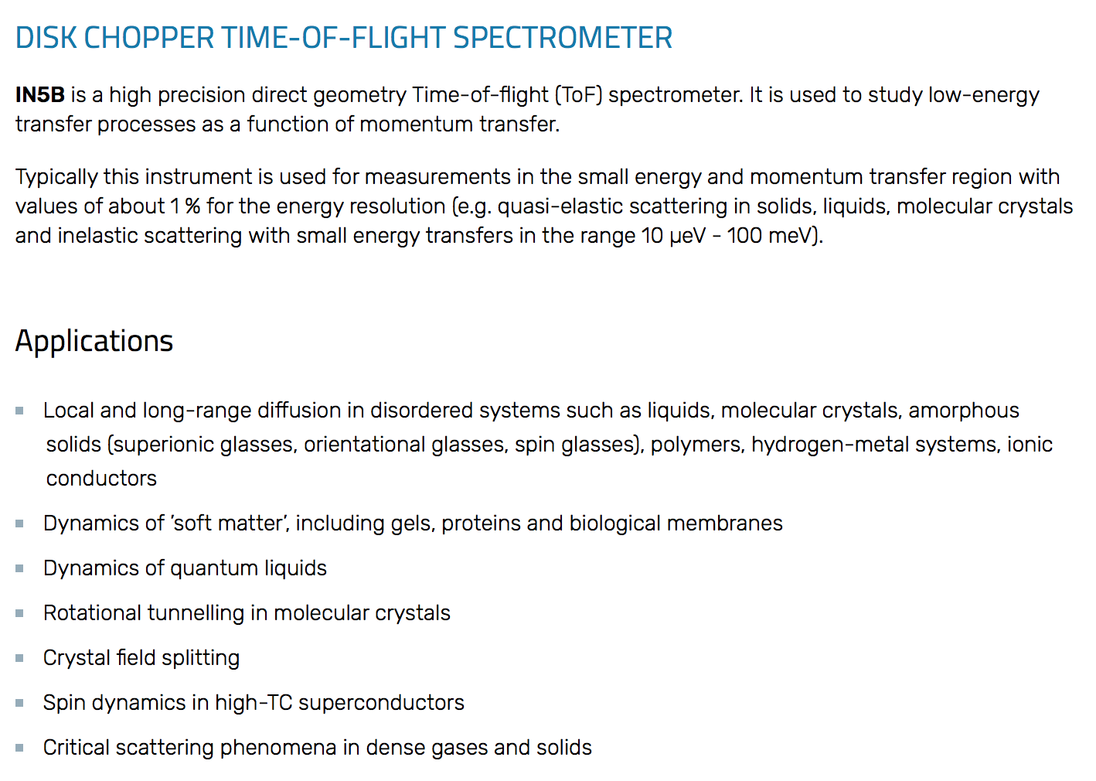
ILL IN5
Cold, in ILL7 guide hall
- On a guide with a 6-diskchopper setup

Slide 16
ILL IN5 resolution
Locate the ILL_IN5_Spots.instr in the Dropbox
Run the instrument as is, observing diffraction from powder lines
Also visualise the instrument using mcdisplay

Slide 17
Enclosed modifications wrt. IN5 in McStas
Resolution mode ala IN4 simulation, accessible by input parameter RESO=1
Single-peak inelastic Dirac peak accessible by input parameters:
ttspot (where to point the peak in angle)
nspots (how many spots to define)
wspot (magnitude of energy exchange)

Slide 18
Perform studies of resolution, IN5
- Use your gathered experience from the earlier IN4 simulations
Comment on the qualitative difference to the resolution function from IN4

Slide 19
Investigate resolution properties via Spot_sample
Run a simulation with
nspots=1 (one discrete inelastic spot)
wspot=1 (energy-transfer 1meV)
ttspot=-60,60 (vary spot position qvalue)
-N13 (13 scan steps)
Investigate influence of sample size (reduce height and radius parameters)

Slide 20
Investigate resolution properties via Spot_sample
Inelastic: Run a simulation with
nspots=1 (one discrete inelastic spot)
wspot=1,4 (energy-transfer 1meV to 4meV)
ttspot=0 (vary spot position qvalue)
-N21 (21 scan steps)
Optionallu launch iFit/Matlab and load data from one or more of the TOF monitor outputs of the scan, e.g.
a=iData(‘folder/5/in5*.t’)
a.error=1
fits(a,’gauss’)
plot(a)

