Slide 1






Practical:
Single crystals and powders

Slide 2



Agenda
Laue Camera
Build along in 4 steps!
Use the diffractometer
PSI_DMC
Laue Camera revisited

Slide 3
Build along Laue Camera
First insert a source
File → New Instrument
Insert → Sources → Source_simple
// insert components here (e.g. Insert -> Source -> ...)
COMPONENT source_simple = Source_simple(
radius=0.05, dist=5, focus_xw=0.02,
focus_yh=0.05, lambda0=2, dlambda=1.9)
AT (0, 0, 0) RELATIVE PREVIOUS

Slide 4
Build along Laue Camera
Now add a guide
Insert → Optics → Guide
COMPONENT guide = Guide(
w1=0.02, h1=0.05, w2=0.02, h2=0.05, l=20, m=1)
AT(0,0,2) RELATIVE source_simple

Slide 5
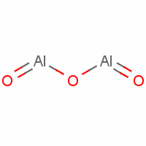
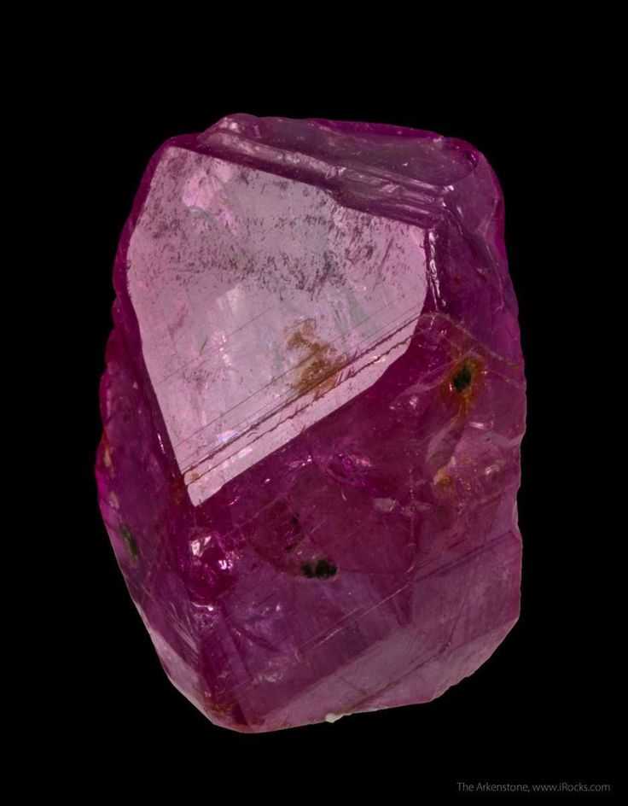
Build along Laue Camera
Add a sample – in this case a standard crystal
Insert → Samples → Single_crystal
COMPONENT single_crystal = Single_crystal(
reflections="Al2O3_sapphire.lau",
yheight=0.05, radius=0.01, mosaic=1, delta_d_d=1e-4,
az=4.757, ay=0, az=0, bx=2.3785, by=0, bz=-3.364,
cx=0, cy=12.9877, cz=0,
p_transmit=0.1, order=1)
AT (0, 0, 0) RELATIVE PREVIOUS

Slide 6
Build along Laue Camera
Add the ideal Laue Camera Monitor – covering 4π
Insert → Monitors → PSD_monitor_4PI
COMPONENT fourpi = PSD_monitor_4PI(
radius=1, filename="fourpi.dat", nx=201, ny=201)
AT(0,0,0) RELATIVE PREVIOUS

Slide 7
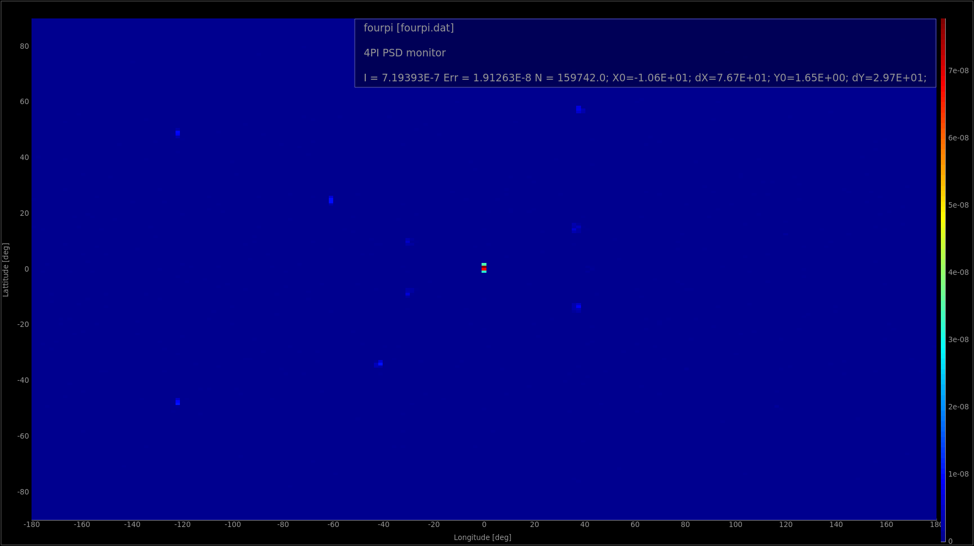
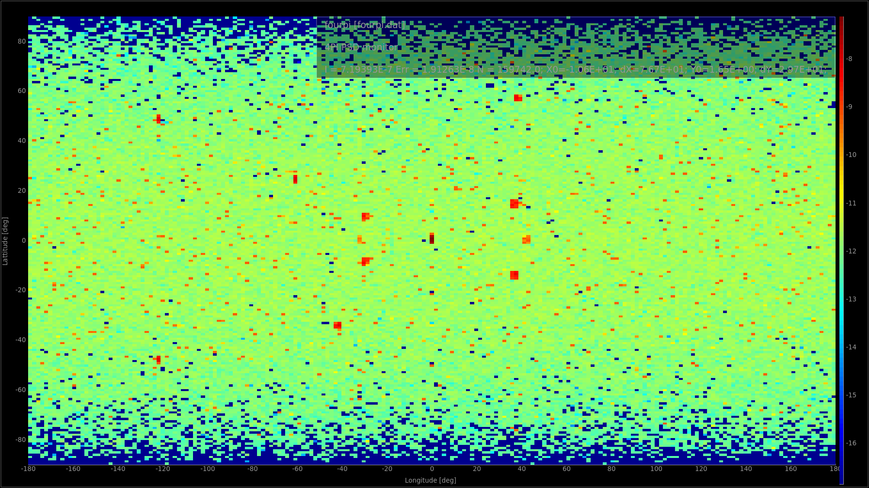
Build along Laue Camera
Run your simulation ( you can safely increase the number of rays to 10⁷ - the ncount ) – you should get something like:
Press L for
logarithmic

Slide 8








Build along Laue Camera
The coherent scattering is not much stronger than the incoherent “background”. Let’s use EXTEND and WHEN to make a monitor which only senses the coherent signal.
In the DECLARE section of your instrument – declare a variable of type char;
Add an EXTEND-block to the end of the Single_crystal component:
EXTEND
%{
myvar = hkl_info.type;
%}
Add another 4-PI monitor and insert WHEN (myvar==99) in front of the AT keyword.
Run your instrument again...

Slide 9
Build along Laue Camera
Play around with this example instrument:
Add an Arm components before the sample to allow rotation around the Y-axis.
Add “SPLIT 20” before the sample COMPONENT statement. What happens?
Try to extend this to Y, Z, Y rotation (Eulerian cradle).
Insert a different crystal instead e.g. “Al.lau”. i.e. change the crystal unit cell parameters and the reflection list.
Insert a powder sample instead

Slide 10
PowderN exercise
In this exercise we will try to put two powder samples together in a few ways and compare the results.
Two samples in the same spot, and stochastically choose between them
Two samples stacked vertically
Two samples where one is behind the other.

Slide 11
PowderN exercise
Let’s use the PSI_DMC instrument as a starting point. We will now make the simulation randomly choose between two powders.
Add another powder in the same spot as the one already there.
Add double r; inside the DECLARE section of the instrument file.
Add an Arm in front of the first one, and add to it an EXTEND-block. Add the following code in it: r=rand01();
Now add the following before the AT on the two powders. WHEN(r<0.5) and WHEN(r>0.5) respectively.
Run the instrument again – Do you get what you expect?
What would you change to make the mixing factor !=0.5?

Slide 12
PowderN exercise
Let’s change this to have two samples on top of each other.
Make a new copy of the instrument (or remove the edits you did before, leaving the second Powder sample in place).
Change the y-position and size of the samples to be +- height/2.0 and height/2.0 respectively
Add the statement GROUP sample after the AT at both samples. (N.b. sample is a name chosen arbitrarily. It has to be different than the component names though.)
Run a simulation – is there any difference to the previous result? Why/Why not?

Slide 13
PowderN exercise
Move samples around such that one is in front of the other.
Run a simulation – Do you still see the signatures of both samples?
Do you remember why this can be?
How can we get around this?

Slide 14
Intermission: A quick trick to remove the direct beam
If your monitor also can be hit by the direct beam, “swamping” the signal, you can do this:
Add the following code just after your sample code: EXTEND %{ if (!SCATTERED){ABSORB;}
%}
This will terminate all rays which the sample-code has not flagged as scattered. Bear in mind the McStas definition of scattered includes many things (guide-wall reflections etc.)

Slide 15
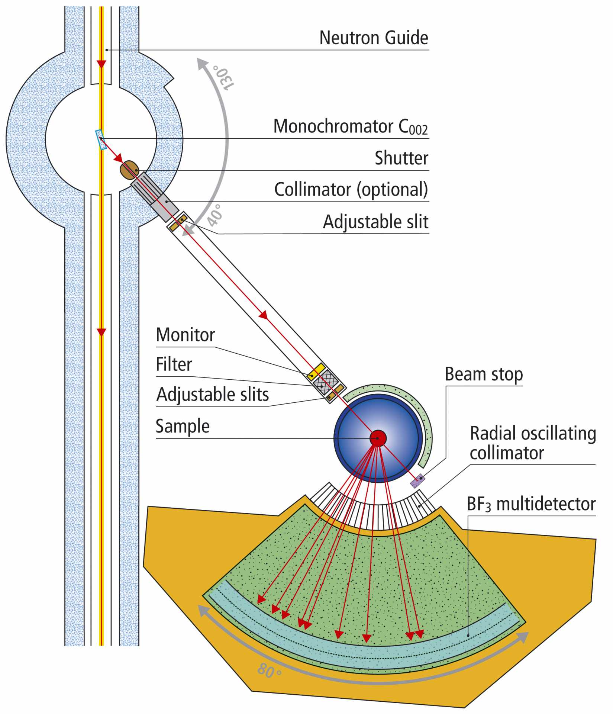
Real Instruments
PSI DMC
Increase the height of the detector and make it resolve the signal along y.
Set:
Options="banana, theta y auto limits bins=20", yheight=0.3
In the detector.
...and change the sample to be e.g. an Aluminium crystal.
COMPONENT single_crystal = Single_crystal(
reflections="Al.lau",
yheight=0.05, radius=0.01, mosaic=1, delta_d_d=1e-4,
az=4.0495, ay=0, ax=0, bx=4.0495, by=0, bz=0,
cx=0, cy=4.0495, cz=0,
p_transmit=0.1)
AT (0, 0, 0) RELATIVE PREVIOUS

