Slide 1
SPLIT, EXTEND, WHEN & GROUP
Advanced language features 2:

Slide 2
SPLIT
Increase statistics beyond this point in the instrumentfile
SPLIT n MyArm = Arm()
AT somewhere
will “formulate an if-statement”:
for j=1:n
comp1
comp2
comp3
...
end (of instrument)
ONLY meaningful in case of Monte Carlo choices after SPLIT point...

Slide 3
SPLIT
Increase statistics beyond this point in the instrumentfile
SPLIT n MyArm = Arm()
AT somewhere
will “formulate an if-statement”:
for j=1:n
comp1
comp2
comp3
...
end (of instrument)
ONLY meaningful in case of Monte Carlo choices after SPLIT point...

Slide 4
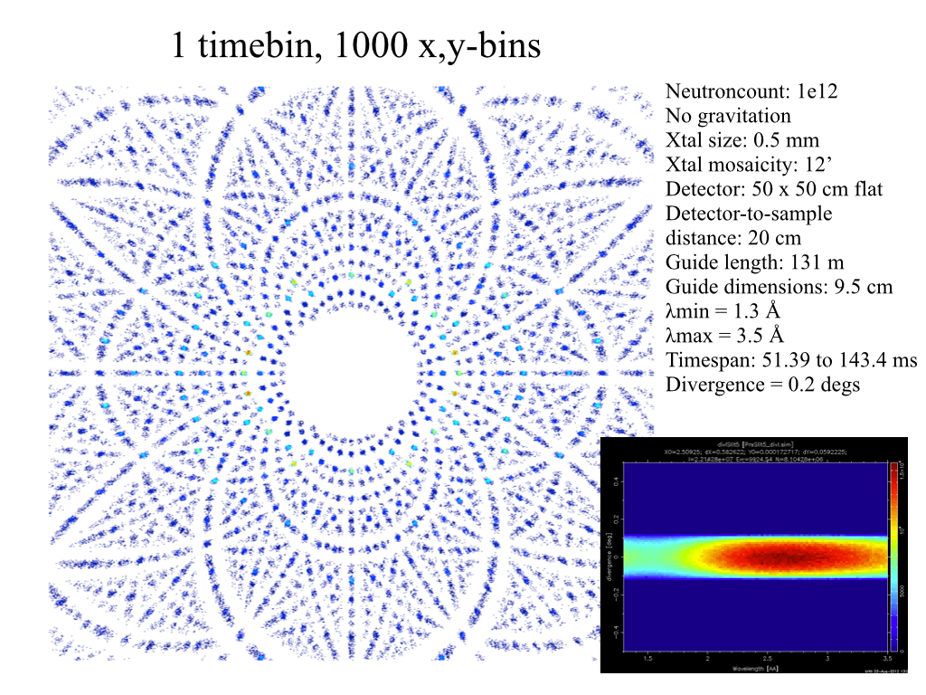
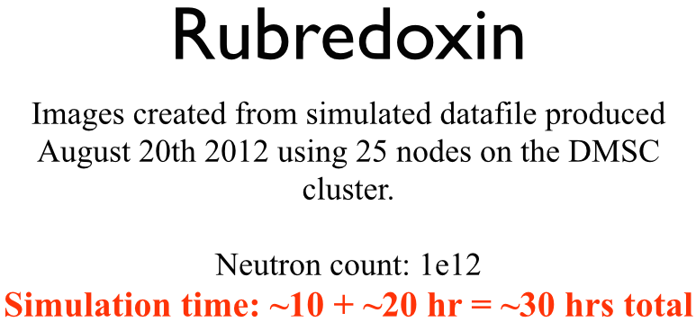
Problem: McStas Single_crystal.comp “slow” for large unit cell diffraction studies
slight sidetrack….
Example: Rubredoxin
Reflection list ~ 124 K reflections (still “small” in the PX world!!)

Slide 5
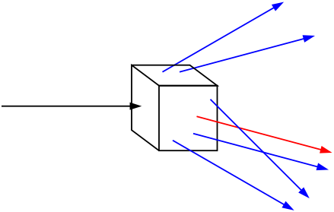
Algorithm improvement: Use incoming neutrons more efficiently - scatter each one on all possible reflections
slight sidetrack….
Red: Original algorithm, one incoming neutron used only once
Blue: Improved algorithm, each incoming neutron scattered (via SPLIT keyword) all possible times
Component makes estimate on average number of “active” diffraction spots - in the case Rubredoxin this is around 50!

Slide 6

GROUP - components working in parallel
COMPONENT Mono1 = Monochromator_curved(...)
AT (0,0,-LMM) RELATIVE Cradle ROTATED (0,A1/2,0) RELATIVE Cradle
GROUP IN6Monoks
COMPONENT Mono2 = Monochromator_curved(...)
AT (0,0,0) RELATIVE Cradle ROTATED (0,A2/2,0) RELATIVE Cradle
GROUP IN6Monoks
- One comp after the other is “tried” in sequential order until the neutron was SCATTERED.

Slide 7
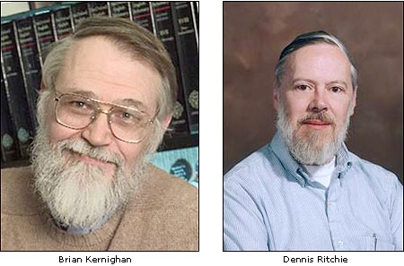

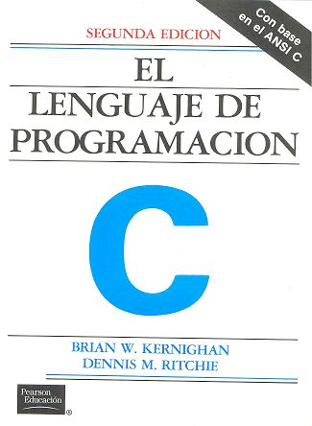
EXTEND
Enrich component behaviour using EXTEND:
COMPONENT Mono1 = Monochromator_curved(...)
AT (0,0, -LMM) RELATIVE Cradle ROTATED (0,A1/2,0) RELATIVE Cradle
GROUP IN6Monoks
EXTEND
%{
if (SCATTERED) { myvar = 1; }
%}
...
COMPONENT Mono2 = Monochromator_curved(...)
AT (0,0, 0) RELATIVE Cradle ROTATED (0,A2/2,0) RELATIVE Cradle
GROUP IN6Monoks
%{
if (SCATTERED) { myvar = 2 ;}
%}
K & R. / GNU

Slide 8

WHEN
Syntax:
COMPONENT Mine = Yours(blah, blah)
WHEN (c-expression) AT (....)
Is very powerful when combined with EXTEND and user variables, or as a method to let input parameters select if certain components are active.
Example: Use EXTEND to flag if neutron was scattered on one monochromator blade or another. Then later use WHEN to only show contribution from blade N at sample position?
COMPONENT Mon = PSD_monitor(...)
WHEN (myvar==1) AT (0,0,0) RELATIVE Sample
K & R. / GNU

