Slide 1
McStas Union components
Mads Bertelsen, ESS DMSC

Slide 2
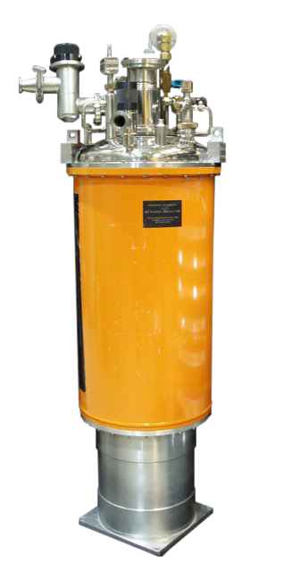
Multiple scattering
Multiple scattering can happen in all systems
Adding several materials complicates matters
In spatially large systems time of flight is affected by multiple scattering

Slide 3
Multiple scattering
q_2
k_f
q
k_i
q_1
Multiple scattering can happen in all systems
Adding several materials complicates matters
In spatially large systems time of flight is affected by multiple scattering
k_f
q_2
q
k_i
q_1
k_f
q_2
q
t = s lambda
k_i
q_1

Slide 4


Concentric keyword in McStas
Simple sample container
COMPONENT a = Container_1(concentric=1, …) AT (0,0,0) RELATIVE sample_position
COMPONENT b = Sample(…) AT (0,0,0) RELATIVE sample_positon
COMPONENT c = Container_2(concentric=0,…) AT (0,0,0) RELATIVE Container_1

Slide 5
Concentric keyword in McStas
Sample environment
COMPONENT a = Container_1(concentric=1, …) AT (0,0,0) RELATIVE sample_position
COMPONENT b = Sample(…) AT (0,0,0) RELATIVE sample_positon
COMPONENT c = Container_2(concentric=0,…) AT (0,0,0) RELATIVE Container_1

Slide 6
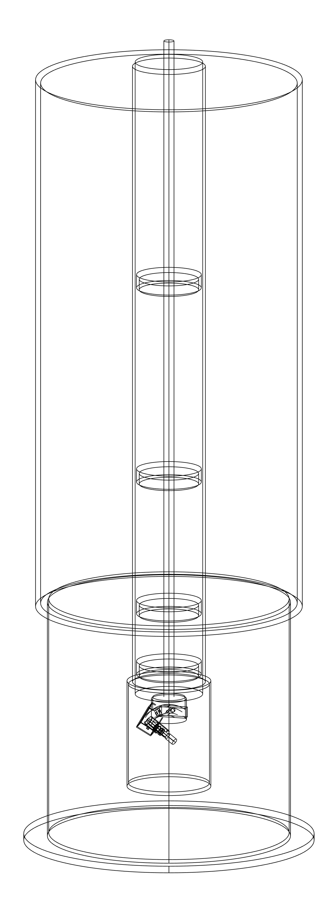
Union introduction
Modular geometry and physics
Aims to simulate complex systems
All trajectories allowed

Slide 7
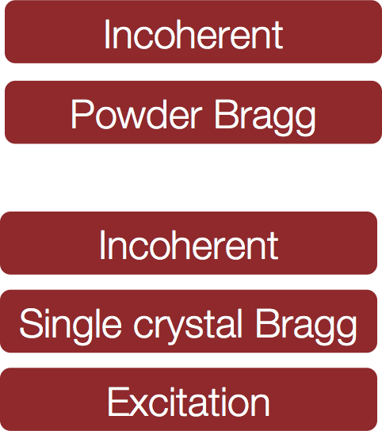
Union overview
Geometry
Materials
Processes

Slide 8
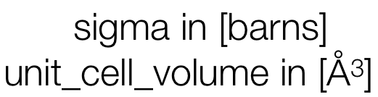

Union process syntax
COMPONENT Al_incoherent = Incoherent_process( sigma=4*0.0082,packing_factor=1, unit_cell_volume=66.4) AT (0,0,0) ABSOLUTE
COMPONENT Al_powder = Powder_process( reflections="Al.laz") AT (0,0,0) ABSOLUTE
COMPONENT Al = Union_make_material( my_absorption=100*4*0.231/66.4, process_string=“Al_incoherent,Al_powder”) AT (0,0,0) ABSOLUTE
my [1/m] = cross section per unit cell / unit cell volume

Slide 9
Union concepts: Priority
Aluminium priority = 8.2
Priority to handle overlapping geometries
The highest priority is simulated in regions where more are overlapping
Vanadium priority = 5.1

Slide 10
Union concepts: Priority
Priority to handle overlapping geometries
The highest priority is simulated in regions where more are overlapping

Slide 11
Union concepts: Syntax
COMPONENT cryostat_shell = Union_cylinder( radius=0.15,height=0.4, priority=10,material_string="Al") AT (0,0,0) RELATIVE target ROTATED (0,0,0) RELATIVE target
COMPONENT cryostat_vacuum = Union_cylinder( radius=0.147,height=0.39, priority=11,material_string="Vacuum") AT (0,0,0) RELATIVE target ROTATED (0,0,0) RELATIVE target

Slide 12
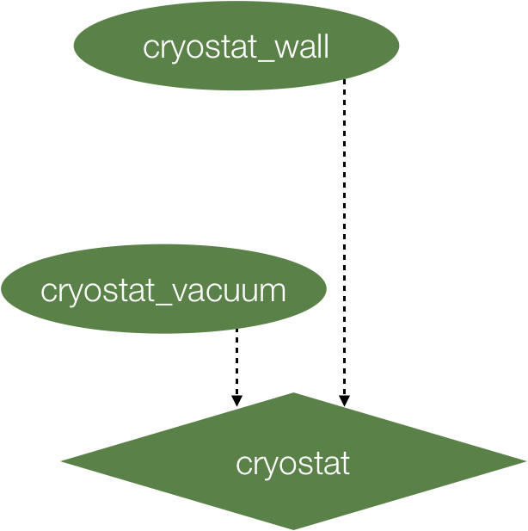
Union concepts: Syntax
COMPONENT cryostat_shell = Union_cylinder( radius=0.15,height=0.4, priority=10,material_string="Al") AT (0,0,0) RELATIVE target ROTATED (0,0,0) RELATIVE target
COMPONENT cryostat_vacuum = Union_cylinder( radius=0.147,height=0.39, priority=11,material_string="Vacuum") AT (0,0,0) RELATIVE target ROTATED (0,0,0) RELATIVE target
COMPONENT cryostat = Union_master() AT (0,0,0) RELATIVE target ROTATED (0,0,0) RELATIVE target

Slide 13
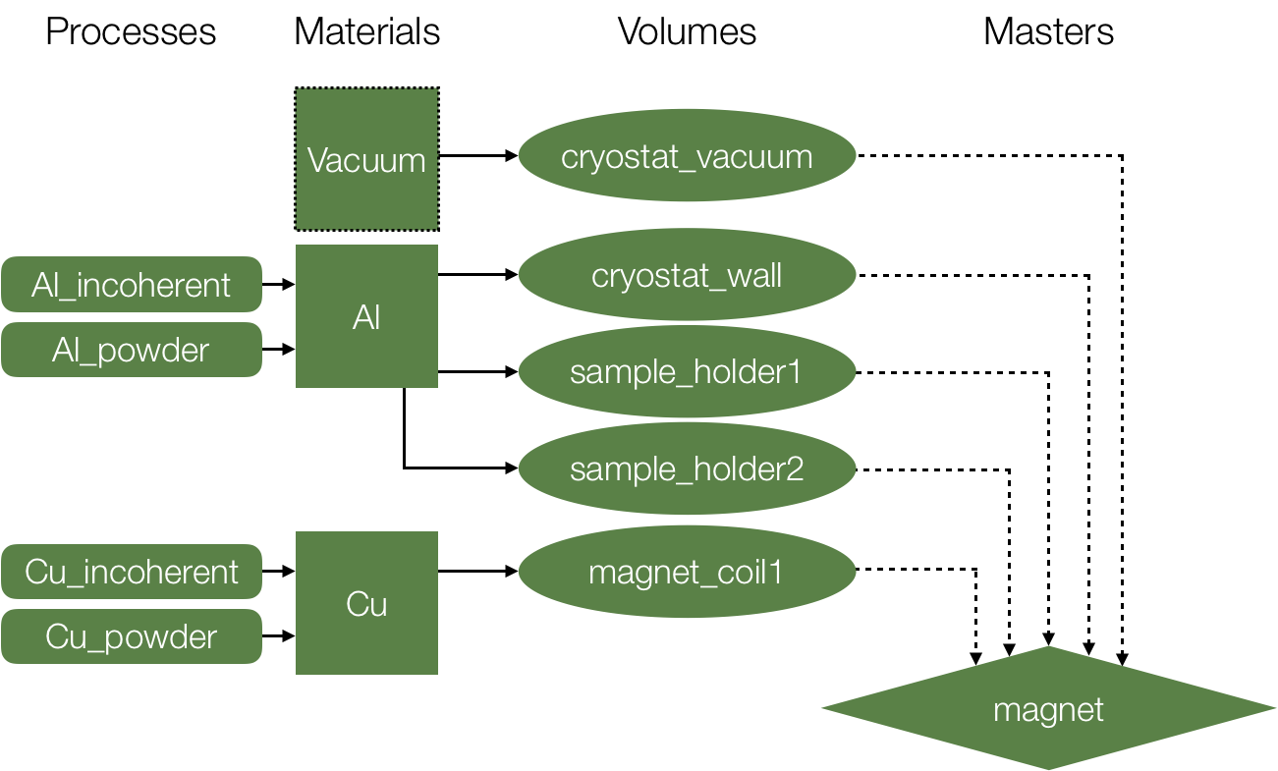
Union concepts: Syntax

Slide 14
Union concepts: Syntax
Define process
Define material (many processes)
Define geometries (one material each)
Define loggers (optional)
Define conditionals (on loggers)
Execute simulation (defined geometries)
Issue: tangent planes / points

Slide 15
Exercise
File with a number of material definitions, source, Union sample and monitors
Expand to include some sample environment!

