Slide 1

ICAN 2026 Contest
Software
Onoken team members:
Duong, 高橋, 蟹江, 萩原, 西原
Notes:
A molecular quantum spin network
controlled by a single qubit

Slide 2
Table of Contents
1. Basic setup
3. From XIAO microcontroller to laptop
2. From sensors to XIAO microcontroller
Notes:
Spins as quantum bits (Qubits)
Nitrogen-Vacancy (NV) center in diamond
Molecular Spin Network with Spin Labels
Measure and control spins

Slide 3
1. Basic setup
Real time Web display
Users
Sensor combination logic (IMU+Condenser mics)
XIAO Microcontroller
Send data through Bluetooth Low Energy (BLE)
Calculate and display information about:
Number of punches
Magnitude of punches
Maximum and Average punches
Calculate impact force by:
Angular acceleration of the sandbag
Impact location -> Determined by the peaks of the noise traveling within the sandbag
Punches or Kicks

Slide 4
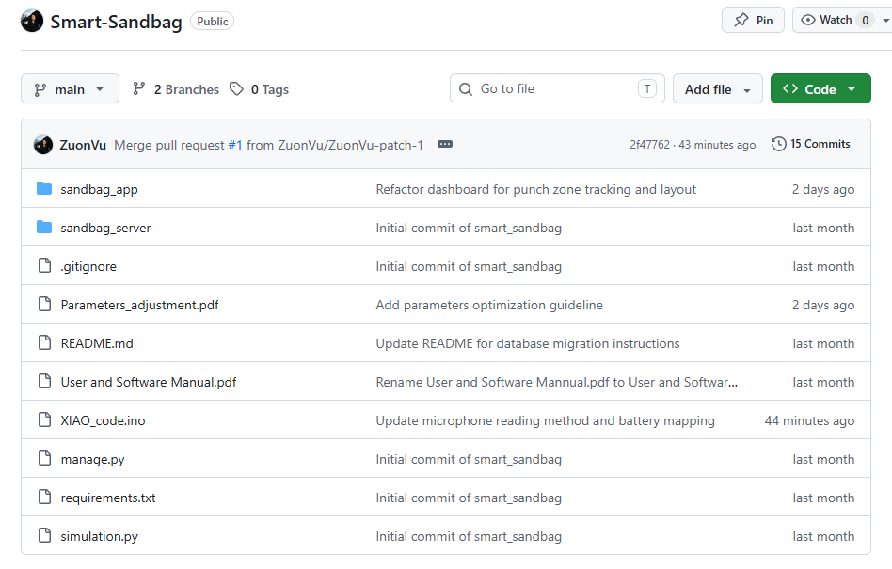
All systems are available on GitHub

Slide 5
Basic setup (Sensors -> XIAO Microcontroller -> Web)
XIAO
Laptop
Top mic
Bottom mic

Slide 6
Basic setup (Sensors -> XIAO Microcontroller -> Web)
BANG!!!
XIAO
Top mic
Laptop
Bottom mic

Slide 7

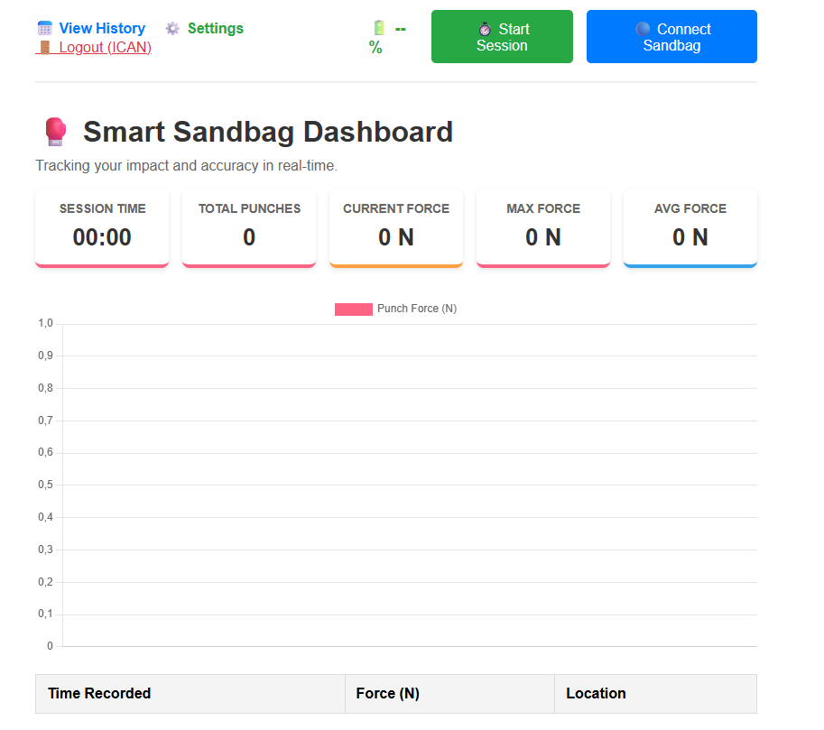
Basic setup (Sensors -> XIAO Microcontroller -> Web)
Nice jab man!
Angular acceleration (IMU)
XIAO
High noise peak
=> Punch location detected
Top mic
Calculate and Display
Low noise
peak
Bottom mic

Slide 8
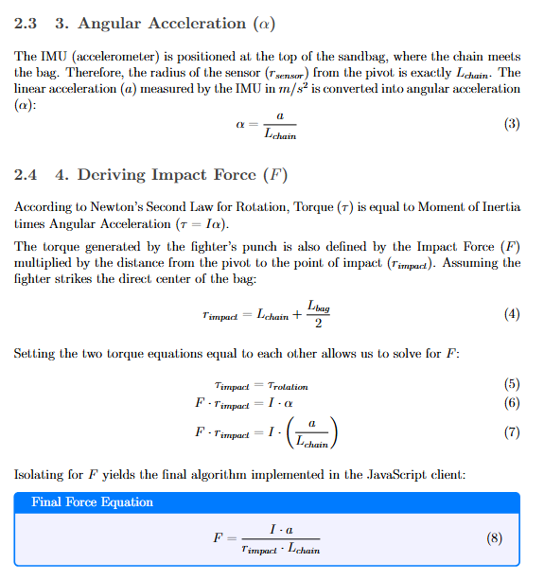
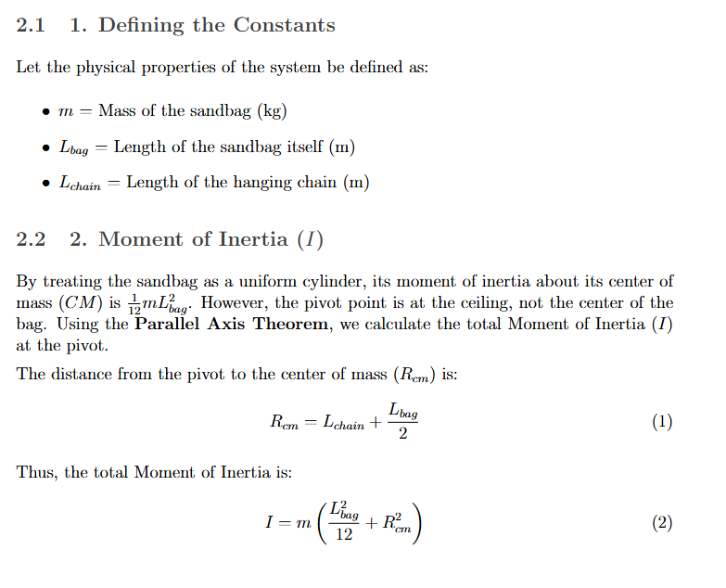
Force Calculation Formula

Slide 9
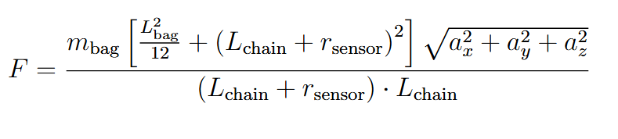
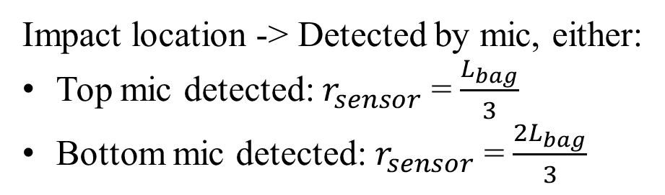
Force Calculation Formula
Angular acceleration (from IMU on XIAO microcontroller)
Moment of Inertia
Impact location -> Detected by mic, either:
Top mic detected: $r_{sensor}$ = $\frac{L_{bag}}{3}$
Bottom mic detected: $r_{sensor}$ = $\frac{2L_{bag}}{3}$

Slide 10
Web display (URL: http://smartpunch:8000/ )

Slide 11
2. From sensors to XIAO microcontroller
Audio Peak Detection Algorithm
Data Optimization
IMU: Converts raw G-force floats to integers (x100) to save Bluetooth bandwidth.
Runs a 5-millisecond loop (25 reads, 200µs apart) to capture the absolute peak of the sound wave. Applies a Noise Gate (< 10) to avoid fluctuation.
Battery: Maps raw voltage decay (360-430) to a linear 0-100% scale.
BLE Transmission Protocol
Packages two microphone integers into a highly efficient 4-byte array.
Operates at 50Hz (15ms delay) to ensure real-time streaming without crashing the Bluetooth buffer.

Slide 12
3. From XIAO microcontroller to Laptop
Sensor Combination
Combines sensors to ignore bag swinging and chain rattling.
Soft-Body Physics Engine
Calculates theoretical force (Newtons) based on bag mass and moment of inertia.
Logic: Requires simultaneous IMU spike (> 1.57G) AND Audio spike (> 100).
Applies a 700ms Cooldown to let post-punch vibrations fade.
Applies a Calibration Factor (0.35) to correct for the fist sinking into soft sand, converting raw G-force into realistic human impact values (1,000–5,000 N).

Slide 13
Backend Architecture (Django Web Server)
Secure Transfer
The browser packages the finalized punch math into a JSON payload and sends it via a secure POST request.
Database & User Tracking
Django automatically links the incoming data to the actively logged-in User ID.
History Visualization
The server queries the database to pull a user's historical rows.
Permanently saves the Timestamp, Force, and Location to a SQL Database.
Renders progression charts to track athletic improvement over time.

