Slide 1
CH-PROJ-M · T6 · UNI BAMBERG · SS 2026
2026 · 05 · 18
Computational Humanities — Master's Project
5 min talk · 5 min Q&A
PROJECT
Audio-to-Text Captioning with Large Audio-Language Models
Can these models describe sounds that overlap?
P2
MILESTONE 2 OF 5
Data Acquisition Strategy
01
02
03
04
05
Test corpus · Clotho v2.1
Acquisition · which mics?
Properties · + annotation
Classes · polyphony test
Risks · path forward
AUTHOR
P1 CALLBACK
Zuraiz
Closing the loop on contamination
Mat. 2177213
— the Risk to Watch I named last time.
Zuraiz · P2 · 2026-05-18
Title
Notes:
Good morning. My project is Audio-to-Text Captioning with Large Audio-Language Models — course code T6. The simple idea: the model listens to a sound clip, and writes a sentence about that sound. The big question I am chasing across the semester is whether these models can describe sounds that overlap. Today is the P2 milestone — the Data Acquisition Strategy. I'll cover five things in five minutes: which test corpus I picked and why, where the audio actually came from, the audio properties and annotation type, the sound classes plus the formal polyphony test, and finally the risks and the path to first evaluation. This whole talk closes the loop on contamination — the Risk to Watch I named in P1.

Slide 2
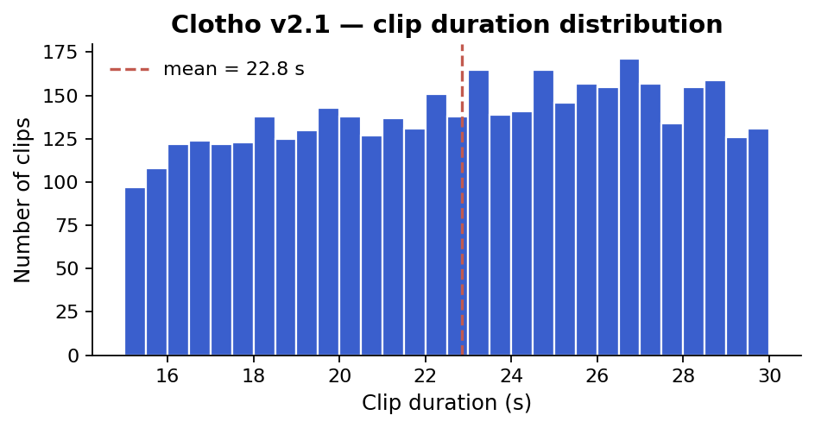
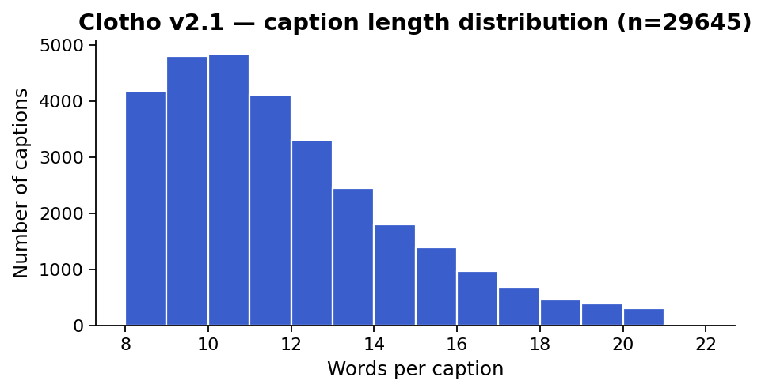
P2 · DATA ACQUISITION STRATEGY
Clotho v2.1 — and why it is the right test corpus
Zero-shot evaluation, so no recording. The question is which test corpus.
CHOSEN — CLOTHO V2.1
CONSIDERED & REJECTED
✓
DCASE Task 6 official benchmark — leaderboard parity
✕
AudioCaps — derived from AudioSet (LALM training overlap)
✓
5 captions per clip — dense annotation enables under-description detection
✓
FreeSound-sourced, not AudioSet — lower contamination risk than AudioCaps
✕
AudioSetCaps — same AudioSet family
✕
WavCaps — web-scraped, overlap risk with Clotho / AudioCaps
Zenodo · DOI 4783391
CC-BY 4.0
FAIR
✕
Cacophony — contrastive training corpus, not an eval benchmark
FRAME
The ALM Datasets Survey 2025 calls unverified pretrain overlap the "zero-shot illusion." This deck makes our test-corpus choice defensible against it.
Zuraiz · P2 · 2026-05-18
01 / 06
Notes:
My choice is Clotho v2.1 — the official DCASE Task 6 benchmark, five human captions per clip, CC-BY 4.0 on Zenodo, fully FAIR. I considered four alternatives and rejected each. AudioCaps and AudioSetCaps are built on AudioSet — almost every LALM trains on AudioSet, so a zero-shot claim there is not really zero-shot. WavCaps is web-scraped, high overlap risk. Cacophony is a contrastive training corpus, not an eval benchmark. One question frames the whole talk: can we trust the words 'zero-shot' when the model was trained on a corpus that may overlap our test set? Lecture 4 calls this Good Scientific Practice. The ALM Datasets Survey 2025 calls it the zero-shot illusion.

Slide 3
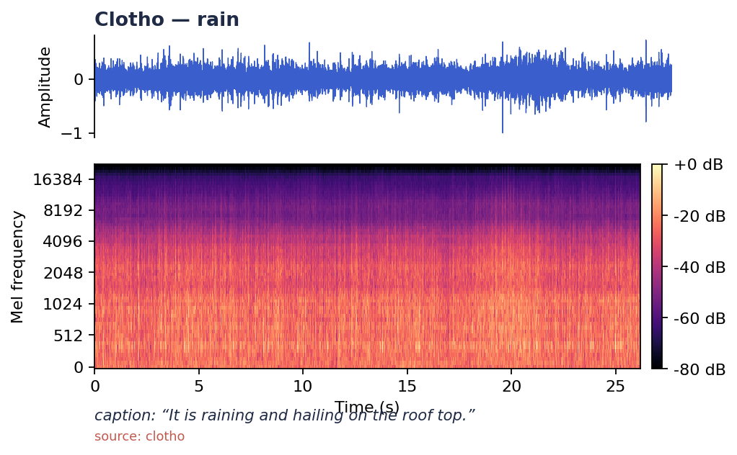
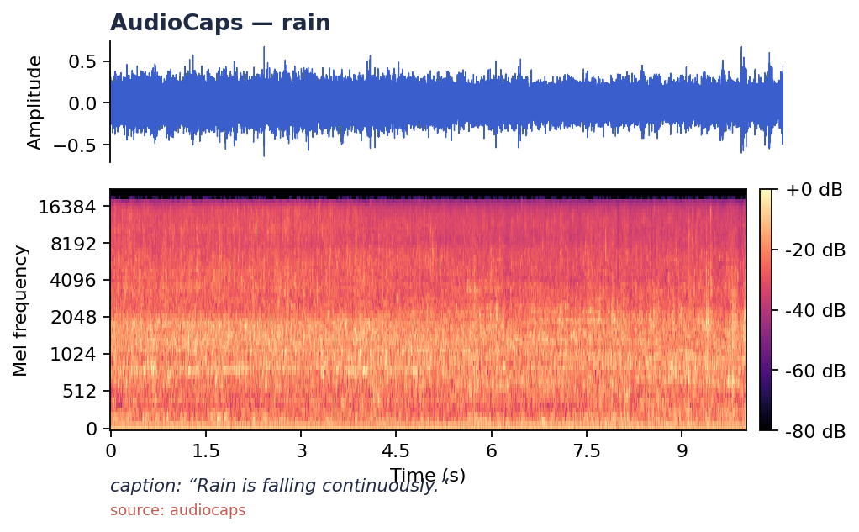
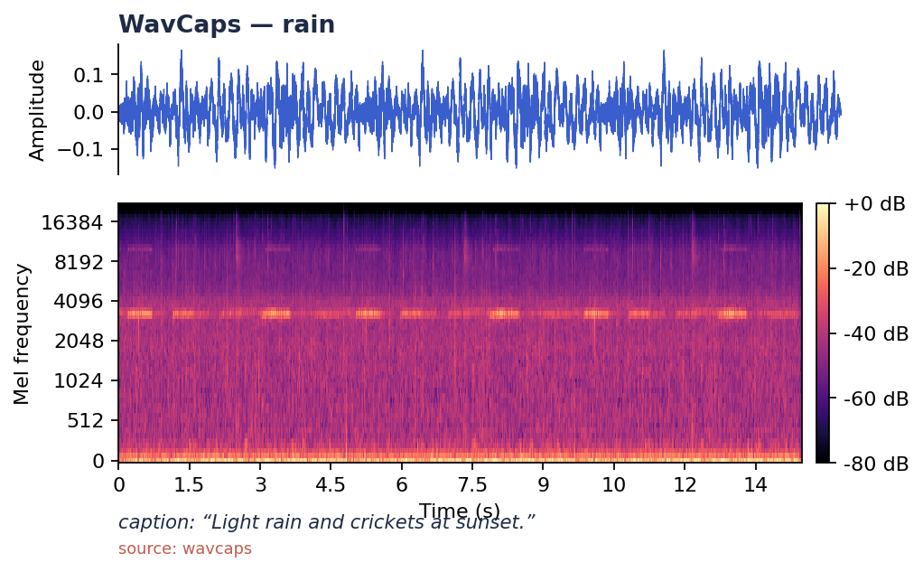
ACQUISITION
Which mics? — community-curated, heterogeneous devices
The honest answer is all of them. Device mismatch is built in.
Curated, not recorded.
Drossos, Lipping & Virtanen (Tampere) assembled Clotho from FreeSound uploads. The team's contribution is the captions — every clip carries its uploader's recording device.
DEVICE MISMATCH · IN ONE LINE
Studio condenser vs. MEMS mic
Device mismatch is built in.
Frequency response, self-noise & SPL handling differ by an order of magnitude. Real deployment audio is a mixture of both — Clotho's heterogeneous FreeSound provenance is a feature, not a bug.
Studio condensers, field recorders, mobile phones with MEMS mics — Clotho samples all of them . This is a generalisation hazard we acknowledge; we treat it as a realistic property of deployment audio.
The strip below makes it visible.
Same nominal sound (rain) from three corpora. Length, SNR & recording quality differ visibly across Clotho / AudioCaps / WavCaps.
Studio condenser
MEMS phone mic
SAME NOMINAL SOUND — RAIN — THREE CORPORA
Clotho · curated, 15–30 s, mono WAV
AudioCaps · YouTube 10 s, encoding artifacts
WavCaps · web-scraped, variable length & SNR
Zuraiz · P2 · 2026-05-18
02 / 06
Notes:
Clotho clips come from FreeSound — a community platform. Drossos and colleagues at Tampere curated them in 2020. No one recorded Clotho for the dataset; the audio is community-uploaded. So 'which mics' has an honest answer: all of them. Studio gear, field recorders, phones with MEMS microphones. This is exactly the device mismatch Lecture 4 warned us about — and it is a built-in caveat of every FreeSound-derived corpus. You can hear and see the difference. Same nominal sound — rain — recorded three ways. Clotho is clean and short. AudioCaps clips are noisier YouTube extracts. WavCaps is web-scraped, length and quality vary widely. The waveforms and spectrograms show it. Bottom line: heterogeneous mics are not a bug for our study, they are realistic. Real deployment audio is also heterogeneous. We just have to acknowledge it.

Slide 4
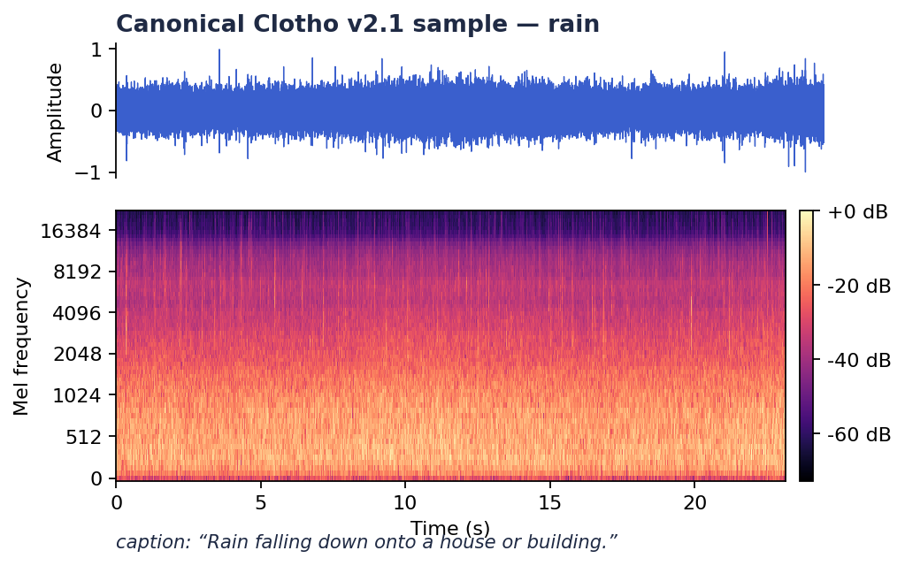
PROPERTIES & ANNOTATION
Audio properties + annotation
Weak-label benchmark, 5 captions per clip, spectrograms via librosa.stft.
AT A GLANCE
Sample rate
44.1 kHz
Channels
1 (mono)
Bit depth
16-bit
Format
WAV (PCM)
Clip duration
15 – 30 s
Captions / clip
5
Caption length
8 – 20 words
Canonical Clotho clip · waveform + log-mel · librosa.stft
ANNOTATION TYPE · WEAK (CLIP-LEVEL, NO TIME-STAMPS)
Vocabulary
open (no fixed taxonomy)
5 human-written captions per clip, 8–20 words, crowdsourced via Amazon MTurk. Post-processed to remove unique words, named entities & speech transcription — Clotho is not a speech corpus.
Licence
CC-BY 4.0
Distribution
Zenodo record 4783391 · FAIR
Strong (segment-level) labels are derived later via PaSST / PANNs SED for the polyphony split.
Zuraiz · P2 · 2026-05-18
03 / 06
Notes:
The numbers, briefly. 44.1 kilohertz, mono, 16-bit WAV. Fifteen to thirty seconds per clip. Around seven thousand clips across development, validation, and evaluation splits. Five captions per clip, eight to twenty words each. Annotation type: weak. Clip-level. No time-stamps. Lecture 4 calls this audio-tagging-style annotation. Strong labels — segment-level with start and end times — exist in DCASE Task 4, not here. We will derive pseudo-strong labels with a sound-event detector for the polyphony split on the next slide. Here is what a typical Clotho clip looks like — waveform on top, log-mel spectrogram on the bottom, generated with librosa dot S-T-F-T exactly as Lecture 4 specifies.

Slide 5
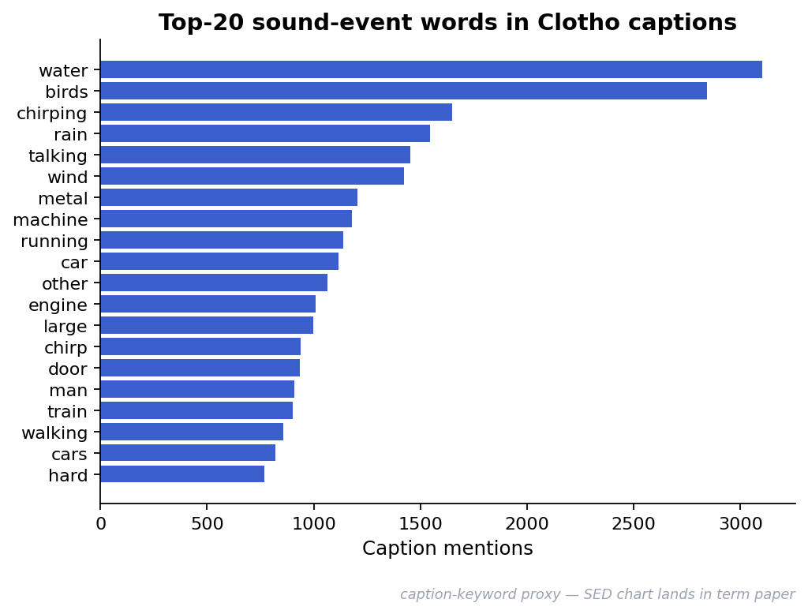
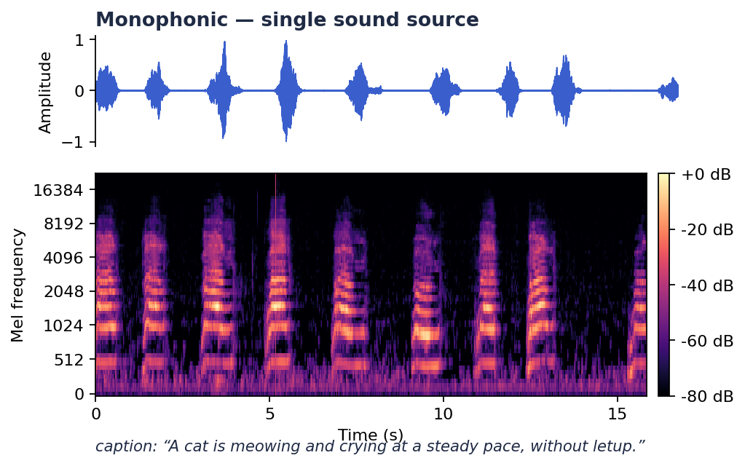
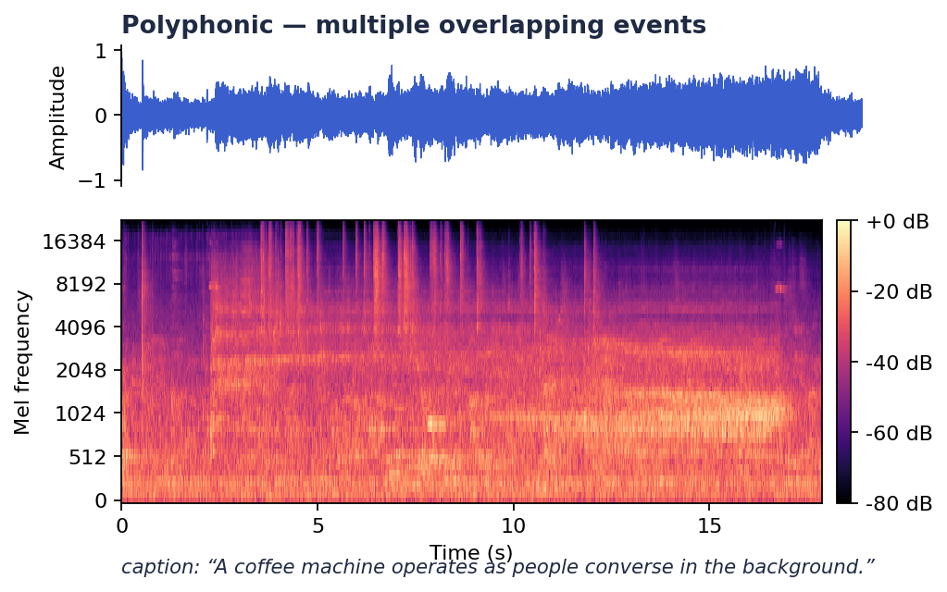

CLASSES · EXAMPLES · THE FORMAL TEST
Sound classes, examples — and how I detect under-description
POLYPHONY BUCKET · SINGLE-SOURCE VS. MIXED-SOURCE
Top-20 caption-keyword proxy · PaSST / PANNs CNN14 SED on the dev split
→
Open-vocabulary captions — no fixed taxonomy. Pseudo-classes derived by PANNs tagging.
Monophonic · one source · audio: mono_example.wav
Polyphonic · ≥ 2 overlapping sources · audio: poly_example.wav
→
Long-tail distribution dominated by music, water, traffic.
E
audio
= SED-detected events · E
ref
= union of 5 captions · E
RQ2 · UNDER-DESCRIPTION TEST
= model output entities.
card(E_{model}) < card(E_{ref} ∩ E_{audio})
model
A clip is under-described iff
Δ MACE = poly-bucket rate − mono-bucket rate.
Zuraiz · P2 · 2026-05-18
04 / 06
Notes:
Clotho has no fixed class taxonomy — captions are open-vocabulary. To answer the 'which classes' question, I tagged the development split with PANNs CNN14. The top twenty AudioSet classes look like this. Music, water, traffic dominate. Long tail beyond that. A monophonic example: one dog barking. The spectrogram shows a single source. The caption mentions one event. A polyphonic example: footsteps, rain, distant traffic. Three energy bands in the spectrogram. The reference caption mentions all three. And here is how I will measure under-description, formally. A clip is under-described if the model's output entity set is smaller than the intersection of the reference captions and the detected audio events. Cardinality of E-model less than cardinality of E-ref intersect E-audio. The fraction of clips where this happens, split by polyphony bucket, is my Delta MACE for RQ2.

Slide 6
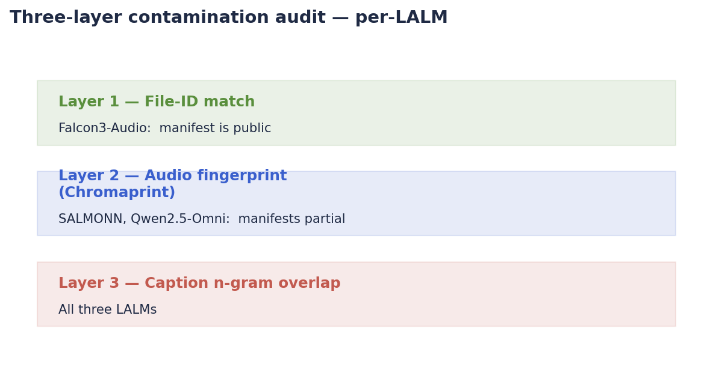
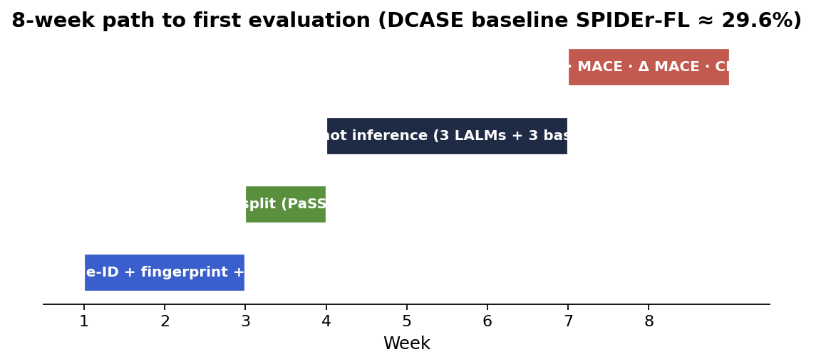
RISKS · PATH TO EVALUATION
Risks I am closing on this slide
P1 closed with contamination as my Risk to Watch and an open question: do the three LALMs fail polyphony the same way , or differently? Both shape this slide.
EMPIRICAL WEDGE
FD-DeCap (IEEE TASLP 2025, doc 11333308) reports SPIDEr after causal-inference debiasing:
·
Audit scope: the 3 LALMs only (Falcon3-Audio · SALMONN · Qwen2.5-Omni). The 3 traditional baselines (CNN14 / AST / EnCLAP) use small, fully-known corpora — no contamination concern.
0.282
0.429
vs.
·
Per-model, not aggregated. Aggregation hides differential failure modes.
CLOTHO
AUDIOCAPS
·
Falcon3-Audio manifest is public — File-ID layer is fully usable there. For SALMONN / Qwen2.5-Omni, Chromaprint + caption n-gram cover the gap.
The contaminated corpus scores ~50 % higher — the direct empirical wedge for the Clotho choice.
Out of scope: original recording (zero-shot protocol).
HOW CLOTHO SERVES EACH RESEARCH QUESTION
RQ1
Baseline parity
RQ2
Polyphony · core
RQ3
Hallucination
SPIDEr-FL · CIDEr
Δ MACE (poly − mono)
CHAIR-audio · MACE Precision
DCASE Task 6 leaderboard parity — direct comparison to the 29.6 % CNN14 baseline.
5-caption union = E_{ref} ; PaSST / PANNs SED on Clotho dev = E _{audio}.
5-caption density makes invented-entity detection statistically reliable.
Zuraiz · P2 · 2026-05-18
05 / 06
Notes:
Closing the loop on the P1 Risk to Watch. I will run a three-layer contamination audit, per LALM — not aggregated. P1 also closed with an open question: do the three LALMs fail polyphony the same way? Per-model reporting is the only way to answer that. Layer one — file-ID match. Falcon3-Audio's training manifest is public — its key selling point. So file-ID works there. Layer two — Chromaprint fingerprint — covers SALMONN and Qwen2.5-Omni whose manifests are not fully public. Layer three — caption n-gram overlap — a final safety net. And one empirical fact that motivates this whole audit: FD-DeCap reports SPIDEr point two-eight-two on Clotho versus point four-two-nine on AudioCaps. Even after causal-inference debiasing, the contaminated corpus scores fifty percent higher. That gap is the wedge. Eight weeks to first evaluation. Audit, then split, then inference, then metrics. DCASE 2024 baseline SPIDEr-FL is 29.6 percent — that is the reference value. Thank you. I am happy to take your questions.

Slide 7
REFERENCES
References — IEEE format
[1]
Drossos, K., Lipping, S., Virtanen, T. "Clotho: An Audio Captioning Dataset." IEEE ICASSP, 2020. Zenodo record 4783391 (v2.1).
[5]
Mei et al. "Beyond the Status Quo: Critical Reflection on Audio Captioning Metrics." IEEE/ACM TASLP, 2023. doi:10.1109/TASLP.2023.3321968
[2]
Falconi et al. "Competitive Audio-Language Models with Data-Efficient Single-Stage Training on Public Data (Falcon3-Audio)." IEEE ASRU, 2025. ieeexplore.ieee.org/document/11434596
[6]
Dixit / Khare et al. "FD-DeCap: A Front-Door Causal Inference-Based Framework for Debiasing Audio Captioning." IEEE/ACM TASLP, 2025. ieeexplore.ieee.org/document/11333308
[3]
Dixit et al. "MACE: Leveraging Audio for Evaluating Audio Captioning Systems." IEEE ICASSP-W, 2025. ieeexplore.ieee.org/document/11011270
[7]
Kong et al. "PANNs: Large-Scale Pretrained Audio Neural Networks for Audio Pattern Recognition (CNN14)." IEEE/ACM TASLP, vol. 28, pp. 2880–2894, 2020. doi:10.1109/TASLP.2020.3030497
[4]
IEEE ASRU 2025. "Data Leakage Benchmark." ieeexplore.ieee.org/document/11450559
[8]
Mei et al. "WavCaps: A ChatGPT-Assisted Weakly-Labelled Audio Captioning Dataset for Audio-Language Multimodal Research." IEEE/ACM TASLP, 2024. arxiv.org/abs/2303.17395
Shortlist of 8 data-strategy references from the project's 49-paper corpus. Full corpus + 38 read papers indexed in the project wiki.
Zuraiz · P2 · 2026-05-18
06 / 06
Notes:
These are the eight data-strategy references for this talk. Drossos 2020 for Clotho. MACE 2025 for the metric. Data-Leakage Benchmark and FD-DeCap for audit methodology and the empirical wedge. ALM Datasets Survey 2025 for the zero-shot illusion framing. PANNs / CNN14 as the SED tool. Falcon3-Audio for the public-manifest claim. And WavCaps as the web-scraped counter-example.

Slide 8
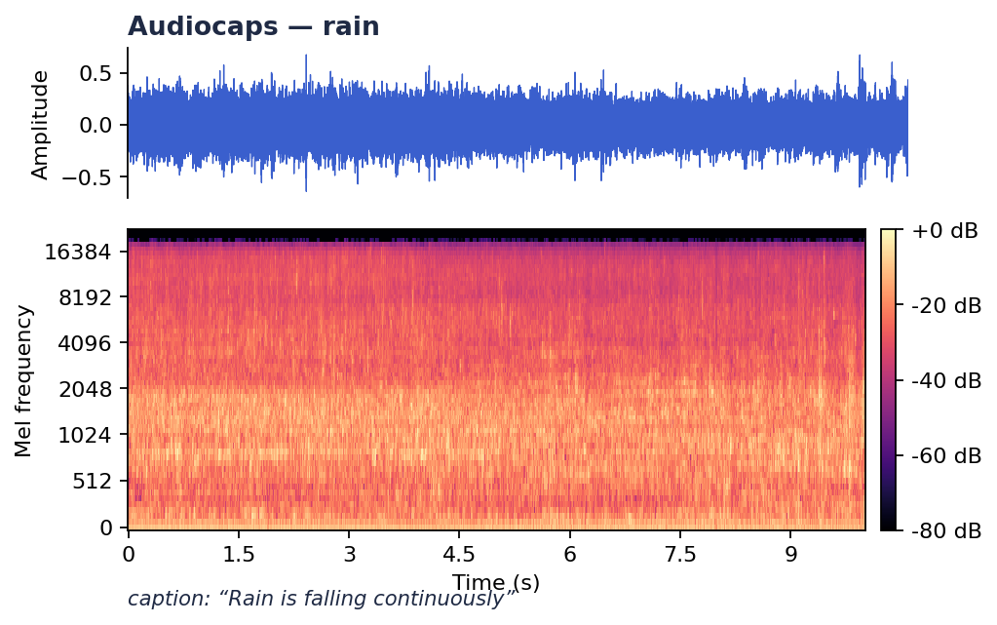
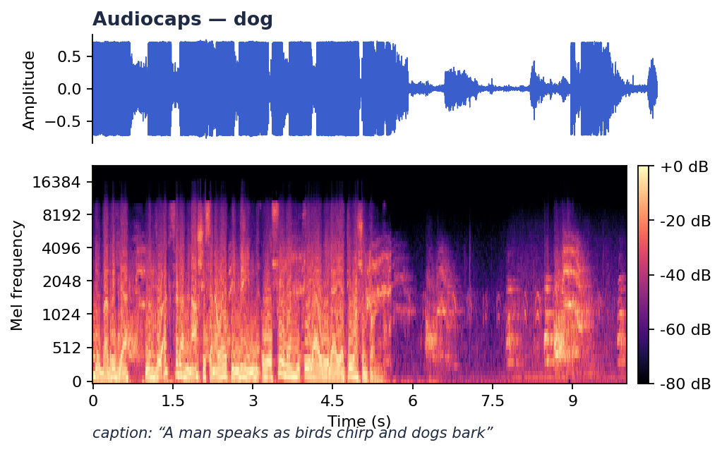
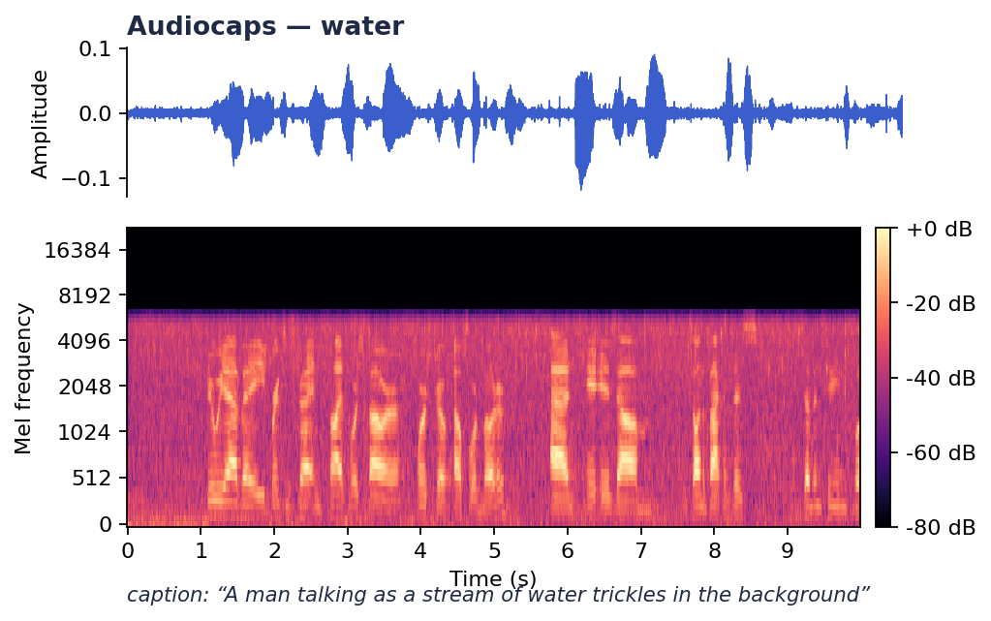
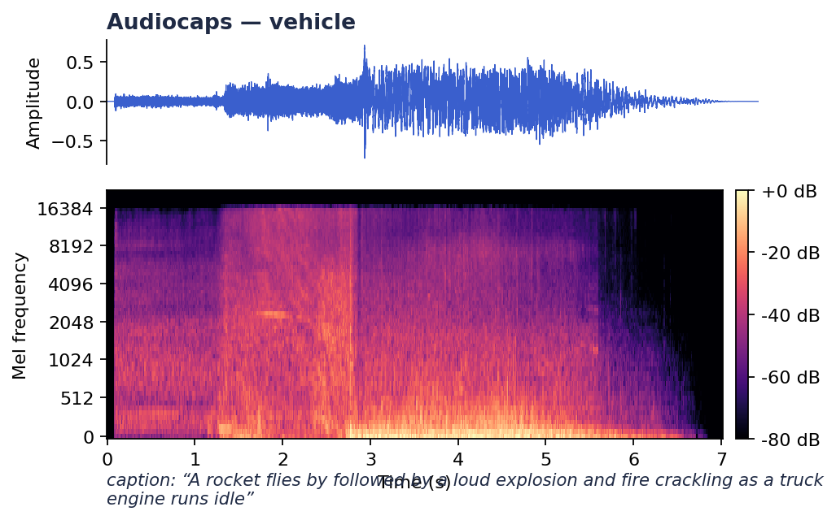
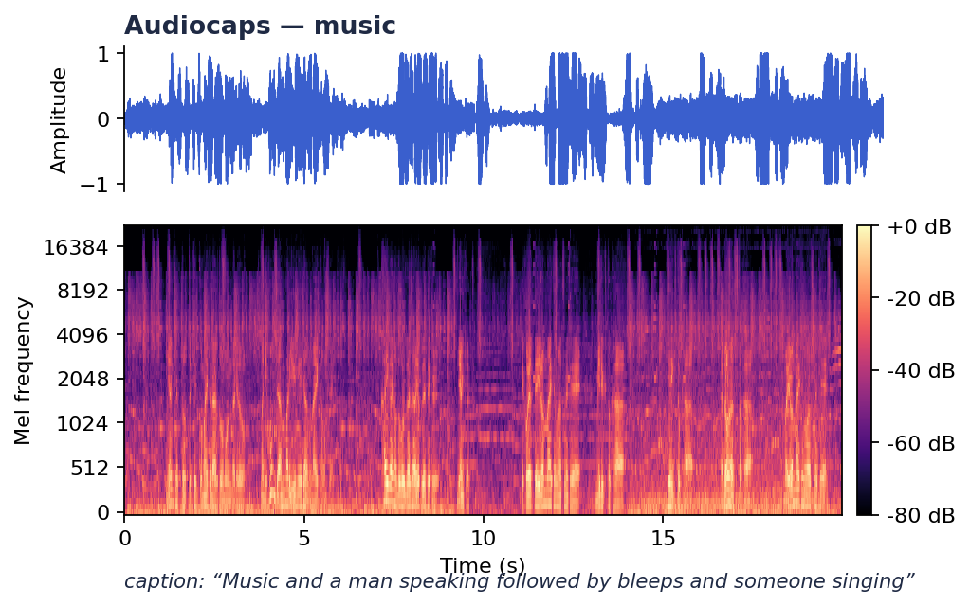
APPENDIX A · Q&A ONLY
AudioCaps — five representative clips
Shown only if asked. AudioCaps = 10-second YouTube segments from AudioSet , single-annotator captions. Note YouTube-encoding artifacts and uneven SNR.
"Rain is falling continuously."
"A man speaks as birds chirp and dogs bark."
"A man talking as a stream of water trickles in the background."
WHY THIS MATTERS
Captions are single-annotator — one of the three reasons Clotho (5 captions per clip) is preferred for a clean zero-shot benchmark.
"A rocket flies by followed by a loud explosion and fire crackling as a truck engine runs idle."
"Music and a man speaking followed by bleeps and someone singing."
Zuraiz · P2 · 2026-05-18 · Appendix A
A1 — Q&A only
Notes:
Appendix A — shown only if asked. AudioCaps is derived from ten-second YouTube segments of AudioSet. Captions are single-annotator. These five clips span common categories — note the strong YouTube-encoding artifacts and uneven SNR. Captions in this corpus are single-annotator, which is one of the three reasons Clotho with five captions per clip is preferred.

Slide 9
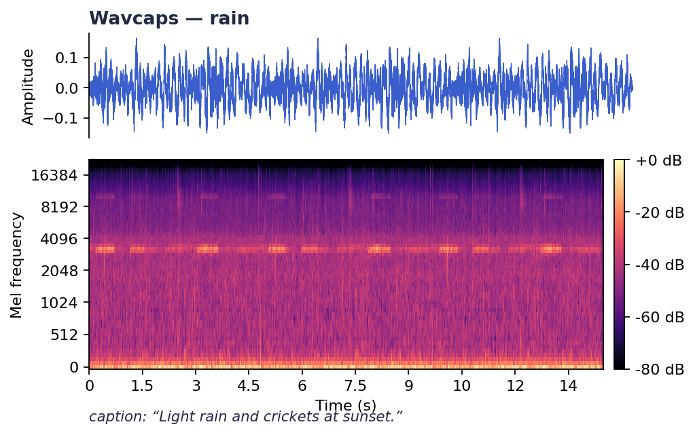
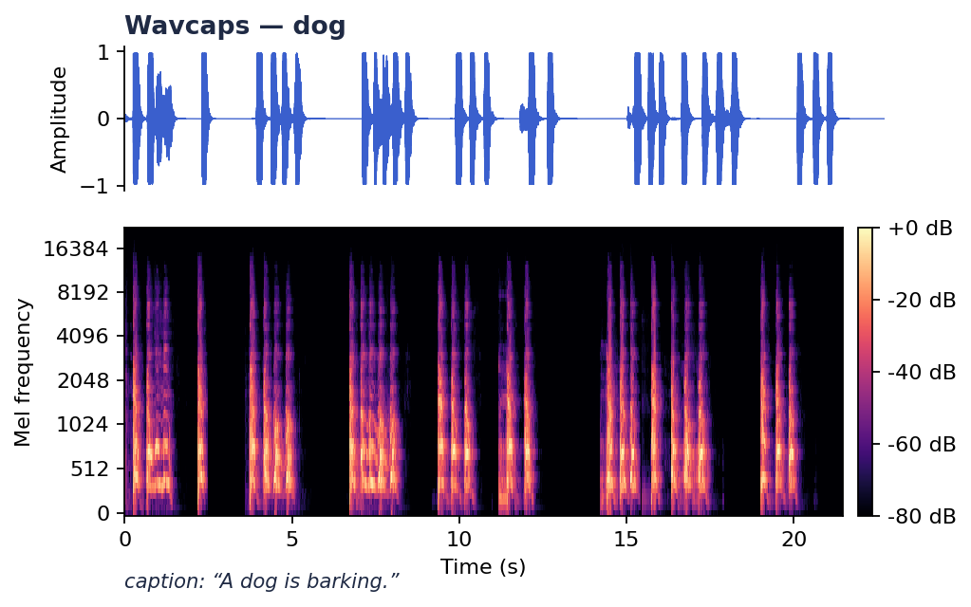
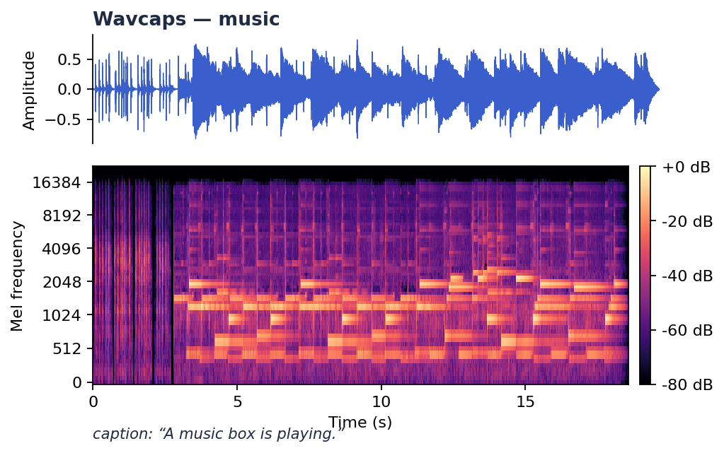
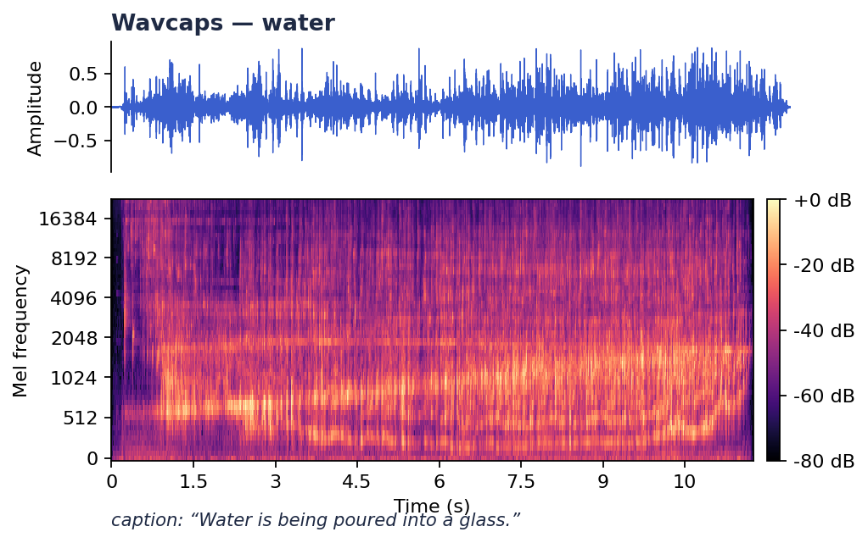
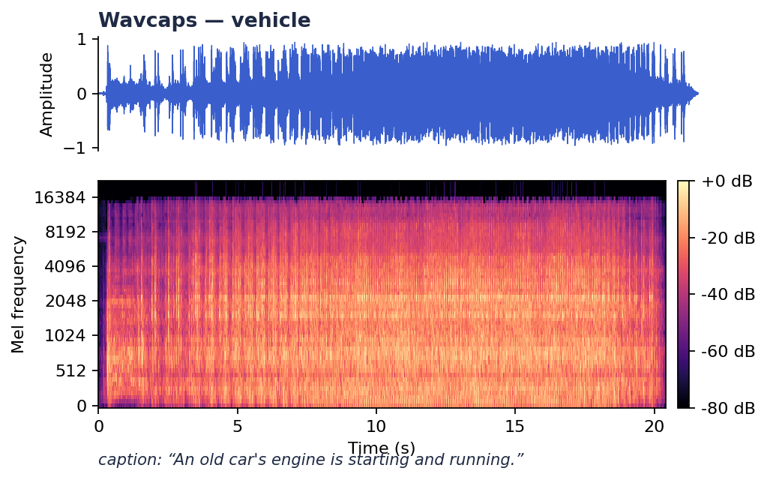
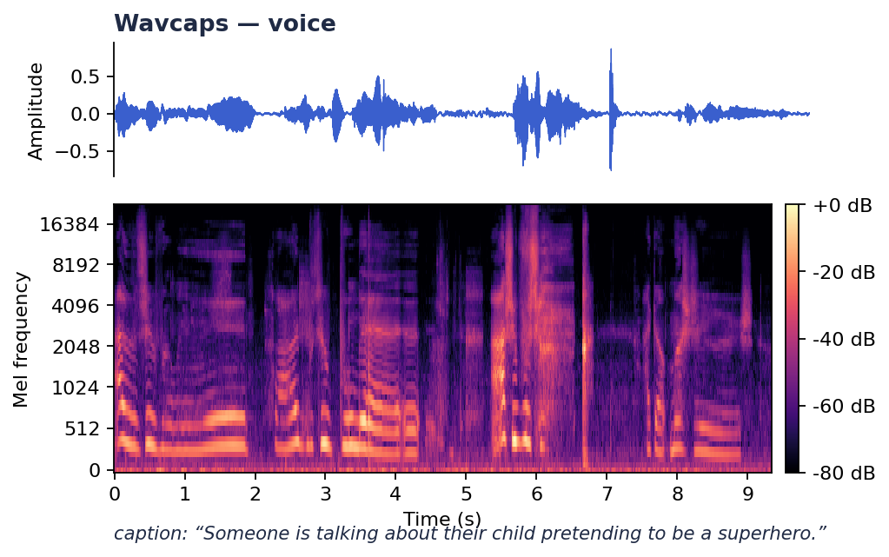
APPENDIX B · Q&A ONLY
WavCaps — SoundBible subset, six clips
Shown only if asked. WavCaps = 400K-clip web-scraped corpus over four sub-sources (AudioSet_SL · BBC Sound Effects · FreeSound · SoundBible). SoundBible is the most curated subset.
"Light rain and crickets at sunset."
"A dog is barking."
"A music box is playing."
"Water is being poured into a glass."
"An old car's engine is starting and running."
"Someone is talking about their child pretending to be a superhero."
Why this matters WavCaps captions are LLM-generated from web metadata — they inherit any biases of the generating LLM. The FreeSound subset overlaps Clotho's source platform — a contamination risk. Both are reasons Clotho is preferred for a clean zero-shot benchmark.
Zuraiz · P2 · 2026-05-18 · Appendix B
A2 — Q&A only
Notes:
Appendix B — shown only if asked. WavCaps is a 400K-clip web-scraped corpus combining four sub-sources: AudioSet_SL, BBC Sound Effects, FreeSound, and SoundBible. The SoundBible subset shown here is the most curated; the FreeSound subset overlaps directly with Clotho's source platform — a contamination risk. WavCaps captions are LLM-generated from web metadata — they inherit any biases of the generating LLM. Both are reasons Clotho is preferred for a clean zero-shot benchmark.

