Slide 1
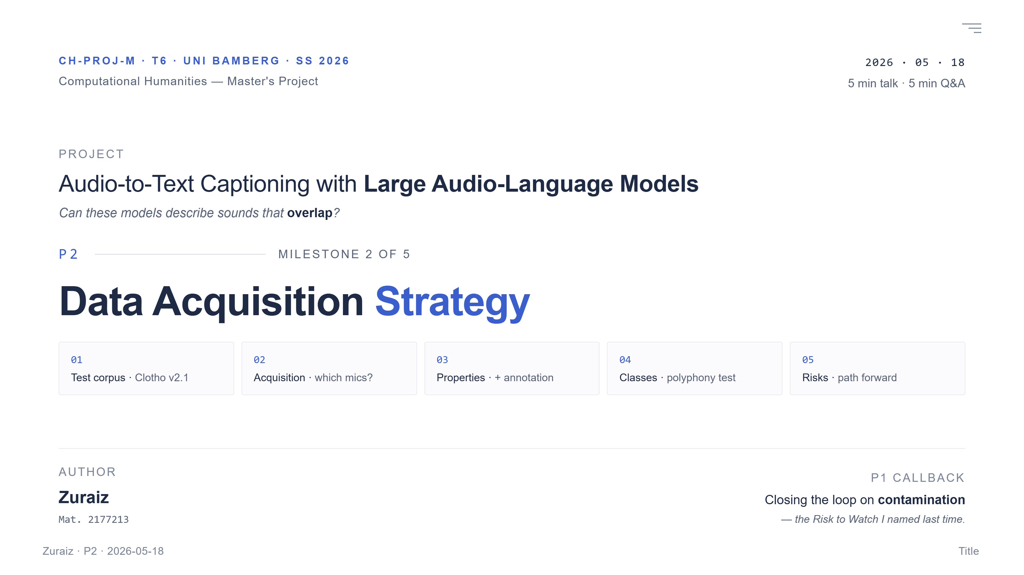
Notes:
Good morning. My project is Audio-to-Text Captioning with Large Audio-Language Models — course code T6. The simple idea: the model listens to a sound clip, and writes a sentence about that sound. The big question I am chasing across the semester is whether these models can describe sounds that overlap. Today is the P2 milestone — the Data Acquisition Strategy. I'll cover five things in five minutes: which test corpus I picked and why, where the audio actually came from, the audio properties and annotation type, the sound classes plus the formal polyphony test, and finally the risks and the path to first evaluation. This whole talk closes the loop on contamination — the Risk to Watch I named in P1.

Slide 2
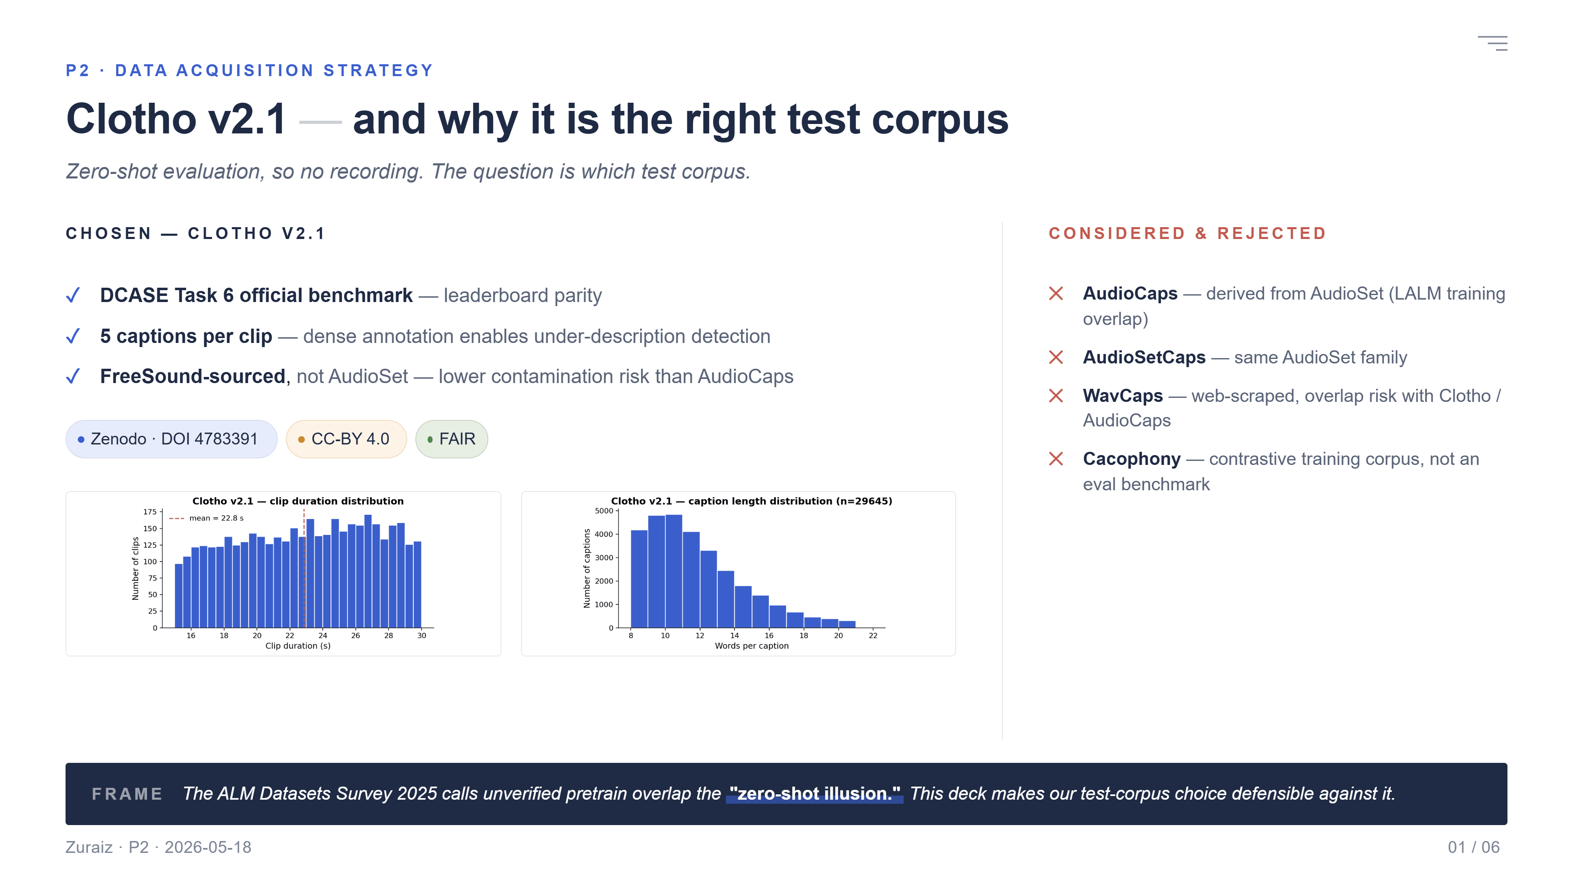
Notes:
My choice is Clotho v2.1 — the official DCASE Task 6 benchmark, five human captions per clip, CC-BY 4.0 on Zenodo, fully FAIR. I considered four alternatives and rejected each. AudioCaps and AudioSetCaps are built on AudioSet — almost every LALM trains on AudioSet, so a zero-shot claim there is not really zero-shot. WavCaps is web-scraped, high overlap risk. Cacophony is a contrastive training corpus, not an eval benchmark. One question frames the whole talk: can we trust the words 'zero-shot' when the model was trained on a corpus that may overlap our test set? Lecture 4 calls this Good Scientific Practice. The ALM Datasets Survey 2025 calls it the zero-shot illusion.

Slide 3
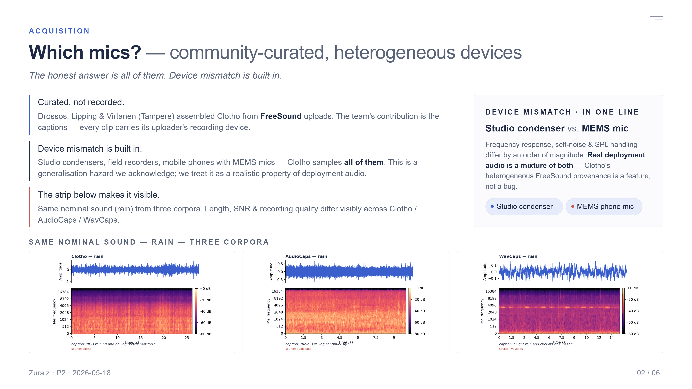
Notes:
Clotho clips come from FreeSound — a community platform. Drossos and colleagues at Tampere curated them in 2020. No one recorded Clotho for the dataset; the audio is community-uploaded. So 'which mics' has an honest answer: all of them. Studio gear, field recorders, phones with MEMS microphones. This is exactly the device mismatch Lecture 4 warned us about — and it is a built-in caveat of every FreeSound-derived corpus. You can hear and see the difference. Same nominal sound — rain — recorded three ways. Clotho is clean and short. AudioCaps clips are noisier YouTube extracts. WavCaps is web-scraped, length and quality vary widely. The waveforms and spectrograms show it. Bottom line: heterogeneous mics are not a bug for our study, they are realistic. Real deployment audio is also heterogeneous. We just have to acknowledge it.

Slide 4
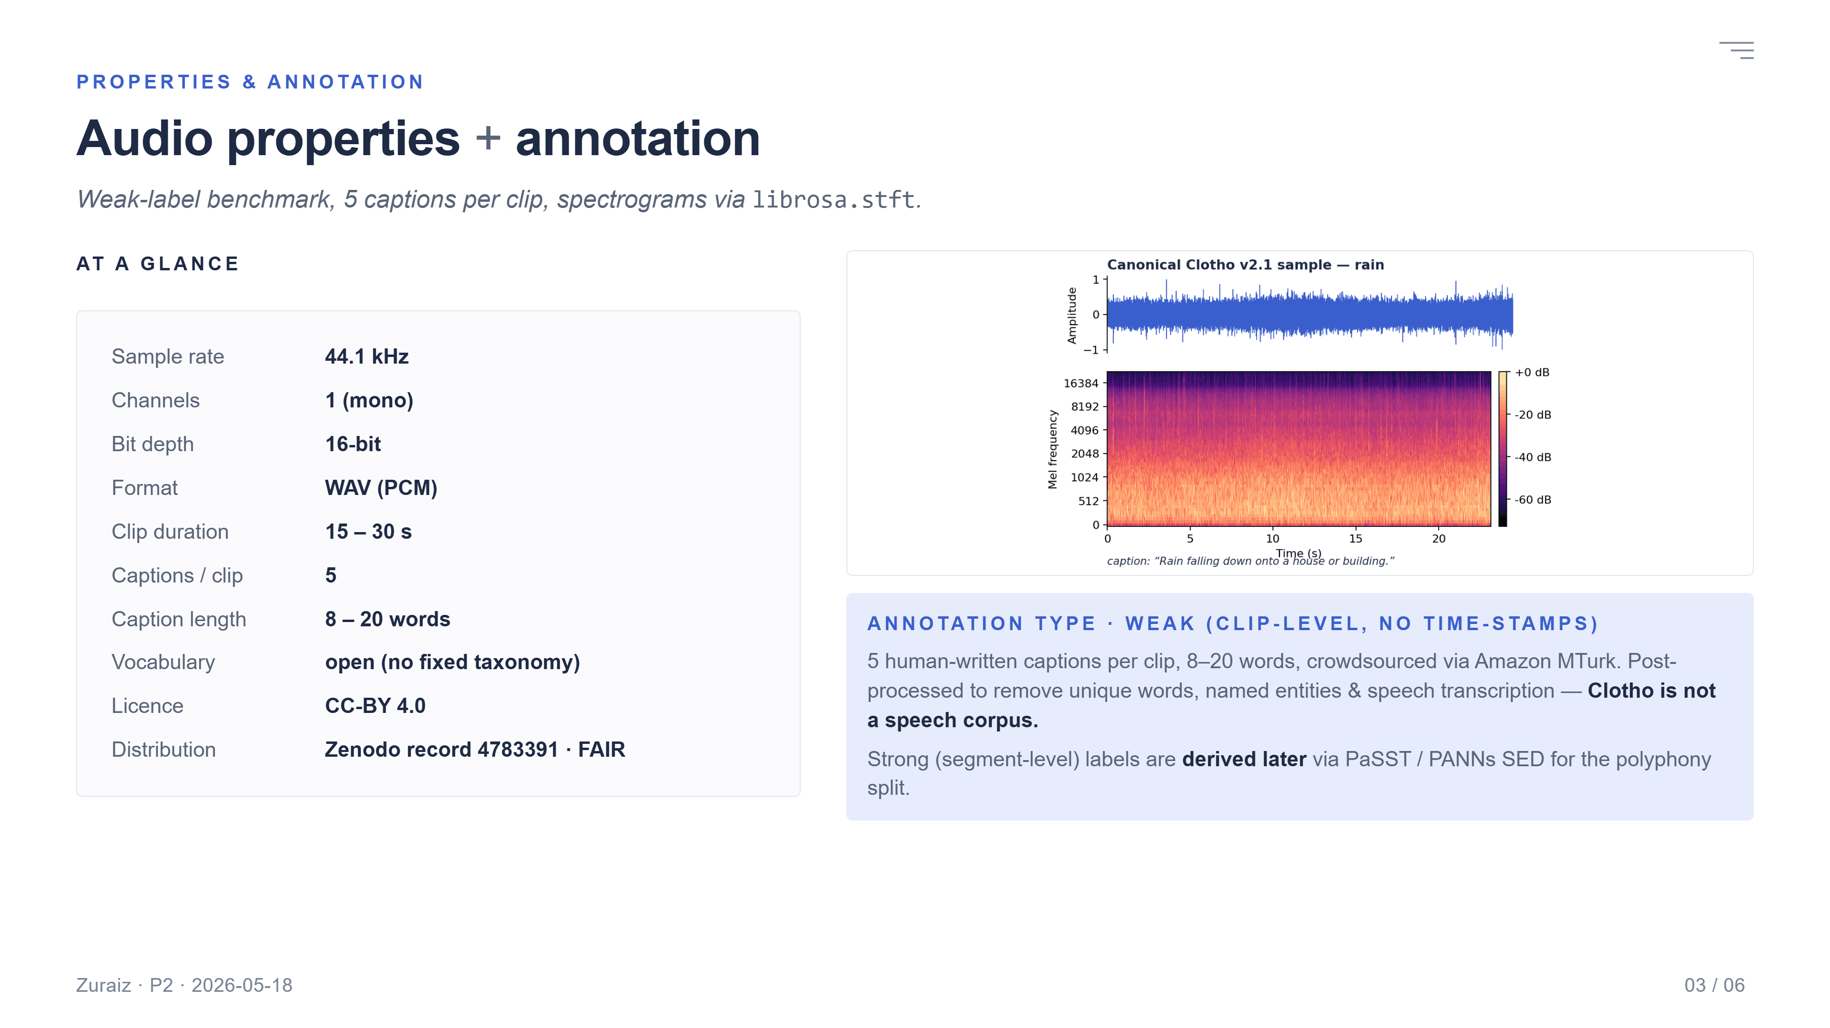
Notes:
The numbers, briefly. 44.1 kilohertz, mono, 16-bit WAV. Fifteen to thirty seconds per clip. Around seven thousand clips across development, validation, and evaluation splits. Five captions per clip, eight to twenty words each. Annotation type: weak. Clip-level. No time-stamps. Lecture 4 calls this audio-tagging-style annotation. Strong labels — segment-level with start and end times — exist in DCASE Task 4, not here. We will derive pseudo-strong labels with a sound-event detector for the polyphony split on the next slide. Here is what a typical Clotho clip looks like — waveform on top, log-mel spectrogram on the bottom, generated with librosa dot S-T-F-T exactly as Lecture 4 specifies.

Slide 5
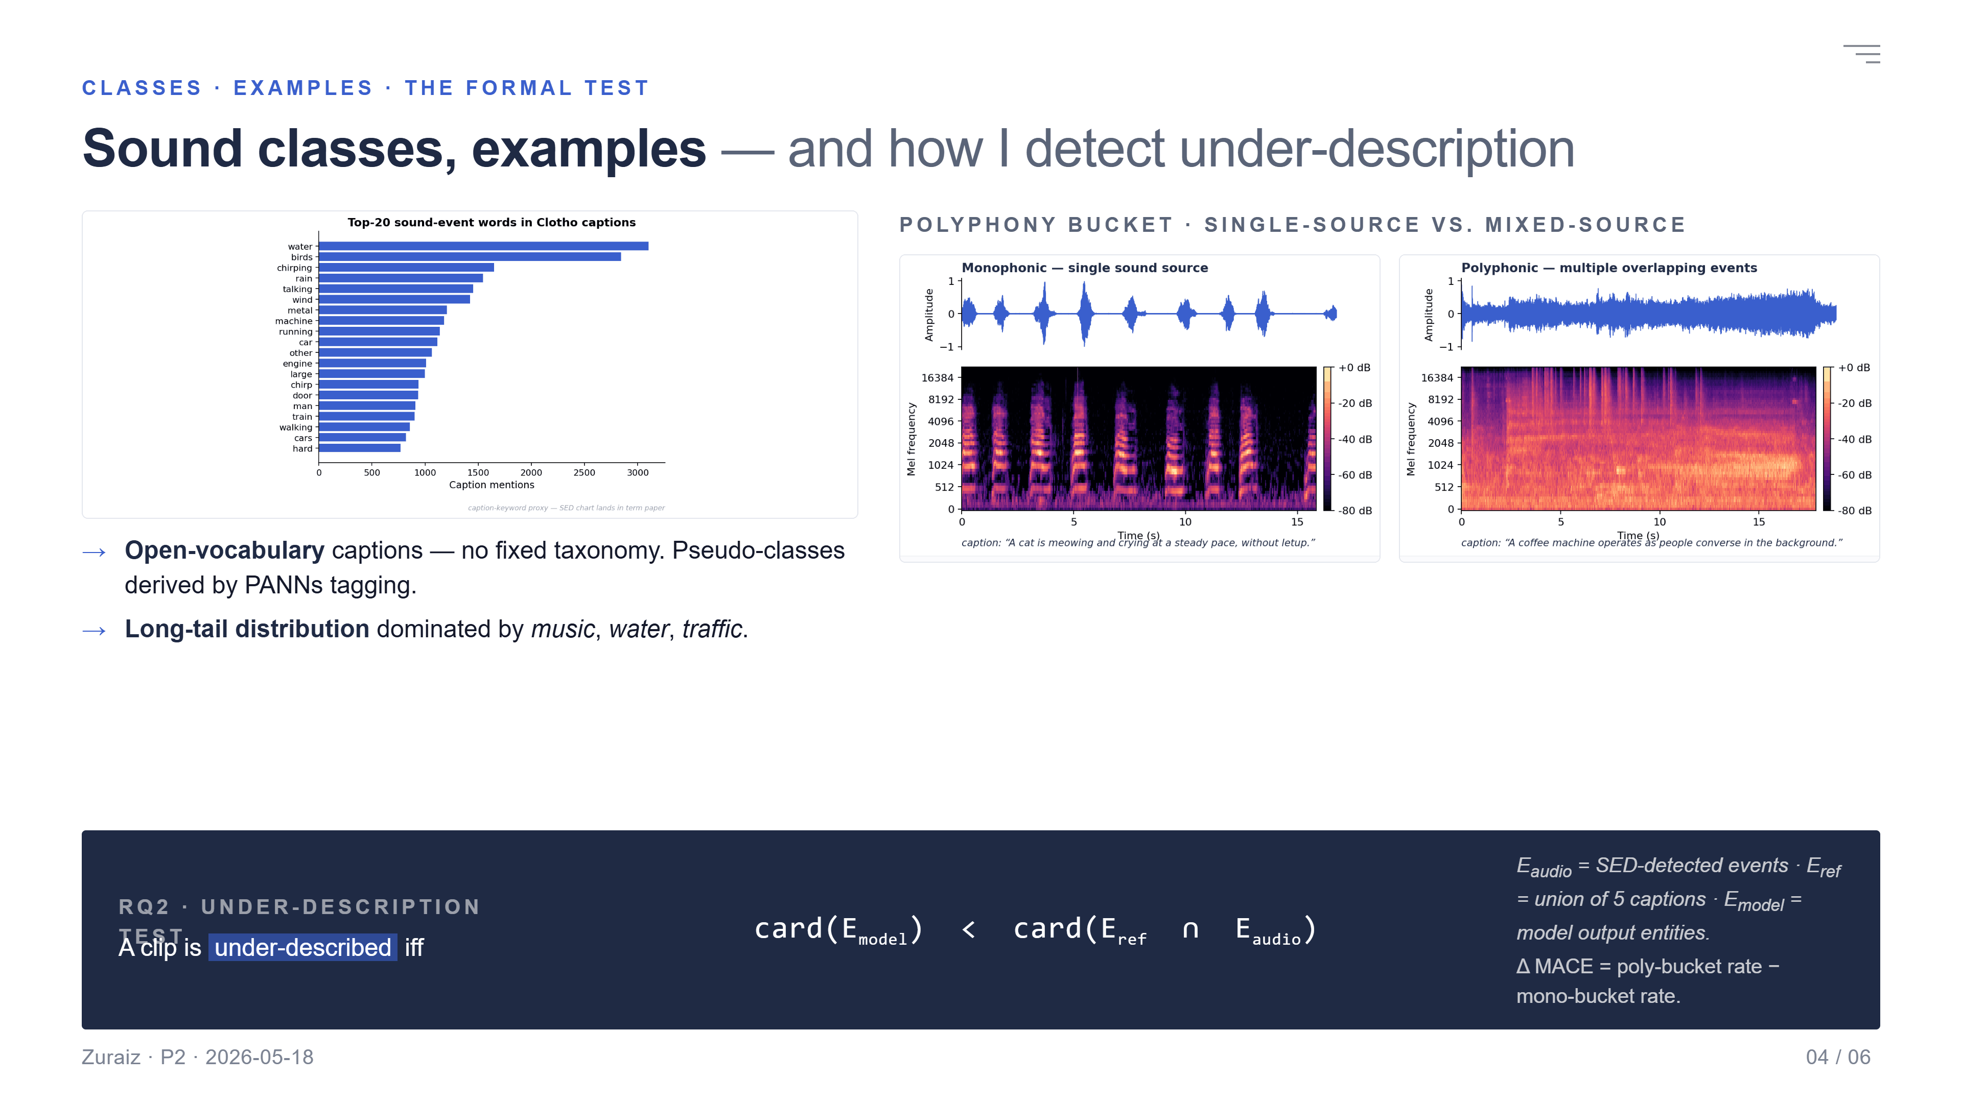
Notes:
Clotho has no fixed class taxonomy — captions are open-vocabulary. To answer the 'which classes' question, I tagged the development split with PANNs CNN14. The top twenty AudioSet classes look like this. Music, water, traffic dominate. Long tail beyond that. A monophonic example: one dog barking. The spectrogram shows a single source. The caption mentions one event. A polyphonic example: footsteps, rain, distant traffic. Three energy bands in the spectrogram. The reference caption mentions all three. And here is how I will measure under-description, formally. A clip is under-described if the model's output entity set is smaller than the intersection of the reference captions and the detected audio events. Cardinality of E-model less than cardinality of E-ref intersect E-audio. The fraction of clips where this happens, split by polyphony bucket, is my Delta MACE for RQ2.

Slide 6
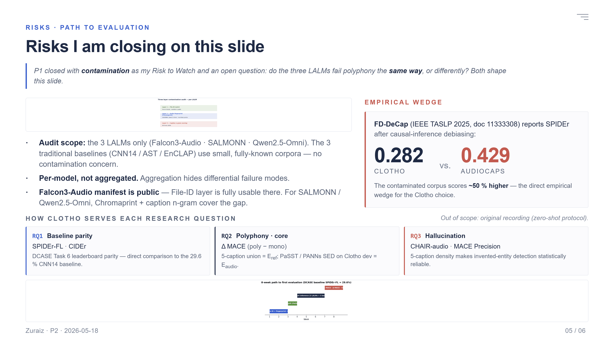
Notes:
Closing the loop on the P1 Risk to Watch. I will run a three-layer contamination audit, per LALM — not aggregated. P1 also closed with an open question: do the three LALMs fail polyphony the same way? Per-model reporting is the only way to answer that. Layer one — file-ID match. Falcon3-Audio's training manifest is public — its key selling point. So file-ID works there. Layer two — Chromaprint fingerprint — covers SALMONN and Qwen2.5-Omni whose manifests are not fully public. Layer three — caption n-gram overlap — a final safety net. And one empirical fact that motivates this whole audit: FD-DeCap reports SPIDEr point two-eight-two on Clotho versus point four-two-nine on AudioCaps. Even after causal-inference debiasing, the contaminated corpus scores fifty percent higher. That gap is the wedge. Eight weeks to first evaluation. Audit, then split, then inference, then metrics. DCASE 2024 baseline SPIDEr-FL is 29.6 percent — that is the reference value. Thank you. I am happy to take your questions.

Slide 7
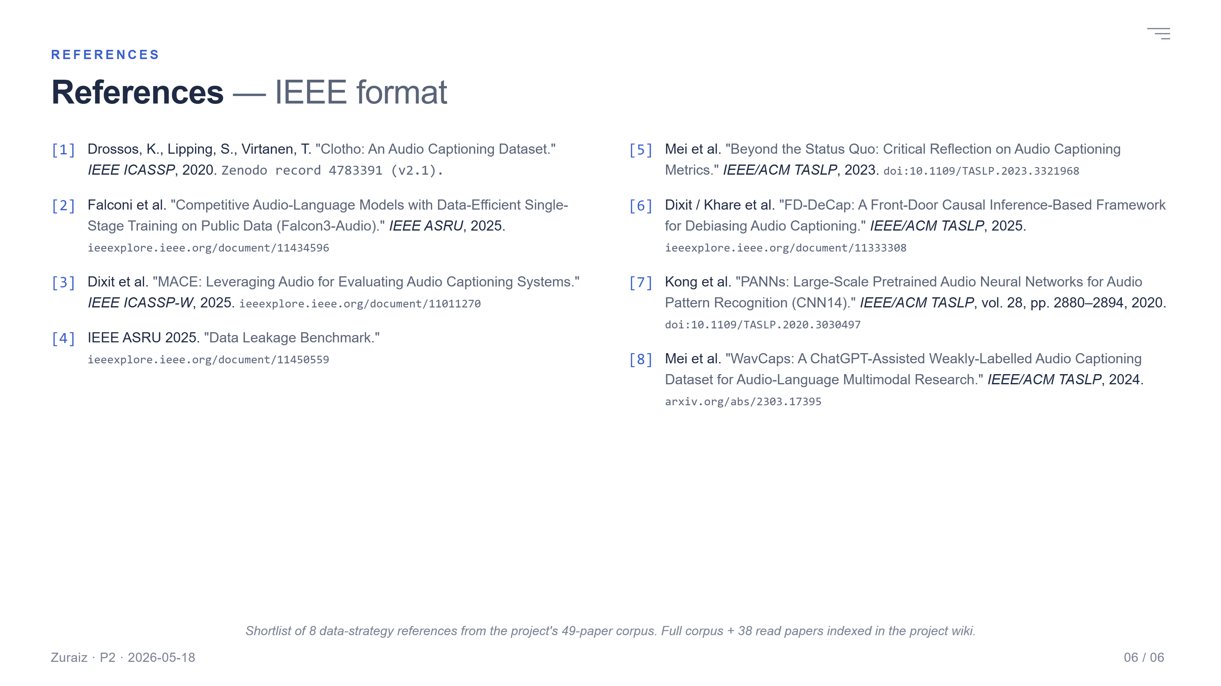
Notes:
These are the eight data-strategy references for this talk. Drossos 2020 for Clotho. MACE 2025 for the metric. Data-Leakage Benchmark and FD-DeCap for audit methodology and the empirical wedge. ALM Datasets Survey 2025 for the zero-shot illusion framing. PANNs / CNN14 as the SED tool. Falcon3-Audio for the public-manifest claim. And WavCaps as the web-scraped counter-example.

Slide 8
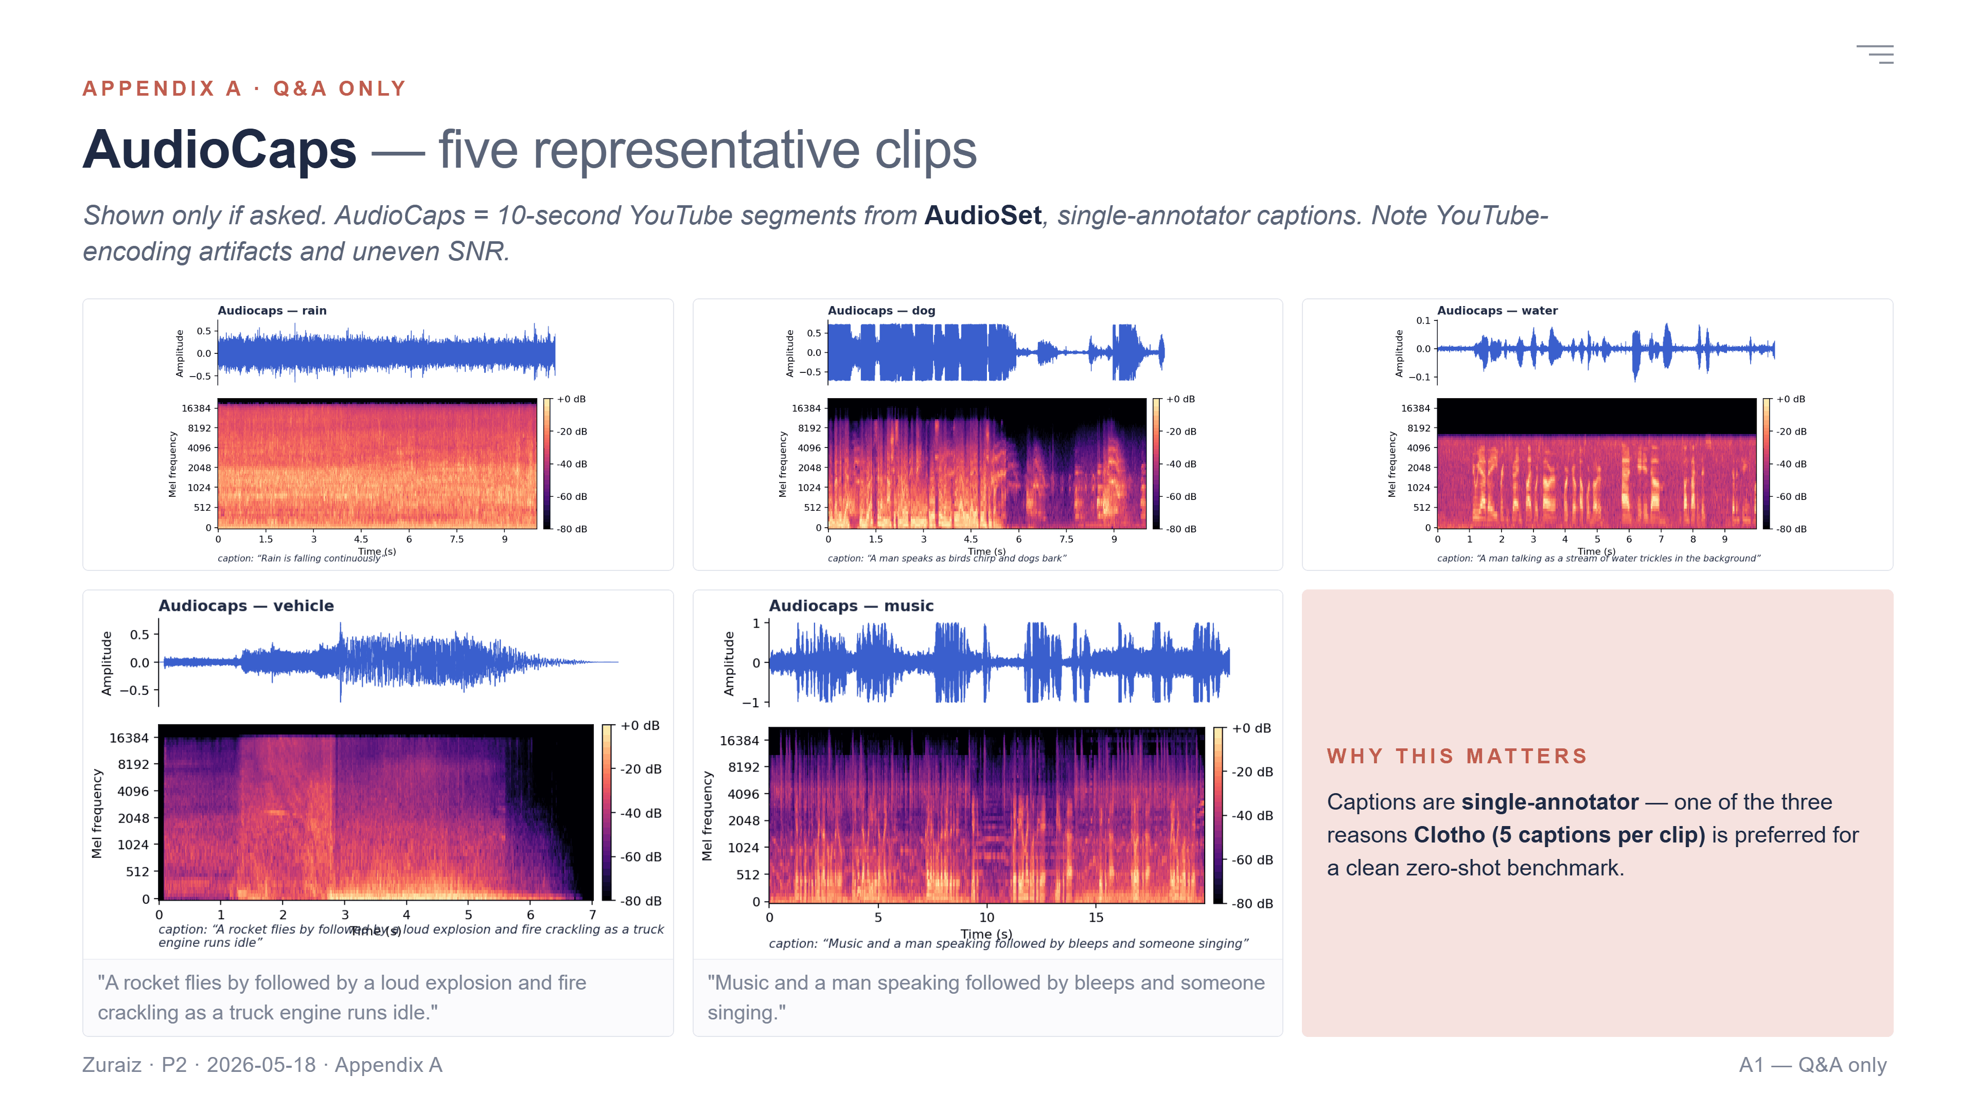
Notes:
Appendix A — shown only if asked. AudioCaps is derived from ten-second YouTube segments of AudioSet. Captions are single-annotator. These five clips span common categories — note the strong YouTube-encoding artifacts and uneven SNR. Captions in this corpus are single-annotator, which is one of the three reasons Clotho with five captions per clip is preferred.

Slide 9
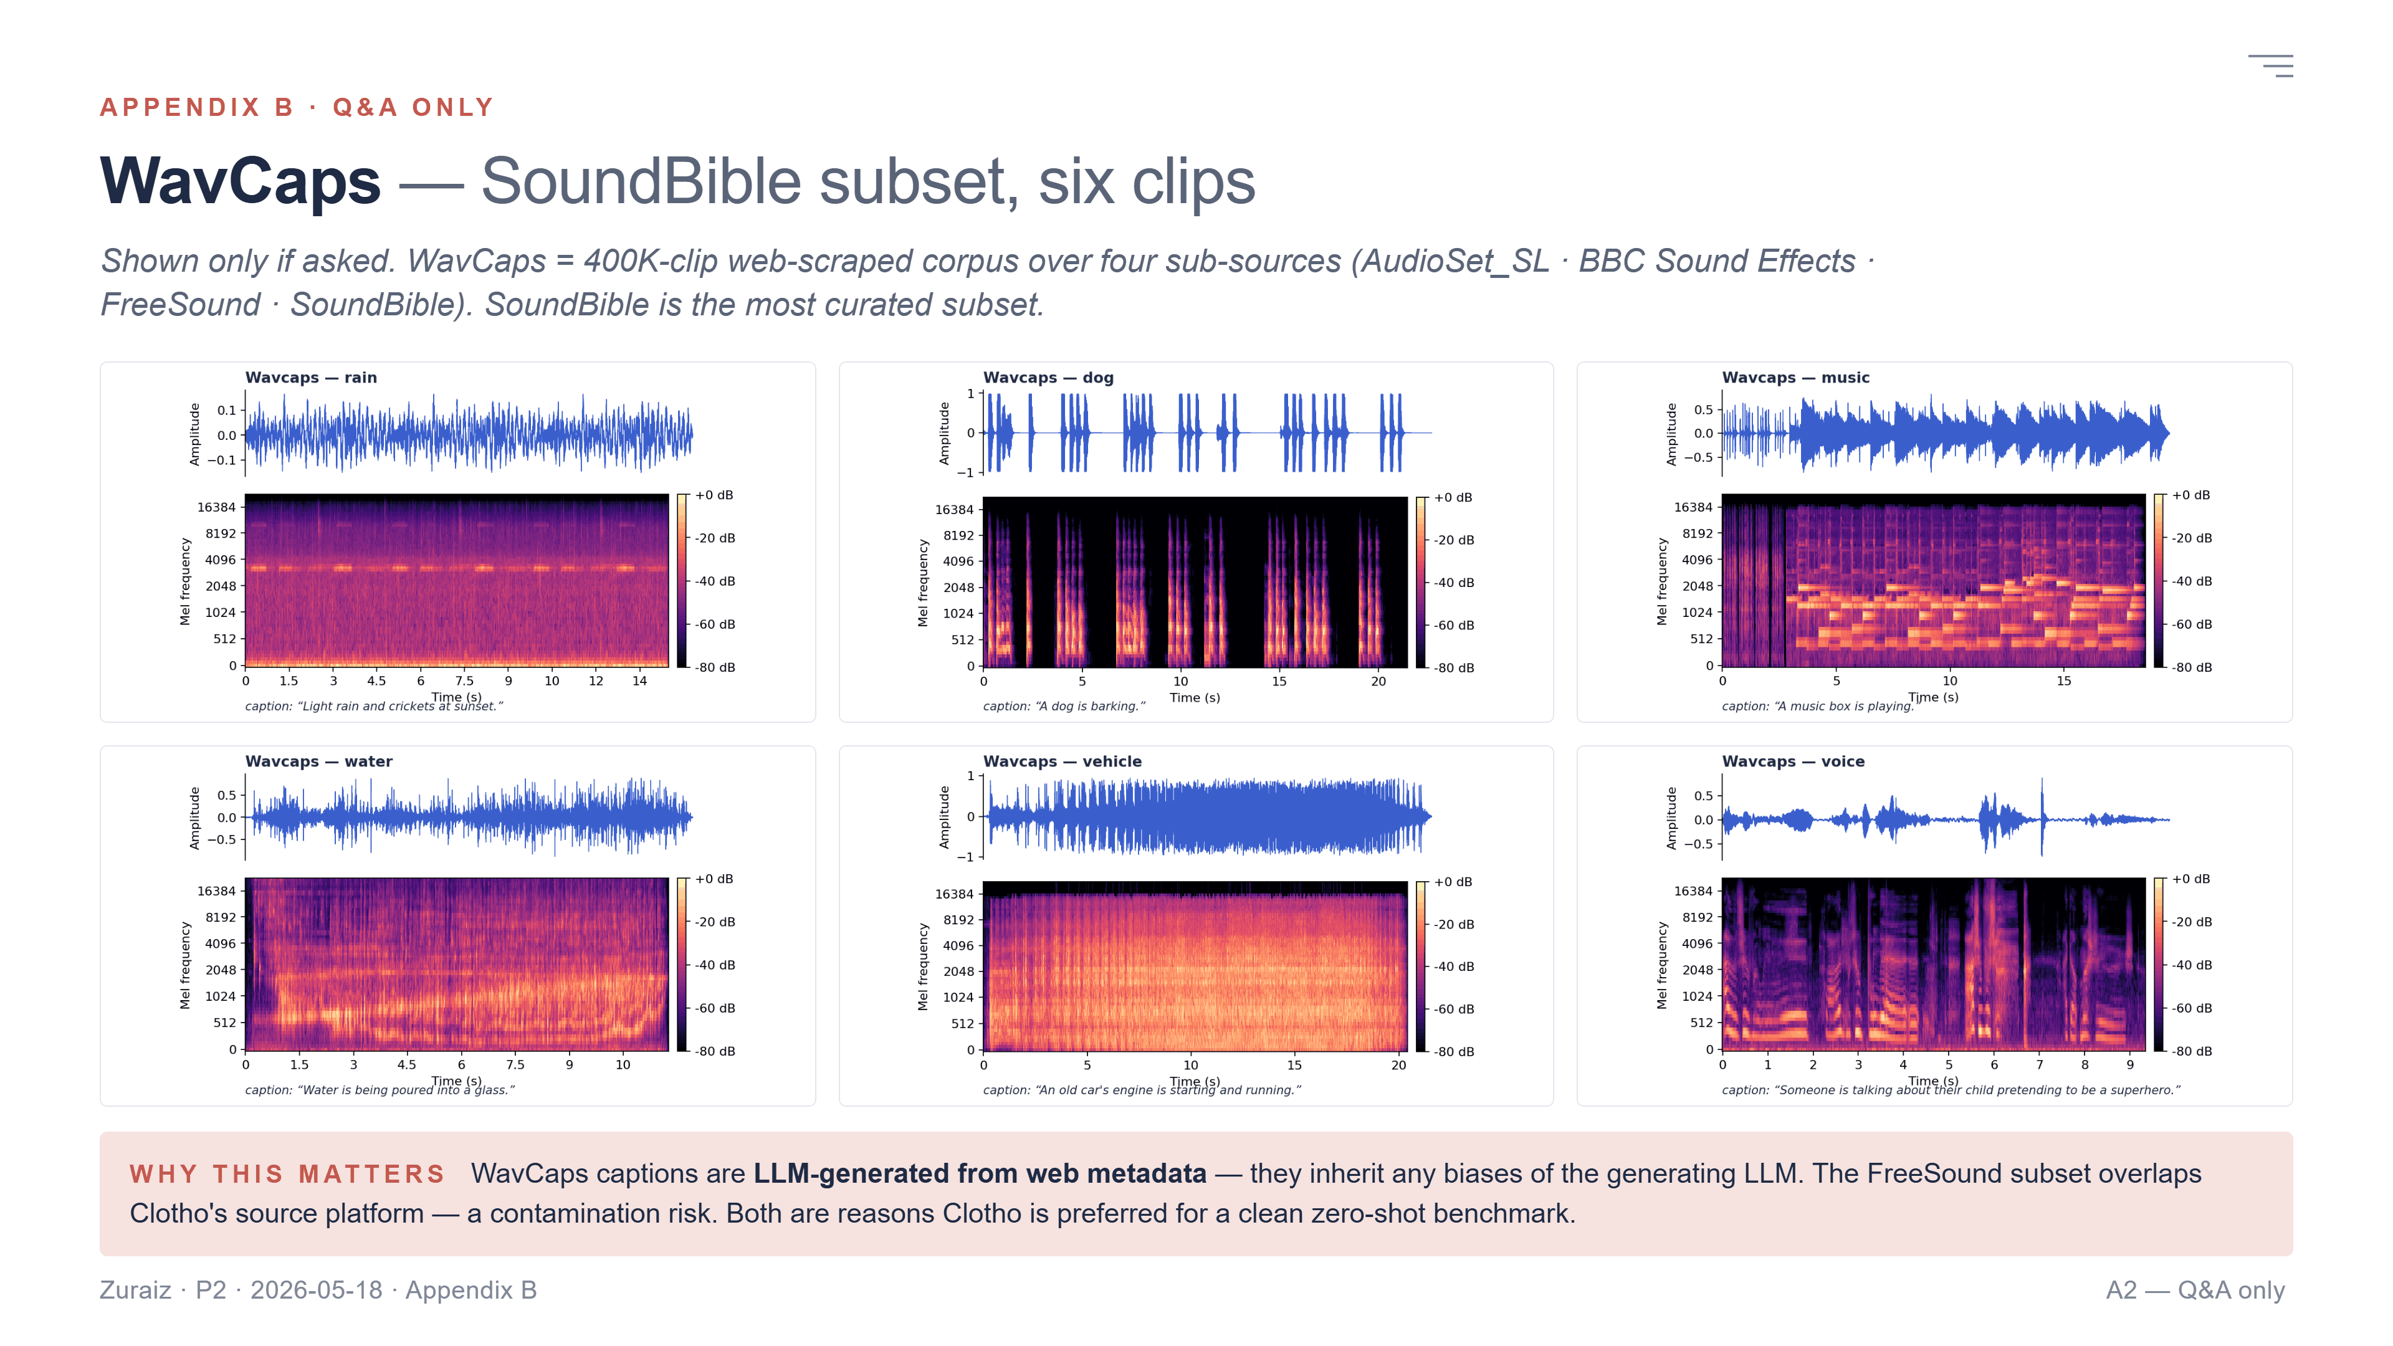
Notes:
Appendix B — shown only if asked. WavCaps is a 400K-clip web-scraped corpus combining four sub-sources: AudioSet_SL, BBC Sound Effects, FreeSound, and SoundBible. The SoundBible subset shown here is the most curated; the FreeSound subset overlaps directly with Clotho's source platform — a contamination risk. WavCaps captions are LLM-generated from web metadata — they inherit any biases of the generating LLM. Both are reasons Clotho is preferred for a clean zero-shot benchmark.

