Slide 1
Status Meeting III
Project 8 — Entanglement in Online Choir
SNA-OSN-M Summer 2026
Uni Bamberg × Uni Köln × HSLU
Team: Zuraiz · Hammad Anwar · Hassaan Ahmed · Kumaran Vasu
Presented by Hammad Anwar
May 21, 2026
14:00 CET
Supervisors: Prof. Janine Hacker · Prof. Peter Gloor

Slide 2
What we are building
How coordinated is a choir singing together over the internet?
We measure it with one metric: E(t)
Combines audio sync, visual coupling, network influence
Test across latency, topology, and visual conditions
Entanglement Score
E(t) = (A + V + N) / 3
Per-singer, per-frame quantification of group coordination using Honest Signals and network science

Slide 3
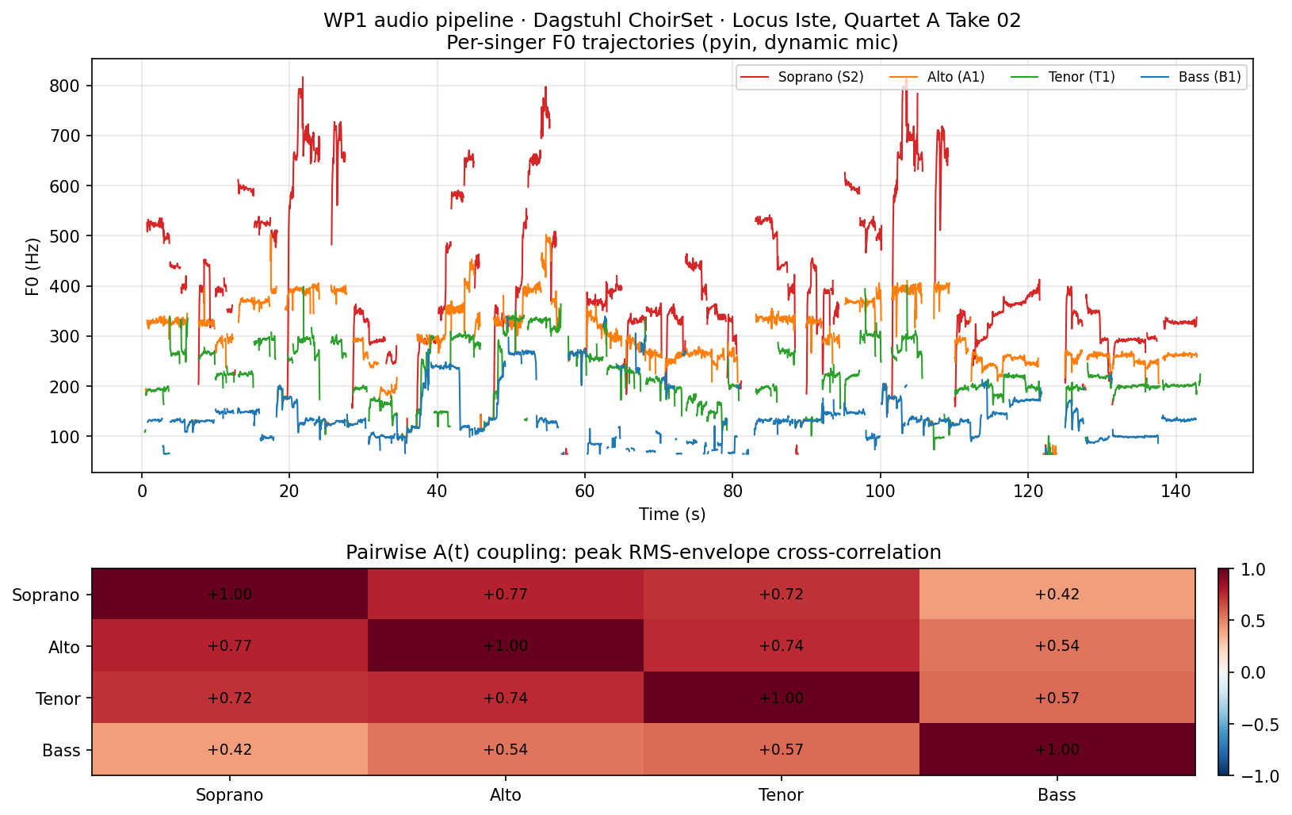
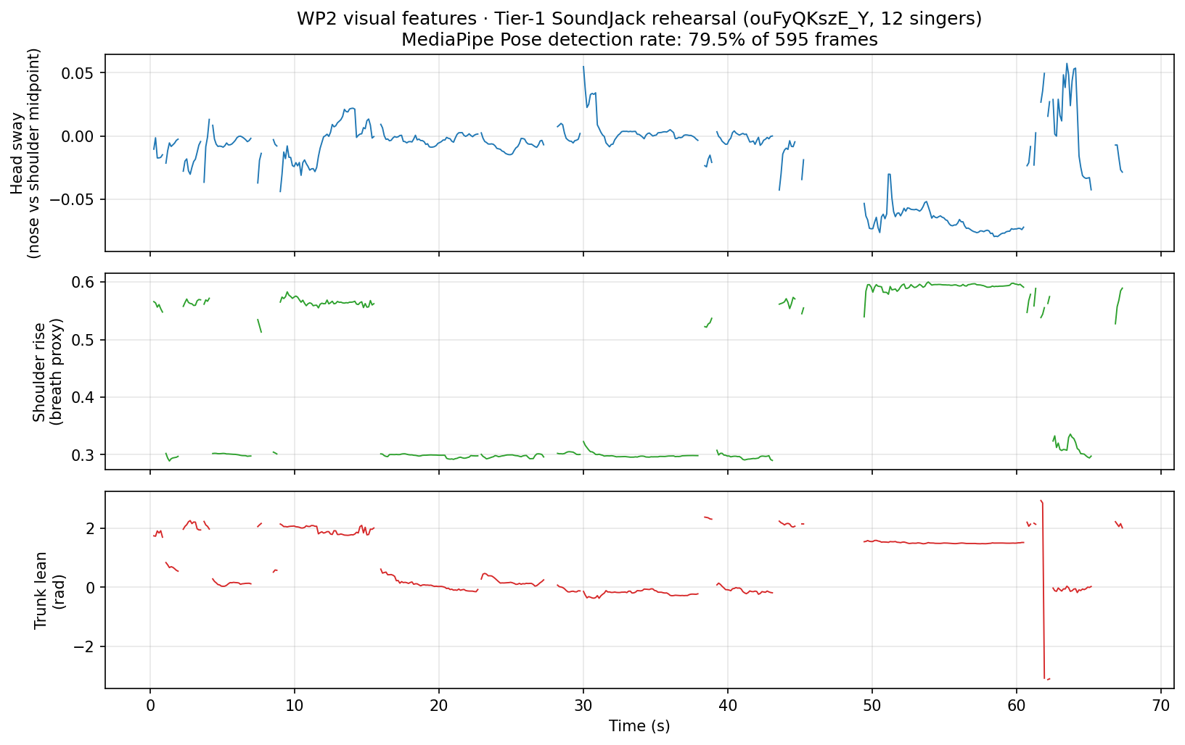
Sprint 2 progress: Audio + Video
WP1: pitch tracks of a Dagstuhl quartet; adjacent voices align 0.72–0.77
WP2: breathing & head sway from Tier-1 SoundJack rehearsal (80% detection)
Both pipelines end-to-end on real data, parquet outputs, smoke tests pass

Slide 4
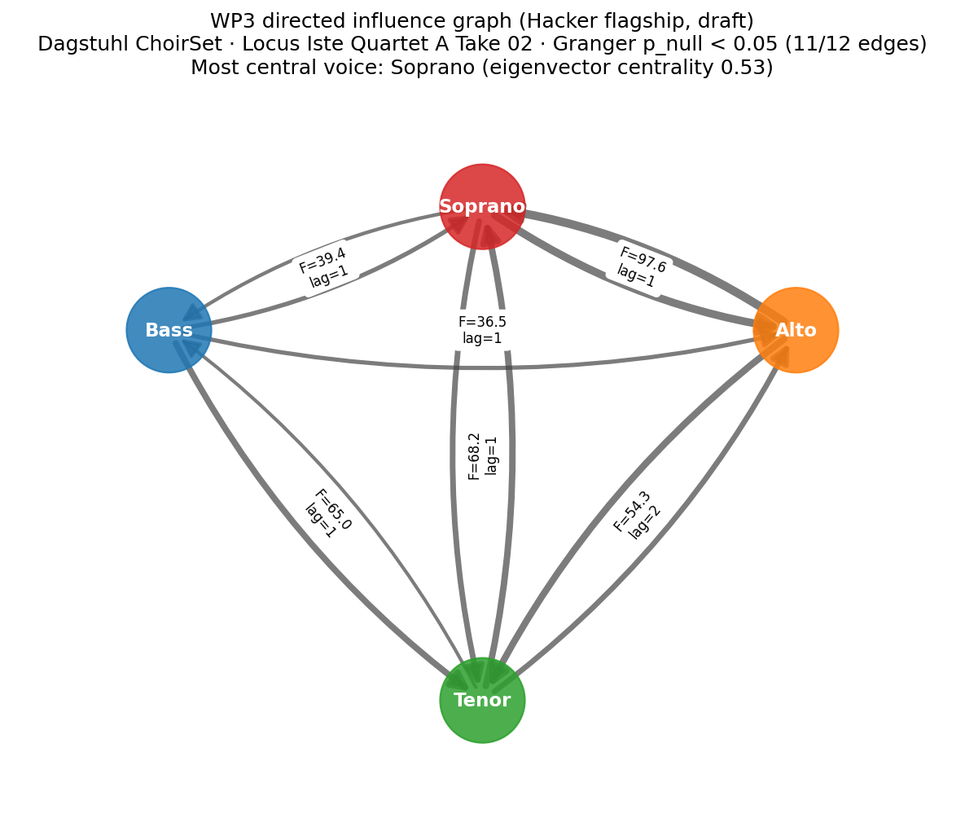
Sprint 2 progress: Network Influence (WP3)
Granger causality analysis on pitch tracks
Directed acyclic graph: who leads, who follows
Soprano is central hub (eigenvector centrality 0.53)
11 of 12 possible edges significant (p < 0.05)
Lag-1 temporal coupling across voices
Dataset: Dagstuhl ChoirSet, Locus Iste Quartet A, Take 02

Slide 5
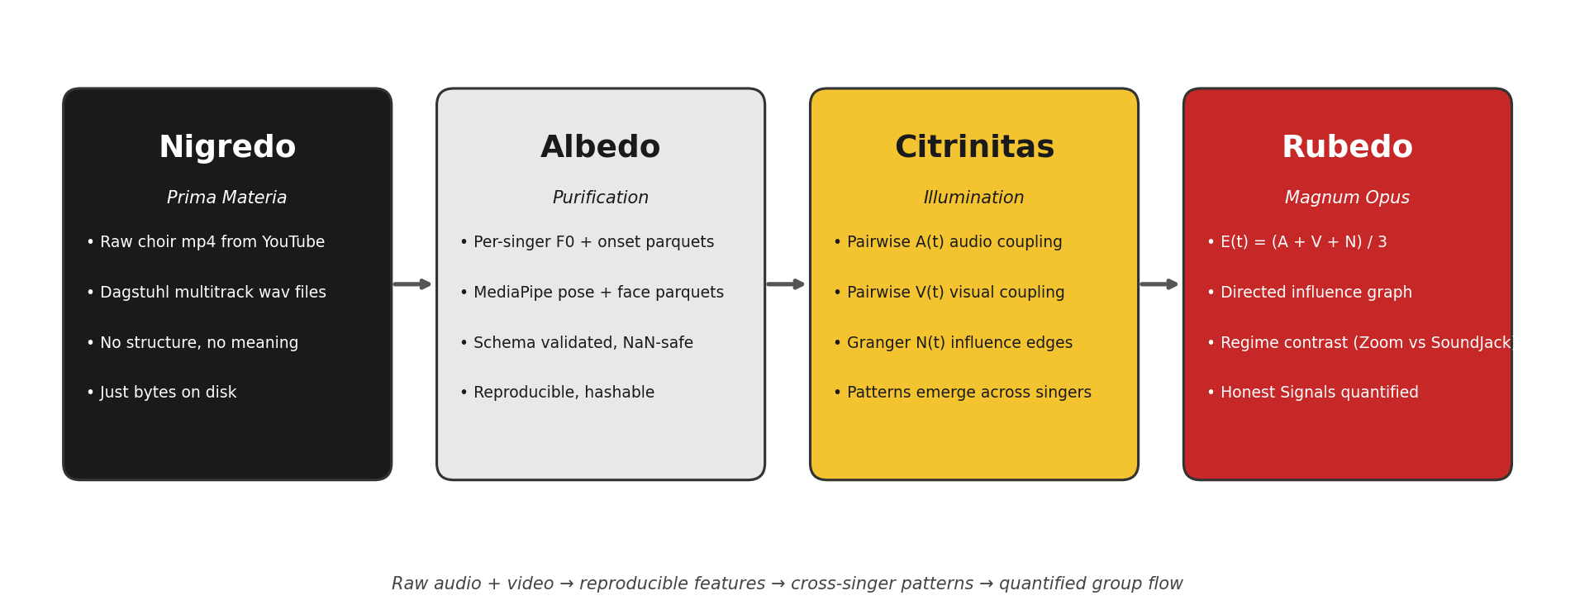
Sprint 2 progress: Dashboard (WP4)
Nigredo: Raw choir files (YouTube, Dagstuhl)
Albedo: Feature extraction (F0, pose, parquet schemas)
Citrinitas: Cross-singer patterns (A(t), V(t), N(t) metrics)
Rubedo: Entanglement quantification (E(t) = (A+V+N)/3)
Honest Signals applied to networked choir performance
Regime contrast: Zoom vs. SoundJack latency profiles

Slide 6
Sprint 2 progress: Data
Tier-2: Dagstuhl ChoirSet
Tier-1: YouTube Corpus
5.1 GB multitrack (SATB + mix)
MD5 verified vs. Zenodo
13 singers, SATB sections + full choir + quartet groupings
Latency-free ground truth for validation
29 videos verified & hashed
1.3 GB on disk (SHA-256)
~4 hours of total duration across 29 videos
All metadata in manifest.csv
Platform Stratification by Latency Regime (n=29)
11
5
4
9
Jamulus
Jamulus + Zoom
SoundJack
Zoom-only
<50ms
<100ms
>150ms
Key Insights
H1 contrast enabled: 20 low-latency (Jamulus/SoundJack) vs. 9 high-latency (Zoom) provides statistical power to test entanglement degradation
Authenticity verified: All 29 videos curated via deliberate unedited framing (no vocal comping possible); technical glitches document real-time transmission
Scale achieved: From 4 Hacker-confirmed Tier-0 seeds to 29 Tier-1 videos in 6 weeks; ready for WP1-3 feature extraction in Sprint 3
Feature extraction on all 29 runs in Sprint 3 against signed DPIA (filed today)

Slide 7
Sprint 3: May 21 → Jun 11 (3 weeks)
WP1: Audio
WP2: Video
WP3: Network
WP4: Legal
Scale pipeline to all Dagstuhl pieces
MediaPipe on 10 Tier-1 videos
Granger causality on 5 pieces
DPIA sign-off from Bamberg DPO
Compute A(t) per piece
Output: parquet format
100% Dagstuhl coverage
Pose + FaceMesh extraction
Calibration note (1 page)
Per-singer parquet
Directed influence graphs
Standard + COP-GC variants
Cross-piece comparison
Full DPIA document
Cleared for large-scale extraction
Blocks Tier-3 injection
Due: Jun 4
Due: Jun 11
Due: Jun 11
Due: Jun 11
Critical Path
Jun 14: Tier-3 controlled latency injection only after WP1 + WP3 land (audio features + influence graphs required)
Per Apr-17 DSP blocker: Tier-1 YouTube remains visual-only; no per-singer audio features attempted on mixed-stereo
Depends on: DPIA sign-off (WP4) before large-scale extraction can proceed

Slide 8
Sprint 2 retrospective
What worked
What slipped
Tier-1 corpus criteria re-discovered 4 of 5 supervisor URLs
All 4 WPs shipped Sprint-2 milestones with flagship figures
Cross-WP communication on Slack improved velocity
Data authenticity audits (no vocal comping detected)
Intermediate dates slipped 9–17 days (Zenodo bandwidth)
Audio pipeline blocked on Tier-2 download (May 1 → May 17)
Coordination is task-heavy, bond-light
WP2/3 brought forward to avoid total slip
Process fix
Weekly 15-min Monday async check-in
Each WP posts: shipping / stuck / need
Dependency graph reviewed for blockers
All slides drafted by Thu EOD for Friday review

Slide 9
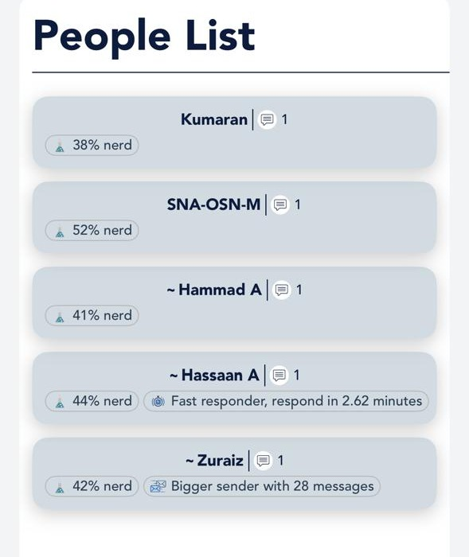
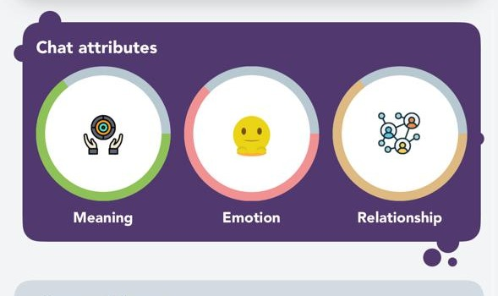
Virtual Mirror: Team dynamics & communication
We coordinate around tasks Sprint-3 fix: weekly 15-min async check-in
Chat character: HIGH Meaning, LOW Emotion, MEDIUM Relationship
Activity: Zuraiz drives volume; Hassaan responds fastest
Activity metrics
Communication profile
Zuraiz: 28 messages (42% of team)
HIGH Meaning: task-focused exchanges
Hassaan: 2.62 min response (fastest)
LOW Emotion: professional tone
Response range: 2.62 min – 1.41 hrs
MEDIUM Relationship: structured interaction

Slide 10
What we are tracking, what we need from the room
Active risks (with plan)
DPO sign-off pending; following up weekly until Jun 14
MediaPipe pose accuracy unvalidated; Sprint-3 OpenPose comparison planned
Thank you
Questions?

