Slide 1
Status Meeting VI
Project 8: Entanglement in Online Choir
SNA-OSN-M Summer 2026 - Uni Bamberg x Uni Koeln x HSLU
Presented by Hammad & Zuraiz, on behalf of the team
Supervisors: Prof. Janine Hacker - Prof. Peter Gloor
2026-07-09 - 14:00 CET

Slide 2
RECAP
Goals and plan
We are measuring how well online choirs coordinate when singers are not in the same room.
E(t)
One coordination score over time from audio, network, and visual signals.
H1
Does higher latency reduce choir coordination?
H2
Do influence networks show leadership structure?
H3 and plan
Test visual/body signals when data exists; prepare the report and final dashboard demo.
Today we connect the project goal to the latest results and the final-presentation plan.
Project 8 - Entanglement in Online Choir
2 / 9

Slide 3
PROGRESS
Progress during the last iteration
Since Status Meeting V, we completed the Jul-9 report checkpoint.
Report draft v1
Now writes up the H1 result.
H1
Ready to use in the report as the main timing result.
H2
Cleaner interpretation: weak leadership signal in human choir networks.
H3
Open because the needed paired audio-video data is unavailable.
Status VI
Slides, script, and Q&A notes are prepared.
The work moved from finding results to preparing the final presentation and report.
Project 8 - Entanglement in Online Choir
3 / 9

Slide 4
PROGRESS
Report draft v1 is ready for review
What is in the draft
Abstract, hypotheses, data, methods, results, limitations, conclusion.
H1 presented as the headline result.
H2 presented as a measured leadership signal in human datasets.
H3 presented as an open data-availability limitation.
H1
Supported in onset timing
H2
Partially supported
H3
Open
The Jul-9 hard milestone from Status Meeting V is met: the latency result is in prose, with methods and limitations already stated.
The Jul-9 report milestone from Status Meeting V is met.
Project 8 - Entanglement in Online Choir
4 / 9

Slide 5
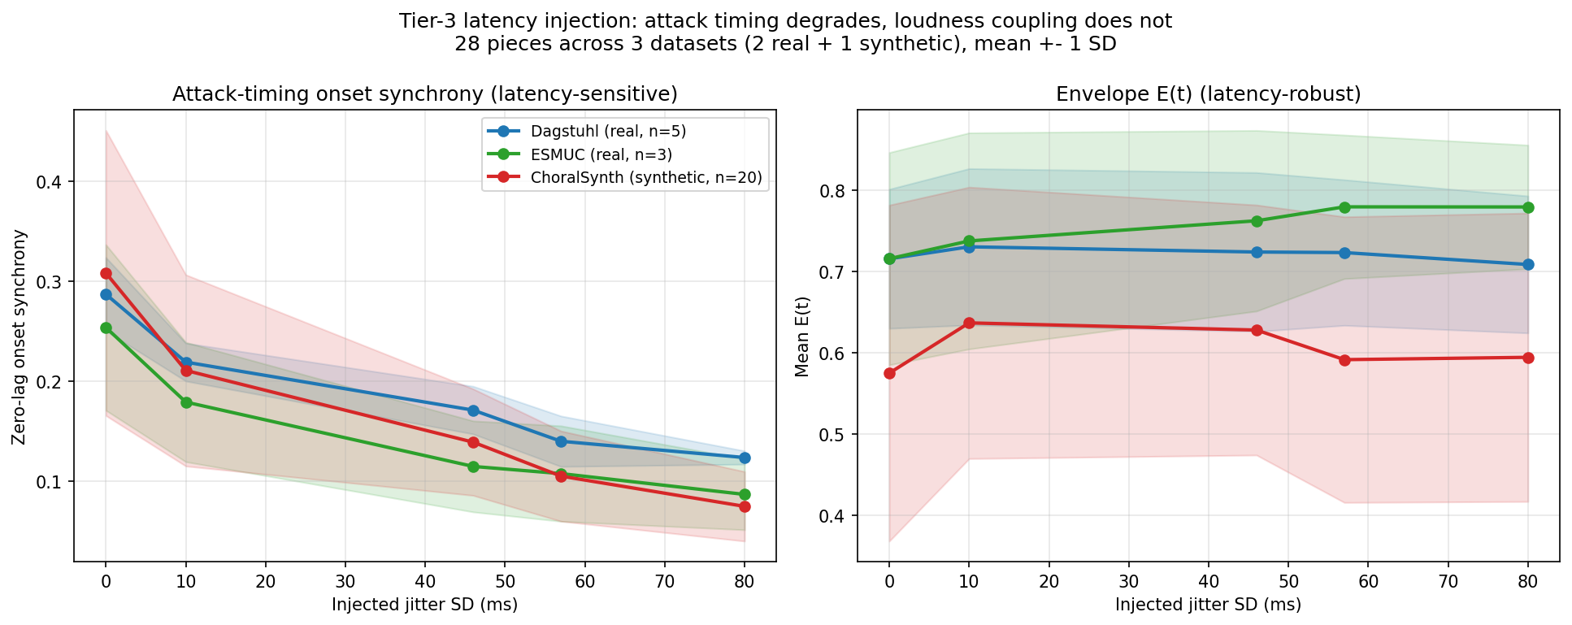
RESULT
H1: latency breaks attack timing
Result summary: - Onset synchrony falls strongly as jitter rises. - Loudness-envelope coupling stays almost flat. - Latency breaks when singers land notes, not how loud they are. Clean -> Zoom drop: Dagstuhl 57% ESMUC 66% ChoralSynth 76%
An envelope-only metric would have missed the real latency effect.
Project 8 - Entanglement in Online Choir
5 / 9

Slide 6
RESULT
H2: leadership appears in human choir networks
What the original H2 asked
Original: networks become leader-dominated as latency rises.
Current data cannot test that cleanly because injected delay on pre-recorded audio cannot create a behavioral leader.
3/5
Dagstuhl significant
2/3
ESMUC significant
2/20
ChoralSynth, approx. chance
Interpretation: leadership appears as a weak human coordination signal, not as a synthetic-rendering artifact. We do not claim strong hierarchy.
Current H2 result
Clean human choir influence networks carry weak leadership structure above a density-matched random null.
Definition (operational): leader dominance = out-degree centralization of the directed influence graph, measured as the Gini coefficient of node out-degree. 0 = every singer exerts equal outgoing influence (democratic); toward 1 = one singer Granger-causes the others without following back (a leader). Test: observed Gini vs 1000 random graphs of identical size and density. Observed corpus mean 0.154 vs null 0.139.
Leadership appears as a human coordination signal, not a synthetic-rendering artifact.
Project 8 - Entanglement in Online Choir
6 / 9

Slide 7
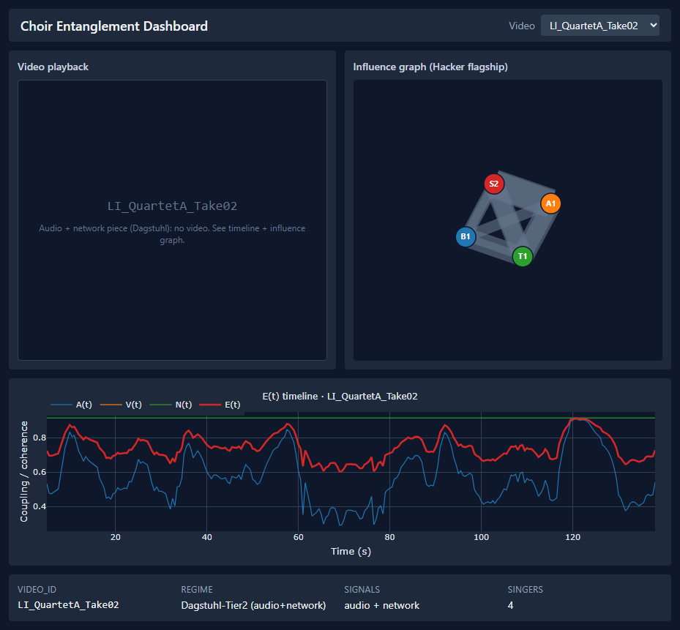
PROGRESS
Dashboard alpha uses real outputs
Real alpha: - E(t) from the real pipeline - Graph from real Granger GEXF - Pose overlay from real parquet - Metadata shows available signals This screenshot shows the current real-data alpha used for demo planning. Demo structure: One audio/network example shows E(t) and the influence graph. One video/pose example shows playback and pose overlay.
The final demo can be clear and honest even though no current piece has all three signals.
Project 8 - Entanglement in Online Choir
7 / 9

Slide 8
NEXT
Plan for the next iteration
The next iteration is the final presentation and report phase.
Final presentation
Build the 20-minute Jul-23 deck and demo narration.
Report
Convert draft v1 into the final 10-20 page seminar report.
Reproducibility
Run final checks and regenerate headline figures from committed outputs.
Dashboard
Prepare the presentation laptop and rehearse the demo path.
Limitations
Present H3 and latency-driven H2 as open questions for future data.
The remaining work is final packaging, verification, and rehearsal.
Project 8 - Entanglement in Online Choir
8 / 9

Slide 9
ALIGNMENT
What we need to align before the final presentation
Retrospective output
Null results were kept and explained.
Constant-delay failure led to the stronger jitter/onset result.
Dataset claims now trace to files and generated outputs.
Proposed structure
Research question and hypotheses.
Method, datasets, results, and interpretation.
Implementation, limitations, and next steps.
Questions for feedback
Report format: which specific format should we follow, and what main headings should the final report include?
Main focus: what should receive the most attention in the final presentation?
Dashboard format: is a screenshot enough, or should we show it live?
Thank you.
Project 8 - Entanglement in Online Choir
9 / 9

