Slide 1
Status Meeting IV
Project 8: Entanglement in Online Choir
SNA-OSN-M Summer 2026 · Uni Bamberg × Uni Köln × HSLU
Presented by Hassan Ahmed, on behalf of the team
Supervisors: Prof. Janine Hacker (Uni Bamberg) · Prof. Peter Gloor (MIT/Köln)
2026-06-11 · 14:00 CET

Slide 2
RECAP
Goals and plan
E(t) = mean(A(t) audio, V(t) visual, N(t) network)
a single coordination score per time window
Where we are
Apr 15-16
Block course + status #1
Apr 30
Status #2 · goals + plan
H1 · Latency regimes
Low-latency tools (Jamulus, SoundJack) score higher E(t) than Zoom.
May 21
Status #3 · all 4 WPs running + Virtual Mirror
H2 · Network topology
Influence network shifts democratic → leader-dominated as latency rises.
Jun 11
Status #4 · TODAY: E(t) operational
Jun 25
Status #5 · cross-regime results
H3 · Honest signals
Body sway + breathing add ≥ 10 points of explained variance over audio.
Jul 9
Status #6 · last check-in before final
Jul 23 / 31
Final presentation / final paper
Goals unchanged since April. This iteration delivered the first end-to-end E(t).
Project 8 · Entanglement in Online Choir
2 / 8

Slide 3
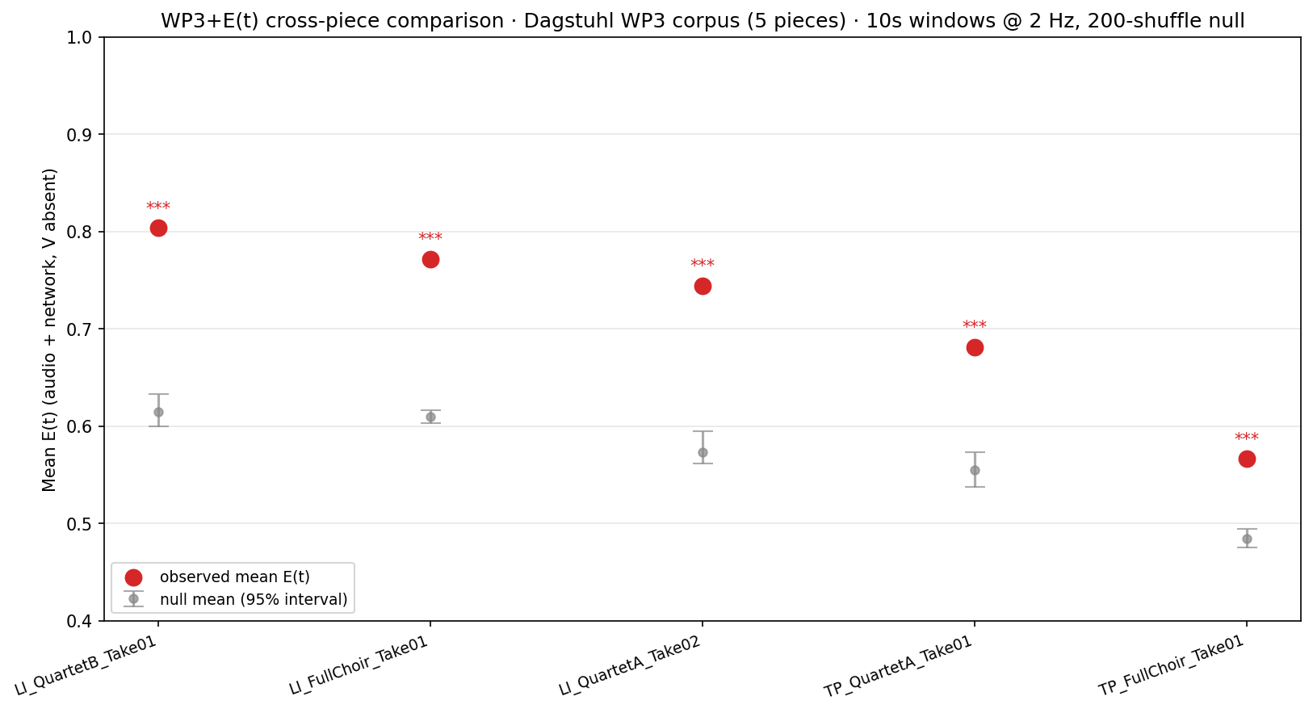
PROGRESS · LAST ITERATION
E(t) is operational: all 5 pieces significant above the null
5 / 5
pieces significantly above the null (p < 0.005)
200
circular-shift permutations per piece
0.57–0.80
observed mean E(t) across pieces
Split follows the music: homophonic chant scores high, polyphony lower. The metric reacts to what the choir is doing.
E(t) is implemented, reproducible, and significant against the null on all five pieces.
Project 8 · Entanglement in Online Choir
3 / 8

Slide 4
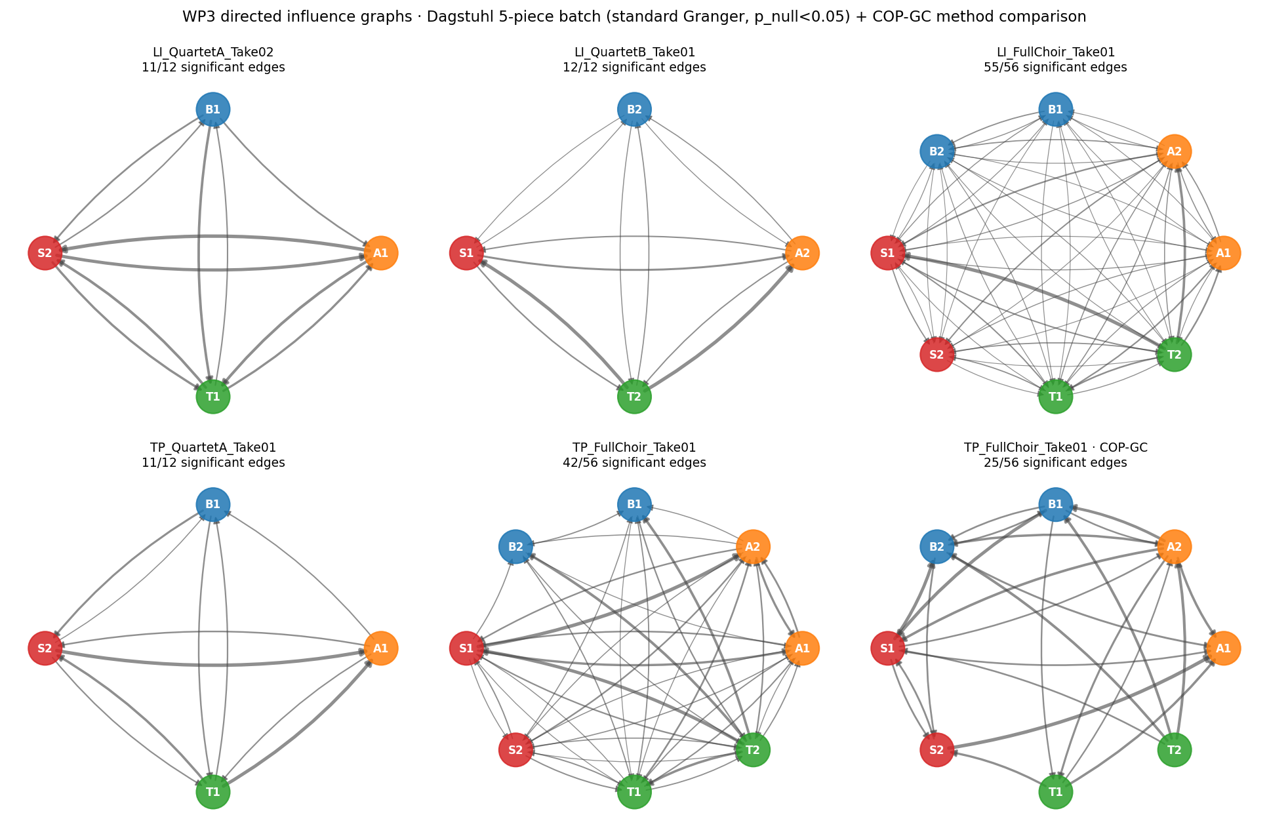
PROGRESS · LAST ITERATION
Audio and network pipelines behind E(t)
25
Dagstuhl takes processed (was 1 last sprint)
288
pairwise audio couplings computed
2
causality methods per piece (Granger + COP-GC)
Methods agree on quartets, diverge on full choir (42 vs 25 of 56 edges). That gap is itself a finding: about 40% of standard edges (17 of 42) rely on linear magnitude, not pattern structure.
Sprint-2 reference reproduces (11/12 edges, density 0.917); the pipeline now scales to the corpus.
Project 8 · Entanglement in Online Choir
4 / 8

Slide 5
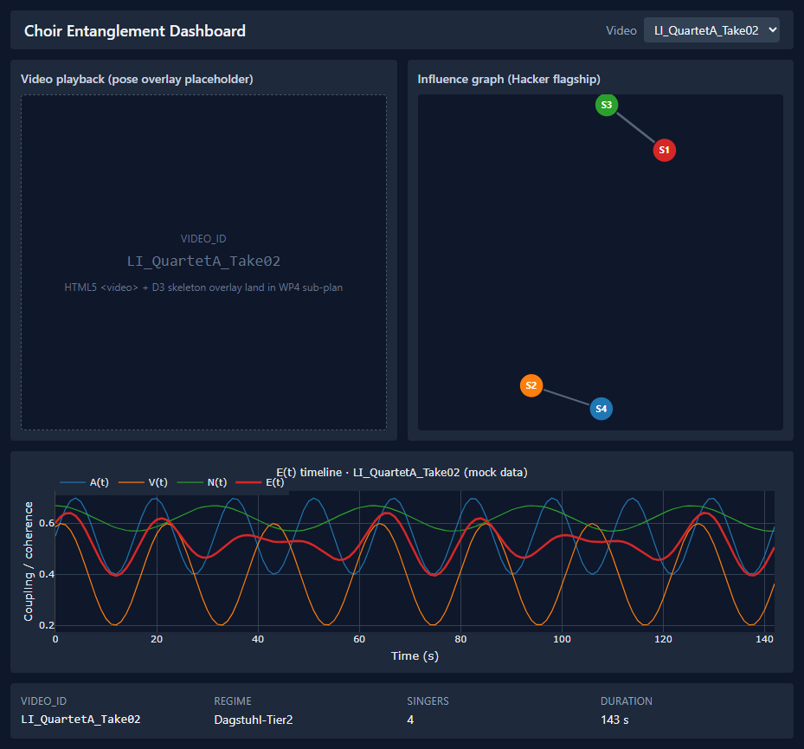
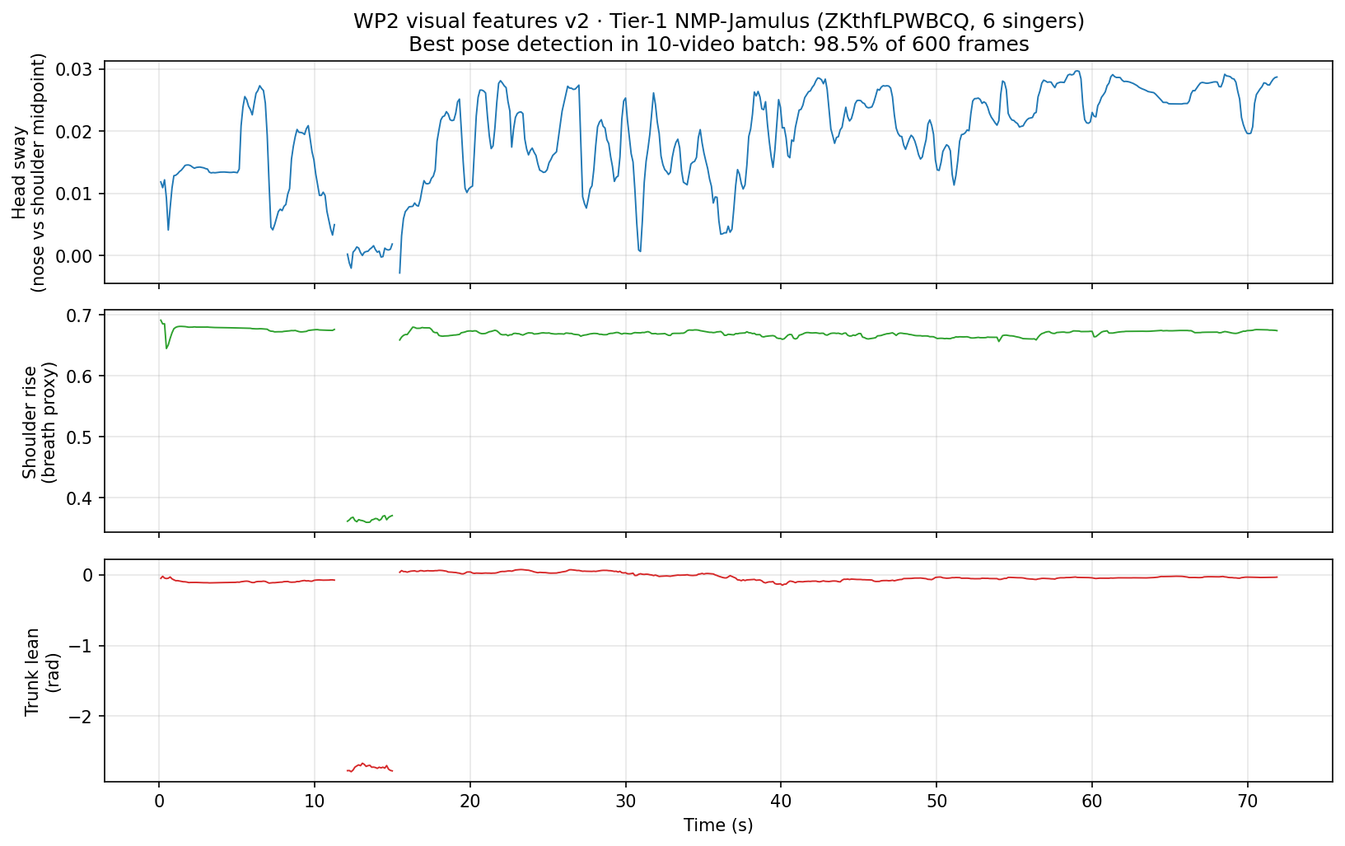
PROGRESS · LAST ITERATION
Video features and dashboard scaffold
10
videos pose-processed
5/10
pass 50% detection
23/23
tests green
WP2: 5 of 10 stratified videos have usable pose tracks (best 98.5% detection); the rest are UI captures or low-res tile grids. The five passing videos form the working set.
WP4: the scaffold renders all four panels end-to-end; real-data wiring follows next iteration.
All four work packages advanced; no blockers.
Project 8 · Entanglement in Online Choir
5 / 8

Slide 6
NEXT ITERATION
Plan: Jun 12 → Jun 25
Track | What ships
WP1 audio | Per-window Granger → time-varying N(t) for the dashboard timeline
WP2 video | Pose on remaining Tier-1 videos, quality-first triage
WP3 network | Tier-3 latency injection: synthetic jitter at 4 regime levels, E(t) per level. First cross-regime test of H1 + H2.
WP4 dashboard | Swap mock JSON for real parquet readers + pose overlay
Data | Download ChoralSynth (Zenodo, research licence) · follow up ESMUC
Hard milestone before status #5: dashboard alpha on real data + first Tier-3 cross-regime result.
Next iteration: from measuring coordination to comparing latency regimes.
Project 8 · Entanglement in Online Choir
6 / 8

Slide 7
RETROSPECTIVE
Sprint 3 retrospective
What worked
One reviewable artefact per work package per iteration.
Documentation updated at every milestone; project state is readable from three files.
What went wrong
ESMUC and ChoralSynth not yet in Tier‑2. ChoralSynth is freely available on Zenodo for research and scheduled for next iteration; ESMUC requires a license (open question).
Half of the Tier‑1 videos are screen captures without visible singers. Future curation will filter on singer visibility, not only NMP regime.
Known limitations
V(t) is absent from current E(t) values; Dagstuhl has no video. The composite reallocates weight until multimodal data exists.
All five E(t) pieces are zero‑latency studio recordings. Cross‑regime variation arrives with Tier‑3.
p < 0.005 means 0 of 200 permutations exceeded the observed value.
All retrospective items are documented in sprint3_results.md.
Project 8 · Entanglement in Online Choir
7 / 8

Slide 8
PROBLEMS / QUESTIONS
Open questions
1 · Prof. Hacker: ESMUC dataset access
Do you have institutional access to the ESMUC multitrack dataset? ChoralSynth is freely available on Zenodo for research and we will download it ourselves; ESMUC is the only dataset where we need support.
2 · Coordinators: cluster access (nice-to-have, not a blocker)
Is CPU time available on a Bamberg or HSLU cluster? The planned next-iteration scope runs overnight on our laptops. Cluster access would let us run denser jitter grids and finer analysis windows, which strengthens the H1 robustness checks.
Thank you.
Project 8 · Entanglement in Online Choir
8 / 8

