Slide 1
Status Meeting V
Project 8: Entanglement in Online Choir
SNA-OSN-M Summer 2026 · Uni Bamberg × Uni Köln × HSLU
Presented by Zuraiz and Kumaran Vasu, on behalf of the team
Supervisors: Prof. Janine Hacker · Prof. Peter Gloor
2026-06-25 · 14:00 CET

Slide 2
RECAP
Goals and plan
E(t) = mean( A audio, V visual, N network ): one coordination score per moment
H1 · Latency
Lower latency → higher coordination. (This iteration's focus.)
H2 · Topology
Influence network shifts democratic → leader-dominated as latency rises.
H3 · Visual signals
Body sway + breathing add information over audio (still data-blocked).
Status meeting 5 of 6. Jun 11: E(t) operational. Today: first test of H1 via latency injection.
This iteration: we found the latency signal, and learned exactly where it lives.
Project 8 · Entanglement in Online Choir
2 / 8

Slide 3
PROGRESS · LAST ITERATION
We found the H1 latency signal (in attack timing)
1 · Constant delay
No E(t) effect. Our coupling is lag-tolerant; it absorbs a constant shift.
2 · Realistic jitter
Still flat. 10s loudness envelopes are robust to tens-of-ms timing noise.
3 · Onset synchrony
Zero-lag attack timing, the quantity latency breaks. The signal appears.
Result: attack-timing synchrony falls 57-76% (clean → Zoom) across 28 pieces; loudness coupling barely moves. A loudness-only metric would have said 'latency doesn't matter', and been wrong.
Latency degrades attack timing, not loudness coupling. The dissociation is the finding.
Project 8 · Entanglement in Online Choir
3 / 8

Slide 4
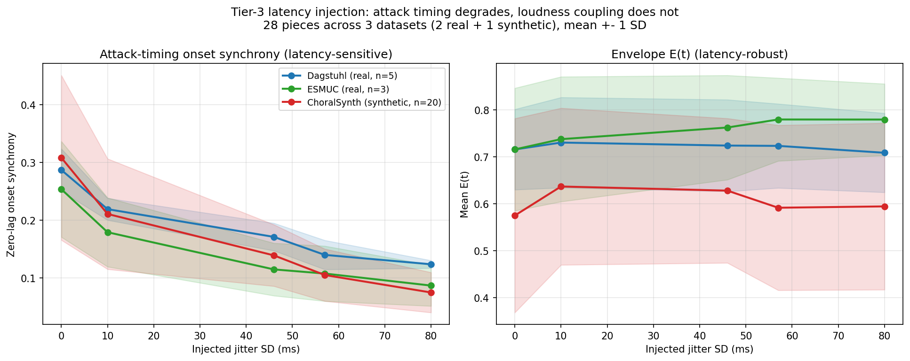
PROGRESS · LAST ITERATION
The dissociation, in one figure
Left: onset synchrony falls with jitter (all 3 datasets). Right: envelope E(t) flat. Jitter SDs are measured, not tuned; the constant-delay dead end is reported, not hidden.
Same recordings, two measures, opposite verdicts.
Project 8 · Entanglement in Online Choir
4 / 8

Slide 5
PROGRESS · LAST ITERATION
It replicates across 3 datasets
−57%
Dagstuhl (real human, 5)
−66%
ESMUC (real human, 3)
−76%
ChoralSynth (synthetic, 20)
Onset-synchrony drop clean → Zoom. 28 pieces, two independent human datasets plus synthetic, all monotonic. Both Tier-2 datasets added this iteration via one unified data adapter (downloaded + MD5-verified vs Zenodo).
The effect holds across real and synthetic choirs, not a single-dataset artifact.
Project 8 · Entanglement in Online Choir
5 / 8

Slide 6
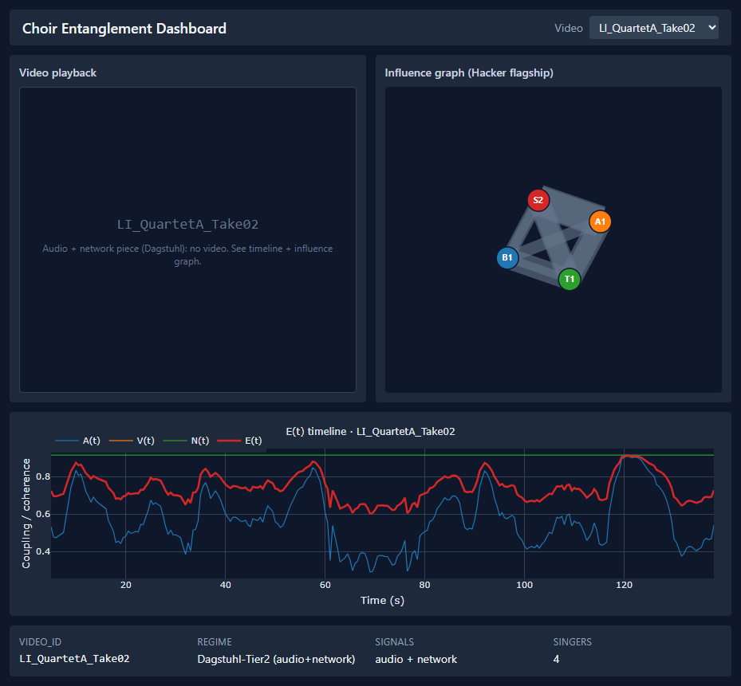
PROGRESS · LAST ITERATION
Dashboard alpha, on real data
Now on real outputs: • Timeline = real E(t) • Graph = real Granger who-leads-whom • Video + 33-point pose overlay synced to play • Each piece shows the signals it has Meets the Jun-21 alpha milestone.
The dashboard runs on the pipeline's real outputs, not mock data.
Project 8 · Entanglement in Online Choir
6 / 8

Slide 7
NEXT ITERATION
Plan: Jun 26 → Jul 9
Integration
Fold onset synchrony into E(t) as its timing-sensitive component
WP3
Per-window time-varying networks; cleaner H2 topology measure
Paper
Draft report methods + results (the latency finding)
WP2 / H3
First visual-onset V(t): pair pose onsets with audio onsets on the 18 usable Tier-1 videos
From 'found the signal' to 'written up and corpus-complete'.
Project 8 · Entanglement in Online Choir
7 / 8

Slide 8
RETROSPECTIVE · OPEN PROBLEMS
Retrospective and open problems
What worked
A wrong first method (constant delay) was caught by its own control and became a sharper one.
Every dataset claim traces to a verified file.
What we fixed
The stale 'ESMUC proprietary' note: it is open on Zenodo, and we used it.
Curation now filters on singer visibility, not just NMP regime.
Open problems
H1 rests on simulated latency (transmission delay, not live adaptation); real latency-varied recordings would test it directly.
H3 visual still data-blocked; H2 topology not cleanly measured yet.
Thank you.
Project 8 · Entanglement in Online Choir
8 / 8

