Slide 1
Measuring Coordination in Online Choirs
Project 8: Entanglement in Online Choir
Zuraiz - Hammad Anwar - Hassan Ahmed - Kumaran Vasu
Supervisors: Prof. Janine Hacker - Prof. Peter Gloor
2026-07-23

Slide 2
GOALS
What we set out to test
Measure network effects on choir coordination and deliver an auditable analysis system.
H1 - latency
Higher latency reduces coordination; primary outcome: zero-lag onset synchrony.
H2 - leadership
Influence networks show leadership structure; outcome: out-degree Gini versus matched random graphs.
H3 - visual information
Visual signals add information beyond audio; the full test compares audio-only with audio-plus-visual prediction.
Directions were declared at project start; metric revisions are dated and documented.
Project 8 - Entanglement in Online Choir
2 / 19

Slide 3
RELATED WORK
Three foundations, one research gap
Entanglement
Temporal alignment has been measured in organizational communication networks.
Honest Signals
Activity, consistency, influence, and mimicry can reveal group coordination.
Choir and NMP research
Multitrack corpora and latency studies provide audio evidence, but no integrated acoustic, visual, and influence measure.
Research gap
Adapt these ideas to singing, test them against controlled degradation, and state where the data cannot support a claim.
Project 8 - Entanglement in Online Choir
3 / 19

Slide 4
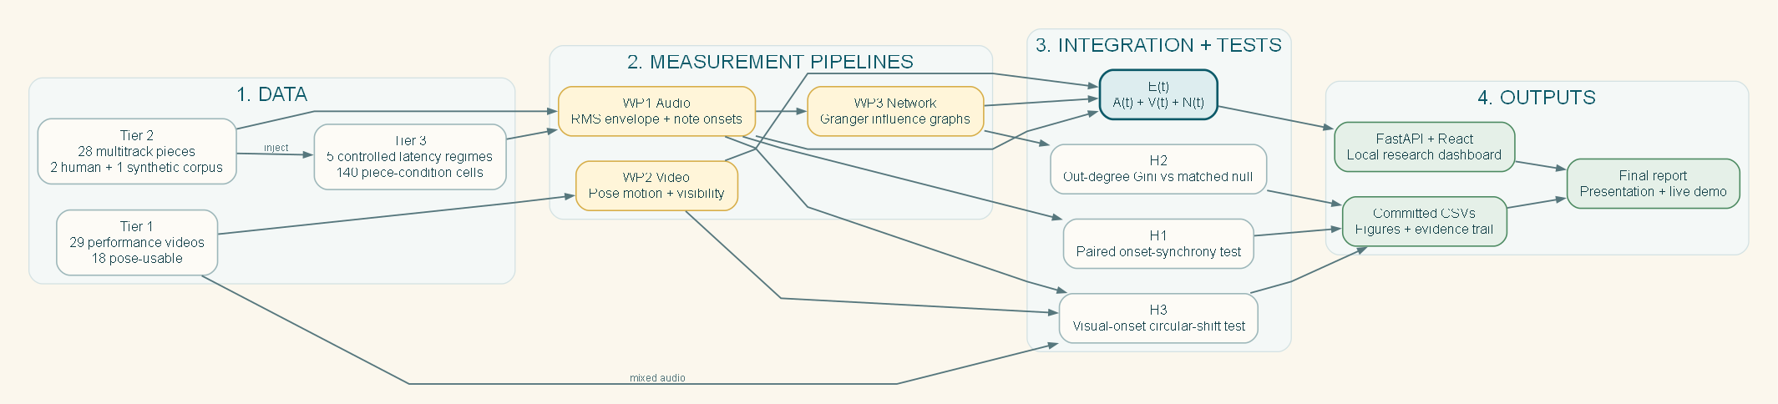
PROJECT
Whole-project structure
Every result has a visible path from source data to tested claim.
Project 8 - Entanglement in Online Choir
4 / 19

Slide 5
DATA
Three tiers and one multimodal constraint
Tier 1 - video
29 virtual-choir videos; 18 pose-usable. Mixed audio plus visual features for exploratory H3.
Tier 2 - multitrack
Dagstuhl 5, ESMUC 3, ChoralSynth 20. Per-singer audio and influence networks.
Tier 3 - controlled degradation
Five regimes applied to all 28 Tier-2 pieces for the H1 latency experiment.
No item has synchronized per-singer audio and per-singer video. Tier 1 has mixed audio; Tier 2 has no video.
Each dataset is used only for the claims it can support.
Project 8 - Entanglement in Online Choir
5 / 19

Slide 6
METHOD
E(t) and the controlled latency grid
E(t) combines available acoustic A(t), visual V(t), and network N(t) coordination.
Clean
0 / 0 / 0%
In-person
25 / 10 / 0%
Jamulus LAN
47 / 46 / 1%
Jamulus WAN
83 / 57 / 3%
Zoom-class
150 / 80 / 8%
Delay ms / jitter SD ms / dropout
Inference
Envelope and network analyses use 2,000 circular shifts per cell. H1 onset inference uses a paired clean-to-Zoom sign test across pieces.
The same piece is evaluated in every regime and serves as its own control.
Project 8 - Entanglement in Online Choir
6 / 19

Slide 7
WORK PROCESS
How the team organized the project
Four work packages
Acoustic/integration, visual extraction, influence networks, and dashboard/report integration.
Iteration outputs
Every iteration ended in a schema, result table, test, figure, or presentation artifact.
Review gates
Seeded scripts, committed summaries, and independent audits connected implementation to claims.
Virtual Mirror
High shared meaning, low emotional exchange, medium relationship intensity; a weekly asynchronous check-in was adopted.
Project 8 - Entanglement in Online Choir
7 / 19

Slide 8
METHOD
Reproducibility is part of the result
One command
`make reproduce` regenerates report-stage statistics, figures, and the PDF.
50 tests
Scientific pipelines, dashboard consistency, figure definitions, H3 controls, and report generation are covered.
Complete grid
140 final cells from the committed 2,000-shuffle SLURM protocol.
Claim provenance
Every numerical statement in the deck traces to a committed CSV.
The results can be audited without relying on the presentation.
Project 8 - Entanglement in Online Choir
8 / 19

Slide 9
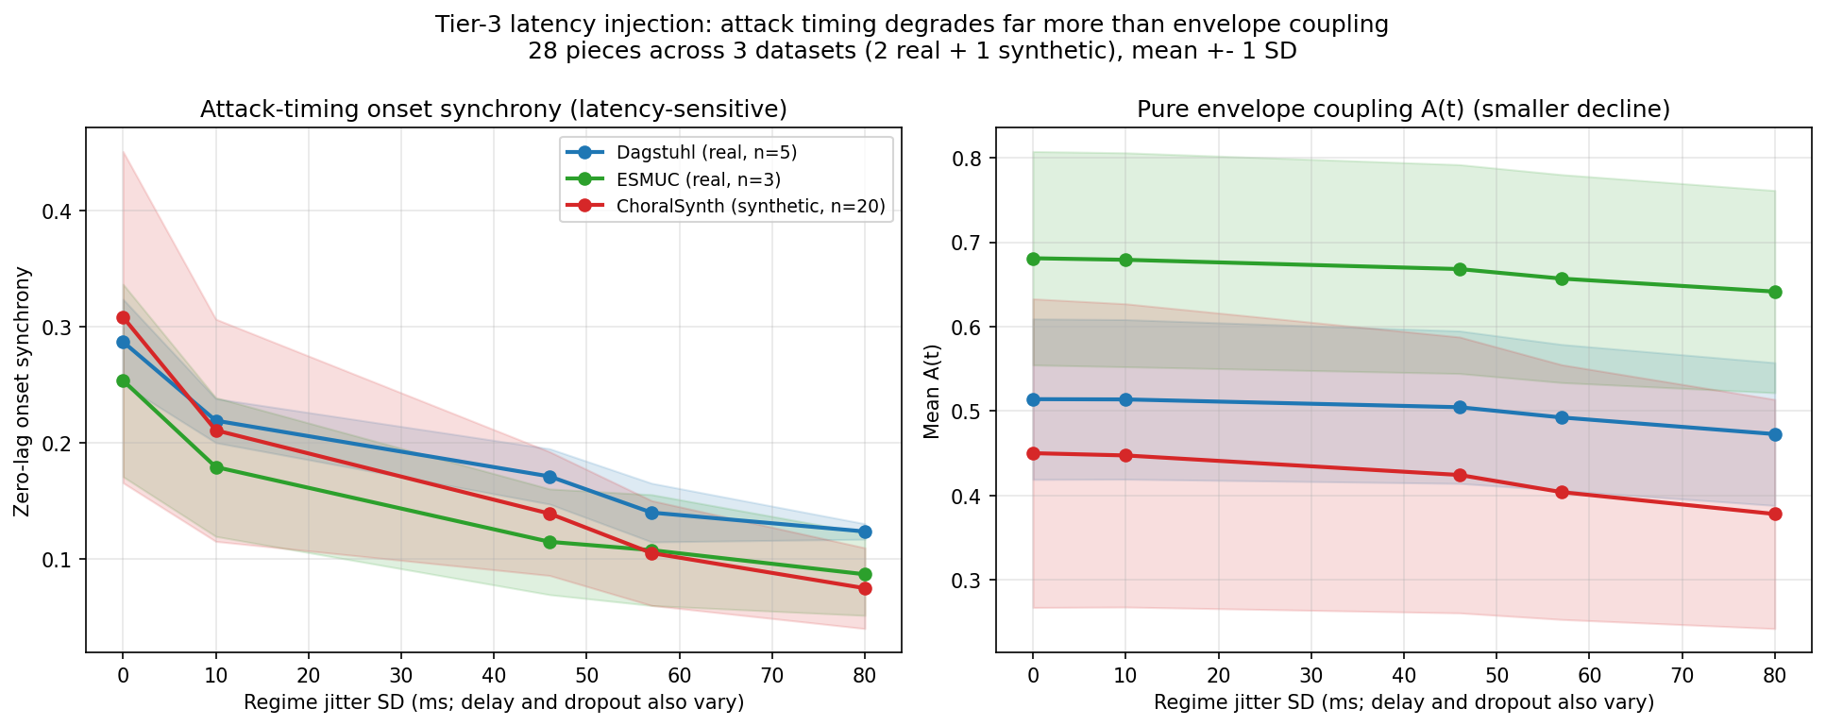
RESULT
H1: latency breaks note timing
-56.5%
Dagstuhl
-65.1%
ESMUC
-75.1%
ChoralSynth
-70.7%
Corpus; 28/28 decrease
Channel comparison
Pure envelope A(t): -7.9% Dagstuhl, -11.9% corpus. The envelope-plus-network E(t) composite can rise because network density offsets the envelope decline.
All 28 pieces decrease; exact one-sided sign-test p = 3.73 x 10^-9.
Project 8 - Entanglement in Online Choir
9 / 19

Slide 10
RESULT
Why the measurement revision matters
Initial null
Constant delay plus lag-tolerant envelope coupling showed little effect.
Control diagnosis
The metric could absorb the lag, so it did not measure simultaneous note attacks.
Operational revision
Zero-lag onset synchrony directly measures whether singers land attacks together.
Dissociation
Timing falls 56% to 75%; pure envelope coupling falls roughly 6% to 14% across corpora.
The hypothesis stayed fixed; the dated metric revision is part of the audit trail.
Project 8 - Entanglement in Online Choir
10 / 19

Slide 11
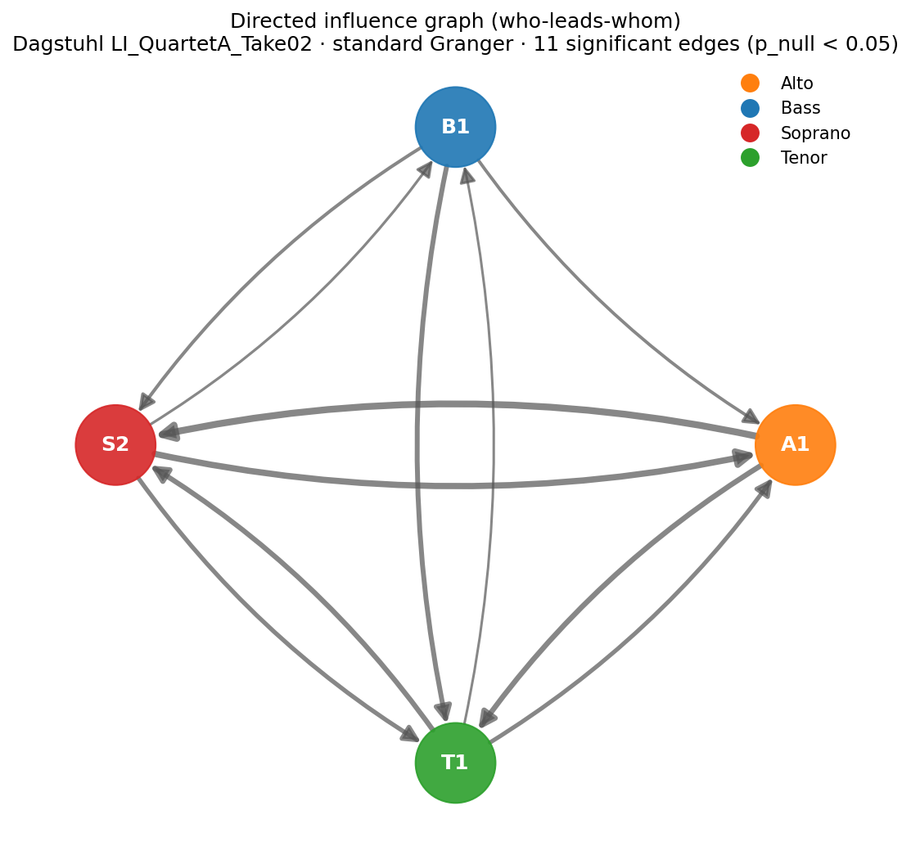
RESULT
H2: limited leadership evidence
0.162
Observed mean
0.155
Matched null
1/5 - 1/3
Dagstuhl - ESMUC
0/20
ChoralSynth
Two human pieces are significant; corpus-level evidence is not significant.
Project 8 - Entanglement in Online Choir
11 / 19

Slide 12
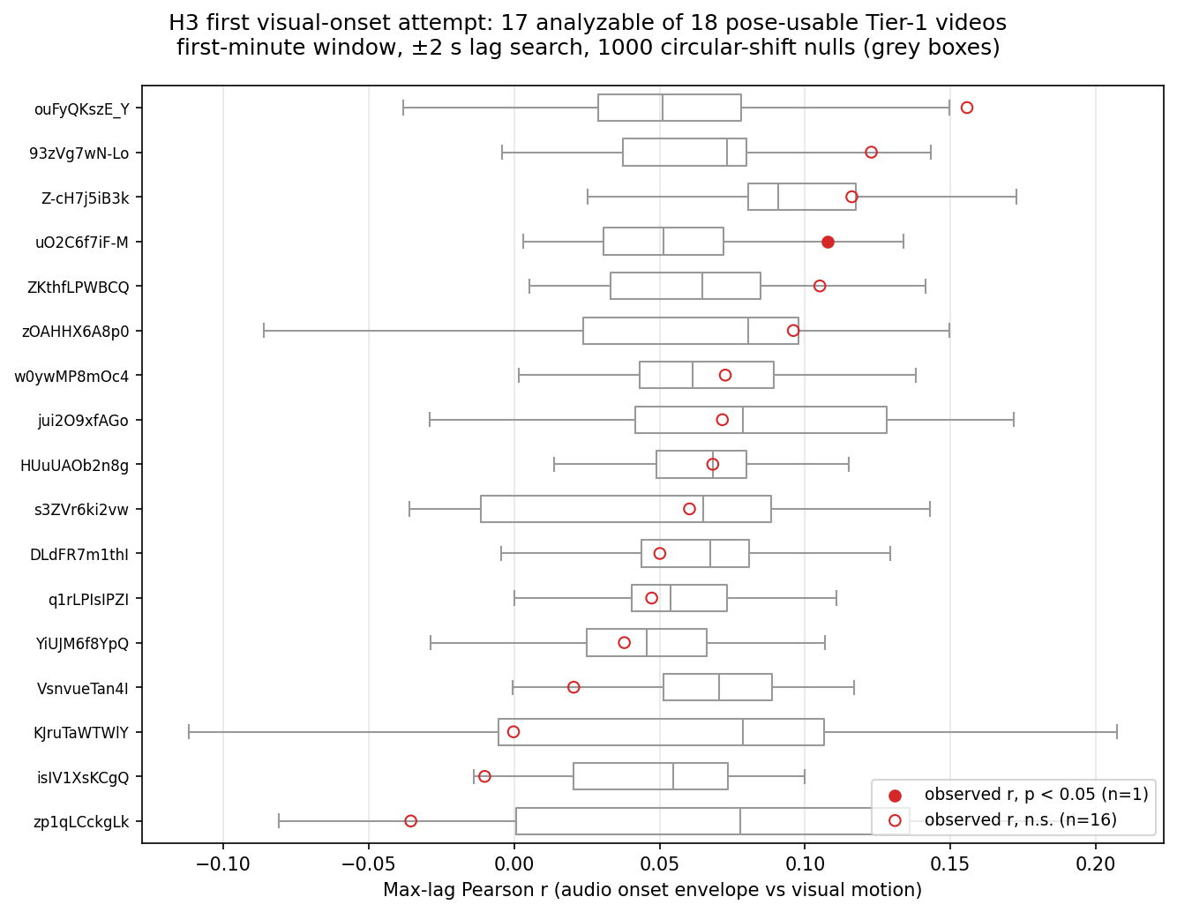
RESULT
H3: an informative exploratory null
17 / 18
videos analyzable
1 / 17
significant, consistent with chance
0.068
median maximum-lag r
What was tested
Maximum signed correlation within 2 s over the first 60-72 s pose window, with 1,000 circular-shift nulls. Full H3 still needs synchronized per-singer audio and video.
The mixed-audio substitute is null; the paired-data requirement is demonstrated.
Project 8 - Entanglement in Online Choir
12 / 19

Slide 13
DEMO
Live dashboard demonstration - 60 seconds
1. Audio and network
Dagstuhl piece: E(t) timeline and influence graph.
2. Video and pose
Tier-1 video: playback with pose overlay.
3. Signal availability
Metadata shows which channels each piece actually contains.
The dashboard uses the same envelope-only E(t) definition as the report.
Project 8 - Entanglement in Online Choir
13 / 19

Slide 14
LIMITS
Weaknesses of the current evidence
Simulated latency
Models transmission, not live singer adaptation.
Co-varying regimes
Delay, jitter, and dropout change together; individual effects are not isolated.
Multimodal gap
No synchronized per-singer audio and video item exists.
H2 strength
Two individual results, but no corpus-level significance.
External validity
E(t) is not yet validated against perceived performance quality.
Project 8 - Entanglement in Online Choir
14 / 19

Slide 15
RESULTS
Main results and implementation
H1 supported for timing
All 28 pieces lose onset synchrony; corpus mean drop 70.7%.
H2 limited
Two human pieces show significant centralization; overall evidence remains weak.
H3 exploratory null
Mixed audio plus one pose stream does not substitute for paired per-singer data.
System delivered
Reproducible pipelines, tested dashboard, figures, report, and presentation package.
Project 8 - Entanglement in Online Choir
15 / 19

Slide 16
EXTENSIONS
What the next study should add
Live latency sessions
Measure behavioral adaptation and latency-driven leadership.
Paired audio-video corpus
Unlock the planned H3 incremental-validity test.
Factorial network experiment
Separate delay, jitter, and dropout effects.
External validation
Compare E(t) with expert ratings, singer experience, and score-alignment errors.
Project 8 - Entanglement in Online Choir
16 / 19

Slide 17
RETROSPECTIVE
What worked and what could improve
What worked well
Controls exposed the first metric mismatch. Seeded scripts, tests, and audits kept claims traceable. Instructor questions improved definitions and limitation framing.
What could improve
Secure paired multimodal data earlier. Resolve work-package dependencies before parallel implementation. Confirm final format and metric expectations earlier.
Thank you. Questions are welcome.
Project 8 - Entanglement in Online Choir
17 / 19

Slide 18
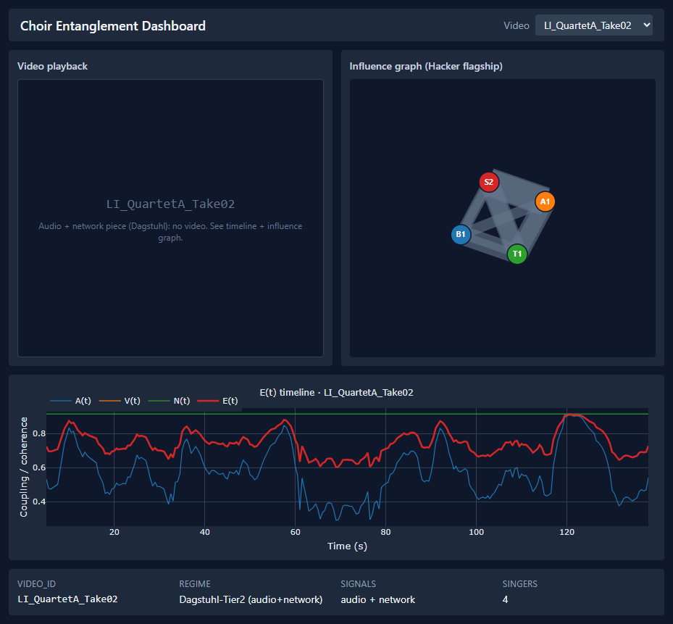
BACKUP
Dashboard on real outputs
Project 8 - Entanglement in Online Choir
18 / 19

Slide 19
BACKUP
Reproducibility protocol
Regenerate
`make reproduce` rebuilds report-stage results and the final PDF.
H1
Exact paired sign test plus seeded bootstrap.
H2
1,000 matched random graphs per piece with plus-one p-values.
H3
1,000 circular shifts per video with deterministic seeds.
Environment
Python 3.11.9 and locked dependencies.
Project 8 - Entanglement in Online Choir
19 / 19

