Slide 1



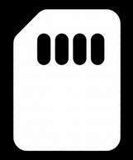

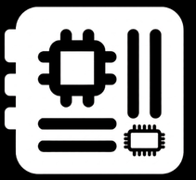
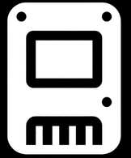



BEYOND THE SCREEN
Understanding and Troubleshooting Your PC
A Field Trips & Seminars outreach program by
College of Computer Studies and Engineering – Lorma Colleges
DIRECTO • MADAYAG • QUIMSON • ROLDAN • RUBIS
Bacnotan National High School • October 21, 2026
Notes:
1.7.2013
[Rubis] Introduction and Prayer (1:05–1:10). Greet the school and introduce the group, our college (CCSE, Lorma Colleges) and why we are here: a Field Trips and Seminars outreach.
‹#›

Slide 2
WELCOME
Welcome to Beyond the Screen!
By the end of this seminar, you will be able to:
1. Know your PC
2. Read the specs
3. Fix common problems
Name the six core parts and what each one is responsible for
Understand GHz, nm, cache, and why bigger numbers don’t always mean better
Use Identify → Isolate → Test → Fix for no display, overheating, and slow PCs
Thank you, Bacnotan National High School, for welcoming us today!
Beyond the Screen • Lorma Colleges – CCSE Outreach Seminar
Notes:
[Madayag] Opening Remarks and Overview (1:10–1:20). Thank Bacnotan National High School. Read the three goals: know your PC, read the specs, fix common problems.

Slide 3







WHAT WE'LL COVER
Today's Roadmap
PART 1
PART 5
Anatomy of a PC
Common Problems & Troubleshooting
Motherboard, CPU, RAM, storage, GPU, PSU
No display, overheating, slow PC — and real fixes
PART 2
PART 6
Decoding the Spec Sheet
Beyond the Desktop
Clock speed, process nodes, cache, DDR vs GDDR, PSU tiers
Mini PCs, laptops, Apple computers, handhelds, and operating systems
PART 3
PART 7
How the Parts Work Together
Everyday Uses & Smart Buying
Data flow, bottlenecks, and upgrading
Picking the right PC and buying secondhand safely
PART 4
Inside a Real PC
A walkthrough of an actual working PC
Beyond the Screen • Lorma Colleges – CCSE Outreach Seminar
Notes:
1.7.2013
[Madayag] Quick roadmap of the 7 parts. Mention the activity first, then the order. Keep this under 1 minute.
‹#›

Slide 4
ICEBREAKER
Guess the Part!
1. I read a clue about one PC part.
2. Raise your hand and name the part.
3. Answer correctly and cheer — then on to the next clue!
Beyond the Screen • Lorma Colleges – CCSE Outreach Seminar
Notes:
[Quimson] Icebreaker 'Guess the Part' (1:20–1:30). Explain the 3 rules, then move on to the clue slide. Aim for 1 minute of explanation.

Slide 5
GUESS THE PART
Who Am I?
1
2
3
I run every instruction — I’m the brain of the PC.
I forget everything the moment the power goes off.
I keep your files and apps even after shutdown.
4
5
6
I draw everything you see on the screen.
I turn wall electricity into power the parts can use.
Every other part plugs into me.
Beyond the Screen • Lorma Colleges – CCSE Outreach Seminar
Notes:
[Quimson] Read clues 1 to 6 one at a time, pause for hands. Give hints if no one answers after about 10 seconds. Do NOT click to the answers yet.

Slide 6
GUESS THE PART
The Answers
1
2
3
CPU
RAM
Storage (SSD / HDD)
The brain
Short-term memory
Long-term memory
4
5
6
GPU
PSU
Motherboard
The visual engine
The power supply
The backbone
Beyond the Screen • Lorma Colleges – CCSE Outreach Seminar
Notes:
[Quimson] Reveal answers and tie each one to the seminar: 'we will see each of these in Part 1.' Thank participants.

Slide 7
PART 1
Anatomy of a PC
Six core parts, and what each one is actually responsible for.
Beyond the Screen • Lorma Colleges – CCSE Outreach Seminar
Notes:
1.7.2013
[Roldan] Part 1: Anatomy of a PC (1:30–1:50, 20 min). Six core parts. Tell them each part has a job and none works alone.
‹#›

Slide 8
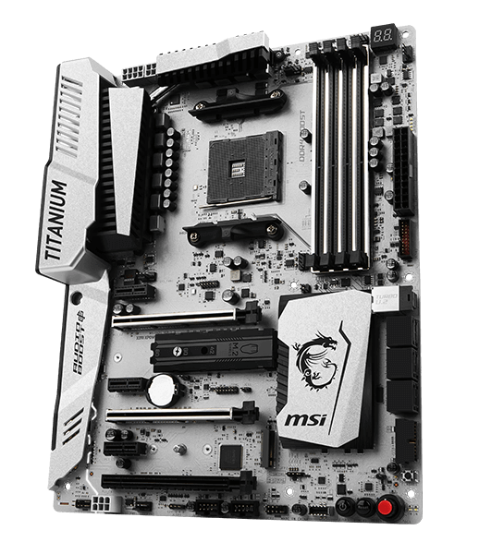
PART 1 – COMPONENT 1 OF 6
The Motherboard — the backbone
    Connects every other part together — CPU, RAM, storage, GPU, and power all plug into it
    The CPU socket decides which processors it can use — mismatched socket = mismatched CPU, no exceptions
    Comes in different sizes: ATX (full size), Micro-ATX, and Mini-ITX (compact builds)
    The chipset controls which features are available — how many USB ports, RAM speed support, expansion slots
GOOD TO KNOW
Modern sockets: AMD AM5 and Intel LGA1851 are the current platforms (2022–now / 2024–now). AM4 and LGA1700 are the previous generation — still extremely common, and what this photo shows. Older sockets like AM1 or Intel LGA775 exist in old machines — same job, just older tech.
AM4 motherboard, top-down view
Beyond the Screen • Lorma Colleges – CCSE Outreach Seminar
Notes:
1.7.2013
[Roldan] Motherboard connects everything. Stress the socket must match the CPU, and board sizes (ATX, Micro-ATX, Mini-ITX).
‹#›

Slide 9
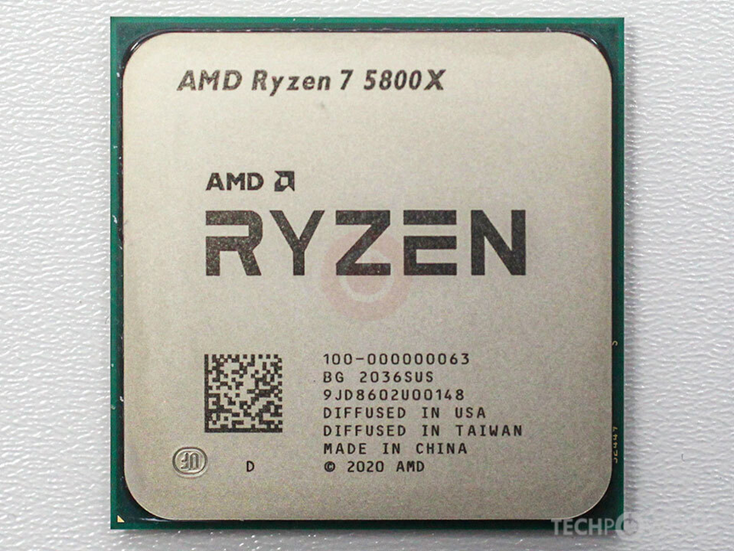
PART 1 – COMPONENT 2 OF 6
The CPU — the brain
    Executes instructions — every calculation, every app action passes through here
    Cores = how many tasks it can truly run at once; Threads = how many it can juggle
    Clock speed (GHz) = how fast each core works through instructions
    Must match the motherboard's socket — an AM4 CPU will not fit an AM5 board, and vice versa
GOOD TO KNOW
AMD went AM1 (2014) → AM4 (2017–2022) → AM5 (2022–now, confirmed supported through 2029). Intel went LGA1151 → LGA1200 → LGA1700 → LGA1851 (2024–now); Intel’s next socket, LGA1954 (Nova Lake), is expected in early 2027. Newer socket ≠ always better — it just means newer supported tech (like DDR5).
AMD Ryzen 7 5800X (AM4)
Beyond the Screen • Lorma Colleges – CCSE Outreach Seminar
Notes:
1.7.2013
[Roldan] CPU executes instructions. Cores vs threads, clock speed, and the AM4 vs AM5 example. Mention AM5 is supported through 2029 per AMD.
‹#›

Slide 10

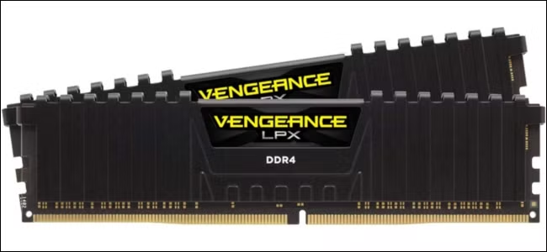
PART 1 – COMPONENT 3 OF 6
RAM — short-term memory
    Temporary workspace for whatever the CPU is actively using — cleared when the PC shuts down
    More RAM = more programs/tabs open smoothly at once, not necessarily faster programs
    Runs in “channels” — two matched sticks (dual-channel) perform noticeably better than one big stick
    Today's newest standard is DDR5 (AM5 / LGA1851); DDR4 (AM4 / LGA1700) remains extremely common
GOOD TO KNOW
DDR generations are NOT physically compatible with each other — a DDR4 stick will not fit a DDR5 slot. This goes back to DDR1 (2000s) — each generation faster, but never interchangeable.
DDR4 RAM, dual-channel kit
Beyond the Screen • Lorma Colleges – CCSE Outreach Seminar
Notes:
1.7.2013
[Roldan] RAM is short-term memory, cleared at shutdown. More RAM means more tabs/apps at once, not faster apps. Dual-channel idea.
‹#›

Slide 11

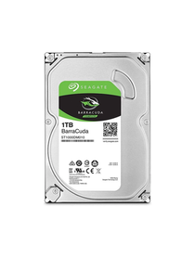
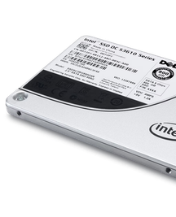
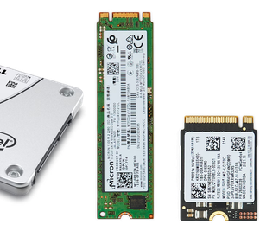
PART 1 – COMPONENT 4 OF 6
Storage — long-term memory
Where your files, apps, and OS live even after shutdown. Three common types today:
HDD
SATA SSD
NVMe SSD
Hard Disk Drive
Solid State Drive
M.2 / PCIe SSD
Spinning magnetic disk. Cheapest per GB, but the slowest — moving parts inside.
No moving parts. Much faster than HDD, same connector/shape as older drives.
Plugs directly onto the motherboard. The fastest option available today.
~120 MB/s sequential
~550 MB/s (SATA III cap) sequential
2,000–7,000+ MB/s sequential
Older machines may still use IDE/PATA drives — same idea as HDD, just an older connector standard. Figures are typical sequential read speeds; real-world random access narrows the gap somewhat.
Beyond the Screen • Lorma Colleges – CCSE Outreach Seminar
Notes:
1.7.2013
[Roldan] Storage: HDD, SATA SSD, NVMe SSD. Compare speeds. Tell them SSD is the biggest upgrade for an older PC.
‹#›

Slide 12

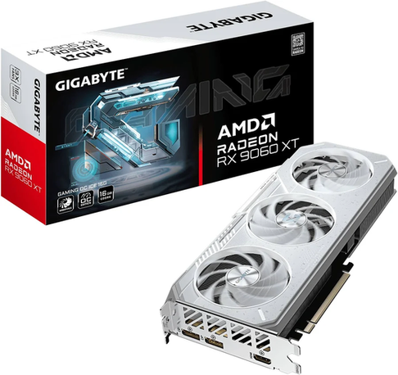
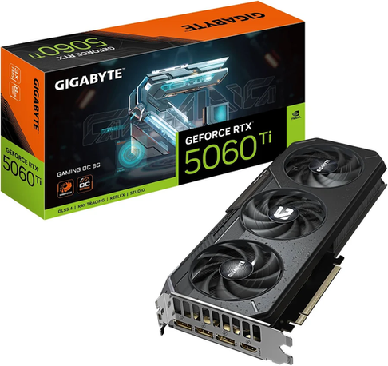
PART 1 – COMPONENT 5 OF 6
The GPU — the Visual Engine
    Renders everything you see on screen — more demanding for games, video editing, and AI work
    Integrated GPU: built into the CPU, fine for browsing and office work
    Dedicated GPU: its own card with its own VRAM, needed for gaming or rendering
    These two current 2025–2026 cards are direct competitors — same price bracket, different brand. Prices are inflated in 2026 by memory shortages
AMD Radeon RX 9060 XT
NVIDIA GeForce RTX 5060 Ti
Beyond the Screen • Lorma Colleges – CCSE Outreach Seminar
Notes:
1.7.2013
[Roldan] GPU: integrated vs dedicated. The two cards shown are current competitors. Mention prices are inflated in 2026 due to memory shortages.
‹#›

Slide 13

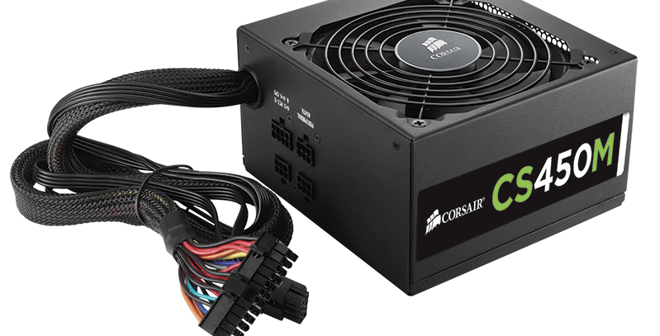
PART 1 – COMPONENT 6 OF 6
The PSU — the Power Supply
    Converts wall electricity into power every other part can safely use
    Rated in watts — needs enough headroom for the CPU, GPU, and drives combined
    Look for 80+ certification as a quick efficiency signal
HEADS UP
A weak or cheap PSU is one of the most common causes of random shutdowns, restarts, or even damage to other parts. It's the one component worth never cutting corners on.
Corsair CS450M, 80+ Bronze
Beyond the Screen • Lorma Colleges – CCSE Outreach Seminar
Notes:
1.7.2013
[Roldan] PSU powers everything. Watts need headroom. A weak PSU causes random shutdowns, so do not cheap out.
‹#›

Slide 14

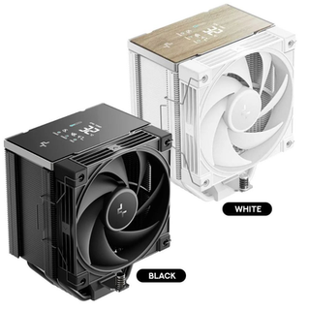
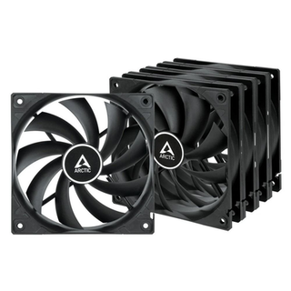
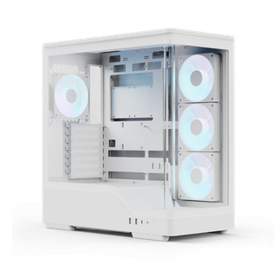
PART 1 – BONUS
Cooling & the Case
Not one of the “core six,” but this is exactly what keeps every other part alive and running cool — directly connects to the overheating problem in Part 5.
CPU Cooler
Case Fans
The Case
Draws heat away from the CPU. Stock coolers work, but bigger air/liquid coolers handle heavier loads better.
Move air through the case — cool air in, hot air out. Poor fan placement can bottleneck cooling even with a good cooler.
More than looks — airflow design, dust filters, and space for cable management all affect long-term temps.
Beyond the Screen • Lorma Colleges – CCSE Outreach Seminar
Notes:
1.7.2013
[Roldan] Bonus: cooling and case. Link forward to overheating in Part 5.
‹#›

Slide 15
PART 2
Decoding the Spec Sheet
GHz, nm, MB of cache, GDDR7 — what these numbers actually mean, and which ones matter.
Beyond the Screen • Lorma Colleges – CCSE Outreach Seminar
Notes:
1.7.2013
[Roldan] Part 2: Decoding the Spec Sheet (1:50–2:00, only 10 min). Go fast: pick the 2 or 3 numbers that matter most for beginners (GHz, cache, DDR vs GDDR) and skip the rest.
‹#›

Slide 16
PART 2 – READING THE NUMBERS
Clock Speed — GHz Explained
    Measured in GHz — billions of cycles per second a chip can execute
    CPU: how fast each core works through instructions
    RAM: how fast data moves between RAM and CPU (MHz / MT/s)
    GPU: similar idea, but VRAM bandwidth often matters more
CPU CLOCK
~3–6 GHz
base to boost
RAM SPEED
4,800–8,000
MT/s (DDR5)
GPU CLOCK
~2–3 GHz
core clock
GOOD TO KNOW
Clock speed alone doesn't decide performance — a 3.5 GHz chip from 2026 can easily beat a 5 GHz chip from 2016. Architecture matters as much as frequency.
Beyond the Screen • Lorma Colleges – CCSE Outreach Seminar
Notes:
1.7.2013
[Roldan] GHz is cycles per second. Compare CPU, RAM, and GPU numbers. Do not compare across brands by GHz alone.
‹#›

Slide 17

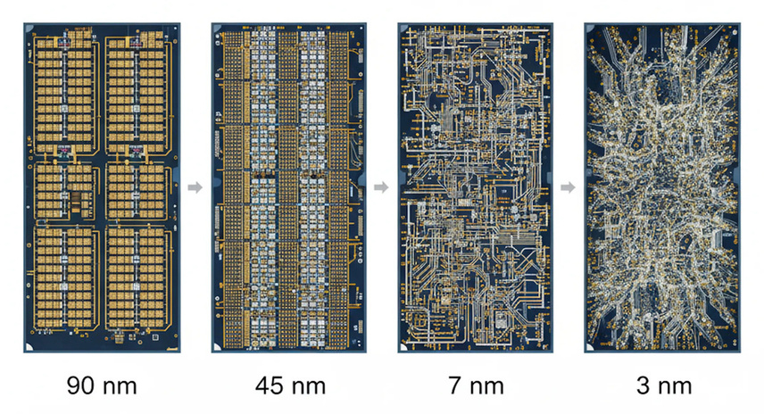
PART 2 – READING THE NUMBERS
Process Node — Die Shrink & Nanometers
    The “nm” number describes the size of transistors packed onto a chip
    Smaller node = more transistors in the same space = more performance and/or better efficiency
    A “die shrink” means fitting the same or better design into a smaller, more efficient process
2026 SNAPSHOT
TSMC's N2 and Intel's 18A are the current leading-edge nodes, both roughly “2nm-class.” Marketing names like “3nm” no longer match a literal physical measurement — they're a branding convention. What matters in practice is the density and efficiency gain over the previous node.
7nm (2019)
3nm (2023)
2nm (2026)
Relative transistor size (illustrative)
Beyond the Screen • Lorma Colleges – CCSE Outreach Seminar
Notes:
1.7.2013
[Roldan] nm describes transistor size, and today it is partly a marketing label. Smaller generally means more efficient.
‹#›

Slide 18
PART 2 – READING THE NUMBERS
IPC — Instructions Per Cycle
    IPC = how much useful work a CPU core finishes in a single clock cycle
    Two chips at the same GHz can perform very differently if their IPC differs
    This is why each new generation can be faster even at similar clock speeds
Same 4.0 GHz clock speed — different generations:
2016-era CPU
Baseline work done
2026-era CPU
~45% more work (illustrative) — same clock speed
Rule of thumb: GHz × IPC ≈ real-world performance. Comparing CPUs on clock speed alone is comparing the wrong number.
Beyond the Screen • Lorma Colleges – CCSE Outreach Seminar
Notes:
1.7.2013
[Roldan] IPC: same GHz, different generations, different work done. The 45% bar is only an illustration.
‹#›

Slide 19

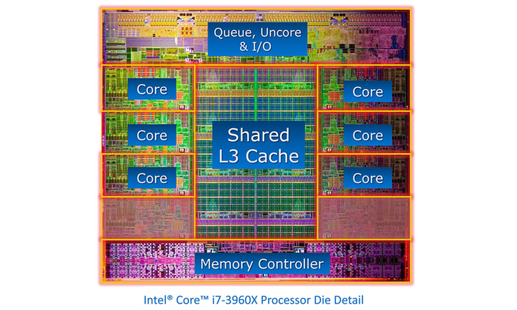
PART 2 – READING THE NUMBERS
Cache Hierarchy — L1, L2, L3 & 3D V-Cache
    Cache is small, extremely fast memory built into the CPU itself — much faster than RAM
    L1: smallest & fastest, per-core. L2: bigger, still per-core. L3: largest, shared across all cores
    The CPU checks L1 → L2 → L3 → RAM in that order whenever it needs data
    AMD's 3D V-Cache (“X3D” chips) stacks extra L3 cache vertically — up to 3x the normal capacity
GOOD TO KNOW
More L3 cache means fewer trips to slower RAM — which is exactly why X3D chips excel at gaming, where the same data (map, physics, AI) gets reused constantly. The tradeoff: X3D chips run slightly lower clocks to manage the extra heat.
Beyond the Screen • Lorma Colleges – CCSE Outreach Seminar
Notes:
1.7.2013
[Roldan] Cache L1, L2, L3, and 3D V-Cache. Analogy: cache is a desk, RAM is a bookshelf, storage is the warehouse.
‹#›

Slide 20
PART 2 – READING THE NUMBERS
DDR vs GDDR — Two Different Jobs
DDR (System RAM)
GDDR (VRAM)
    Used by the CPU for general tasks
    Prioritizes low latency — quick back-and-forth access
    Current: DDR5. Common: DDR4
    Not interchangeable with VRAM
    Used by the GPU for textures & frame data
    Prioritizes raw bandwidth — huge chunks of data at once
    Current: GDDR7 (RTX 50 series). Common: GDDR6
    Soldered to the graphics card, not user-replaceable
Both are “Double Data Rate” memory, but built for different priorities — that's why a graphics card can't just use regular RAM sticks.
Beyond the Screen • Lorma Colleges – CCSE Outreach Seminar
Notes:
1.7.2013
[Roldan] DDR is for the CPU (low latency); GDDR is for the GPU (high bandwidth). Not interchangeable.
‹#›

Slide 21
PART 2 – READING THE NUMBERS
PSU Tiers — Not All Watts Are Equal
80+ White/Bronze
80+ Silver/Gold
80+ Platinum
80+ Titanium
~82–85% efficient
~87–90% efficient
~90–92% efficient
~92–94%+ efficient
80+ certification measures energy efficiency at typical load — higher tiers waste less power as heat. It says nothing about build quality on its own, which is the other half of the picture:
    Reputable brands (Seasonic, Corsair, be quiet!, Super Flower) consistently test well on protections and ripple control
    Fully modular = cleanest cable management; non-modular = cheapest but every cable is permanent
    For a modern build, 80+ Gold with ATX 3.0/3.1 support is the sensible baseline — it's the current standard connector for newer GPUs
Beyond the Screen • Lorma Colleges – CCSE Outreach Seminar
Notes:
1.7.2013
[Roldan] 80+ tiers measure efficiency, not quality. Buy a reputable PSU, not just a high tier.
‹#›

Slide 22
PART 3
How the Parts Work Together
None of these components matter alone — it's the flow between them that makes a PC fast or slow.
Beyond the Screen • Lorma Colleges – CCSE Outreach Seminar
Notes:
1.7.2013
[Madayag] Part 3: How the Parts Work Together (2:00–2:10).
‹#›

Slide 23
PART 3
The Journey of a Task
Example: opening a photo editing app
→
→
→
Storage
RAM
CPU
GPU
App files are read from your SSD/HDD
Loaded into RAM so the CPU can reach it instantly
Processes the app's instructions step by step
Renders the image and interface on screen
BOTTLENECKS & UPGRADE LOGIC
A “bottleneck” happens when one weak part slows down everything else — like a powerful GPU paired with an old, slow CPU. Before upgrading, identify which part is actually holding you back; upgrading the wrong part wastes money and barely improves performance.
Beyond the Screen • Lorma Colleges – CCSE Outreach Seminar
Notes:
1.7.2013
[Madayag] Walk the journey: storage to RAM to CPU to GPU. Then explain bottlenecks with the 'weakest link' idea and upgrade logic (fix the bottleneck first).
‹#›

Slide 24
PART 4
Inside a Real PC
A closer look at an actual working PC — not just diagrams.
Beyond the Screen • Lorma Colleges – CCSE Outreach Seminar
Notes:
1.7.2013
[Directo] Part 4: Inside a Real PC (2:10–2:20). Use the photos on the next slide; if a school PC is available (with permission), show the real thing.
‹#›

Slide 25
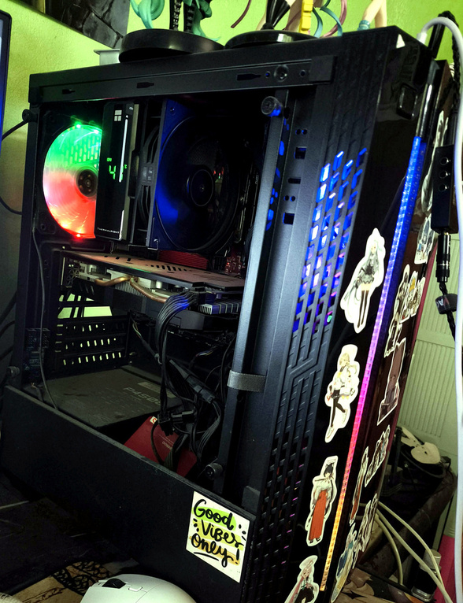
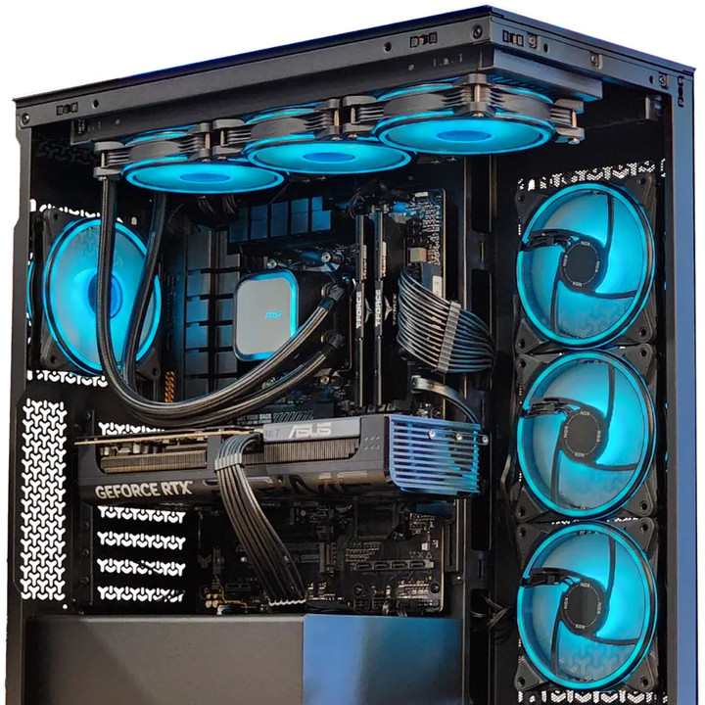
PC rig — Thermalright air cooler, RGB fans, mid-tower build
What to point out:
    The CPU cooler (Thermalright) sitting directly over the CPU socket
    RAM sticks in their slots next to the cooler
    The GPU seated in the main PCIe slot, with its power cables
    Cable routing behind the tray, and the case fans for airflow
    The visible dust on the fans and heatsink — a perfect example for the overheating section later
Sample PC no. 2
Beyond the Screen • Lorma Colleges – CCSE Outreach Seminar
Notes:
1.7.2013
[Directo] Point out the CPU cooler, RAM, GPU, cables, fans, and the dust. If using a borrowed school PC, only point; do not touch or unplug anything.
‹#›

Slide 26
PART 5
Common Problems & Troubleshooting
A simple method beats guesswork — every time.
Beyond the Screen • Lorma Colleges – CCSE Outreach Seminar
Notes:
1.7.2013
[Directo] Part 5: Troubleshooting (2:20–2:35, 15 min). Keep it practical and beginner-safe.
‹#›

Slide 27


PART 5
A Simple Troubleshooting Method
1. Identify
→
2. Isolate
→
3. Test
→
4. Fix
What exactly is happening? No power, no display, weird noise, restarts?
Narrow it down — is it the PC, the cable, the monitor, or the outlet?
Try one change at a time — reseat, swap, or remove a part to test
Apply the fix, then confirm the problem is actually gone — not just hiding
Keep this loop in mind for every problem in the next few slides.
Beyond the Screen • Lorma Colleges – CCSE Outreach Seminar
Notes:
1.7.2013
[Directo] Teach the loop: Identify, Isolate, Test, Fix. Say it together with the audience once.
‹#›

Slide 28

PART 5 – PROBLEM 1
No Display / Won't Boot
WHAT YOU MIGHT NOTICE
    PC powers on (fans spin, lights turn on) but the monitor shows nothing
    PC doesn't respond at all when the power button is pressed
    You hear a series of beeps on startup
QUICK CHECKS — SAFE FOR BEGINNERS
    Check the monitor is on and set to the right input source
    Make sure the video cable is connected to the GPU, not the motherboard (if a dedicated GPU is installed)
    Reseat the RAM sticks — remove and firmly click them back in
    Confirm the power cable is fully seated at both ends
    Listen for beep codes — they usually point to RAM or GPU issues
Beyond the Screen • Lorma Colleges – CCSE Outreach Seminar
Notes:
1.7.2013
[Directo] No display: check monitor, cable on the GPU not the motherboard, reseat RAM. Mention beep codes.
‹#›

Slide 29

PART 5 – PROBLEM 2
Overheating & Random Shutdowns
WHAT YOU MIGHT NOTICE
    PC feels/sounds hot, fans running loud and constant
    Random restarts or shutdowns during heavier use (games, video editing)
    Performance drops significantly after running for a while (thermal throttling)
QUICK CHECKS — SAFE FOR BEGINNERS
    Check for dust buildup in fans, heatsinks, and vents — clean gently with compressed air
    Make sure the case has clear airflow — not pressed against a wall or inside a cabinet
    Old thermal paste (3+ years) can lose effectiveness and may need reapplying
    Confirm all case/CPU fans are actually spinning
Beyond the Screen • Lorma Colleges – CCSE Outreach Seminar
Notes:
1.7.2013
[Directo] Overheating: dust, fan direction, thermal paste age. Safe checks only; clean gently with compressed air.
‹#›

Slide 30

PART 5 – PROBLEM 3
The PC Feels Slow
Too many startup programs
Storage nearly full
Apps auto-launching in the background eat RAM and CPU before you even open anything
A drive over ~90% full slows down significantly — especially on HDDs
Malware or unwanted programs
Not enough RAM for your usage
Unknown processes silently using CPU/network in the background
Too many browser tabs + apps open at once forces the PC to swap to disk, which is much slower
Beyond the Screen • Lorma Colleges – CCSE Outreach Seminar
Notes:
1.7.2013
[Directo] Slow PC: startup programs, full storage, malware, too little RAM. Ask 'which one have you experienced?'
‹#›

Slide 31
PART 6
Beyond the Desktop
A tower isn't the only kind of PC — mini PCs, laptops, handhelds, and the OS choice behind all of them.
Beyond the Screen • Lorma Colleges – CCSE Outreach Seminar
Notes:
1.7.2013
[Directo] Part 6: Beyond the Desktop (2:35–2:45, only 10 min). Spend about 2 minutes per slide.
‹#›

Slide 32
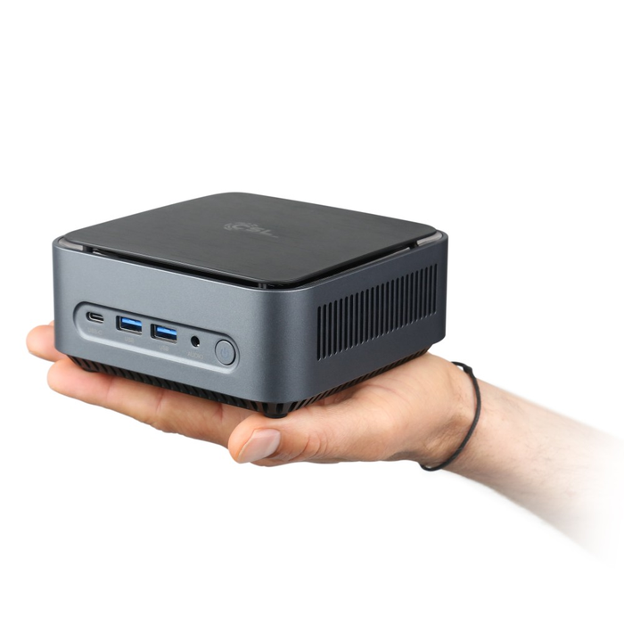
PART 6 – OTHER FORM FACTORS
Mini PCs
    Same core parts as a desktop, squeezed into a case the size of a paperback book
    Great for browsing, office work, home servers, and even light-to-serious gaming on newer models
    Some 2026 mini PCs use powerful integrated GPUs strong enough to rival budget dedicated graphics cards
    Examples: Intel NUC-style mini PCs, Beelink, Minisforum
HEADS UP
The tradeoff for the small size: limited or no upgradeability (RAM/storage are sometimes soldered), and less headroom for cooling under sustained heavy loads.
A full PC small enough to fit in one hand
Beyond the Screen • Lorma Colleges – CCSE Outreach Seminar
Notes:
1.7.2013
[Directo] Mini PCs: same parts in a tiny case. Good for office use and light gaming.
‹#›

Slide 33

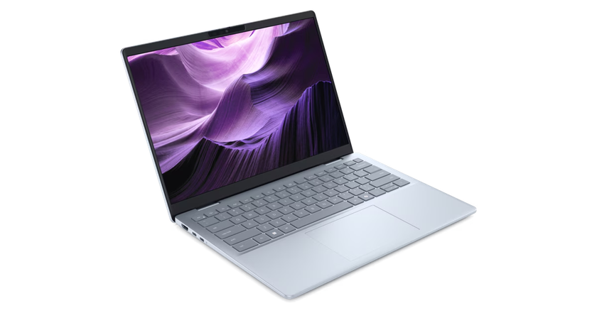
PART 6 – OTHER FORM FACTORS
Laptops
    The whole PC — including the display and battery — built into one portable unit
    “Mobile” versions of CPUs/GPUs trade some performance for lower power draw and heat
    Most components are soldered or proprietary — RAM and storage upgrades are often limited or impossible
    Good cooling design matters even more here — thermal throttling is common in thin laptops under load
HEADS UP
A laptop and a desktop with the “same” chip name often perform differently — the mobile version is usually a lower-power variant tuned for battery life, not the identical desktop part.
A typical Windows ultrabook
Beyond the Screen • Lorma Colleges – CCSE Outreach Seminar
Notes:
1.7.2013
[Directo] Laptops: mobile parts trade performance for efficiency; upgrades are limited.
‹#›

Slide 34

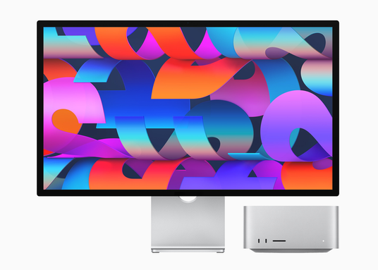
PART 6 – OTHER FORM FACTORS
Apple Computers — a Different Approach
    Runs macOS exclusively — Apple's own hardware and software, built together
    Uses Apple Silicon (M-series chips) — CPU, GPU, and unified RAM built onto a single chip
    “Unified memory” means the CPU and GPU share the same fast pool of RAM instead of separate pools
    Excellent battery life and efficiency, but almost nothing is upgradeable after purchase
    Mac Studio / Mac mini fill the same “compact desktop” role as mini PCs, just Apple-exclusive
MacBook
Mac Studio + Studio Display
Beyond the Screen • Lorma Colleges – CCSE Outreach Seminar
Notes:
1.7.2013
[Directo] Apple: unified memory on a single chip, macOS only. Mention macOS 27 'Golden Gate' is the current release.
‹#›

Slide 35

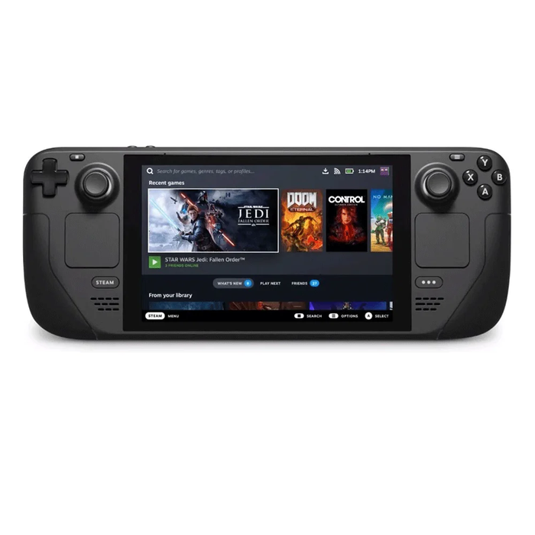
PART 6 – OTHER FORM FACTORS
Handheld Gaming PCs
    A full PC in a gamepad-shaped body — plays PC games on the go, not just console/mobile titles
    Examples in 2026: Steam Deck OLED (SteamOS), ASUS ROG Xbox Ally / Ally X (Windows 11), Lenovo Legion Go S (SteamOS option)
    SteamOS-based handhelds tend to boot faster and run cooler than the same hardware running Windows
    Windows-based handhelds offer wider software/launcher compatibility (Steam, Epic, Battle.net, Game Pass)
GOOD TO KNOW
This is a real, current example of how much the operating system itself affects performance and battery life — not just the hardware underneath it. Note: handheld prices rose sharply in 2026 due to memory shortages.
Steam Deck, running SteamOS
Beyond the Screen • Lorma Colleges – CCSE Outreach Seminar
Notes:
1.7.2013
[Directo] Handhelds: SteamOS vs Windows. Prices rose sharply in 2026 due to memory shortages.
‹#›

Slide 36


PART 6 – OTHER FORM FACTORS
Operating Systems — The Software Underneath It All
Windows 11
Most widely used desktop OS — broadest software and game support, runs on almost any PC hardware
macOS (Golden Gate)
Apple's OS — only runs on Apple's own Mac hardware, tightly integrated with iPhone/iPad
Linux (Ubuntu, Mint, Fedora, etc.)
Free and open-source — highly customizable, popular for developers, servers, and older hardware revival
ChromeOS
Lightweight, browser-centric OS built for Chromebooks — simple, secure, limited offline software
SteamOS
Valve's Linux-based gaming OS — powers the Steam Deck and select handhelds, optimized for game performance and battery life
Beyond the Screen • Lorma Colleges – CCSE Outreach Seminar
Notes:
1.7.2013
[Directo] Operating systems: Windows, macOS, Linux, ChromeOS, SteamOS. The OS affects performance and battery life.
‹#›

Slide 37
PART 7
Everyday Uses & Smart Buying
Picking the right PC for what you actually do — and buying secondhand parts safely.
Beyond the Screen • Lorma Colleges – CCSE Outreach Seminar
Notes:
1.7.2013
[Rubis] Part 7: Everyday Uses & Smart Buying (2:45–2:50, only 5 min). Be brief.
‹#›

Slide 38

PART 7
Choosing the Right PC for You
School work & browsing
Gaming
Video/photo editing
Any modern CPU, 8GB RAM, SSD storage — no dedicated GPU needed
Prioritize the GPU first, then a matching CPU — 16GB RAM is the comfortable baseline today
Prioritize CPU cores and RAM (16–32GB); fast NVMe storage speeds up large files a lot
Buying Secondhand Parts Safely
    Ask to test the part before paying, if possible — boot it up, check temps and stability
    Check for physical damage: bent pins (CPU), swollen capacitors (motherboard/PSU), burn marks
    Buy from sellers with a track record/reviews — and get a warranty period in writing when offered
    RAM, GPU and storage prices are unusually high in 2026 — compare sellers and never overpay for “like new”
Beyond the Screen • Lorma Colleges – CCSE Outreach Seminar
Notes:
1.7.2013
[Rubis] Match the PC to the use: school work, gaming, editing. Secondhand tips: test the part, check for damage, buy from trusted sellers. Prices are high in 2026, so compare before buying.
‹#›

Slide 39
BEFORE WE GO
Quick Recap
A PC is six parts working as one system — not just a CPU or a GPU alone
Bigger numbers (GHz, nm, cache) don't automatically mean better — read specs together, not alone
Bottlenecks come from the weakest part in the chain, not the whole PC
Identify → Isolate → Test → Fix works for almost any hardware problem
Desktops aren't the only option — mini PCs, laptops, and handhelds trade power for portability
Match the PC (and OS) to what you actually do — not to what looks impressive
Beyond the Screen • Lorma Colleges – CCSE Outreach Seminar
Notes:
1.7.2013
[Rubis] Recap in 30 seconds: parts, specs, bottlenecks, the troubleshooting loop, other PC types, and smart buying.
‹#›

Slide 40
OPEN FORUM
Questions & Answers
Ask about the parts, the specs, or any PC problem you’ve had.
Bring your own PC story — we’ll walk through how to troubleshoot it together.
Beyond the Screen • Lorma Colleges – CCSE Outreach Seminar
Notes:
[All / Quimson moderates] Open Forum. If there are no questions, ask: 'Which PC problem have you faced at home?' Keep within the time left before 2:50.

Slide 41
CLOSING
Certificates, Photo & Feedback
Certificates
Photo opportunity
Evaluation form
Awarding of certificates to our participants
Group photo with all organizers and participants
Please answer the short evaluation form before you leave
Beyond the Screen • Lorma Colleges – CCSE Outreach Seminar
Notes:
[All] Awarding of Certificates, Photo Opportunity, Closing Remarks (2:50–3:00). Hand out the evaluation form and collect the attendance sheet before leaving.

Slide 42
Thank You!
Questions? Let's talk about your own PC.
College of Computer Studies and Engineering – Lorma Colleges
DIRECTO • MADAYAG • QUIMSON • ROLDAN • RUBIS
Notes:
1.7.2013
[All] Thank the school, Dr. Badua, and Mr. Buccat. Invite last questions.
‹#›

