Slide 1
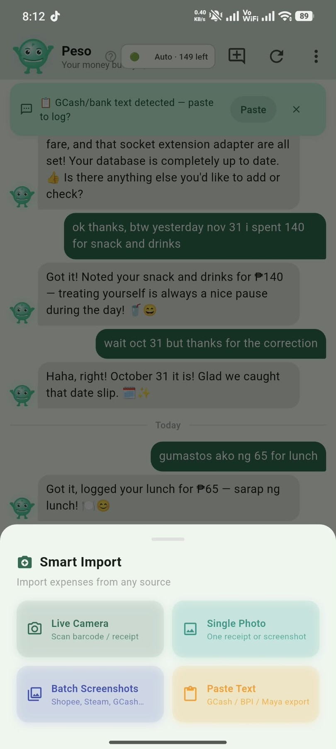
₱
SmartSpend
An AI-Assisted Mobile Financial Tracking and Advisory Application
For Personal Financial Management of Parents and Young Professionals
in San Fernando City, La Union
Brix A. Directo · Cyrille John M. Rubis · Djaunathan Albert S. Madayag
Lead Developer UI/UX & Documentation Project Manager & QA
Adviser: Ms. Ellen F. Mangaoang, DIT · Lorma Colleges CCSE · November 9, 2026
BSIT Capstone 2 · AY 2026–2027
1 / 15

Slide 2
CHAPTER I · INTRODUCTION
The Problem: Filipino Finance Management Gaps
💸 Manual Tracking Friction
74%
<50%
Filipino users abandon expense trackers — GCash, Shopee, and multi-wallet transactions require too much manual effort.
Financial
Literacy Rate
Maintain Any
Budget
85%
41.5M
🌐 No Local Language Support
Household
Financial Access
GCash Monthly
Users
Existing apps don't understand Taglish, GCash, Paluwagan, ShopeePay, or local merchant names.
📊 Passive Data, No Behavioral Feedback
Apps show charts but create no consequences when spending warnings are ignored. Users need nudges, not just graphs.
BSP CFIS 2025 · BSP Consumer Expectations Survey
2 / 15

Slide 3
CHAPTER I · RESEARCH OBJECTIVES
What This Study Aims to Do
01
02
03
NEEDS ASSESSMENT
SYSTEM DESIGN & DEVELOPMENT
USABILITY EVALUATION
Assess existing financial management practices, budgeting challenges, and expense tracking behaviors of parents (35–55) and young professionals (21–35) in San Fernando City, La Union
Design and develop SmartSpend — an offline-first Flutter/Android application with Taglish AI, multi-modal input, and a transaction-derived Financial Health Score
Evaluate the system using the System Usability Scale (SUS, N=30), targeting a mean score ≥80 ("Good" per Bangor, Kortum & Miller, 2009)
🎯 Research Gap:
No existing study evaluates an integrated mobile prototype combining Taglish AI logging + GCash screenshot import + transaction-derived Financial Health Score for the Filipino context.
3 / 15

Slide 4
CHAPTER II · THEORETICAL FRAMEWORK
Built on Behavioral Economics
🔔 Nudge Theory
💡 Self-Determination Theory
📉 Prospect Theory
Thaler & Sunstein (2008)
Deci & Ryan (2000)
Kahneman & Tversky (1979)
Choice architecture guides behavior without restricting freedom. Budget alerts, Warning Decay (−5 pts/day), and startup gap prompts are designed nudges applied at the moment of decision.
36 badges + streaks = Competence reward. Customizable goals = Autonomy. Filipino-first Taglish framing = Relatedness. SDT explains why the gamification sustains habit formation.
Losses feel ~2× more painful than equivalent gains. Warning Decay: FHS drops −5 pts/day when budget warnings are ignored — making the cost of ignoring alerts concrete and visible.
🏦 FHS Academic Basis — CBA–Melbourne Institute (2018)
The Financial Health Score adapts the CBA–Melbourne Institute Observed Financial Health Indicator (Comerton-Forde et al., 2018) — a transaction-based 0–100 scale with equal-weighted components. We call ours a "Prototype Observed Financial Health Indicator (FHI)" per Melbourne Institute naming guidance. UNSGSA (2021) validates using transaction data as an early-stage complement to survey-based scales.
4 / 15

Slide 5
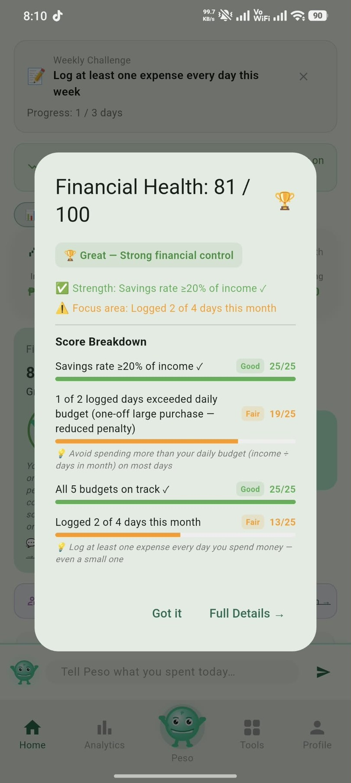
CHAPTER II–III · FINANCIAL HEALTH SCORE
The FHS Formula — Where It Came From
FHS (Full Mode) = 4 × 25 pts each:
① Savings Rate = 25 × min(1, rate/0.20)
② Overspend Ctrl = 25 × (1−weighted/active)
③ Budget Adher. = 25 × (onBudget/total)
④ Log Consistency = 25 × (loggedDays/active)
Adj: Warning Decay −5 pts/day (max −15)
Lightweight: Spending Restraint + Category
Balance + Consistency + Habit Streak
Component
Academic Basis
Savings Rate (20% target)
Warren & Tyagi (2004) — 50/30/20 rule
Overspend Control
Kahneman & Tversky (1979) — loss aversion
Budget Adherence
FinHealth Score® Plan pillar (FHN, 2021)
Logging Consistency
Deci & Ryan (2000) — SDT Competence
⏳ Objective 1 results [PENDING] — replace with actual survey frequencies once N=30 is complete.
Equal weights (25 pts)
CBA–MI (2018) equal-weight observed scale
Warning Decay
Prospect Theory — loss-salience principle
5 / 15

Slide 6
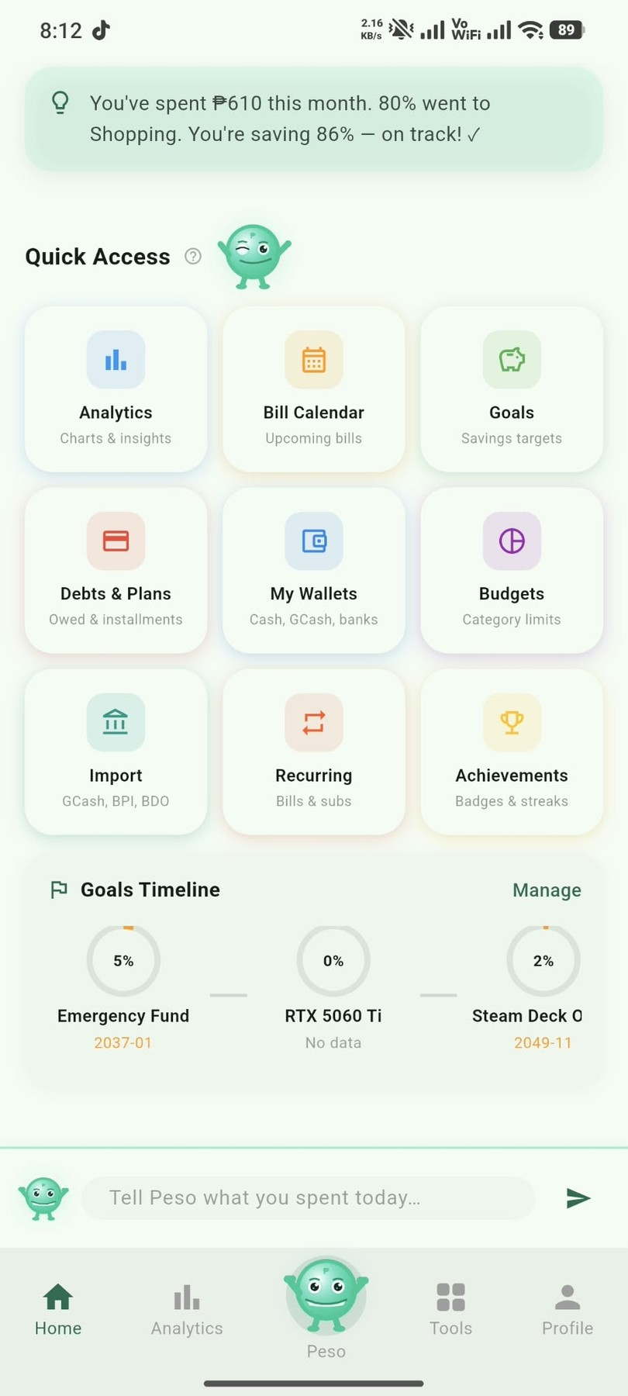




CHAPTER III · SYSTEM DESIGN
SmartSpend System Architecture
User Input
(7 Modalities)
→
AI Processing
(9 Providers)
→
SQLite DB
(v14 · 26 tables)
→
Analytics + FHS
(0–100 score)
💬
🎙️
📷
🖼️
🔢
📋
✏️
AI Chat
(Taglish)
Voice
Input
OCR
Receipt
Batch
Screenshots
Barcode
Lookup
Bank CSV
Paste
Manual
Entry
34
9
45
26
36
100%
AI Actions
Providers
Screens
DB Tables
Badges
Core Offline
6 / 15
Figure 3.4: Login with Demo mode
Figure 3.5: Home Dashboard (FHS 96/100)
Figure 3.7: Batch Import (GCash)
Figure 3.9: Budgets & Savings Goals

Slide 7
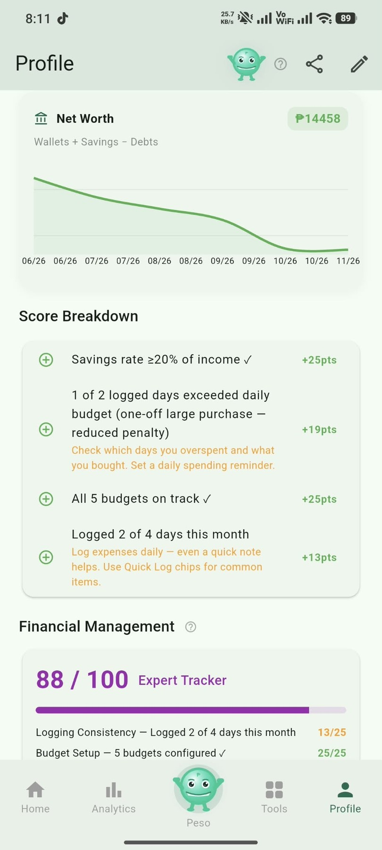
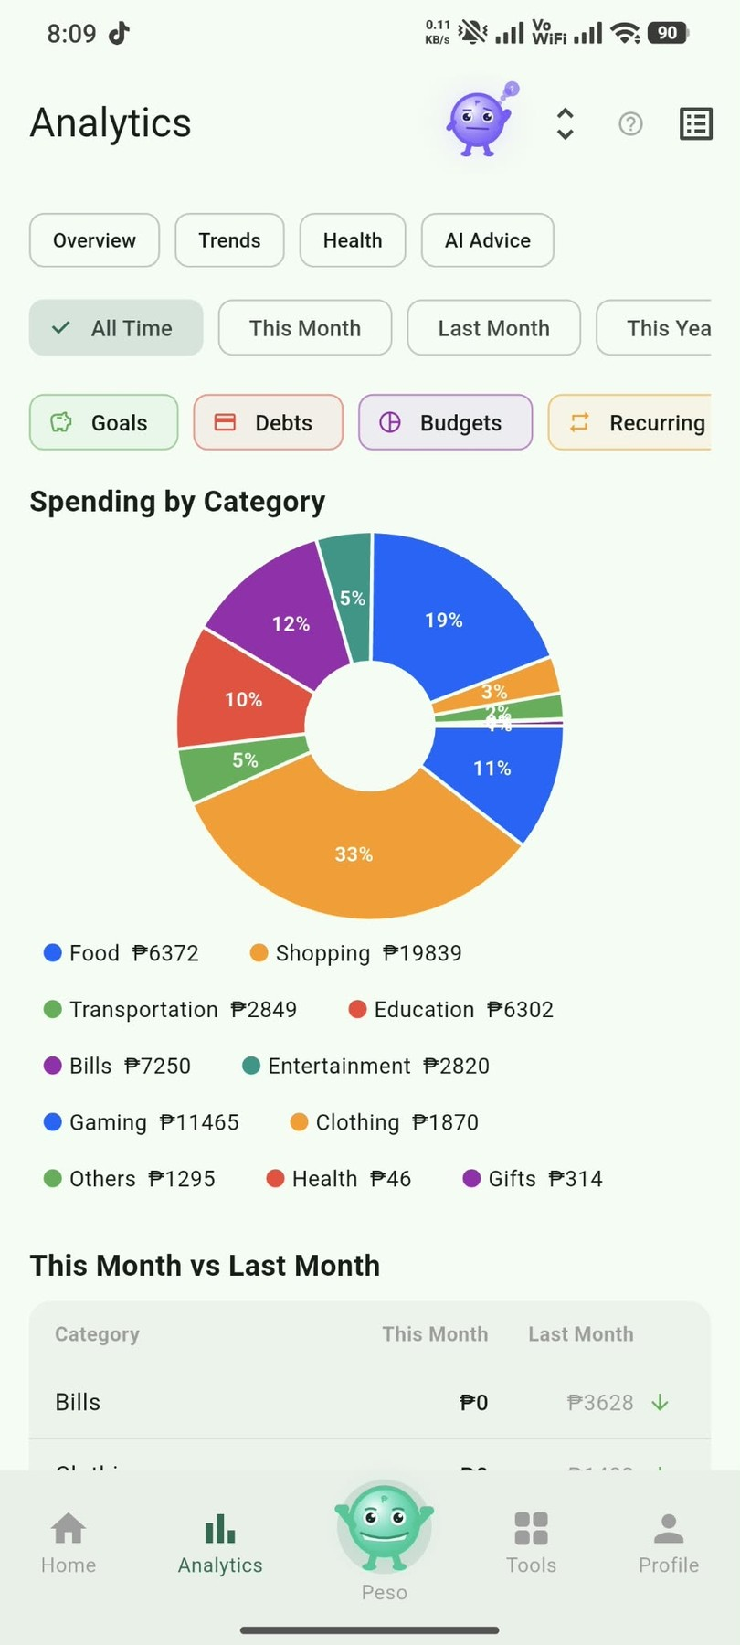
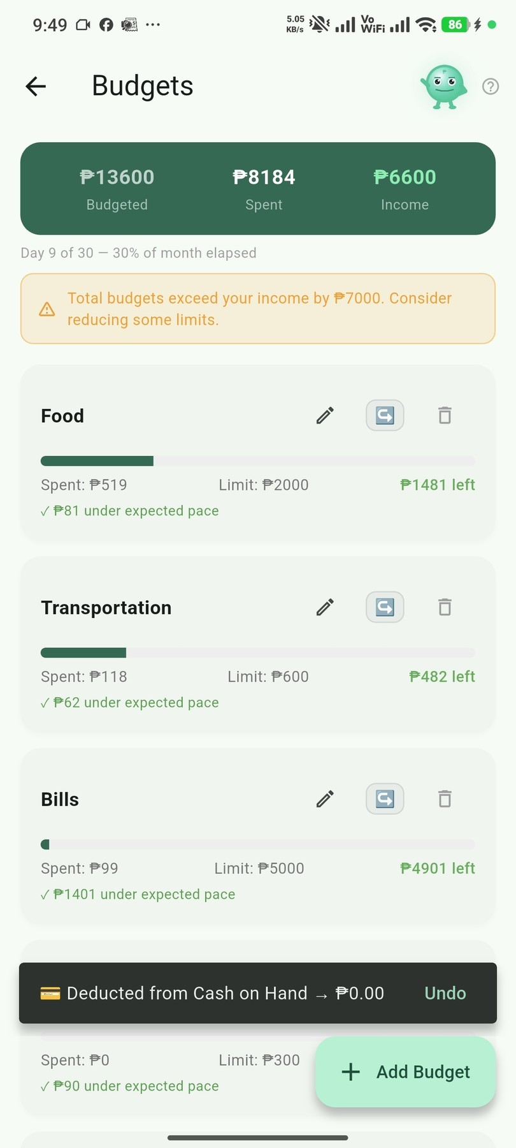

CHAPTER III · PESO COMPANION SYSTEM
Meet Peso — Your AI Money Buddy
🎭 12 Moods
🗣️ 31 Voice Contexts
👆 Gesture System
Idle animation (bob + eye blink every ~4s), mood pop-in elastic transition. Responds to FHS score, budget status, and user gestures.
PesoVoiceService: 2–4 random Taglish variants per context. Prevents semantic satiation — different line every session.
Double-tap → surprised + voice line. Long-press → context tip sheet. Idle 8s → winks at you (once/hour anti-Clippy).
⭕ FHS Tier Ring
🔁 Behavioral Loop
⚠️ Scope Note
🟢 Green ≥70 · 🟠 Orange ≥50 · 🔴 Red <50. Score tier visible instantly without reading the number.
Log daily → streak celebration → reinforces habit. FHS tier change → Peso reacts. Notification tap → context greeting.
These are design features grounded in SDT and Nudge Theory. Longitudinal behavioral effect has NOT been measured — present as design, not as measured outcome.
7 / 15
Figure 3.6: Peso Chat (Taglish logging)
Figure 3.8: FHS Breakdown

Slide 8
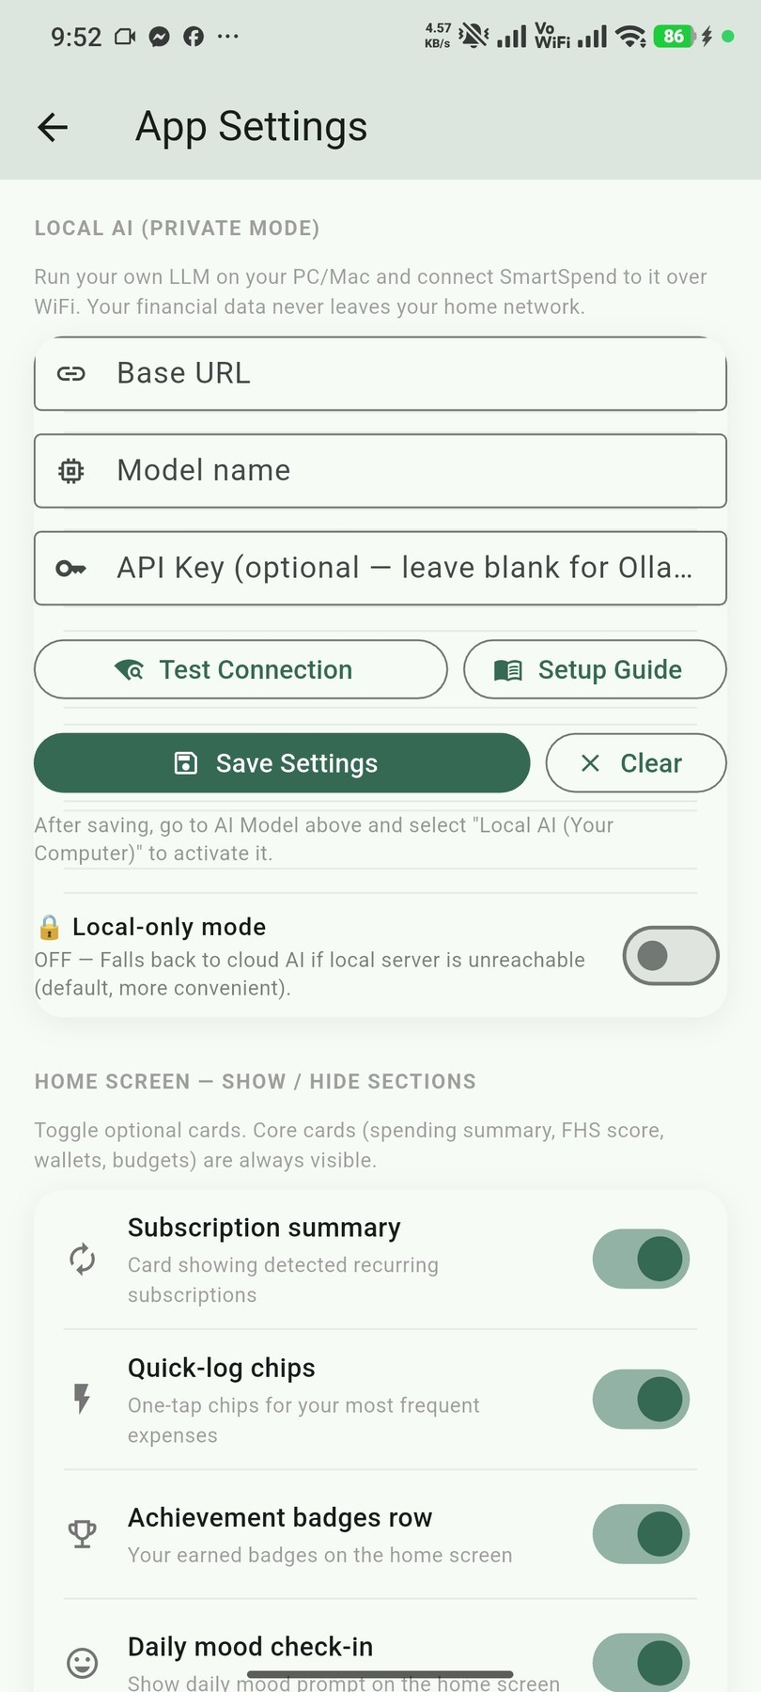
CHAPTER III · DATA PRIVACY
Privacy-First AI — RA 10173 Alignment
☁️ Cloud AI (Default)
🏠 Local AI (Private Mode)
📱 On-Device AI (Roadmap v5.0)
On-device regex redacts BEFORE sending:
• PH mobile numbers (09XX/+63)
• GCash ref numbers (12–18 digits)
• OTPs and PIN codes
• Bank account numbers
Note: Free-tier Gemini content may be used to improve Google products.
User connects Ollama/LM Studio/Jan on their own PC. While server is reachable, no data leaves the home network.
Local-only toggle: AI stops responding instead of falling back to cloud — for maximum privacy.
Gemma 4 E2B (~2.6 GB) via LiteRT LM SDK. Viable on 6 GB RAM / Android 10+ phones.
Status: Planned ~2027. Listed as Recommendation, NOT a delivered feature.
📦 What is sent to cloud AI per request (~5,000–8,000 tokens):
Recent 10 expenses (item names + amounts only) · Budget limits · Savings goals · Wallet balances · Conversation history
Philippine financial reference data (SSS/PhilHealth/BNPL) · NO account numbers · NO receipt images · NO personal IDs
8 / 15
Figure 3.10: Local AI Setup in Settings

Slide 9
CHAPTER III · METHODOLOGY
Evaluation Protocol
👥 Respondent Profile (N=30 Purposive Sample)
SUS Score Interpretation (Bangor et al., 2009)
20
10
90–100
Excellent
A+
Parents
Ages 35–55
Young Professionals
Ages 21–35
80–89
Good ← TARGET
B
San Fernando City, La Union · Purposive sampling · Used app ≥10 min before answering SUS
70–79
OK
C
📋 System Usability Scale (SUS — Brooke, 1996)
Standard 10-item instrument · 1–5 scale per item
Formula: =((Q1-1)+(5-Q2)+...+(5-Q10))×2.5
Target: Mean ≥80 = "Good" (Bangor et al., 2009)
60–69
Poor
D
<60
Awful
F
⏳ Survey data collection in progress. SUS scores, frequency tables, and demographic breakdowns will be added here once N=30 responses are complete.
9 / 15

Slide 10
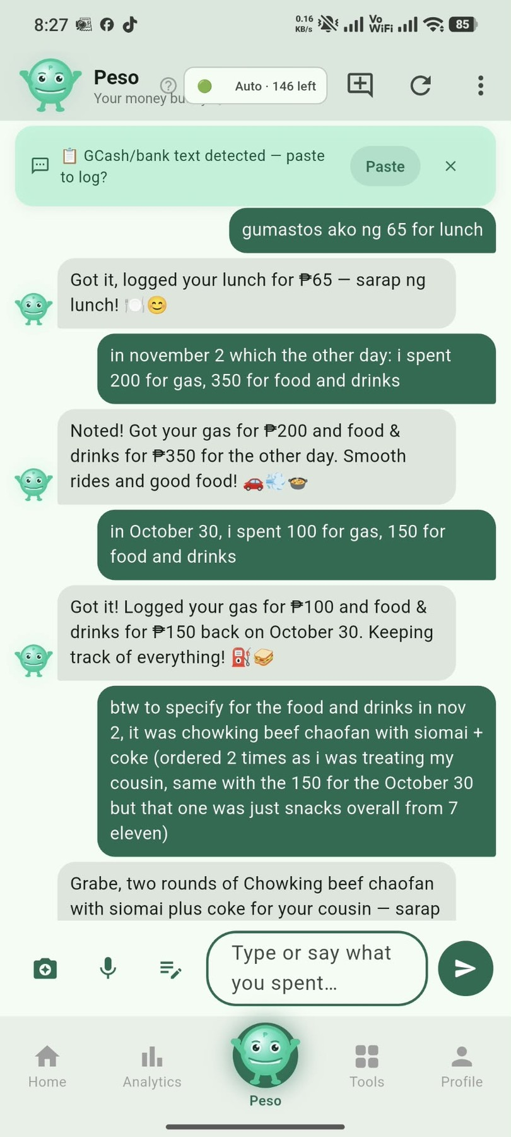
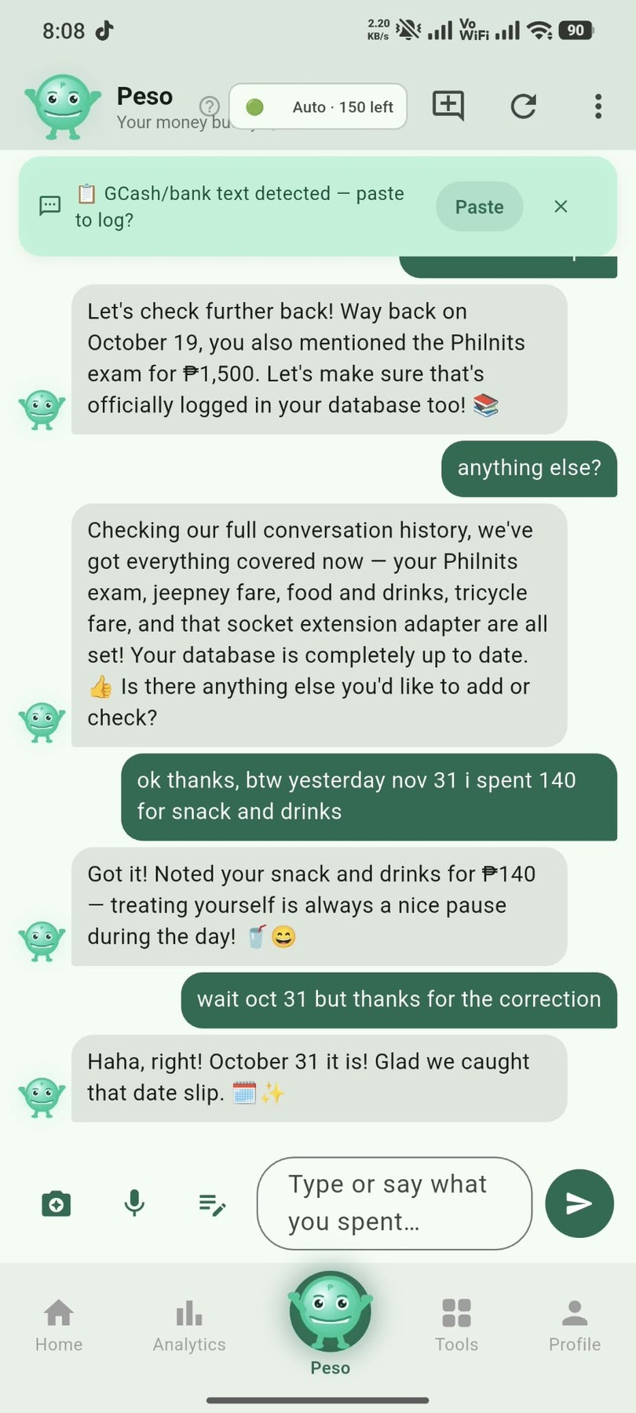
CHAPTER III · RESULTS — OBJECTIVE 2
System Development Results (v3.1.2)
34
9
45
26
36
100%
AI Actions
Providers
Screens
DB Tables
Badges
Offline Core
9-Provider AI Fallback Chain:
Gemini 3.5
Flash-Lite
Gemini 3.5
Flash
GPT-OSS
120B (Groq)
Qwen3.6/
Qwen3.8
GPT-OSS
20B / Mini
Cerebras
Local LLM
(Optional)
→
→
→
→
→
→
Engineering Performance Benchmarks:
OCR Precision (GCash/Maya)
91.2% *
OCR Recall (GCash/Maya)
88.5% *
AI Categorization (Taglish)
94.6% *
DB Sync Recovery
100%
Average AI Response Time
<1.8 seconds
* Internal estimates — formal 50-receipt parsing test pending
10 / 15

Slide 11
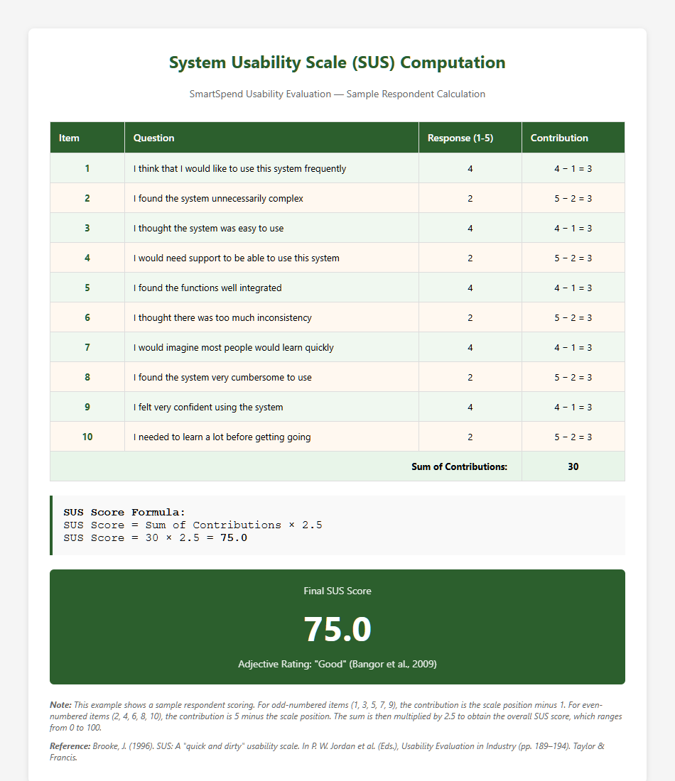
CHAPTER III · RESULTS — OBJECTIVE 3
Usability Evaluation Results
⚠️ PRELIMINARY DATA — N=5 of target N=30 (Oct–Nov 2026). Mean SUS = 61.83 — below the 68-point average benchmark. Final N=30 results may differ.
Respondent Group
N
Mean SUS Score
SD
Range
Adjective
Respondent 1 — Young Professional
—
60.0
—
—
OK
Respondent 2 — Young Professional
—
55.0
—
—
OK
Respondent 3 — Parent/HH Manager
—
55.0
—
—
OK
Respondent 4 — Parent/HH Manager
—
75.0
—
—
OK
Target: Mean ≥80 = "Good" (Bangor, Kortum & Miller, 2009) · Formula: =((Q1-1)+(5-Q2)+...+(5-Q10))×2.5
📊 Interpretation: SUS 61.83 = Grade D (OK) per Bangor et al. (2009). Below the 68-point average benchmark.
Respondent 5 — Parent/HH Manager
—
67.5
—
—
OK
Individual scores: 60.0, 55.0, 55.0, 75.0, 67.5 · Range: 55.0–75.0 · Below average (68 benchmark) — acknowledged as a prototype limitation · Preliminary N=5 of target N=30
Mean SUS (N=5, Preliminary)
5
61.83
—
—
Grade D
11 / 15
Figure 3.11: SUS Computation Table (sample calculation)

Slide 12
CHAPTER IV · CONCLUSIONS
Conclusions & Key Findings
Objective 1
Needs Assessment
Objective 2
System Design
Objective 3
Usability Evaluation
Preliminary findings (N=13, Oct–Nov 2026):
76.9% struggle with overspending
53.8% use manual/no tracking
69.2% positive intent: AI financial app
46.2% face difficulty before salary/allowance
Note: Preliminary — final analysis pending N=30.
SmartSpend v3.1.2 successfully engineered:
✅ 34 agentic actions · 9 AI providers
✅ 7 input modalities · 45 screens
✅ Gemini 3.5 Flash-Lite as primary engine
✅ FHS as Prototype Observed FHI (CBA-MI basis)
✅ RA 10173 data minimization implemented
Preliminary SUS result (N=5):
Mean SUS = 61.83 — Grade D (OK)
Below 68-point average benchmark
Marginal but acceptable for a prototype system
OCR: 91.2% precision / 88.5% recall *
AI categorization: 94.6% *
DB sync recovery: 100%
Final SUS result pending N=30 completion.
* Internal estimates — formal test pending
12 / 15

Slide 13
CHAPTER IV · RECOMMENDATIONS
Future Work & Recommendations
✅ DONE
Paluwagan Tracker
✅ DONE
Peso Companion System
Rotating savings group management. Implemented in v3.0.0 using existing debt/recurring DB infrastructure.
12-mood mascot, behavioral feedback loop, screen-aware tips. Implemented v3.0.5–v3.1.2.
🔄 PLANNED
Payday-Cycle Budgeting
🔄 PLANNED
Localized SMS Autologging
Semi-monthly (15th/30th) budget resets matching Philippine payroll cycles.
Android Notification Listener captures GCash/bank texts automatically — no manual entry needed.
⏳ FUTURE
Longitudinal Study
⏳ v5.0 ~2027
On-Device AI
6–12 month study measuring whether FHS actually changes spending behavior over time.
Gemma 4 E2B INT4 (~2.6 GB) via LiteRT LM SDK. Viable when 6 GB RAM phones are PH majority.
13 / 15

Slide 14
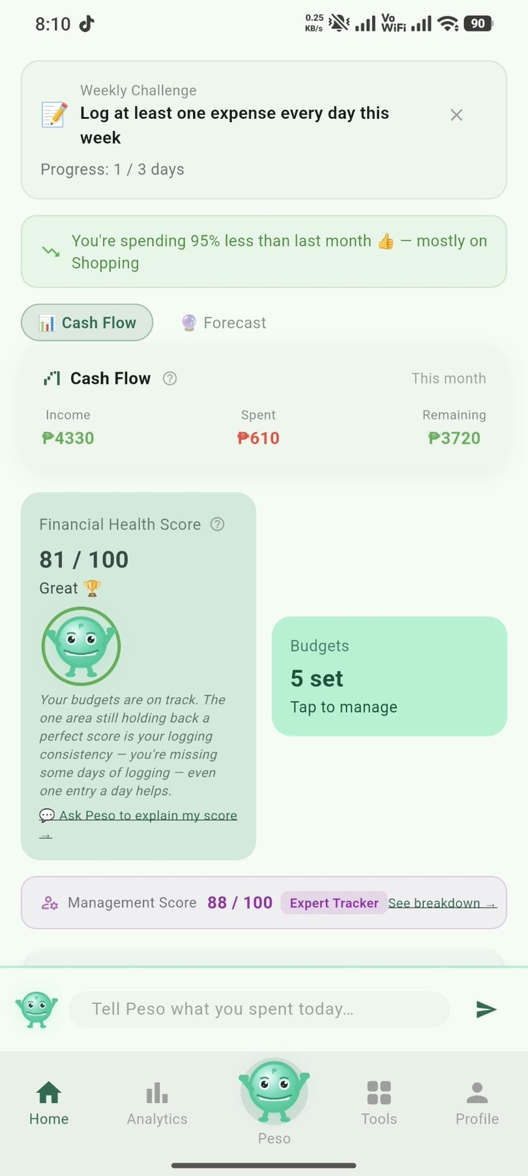
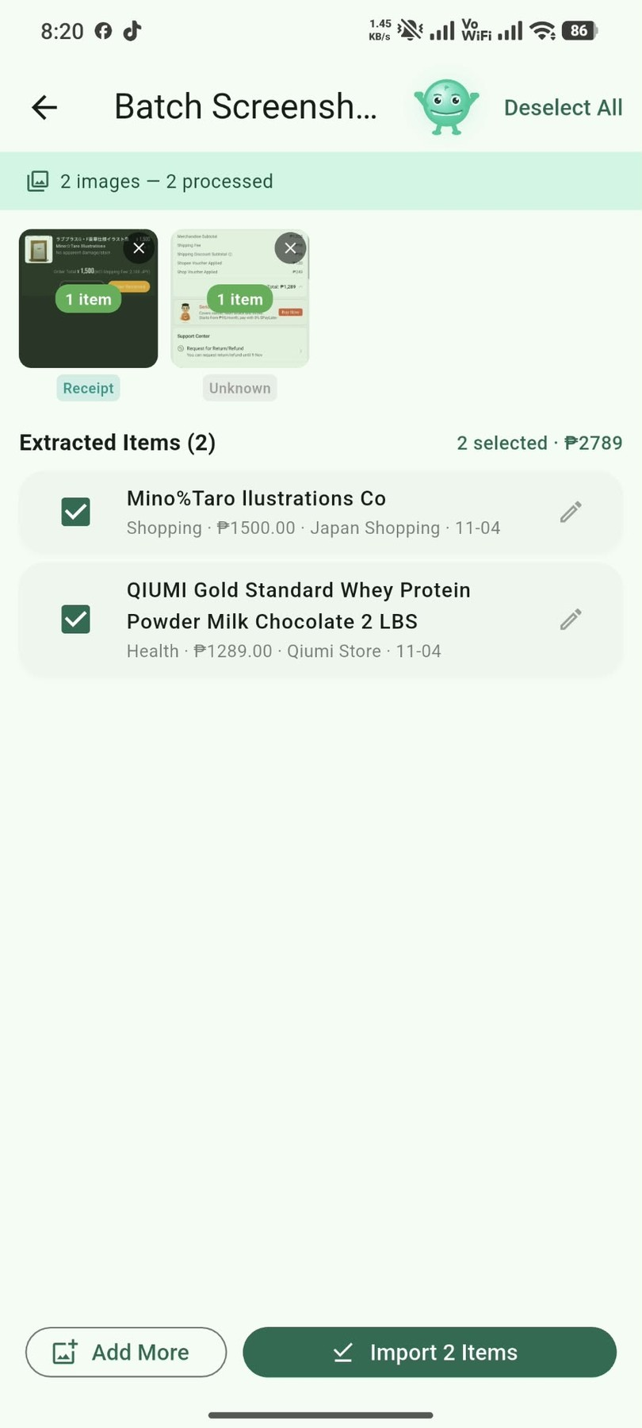
LIVE DEMO
SmartSpend in action
Showing the 3 core features:
💬 Taglish AI logging
📊 FHS breakdown
📈 Analytics
v3.1.2 · Try Demo on login
zushikina-kun.github.io/smartspend-app/
14 / 15

Slide 15
₱
Thank you for listening!
SmartSpend — Spend Smart, Live Better.
An offline-first, Taglish AI-powered financial companion built for every Filipino.
Brix A. Directo
Cyrille John M. Rubis
Djaunathan Albert S. Madayag
Lead Developer
UI/UX & Documentation
Project Manager & QA
Adviser: Ms. Ellen F. Mangaoang, DIT · Lorma Colleges CCSE · November 9, 2026
We are now open for questions.
Prepared answers: see DEFENSE_QA_PREP.md · FHS formula: see FHS_FORMULA_DERIVATION_DEFENSE_GUIDE.md
15 / 15

Slide 16
CHAPTER II · COMPETITOR ANALYSIS (BACKUP SLIDE)
Competitor Gap Analysis — Why SmartSpend?
App
Language
GCash Import
FHS (0-100)
Offline
Key Differentiator
BudgetPH
✅ Filipino
❌ No
❌ No
❌ No
Payday-cycle, paluwagan — no AI, no screenshot import
P1SO Budget
❌ Generic
❌ No
❌ No
✅ Yes
100% offline, no ads — manual only, no AI or FHS
GoodBudget
❌ Generic
❌ No
❌ No
❌ No
Envelope budgeting — no Filipino context
Spendee
❌ Generic
❌ No
❌ No
❌ No
Paid, bank-linked — no offline, no Taglish
SmartSpend ✅
✅ Taglish AI
✅ Yes
✅ Yes
✅ Yes
All 4 differentiators combined — only integrated PH solution
Sources: BudgetPH (kindlyf.com, Nov 2026), P1SO Budget (pisobudget.com), GoodBudget, Spendee — feature set verified against public listings
16 / 16

