Slide 1

SmartSpend
An AI-Assisted Mobile Financial Tracking and Advisory Application for Personal Financial Management
Directo, Brix A.
Rubis, Cyrille John M.
Madayag, Djaunathan Albert S.
Adviser: Ellen F. Mangaoang, DIT
College of Computer Studies and Engineering, LORMA Colleges
November 2026
Notes:
PRESENTER: Brix A. Directo (approx. 0.5 min)
Good day to our panelists, to Ma'am Ellen Mangaoang, our adviser, and to everyone present. We are Brix Directo, Cyrille John Rubis, and Djaunathan Albert Madayag, Bachelor of Science in Information Technology students of the College of Computer Studies and Engineering, LORMA Colleges. Our capstone project is SmartSpend: an AI-assisted mobile financial tracking and advisory application for personal financial management. I will open with the problem and our objectives. Cyrille will then walk you through our methodology, the system, and the AI engine. Djaunathan will close with the results, limitations, and recommendations.

Slide 2
Money is managed without a system
2%
< 50%
10%
of Filipino adults answered all six basic financial literacy questions correctly
reported keeping any household or personal budget
of our 30 respondents use a mobile app to track expenses
BSP Financial Inclusion Survey, 2021
BSP Financial Inclusion Survey, 2021
SmartSpend needs assessment
A mixed picture (BSP CFIS 2025): basic literacy rose from 69% to 74%, but formal account ownership fell from 56% to 50%.
Notes:
PRESENTER: Brix A. Directo (approx. 1.25 min)
Financial mismanagement is a documented problem in the Philippines. In the 2021 BSP Financial Inclusion Survey, only 2 percent of Filipino adults answered all six basic financial literacy questions correctly, and fewer than half kept any household or personal budget. In our own survey of 30 respondents, only 3 of them, or 10 percent, used a dedicated mobile app to track expenses. Most relied on receipts and mental estimates. The picture is shifting, but unevenly. BSP's 2025 survey shows basic financial literacy rising from 69 to 74 percent, yet formal account ownership fell from 56 to 50 percent. So the problem is not resolved, and that mixed picture is our motivation. Our primary users are parents aged 35 to 55, who are the main household financial decision-makers, and our secondary users are young professionals aged 21 to 35, in La Union.

Slide 3



The gap exists at three levels
International
National (PH)
Demographic
PROBLEM
PROBLEM
PROBLEM
Manual entry dominates; AI categorization degrades for non-English transactions.
Local apps lack LLM chat, spending behavior analysis, and health scoring.
Parents abandon apps due to manual effort; warnings are ignored without consequences.
SMARTSPEND
SMARTSPEND
SMARTSPEND
LLM-based parsing for Filipino-English input
Conversational AI, Financial Health Score, multi-period summaries
Automated input and a score decay consequence system
Notes:
PRESENTER: Brix A. Directo (approx. 1 min)
We analyzed the gap at three levels. Internationally, expense apps depend on manual entry, and AI categorization gets worse for non-English transactions. SmartSpend answers this with LLM-based parsing that understands Filipino-English, or Taglish, input. Nationally, local apps lack conversational AI, spending behavior analysis, and health scoring. We respond with a conversational assistant, a Financial Health Score, and multi-period summaries. At the demographic level, parents abandon apps because manual effort is high and warnings can be ignored with no visible consequence. So we built automated input, and a score that decays when warnings are ignored.

Slide 4
What existing apps leave out
Feature | Tarsi | YNAB | Monarch | Copilot | BudgetPH | Alkansya AI | SmartSpend
Offline mode | ✓ | – | – | – | ✓ | – | ✓
LLM chat assistant | – | – | – | – | Insights | Basic | ✓
Financial Health Score | – | – | – | – | Simpler | – | ✓
OCR receipt scanning | ✓ | – | – | – | – | – | ✓
Voice input (en-PH) | – | – | – | – | – | – | ✓
Filipino-English AI | – | – | – | – | – | ✓ | ✓
Batch screenshot import | – | – | – | – | – | – | ✓
Bank synchronization | – | ✓ | ✓ | ✓ | CSV | – | –
Hands-on comparison of the apps in Table 1.2. Other PH apps (Agila, PISO Budget Tracker, Lista, Kibo, BunnyWise, GCash Pera Coach) are acknowledged; SmartSpend is an evaluated integrated prototype, not a claim to be first or only.
Notes:
PRESENTER: Brix A. Directo (approx. 1.25 min)
Here is how SmartSpend compares with existing apps, using the features that matter most to our users. SmartSpend is offline-first, has an LLM chat assistant, a 0 to 100 Financial Health Score, receipt OCR, Filipino-English voice input, Taglish AI, and batch screenshot import. We want to be honest about what we do not do: SmartSpend has no bank synchronization, because open-banking APIs are not accessible in the Philippines and sending banking credentials to a third party raises privacy concerns. We also acknowledge other Philippine apps, such as Agila, PISO Budget Tracker, Lista, Kibo, BunnyWise, and GCash Pera Coach. We are not claiming to be the first or only Filipino finance app. Our contribution is an evaluated, integrated prototype that bundles these capabilities in one offline-first app.

Slide 5
Three objectives guided the study
1
Assess
Financial management practices, budgeting challenges, and expense tracking behaviors of parents (35–55) and young professionals (21–35) in San Fernando City, La Union.
2
Design and develop
The SmartSpend app: multi-modal input, cloud sync, and an LLM API selected through comparative technical evaluation.
3
Evaluate
Usability and performance using the System Usability Scale (SUS) and user feedback.
Notes:
PRESENTER: Brix A. Directo (approx. 1 min)
Our general objective is to design, develop, and evaluate SmartSpend. Specifically, we set three objectives. First, to assess the financial management practices, budgeting challenges, and expense tracking behaviors of parents and young professionals in San Fernando City, La Union, through a structured survey. Second, to design and develop the SmartSpend application, including multi-modal input, cloud synchronization, and an LLM API chosen through a comparative technical evaluation. Third, to evaluate usability and performance using the System Usability Scale and user feedback.

Slide 6
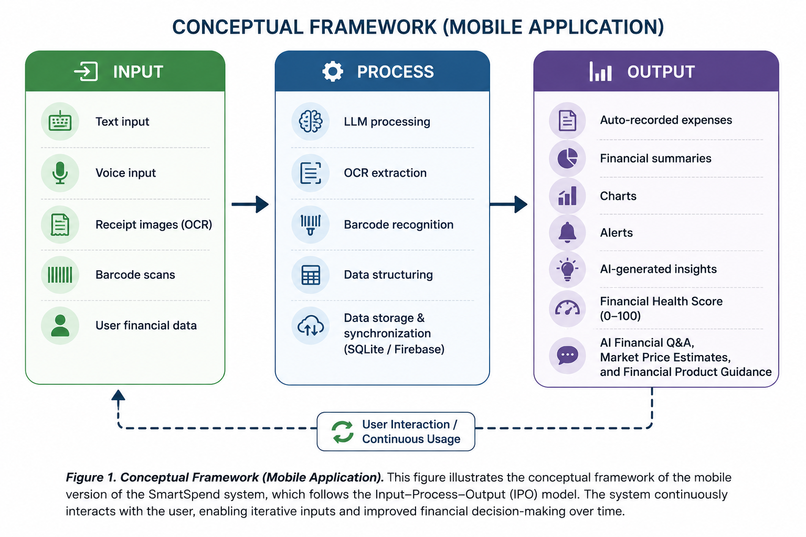
The Input-Process-Output framework
Input
Text, voice, receipt images, barcodes, user financial data
Process
LLM parsing, OCR, barcode recognition, SQLite storage, Firebase sync
Output
Auto-recorded expenses, charts, alerts, insights, Financial Health Score, AI Q&A
Notes:
PRESENTER: Brix A. Directo (approx. 1 min)
Our conceptual framework follows the Input-Process-Output model. On the input side, users can type, speak, photograph a receipt, scan a barcode, or provide their financial data. In the process stage, the LLM interprets the input, OCR extracts text, barcode recognition identifies products, the data is structured, and then stored in a local SQLite database and synchronized with Firebase. The outputs are automatically recorded expenses, summaries, charts, alerts, AI-generated insights, the Financial Health Score, and financial assistance such as general Q and A, market price estimates, and financial product guidance. Cyrille will now take us through how we built and tested it.

Slide 7
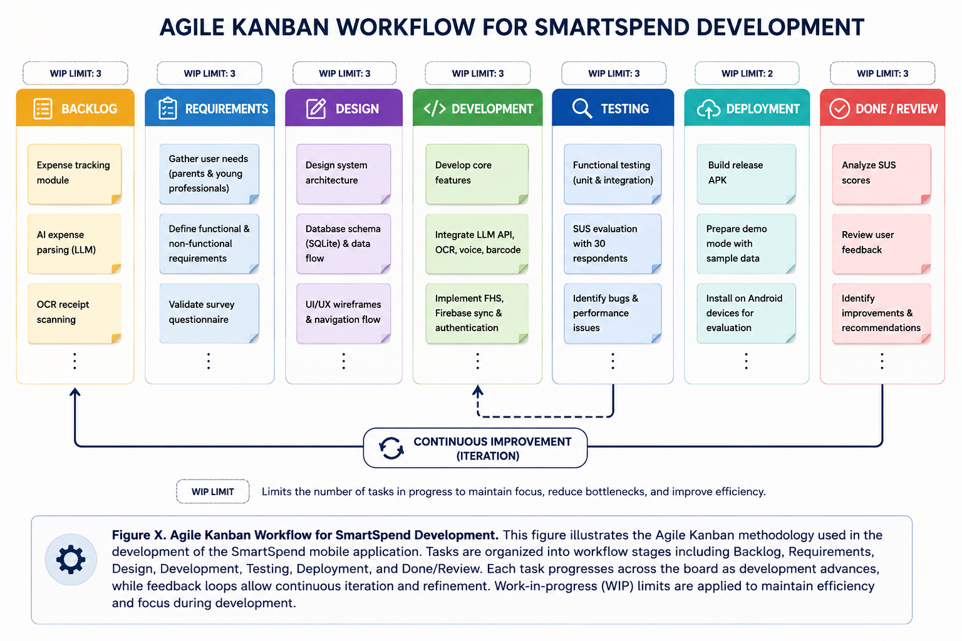
Mixed methods, built with Agile Kanban
30
respondents, purposive sampling: 13 parents, 14 young professionals, 3 both
2
expert validators: survey content and technical/SUS process
10
item SUS questionnaire after a live demonstration of the app
Seven columns, WIP limits, continuous improvement loop
Notes:
PRESENTER: Cyrille John M. Rubis (approx. 1.25 min)
Thank you, Brix. We used a mixed-methods design combined with a descriptive-developmental approach, meaning we built a working system and evaluated it with real users. We surveyed 30 respondents selected through purposive sampling: 13 parents, 14 young professionals, and 3 who identified as both. The survey questionnaire was content-validated by a financial management expert, and a technical expert reviewed our SUS process and the system's core features. We obtained informed consent and kept responses confidential. For development we used the Agile Kanban method, shown on the right, with seven columns from Backlog to Done and Review, work-in-progress limits, and a continuous improvement loop. This suited us because we were integrating AI, OCR, and cloud sync at the same time and needed to iterate.

Slide 8
Objective 1: the need is real
96.7%
How respondents track expenses today (% of 30, multiple answers)
intend to use an AI-powered financial app
93.3%
already use GCash (28 of 30)
Notes:
PRESENTER: Cyrille John M. Rubis (approx. 1 min)
For Objective 1, the survey confirmed the need. 96.7 percent of respondents expressed positive intent to use an AI-powered financial app, and 93.3 percent, 28 of 30, already use GCash. That is why e-wallet transaction import became a core feature. The chart shows how they track expenses today. 90 percent use receipts, 53 percent rely on mental estimates, and 43 percent use e-wallet history. Only 10 percent use a mobile app. In other words, most tracking is manual or memory-based, which supports automating capture through receipt scanning and screenshot import. The most common challenges were rising prices of basic goods, unexpected medical expenses, and family responsibilities. Objective 1 was achieved.

Slide 9
SmartSpend v3.1.0 at a glance
34
7
40+
26
autonomous AI actions
input modalities
screenshot platforms
SQLite tables
45
36
9
57
screens
achievement badges
AI providers (8 cloud + local)
currencies
Flutter (Android) • SQLite offline-first • Firebase sync and auth • APK ≈ 47.5 MB
Notes:
PRESENTER: Cyrille John M. Rubis (approx. 1 min)
SmartSpend version 3.1.0 is an Android app built with Flutter. It stores everything locally in SQLite across 26 tables and syncs to Firebase when the user is online. The AI assistant can perform 34 autonomous financial actions through natural language, such as logging expenses, setting budgets, updating income, and creating savings goals. Users have seven input modalities, including text, voice, camera, barcode, and batch screenshot import that recognizes more than 40 platform types like GCash, Shopee, and Lazada. The app has 45 screens, 36 achievement badges, and supports 57 currencies. It also has a Demo Mode, so anyone can try it with sample data without creating an account.

Slide 10




The app in action
Login and Demo Mode
Home and Health Score
Taglish chat with Peso
Receipt scanning (OCR)
Batch screenshot import
Notes:
PRESENTER: Cyrille John M. Rubis (approx. 1.25 min)
Here are actual screens from the app. First, the login screen with Demo Mode and a Continue Without Account option, where all data stays on the device. Second, the home dashboard showing the Financial Health Score, budgets, and AI insights. Third, the chat with Peso, our mascot and assistant. Here the user types in Taglish, 'nag-lunch ako 150 pesos,' and Peso records it and reports the score change. Fourth, receipt scanning, where OCR extracts the text and the user can review it before sending it to the AI. Fifth, batch screenshot import, where the app reads many e-wallet transactions at once and the user reviews and imports them. These tools exist to remove the manual effort that makes people abandon tracking apps.

Slide 11
Choosing the AI engine
Evaluation criteria weights (%), 20 candidate models
PRIMARY MODEL
Gemini 3.5 Flash-Lite
1M-token context, native function calling for 34 actions, strong Taglish in trials, high free-tier quota
7 fallback providers across Google, Groq, and Cerebras keep the assistant running if one is down or rate-limited.
Full-context injection, not RAG: a user's data is only ~1,000–5,000 tokens.
Notes:
PRESENTER: Cyrille John M. Rubis (approx. 1.25 min)
Choosing the language model was a key design decision, so we compared 20 candidate models using weighted criteria: Filipino-English accuracy at 25 percent, speed and tool use and JSON reliability at 20 percent each, free-tier availability at 15, context window at 10, and financial reasoning at 10. Gemini 3.5 Flash-Lite was selected as the primary model because it has a generous free-tier quota, good Taglish handling in our trials, a one-million-token context window, and native function calling for our 34 actions. Seven fallback providers across Google, Groq, and Cerebras keep the assistant running if one is unavailable or rate-limited. Paid models like GPT-4o Mini and Claude were excluded for cost. We inject the user's full financial context instead of using RAG, because a typical user's data is only about 1,000 to 5,000 tokens, so vector search would add overhead for no benefit.

Slide 12
Financial Health Score: 0 to 100
Full Mode (income tracking on)
25
pts
25
pts
25
pts
25
pts
Savings Rate
Overspend Control
Budget Adherence
Logging Consistency
Lightweight Mode (no income tracking)
25
pts
25
pts
25
pts
25
pts
Spending Restraint
Logging Consistency
Category Balance
Habit Streak
Warning Decay up to −15 Gap Adjustment +2 no-spend / −3 unlogged day Clamped 0–100
Notes:
PRESENTER: Cyrille John M. Rubis (approx. 1.5 min)
The Financial Health Score is our core academic contribution. It gives users one number from 0 to 100 describing their budgeting behavior. We position it formally as a Prototype Observed Financial Health Indicator. It is computed from the user's own transaction data, following the Commonwealth Bank of Australia and Melbourne Institute observed scale, and it adapts the Spend, Save, and Plan ideas from the Financial Health Network's FinHealth Score. In Full Mode, when income tracking is on, four components are worth 25 points each: Savings Rate, with a 20 percent target from the 50-30-20 rule; Overspend Control; Budget Adherence; and Logging Consistency. In Lightweight Mode, for students and informal workers without fixed income, the components are Spending Restraint, Logging Consistency, Category Balance, and Habit Streak. Two adjustments add consequence: Warning Decay can deduct up to 15 points for discretionary overspending, and Gap Adjustment gives plus 2 per confirmed no-spend day and minus 3 per unlogged day. We state plainly that the equal weights are a design choice, not a statistically derived result, and that is why it is called a prototype. Djaunathan will continue with privacy and our evaluation.

Slide 13
Privacy by design: three AI tiers
1
Cloud AI (default)
2
Private Local Mode
3
On-device AI
On-device redaction of mobile numbers, reference numbers, and account patterns. 150 AI requests per user per day. Disclosure shown before the first AI message.
Requests go only to a model on the user's own PC (Ollama, LM Studio, Jan). Local-only switch blocks cloud fallback.
A model running on the phone itself, with no network. Feasible on 2026 flagships, not yet on 4 GB mid-range phones.
Implemented
Implemented
Planned
Designed with the Data Privacy Act of 2012 in mind. A risk-reduction measure, not a certification of legal compliance.
Notes:
PRESENTER: Djaunathan Albert S. Madayag (approx. 1.25 min)
Thank you, Cyrille. SmartSpend handles personal financial data, so we designed it with the Data Privacy Act of 2012 in mind. We describe AI privacy as three tiers. In Tier 1, Cloud AI, which is the default, an on-device layer first redacts mobile numbers, reference numbers, and bank account patterns before anything is sent. The app limits each user to 150 AI requests a day, and shows a privacy disclosure before the first AI message. Because we use Google's free Gemini quota, whose terms allow content to be reviewed, redaction reduces but does not remove exposure. Tier 2, Private Local Mode, is implemented: requests go only to a model running on the user's own PC over the home network, and a Local-only switch stops the AI from falling back to the cloud. Tier 3, fully on-device AI, is planned but not yet implemented. To be clear, this is a risk-reduction measure, not a claim of full legal compliance.

Slide 14
Objective 3: usability scored 61.83 (OK)
61.83
Mean SUS score (N = 30 valid of 36 responses)
Grade D, adjective "OK"
SD 17.58, median 55.0
Range 35.0–92.5
Q1 intent to use often: 4.35 / 5
Q9 felt confident: 4.19 / 5
Concerns: consistency (Q6), complexity (Q2, Q4)
Notes:
PRESENTER: Djaunathan Albert S. Madayag (approx. 1.5 min)
For Objective 3, we measured usability with the System Usability Scale. Of 36 people who attempted the survey, 30 used the app for the required 10 minutes and were included. Six were excluded: five for insufficient usage time and one for straight-line responses. SmartSpend scored a mean of 61.83, with a standard deviation of 17.58, a median of 55, and a range from 35 to 92.5. That is Grade D, an adjective rating of OK. It is below the 68-point average benchmark and below our pre-set target of 80. We want to say that directly. Young professionals scored 63.62 and parents scored 58.25, so both groups fell in the OK range, with parents finding it harder. On the positive side, respondents showed strong intent to use the system frequently, with a mean of 4.35 out of 5, and felt confident using it, at 4.19. Their main concerns were consistency and complexity, which tells us where to improve the interface.

Slide 15





Limitations we acknowledge
Usability below target
Android and internet
Prototype-grade security
SUS 61.83 is under the 68 benchmark and the 80 target.
Android only; all AI features need a connection.
API key via Remote Config; local database not encrypted.
Parsing accuracy
Behavior impact unmeasured
Small, local sample
91.2% precision / 88.5% recall from preliminary developer testing only.
Peso and badges were added after the evaluation was designed.
30 purposive respondents from one locale; not generalizable.
Notes:
PRESENTER: Djaunathan Albert S. Madayag (approx. 1.25 min)
We want to be transparent about the limitations. First, usability is below the benchmark and our target. Second, the app is Android-only, and every AI feature needs an internet connection. Third, security is prototype-grade: the API key is fetched through Firebase Remote Config, which can still be extracted from a decompiled app, and the local database is not encrypted. A backend proxy and SQLCipher are planned. Fourth, the 91.2 percent precision and 88.5 percent recall for import parsing come from preliminary developer testing, not a formal field evaluation. Fifth, features like Peso and the badges were added after our evaluation was designed, so their effect on behavior has not been measured. Sixth, our sample is 30 purposive respondents from one locale, so the findings should not be generalized.

Slide 16
Conclusions
1
Needs assessment
96.7% intent to use an AI finance app; 93.3% use GCash.
Achieved
2
Design and development
v3.1.0 working Android app: 34 AI actions, Gemini 3.5 Flash-Lite with failover, Financial Health Score.
Achieved
3
Usability evaluation
SUS 61.83 (OK): below target, acceptable for a prototype; UI/UX areas identified.
Partially achieved
Notes:
PRESENTER: Djaunathan Albert S. Madayag (approx. 1 min)
To conclude, all three objectives were addressed. Objective 1 was achieved: the needs assessment confirmed 96.7 percent intent to use an AI financial app and 93.3 percent GCash use. Objective 2 was achieved: SmartSpend version 3.1.0 was developed as a working Android app with multi-modal input, offline-first storage, 34 AI actions, and a Financial Health Score, with Gemini 3.5 Flash-Lite selected from 20 candidate models and backed by a failover chain. Objective 3 was evaluated and is partially achieved: the SUS score of 61.83 is below our target, though acceptable for a prototype, and it identified specific UI and UX areas to improve.

Slide 17
Recommendations
Payday-cycle budgeting
Resets aligned to the 15th and 30th salary cycle
SQLite encryption
SQLCipher for the local database
1
5
Backend API proxy
Server-side keys and per-user limits
Household and OFW features
Family wallets and remittance tracking
2
6
Google Play release
After the proxy and privacy policy are in place
Longitudinal study
3–6 months, larger sample, measure behavior change
3
7
On-device AI tier
Opt-in ~2.6 GB model for fully offline AI
4
Notes:
PRESENTER: Djaunathan Albert S. Madayag (approx. 1.25 min)
We have seven recommendations. One, payday-cycle-aware budgeting aligned to the 15th and 30th salary cycle. Two, a backend API proxy with per-user limits, since the free-tier quotas are currently shared by every user. Three, a Google Play release once the proxy and a privacy policy are in place. Four, an opt-in on-device AI tier of about 2.6 gigabytes for fully offline AI. Five, SQLCipher encryption for the local database. Six, shared family wallets and OFW remittance tracking. And seven, a longitudinal study over three to six months with a larger sample, to measure SmartSpend's effect on actual financial behavior.

Slide 18
Salamat po!
Questions and discussion
Directo, Rubis, Madayag
Adviser: Ellen F. Mangaoang, DIT
github.com/Zushikina-kun/smartspend-app
Notes:
PRESENTER: Djaunathan Albert S. Madayag (approx. 0.5 min)
That concludes our presentation of SmartSpend. We thank our adviser, Ma'am Ellen Mangaoang, our panelists, the College of Computer Studies and Engineering, and everyone who supported us. Salamat po. We are now ready for your questions.

