Slide 1

SmartSpend
An AI-Assisted Mobile Financial Tracking and Advisory Application for Personal Financial Management
Directo, Brix A.
Rubis, Cyrille John M.
Madayag, Djaunathan Albert S.
Adviser: Ellen F. Mangaoang, DIT
College of Computer Studies and Engineering, LORMA Colleges
Final Defense · November 16, 2026

Slide 2
Opening Prayer

Slide 3
Pitch Video
SmartSpend · Team Lucid Frame

Slide 4
Agenda
I
Introduction
Problem, gap, objectives, conceptual framework
II
Design and Methodology
Respondents, instruments, SUS scoring, ethics, Agile Kanban
III
Results and Discussion
Needs assessment, the system we built, SUS results
IV
Conclusions and Recommendations
What was achieved, limitations, and what comes next
▶
Live demonstration
SmartSpend v3.1.0 on an Android phone

Slide 5
Money is managed without a system
2%
< 50%
10%
of Filipino adults answered all six basic financial literacy questions correctly
reported keeping any household or personal budget
of our 30 respondents use a mobile app to track expenses
BSP Financial Inclusion Survey, 2021
BSP Financial Inclusion Survey, 2021
SmartSpend needs assessment
A mixed picture (BSP CFIS 2025): basic literacy rose from 69% to 74%, but formal account ownership fell from 56% to 50%.

Slide 6
The gap exists at three levels
International
National (PH)
Demographic
PROBLEM
PROBLEM
PROBLEM
Manual entry dominates; AI categorization degrades for non-English transactions.
Local apps lack LLM chat, spending-behavior analysis, and health scoring.
Parents and young professionals abandon apps because of manual effort; warnings are ignored without consequences.
SMARTSPEND
SMARTSPEND
SMARTSPEND
LLM-based parsing for Filipino-English input
Conversational AI, Financial Health Score, multi-period summaries
Automated input and a score-decay consequence system

Slide 7
What existing apps leave out
Feature | Tarsi | YNAB | Monarch | Copilot | BudgetPH | Alkansya AI | SmartSpend
Offline mode | ✓ | – | – | – | ✓ | – | ✓
LLM chat assistant | – | – | – | – | Insights | Basic | ✓
Financial Health Score | – | – | – | – | Simpler | – | ✓
OCR receipt scanning | ✓ | – | – | – | – | – | ✓
Voice input (en-PH) | – | – | – | – | – | – | ✓
Filipino-English AI | – | – | – | – | – | ✓ | ✓
Batch screenshot import | – | – | – | – | – | – | ✓
Bank synchronization | – | ✓ | ✓ | ✓ | CSV | – | –
15th and 30th payday cycle | – | – | – | – | ✓ | – | –
Hands-on comparison of the apps in Table 1.2. Other PH apps (Agila, PISO Budget Tracker, Lista, Kibo, BunnyWise, GCash Pera Coach) are acknowledged. SmartSpend is an evaluated integrated prototype, not a claim to be first or only. Payday-cycle budgeting is an honest gap: see Recommendation 6.

Slide 8
Three objectives guided the study
Assess
Financial management practices, budgeting challenges, and expense-tracking behaviors of parents (35–55) and young professionals (21–35) in San Fernando City, La Union.
1
Design and develop
The SmartSpend app: multi-modal input, cloud sync, and an LLM API selected through a comparative technical evaluation.
2
Evaluate
Usability and performance using the System Usability Scale (SUS) and user feedback.
3

Slide 9
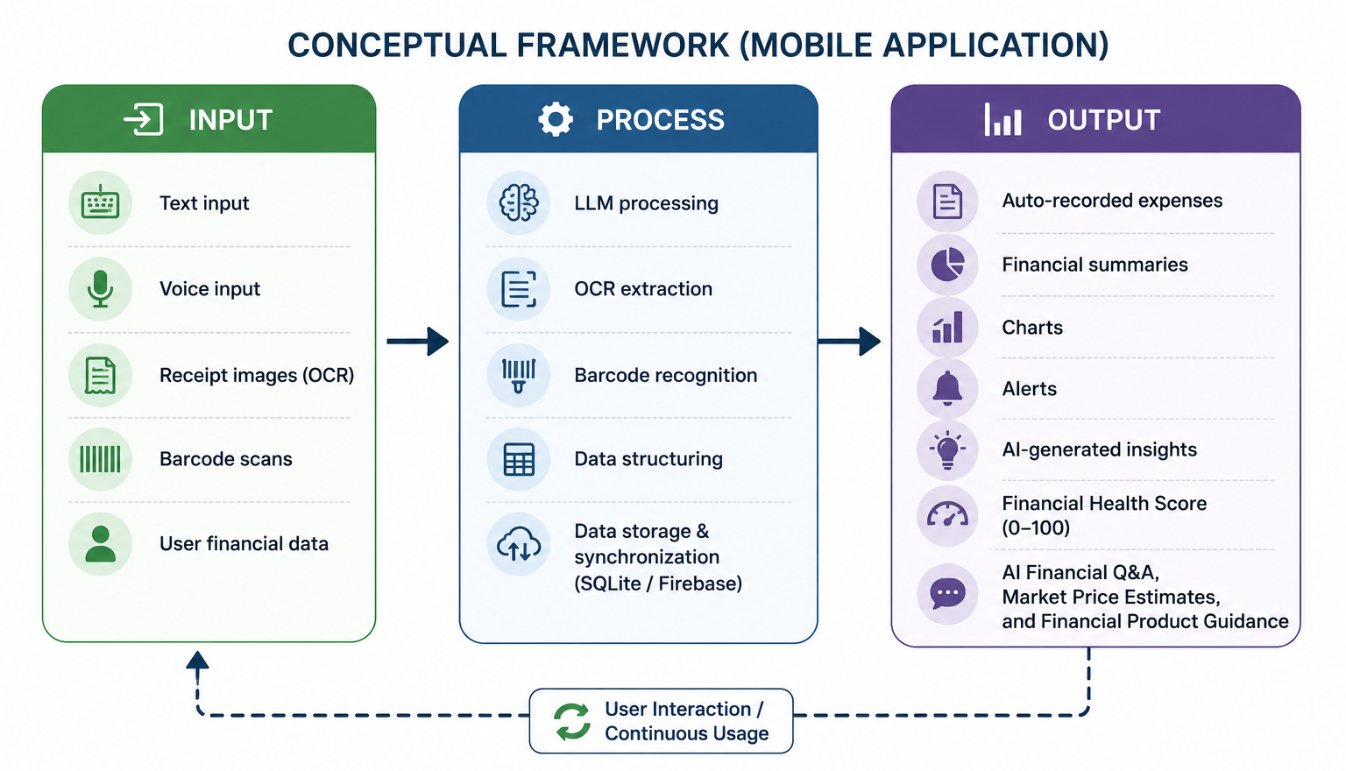
The Input-Process-Output framework
Input
Text, voice, receipt images, barcodes, user financial data
Process
LLM parsing, OCR, barcode recognition, data structuring, SQLite storage, Firebase sync
Output
Auto-recorded expenses, charts, alerts, insights, Financial Health Score, AI Q&A
Figure 1.2. Conceptual framework (mobile application)

Slide 10
Methods: who took part
30
36 → 30
2
Needs assessment
SUS evaluation
Expert validators
13 parents · 14 young professionals · 3 identified as both
10 parents · 20 young professionals. Excluded 6: 5 for insufficient use time, 1 for straight-lining
1 content validator (survey) · 1 technical validator (system and SUS process)
Mixed methods · purposive sampling · San Fernando City, La Union · two separate samples (some individuals may overlap)

Slide 11
Methods: instruments and procedure
Needs-assessment questionnaire
Procedure
13 items in 5 sections: profile, practices, challenges, tracking behaviors, feature needs
Content-validated before distribution
Analyzed with frequency and percentage
1
Validate the questionnaire
2
Obtain consent from respondents
3
Distribute the survey
System Usability Scale (Brooke, 1996)
4
Benchmark candidate LLM APIs
10 items, 5-point scale
Taken online after at least 10 minutes with the full app or Demo Mode
Screening question enforced the minimum use time
5
Use SmartSpend, then answer the SUS
6
Tabulate and analyze

Slide 12
Methods: how the SUS was scored and judged
SUS = 2.5 × [ Σ(rating − 1, odd items) + Σ(5 − rating, even items) ]
Pre-set target
80 or higher (aspirational, set before data collection)
Odd items (1, 3, 5, 7, 9): rating minus 1
Even items (2, 4, 6, 8, 10): 5 minus rating
Total: sum of ten contributions × 2.5 gives 0 to 100. The study score is the mean of all valid respondents.
Average benchmark
68 (Sauro and Lewis, 2016)
Adjective anchors
OK about 51 · Good about 71 · Excellent about 85 (Bangor et al., 2009)
Acceptability
Below 51 not acceptable · 51–70 marginal · 71 and up acceptable (Bangor et al., 2008)

Slide 13
Ethics and data privacy
Informed consent
Voluntary participation
Confidentiality
Purpose, procedures, and rights explained before participation
Free to decline or withdraw at any time without penalty
Results reported in group form; used only for academic purposes
No sensitive identifiers
Data minimization in the app
Data Privacy Act of 2012
Respondents told not to enter account numbers or passwords
Mobile, reference, and account numbers redacted on-device before any cloud AI call
Designed with RA 10173 in mind: a risk-reduction measure, not a compliance certification

Slide 14
Agile Kanban: seven columns, WIP limits
Phase | Key tasks | Deliverable
Backlog | Define features; needs survey; literature review | Prioritized feature list
Requirements | Translate findings into specs; validate questionnaire; benchmark LLMs | Validated questionnaire; benchmark matrix
Design | SQLite schema (26 tables); FHS formula; wireframes; data flow | System architecture; FHS documentation
Development | Expense tracking; Gemini integration; OCR, voice, batch import; FHS engine; sync | Functional app; 34 agentic actions
Testing | LLM parsing checks; SUS with 30 respondents; bug log | SUS scores; parsing observations
Deployment | Release APKs; Demo Mode; GitHub Releases | Release APK v3.1.0
Done/Review | Analyze SUS; review feedback; document recommendations | Evaluation report; roadmap
Why Kanban: AI, OCR, voice, and cloud sync had to be integrated and refined continuously, so work could overlap and repeat instead of following a fixed sequence.

Slide 15
Chapter III: Results and Discussion
Objective 1
Objective 2
Objective 3
96.7% intend to use an AI finance app
v3.1.0 with 34 AI actions
SUS 61.83 (Grade D, OK)

Slide 16
Objective 1: respondents track by hand
96.7%
intend to use an AI-powered finance app (29 of 30)
93.3%
already use GCash (28 of 30)
90.0%
track with receipts overall; only 10.0% use a mobile app

Slide 17
Objective 1: findings shaped the design
What respondents told us | What we built
90.0% track expenses with receipts | OCR receipt scanning with a multi-item import review screen
93.3% use GCash | GCash/Maya text parsing and batch screenshot import (40+ platforms)
53.3% rely on mental estimates; 10.0% use an app | Natural-language logging in Taglish, for example "nag-lunch ako 150 pesos"
96.7% would use an AI finance app | Conversational assistant with 34 actions and a Financial Health Score
Most prevalent challenges reported: rising prices of basic goods, unexpected medical expenses, and family responsibilities.
Read with care: 30 purposive respondents from one locale, and intent to use is stated intention, not behavior.
Objective 1 achieved: practices, challenges, and tracking behaviors were assessed through the validated survey.

Slide 18
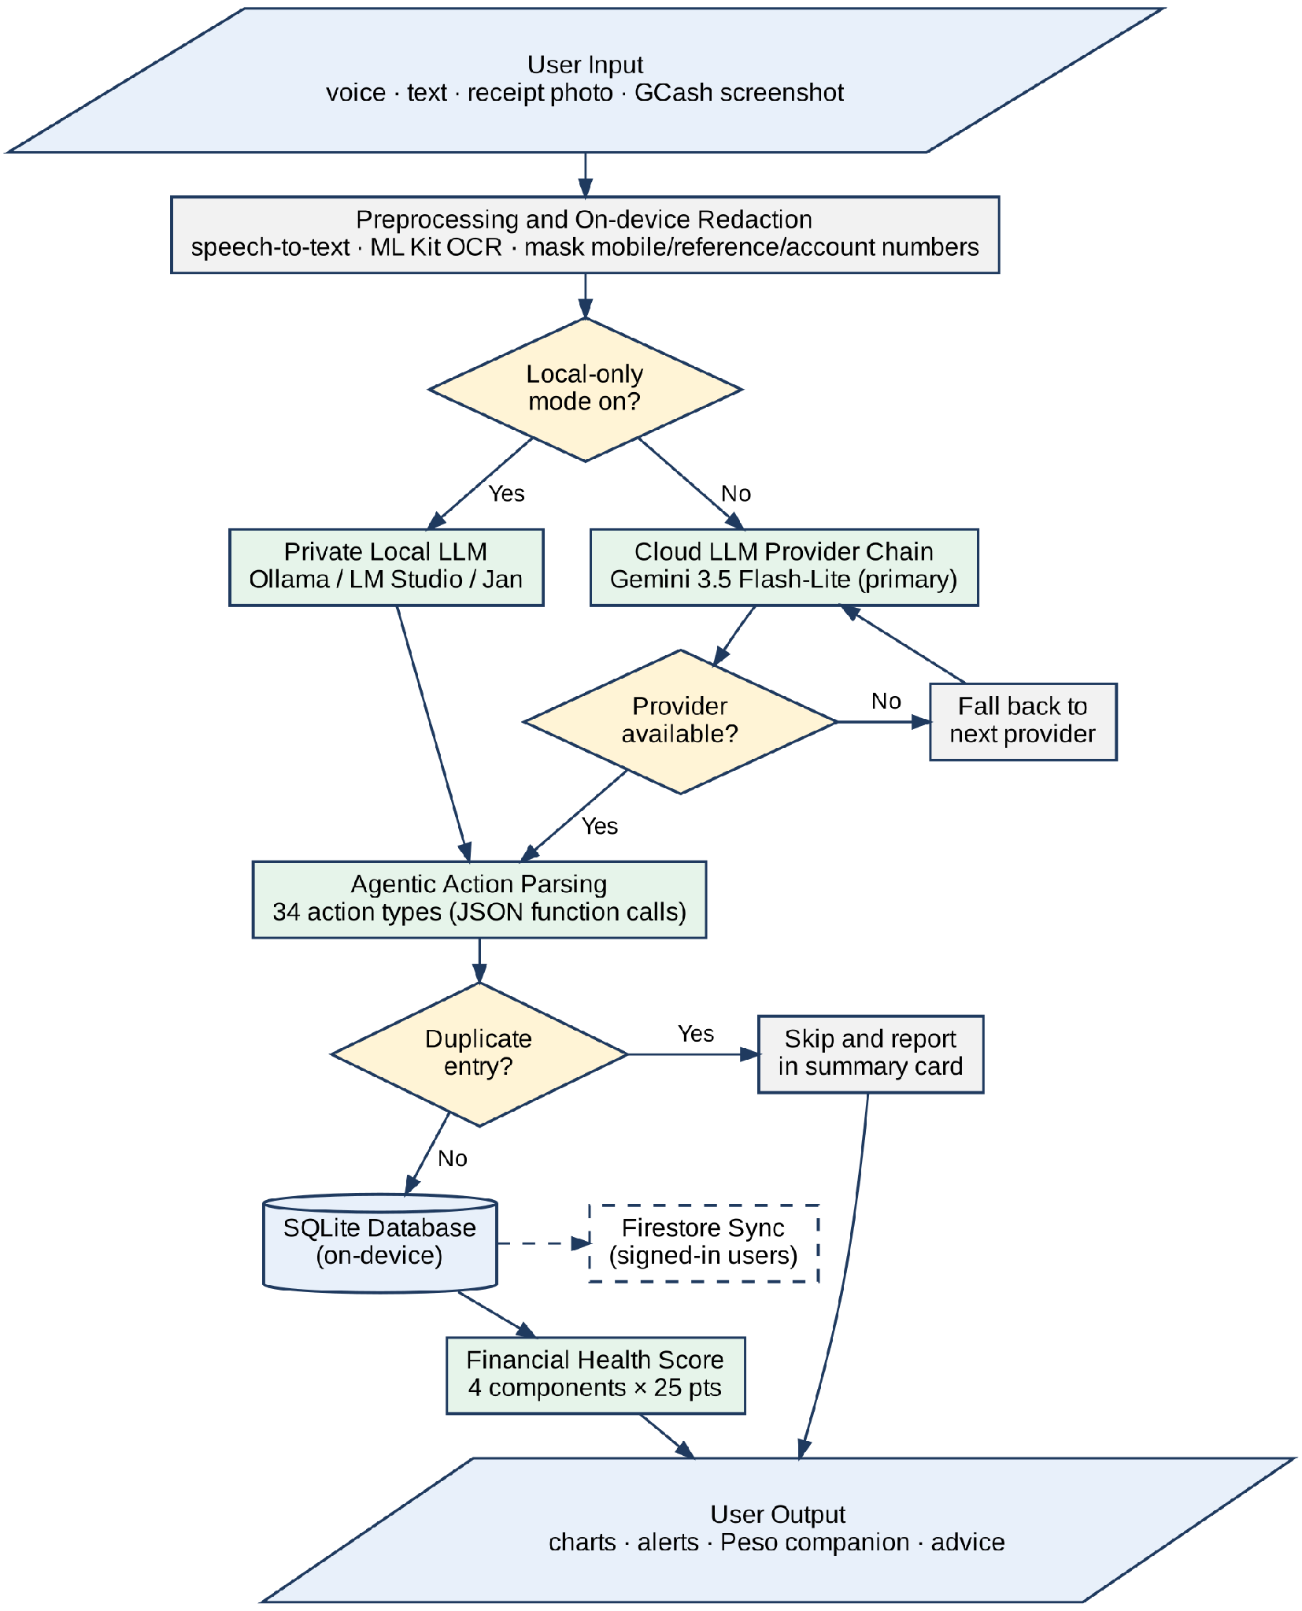
Objective 2: how SmartSpend processes an input
1
Redact first
Mobile, reference, and account numbers are masked on-device before any cloud call.
2
Route
Private Local Mode uses a model on your own PC. Otherwise the cloud chain runs: Gemini 3.5 Flash-Lite first, next provider if one is down.
3
Parse and act
34 action types through JSON function calls; duplicates are skipped and reported in a summary card.
4
Store
SQLite on the device; Firestore sync, scoped to the signed-in user.
5
Score and respond
Financial Health Score, charts, alerts, and Peso’s advice.
Figure 3.1. System flowchart

Slide 19
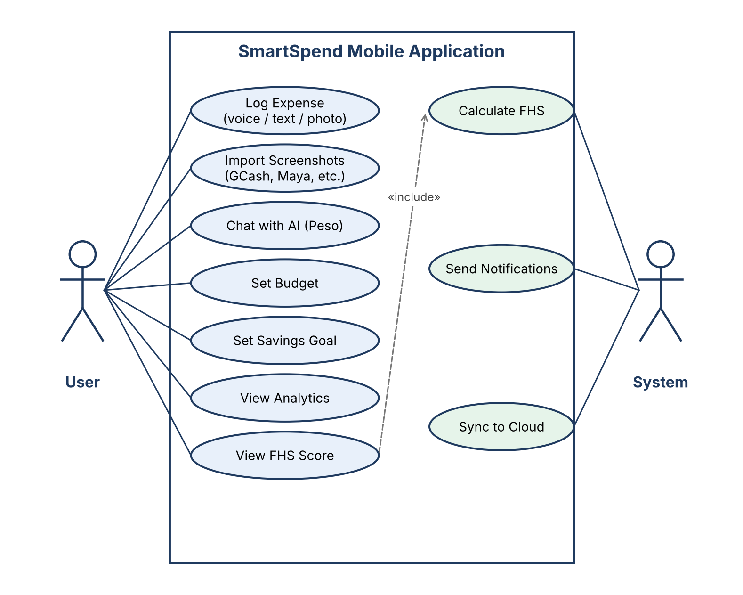
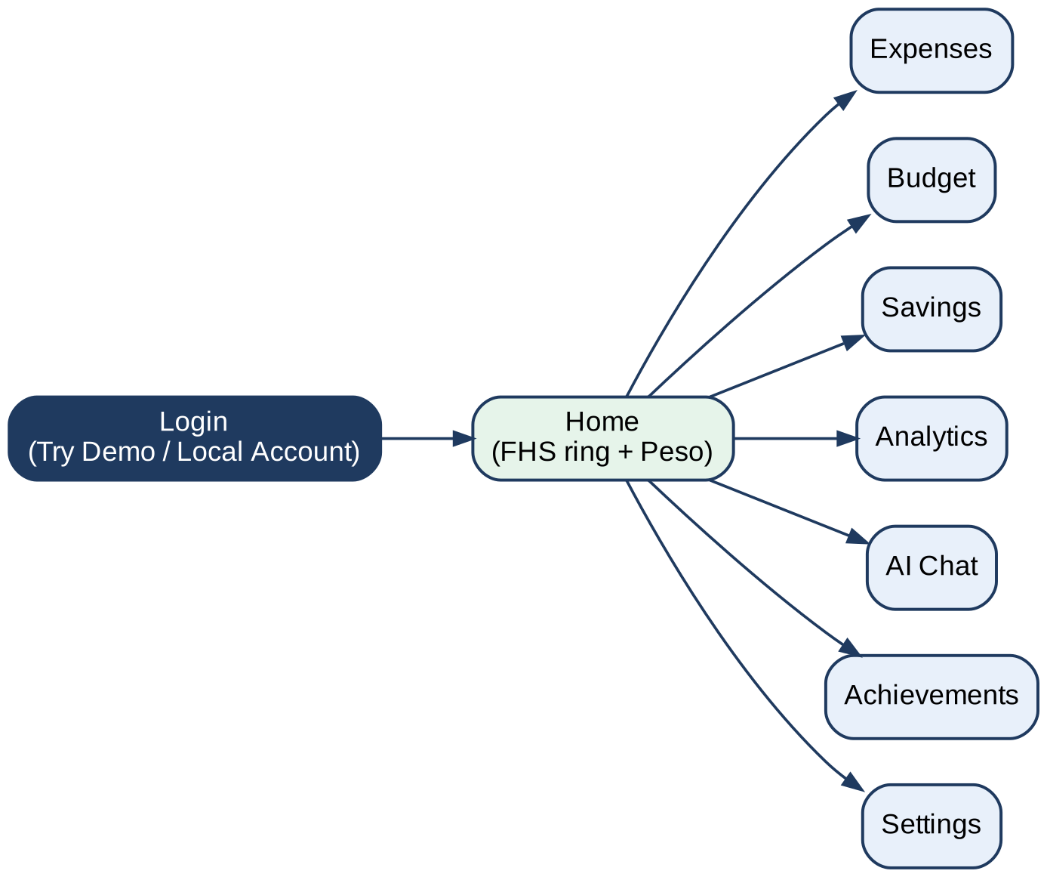
Objective 2: system design views
Figure 3.2. Use case diagram
Figure 3.3. Visual table of contents
The user acts on seven features; the system calculates the score, sends notifications, and syncs to the cloud.

Slide 20
Objective 2: choosing the AI engine
PRIMARY MODEL
Gemini 3.5 Flash-Lite
1M-token context, native function calling for 34 actions, strong Taglish in team trials, and a high free-tier quota
Fallback order (7)
Gemini 3.5 Flash → GPT-OSS 120B → Qwen 3.6 27B → Qwen 3.8 27B → GPT-OSS 20B → Groq Compound Mini (all Groq) → GPT-OSS 120B (Cerebras)
Full-context injection, not RAG: one user’s data is only about 1,000–5,000 tokens, so it fits any evaluated context window.

Slide 21
Objective 2: LLM comparison (excerpt of Table 3.2)
Model | Context | Speed (t/s) | Filipino | Tool use | Free tier | Status
Gemini 3.5 Flash-Lite | 1,048,576 | ~400–600 | 5/5 | 5/5 | ~500/day | Primary
Gemini 3.5 Flash | 1,048,576 | ~200–400 | 5/5 | 5/5 | ~20/day | Fallback 1
GPT-OSS 120B (Groq) | 131,072 | ~500 | Not measured | 5/5 | ~1,000/day | Fallback 2
GPT-OSS 120B (Cerebras) | 131,072 | ~3,000 | Not measured | 5/5 | 1M tokens/day | Fallback 7
LLaMA 3.3 70B (Groq) | 128,000 | ~315 | 4/5 | 5/5 | ~1,000/day | Retired by Groq
GPT-4o Mini | 128,000 | ~120 | 4/5 | 5/5 | No free tier | Not used: cost
claude-3-5-haiku | 200,000 | ~80 | 5/5 | 5/5 | Paid only | Not used: cost
DeepSeek V3 | 64,000 | ~200 | 3/5 | 3/5 | $0.14/1M | Not used: weak Filipino
Table 3.2 lists all 20 candidates. "Not measured" means not measured in the team’s own benchmark run. Free-tier quotas are third-party figures from September 2026 and change often. The weights justify the criteria; a weighted total per model is not reported.

Slide 22
Objective 2: Financial Health Score, 0 to 100
FULL MODE (income tracking on): 4 × 25 points
Savings Rate
Overspend Control
25 × min(1, savings rate ÷ 0.20)
25 × (1 − (hard + 0.5 × soft) ÷ active days)
Budget Adherence
Logging Consistency
25 × (on-budget ÷ budgeted categories)
25 × (logged days ÷ active days)
LIGHTWEIGHT MODE (no income tracking): Spending Restraint · Logging Consistency · Category Balance · Habit Streak
Warning Decay up to −15 (discretionary overspend only) · Gap Adjustment +2 no-spend day, −3 unlogged day · Clamped 0–100
A Prototype Observed Financial Health Indicator: it follows the transaction-data approach of the CBA–Melbourne Institute scale (2018) and the Spend, Save, Plan ideas of the FinHealth Score (2021). The weights are a design choice, not a statistically derived result, so it is not a validated instrument.

Slide 23
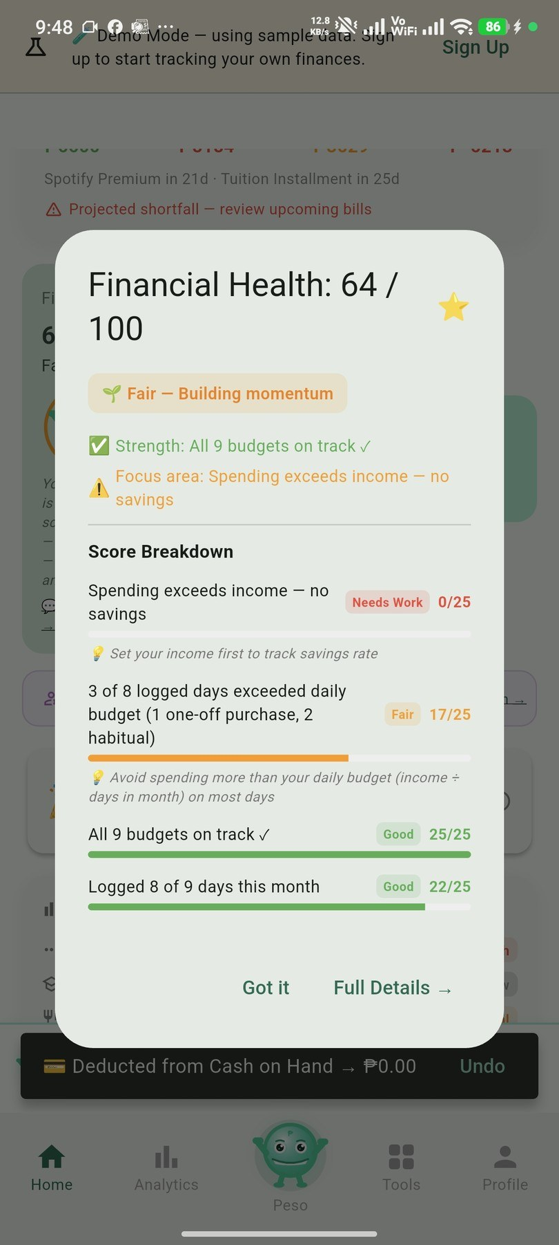
Objective 2: the score is explainable
Component | Evidence on screen and computation | Points
Savings Rate | Spending exceeds income | 0 of 25
Overspend Control | 3 of 8 logged days over budget (2 habitual, 1 one-off): 25 × (1 − (2 + 0.5) ÷ 8) | 17 of 25
Budget Adherence | All 9 budgets on track | 25 of 25
Logging Consistency | Logged 8 of 9 days: 25 × 8 ÷ 9 | 22 of 25
Total | Shown on screen as "Fair — Building momentum" | 64 of 100
Figure 3.8 (Demo Mode data). The four component scores add up to the displayed 64, so the formulas on the previous slide are what the app actually runs.

Slide 24

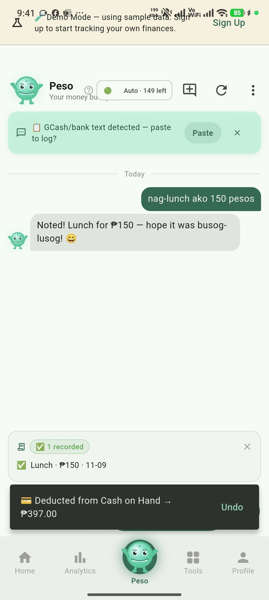
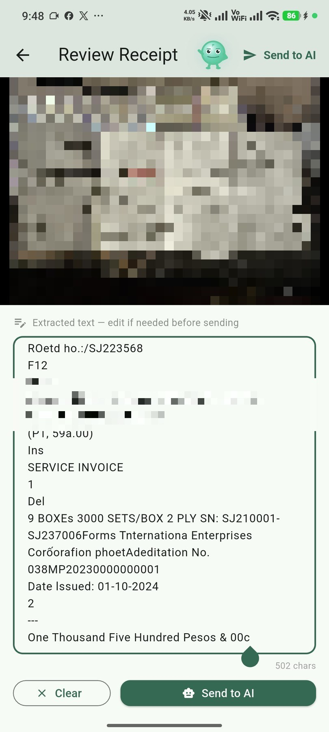

Objective 2: the app in action
Login and Demo Mode
Home and Health Score
Taglish chat with Peso
Receipt scanning (OCR)
Batch screenshot import
Fig. 3.4
Fig. 3.5
Fig. 3.6
Fig. 3.7
Fig. 3.7

Slide 25
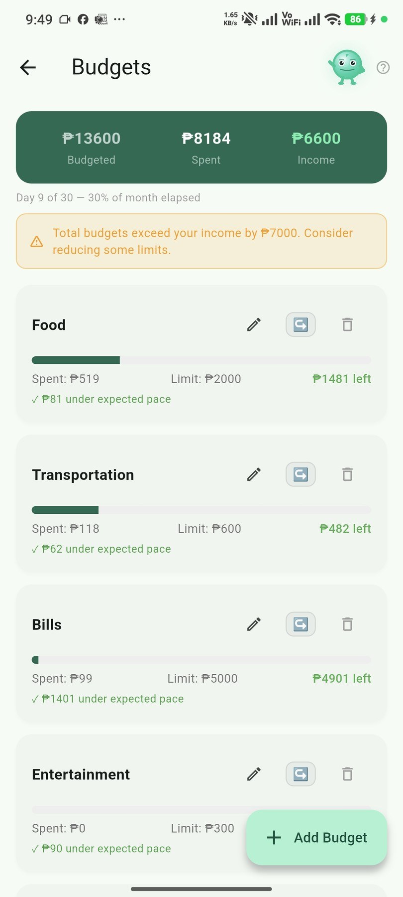
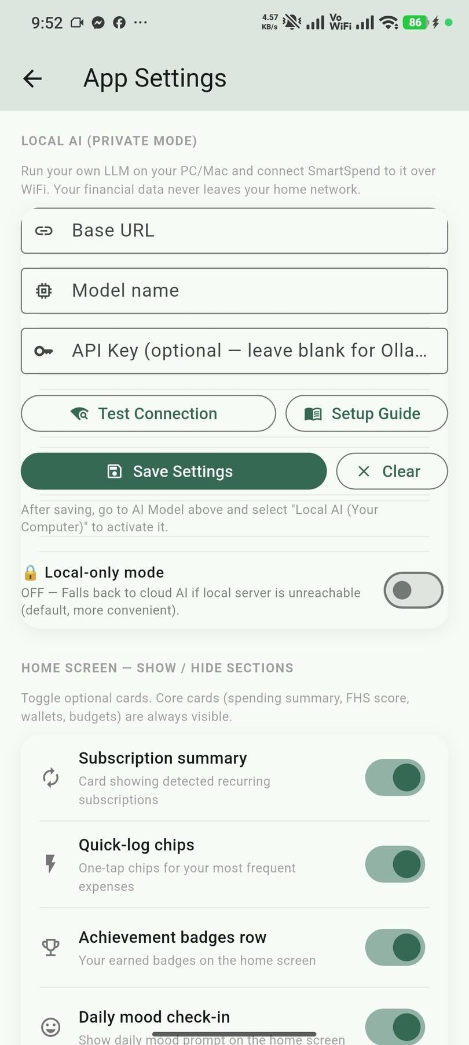
Objective 2: explainable score, budgets, private AI
Score breakdown
Budgets
Private Local Mode
Each component shows its points and a focus area, so users see why the score moved.
Warns when total budgets (₱13,600) exceed income (₱6,600).
Your own PC or Mac runs the model. Local-only blocks cloud fallback.
Figures 3.8 to 3.10

Slide 26
Objective 2: privacy by design, three AI tiers
1
Cloud AI (default)
2
Private Local Mode
3
On-device AI
On-device redaction of mobile numbers, reference numbers, and account patterns. 150 AI requests per user per day. Disclosure shown before the first AI message. Under Google’s free tier, content may be reviewed, so redaction reduces exposure but does not remove it.
Requests go only to a model on the user’s own PC (Ollama, LM Studio, Jan). The Local-only switch blocks cloud fallback.
A model on the phone itself, with no network. Feasible on 2026 flagships, not yet on 4 GB mid-range phones.
Implemented
Implemented
Planned
Designed with the Data Privacy Act of 2012 in mind. A risk-reduction measure, not a certification of legal compliance. The local database is not encrypted yet (Recommendation 4).

Slide 27
Objective 2: SmartSpend v3.1.0 at a glance
34
7
40+
26
autonomous AI actions
input modalities
screenshot platforms
SQLite tables
45
36
9
57
screens
achievement badges
AI providers (8 cloud + local)
currencies
Flutter (Android) · SQLite offline-first · Firebase sync and auth · APK about 47.5 MB
Objective 2 achieved: a working Android app, Gemini 3.5 Flash-Lite with failover, and the Financial Health Score.

Slide 28
System demonstration
1
Login: tap "Try Demo (Sample Data)"
Backup plan
2
Home: health score ring and Peso
AI features need internet: test the venue Wi-Fi first
Keep a screen recording of the full flow on the phone
Demo Mode needs no account and uses sample data
3
Type "nag-lunch ako 150 pesos": auto-recorded, with Undo
4
Scan a receipt: review the extracted text, send to AI
5
Batch screenshot import for GCash
6
Tap the health score: see the breakdown
7
Settings → Local AI → Local-only switch
Questions and comments are welcome during the demonstration.

Slide 29
Objective 3: usability scored 61.83
61.83
Grade D, adjective "OK"
SD 17.58, median 55.0
Range 35.0–92.5
N = 30 valid of 36 responses
Q1 intent to use often: 4.35 / 5
Q9 felt confident: 4.19 / 5

Slide 30
Objective 3: reading the score honestly
SmartSpend 61.83
Target 80
Avg 68
Not acceptable (< 51)
Marginal (51–70)
Acceptable (71+)
OK
Good
Excellent
Below the average
Below our target
Partially achieved
Under the 68 benchmark (Sauro and Lewis, 2016)
Under the pre-set target of 80, which we did not lower after seeing the result
Usability was evaluated as planned, but the score is marginal and not acceptable by our criteria
Grade D follows the Sauro and Lewis (2016) curved grading scale.

Slide 31
Objective 3: what the results tell us
Strengths
Concerns
Intent to use often scored 4.35 out of 5 (Q1) and confidence 4.19 (Q9): users want the app and feel capable with it.
Consistency (Q6), complexity (Q2), and needing support (Q4) drag the score. With 45 screens and 34 AI actions, the interface can feel heavy.
Groups
Technical performance
Young professionals 63.62 vs parents 58.25: a 5.37-point gap, descriptive only, with 20 vs 10 respondents and no significance test.
Parsing precision 91.2% and recall 88.5% come from preliminary developer testing. Table 3.5 marks every modality as not formally measured.
These findings feed Recommendation 1 (UI/UX refinement) and Recommendation 2 (formal parsing evaluation).

Slide 32
Limitations we acknowledge
Usability below target
Android and internet
Prototype-grade security
SUS 61.83 is under the 68 average and the 80 target.
Android only; all AI features need a connection.
API key via Remote Config; local database not encrypted.
Fix: Rec. 1
Fix: Rec. 5
Fix: Rec. 3, 4
Parsing accuracy
Behavior impact unmeasured
Small, local sample
91.2% precision / 88.5% recall from developer testing, not a formal test set.
Peso and badges were not evaluated for effect on behavior.
30 purposive respondents from one locale; 10 parents in the SUS sample; not generalizable.
Fix: Rec. 2
Fix: Rec. 8
Fix: Rec. 8

Slide 33
Chapter IV: Conclusions
Needs assessment
96.7% intent to use an AI finance app; 93.3% use GCash. The first objective was achieved.
1
Achieved
Design and development
v3.1.0: a working Android app with 34 AI actions, Gemini 3.5 Flash-Lite with failover, and the Financial Health Score. The second objective was achieved.
2
Achieved
Usability evaluation
SUS 61.83 (Grade D, OK): below the 68 average and the 80 target; UI/UX areas identified. The third objective was partially achieved.
3
Partially achieved

Slide 34
Chapter IV: Recommendations
UI/UX refinement
Formal parsing evaluation
1
2
Unify and simplify screens (SUS Q6, Q2, Q4)
50+ standardized receipts across platforms
Backend API proxy, then Google Play
SQLite encryption
3
4
Server-side keys and per-user limits first
SQLCipher for the local database
On-device AI tier
Payday-cycle budgeting
5
6
Opt-in ~2.6 GB model for offline AI
Resets on the 15th and 30th
Household and remittance
Longitudinal evaluation
7
8
Shared wallets; OFW remittance income category
3–6 months, larger sample, measure behavior change

Slide 35
Salamat po!
Questions and discussion
Directo, Rubis, Madayag
Adviser: Ellen F. Mangaoang, DIT
github.com/Zushikina-kun/smartspend-app
Source-available, non-commercial license

