Slide 1
Online Task & Productivity Tracker
Zuveriya Tabassum Shaik

Slide 2



Project Overview
Web-Based Tracker
Comprehensive Task Management
Analytics & Reports
Access your tasks from any device with a web browser.
Visualize time spent on tasks and track progress with insightful data.
Create, edit, and delete tasks with ease to stay organized.

Slide 3
Robust Technology Stack
Frontend
Database
HTML, CSS, JavaScript
SQLite (development)
Bootstrap for responsive design
PostgreSQL (production)
Backend
Visualizations & Export
Python with Flask framework
Chart.js for interactive charts
Flask-Login for secure authentication
FPDF for PDF generation

Slide 4





Core Features for Enhanced Productivity
User Registration & Login
Categorized Task Management
Live Time Tracking
Secure personal accounts for task management.
Monitor time spent on each task in real-time.
Organize tasks by categories for better clarity.
Dashboard Analytics
Data Export Options
View weekly and monthly progress reports.
Export reports in PDF and CSV formats.

Slide 5
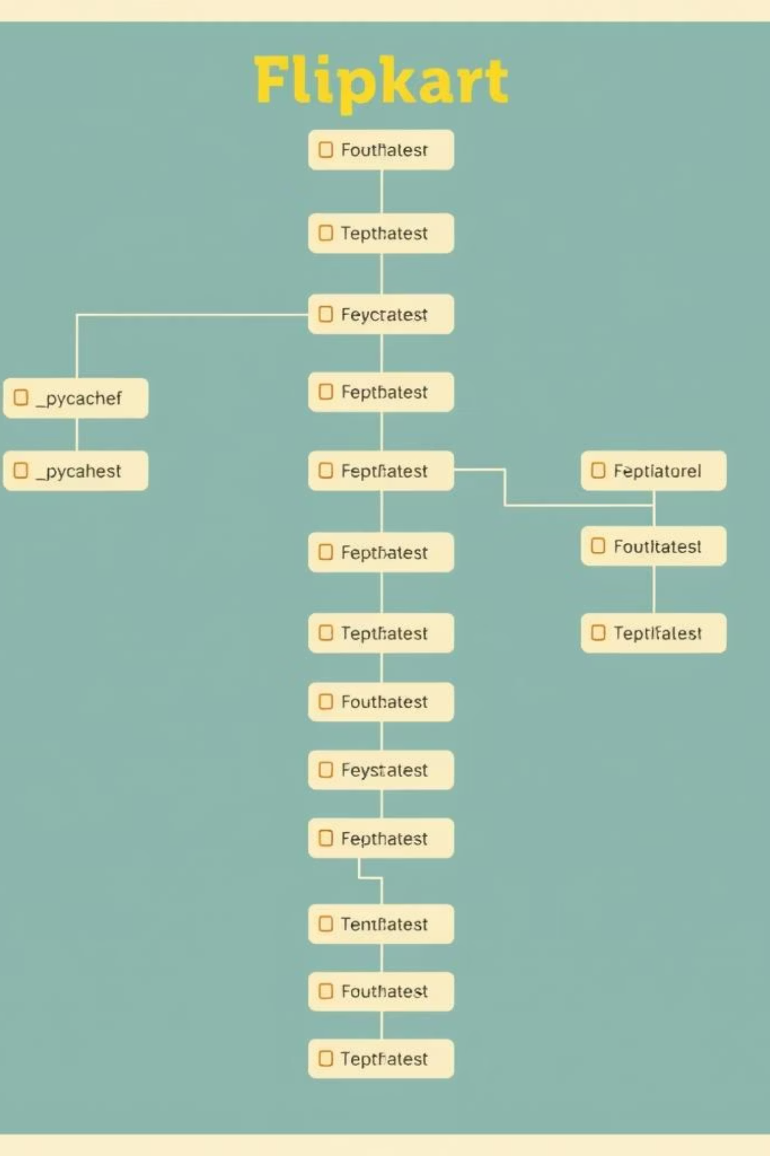
Structured Project Architecture
app.py: Main application logic and routing.
templates/: HTML templates for user interface.
static/: Stores CSS and JavaScript files.
instance/: Contains SQLite database file.
requirements.txt: Lists Python dependencies.
runtime.txt: Specifies Python runtime environment.

Slide 6




Setup & Deployment Workflow
Clone Repository
Install Requirements
Obtain the project code from GitHub.
Use pip install -r requirements.txt for dependencies.
Run Locally
Render Deployment
Execute python app.py to start the application.
Deployed via Render platform utilizing Procfile and runtime.txt.

Slide 7

Future Enhancements & Ideas
01
Implement role-based dashboards for personalized experiences.
02
Expand export options to include Excel format.
03
Optimize mobile responsiveness for seamless use on all devices.
04
Enhance session management and timeout handling.
05
Integrate Tailwind CSS for a modern UI refresh.

Slide 8
Key Learnings & Achievements
Full-Stack Development
User Authentication & Sessions
Data Visualization & Export
Gained experience building a complete web application.
Mastered chart integration and document generation.
Successfully integrated secure user login and session management.
Database Management
Real-Time Deployment
Handled smooth transitions between SQLite and PostgreSQL.
Deployed a live Flask application on a cloud platform.

Slide 9
Thank You!
Thank you, Flipkart Team, for this amazing opportunity.
Presented by: SHAIK ZUVERIYA TABASSUM
github.com/Zuveriya-Tabassum

