Slide 1
A hotel manager wants to determine whether the average customer rating of a new room design is significantly different from the standard rating of 7. Which test should be used? A. Chi-squared test B. One-sample t-test C. Independent t-test D. Correlation

Slide 2
A hotel manager wants to determine whether the average customer rating of a new room design is significantly different from the standard rating of 7. Which test should be used? A. Chi-squared test B. One-sample t-test C. Independent t-test D. Correlation

Slide 3
A researcher wants to see if there is a significant relationship between the number of years of work experience and annual salary among hotel employees. Which test should be used? A. Paired t-test B. Chi-squared test C. Correlation D. One-sample t-test

Slide 4
A researcher wants to see if there is a significant relationship between the number of years of work experience and annual salary among hotel employees. Which test should be used? A. Paired t-test B. Chi-squared test C. Correlation D. One-sample t-test

Slide 5
A hotel manager is analyzing whether there is an association between customer satisfaction (categorized as satisfied, neutral, or dissatisfied) and the type of room they stayed in (standard, deluxe, or suite).Which test should be used? A. Chi-squared test B. Correlation C. Independent t-test D. Paired t-test

Slide 6
A hotel manager is analyzing whether there is an association between customer satisfaction (categorized as satisfied, neutral, or dissatisfied) and the type of room they stayed in (standard, deluxe, or suite).Which test should be used? A. Chi-squared test B. Correlation C. Independent t-test D. Paired t-test

Slide 7
A hotel manager is analyzing whether there is an association between customer satisfaction (categorized as satisfied, neutral, or dissatisfied) and the type of room they stayed in (standard, deluxe, or suite).Which test should be used? A. Chi-squared test B. Correlation C. Independent t-test D. Paired t-test

Slide 8
A hotel manager is analyzing whether there is an association between customer satisfaction (categorized as satisfied, neutral, or dissatisfied) and the type of room they stayed in (standard, deluxe, or suite).Which test should be used? A. Chi-squared test B. Correlation C. Independent t-test D. Paired t-test

Slide 9
A restaurant manager wants to know if there is a significant difference in tip amounts before and after implementing a new service policy, measured on the same customers. The data is not normally distributed. Which test should be used? A. Mann-Whitney U test B. Paired t-test C. Independent t-test D. Correlation

Slide 10
A restaurant manager wants to know if there is a significant difference in tip amounts before and after implementing a new service policy, measured on the same customers. The data is not normally distributed. Which test should be used? A. Mann-Whitney U test B. Paired t-test C. Independent t-test D. Correlation

Slide 11
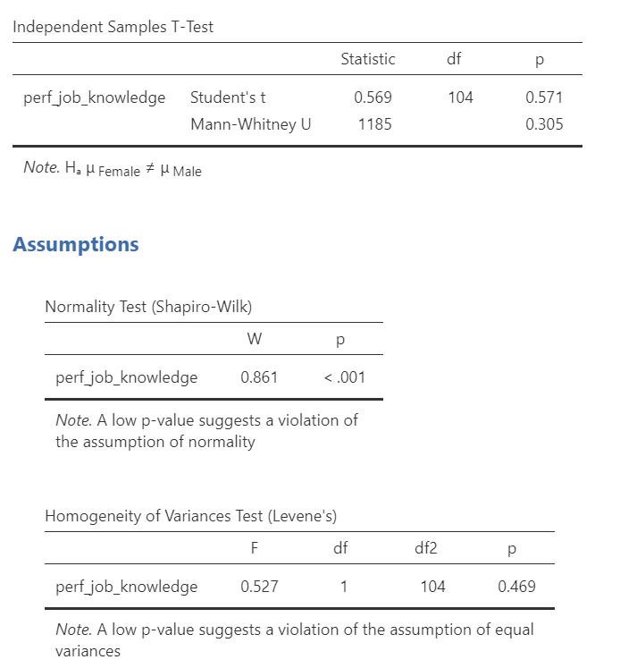
A researcher is testing if gender influences job knowledge. What p-value should they report?
A) 0.571
B) 0.305
C) <.001
D) 0.469

Slide 12
A researcher is testing if gender influences job knowledge. What p-value should they report?
A) 0.571
B) 0.305
C) <.001
D) 0.469

Slide 13
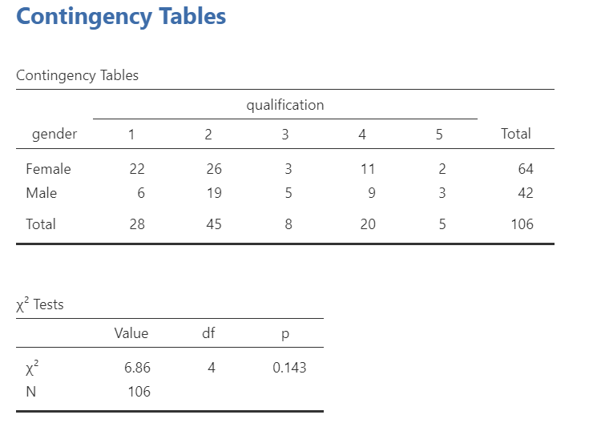
What is the expected cell count for the highlighted box?
3
5.32
42.5
1.98

Slide 14
What is the expected cell count for the highlighted box?
3
5.32
42.5
1.98

Slide 15
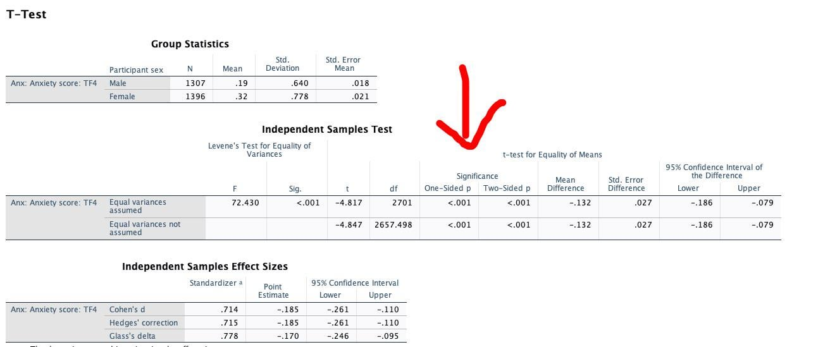
Based on the above SPSS output of the T-test, what can we conclude about the homogeneity of our data?
The p-value is significant therefore our data meets the requirement of being homogeneous
The p-value is NOT significant therefore our data meets the requirement of being homogeneous
The p-value is significant therefore our data does NOT meet the necessary requirements
Levene’s test is not found in the above table, therefore we cannot conclude anything about the homogeneity of our data

Slide 16
Based on the above SPSS output of the T-test, what can we conclude about the homogeneity of our data?
The p-value is significant therefore our data meets the requirement of being homogeneous
The p-value is NOT significant therefore our data meets the requirement of being homogeneous
The p-value is significant therefore our data does NOT meet the necessary requirements
Levene’s test is not found in the above table, therefore we cannot conclude anything about the homogeneity of our data

Slide 17
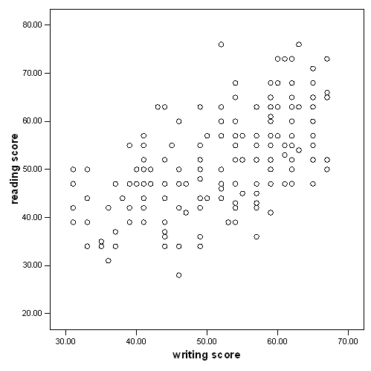
What can we conclude about the pictured data?
There is no apparent correlation
This data does not meet the requirements necessary to run a correlation
There is a negative correlation
There is a positive correlation

Slide 18
What can we conclude about the pictured data?
There is no apparent correlation
This data does not meet the requirements necessary to run a correlation
There is a negative correlation
There is a positive correlation

Slide 19
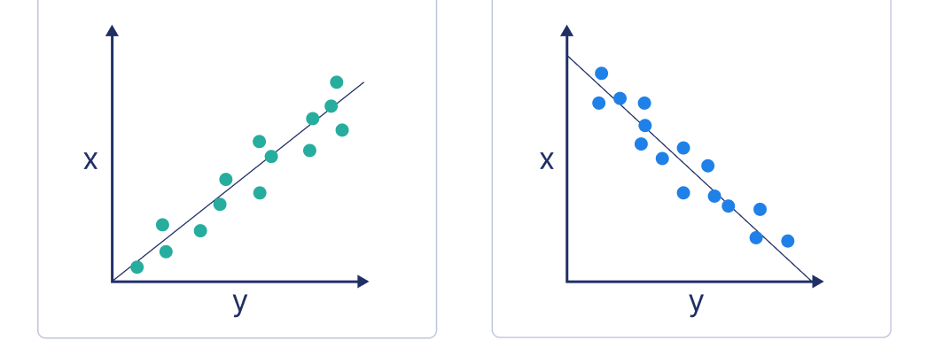
A
B
Based on the above two graphs, which one is better for a correlation analysis?
Graph A because it is positive
Graph B because it is negative
Neither meets the requirements for a correlation
A correlation could be run on both these graphs.

Slide 20
A
B
Based on the above two graphs, which one is better for a correlation analysis?
Graph A because it is positive
Graph B because it is negative
Neither meets the requirements for a correlation
A correlation could be run on both these graphs.

Slide 21
To run a Chi 2 test, what sort of data do we need?
A) 2 categorical variables
B) 1 ordinal and 1 nominal variable
C) Either 2 nominal variables, or 2 ordinal variables
D) All of the above are fine.

Slide 22
To run a Chi 2 test, what sort of data do we need?
A) 2 categorical variables
B) 1 ordinal and 1 nominal variable
C) Either 2 nominal variables, or 2 ordinal variables
D) All of the above are fine.

Slide 23
A study claims that an experimental treatment improves memory. The researcher ensures the study is free from biases, controls extraneous variables, and that the treatment, not other factors, causes the observed effects. What type of validity is being ensured here? a) Internal Validity b) External Validity c) Construct Validity d) Content Validity

Slide 24
A study claims that an experimental treatment improves memory. The researcher ensures the study is free from biases, controls extraneous variables, and that the treatment, not other factors, causes the observed effects. What type of validity is being ensured here? a) Internal Validity b) External Validity c) Construct Validity d) Content Validity

Slide 25
A new leadership assessment tool looks professional and seems intuitively to measure leadership qualities. However, no rigorous testing was conducted to confirm its accuracy. What type of validity does this refer to? a) Criterion Validity b) Content Validity c) Face Validity d) Construct Validity

Slide 26
A new leadership assessment tool looks professional and seems intuitively to measure leadership qualities. However, no rigorous testing was conducted to confirm its accuracy. What type of validity does this refer to? a) Criterion Validity b) Content Validity c) Face Validity d) Construct Validity

Slide 27
A new math placement test is shown to predict students' future performance in college-level math courses by correlating test scores with final grades. What type of validity does this situation demonstrate? a) Criterion Validity b) Content Validity c) Construct Validity d) Face Validity

Slide 28
A new math placement test is shown to predict students' future performance in college-level math courses by correlating test scores with final grades. What type of validity does this situation demonstrate? a) Criterion Validity b) Content Validity c) Construct Validity d) Face Validity

Slide 29
A psychological test for anxiety is designed, and its items are checked to ensure they actually measure anxiety and not something else, such as stress or sadness. What type of validity is this? a) Construct Validity b) Criterion Validity c) Content Validity d) Face Validity

Slide 30
A psychological test for anxiety is designed, and its items are checked to ensure they actually measure anxiety and not something else, such as stress or sadness. What type of validity is this? a) Construct Validity b) Criterion Validity c) Content Validity d) Face Validity

Slide 31
A researcher divides the population of hotel employees into groups based on their job roles (housekeeping, front desk, management) and then randomly selects a proportional number of employees from each group. What sampling method is being used? a) Quota Sampling b) Stratified Sampling c) Simple Random Sampling d) Snowball Sampling

Slide 32
A researcher divides the population of hotel employees into groups based on their job roles (housekeeping, front desk, management) and then randomly selects a proportional number of employees from each group. What sampling method is being used? a) Quota Sampling b) Stratified Sampling c) Simple Random Sampling d) Snowball Sampling

Slide 33
A study on tourists' preferences posts an online survey and encourages anyone interested in the topic to participate. What sampling method does this represent? a) Systematic Sampling b) Quota Sampling c) Self-Selection Sampling d) Simple Random Sampling

Slide 34
A study on tourists' preferences posts an online survey and encourages anyone interested in the topic to participate. What sampling method does this represent? a) Systematic Sampling b) Quota Sampling c) Self-Selection Sampling d) Simple Random Sampling

Slide 35
A hotel manager surveys customers and asks if they are satisfied (Yes/No) and if they would recommend the hotel to others (Yes/No). Which test should be used to determine if there is an association between the two responses?
A) Chi-square test
B) Correlation
C) T-test
D) ANOVA

Slide 36
A hotel manager surveys customers and asks if they are satisfied (Yes/No) and if they would recommend the hotel to others (Yes/No). Which test should be used to determine if there is an association between the two responses?
A) Chi-square test
B) Correlation
C) T-test
D) ANOVA

Slide 37
A researcher is interested in comparing the average daily sales from three different restaurant branches to see if they are significantly different. Which statistical test should be used?
A) Chi-square test
B) Correlation
C) T-test
D) ANOVA

Slide 38
A researcher is interested in comparing the average daily sales from three different restaurant branches to see if they are significantly different. Which statistical test should be used?
A) Chi-square test
B) Correlation
C) T-test
D) ANOVA

Slide 39
A professor wants to know if there is a difference in exam scores between two classes of students, one class being taught with traditional methods and the other with new techniques. Which statistical test should be used? A) Chi-square test B) Correlation C) T-test D) ANOVA

Slide 40
A professor wants to know if there is a difference in exam scores between two classes of students, one class being taught with traditional methods and the other with new techniques. Which statistical test should be used? A) Chi-square test B) Correlation C) T-test D) ANOVA

Slide 41
A researcher wants to test whether the type of hotel (luxury, mid-range, budget) has an effect on average room prices. Which statistical test should be used? A) Chi-square test B) Correlation C) T-test D) ANOVA

Slide 42
A researcher wants to test whether the type of hotel (luxury, mid-range, budget) has an effect on average room prices. Which statistical test should be used? A) Chi-square test B) Correlation C) T-test D) ANOVA

Slide 43
What is the main purpose of using ANOVA? A) To compare means between two groups B) To test for correlations between two variables C) To compare means across three or more groups D) To determine the association between categorical variables

Slide 44
What is the main purpose of using ANOVA? A) To compare means between two groups B) To test for correlations between two variables C) To compare means across three or more groups D) To determine the association between categorical variables

Slide 45
Which of the following is a key assumption of ANOVA? A) The dependent variable is categorical B) The data have homogeneity of variance C) The groups have different variances D) The independent variable is continuous

Slide 46
Which of the following is a key assumption of ANOVA? A) The dependent variable is categorical B) The data have homogeneity of variance C) The groups have different variances D) The independent variable is continuous

Slide 47
What is the appropriate test to do if Levene’s test is significant and you have 3 groups? A) Mann-Whitney U B) ANOVA F C) Welch D) Post-Hoc

Slide 48
What is the appropriate test to do if Levene’s test is significant and you have 3 groups? A) Mann-Whitney U B) ANOVA F C) Welch D) Post-Hoc

Slide 49
Levene’s test give a p-value of 0.04? What are the appropriate follow up steps A) ANOVA F-test with a Games-Howell B) ANOVA F-test with a Bonferonni C) ANOVA Welch test with a Games Howell D) ANOVA Welch test with a Bonferroni

Slide 50
Levene’s test give a p-value of 0.04? What are the appropriate follow up steps A) ANOVA F-test with a Games-Howell B) ANOVA F-test with a Bonferonni C) ANOVA Welch test with a Games Howell D) ANOVA Welch test with a Bonferroni

Slide 51
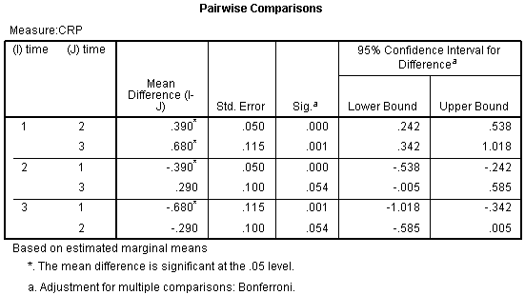
Which pair is the MOST significant?
1-2
1-3
2-3
3-1

Slide 52
Which pair is the MOST significant?
1-2
1-3
2-3
3-1

Slide 53
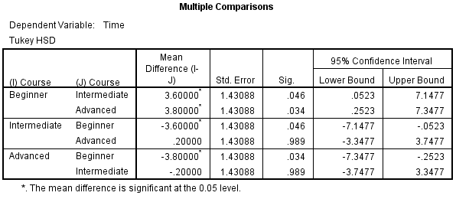
What can we conclude about the groups above? Where is there a significant difference?

Slide 54
What is the null hypothesis in a one-way ANOVA? A) All group means are equal B) At least one group mean is different C) The variances between groups are the same D) The data are not normally distributed

Slide 55
What is the null hypothesis in a one-way ANOVA? A) All group means are equal B) At least one group mean is different C) The variances between groups are the same D) The data are not normally distributed

Slide 56
A manager is studying whether the proportions of male and female guests using the hotel's gym facilities are equal. Which statistical test should be used? A) Chi-square test B) Correlation C) T-test D) ANOVA

Slide 57
A manager is studying whether the proportions of male and female guests using the hotel's gym facilities are equal. Which statistical test should be used? A) Chi-square test B) Correlation C) T-test D) ANOVA

Slide 58
What is the main difference between a regular one-way ANOVA and Welch’s ANOVA? A) Welch’s ANOVA assumes equal variances B) Welch’s ANOVA is used when the variances between groups are unequal C) One-way ANOVA can only compare two groups D) Welch’s ANOVA is used for categorical dependent variables

Slide 59
What is the main difference between a regular one-way ANOVA and Welch’s ANOVA? A) Welch’s ANOVA assumes equal variances B) Welch’s ANOVA is used when the variances between groups are unequal C) One-way ANOVA can only compare two groups D) Welch’s ANOVA is used for categorical dependent variables

