Slide 1
Amazon DynamoDB
Ukčo: 86974125

Slide 2
Basic characteristics
NoSQL database
Multi-model database
Spread the data and traffic for the table over a sufficient number of servers
On-demand backup of tables capability
AWS Management Console - monitoring resource utilization and performance metrics

Slide 3
Download and installation strategy
Create AWS account
Setting up:
Web service
Local – downloadable version
Accessing DynamoDB
Using the AWS Management Console
Using the AWS Command Line Interface (AWS CLI)
Using the API – Java, .NET, Node.js, PHP, Python, Ruby, C++, JavaScript in the browser, …
Using the NoSQL workbench
My strategy: locally downloaded database, configuration by AWS CLI, access by API in Python

Slide 4
My strategy
Creating AWS account – sign into console
Create a new user – Security credentials – Users – Add users - Provide user access to the AWS Management Console - I want to create an IAM user – Attach policies directly – filter all dynamodb permissions policies – select AmazonDynamoDBFullAccess, AmazonDynamoDBFullAccess
After creating a new user, click on the user's name – Security credentials – Access keys – Create access key – Command Line Interface – Create access key – download .csv (with AWS access key id)
Download and install AWS CLI
Download and install DynamoDB (requires JRE)
set the AWS Access Key ID and AWS Secret Access Key as the data from the downloaded .csv file

Slide 5
Data models
Key-value model
Document data model
Supports the document data model, which allows you to store and query nested data structures within a single item
Supports composite primary keys - a combination of hash key and range key to uniquely identify items
Maximum item size: 400 KB
Maximum number of items per partition key value: 10 GB
Limited support for secondary indexes
No support for joins or transactions

Slide 6
Operations – create table
Linux
Windows CMD
aws dynamodb create-table \
--table-name Music \
--attribute-definitions \
AttributeName=Artist,AttributeType=S \
AttributeName=SongTitle,AttributeType=S \
--key-schema \
AttributeName=Artist,KeyType=HASH \
AttributeName=SongTitle,KeyType=RANGE \
--provisioned-throughput \
ReadCapacityUnits=5,WriteCapacityUnits=5 \
--table-class STANDARD
aws dynamodb create-table ^
--table-name Music ^
--attribute-definitions ^
AttributeName=Artist,AttributeType=S ^
AttributeName=SongTitle,AttributeType=S ^
--key-schema ^
AttributeName=Artist,KeyType=HASH ^
AttributeName=SongTitle,KeyType=RANGE ^
--provisioned-throughput ^
ReadCapacityUnits=5,WriteCapacityUnits=5 ^
--table-class STANDARD

Slide 7
Operations – write data
Linux
Windows CMd
aws dynamodb put-item \
--table-name Music \
--item \
'{"Artist": {"S": "No One You Know"}, "SongTitle": {"S": "Call Me Today"}, "AlbumTitle": {"S": "Somewhat Famous"}, "Awards": {"N": "1"}}'
aws dynamodb put-item ^
--table-name Music ^
--item ^
"{\"Artist\": {\"S\": \"No One You Know\"}, \"SongTitle\": {\"S\": \"Call Me Today\"}, \"AlbumTitle\": {\"S\": \"Somewhat Famous\"}, \"Awards\": {\"N\": \"1\"}}"

Slide 8
Operations – read data
Linux
Output
aws dynamodb get-item --consistent-read \
--table-name Music \
--key '{ "Artist": {"S": "Acme Band"}, "SongTitle": {"S": "Happy Day"}}'
{
"Item": {
"AlbumTitle": {
"S": "Songs About Life"
},
"Awards": {
"S": "10"
},
"Artist": {
"S": "Acme Band"
},
"SongTitle": {
"S": "Happy Day"
}
}
}
Windows cmd
aws dynamodb get-item --consistent-read ^
--table-name Music ^
--key "{\"Artist\": {\"S\": \"Acme Band\"}, \"SongTitle\": {\"S\": \"Happy Day\"}}"

Slide 9
Querying
SQL
DynamoDb
/* Return a single song, by primary key */
SELECT * FROM Music
WHERE Artist='No One You Know‘
AND SongTitle = 'Call Me Today';
{
TableName: "Music",
KeyConditionExpression: "Artist = :a and SongTitle = :t",
ExpressionAttributeValues: {
":a": "No One You Know",
":t": "Call Me Today"
}
}

Slide 10
Chosen Domain
football league

Slide 11
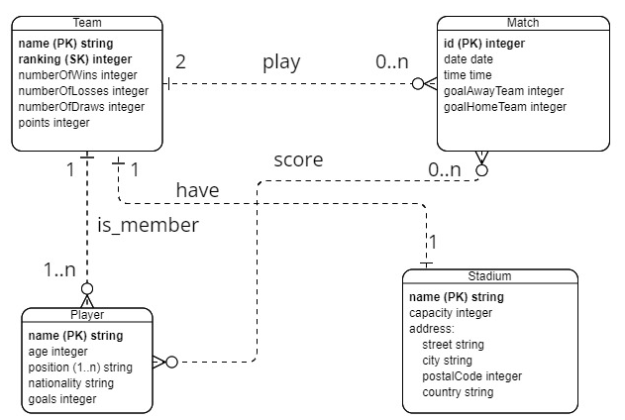
ER schema

Slide 12
Logical (Database) Schema
Entity tables:
Team(team_name, ranking, numberOfWins, numberOfLosses, numberOfDraws, points, stadium_name)
Player(player_name, age, position, nationality, goals, team_name)
Match(match_id, date, time, goalHomeTeam, goalAwayTeam, homeTeam_name, awayTeam_name)
Stadium(stadium_name, capacity, address(street, city, postal_code, country))
Relationship tables:
PlayerMatch(id, player_name, match_id)

Slide 13
Sample Data
Downloaded data from:
Kaggle: https://www.kaggle.com/rajatrc1705/english-premier-league202021
Football Data: https://www.football-data.co.uk/englandm.php

Slide 14
Queries + Description
Všichni hráči dané národnosti
Hráči daného týmu, kteří skórovali když hrál tým venku
Průměrný věk hráčů každého týmu

Slide 15
Results of Experiments
returnAllPlayersOfNationality:
Average query time of: 0.0358999490737915 seconds
One query duration: 0.03200 seconds
playersScoringForTeamAway:
Average query time of: 1.8221004605293274 seconds
One query duration: 1.81300 seconds
averageAge:
Average query time of: 0.03980010747909546 seconds
One query duration: 0.06200 seconds

Slide 16
List of Additional Files
erModel.jpg – ER model
executeQueries.py – script for executing queries
generateData.py – script for generating and save data into database
matches.csv – data about matches
measuringEfficiency.py – script for measuring efficiency of queries
playerMatch.csv – data about relationship player and match
players.csv – data about players
stadiums.csv – data about stadiums
teams.csv – data about Teams
textOfQueries.txt – queries in text form
resultOfMeasuring.txt – result of measuring efficiency of queries in text form
requirements.txt – requirements for running scripts

