Slide 1


Investment Campaign Case Study
Vojtěch Flídr
Zuzana Shivram Sami
Daniela Pinkasová
Data Science Coding Bootcamp Team

Slide 2
Case Study Definition & Objectives
Banking campaign for investment product
First round of campaign already performed, results are available
Result for each client: success = client invested, failure = client did not invest
Objective of the case study is to target additional 3,000 clients for second round of campaign who are most likely to invest and therefore maximize bank’s revenue
Clients will be offered a cash-back bonus of 1,000 CZK if they decide to invest in the product

Slide 3
Workflow
Evaluating the Results
Data Preprocessing
Model Selection, Hyperparameter Tuning
Conclusion
Feature Engineering
Selection of the Best Model

Slide 4
Data Preprocessing
Dataset of 11,162 clients, for 2,299 results from first round are available
Database of 4 tables
Client’s personal info
Client’s bank product info
Client’s balances
Results from first round of investment campaign
Data cleaning
Replacing missing values
Label encoding of categorical variables
Client balances recalculated to CZK using daily FX rates for EUR and USD

Slide 5
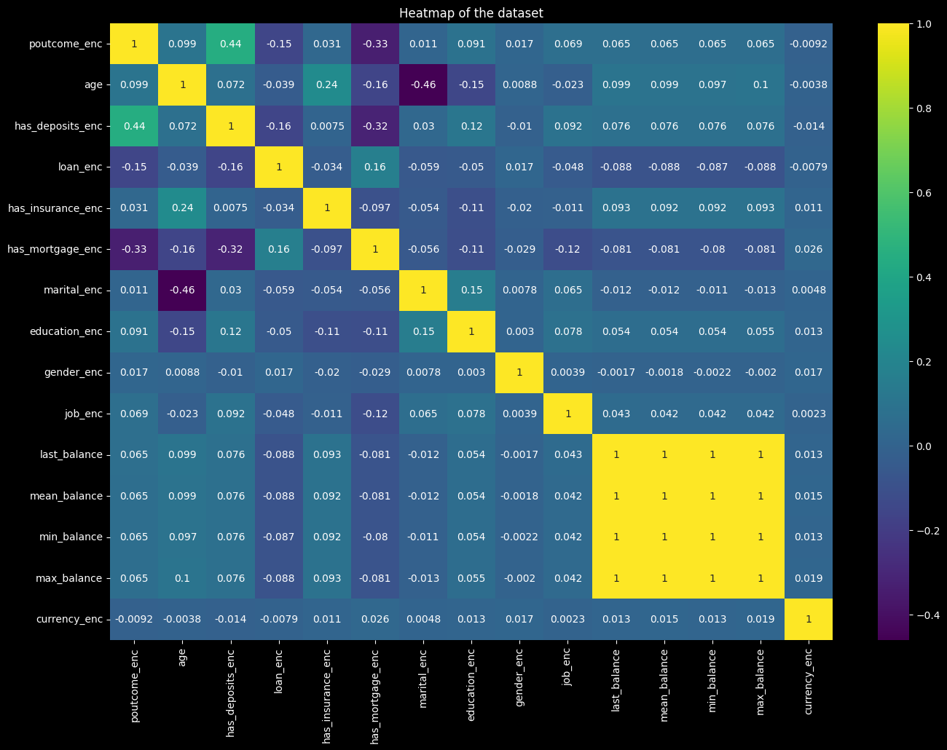
Visualization of variable relationships

Slide 6
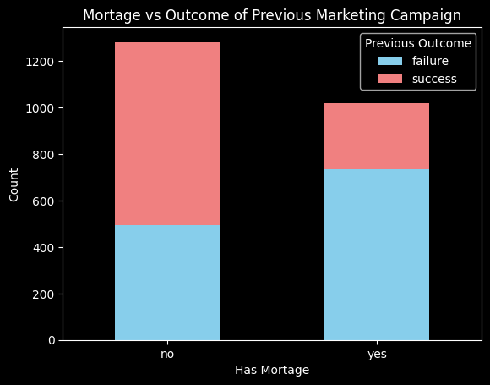
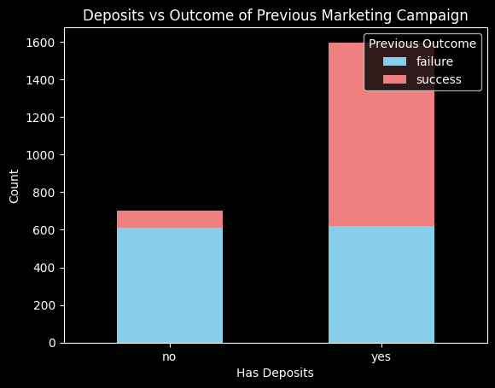
Exploratory Analysis of First Round
Clients who do not have mortgage and have deposits were more likely to invest in first round of campaign

Slide 7
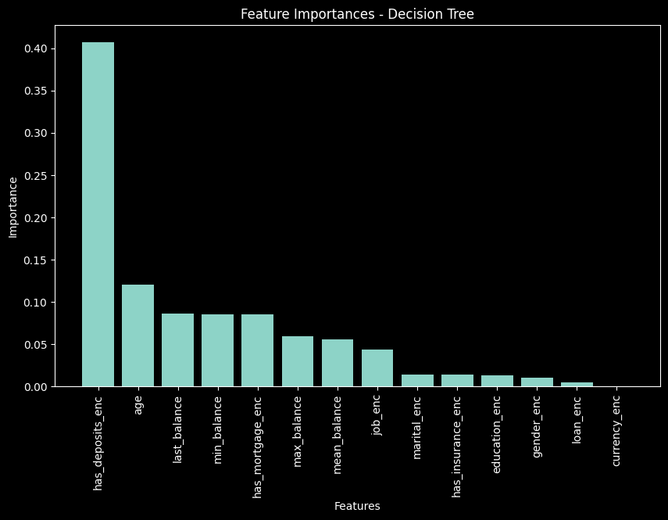
Feature Engineering
Developing new variables
Mean, Last, Min, Max balances
Currency
Selecting most important features based on a Decision Tree algorithm

Slide 8
Model Selection
Hyperparameter tuning
Random Forest
Logistic Regression
K-Nearest Neighbors (KNN)
Adaptive Boosting (AdaBoost)
Neural Network
Finding the best combination of parameters to achieve the maximum performance of the models
E.g. What should be the number of trees in a random forest or number of layers in neural network?
GridSearch - build model for each combination of parameters, evaluating each model and selecting the architecture which produces the best results

Slide 9
Metrics Used for Model Evaluation
 | Random Forest | Logistic Regression | KNN | Adaboost | Neural network
F1 Score | 0.672 | 0.679 | 0.660 | 0.681 | 0.693
AUC-ROC | 0.749 | 0.746 | 0.716 | 0.760 | 0.751
AUC-PR | 0.655 | 0.646 | 0.610 | 0.681 | 0.642
Accuracy | 0.699 | 0.700 | 0.670 | 0.699 | 0.696
Random Forest Metrics: F1 Score: 0.6719242902208201 AUC-ROC: 0.7489855954554676 AUC-PR: 0.6551377546732486 Accuracy: 0.6985507246376812 y_scores: [0.58219598 0.54469183 0.61534236 0.59178956 0.50890778 0.34073552 0.26602721 0.44834981 0.64927771 0.26851645 0.48489057 0.59838066 0.57596129 0.24047291 0.59290651 0.24047291 0.46962086 0.60597088 0.46453449 0.48580554 0.60281405 0.4833163 0.47888487 0.59838066 0.32669989 0.5994976 0.4833163 0.59838066 0.26851645 0.46634309 0.39725143 0.58548054 0.47021014 0.3161592 0.59415528 0.26851645 0.6296649 0.59838066 0.27170937 0.24832528 0.24862618 0.61678736 0.27419861 0.30886523 0.60517976 0.59838066 0.59838066 0.60623303 0.49788329 0.26851645 0.22932686 0.3161592 0.40421854 0.60372299 0.59858867 0.34702373 0.57888945 0.2805942 0.5779706 0.3569202 0.58756418 0.48169861 0.49003092 0.59838066 0.59415528 0.22732806 0.59415528 0.5732138 0.25430182 0.23624753 0.24256284 0.47918857 0.46069088 0.5994976 0.3569202 0.60940515 0.24678822 0.50322562 0.59415528 0.26602721 0.20206806 0.19505914 0.4833163 0.59415528 0.17833759 0.60623303 0.58548054 0.32038458 0.56238357 0.49003092 0.23220393 0.49114786 0.60372299 0.59415528 0.30318959 0.59838066 0.48517753 0.24862618 0.22932686 0.55410096 0.59838066 0.47287004 0.58219598 0.6296649 0.57888945 0.48169861 0.21635726 0.5779706 0.34073552 0.59838066 0.48580554 0.48580554 0.3161592 0.25430182
...
[0.67381555] [0.72699296] [0.451205 ] [0.44824973]]
Output is truncated. View as a scrollable element or open in a text editor. Adjust cell output settings...

Slide 10
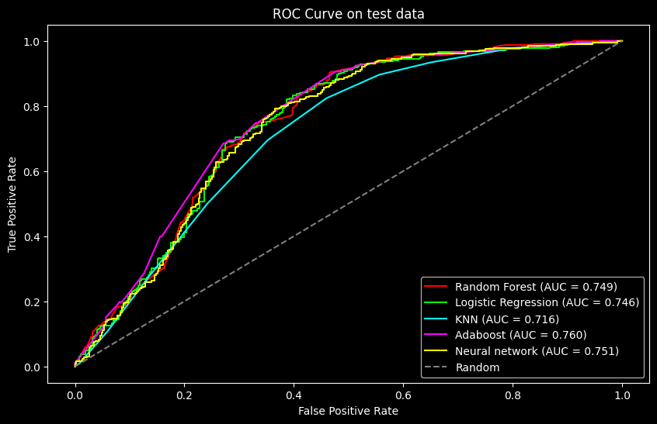
ROC Curve

Slide 11
Selection of The Best Model
Random Forest
Metric scores are lower compared to others, computationally inefficient
KNN
Overall lowest performance
AdaBoost
Highest AUC scores but does not provide default probabilistic output
Neural Network
Highest F1 Score but no interpretability
Logistical Regression
Highest Accuracy, Highest Robustness between train and test data, Model Simplicity

Slide 12

DATA WIZARDS
NEURAL NETWORK
LOGISTIC
REGRESSION

Slide 13
Evaluating the Results
Run the logistic regression model with best hyperparameters
Output is probability of success (investment) for each client
Based on the outputs 3,000 clients were chosen
Our data-driven solution predicted 71.4% of the investments
Comparison of data-driven solution and random choice
If each client invests on average 5,000 CZK
Based on our model: total amount invested by clients would be 6,890,000 CZK
Based on random choice: total amount invested by clients would be 3,595,000 CZK

Slide 14
3,295,000 CZK
Potential increase in the clients investments with data-driven solution

Slide 15
Do you have any questions?
THANK YOU
FOR YOUR ATTENTION

