Slide 1

Weekly Status Report
Phantom Unit
TL1 - Zuzanna Whitman

Slide 2

GIT Directory Structure
https://github.com/ZuziaWhit/ET-Pizzeria/tree/main

Slide 3
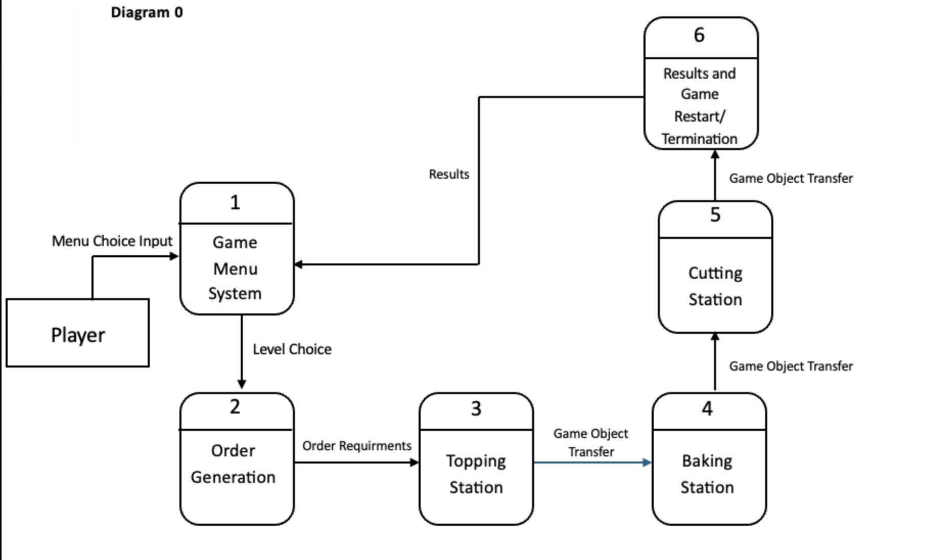
Introduction to the Game

Slide 4
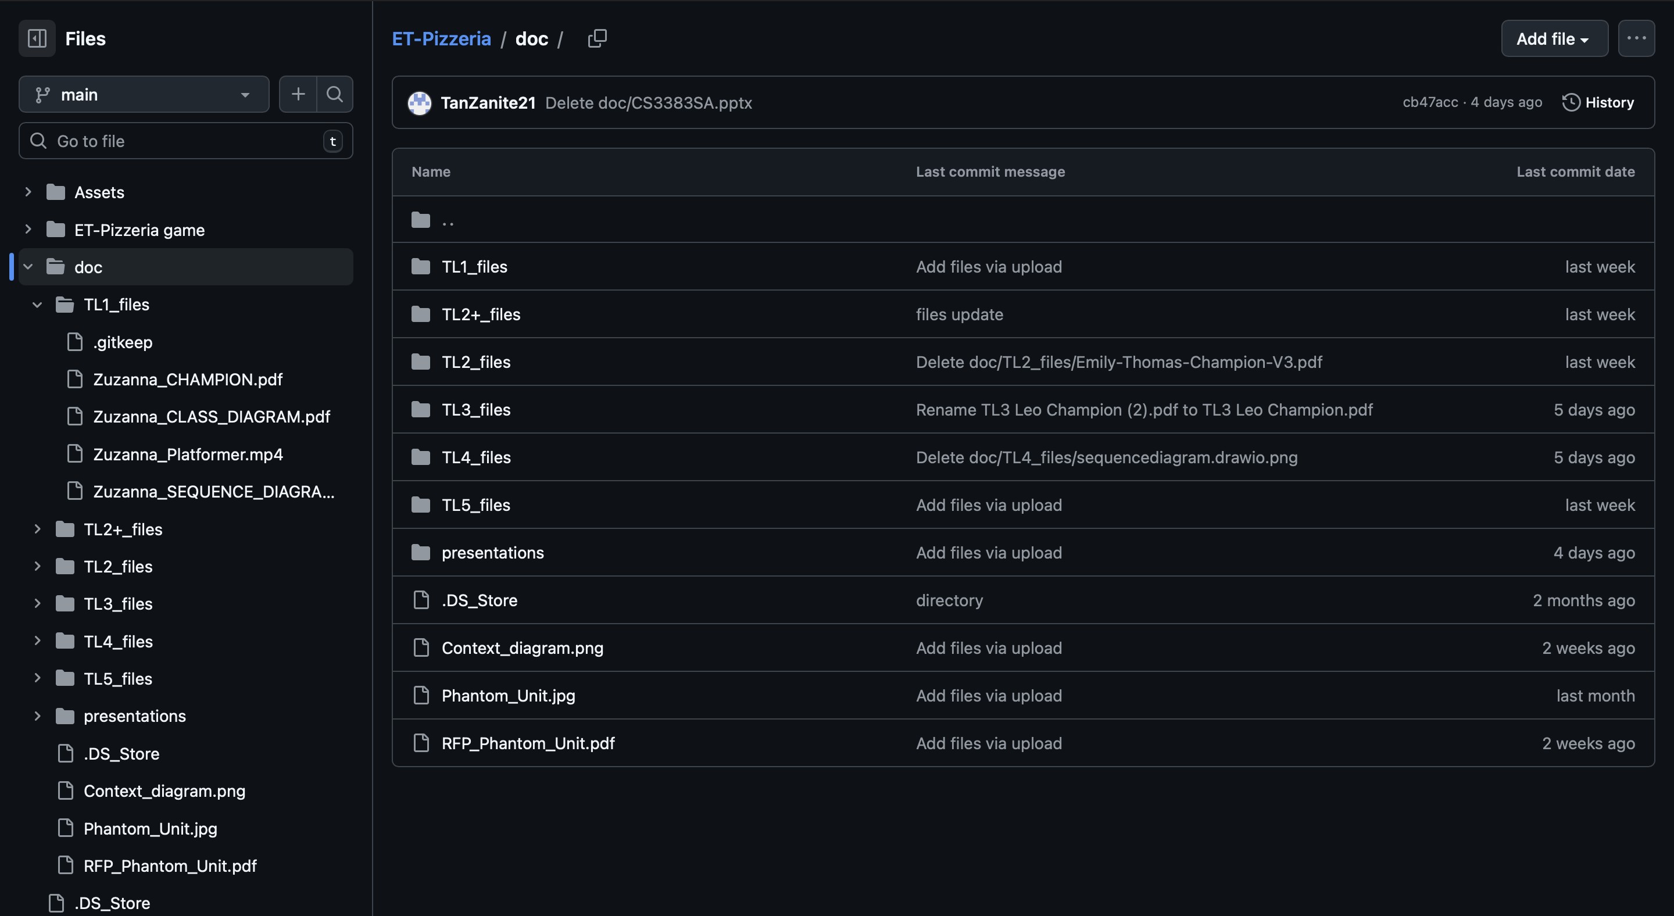
Documentation Folder (doc)

Slide 5
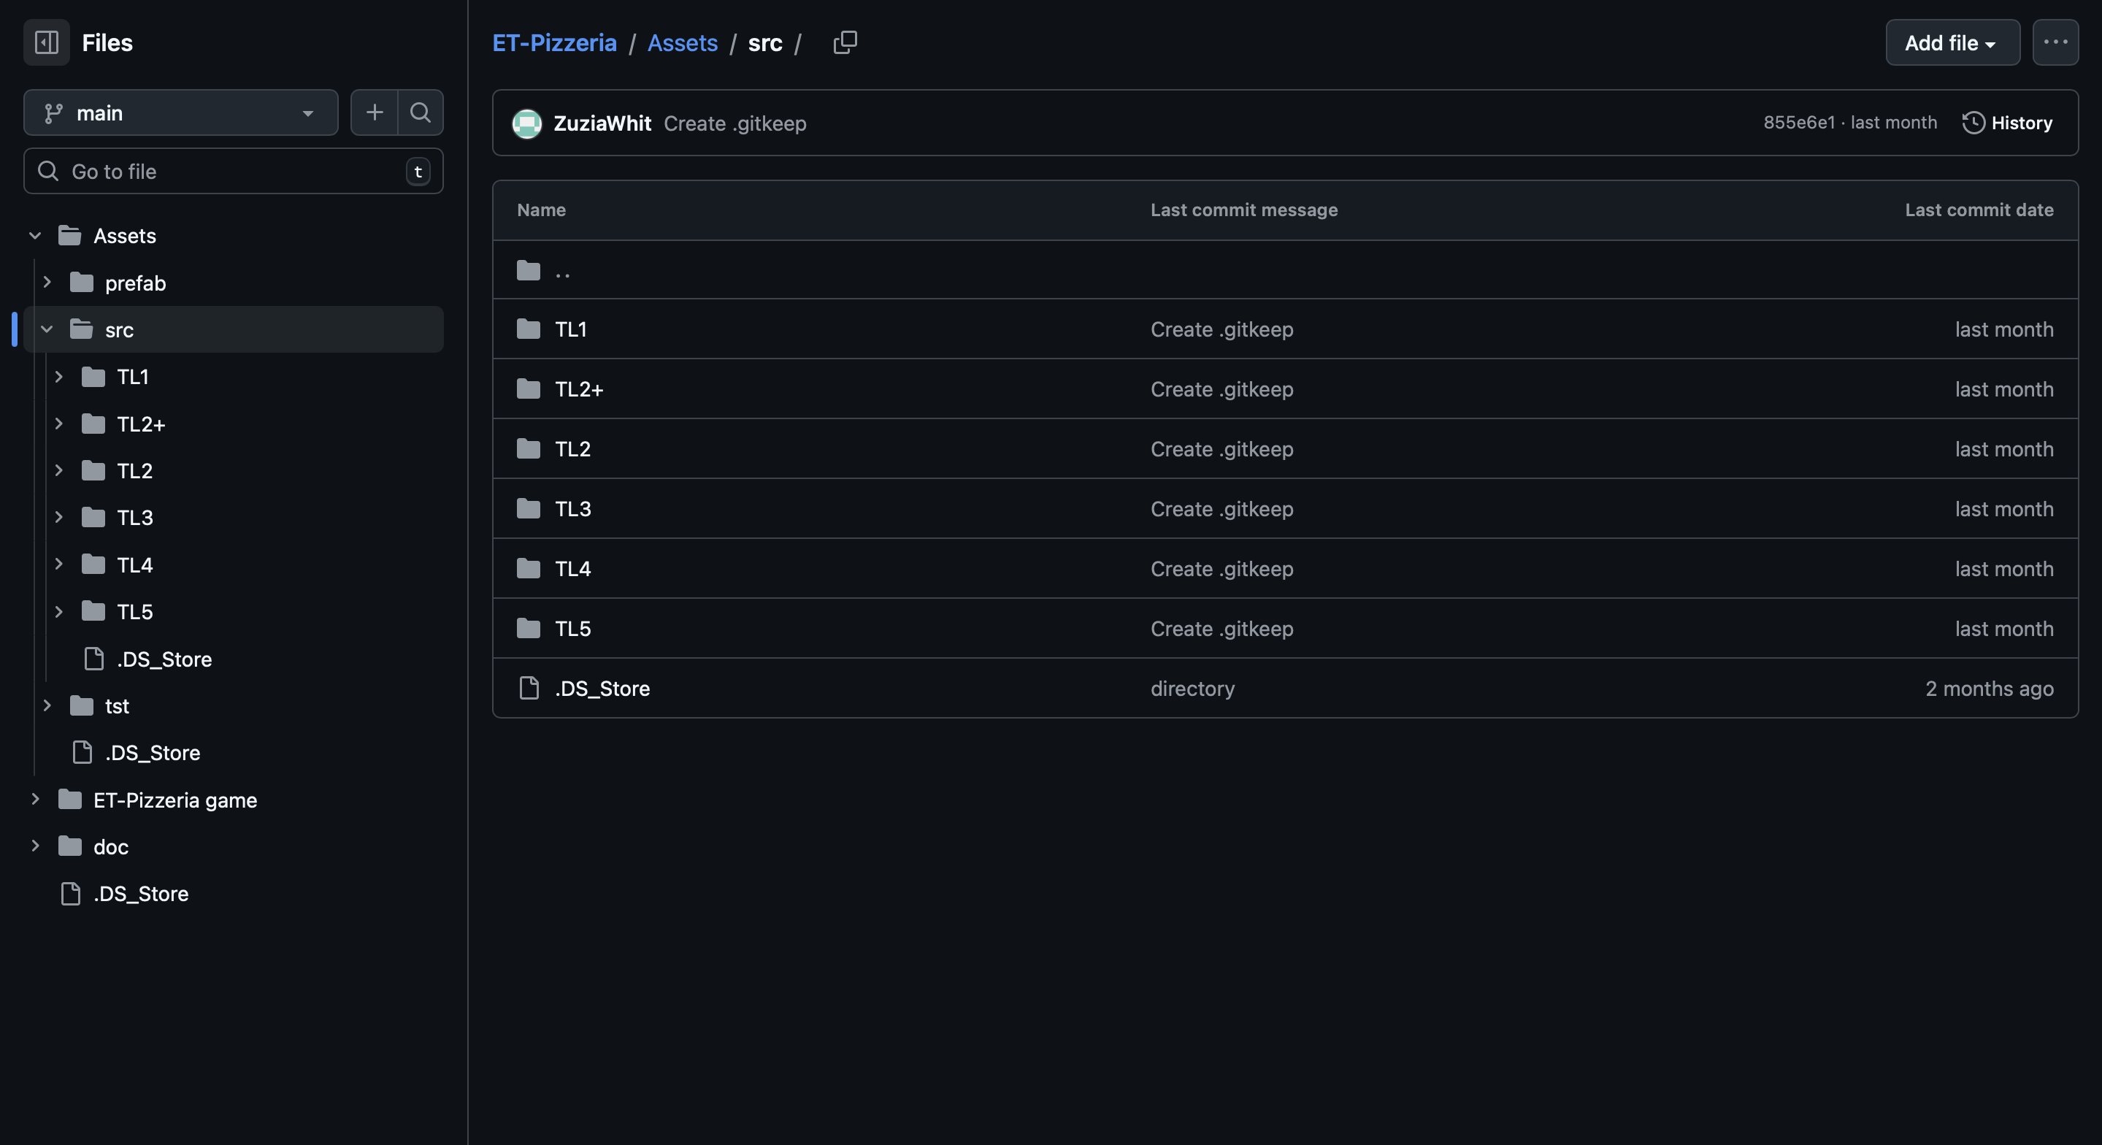
Source Code Folder (src)

Slide 6
Team Contributions
Personal assignments
Team assignments
Source code and other assets (in the future)

