Slide 1

Energy Consumption and Efficiency of Biologically Inspired Neural Networks Simulated on GPUs
By Muhammad Zuhair and Haseeb Ahmed
Students of the electrical engineering department (EEIB)

Slide 2

Agenda
Introduction & Problem Statement
Some Facts about the Problem
Existing Work on this topic
Our Approach
Project Goals
Project Evaluation Criteria

Slide 3
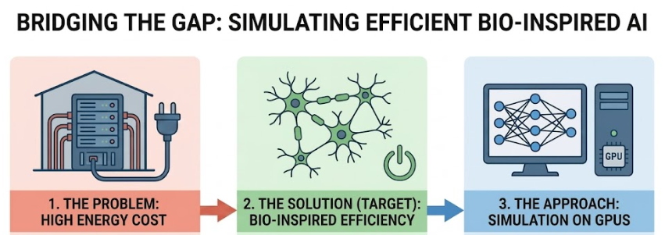
The Problem Statement
Artificial Intelligence relies on heavy computing hardware
Works brilliantly, but uses enormous energy
Biologically-inspired networks: similar results, far less energy
Our approach: simulate it on widely accessible hardware;GPUs .
Source: Generated using AI

Slide 4
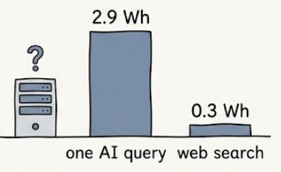
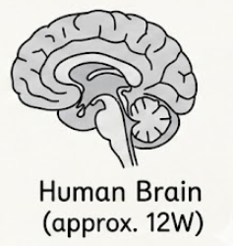
So how big is this energy problem ?
And why biological inspired approach ?
GPT-3 training ≈ 1.3 million kWh
one AI query ≈ 2.9 Wh vs 0.3 Wh for a web search (source : Medium, R. Thompson, Article: AI’s Dirty Secret …)
→ nature hints there's a far more efficient way
→ Human Brain : approx. 12 watts (inspiration, not a current claim)

Slide 5
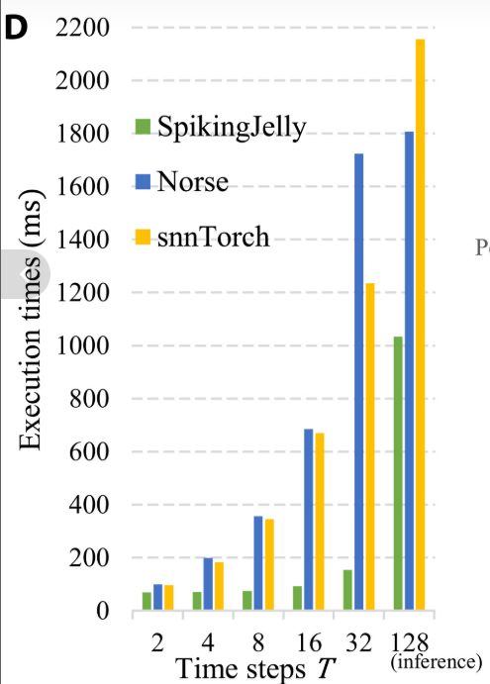
Others’ existing work so far:
Open community project comparing frameworks on raw latency – Open Neuromorphic
(source : https://github.com/open-neuromorphic/snn-library-benchmarks)
Compared simulation frameworks, majorly on speed — Science Advances (2023) (source : https://www.science.org/doi/10.1126/sciadv.adi1480 )
Source: Model Speed comparisons across frameworks from Science Advances Research Journal

Slide 6
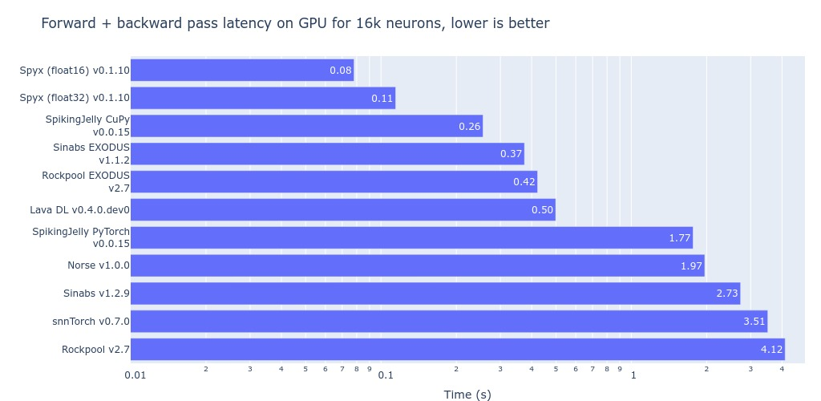
Others’ existing work so far (continued)
Our Approach:
compare accuracy, memory, energy & ease of use together, then optimize further

Slide 7

Biologically inspired neural dynamic behaviour

Slide 8
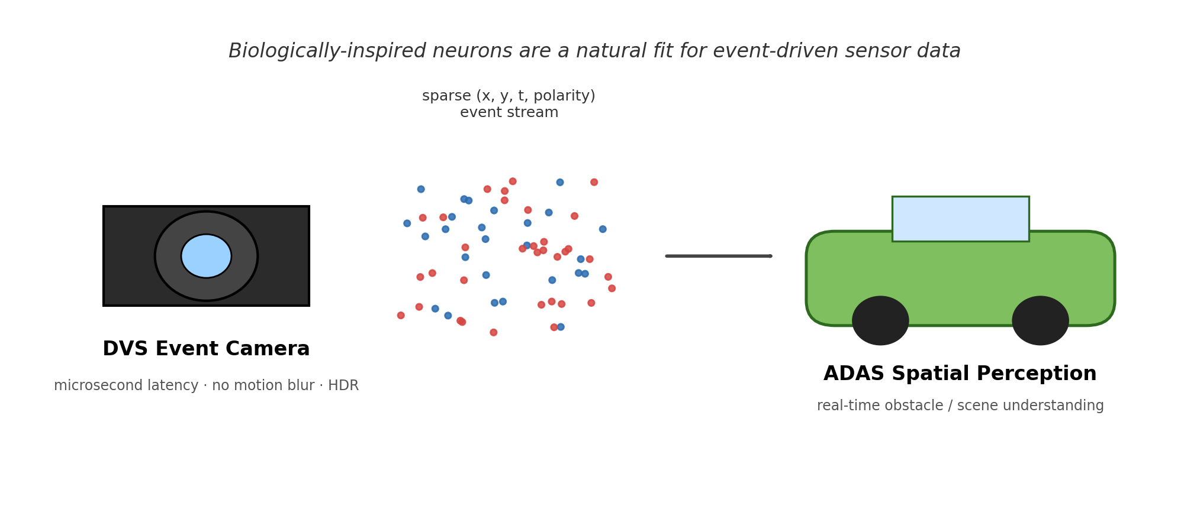

Slide 9
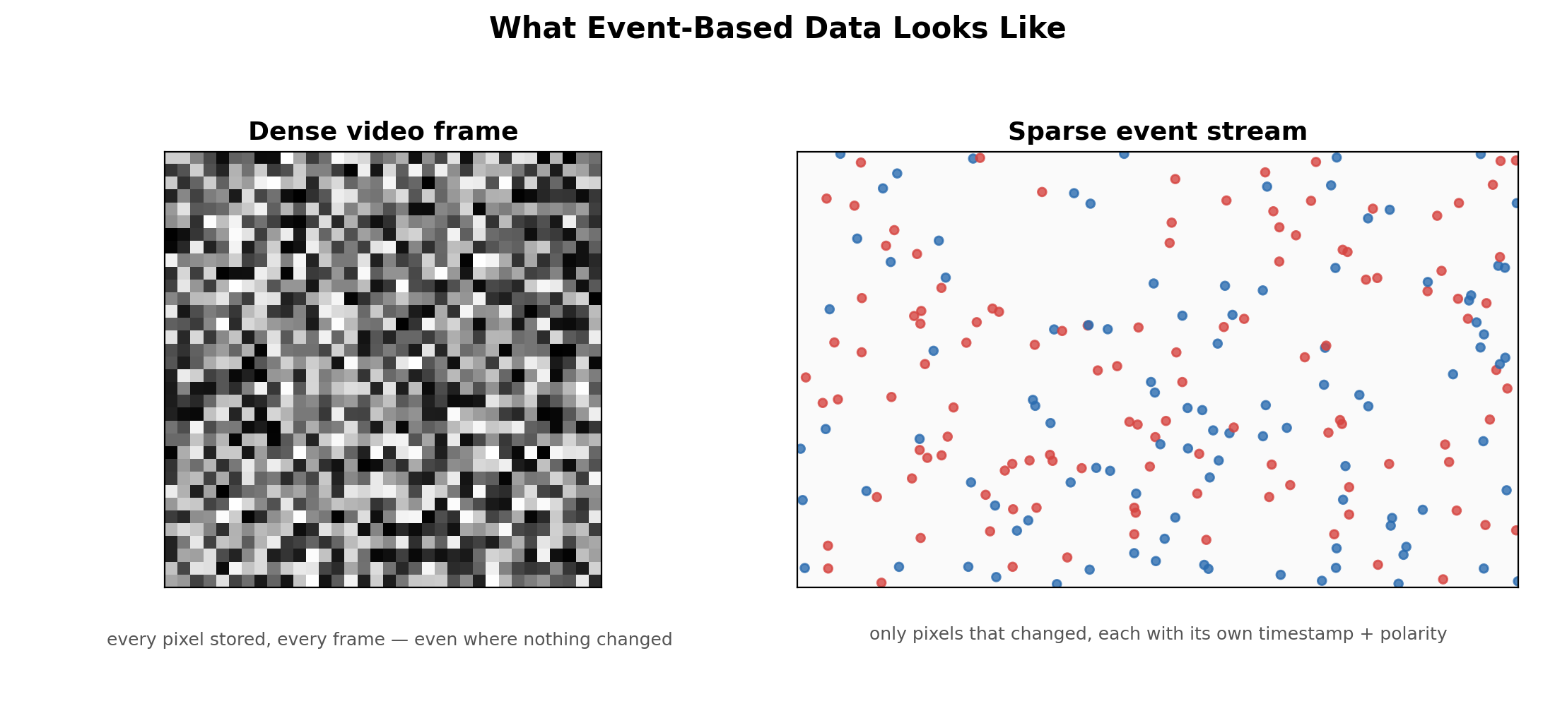

Slide 11

Training & Inference Pipeline
Settings
Framework Backends
skeleton.Settings reads SNN_module.yaml
NeuromorphicEncoder
Norse
Working
Default — LIF cell, tau_mem_inv
event_data_workflow: DVS events → DataLoader
SNNTorch
Working
Alpha/Leaky neurons, MSE count loss
Framework Model
MODELS[cfg.FRAMEWORK] → SNN_NORSE / TORCH / SJ…
SpikingJelly
Working
Izhikevich neurons, pre-summed [B,C]
SNNTrainer.train()
Sinabs
Working
DVS-first, exports to SynSense Speck chip
BPTT + TRADES + STDP + Activity Reg per batch
BindsNET
Working
SNNTester.run()
STDP-only, no BPTT backprop
Accuracy · Energy/sample (pJ) · Firing rate (Hz)
Spyx
Working
JAX + Haiku, DLPack bridge
AdversarialEvaluator
JAX / Flax
Extension
TRADES robustness: KL-div under ε-perturbation
XLA training, DLPack at boundary
we wont be building our own rather utilising the build community and popular frameworks and wanting to simulate them on gpus.

Slide 12


System Overview — Project Structure
A unified Python platform: configuration, framework wrappers, data pipeline, training, and evaluation.
src/learning/
skeleton/
Training · Inference · Adversarial Eval
Configuration · Settings · Network Generation
main.py — entry point, wires all components
training.py — SNNTrainer: BPTT, TRADES, STDP, Activity Reg
inference.py — SNNTester: accuracy, energy, firing rate
adversarial_robustness.py — AdversarialEvaluator (TRADES)
frameworks/ — one file per SNN backend
snn_config.py — Settings class, reads two YAML files
SNN_module.yaml — all runtime parameters
network_architecture.yaml — Conv-SNN topology
network_struct: S (stable) | A (ascending) | D (descending)
generate_network_structure() builds layer list at init
What are doing to simulate them on gpu like we have this design in place and want to develop a constructive testing and simulating environment. 1 visual containing our roadmap.
Entry point: python src/learning/main.py | Reads SNN_module.yaml → builds model → trains → evaluates

Slide 13
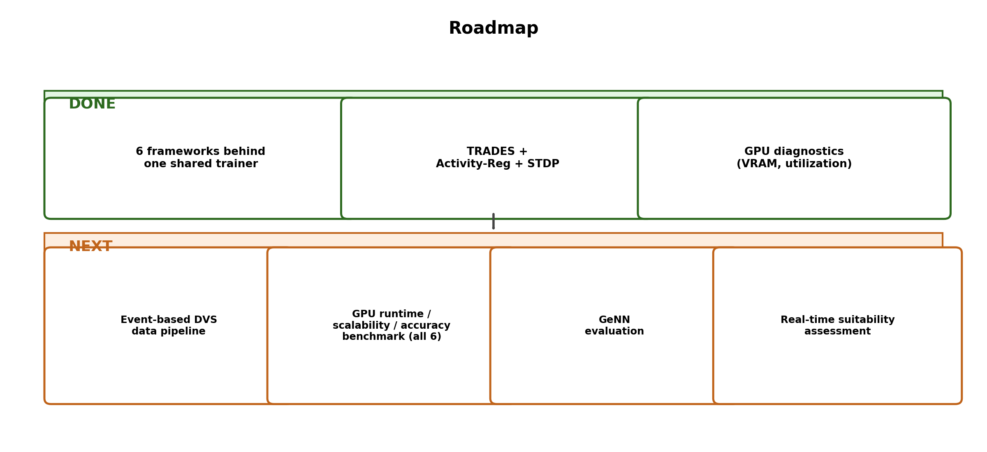
Application Setup Architecture

Slide 14
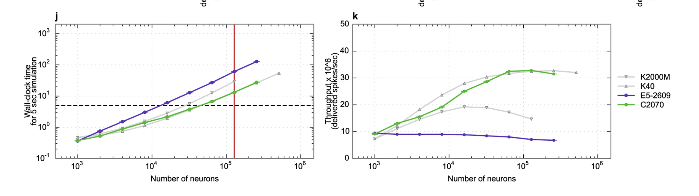
GeNN
We refer to one extra work that is relates to GeNN. It's an appropriate snn built on c++ but needs to be evaluated
GeNN is a GPU-enhanced Neuronal Network simulation environment based on code generation for NVIDIA CUDA and AMD HIP.
you specify neuron/synapse models through a Python API (PyGeNN), and it compiles those specs ahead-of-time
GeNN's entire reason to exist is the claim that code-generated kernels beat interpreted/autograd execution at scale.

Slide 15
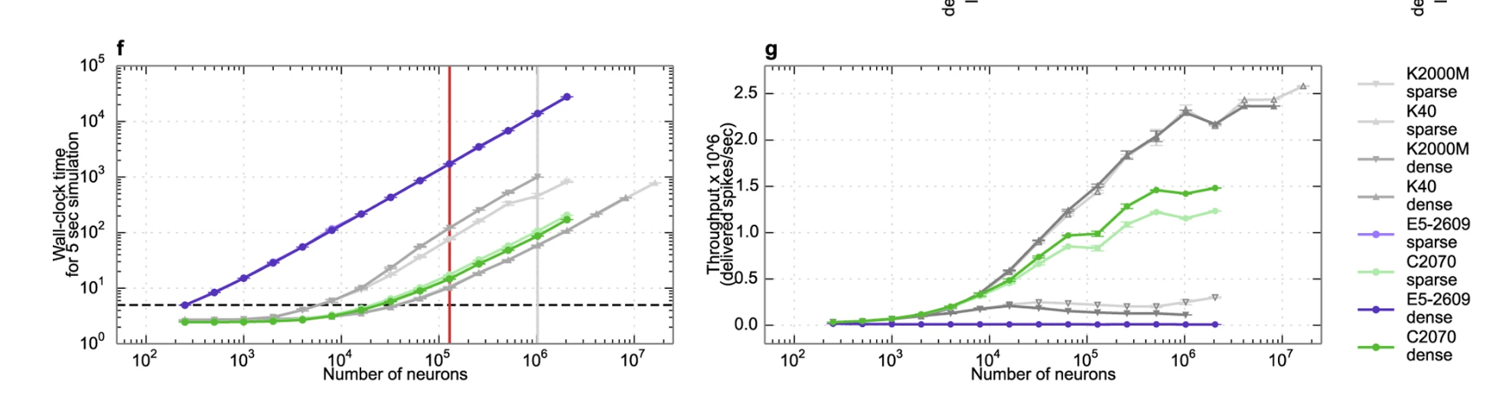
GeNN
but it has none of the deep-learning layer abstractions our project depends on — no Conv2d, no MaxPool2d, no Sequential, no autograd through stacked heterogeneous layers. Building our actual architecture (Conv→LIF→Pool→Conv→LIF→Pool→FC→LIF, trained end-to-end with backprop) in GeNN would mean hand-wiring every connection ourselves — GeNN gives you no scaffolding for "deep."
That changes what a fair GeNN benchmark actually looks like:
What it can't be: "implement our conv-SNN classifier in PyGeNN and compare training accuracy/runtime" — that's not a benchmark, that's reimplementing a deep learning framework's layer system from scratch inside a tool that was never built to have one.

Slide 16
no multi-layer end-to-end backprop, no event-camera ingestion pipeline, no PyTorch interop, no adversarial-robustness tooling. It was never built to be a deep-learning framework — it's a neuron-population simulator.
That's exactly why our architectural choice is the appropriate one for this project's actual goal: we're not trying to simulate biologically faithful neuron populations for neuroscience — we're trying to build and train deep, multi-layer spiking classifiers on real event-camera data for an applied perception task (ADAS spatial perception), with robustness guarantees, across multiple interchangeable community frameworks. GeNN's existence doesn't compete with that scope, it confirms the gap: the kernel-efficiency problem is being handled seriously elsewhere, and nothing in that space touches the deep-learning-pipeline-plus-event-data-integration problem this project actually solves.

Slide 17


Learning Objectives & Regularization Stack
Three differentiable objectives combine into a single composite loss per training batch:
BPTT + Surrogate Grad
TRADES Adversarial
Activity Reg. + STDP
Primary Loss
Robustness
Bio-Inspired
Backpropagation Through Time across T timesteps
Non-differentiable spike fn approximated by surrogate
Each SNN backend implements its own surrogate function
Output loss: Cross-Entropy or MSE Count (YAML-selected)
Gradient flows through all T timesteps to update weights
Loss = CrossEntropy(clean) + λ · KL(clean ∥ adversarial)
PGD inner loop finds worst-case ε-ball perturbation
trades_steps PGD iterations per batch (default 3, rec. 10)
Adversarial grad via autograd — no parameter grad leak
Hooks paused during adversarial forward to isolate STDP
Two-sided per-neuron rate penalty on hidden LIF layers
Dead neuron prevention: λ_low if rate < 1% timesteps
Saturation prevention: λ_high if rate > 50% timesteps
STDP causal correlation added as differentiable loss term
STDP tau, A+, A− set in YAML — gradient compatible
All three losses combine in SNNTrainer.train() — AMP GradScaler wraps the total loss for mixed-precision backward

Slide 18

Key Architecture Takeaways
01
Zero Hard-Coded Values
02
Framework-Agnostic at the Model Boundary
SNN_module.yaml is the single source of truth — architecture, training schedule, regularization, dataset, and output paths all live there.
Six backends (Norse, SNNTorch, SpikingJelly, Sinabs, BindsNET, Spyx) switch via one YAML key. ModelInterface contract unifies them all.
03
Biology-Informed Training Stack
BPTT + surrogate gradient, TRADES adversarial robustness, two-sided activity regularization, and STDP all operate as differentiable loss terms.

Slide 19
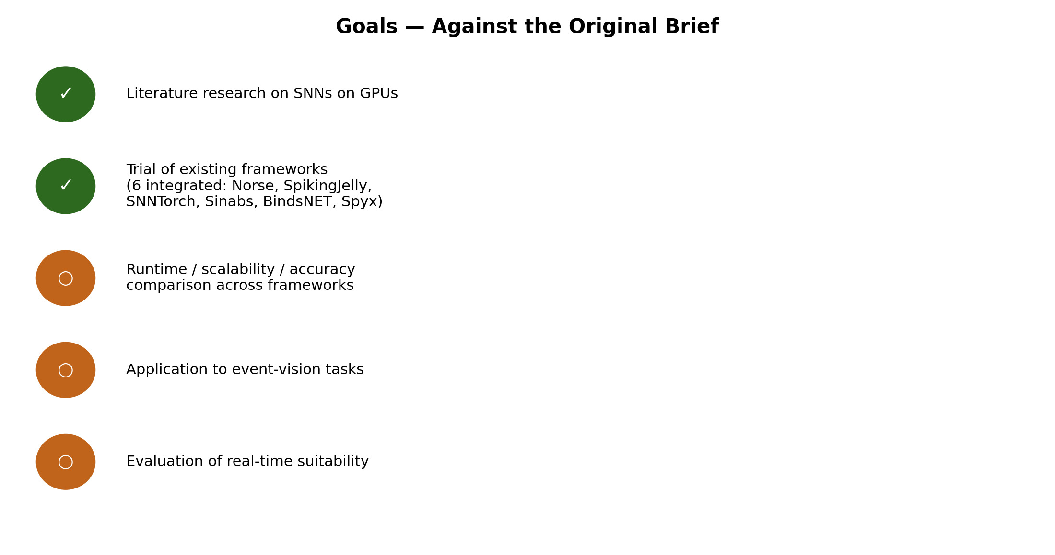

Slide 20
Our Goal(s)
Simulate the bio-inspired model on existing hardware (GPUs)
Compare the simulation frameworks to looking at accuracy, memory, energy - not just speed
Optimize the simulation pipeline — study effect on energy consumption , memory utilisation

Slide 21
Evaluation Criteria
⚡
⏱
Memory
Speed
GPU memory used during training and inference
🔋
Time to train and to run (per epoch / inference )
🎯
Energy consumption
Performance Accuracy
📈
GPU Power/energy consumed for the same task while achieving same accuracy
How correctly the model produces results
📊
Optimization Effect
Comparative benchmarking
Change in energy & memory after improving our pipeline
Comparison of simulation frameworks from use case perspective

Slide 22
Key Architecture Takeaways
01
Zero Hard-Coded Values
02
Framework-Agnostic at the Model Boundary
SNN_module.yaml is the single source of truth — architecture, training schedule, regularization, dataset, and output paths all live there.
Six backends (Norse, SNNTorch, SpikingJelly, Sinabs, BindsNET, Spyx) switch via one YAML key. ModelInterface contract unifies them all.
03
Adaptive Neuromorphic Data Pipeline
04
Biology-Informed Training Stack
NeuromorphicEncoder handles temporal slicing, configurable window overlap, and auto-selects the best cache tier (VRAM / RAM / Disk).
BPTT + surrogate gradient, TRADES adversarial robustness, two-sided activity regularization, and STDP all operate as differentiable loss terms.

Slide 23
event_data_workflow — Neuromorphic Data Pipeline
Converts raw event-camera streams into batched tensors ready for SNN training — fully config-driven.
1
DVS / DAVIS Camera Input
2
NeuromorphicEncoder
Event-based sensor stream
Polarity · timestamp · (x, y) position
INI Vation / Prophesee / Tonic-supported formats
Temporal slicing into fixed windows
temporal_slice_duration (default 15 ms)
Overlap ∈ [0, duration) configured in YAML
3
Adaptive Cache Strategy
4
DataLoader
Auto-selects tier at runtime:
VRAM cache → RAM cache → Disk cache
Based on detected free system resources
cfg.NUM_WORKERS prefetch workers
GPU batch delivery · neuromorphic MNIST default
Configurable data_path in SNN_module.yaml
Output: batched event tensors [T, B, C, H, W] delivered to SNNTrainer at each iteration

