Slide 1




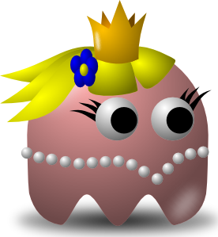
Pac-Man Game
Team Name: GOOD
Team Member:
Team Lead: Ying-Hsuan Chen
Tech Lead: Steven Li
Documentation Lead: Yan Xu
Developer: Zewen Xu; Serena Chen; Yuxi Liang; Jiacheng Sun
Date: Nov. 19, 2021

Slide 2
Use Case - Overview
Use Case
Game Rules Design
UML
API
Demo

Slide 3
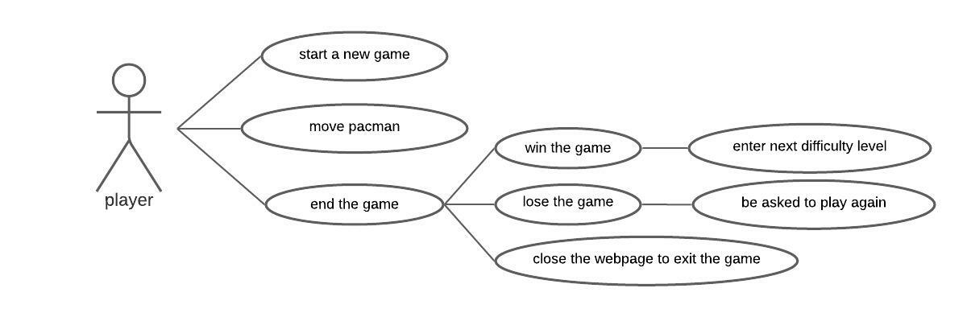
Use case

Slide 4
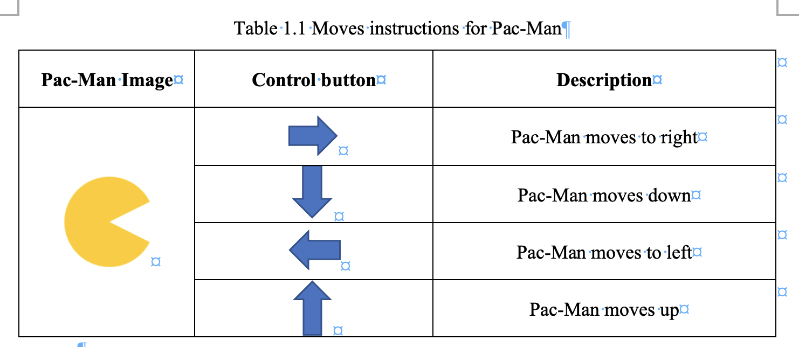
Use case

Slide 5
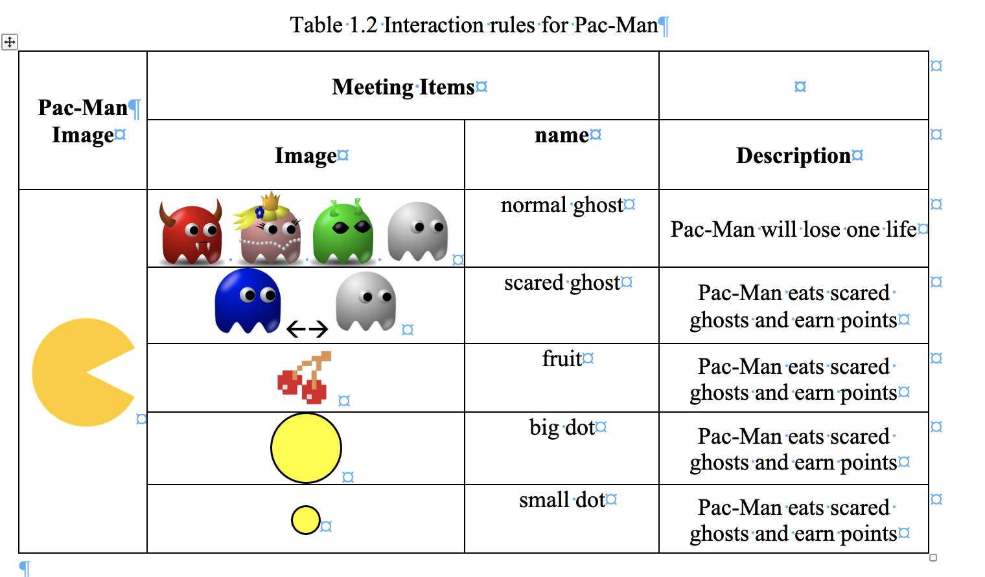

Slide 6
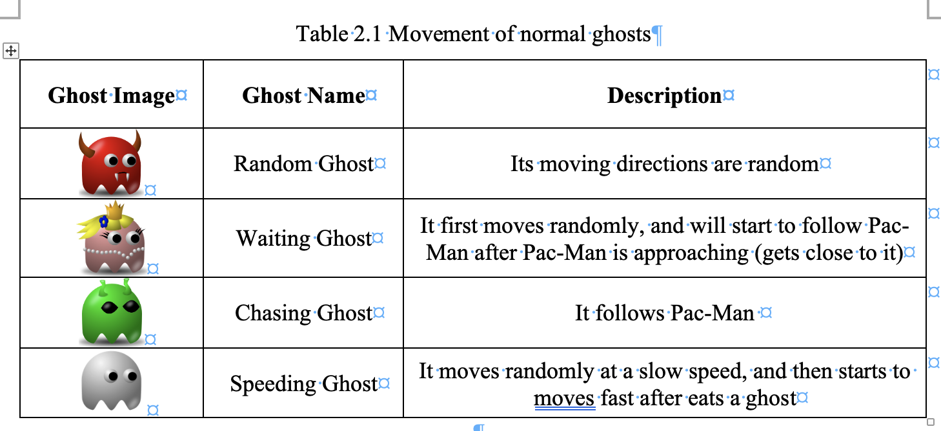

Slide 7
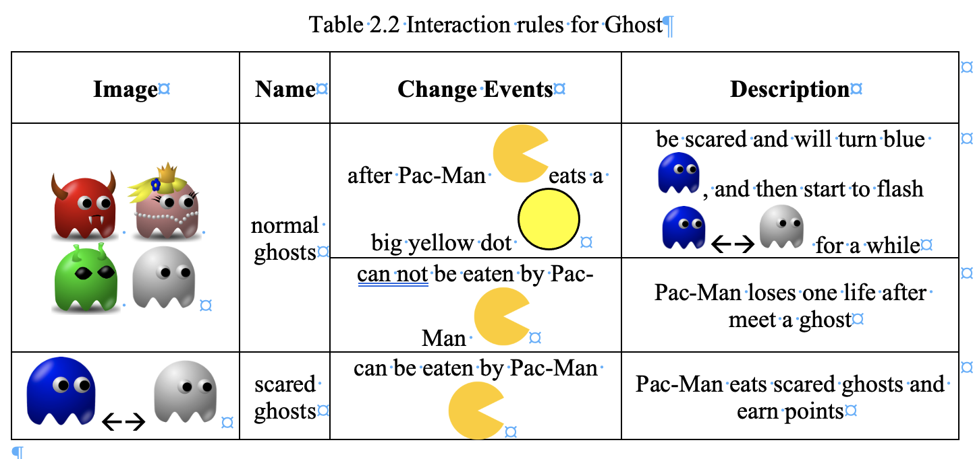

Slide 8
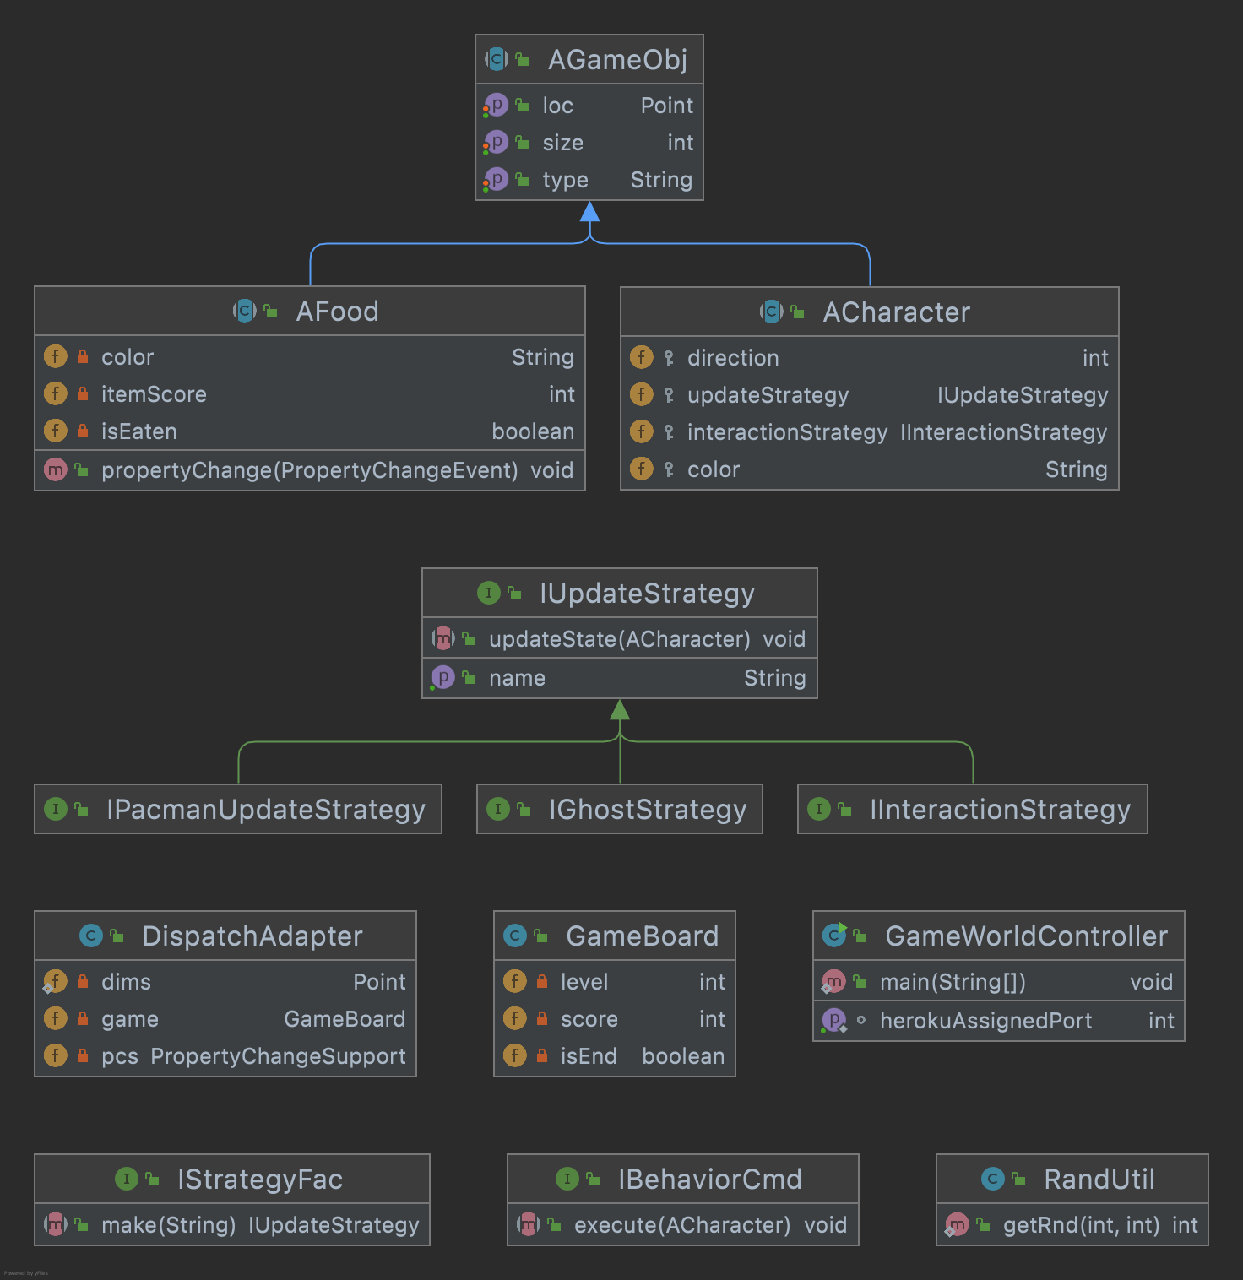

Slide 9
API end points
Endpoint | Method | Use Case
"/initial" | get | The user starts a new game
"/update" | post | the AGameObject updates its movement
"/level/:id" | post | decide the difficulty level

Slide 10
Interface & Abstract - Controller
Post
/signUp
/login
/createChannel
Get
/invite/:userId
/joinChannel/:channelId
/leave/:channelId
/leaves
Notes:
This is our Controller design
There two different kinds of endpoints: post and get
There are three endpoints is post
There are four endpoints is get Next, 加成 will demo the application

Slide 11
Demo
https://hw5-chat.herokuapp.com/
Notes:
This is our Controller design
There two different kinds of endpoints: post and get
There are three endpoints is post
There are four endpoints is get Next, 加成 will demo the application

Slide 12
Thank you!
Any questions?
Notes:
This is our Controller design
There two different kinds of endpoints: post and get
There are three endpoints is post
There are four endpoints is get Next, 加成 will demo the application

