Slide 1

Chat APP
COMP 504 Group Project
Team Name: GOOD
Team Member:
Team Lead: Ying-Hsuan Chen
Tech Lead: Steven Li
Documentation Lead: Yan Xu
Developer: Zewen Xu; Serena Chen; Yuxi Liang; Jiacheng Sun
Date: Nov. 5, 2021
Notes:
Hello everyone, welcome to attend our project presentation
Our topic is Chat App application
We are Good team
I’m team lead
He is teach lead
She is Documentation Lead
Others are our developers

Slide 2
Outline
Use case
UML
API
Demo
Notes:
This is the outline
We will introduce the following topics
The first is Use Case
Second is UML
The third is API
The final is Demo
Next, 言丰 will introduce the Use Cases

Slide 3
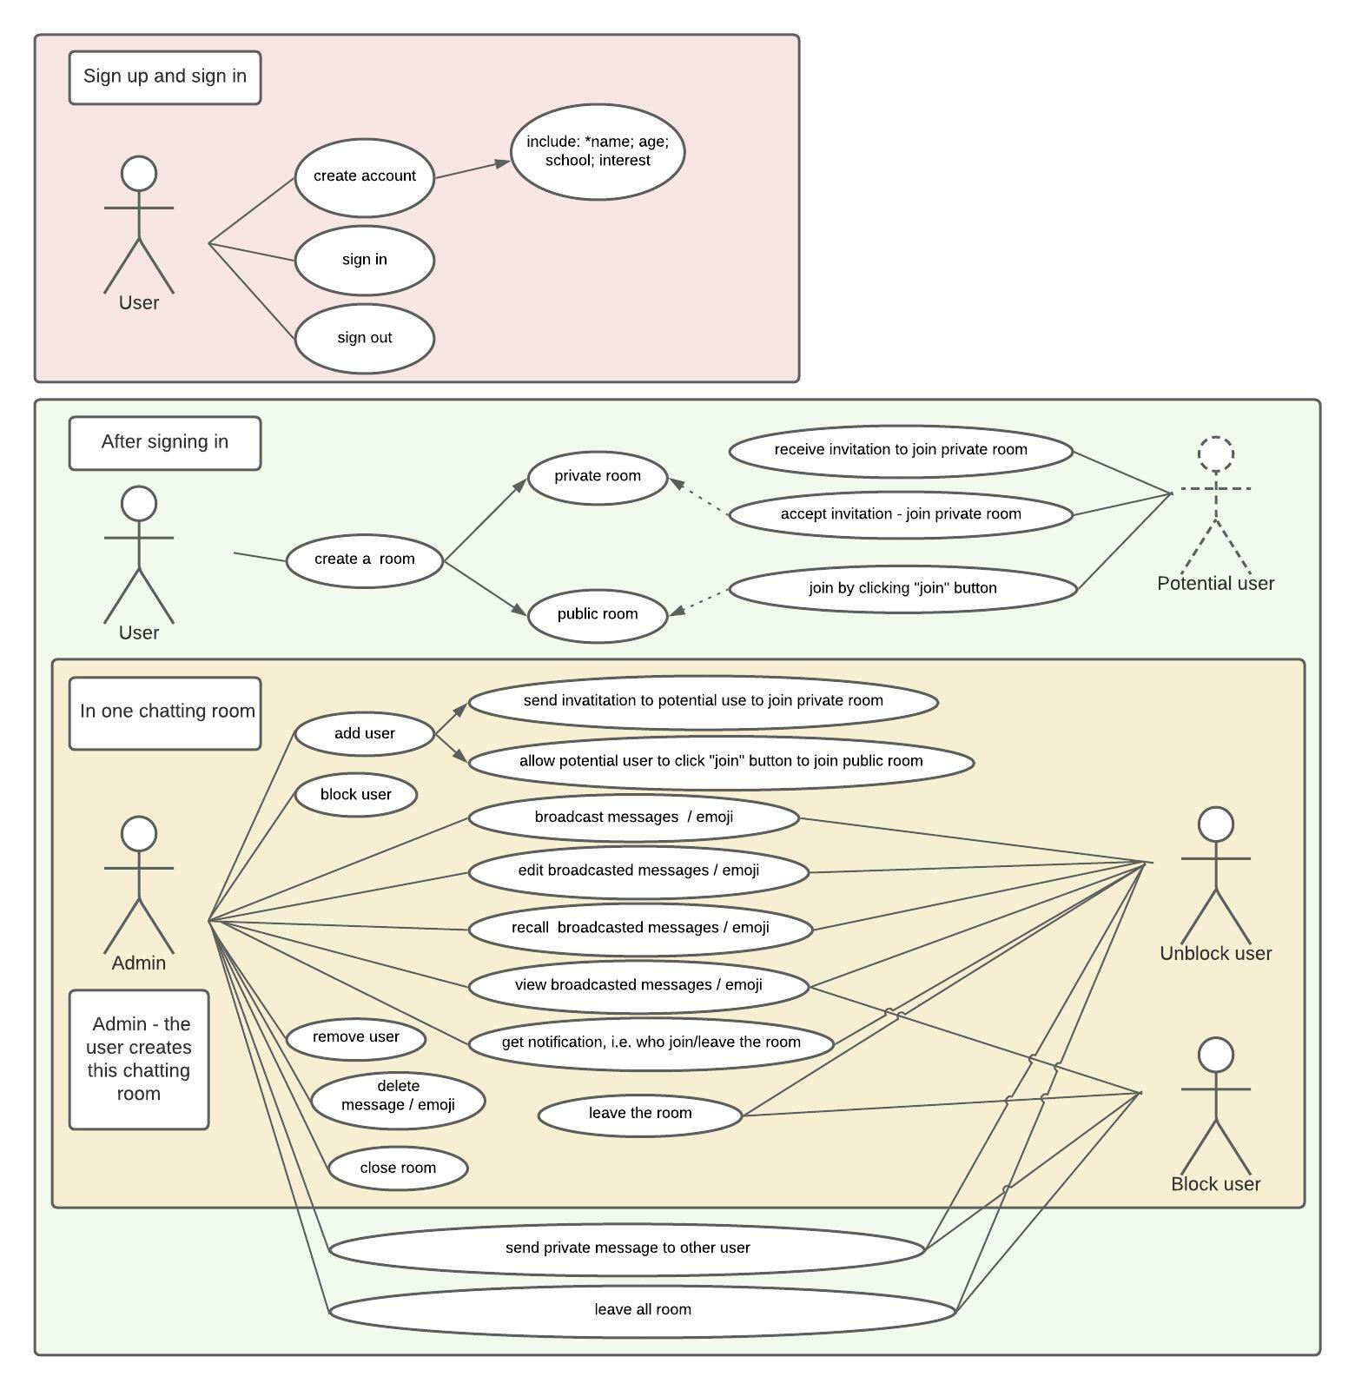
Use Case - Overview
Sign up & sign in
Before joining a room
After signing in
In one chatting room

Slide 4
Use Case
Sign up & sign in
Before join a chatting room

Slide 5
Use Case
In chatting room
Notes:
Yuxi presents

Slide 6
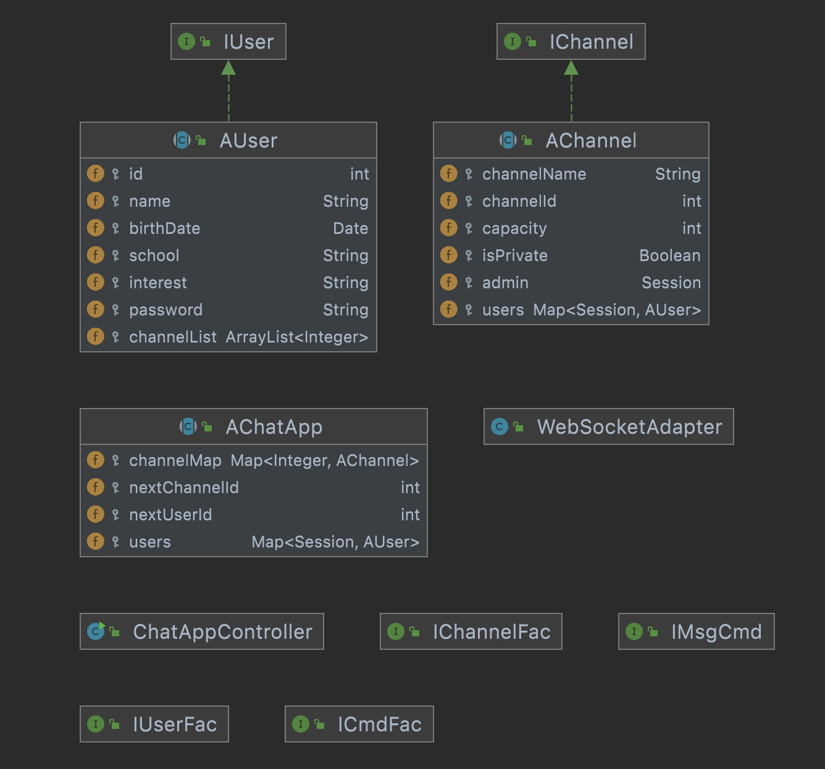
UML Diagram Overview
Notes:
Models and controller
Introduce models first

Slide 7
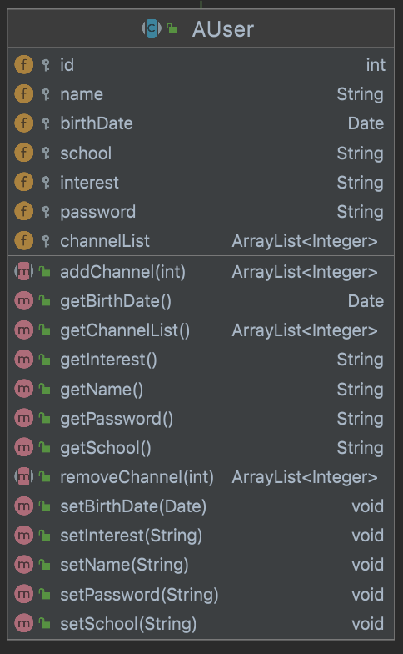
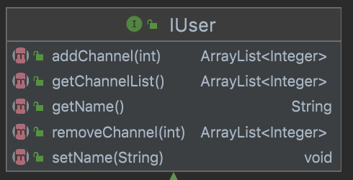
User Class
Notes:
User class stands for each user in chat app.
Abstract user class implements user interface.
Remember use cases(register): name, birthdate, school, interest, password
Id generated by system, unique

Slide 8
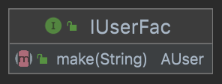
User Factory
Factory Design Pattern
Create two types: User and Null User
Null User is a singleton object

Slide 9
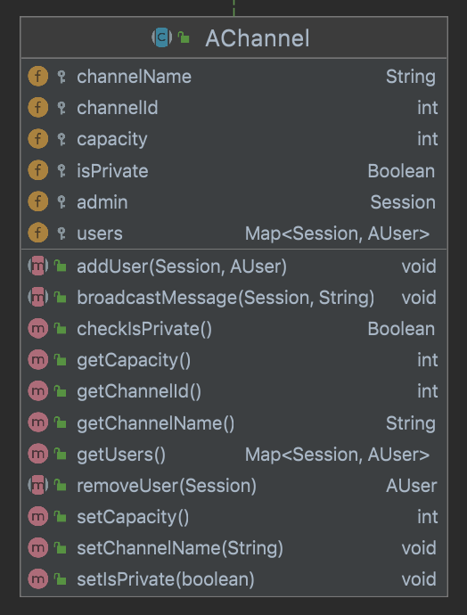
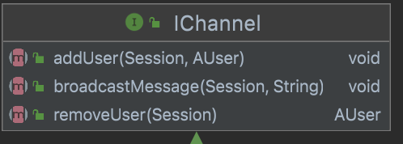
Channel Class
Notes:
Channel class stands for each channel in chat app.
Abstract channel class implements channel interface.
Remember use cases(create channels):
Id generated by system, unique

Slide 10
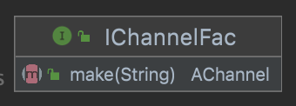
Channel Factory
Factory Design Pattern
Create three types: Public Channel, Private Channel and Null Channel
Null Channel is a singleton object

Slide 11
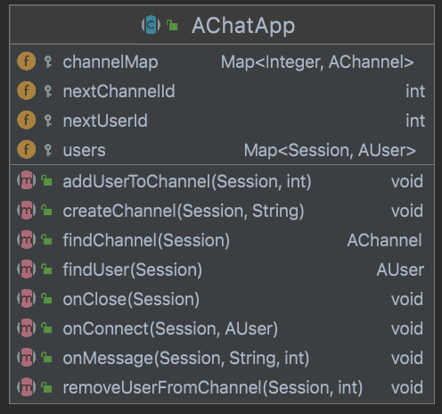
Chat App Class
Stores channels and users
Singleton
Notes:
Class in charge of everything.
Stores all users and channels.
Generate user id and channel id.
Functions to add/remove user
Functions to add channel
Functions to add/remove user from channel.
Transite to Ying-Hsuan

Slide 12
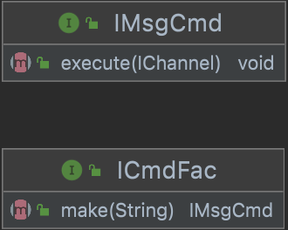
Interface & Abstract - Command
IMsgCmd
Channel can use cmd to send Message / Notification
Extensible
ex: Send file
ICmdFac
Manage all IMsgCmd
Notes:
This is our Command design pattern
We have the IMsgCmd interface, Channel can use cmd to send Message or Notification
It can be easily to extend if there a new requirement , such as we can easily add send file msg , then channel can send file in message
Finally, we have ICmdFac, it can manage all msgCmd

Slide 13
Interface & Abstract - Controller
Post
/signUp
/login
/createChannel
Get
/invite/:userId
/joinChannel/:channelId
/leave/:channelId
/leaves
Notes:
This is our Controller design
There two different kinds of endpoints: post and get
There are three endpoints is post
There are four endpoints is get Next, 加成 will demo the application

Slide 14
Demo
https://hw5-chat.herokuapp.com/
Notes:
This is our Controller design
There two different kinds of endpoints: post and get
There are three endpoints is post
There are four endpoints is get Next, 加成 will demo the application

Slide 15
Thank you!
Any questions?
Notes:
This is our Controller design
There two different kinds of endpoints: post and get
There are three endpoints is post
There are four endpoints is get Next, 加成 will demo the application

