Slide 1
Introduction to Face Recognition Project
The goal of this project is to develop a face recognition model using a custom Convolutional Neural Network (CNN) architecture. Face recognition technology has significant applications in security systems, authentication processes, and organizing personal photo collections.

Slide 2
Technical Setup and Dependencies
This project utilizes Python as the primary programming language with PyTorch for model development and training. Image processing is performed using OpenCV. Additional libraries include PIL for image handling and torchvision for image transformations.

Slide 3
Dataset Overview and Preparation
The dataset is comprised of images categorized into 'face' and 'non-face' groups. A custom parsing function organizes the data into training and testing sets, ensuring a diverse representation for model training.

Slide 4
Data Augmentation Techniques
To enhance the dataset and improve model robustness, various augmentation techniques are applied. These include random horizontal and vertical flips, grayscale conversion, color jittering, and the application of Gaussian blur.

Slide 5
CNN Architecture with Batch Normalization
The model, SimpleCNNWithBatchNorm, features convolutional layers with batch normalization, max pooling, and fully connected layers. Activation functions include ReLU for intermediate layers and a sigmoid function for the output layer.

Slide 6
Model Training and Optimization
Model training involves the use of the Adam optimizer with specific learning rate and weight decay settings. The training process employs batch processing with DataLoader for efficient data handling, and the BCEWithLogitsLoss function for loss calculation.

Slide 7
Training and Validation Performance
Throughout the training phases, the model's performance is monitored by tracking the loss and accuracy metrics for both training and validation datasets. This iterative evaluation helps in fine-tuning model parameters for optimal performance.

Slide 8
Model Testing and Final Accuracy
Upon completion of training, the model is tested with a separate dataset to evaluate its performance on unseen data. The final accuracy metric provides insight into the model's effectiveness in recognizing faces.
 | P | N
True | 0.3% | 98%
False | 0.12% | 1.6%

Slide 9
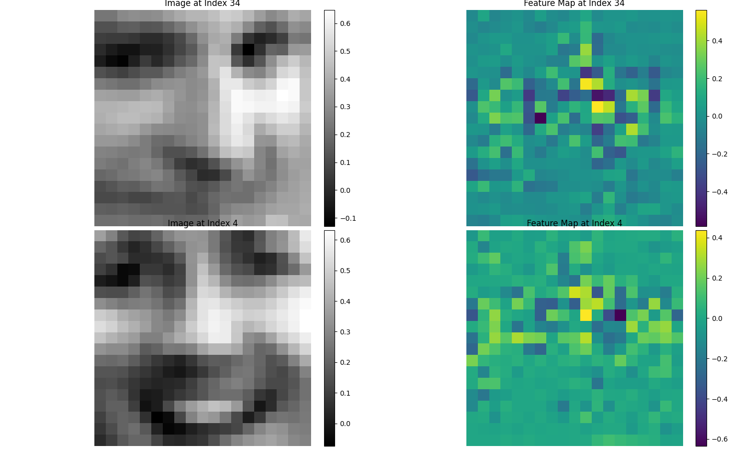

Slide 10
Challenges Faced and Future Improvements
The project encountered challenges such as handling diverse image data and optimizing the model for better accuracy. Future work may explore more complex model architectures and advanced data augmentation techniques for further improvements.

Slide 11
Conclusion and Directions for Future Work
The project successfully demonstrates the capability of a CNN model for face recognition. Potential future directions include the integration of the model into practical applications and exploring its performance on larger, more varied datasets.

Slide 12
Questions and Answers
The floor is now open for any questions. Feel free to ask about the project's implementation, results, challenges faced, or any other related queries.

